Slide 1
Food Ordering Behaviour Analytics
Interactive Tableau project presentation. Click a topic to jump to it.
2 Introduction
3 Problem & Objectives
4 Dataset
5 Data Preparation
6 Dashboard Overview
7 Cities & Cuisines
8 Cuisine & Order Time
9 Age & Company
10 Meals & Ratings
11 Key Findings
12 Recommendations
13 Limitations
14 Conclusion
Notes:
Welcome. This deck summarizes the Food Ordering Behaviour dashboard built in Tableau from 50,000 orders. Click any topic to jump to it; Home returns here.

Slide 2
Introduction
Online food ordering is now part of everyday urban life, across many cuisines, restaurant types and meal occasions.
Businesses need to know who orders, what they order, where, and how satisfied they are.
This project analyzes 50,000 orders: city, cuisine, meal type, age group, company, order value, delivery fee, order time and ratings.
Tableau turns the dataset into one interactive dashboard with KPI cards, charts and parameters.
Based on 50,000 orders from six Indian cities; not a picture of the whole food-delivery market.
Home
<
>
Notes:
Online food ordering is part of daily urban life. The project analyzes 50,000 orders across six cities.

Slide 3
Problem & Objectives
Objectives
Problem
Summarize KPIs: orders, value, fees, rating
Compare cities and city–cuisine mixes
Measure cuisine preference
Analyze spending by age group
Analyze ordering company
Study time taken to order
Analyze ratings and meal-type revenue
Enable exploration with parameters
Raw order records do not show which cities, cuisines, meal types or customer groups matter most, how revenue is spread, or whether satisfaction differs.
Goal: analyze food-ordering behaviour and present it as an interactive Tableau dashboard.
Home
<
>
Notes:
The problem is that raw order records do not show where demand is concentrated.

Slide 4
Dataset
50,000
19
6
6
4
records
fields
cities
cuisines
meal types
food_ordering_behavior_dataset.csv
Order: order_id, user_id, city, order_time, day_type
Food: cuisine, meal_type, restaurant_type
Spend: order_value, discount_applied, delivery_fee
Customer: age, company, mood, hunger_level, rainy_weather, repeat order, rating, time taken
Home
<
>
Notes:
50,000 orders, 19 fields.

Slide 5
Data Preparation
Preprocessing
Calculated fields in Tableau
Inspected 50,000 rows and 19 columns
No missing values in any field
Ranges valid: age 18–44, rating 1–5, fee 20–99
No duplicate order IDs
Text categories checked for consistency
Age Group: Child 18–20, GenZ 21–30, Millennial 31–40, Adult 41–44
Time Taken To Order in 2-minute bins
Parameters: City, Cuisine, Meal Type
KPIs: count of orders; sums of value and fees; average rating
Age-group boundaries were reconstructed from the dashboard values.
Home
<
>
Notes:
No missing values; age groups reconstructed from dashboard values.

Slide 6
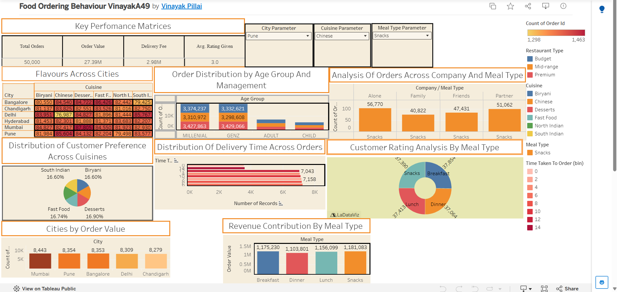
Dashboard Overview
1 cleaned dataset → 4 KPI cards + 8 charts → 1 dashboard with 3 parameters
KPIs
Orders, order value, fees, rating
Cities & cuisine
Heat map, city ranking, cuisine pie
Customers
Age group, company, order time
Meals
Parameters (City, Cuisine, Meal Type) filter selected charts; the captured view shows Pune, Chinese, Snacks.
Revenue and ratings by meal type
Home
<
>
Notes:
One dashboard with four KPI cards, eight charts and three parameters.

Slide 7
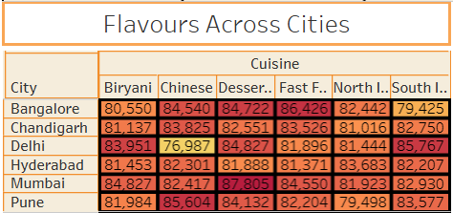
Cities & Cuisines
Peak: Mumbai–Desserts, 1,463 orders
Low: Delhi–Chinese, 1,298 orders
Colour = orders; labels = delivery-fee totals
All six cities sit within 2.2% of each other; Mumbai leads.
Home
<
>
Notes:
Heat map: colour is order count, labels are delivery-fee totals. City orders from the dataset.

Slide 8
Cuisine & Order Time
Desserts leads at 16.9%; North Indian trails at 16.5%, a gap of 0.45 points.
Average 7.5 minutes to place an order. Edge bins are half-height as they hold one value each.
Home
<
>
Notes:
Cuisine shares are almost equal; order time is evenly spread.

Slide 9
Age & Company
Millennials (31–40) and GenZ (21–30) bring about 74% of order value.
In this segment solo diners lead (29.0%), families trail (20.8%).
Home
<
>
Notes:
Order value by age group and restaurant type; company view for Pune, Chinese, Snacks.

Slide 10
Meals & Ratings
Breakfast earns the most; Dinner is lowest, 2.6% below Breakfast.
Satisfaction does not differ between meal types; ratings split evenly across 1–5.
Home
<
>
Notes:
Breakfast leads revenue; ratings are about 3.0 for every meal type.

Slide 11
Key Findings
50,000
27.39M
548
3.0
orders
order value
avg order
avg rating
All six cities are within 2.2%; Mumbai leads with 8,443 orders
Desserts is the top cuisine at 16.9%; the gap to last is 0.45 points
Millennials and GenZ bring about 74% of order value
Dinner is lowest in orders and revenue
Ratings split evenly across 1–5 stars; average 3.0
Discounts, weather and repeat orders barely change order value
Home
<
>
Notes:
Headline numbers and six findings.

Slide 12
Recommendations
Boost dinner
Fix weak cells
Target GenZ & Millennials
Dinner is lowest in orders and revenue; test evening combos and offers.
Delhi–Chinese is the weakest cell; try local promotions and partners.
They bring about 74% of order value; build loyalty and premium offers.
Test group bundles
Probe satisfaction
Fix dashboard labels
Solo diners lead in Pune–Chinese–Snacks; try solo meals and family bundles.
Ratings split evenly 1–5; collect the reasons behind low scores.
Align titles with measures; show all six cities and age labels.
Home
<
>
Notes:
Six actions that follow from the dashboard.

Slide 13
Limitations
Data scope
Measures
Only six Indian cities
No order date, so no trends over time
Very balanced data: differences are small
Observational: no causation
Age groups reconstructed from dashboard values
Time field is time to place the order, not delivery time
Some charts are filtered to Pune, Chinese, Snacks
Currency is not stated
Home
<
>
Notes:
Scope and measurement limits.

Slide 14
Conclusion
Orders and revenue are spread evenly across six cities and six cuisines.
Mumbai, Pune and Desserts sit slightly ahead; Delhi–Chinese and Dinner slightly behind.
Millennials and GenZ are the most valuable age groups.
Ratings, order times and discounts show few strong contrasts.
The city, cuisine and meal-type parameters make the dashboard a tool for exploring segments.
Better labels and an order date would make it stronger for planning menus and promotions.
Interpret within the dataset’s limits: six cities, balanced data, no dates, observational.
Home
<
Notes:
Close with the main message: balanced demand, a few small gaps, and the value of interactivity.

