Slide 1
Assessment scores for NAICS CODES using reviews
Ankur Patel
Drazen Zack

Slide 2
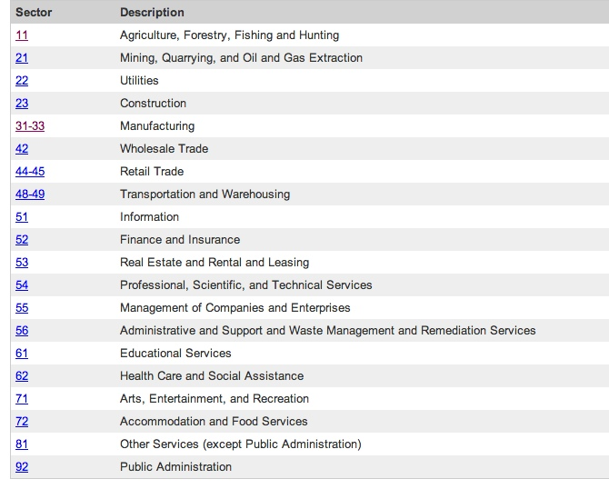
What are NAICS Codes
North American Industry Classification System
Code system developed for use by the Federal Statistical Agencies
For collection, analysis and publication of statistical data for the US Economy
Establishments are classified to an industry according to the primary business activity
Organization:
Sector: 2-digit code
Subsector: 3-digit code
Industry Group: 4-digit code
NAICS Industry: 5-digit code
National Industry: 6-digit code
Notes:
So what are NAICS Codes? It’s a system defined by the government so it’s really nice to learn about it.
Developed jointly by US, Canada, and Mexico for the business statistics in North America

Slide 3
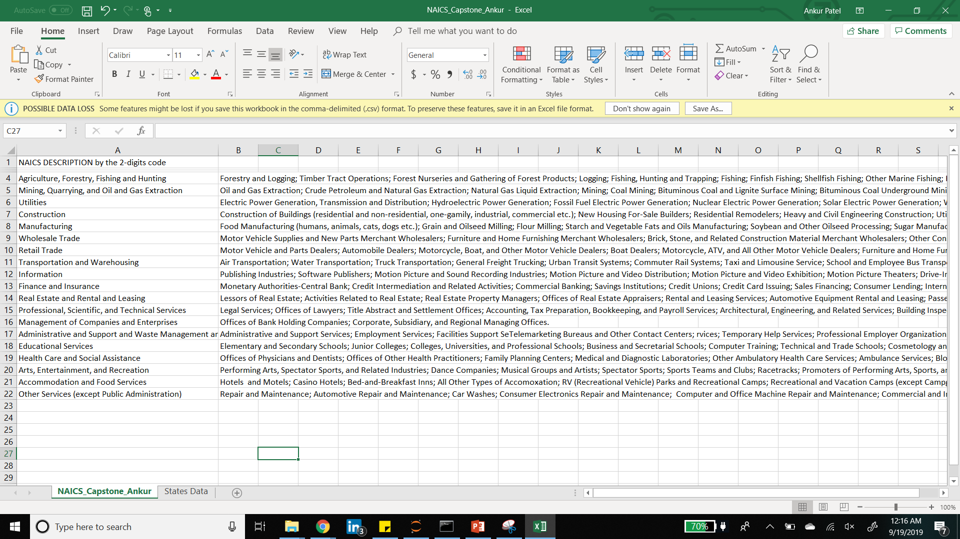
Example of NAICS Codes
Notes:
3 Sectors have a range of Codes.. Manufacturing (31-33), Retail Trade (44-45) and Transportation and Warehousing (48-49)

Slide 4
Goal & Importance
Goal:
Develop an assessment score (0-100) for NACIS Codes from reviews and ratings from social networking sites.
Importance:
Gaining information about industries for decision making
Compare industries within a social networking site
Compare social networking sites by industry
Different social networking sites favor different industries
Not much has been done on topic
Unsupervised social networking site assessment score for an industry
Notes:
Score from review and ratings from social sites
Compare the industries within a platform
Compare what reviews from different platforms say about an industry
_Reviews are very essential for companies because they directly affect the success of companies. If the people don’t like their product or service, they need to improvise.

Slide 5
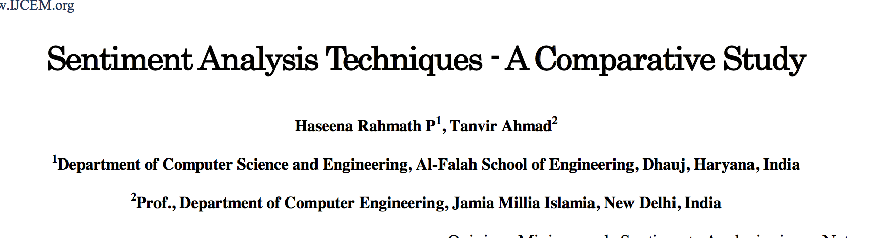
Introduction
Two key issues
How do we get sentiment of reviews without a dependent variable
How do we create a score that could be used for all platforms & industries
Sentiment Analysis Techniques - A Comparative Study
Machine Learning (surprised)
Lexicon (unsurprised)
Hybrid
Notes:
This paper showed their study of the key concepts used in Opinion Mining and Sentiment Analysis. They compared ML, Lex, Hyb
Supervised Machine learning algorithms for sentiment classification. Training dataset to train the classifier and test to evaluate.
Lexicon (unsupervised), sentiment dictionary with sentiment words are used for sentiment classification. The dictionary contains polarity of each word. Which will be matched with words in the document/review. They classified as positive/negative. We used this technique so it’ll be described better later.
Hybrid uses both where the lexicons are used in machine learning algorithms. General purpose lexicon or specific lexicon determining polarity were fed into SVM.
Hybrid High accuracy from supervised machine learning algorithm and achieving stability for lexicon based approach

Slide 6
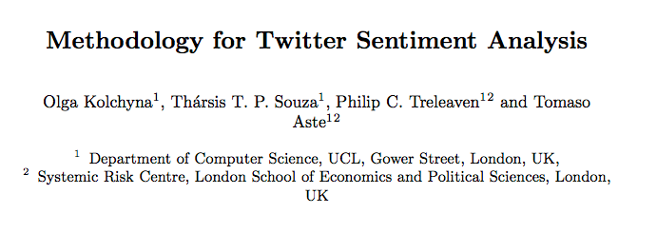
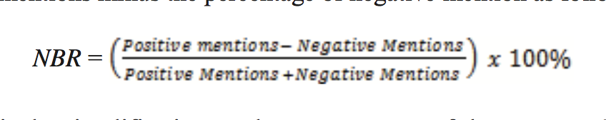
Introduction
Methodology for Twitter Sentiment Analysis
Machine learning & lexicon methods
Machine Learning using Naive Bayes & SVM
Created lexicon & sentiment score from trained data
Twitter Sentiment to Analyze Net Brand Reputation of Mobile Phone Providers
Used Machine learning techniques to predict sentiment on twitter data
Net Brand Reputations (NBR)
Notes:
This paper also used ML and Lexicon. It used a dictionary of words with assigned sentiment scores to calculate the polarity. Then they used machine learning algorithms of Naïve Bayes and SVM for text classification.
The quality of classification in the lexicon-based approach depends solely on the quality of the lexicon.
They described 6 sentiment lexicons that researchers created.
As creation of a good lexicon is crucial for lexicon-based method, selection of features is essential for machine learning model
Twitter: Naïve Bayes, Support Vector Machine, and Decision Tree classifier method
NBR is a clean reputation value of a brand digitally- simplify the measurement of consumer’s loyalty. SVM better

Slide 7




Data Sources Exploration
BBB
Angie’s List
Yelp
Google
Glassdoor
Facebook
Indeed
Tripadvisor
Zocdoc
Etsy

Slide 8
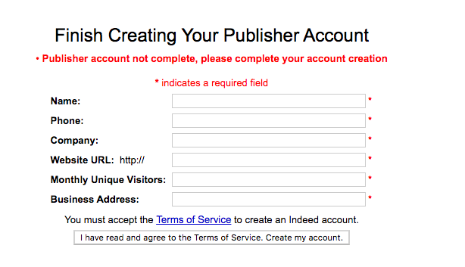
Data Sources Exploration Indeed
Plenty of reviews for every industry
Easy to scrape
Indeed API
Apply to become publisher
Be part of a business or organization
Indeed has the right to place limits on access to any API
Reviews were only for the organization as a whole

Slide 9
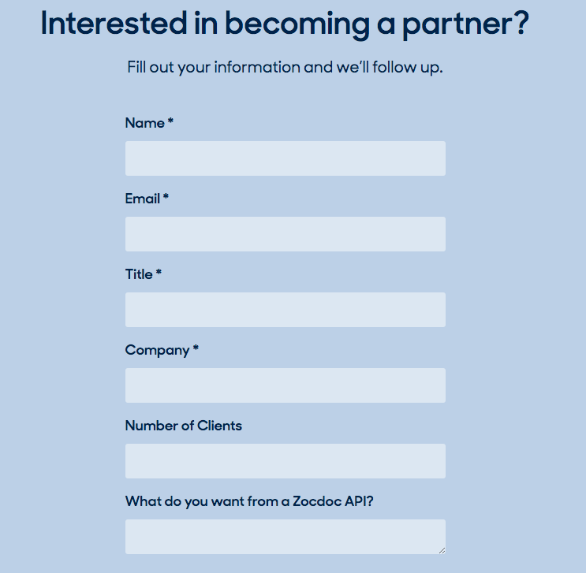
Data Sources Exploration Zocdoc
Great for health care industry
Bias to coastal states
Zocdoc API
Have to become a partner with ZOCDOC
Have to be approved
Be a medical company or have a medical practice
Free of cost & No limits

Slide 10
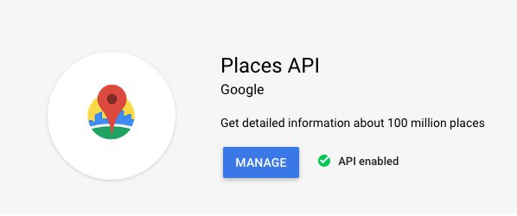
Data Sources Exploration Google
Plenty of reviews of each industry
Google Place API
Atmosphere Data (rating, reviews)
Pay as you go plan
Only 5 reviews per business
Google Place API was used
14,000 businesses of 18,530
64,000 to 65,000 reviews in all

Slide 11
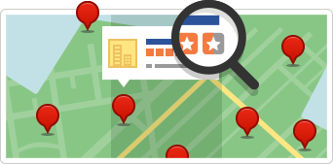
Data Sources Exploration Yelp
Limited industries
Yelp does not allow scraping
Limits of 1000 pages and 30000 companies per category
Yelp Knowledge for Yelp Reviews
Local Analytics & Sentiment (with Partners)
Yelp Open Dataset
An all-purpose dataset for learning
Text Mining for Assessment Scores for NAICS Codes
Notes:
Tools for developers https://www.yelp.com/developers 8 tools
https://www.yelp.com/knowledge 199M+ Reviews, location data
https://www.yelp.com/dataset

Slide 12
Text Mining Yelp Dataset
Due to limitations, the goal for this capstone is to create assessment scores for the NAICS Code 72 of Accommodation and Food Services using reviews in the Yelp dataset.

Slide 13
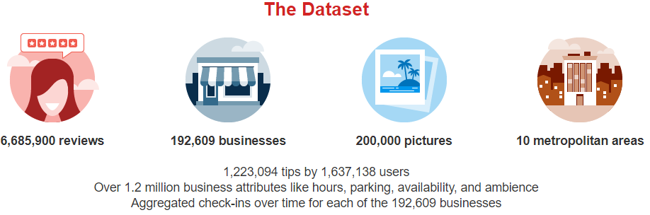
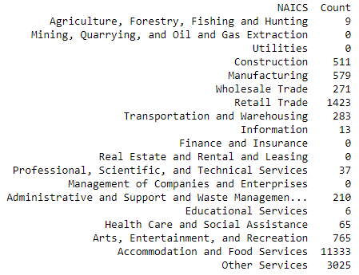
Dataset
Yelp Dataset Challenge
Used the business and reviews .json files
192,609 Businesses
18,530 Unique Businesses
6,685,900 Reviews total
1,266,827 Reviews fit a NAICS Code
Used only Accommodation and Food Services
Sample of 467,688 reviews
Notes:
6 Json files
Selected businesses who’s category matched NAICS subsectors
Subsectors of those 18530 businesses
1.2mil reviews of those businesses

Slide 14
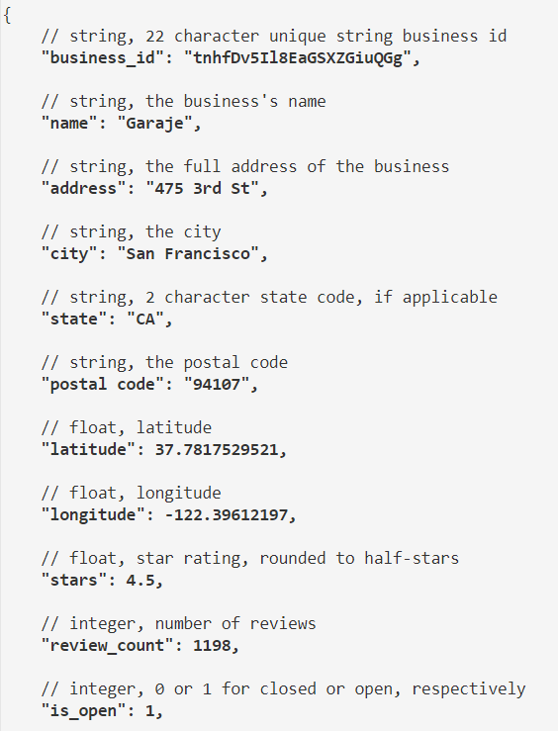
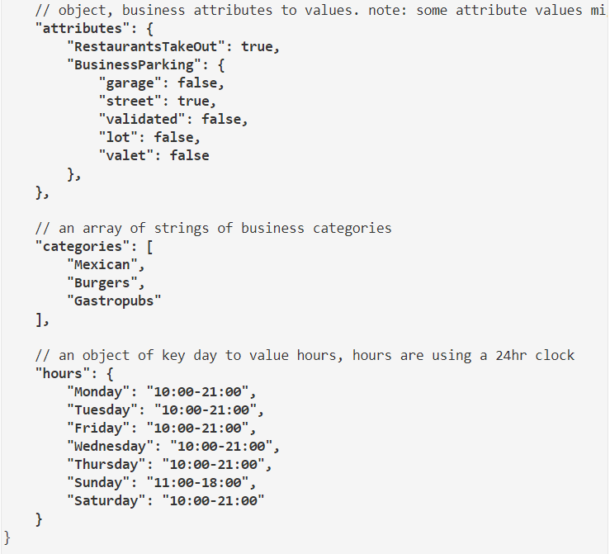
Dataset Business File

Slide 15
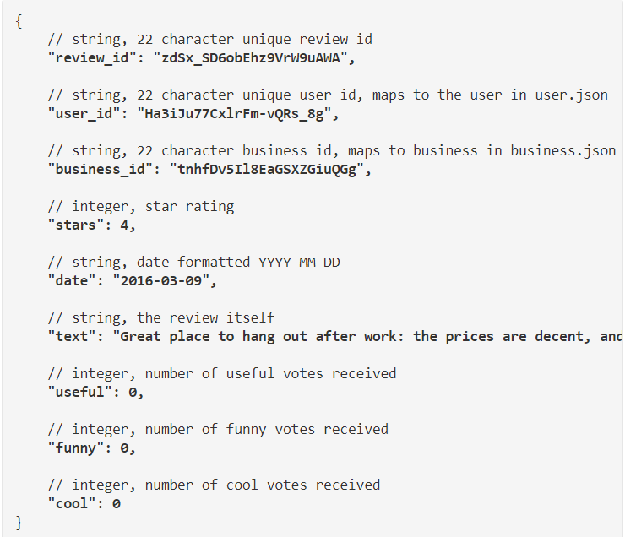
Dataset Reviews

Slide 16
Preprocessing Dataset
Used categories column from business file to match to NAICS subsectors
Checked for businesses in more than one NACIS Code
Can only be in one NACIS Code
Filtered out non–US businesses
Merged businesses that fit a NAICS code in the business file to review file
6,685,900 reviews to 1,266,827 reviews
Took a sample of Accommodation and Food Services
1 million plus reviews to 467,688
Checked to see if all reviews were in English
“langdetect” library in python
467,688 reviews to 454,427 reviews
Added a column for positive and negative reviews by star rating
> 3 positive(1), <= 3 negative (0)
Cleaning Text
Lowercase
Removing punctuation
Stopwords
Stemming and Lemmatization
Notes:
Matched business with NAICS subsectors
Only selected businesses in 1 NAICS code, after checking if in multiple NAICS code
Only selected US businesses
1.2mil reviews… 467000 reviews of AFS
Langdetect English (12000+ non-English)
Created column of the star ratings to 0-1

Slide 17
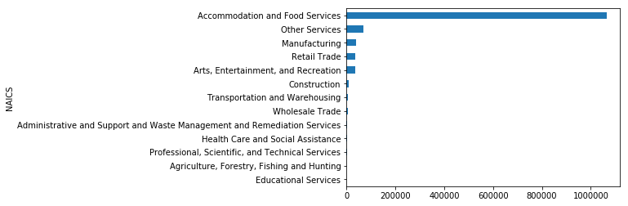
Exploratory Data Analysis
84.2% is Accommodation and Food Services
Selected 454,427 English reviews
Notes:
1066633/1,266,827 = 84.2%

Slide 18
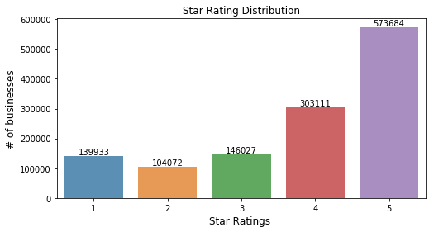
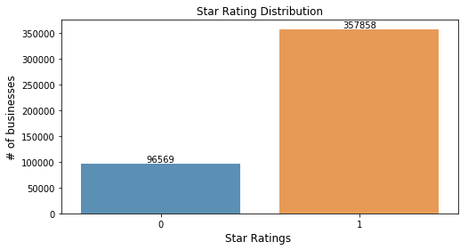
Exploratory Data Analysis
After slicing dataset and grouping with stars, ratio of 1(4,5) to 0(1,2) was 3.7

Slide 19

Sentiment Analysis
Pre made lexicons
Textblob (-1,1)
Lexicon from Stanford NLTK, the training data was movie reviews
Vader (-1,1)
Social media lexicon
Afinn (word score from -5,5)
Manually rated by Finn Årup Nielsen
Domain specific lexicon
Methodology for Twitter Sentiment Analysis
Create a lexicon from trained data

Slide 20
domain specific lexicon Methodology

Slide 21
Methodology
Count vectorize
Count # of times feature is in a Negative or Positive reviews
Calculate Negative and Positive Score
Remove Positive Scores between (0.4-0.6)
Calculate Polarity Score
Lexicon created
Positive and Negative review column
Clean text Dataset

Slide 22
Methodology
Step 1: Cleaning Text
Step 2: Positive and Negative review column
Stars > 3 positive and Stars <= 3 negative
Step 3: Count vectorize
Max features (3000 – 7000)
Ngram range (1-3)
Step 4: Count # of times feature is in a positive or negative review
Created a python function to handle steps 4 - 6
able | absolute | absolutely | absolutely amazing | absolutely delicious
1 | 0 | 0 | 0 | 0
0 | 0 | 1 | 0 | 1
0 | 0 | 1 | 0 | 1
0 | 0 | 0 | 0 | 0
0 | 0 | 0 | 0 | 0

Slide 23
Methodology
Step 5 : Calculate Negative and Positive Scores
Positive Score(Goodness):
# positive mentions / total mentions
Negative Score :
# negative mentions / total mentions
Step 6: Remove features with positive score between 0.4 to 0.6
Neutral words
Step 7: Calculate Polarity Score:
Polarity = 2 * Goodness – 1
Now in a range between (-1 , 1)
word | pos_score | neg_score | polarityScore
yum | 0.909187 | 0.090813 | 0.818375
yum yum | 0.909091 | 0.090909 | 0.818182
yummy | 0.909396 | 0.090604 | 0.818792
yummy food | 0.935714 | 0.064286 | 0.871429
zero | 0.098089 | 0.901911 | -0.80382
zero star | 0.005772 | 0.994228 | -0.98846
zipps | 0.367816 | 0.632184 | -0.26437
zone | 0.659701 | 0.340299 | 0.319403
zucchini | 0.62959 | 0.37041 | 0.259179

Slide 24
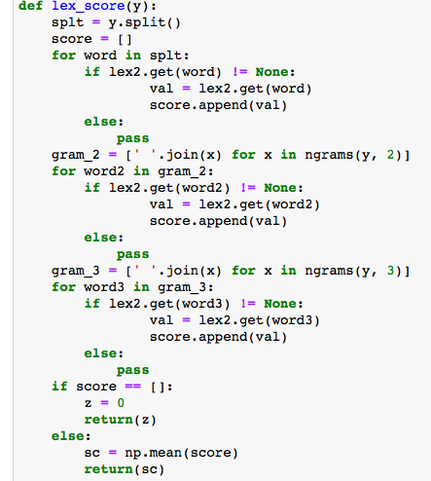
Have A Lexicon, What Next?
Finding score of review
Average of all feature scores in review
Created python function to calculate the average
Split text into single words
Split text into 2-grams
Split text into 3-grams

Slide 25
Results for Domain Lexicon
Classification Testing
Using all reviews (357,858 positive, 96,569 negative)
Under sampling positive reviews (150,000 positive, 96,569 negative)
Vs. Textblob
Under sampling was the best
More features higher specificity
Lexicon | accuracy | specificity | sensitivity
3000_features_sample | 91% | 63% | 98%
4000_features_sample | 91% | 63% | 98%
5000_features_sample | 91% | 64% | 98%
7000_features_sample | 91% | 65% | 98%
3000_features_no_sample | 78% | 0.6% | 99%
4000_features_no_sample | 78% | 0.6% | 99%
Textblob_clean_data | 85% | 40% | 97%
Textblob_raw_text | 86% | 43% | 97%

Slide 26
The NAICS Code Score
Review polarity is in a range from -1 to 1
Need to be between 0 and 100
Scaled the polarity using:
((polarity – (-1) /(1 – (-1)) )* 100
Creates normalized scale across all NAICS Code and social networking sites
Once normalized take mean score for all reviews by NAICS Code
Lexicon | Score
3000_features_sample | 63.22
4000_features_sample | 63.286
5000_features_sample | 63.318
7000_features_sample | 63.399
3000_features_no_sample | 77.768
4000_features_no_sample | 77.832
Textblob_clean_data | 63.988
Textblob_raw_text | 63.784

Slide 27
Risk & Improvement
Risk:
When under sampling strength of positive words decreases
How much to under sample?
Is the polarity of the word accurate
Fake reviews or paid reviews
Improvements:
Computing power
Max features could only get to 7000
More feature = Complete lexicon
Using more NACIS codes and data sources to create lexicon
Polarity score & NACIS code score
Other ways to create a score

Slide 28
Future Plans
Using more of the data
More accurate results
Understanding the data better
Creating Lexicon for each….
NACIS Code or social networking site
Add supervised learning algorithms into the process or just use lexicon methods
Use lexicon to start
Train a regression on the lexicon scores and use the regression to predict the scores of new reviews instead of the lexicon
“High accuracy from a powerful supervised learning algorithm and stability from lexicon based approach”

Slide 29
Conclusion
Data from Yelp Dataset Challenge
Used only NAICS code 72 Accommodation and Food Services
Created a domain specific lexicon for Accommodation and Food Services
Used methodology from “Methodology for Twitter Sentiment Analysis “
Found that under sampling positive reviews was the best
Found a way to scale polarity score to between 0 – 100
Future Plans
Notes:
From the Yelp Dataset, used Business & Reviews for text mining
Only the Accommodation and Food Services sector
Using Methodology for Twitter Sentiment Analysis, created domain specific lexicon
Under sampling gave better results

Slide 30
Thank You

