Slide 1
Solving the Retail Location Spatial Problem (RLSP) using Machine Learning
Drazen Zack, Paul Kegelman

Slide 2
Problem Statement
It is very difficult for strategic planners to identify the location of a New Retail Facility as they are faced with a very difficult spatial resource allocation problem
Simpler Terms:
Identifying optimal locations for retail facilities
What factors will create a successful location

Slide 3
Objective
Find new retail facilities for Starbucks based on demographic & transportation data in three major U.S. cities
Three cities:
Chicago (5.211 million population)
Philadelphia (1.581 million population)
Manhattan (1.629 million population)
Finding the optimal new location is a key for success of a new retail facility
For Starbucks:
Morning Commuters
Population Centers

Slide 4
Data Sources
Census Bureau API
Statistics from American Community Survey (ACS)
Based on the 2010 Census Tract locations
Ridership data
Subway or train system data
Number of people entering/leaving station turnstiles
Chicago – transit website
Philadelphia - Southeastern Pennsylvania Transportation Authority website
Manhattan – MTA website
Starbucks location
Kaggle - February 2017
Store addresses used with Census Bureau API to gather which Census Tracts have Starbucks

Slide 5
What is a Census Tract ?
Small, relatively permanent statistical subdivisions of a county
Roughly equal to a neighborhood in size, but larger than a block
Population of a census tract ranges between 1,200 to 8,000 people
74,134 tracts defined for the 2010 census in the U.S. and its territories
Saint Peter’s University is in census tract 34017002800 or Census Tract 28
34 = State of New Jersey
017 = Hudson county
002800 = tract number

Slide 6
Model Methodology
Logistic regression
Train: 2 cities, Test: 1 city
Predict binary variable (i.e. “No-Starbucks” or “Starbucks”) for each census tract
Probabilities were conducted for each census tract for the test city
Top five census tracts that didn’t have a Starbucks were seen as optimal locations

Slide 7
Predictions
Census Tract | Tract Name | Probability of No Starbucks | Probability of Starbucks
17031080202 | Census Tract 802.02 | 42% | 58%
17031240500 | Census Tract 2405 | 46% | 54%
17031070300 | Census Tract 703 | 48% | 52%
17031071000 | Census Tract 710 | 49% | 51%
17031842300 | Census Tract 8423 | 49% | 51%
Chicago
Philadelphia
Manhattan
Census Tract | Tract Name | Probability of No Starbucks | Probability of Starbucks
42101000801 | Census Tract 8.01 | 37% | 63%
42101000300 | Census Tract 3 | 40% | 60%
42101001202 | Census Tract 12.02 | 41% | 59%
42101000401 | Census Tract 4.01 | 44% | 56%
42101000901 | Census Tract 9.01 | 45% | 55%
Census Tract | Tract Name | Probability of No Starbucks | Probability of Starbucks
36061007800 | Census Tract 78 | 13% | 87%
36061012600 | Census Tract 126 | 18% | 82%
36061008603 | Census Tract 86.03 | 21% | 79%
36061005502 | Census Tract 55.02 | 23% | 77%
36061010800 | Census Tract 108 | 23% | 77%

Slide 8
Predictions Chicago
Census Tract | Tract Name | Probability of No Starbucks | Probability of Starbucks
17031080202 | Census Tract 802.02 | 42% | 58%
17031240500 | Census Tract 2405 | 46% | 54%
17031070300 | Census Tract 703 | 48% | 52%
17031071000 | Census Tract 710 | 49% | 51%
17031842300 | Census Tract 8423 | 49% | 51%
Trained on
Manhattan and Philadelphia
Classification Test
Accuracy of 90%
Observation
Larger than city averages for:
Median house hold income
Median home value
Median rent
Percent of people working
Percent of people leaving for work between 7 & 9
Percent of people with either a masters or bachelors degree
Average distance to a Starbucks from the five tracts 276ft

Slide 9
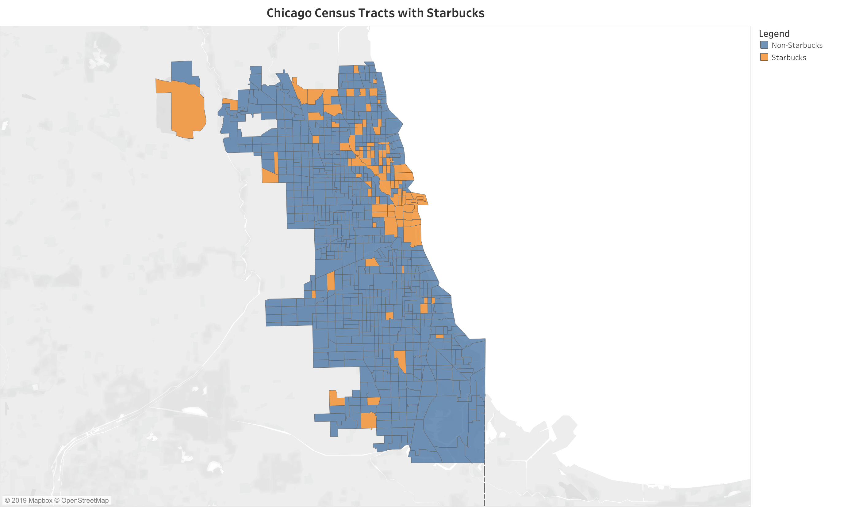
Predictions Chicago (Cook County)

Slide 10
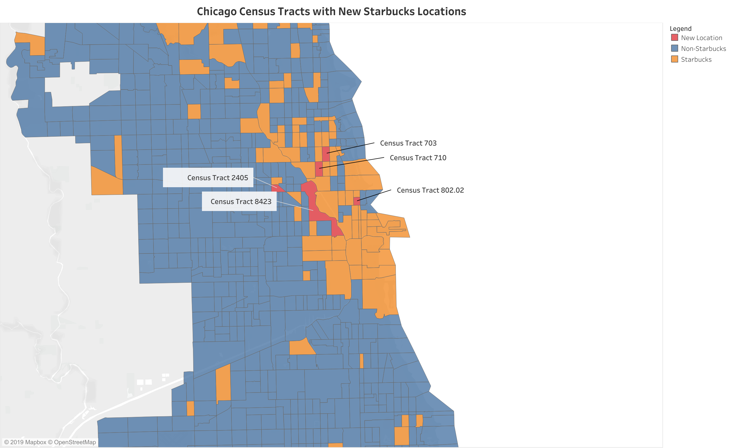
Predictions Chicago (Cook County)

Slide 11
Predictions Philadelphia
Trained on
Manhattan and Chicago
Classification Test
Accuracy of 91%
Observations
All have median age younger than city average median age
Larger than city averages for:
Median home value
Median rent
Percent of workers
Percent of people leaving for work between 7 & 9
Percent of people with either a masters or bachelors degree
Average distance to a Starbucks from the five tracts 303ft
Census Tract | Tract Name | Probability of No Starbucks | Probability of Starbucks
42101000801 | Census Tract 8.01 | 37% | 63%
42101000300 | Census Tract 3 | 40% | 60%
42101001202 | Census Tract 12.02 | 41% | 59%
42101000401 | Census Tract 4.01 | 44% | 56%
42101000901 | Census Tract 9.01 | 45% | 55%

Slide 12
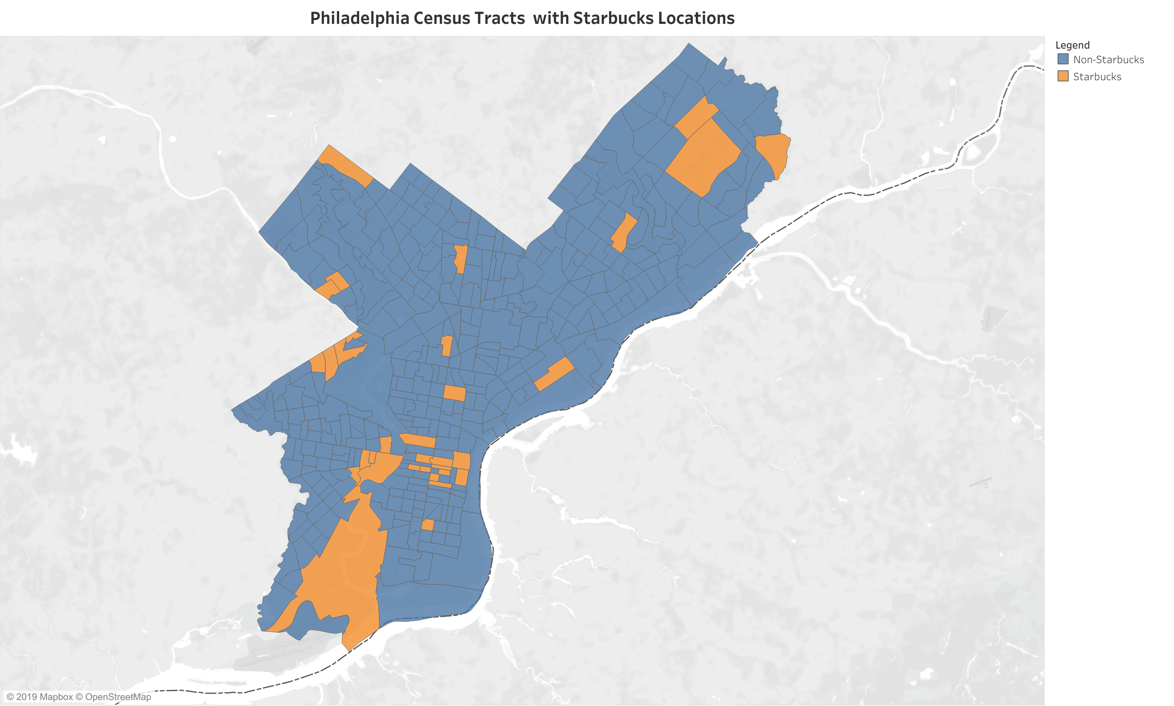
Predictions Philadelphia

Slide 13
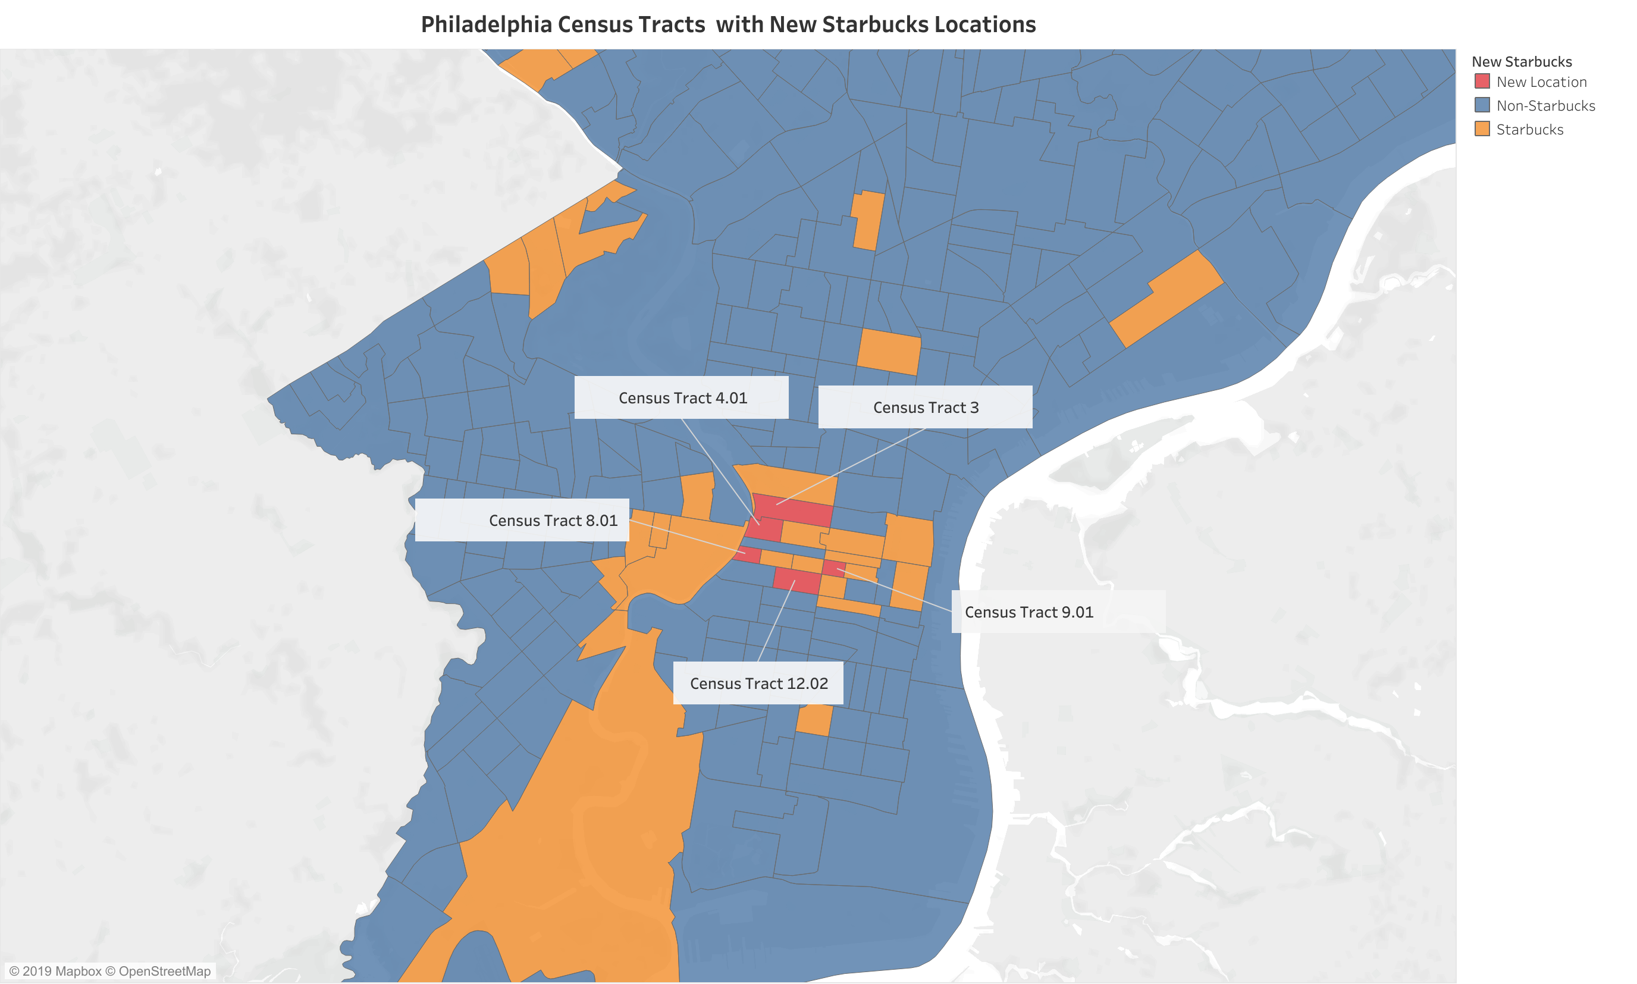
Predictions Philadelphia

Slide 14
Predictions Manhattan
Census Tract | Tract Name | Probability of No Starbucks | Probability of Starbucks
36061007800 | Census Tract 78 | 13% | 87%
36061012600 | Census Tract 126 | 18% | 82%
36061008603 | Census Tract 86.03 | 21% | 79%
36061005502 | Census Tract 55.02 | 23% | 77%
36061010800 | Census Tract 108 | 23% | 77%
Trained on
Chicago & Philadelphia
Classification Test
Accuracy 75%
Observations
Larger than city averages for:
Median rent
Median house hold income
Percent of people with either a masters or bachelors degree
Average distance to a Starbucks from the five tracts 194ft

Slide 15
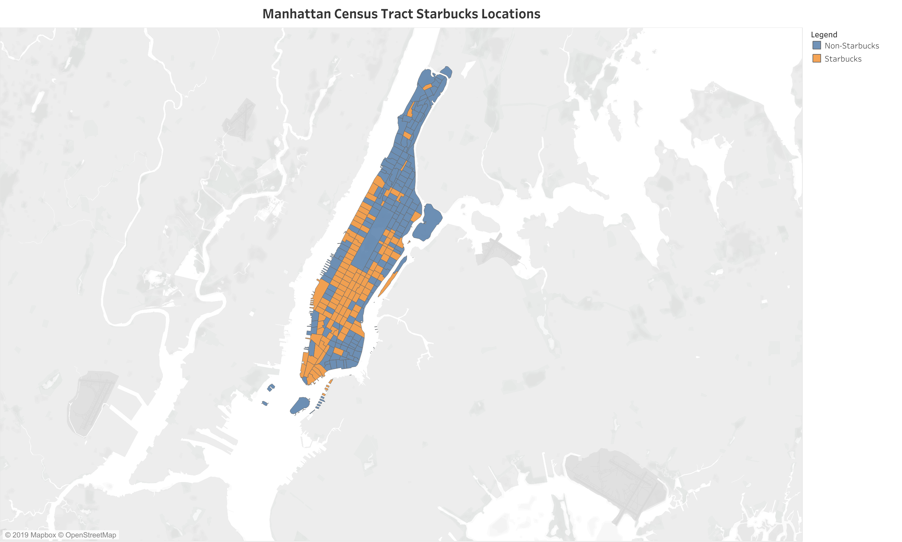
Predictions Manhattan

Slide 16
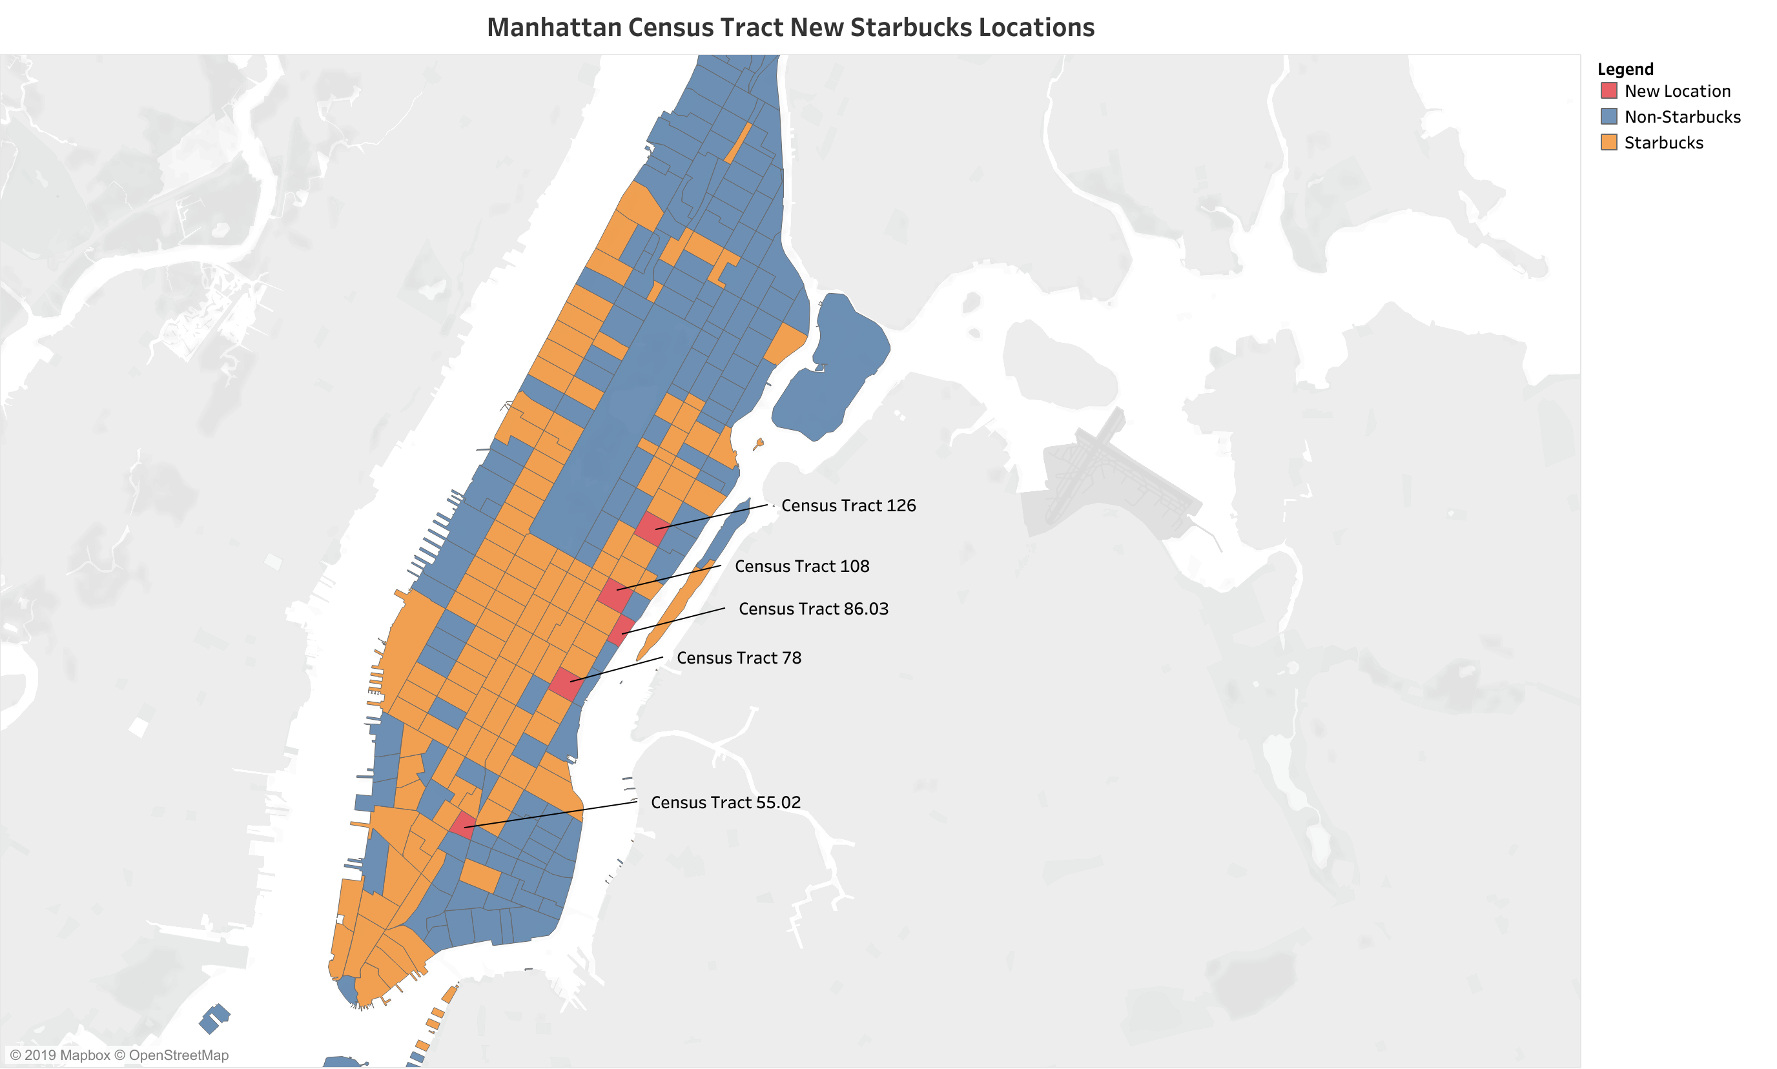
Predictions Manhattan

Slide 17
Conclusion
Optimal Location Demographics
Rent, Home Values, and Income much higher than the city average
Higher percentage of people with college degrees
Higher percentage of people working
Optimal census tracts chosen were nearby cities downtown area
Lots of Starbucks locations in downtown areas
Areas that Starbucks takes advantage of

Slide 18
Future Scope / Improvements
Census Bureau complete dataset
Street level traffic
Include factor of competitors
Include behavioral data of consumers (coffee routine, when, where, how)
Extend to more cities
Houston, LA, D.C., etc.
Different business sectors

Slide 19
Thank You

