Slide 1


US oil extraction profits & Saudi Arabia oil production
Debra Ray’s Project Proposal

Slide 2
Abstract: Predicting oil price volatility
Global oil production impacts oil prices. High oil prices harm transportation and manufacturing industries while low oil prices harm North American upstream oil enterprises involved in exploration and production of crude oil.
Understanding the relationship between U.S. corporate oil extraction profits and global oil production would help transportation and manufacturing enterprises predict shocks to global oil prices and prepare accordingly.
Oil price fluctuations impact transportation and manufacturing costs. Increases in these costs can cripple unprepared businesses. A model that can predict changes in oil prices would help businesses forecast future costs.

Slide 3
General relationship between production and prices
In general, when an oil producing country increases output beyond a certain point (holding demand constant), prices fall.
North American upstream firms struggle with a lack of comparative advantage to produce oil. These firms face higher costs than other oil producing nations.
North American governments cooperate with OPEC to maintain prices above the cost to produce oil to avoid negative profit margins.
Sometimes, in the case of oil price wars like we saw recently with Saudi Arabia and Russia, cooperation fails and the price of oil plummets.

Slide 4
Question of inquiry
This could help in an analysis of whether oil producing countries will:
Continue to cooperate (keeping oil prices high and oil production low) or …
Diverge from cooperation (lowering oil prices through production increases).
What predictors will forecast a positive or negative relationship between U.S. corporate oil extraction profits and Saudi Arabia oil production?

Slide 5
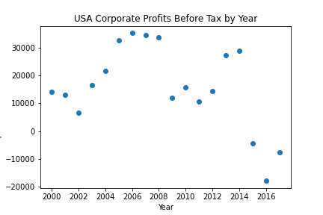
U.S. corporate profits fall between the year 2000 to 2002 and then steadily rise until 2007, reaching a peak in year 2006. U.S. corporate profits fell sharply in year 2009, never fully rebounding. In 2013 and 2014, there was a nice bounce in corporate profits, but profits turned negative in 2015.

Slide 6
Why did U.S. extraction profits turn negative in 2015?
In 2015, the United Nations lifted Iran Sanctions.
In response, Iran drastically increased oil production, lowering oil prices drastically.
Iran was not the only country to boost oil production during this time.
You will see on the following slide that Saudi Arabia also raised its production of oil.

Slide 7
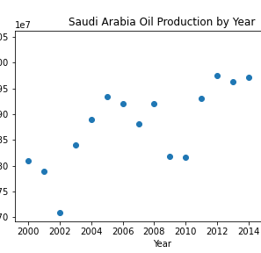
Saudi Arabia oil production by year
Saudi Arabia continues to maintain or increase oil production between the years 2011 - 2017, despite plummeting profits in USA.
Prior to this time period, Saudi Arabia oil production and U.S. corporate extraction profits exhibit a positive relationship.
When Saudi Arabia continued to increase oil production as U.S. corporate extraction profits decrease drastically after 2015, the relationship turns negative.

Slide 8
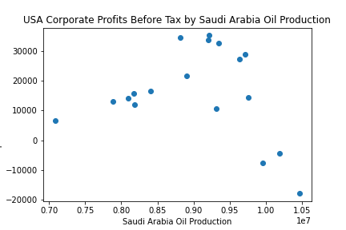
Relationship between U.S. corporate profits & Saudi Arabia oil production volume
U.S. corporate oil extraction profits and Saudi Arabia oil production has a positive relationship below Saudi production levels of around 9210000.
After this point, U.S. profits and Saudi Arabia oil production have a negative relationship.

Slide 9
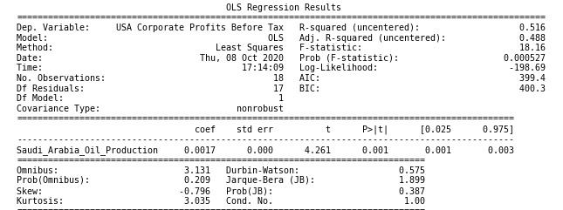
Simple linear regression results
The OLS regression found a statistically significant relationship between U.S. corporate extraction profits before tax and Saudi Arabia oil production at a p-value of .001.
Strong evidence supports the idea that a relationship exists between these two variables at a 1% confidence level.
More analysis is required to develop actionable insights fully.

Slide 10
Key Findings A break from a hypothesis
Hypothesis: Saudi Arabia oil production and U.S. oil production should typically exhibit a negative relationship. As Saudi Arabia increases production of oil, prices should drop. As prices drop, U.S. corporate profits should fall along with prices.
2000–2002
Instead Saudi Arabia production fell and U.S. corporate profits dropped. Then, Saudi Arabia production rebounded alongside U.S. corporate profits between 2003 - 2005.
2009–2010
Saudi Arabia oil production fell sharply. This sharp drop in oil production accompanied a sharp drop in USA corporate profits.
A positive relationship between U.S. profits and Saudi oil production exists during these time periods.

Slide 11
Key Findings The hypothesis holds true!
Hypothesis: Saudi Arabia oil production and U.S. oil production should typically exhibit a negative relationship. As Saudi Arabia increases production of oil, prices should drop. As prices drop, U.S. corporate profits should fall along with prices.
2006
U.S. Corporate Profits hit a peak. During this time between 2006 and 2007, Saudi Arabia decreased oil production slightly.
2011 – 2017
In 2011, Saudi Arabia oil production rebounds, but U.S. corporate profits still lag behind. USA corporate profits do not rebound until 2013 and 2014.
Through 2017, Saudi Arabia continues to maintain or increase oil production, despite plummeting profits in USA.
A negative relationship between U.S. profits and Saudi oil production exists during these time periods.

Slide 12
Explanation: Countervailing factors exist
The hypothetical negative relationship could turn positive if:
A fall in demand for oil could explain periods where Saudi decreases in oil occur with a fall in USA profits.
U.S. cooperation with OPEC countries like Saudi Arabia to stabilize global oil prices could result in a positive relationship between Saudi Arabia oil production and U.S. corporate profits.

Slide 13
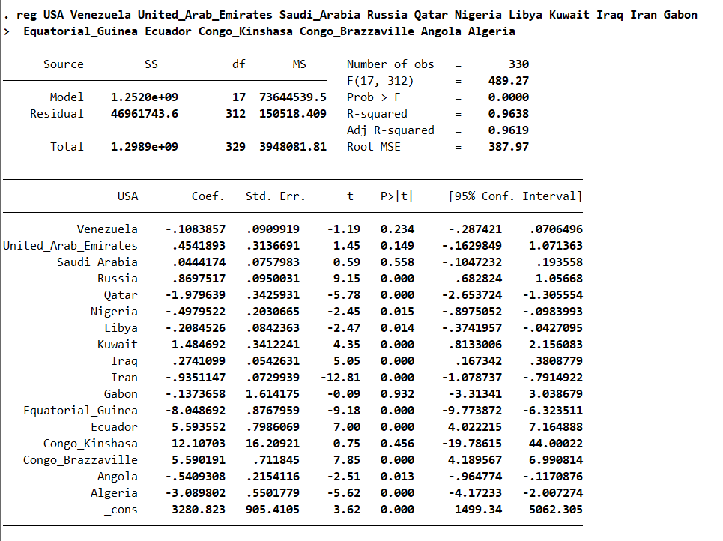
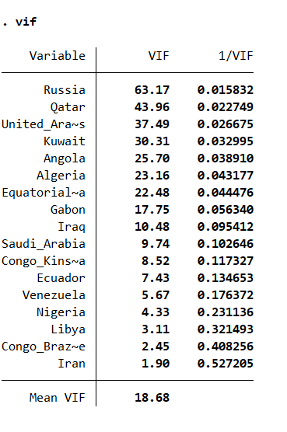
Problem: Multicollinearity based on VIF
Typically, for predictive models, multicollinearity is not necessarily an issue. Nevertheless, it might be worth exploring analysis methods other than typical regression models to uncover data trends between independent variables and/or linearly combine countries with high collinearity to reduce the VIF when constructing the model.

Slide 14
Areas of further research
I would like to expand the data included in this analysis in at least three ways:
Incorporate at least quarterly if not monthly data to increase the observation size and account for seasonal fluctuations.
Add other countries of interest including Russia and OPEC countries like Iran, the United Arab Emirates, and Venezuela to look for relationships of interest in this analysis while accounting for multicollinearity issues.
Nail down the best outcome variable for the project.
This data may help to:
Explain trends in U.S. corporate oil extraction profits and Saudi Arabia oil production choices.
Construct relationship maps to be used in political science critiques.
Build a predictive model of global oil prices.

