Slide 1
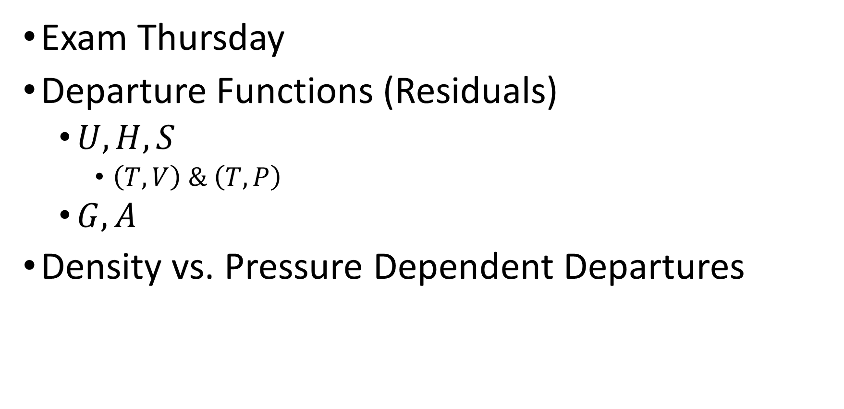
Tuesday, November 15
Exam Thursday
Departure Functions (Residuals)
$U,H, S$
$\left(T,V\right) \& \left(T,P\right)$
$G,A$
Density vs. Pressure Dependent Departures

Slide 2
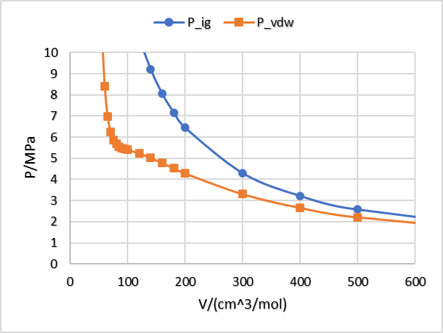
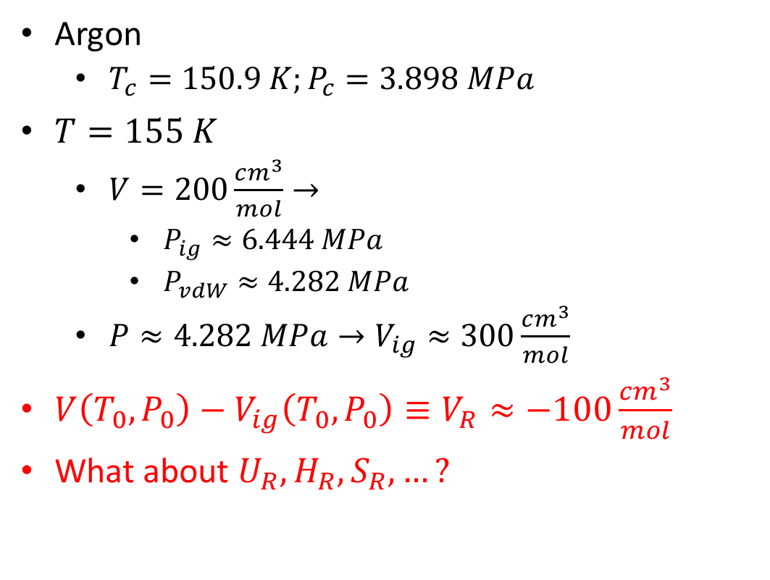
Pressure and Volume Differences: Residuals
Argon
$T_{c}=150.9 K;P_{c}=3.898 MPa$
$T=155 K$
$V=200\frac{cm^{3}}{mol}→$
$P_{ig}≈6.444 MPa$
$P_{vdW}≈4.282 MPa$
$P≈4.282 MPa→V_{ig}≈300\frac{cm^{3}}{mol}$
$V\left(T_{0},P_{0}\right)−V_{ig}\left(T_{0},P_{0}\right)≡V_{R}≈−100\frac{cm^{3}}{mol}$
What about $U_{R},H_{R},S_{R},…?$

Slide 3
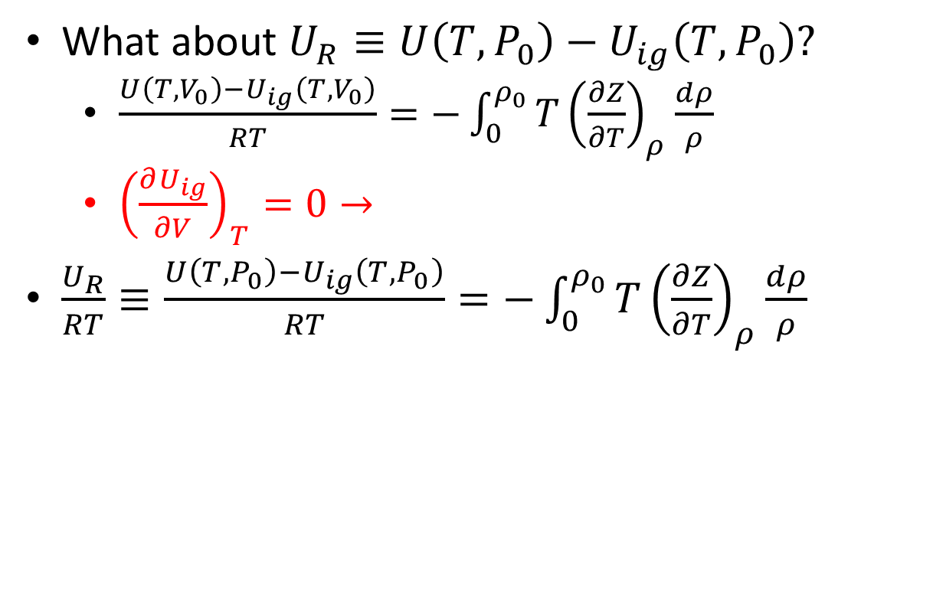
Internal Energy Departures
What about $U_{R}≡U\left(T,P_{0}\right)−U_{ig}\left(T,P_{0}\right)?$
$\frac{U\left(T,V_{0}\right)−U_{ig}\left(T,V_{0}\right)}{RT}=−\int_{0}^{ρ_{0}}{T{\left(\frac{∂Z}{∂T}\right)}_{ρ}\frac{dρ}{ρ}}$
${\left(\frac{∂U_{ig}}{∂V}\right)}_{T}=0→$
$\frac{U_{R}}{RT}≡\frac{U\left(T,P_{0}\right)−U_{ig}\left(T,P_{0}\right)}{RT}=−\int_{0}^{ρ_{0}}{T{\left(\frac{∂Z}{∂T}\right)}_{ρ}\frac{dρ}{ρ}}$
Notes:
If extra time, can show enthalpy departure quickly

Slide 4
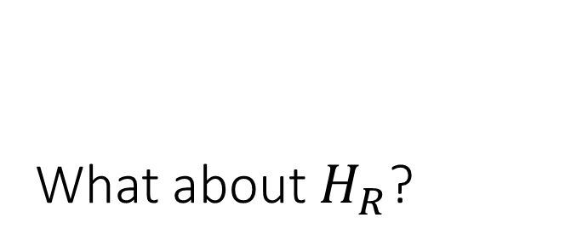
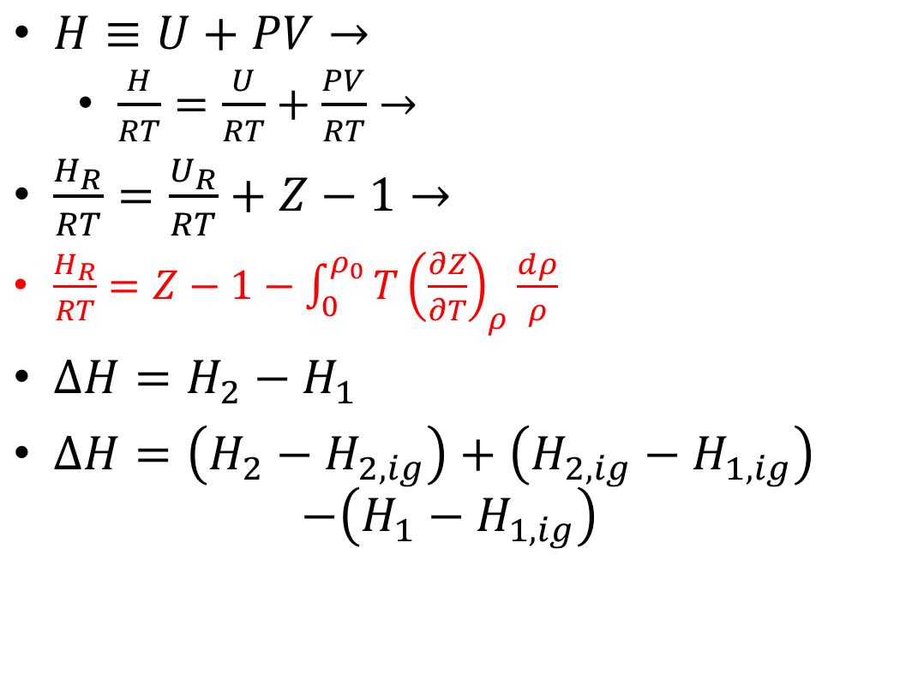
What about $H_{R}$?
$H≡U+PV→$
$\frac{H}{RT}=\frac{U}{RT}+\frac{PV}{RT}→$
$\frac{H_{R}}{RT}=\frac{U_{R}}{RT}+Z−1→$
$\frac{H_{R}}{RT}=Z−1−\int_{0}^{ρ_{0}}{T{\left(\frac{∂Z}{∂T}\right)}_{ρ}\frac{dρ}{ρ}}$
$ΔH=H_{2}−H_{1}$
$ΔH=\left(H_{2}−H_{2,ig}\right)+\left(H_{2,ig}−H_{1,ig}\right)$ $−\left(H_{1}−H_{1,ig}\right)$
Notes:
Can do an example with linear virial, vdW, PR (use PREOS), …

Slide 5
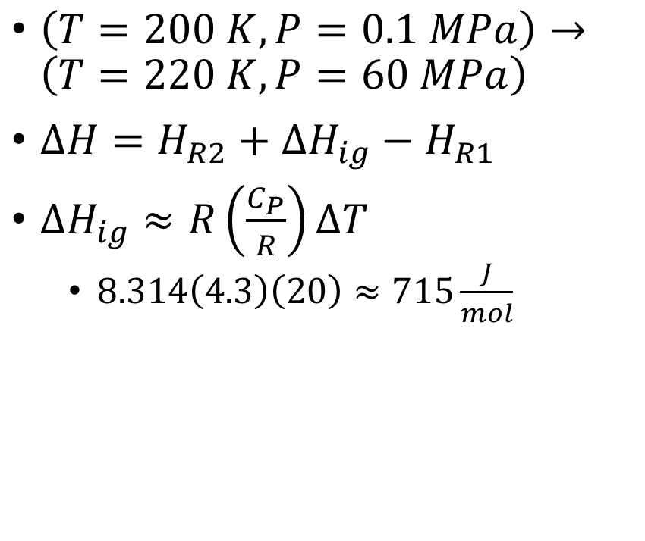
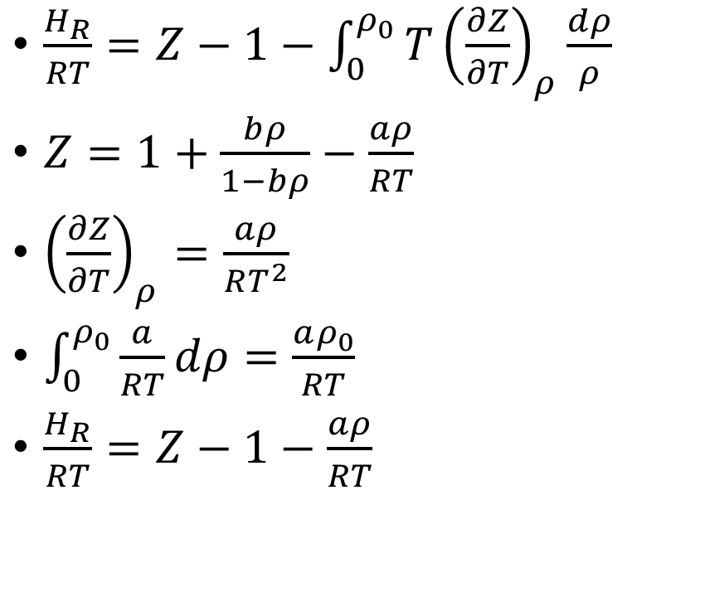
Example: Methane Departure using van der Waals
$\left(T=200 K,P=0.1 MPa\right)→\left(T=220 K,P=60 MPa\right)$
$ΔH=H_{R2}+ΔH_{ig}−H_{R1}$
$ΔH_{ig}≈R\left(\frac{C_{P}}{R}\right)ΔT$
$8.314\left(4.3\right)\left(20\right)≈715\frac{J}{mol}$
$\frac{H_{R}}{RT}=Z−1−\int_{0}^{ρ_{0}}{T{\left(\frac{∂Z}{∂T}\right)}_{ρ}\frac{dρ}{ρ}}$
$Z=1+\frac{bρ}{1−bρ}−\frac{aρ}{RT}$
${\left(\frac{∂Z}{∂T}\right)}_{ρ}=\frac{aρ}{RT^{2}}$
$\int_{0}^{ρ_{0}}{\frac{a}{RT}dρ}=\frac{aρ_{0}}{RT}$
$\frac{H_{R}}{RT}=Z−1−\frac{aρ}{RT}$
Notes:
Do numbers in excel
Columns: $bρ;ρ;1+Z_{rep};\left|Z_{att}\right|;Z;P;\frac{H_{R}}{RT};H_{R}$

Slide 6

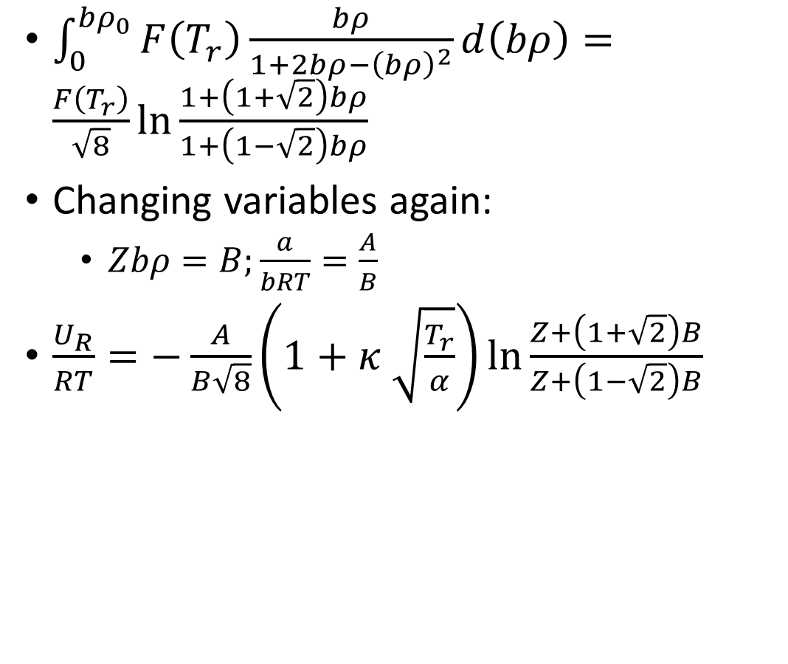
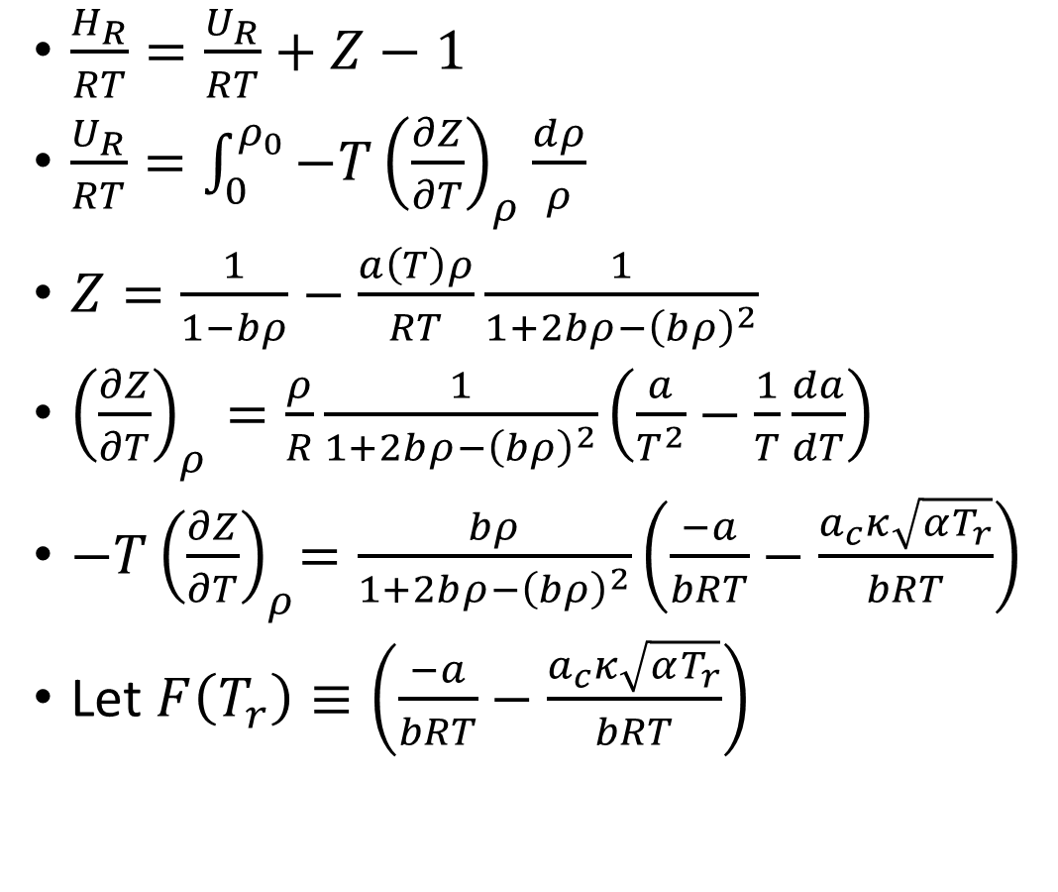
Peng-Robinson $H_{R}$
$\frac{H_{R}}{RT}=\frac{U_{R}}{RT}+Z−1$
$\frac{U_{R}}{RT}=\int_{0}^{ρ_{0}}{−T{\left(\frac{∂Z}{∂T}\right)}_{ρ}\frac{dρ}{ρ}}$
$Z=\frac{1}{1−bρ}−\frac{a\left(T\right)ρ}{RT}\frac{1}{1+2bρ−{\left(bρ\right)}^{2}}$
${\left(\frac{∂Z}{∂T}\right)}_{ρ}=\frac{ρ}{R}\frac{1}{1+2bρ−{\left(bρ\right)}^{2}}\left(\frac{a}{T^{2}}−\frac{1}{T}\frac{da}{dT}\right)$
${−T\left(\frac{∂Z}{∂T}\right)}_{ρ}=\frac{bρ}{1+2bρ−{\left(bρ\right)}^{2}}\left(\frac{−a}{bRT}−\frac{a_{c}κ\sqrt{αT_{r}}}{bRT}\right)$
Let $F\left(T_{r}\right)≡\left(\frac{−a}{bRT}−\frac{a_{c}κ\sqrt{αT_{r}}}{bRT}\right)$
$\int_{0}^{{bρ}_{0}}{F\left(T_{r}\right)\frac{bρ}{1+2bρ−{\left(bρ\right)}^{2}}d\left(bρ\right)}=\frac{F\left(T_{r}\right)}{\sqrt{8}}\ln{\frac{1+\left(1+\sqrt{2}\right)bρ}{1+\left(1−\sqrt{2}\right)bρ}}$
Changing variables again:
$Zbρ=B;\frac{a}{bRT}=\frac{A}{B}$
$\frac{U_{R}}{RT}=−\frac{A}{B\sqrt{8}}\left(1+κ \sqrt{\frac{T_{r}}{α}}\right)\ln{\frac{Z+\left(1+\sqrt{2}\right)B}{Z+\left(1−\sqrt{2}\right)B}}$
Notes:
Do not copy; go to PREOS lol

Slide 7
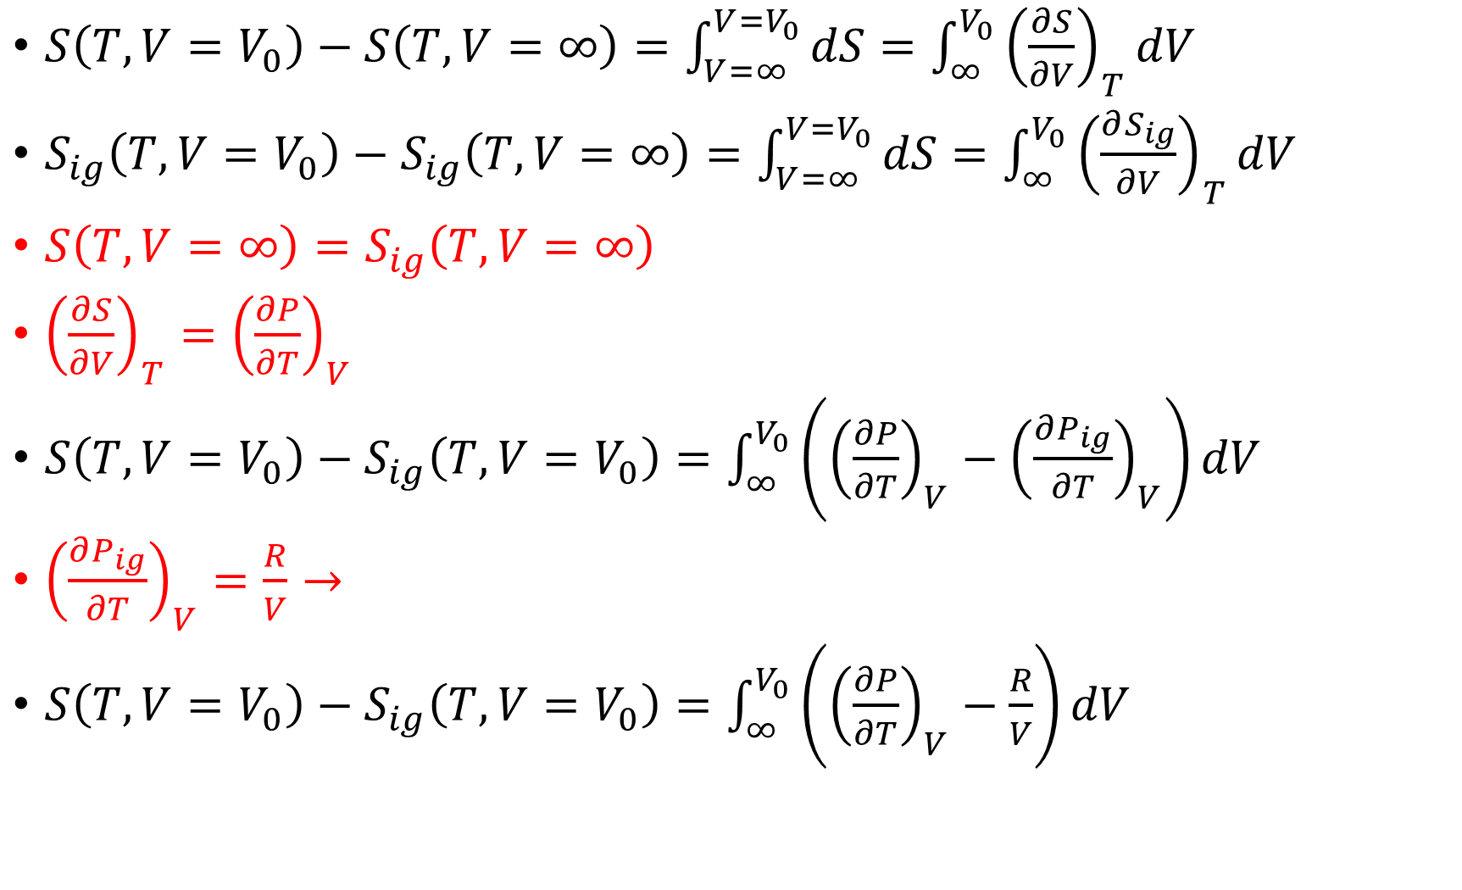
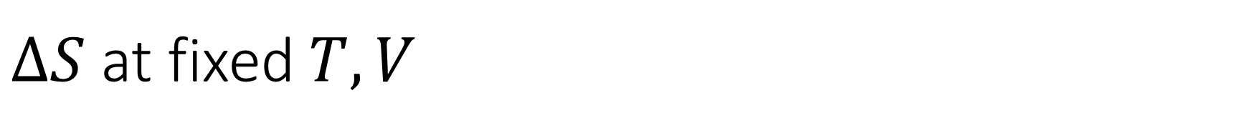
$ΔS$ at fixed $T,V$
$S\left(T,V=V_{0}\right)−S\left(T,V=∞\right)=\int_{V=∞}^{V=V_{0}}{dS}=\int_{∞}^{V_{0}}{{\left(\frac{∂S}{∂V}\right)}_{T}dV}$
$S_{ig}\left(T,V=V_{0}\right)−S_{ig}\left(T,V=∞\right)=\int_{V=∞}^{V=V_{0}}{dS}=\int_{∞}^{V_{0}}{{\left(\frac{∂S_{ig}}{∂V}\right)}_{T}dV}$
$S\left(T,V=∞\right)=S_{ig}\left(T,V=∞\right)$
${\left(\frac{∂S}{∂V}\right)}_{T}={\left(\frac{∂P}{∂T}\right)}_{V}$
$S\left(T,V=V_{0}\right)−S_{ig}\left(T,V=V_{0}\right)=\int_{∞}^{V_{0}}{\left({\left(\frac{∂P}{∂T}\right)}_{V}−{\left(\frac{∂P_{ig}}{∂T}\right)}_{V}\right)dV}$
${\left(\frac{∂P_{ig}}{∂T}\right)}_{V}=\frac{R}{V}→$
$S\left(T,V=V_{0}\right)−S_{ig}\left(T,V=V_{0}\right)=\int_{∞}^{V_{0}}{\left({\left(\frac{∂P}{∂T}\right)}_{V}−\frac{R}{V}\right)dV}$

Slide 8
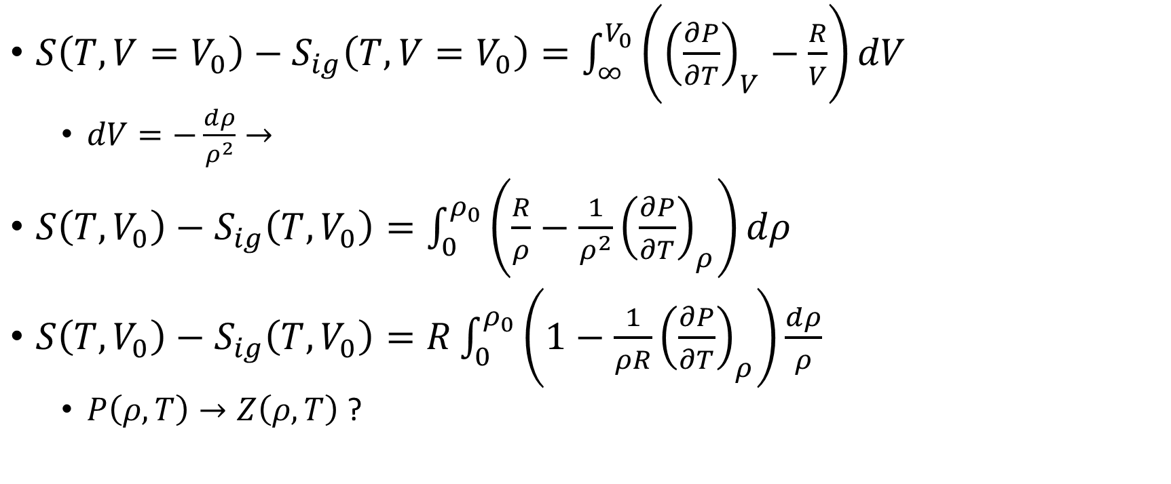

$$V=∞→ρ=0$$
$S\left(T,V=V_{0}\right)−S_{ig}\left(T,V=V_{0}\right)=\int_{∞}^{V_{0}}{\left({\left(\frac{∂P}{∂T}\right)}_{V}−\frac{R}{V}\right)dV}$
$dV=−\frac{dρ}{ρ^{2}}→$
$S\left(T,V_{0}\right)−S_{ig}\left(T,V_{0}\right)=\int_{0}^{ρ_{0}}{\left(\frac{R}{ρ}−\frac{1}{ρ^{2}}{\left(\frac{∂P}{∂T}\right)}_{ρ}\right)dρ}$
$S\left(T,V_{0}\right)−S_{ig}\left(T,V_{0}\right)=R\int_{0}^{ρ_{0}}{\left(1−\frac{1}{ρR}{\left(\frac{∂P}{∂T}\right)}_{ρ}\right)\frac{dρ}{ρ}}$
$P\left(ρ,T\right)→Z\left(ρ,T\right)$ ?

Slide 9
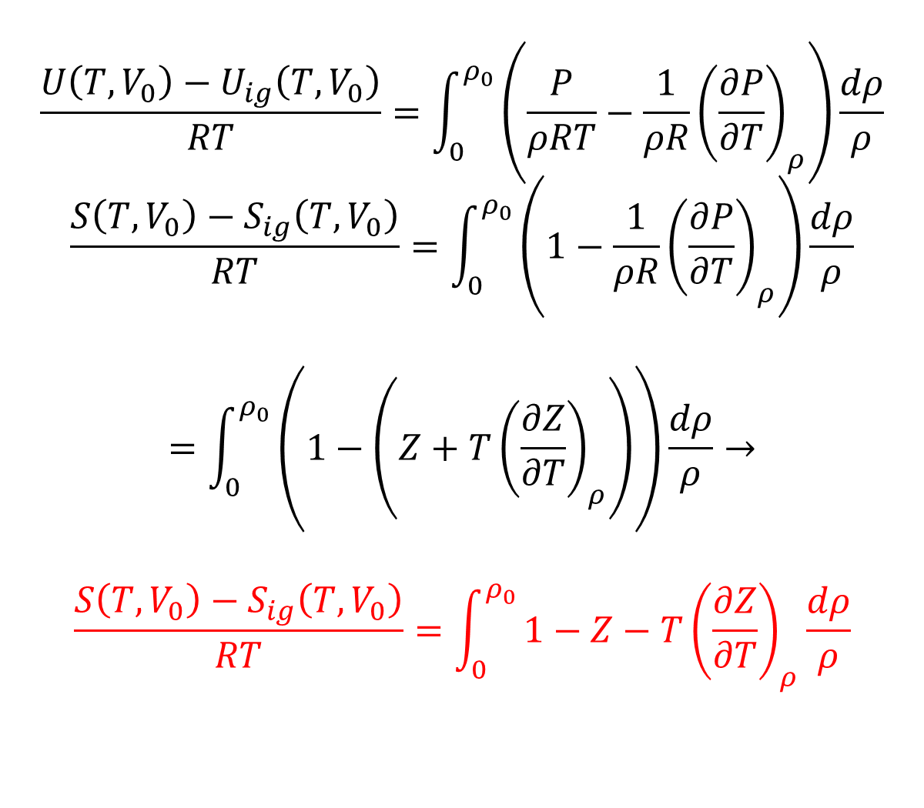
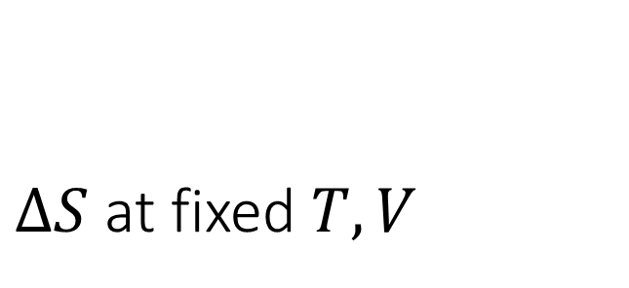
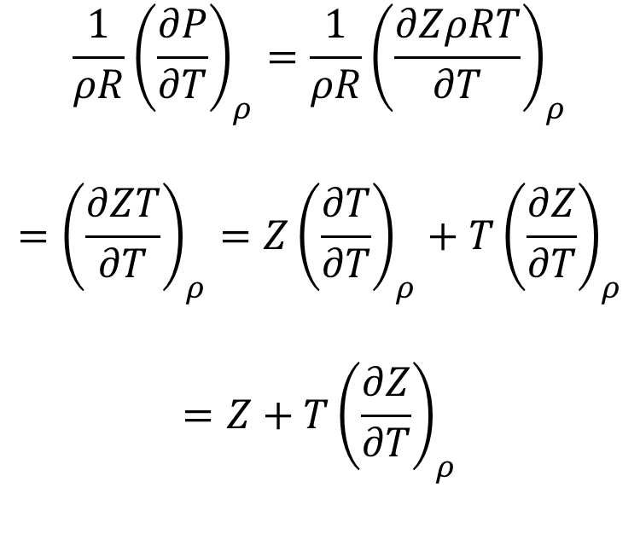
$ΔS$ at fixed $T,V$
$$\frac{U\left(T,V_{0}\right)−U_{ig}\left(T,V_{0}\right)}{RT}=\int_{0}^{ρ_{0}}{\left(\frac{P}{ρRT}−\frac{1}{ρR}{\left(\frac{∂P}{∂T}\right)}_{ρ}\right)\frac{dρ}{ρ}}$$
$$\frac{S\left(T,V_{0}\right)−S_{ig}\left(T,V_{0}\right)}{RT}=\int_{0}^{ρ_{0}}{\left(1−\frac{1}{ρR}{\left(\frac{∂P}{∂T}\right)}_{ρ}\right)\frac{dρ}{ρ}}$$
$$=\int_{0}^{ρ_{0}}{\left(1−\left(Z+T{\left(\frac{∂Z}{∂T}\right)}_{ρ}\right)\right)\frac{dρ}{ρ}}→$$
$$\frac{S\left(T,V_{0}\right)−S_{ig}\left(T,V_{0}\right)}{RT}=\int_{0}^{ρ_{0}}{1−Z−T{\left(\frac{∂Z}{∂T}\right)}_{ρ}\frac{dρ}{ρ}}$$
$$\frac{1}{ρR}{\left(\frac{∂P}{∂T}\right)}_{ρ}=\frac{1}{ρR}{\left(\frac{∂ZρRT}{∂T}\right)}_{ρ}$$
$$={\left(\frac{∂ZT}{∂T}\right)}_{ρ}={Z\left(\frac{∂T}{∂T}\right)}_{ρ}+T{\left(\frac{∂Z}{∂T}\right)}_{ρ}$$
$$=Z+T{\left(\frac{∂Z}{∂T}\right)}_{ρ}$$

Slide 10
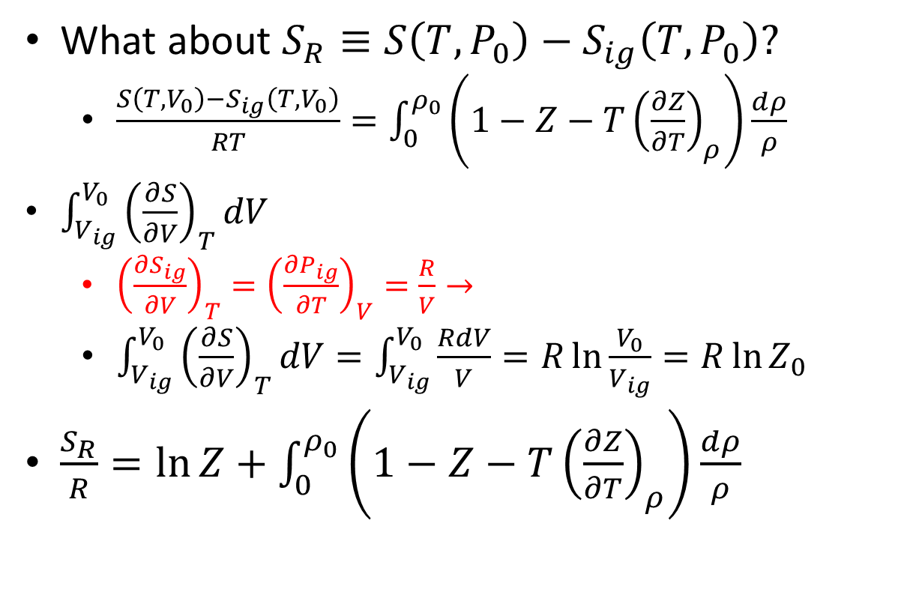
Entropy Departures
What about $S_{R}≡S\left(T,P_{0}\right)−S_{ig}\left(T,P_{0}\right)?$
$\frac{S\left(T,V_{0}\right)−S_{ig}\left(T,V_{0}\right)}{RT}=\int_{0}^{ρ_{0}}{\left(1−Z−T{\left(\frac{∂Z}{∂T}\right)}_{ρ}\right)\frac{dρ}{ρ}}$
$\int_{V_{ig}}^{V_{0}}{{\left(\frac{∂S}{∂V}\right)}_{T}dV}$
${\left(\frac{∂S_{ig}}{∂V}\right)}_{T}={\left(\frac{∂P_{ig}}{∂T}\right)}_{V}=\frac{R}{V}→$
$\int_{V_{ig}}^{V_{0}}{{\left(\frac{∂S}{∂V}\right)}_{T}dV}=\int_{V_{ig}}^{V_{0}}{\frac{RdV}{V}}=R\ln{\frac{V_{0}}{V_{ig}}}=R\ln{Z_{0}}$
$\frac{S_{R}}{R}=\ln{Z}+\int_{0}^{ρ_{0}}{\left(1−Z−T{\left(\frac{∂Z}{∂T}\right)}_{ρ}\right)\frac{dρ}{ρ}}$

Slide 11

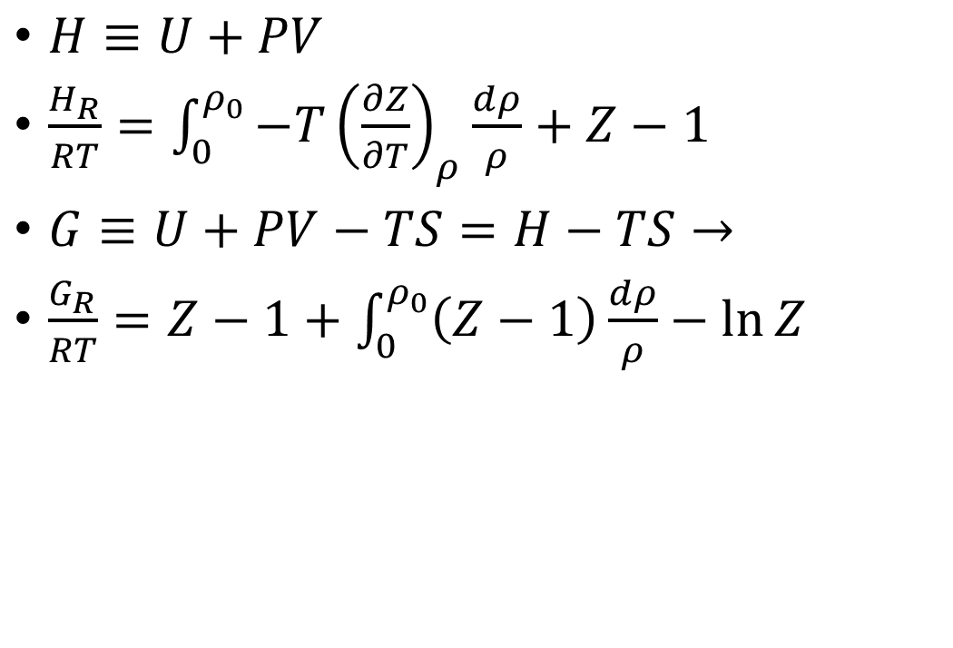
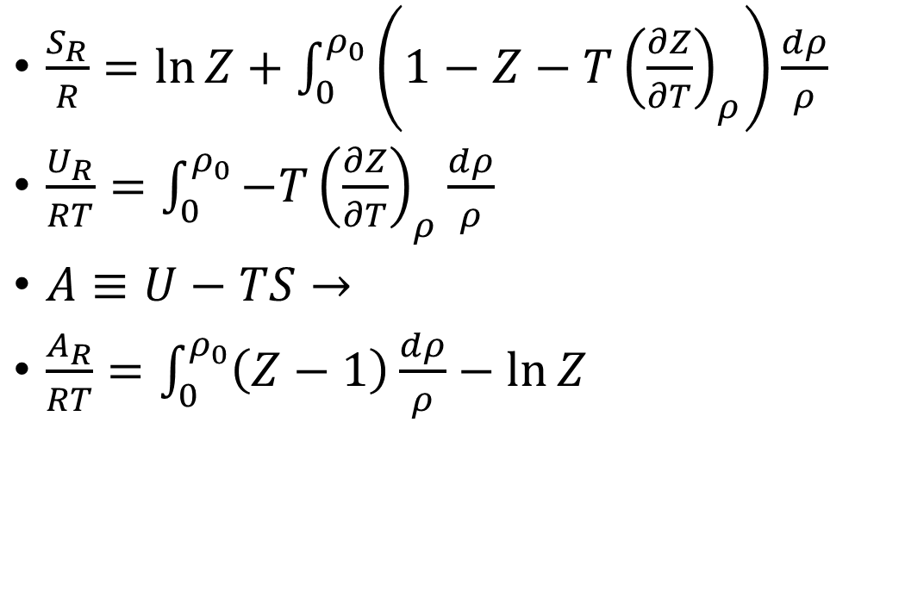
Residuals: Departures at Constant $\left(T,P\right)$
$\frac{S_{R}}{R}=\ln{Z}+\int_{0}^{ρ_{0}}{\left(1−Z−T{\left(\frac{∂Z}{∂T}\right)}_{ρ}\right)\frac{dρ}{ρ}}$
$\frac{U_{R}}{RT}=\int_{0}^{ρ_{0}}{−T{\left(\frac{∂Z}{∂T}\right)}_{ρ}\frac{dρ}{ρ}}$
$A≡U−TS→$
$\frac{A_{R}}{RT}=\int_{0}^{ρ_{0}}{\left(Z−1\right)\frac{dρ}{ρ}}−\ln{Z}$
$H≡U+PV$
$\frac{H_{R}}{RT}=\int_{0}^{ρ_{0}}{−T{\left(\frac{∂Z}{∂T}\right)}_{ρ}\frac{dρ}{ρ}}+Z−1$
$G≡U+PV−TS=H−TS→$
$\frac{G_{R}}{RT}=Z−1+\int_{0}^{ρ_{0}}{\left(Z−1\right)\frac{dρ}{ρ}}−\ln{Z}$
Notes:
Probably go to Excel to make P(H) and G(P) plots

Slide 12

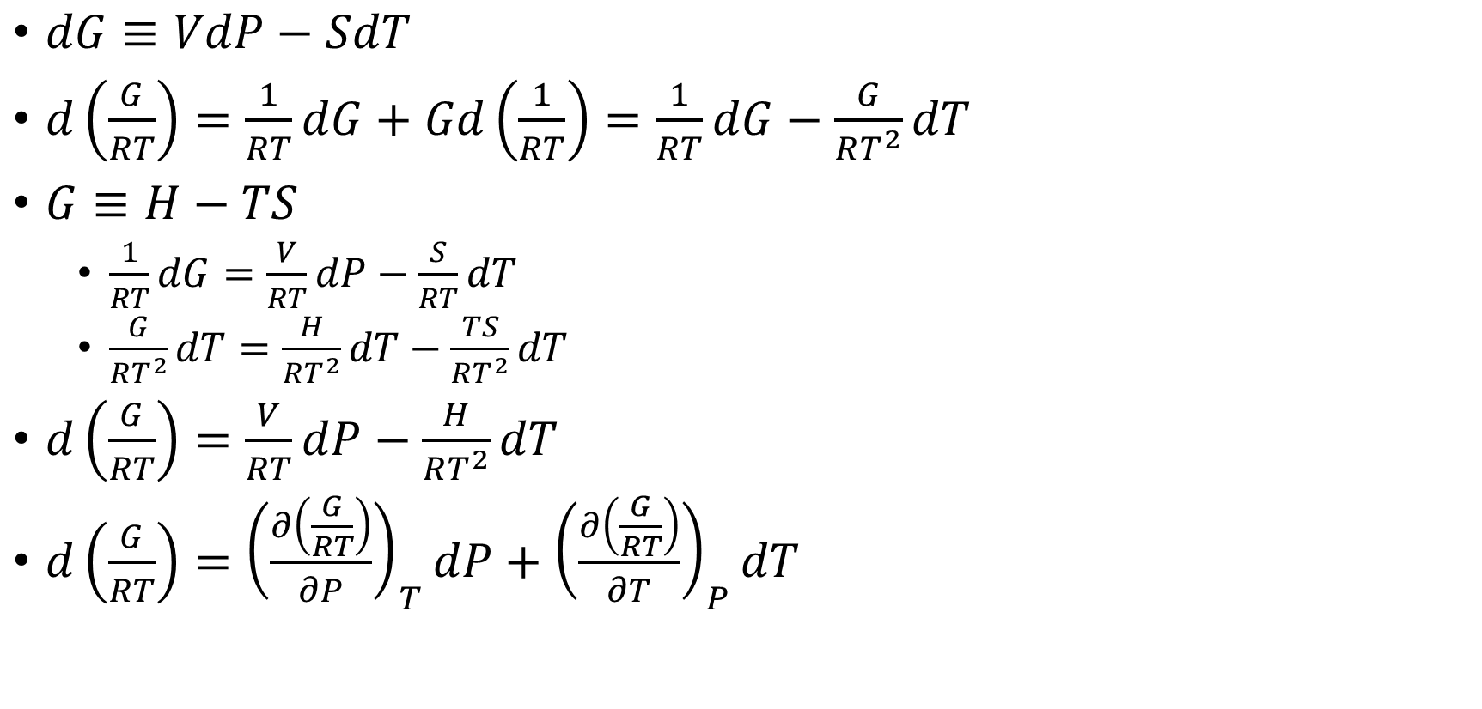
Generating Residuals from $dG$
$dG≡VdP−SdT$
$d\left(\frac{G}{RT}\right)=\frac{1}{RT}dG+Gd\left(\frac{1}{RT}\right)=\frac{1}{RT}dG−\frac{G}{RT^{2}}dT$
$G≡H−TS$
$\frac{1}{RT}dG=\frac{V}{RT}dP−\frac{S}{RT}dT$
$\frac{G}{RT^{2}}dT=\frac{H}{RT^{2}}dT−\frac{TS}{RT^{2}}dT$
$d\left(\frac{G}{RT}\right)=\frac{V}{RT}dP−\frac{H}{RT^{2}}dT$
$d\left(\frac{G}{RT}\right)={\left(\frac{∂\left(\frac{G}{RT}\right)}{∂P}\right)}_{T}dP+{\left(\frac{∂\left(\frac{G}{RT}\right)}{∂T}\right)}_{P}dT$
Notes:
Alluded to in Example 6.7

Slide 13

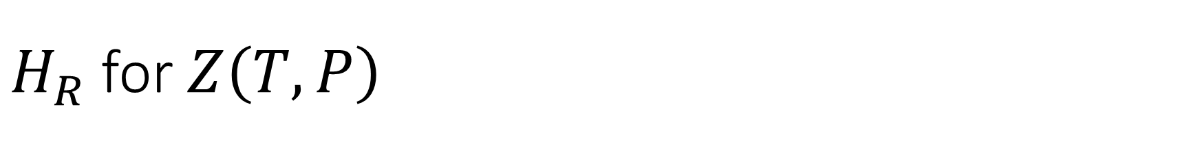
$H_{R}$ for $Z\left(T,P\right)$
$d\left(\frac{G}{RT}\right)=\frac{V}{RT}dP−\frac{H}{RT^{2}}dT$
$d\left(\frac{G_{R}}{RT}\right)=\frac{V_{R}}{RT}dP−\frac{H_{R}}{RT^{2}}dT$
Integrate at constant $T→$
$\frac{G_{R}}{RT}−\frac{G_{R}\left(P=0\right)}{RT}=\int_{0}^{P_{0}}{\frac{V_{R}}{RT}dP}→$
$\frac{G_{R}}{RT}=\frac{G_{R}\left(P=0\right)}{RT}+\int_{0}^{P_{0}}{\left(Z−1\right)\frac{dP}{P}}$
Utilizing ${\left(\frac{∂\left(\frac{G_{R}}{RT}\right)}{∂T}\right)}_{P}=−\frac{H_{R}}{RT^{2}}→$
$\frac{H_{R}}{RT}=\int_{0}^{P_{0}}{−T{\left(\frac{∂Z}{∂T}\right)}_{P}\frac{dP}{P}}$

Slide 14
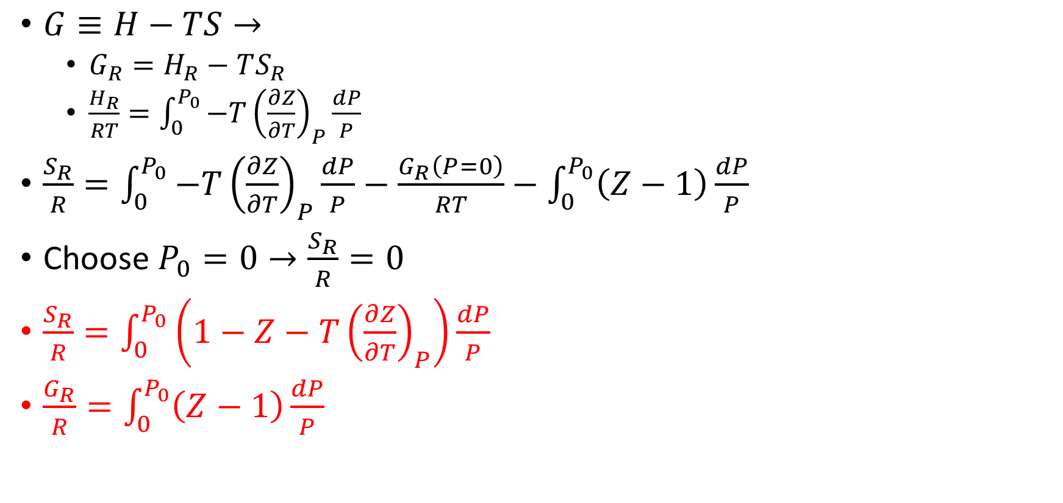

$S_{R}$ for $Z\left(T,P\right)$
$G≡H−TS→$
$G_{R}=H_{R}−TS_{R}$
$\frac{H_{R}}{RT}=\int_{0}^{P_{0}}{−T{\left(\frac{∂Z}{∂T}\right)}_{P}\frac{dP}{P}}$
$\frac{S_{R}}{R}=\int_{0}^{P_{0}}{−T{\left(\frac{∂Z}{∂T}\right)}_{P}\frac{dP}{P}}−\frac{G_{R}\left(P=0\right)}{RT}−\int_{0}^{P_{0}}{\left(Z−1\right)\frac{dP}{P}}$
Choose $P_{0}=0→\frac{S_{R}}{R}=0$
$\frac{S_{R}}{R}=\int_{0}^{P_{0}}{\left(1−Z−T{\left(\frac{∂Z}{∂T}\right)}_{P}\right)\frac{dP}{P}}$
$\frac{G_{R}}{R}=\int_{0}^{P_{0}}{\left(Z−1\right)\frac{dP}{P}}$

Slide 15
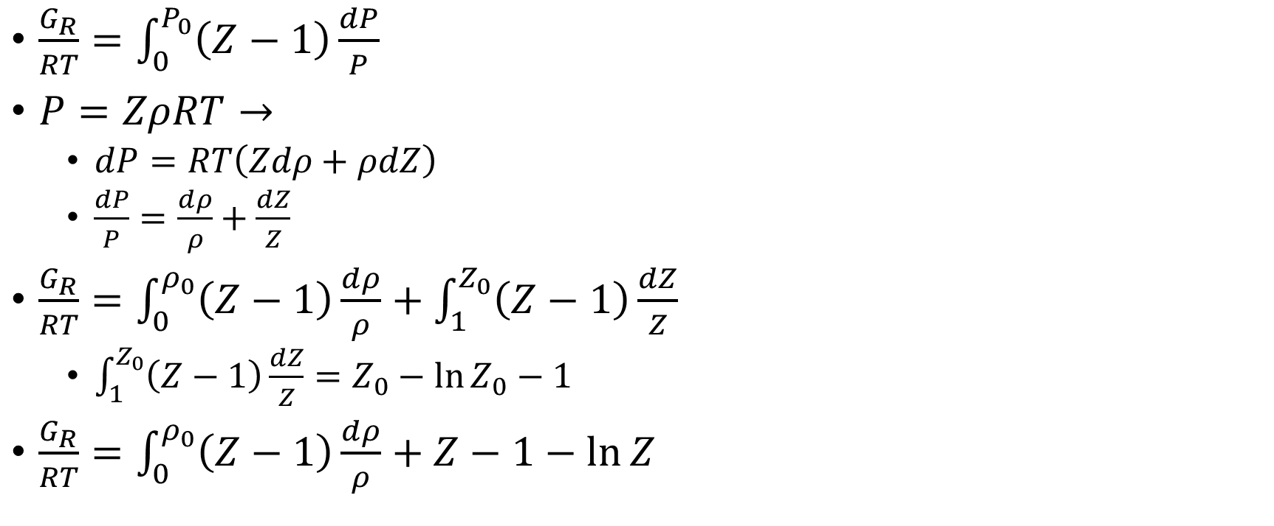
Consistency of Both Derivations: Using the Chain Rule (as always)
$\frac{G_{R}}{RT}=\int_{0}^{P_{0}}{\left(Z−1\right)\frac{dP}{P}}$
$P=ZρRT→$
$dP=RT\left(Zdρ+ρdZ\right)$
$\frac{dP}{P}=\frac{dρ}{ρ}+\frac{dZ}{Z}$
$\frac{G_{R}}{RT}=\int_{0}^{ρ_{0}}{\left(Z−1\right)\frac{dρ}{ρ}}+\int_{1}^{Z_{0}}{\left(Z−1\right)\frac{dZ}{Z}}$
$\int_{1}^{Z_{0}}{\left(Z−1\right)\frac{dZ}{Z}}=Z_{0}−\ln{Z_{0}}−1$
$\frac{G_{R}}{RT}=\int_{0}^{ρ_{0}}{\left(Z−1\right)\frac{dρ}{ρ}}+Z−1−\ln{Z}$

