Slide 1
Tuesday, November 29
Homework Questions
Examples from Chapter 8
Example 6.7
Generating Functions for Residuals (Departures)
Problem 8.4

Slide 2
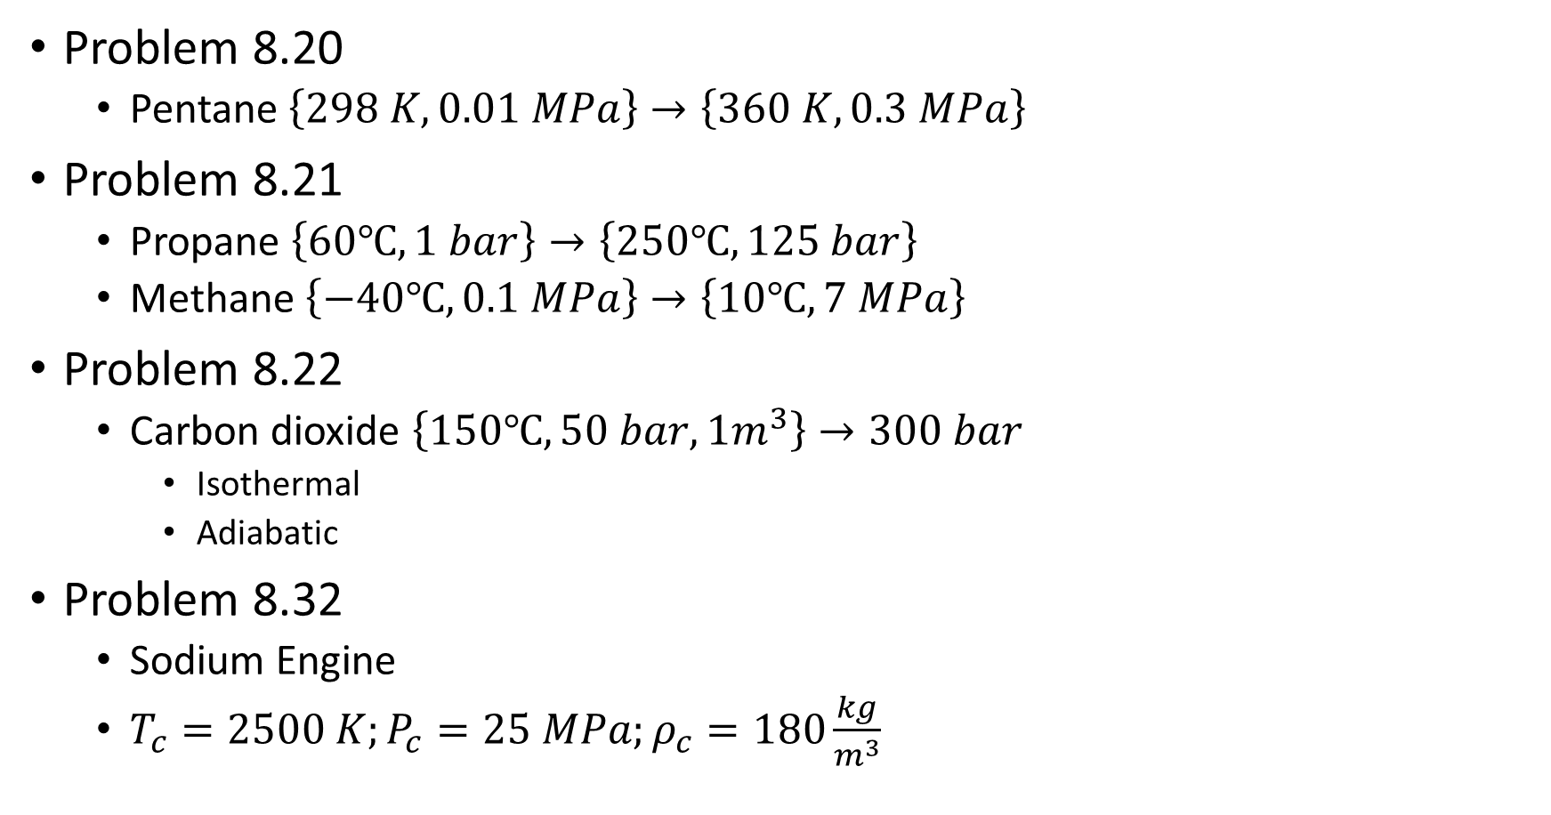
Examples
Problem 8.20
Pentane $\left\{298 K,0.01 MPa\right\}→\left\{360 K,0.3 MPa\right\}$
Problem 8.21
Propane $\left\{60℃,1 bar\right\}→\left\{250℃,125 bar\right\}$
Methane $\left\{−40℃,0.1 MPa\right\}→\left\{10℃,7 MPa\right\}$
Problem 8.22
Carbon dioxide $\left\{150℃,50 bar,1m^{3}\right\}→300 bar$
Isothermal
Adiabatic
Problem 8.32
Sodium Engine
$T_{c}=2500 K;P_{c}=25 MPa;ρ_{c}=180\frac{kg}{m^{3}}$

Slide 3
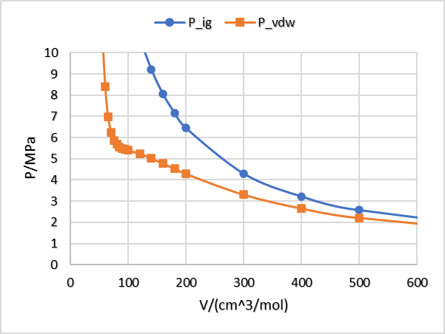
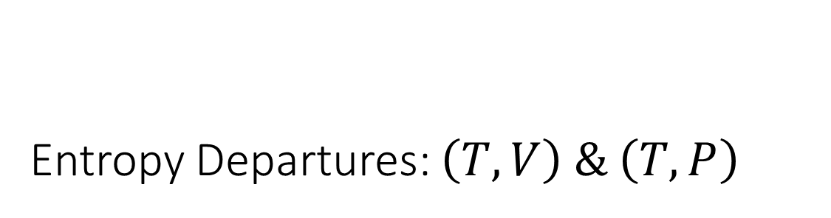
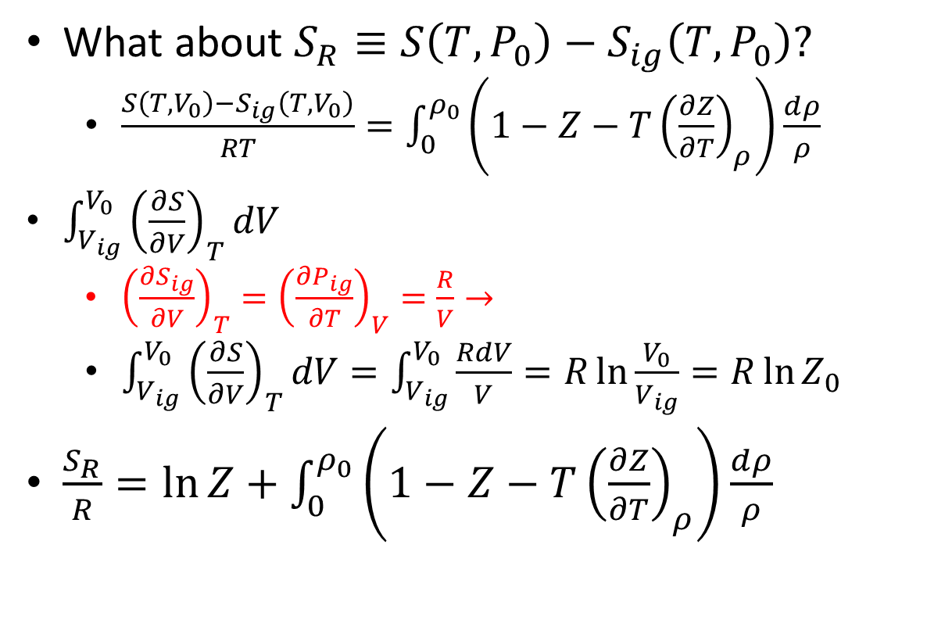
Entropy Departures: $\left(T,V\right) \& \left(T,P\right)$
What about $S_{R}≡S\left(T,P_{0}\right)−S_{ig}\left(T,P_{0}\right)?$
$\frac{S\left(T,V_{0}\right)−S_{ig}\left(T,V_{0}\right)}{RT}=\int_{0}^{ρ_{0}}{\left(1−Z−T{\left(\frac{∂Z}{∂T}\right)}_{ρ}\right)\frac{dρ}{ρ}}$
$\int_{V_{ig}}^{V_{0}}{{\left(\frac{∂S}{∂V}\right)}_{T}dV}$
${\left(\frac{∂S_{ig}}{∂V}\right)}_{T}={\left(\frac{∂P_{ig}}{∂T}\right)}_{V}=\frac{R}{V}→$
$\int_{V_{ig}}^{V_{0}}{{\left(\frac{∂S}{∂V}\right)}_{T}dV}=\int_{V_{ig}}^{V_{0}}{\frac{RdV}{V}}=R\ln{\frac{V_{0}}{V_{ig}}}=R\ln{Z_{0}}$
$\frac{S_{R}}{R}=\ln{Z}+\int_{0}^{ρ_{0}}{\left(1−Z−T{\left(\frac{∂Z}{∂T}\right)}_{ρ}\right)\frac{dρ}{ρ}}$

Slide 4
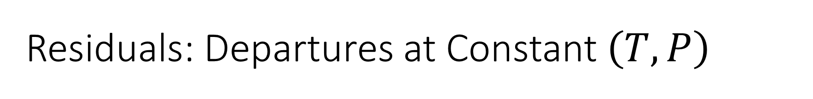
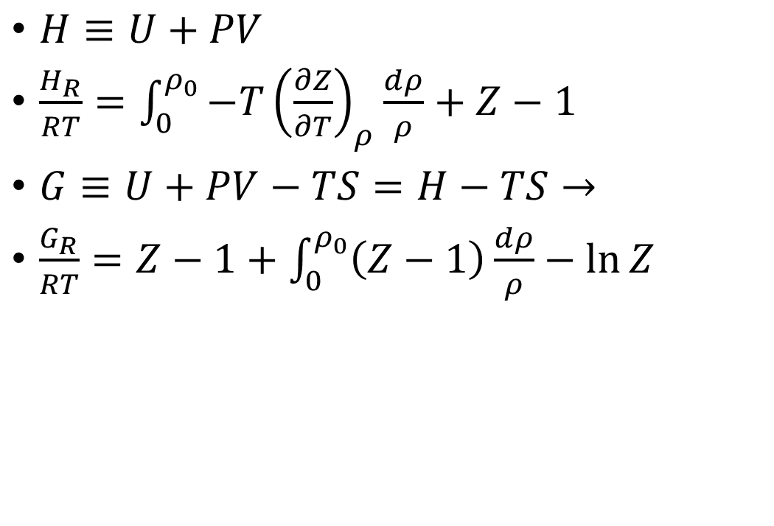
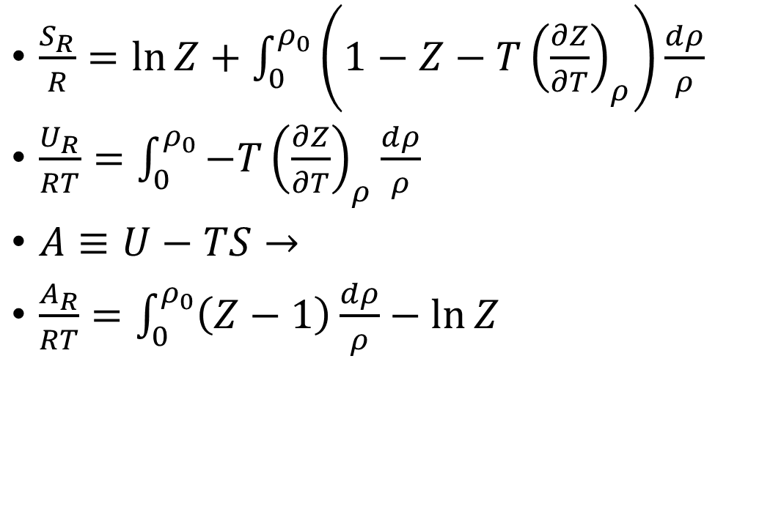
Residuals: Departures at Constant $\left(T,P\right)$
$\frac{S_{R}}{R}=\ln{Z}+\int_{0}^{ρ_{0}}{\left(1−Z−T{\left(\frac{∂Z}{∂T}\right)}_{ρ}\right)\frac{dρ}{ρ}}$
$\frac{U_{R}}{RT}=\int_{0}^{ρ_{0}}{−T{\left(\frac{∂Z}{∂T}\right)}_{ρ}\frac{dρ}{ρ}}$
$A≡U−TS→$
$\frac{A_{R}}{RT}=\int_{0}^{ρ_{0}}{\left(Z−1\right)\frac{dρ}{ρ}}−\ln{Z}$
$H≡U+PV$
$\frac{H_{R}}{RT}=\int_{0}^{ρ_{0}}{−T{\left(\frac{∂Z}{∂T}\right)}_{ρ}\frac{dρ}{ρ}}+Z−1$
$G≡U+PV−TS=H−TS→$
$\frac{G_{R}}{RT}=Z−1+\int_{0}^{ρ_{0}}{\left(Z−1\right)\frac{dρ}{ρ}}−\ln{Z}$
Notes:
Probably go to Excel to make P(H) and G(P) plots

Slide 5
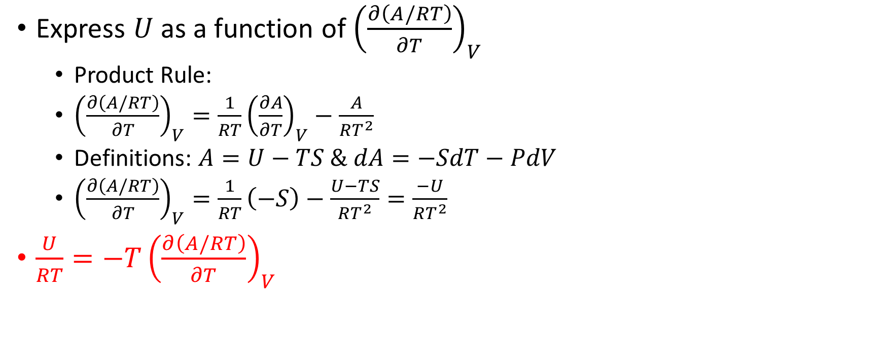
Example 6.7
Express $U$ as a function of ${\left(\frac{∂\left(A/RT\right)}{∂T}\right)}_{V}$
Product Rule:
${\left(\frac{∂\left(A/RT\right)}{∂T}\right)}_{V}=\frac{1}{RT}{\left(\frac{∂A}{∂T}\right)}_{V}−\frac{A}{RT^{2}}$
Definitions: $A=U−TS \& dA=−SdT−PdV$
${\left(\frac{∂\left(A/RT\right)}{∂T}\right)}_{V}=\frac{1}{RT}\left(−S\right)−\frac{U−TS}{RT^{2}}=\frac{−U}{RT^{2}}$
$\frac{U}{RT}=−T{\left(\frac{∂\left(A/RT\right)}{∂T}\right)}_{V}$

Slide 6

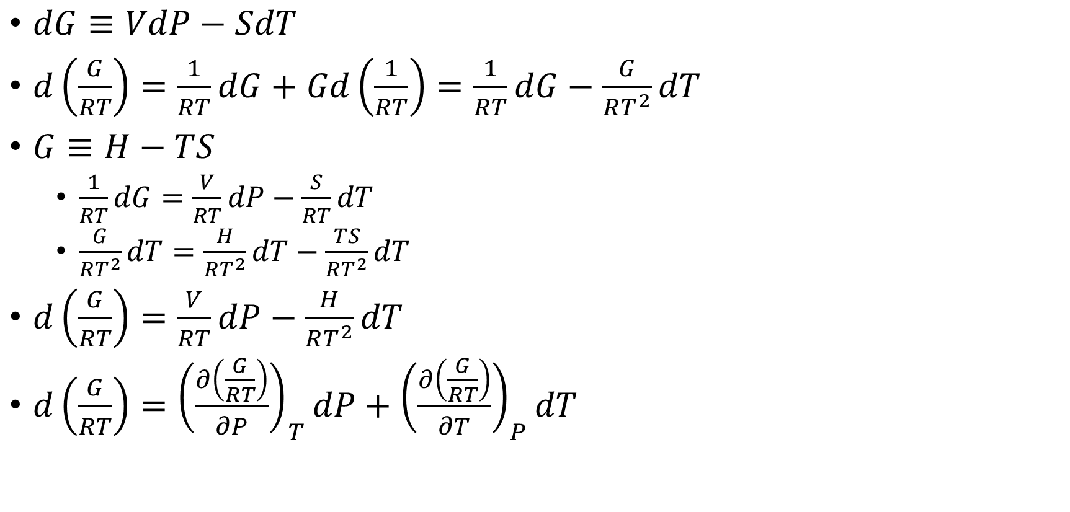
Generating Residuals from $dG$
$dG≡VdP−SdT$
$d\left(\frac{G}{RT}\right)=\frac{1}{RT}dG+Gd\left(\frac{1}{RT}\right)=\frac{1}{RT}dG−\frac{G}{RT^{2}}dT$
$G≡H−TS$
$\frac{1}{RT}dG=\frac{V}{RT}dP−\frac{S}{RT}dT$
$\frac{G}{RT^{2}}dT=\frac{H}{RT^{2}}dT−\frac{TS}{RT^{2}}dT$
$d\left(\frac{G}{RT}\right)=\frac{V}{RT}dP−\frac{H}{RT^{2}}dT$
$d\left(\frac{G}{RT}\right)={\left(\frac{∂\left(\frac{G}{RT}\right)}{∂P}\right)}_{T}dP+{\left(\frac{∂\left(\frac{G}{RT}\right)}{∂T}\right)}_{P}dT$
Notes:
Alluded to in Example 6.7

Slide 7

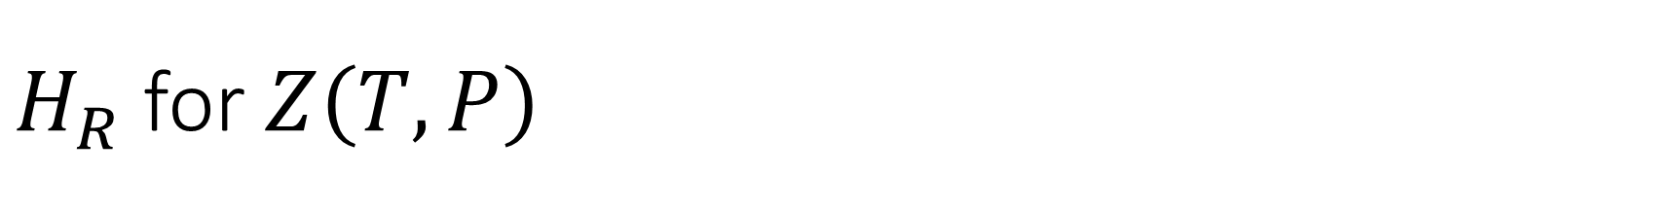
$H_{R}$ for $Z\left(T,P\right)$
$d\left(\frac{G}{RT}\right)=\frac{V}{RT}dP−\frac{H}{RT^{2}}dT$
$d\left(\frac{G_{R}}{RT}\right)=\frac{V_{R}}{RT}dP−\frac{H_{R}}{RT^{2}}dT$
Integrate at constant $T→$
$\frac{G_{R}}{RT}−\frac{G_{R}\left(P=0\right)}{RT}=\int_{0}^{P_{0}}{\frac{V_{R}}{RT}dP}→$
$\frac{G_{R}}{RT}=\frac{G_{R}\left(P=0\right)}{RT}+\int_{0}^{P_{0}}{\left(Z−1\right)\frac{dP}{P}}$
Utilizing ${\left(\frac{∂\left(\frac{G_{R}}{RT}\right)}{∂T}\right)}_{P}=−\frac{H_{R}}{RT^{2}}→$
$\frac{H_{R}}{RT}=\int_{0}^{P_{0}}{−T{\left(\frac{∂Z}{∂T}\right)}_{P}\frac{dP}{P}}$

Slide 8
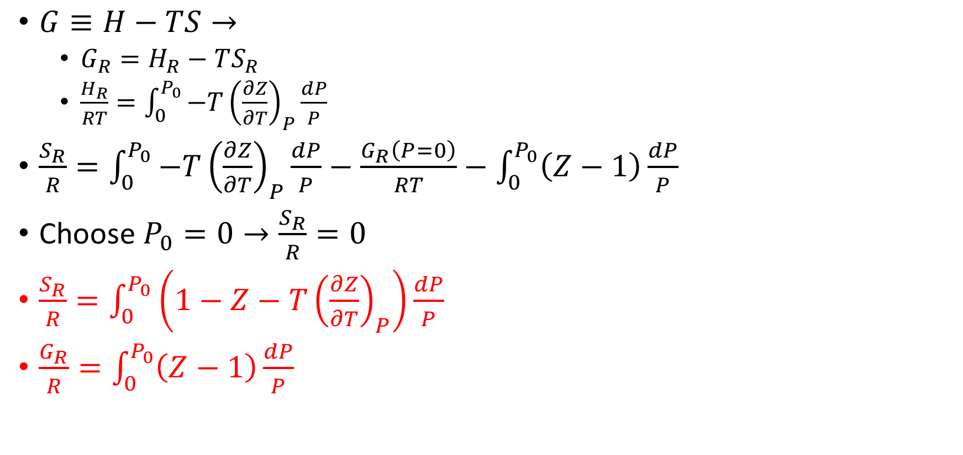
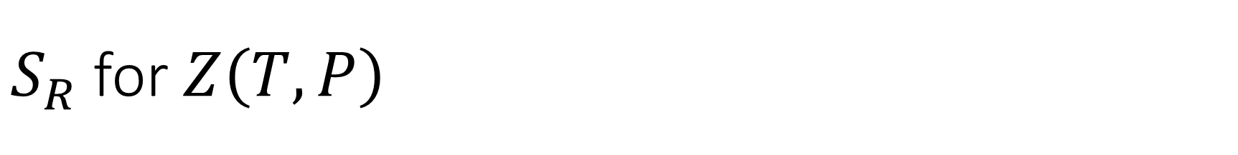
$S_{R}$ for $Z\left(T,P\right)$
$G≡H−TS→$
$G_{R}=H_{R}−TS_{R}$
$\frac{H_{R}}{RT}=\int_{0}^{P_{0}}{−T{\left(\frac{∂Z}{∂T}\right)}_{P}\frac{dP}{P}}$
$\frac{S_{R}}{R}=\int_{0}^{P_{0}}{−T{\left(\frac{∂Z}{∂T}\right)}_{P}\frac{dP}{P}}−\frac{G_{R}\left(P=0\right)}{RT}−\int_{0}^{P_{0}}{\left(Z−1\right)\frac{dP}{P}}$
Choose $P_{0}=0→\frac{S_{R}}{R}=0$
$\frac{S_{R}}{R}=\int_{0}^{P_{0}}{\left(1−Z−T{\left(\frac{∂Z}{∂T}\right)}_{P}\right)\frac{dP}{P}}$
$\frac{G_{R}}{R}=\int_{0}^{P_{0}}{\left(Z−1\right)\frac{dP}{P}}$

Slide 9
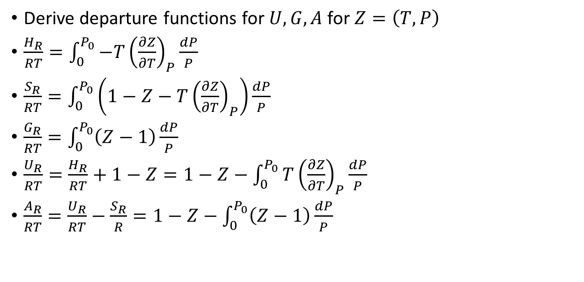
Example 8.4
Derive departure functions for $U,G,A$ for $Z=\left(T,P\right)$
$\frac{H_{R}}{RT}=\int_{0}^{P_{0}}{−T{\left(\frac{∂Z}{∂T}\right)}_{P}\frac{dP}{P}}$
$\frac{S_{R}}{RT}=\int_{0}^{P_{0}}{\left(1−Z−T{\left(\frac{∂Z}{∂T}\right)}_{P}\right)\frac{dP}{P}}$
$\frac{G_{R}}{RT}=\int_{0}^{P_{0}}{\left(Z−1\right)\frac{dP}{P}}$
$\frac{U_{R}}{RT}=\frac{H_{R}}{RT}+1−Z=1−Z−\int_{0}^{P_{0}}{T{\left(\frac{∂Z}{∂T}\right)}_{P}\frac{dP}{P}}$
$\frac{A_{R}}{RT}=\frac{U_{R}}{RT}−\frac{S_{R}}{R}=1−Z−\int_{0}^{P_{0}}{\left(Z−1\right)\frac{dP}{P}}$

Slide 10
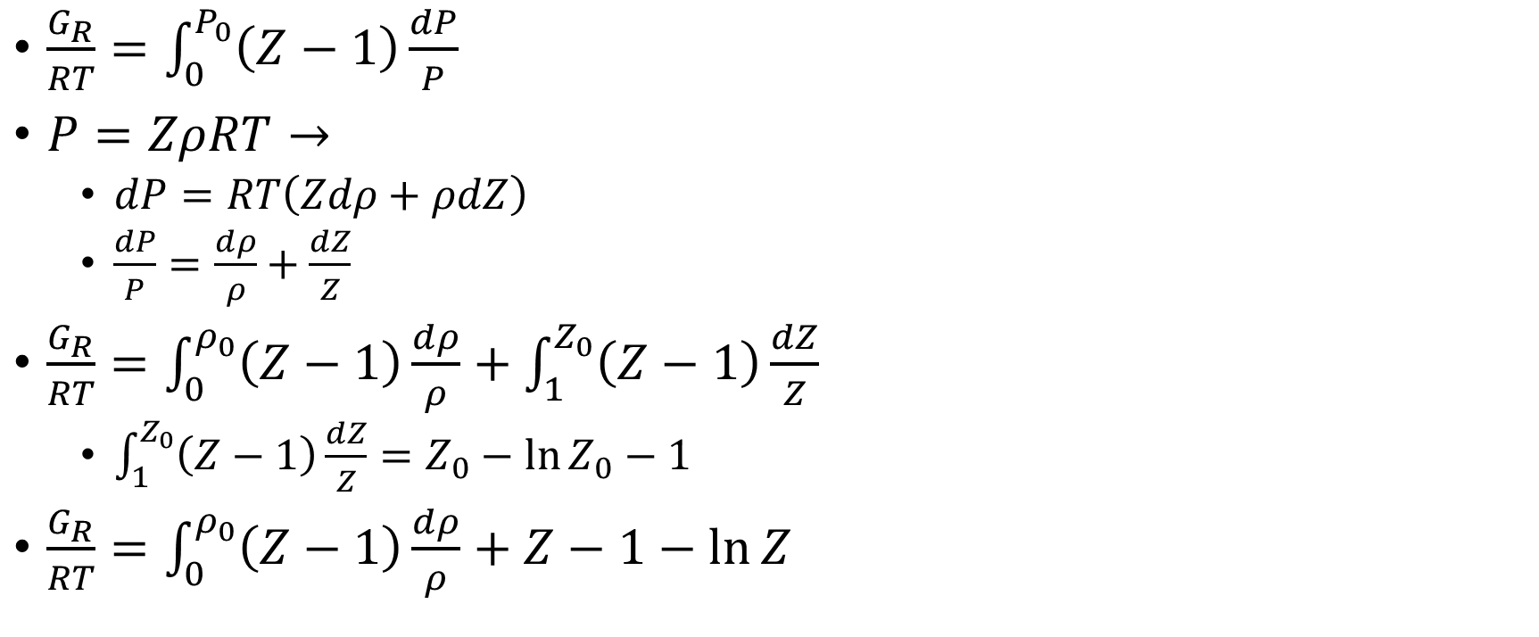
Consistency of Both Derivations: Using the Chain Rule (as always)
$\frac{G_{R}}{RT}=\int_{0}^{P_{0}}{\left(Z−1\right)\frac{dP}{P}}$
$P=ZρRT→$
$dP=RT\left(Zdρ+ρdZ\right)$
$\frac{dP}{P}=\frac{dρ}{ρ}+\frac{dZ}{Z}$
$\frac{G_{R}}{RT}=\int_{0}^{ρ_{0}}{\left(Z−1\right)\frac{dρ}{ρ}}+\int_{1}^{Z_{0}}{\left(Z−1\right)\frac{dZ}{Z}}$
$\int_{1}^{Z_{0}}{\left(Z−1\right)\frac{dZ}{Z}}=Z_{0}−\ln{Z_{0}}−1$
$\frac{G_{R}}{RT}=\int_{0}^{ρ_{0}}{\left(Z−1\right)\frac{dρ}{ρ}}+Z−1−\ln{Z}$
Notes:
Note simplicity of pressure residual: G is a natural function of P, not V

