Slide 1
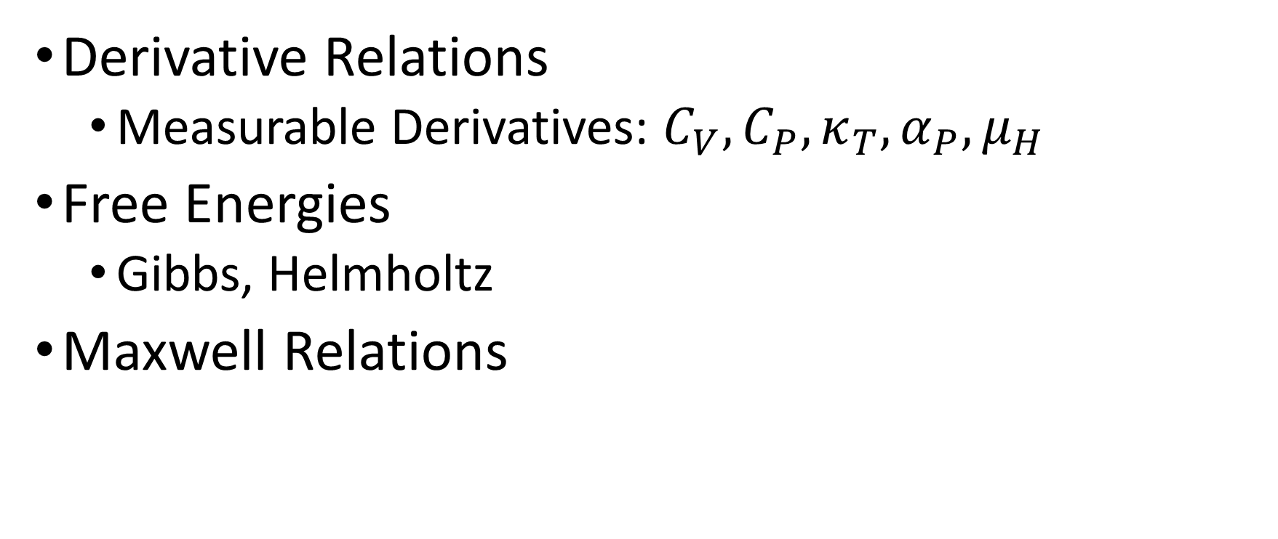
Tuesday, October 11
Derivative Relations
Measurable Derivatives: $C_{V},C_{P},κ_{T},α_{P},μ_{H}$
Free Energies
Gibbs, Helmholtz
Maxwell Relations
Notes:
Helmholtz free energy $A$ from German Arbeit (work) gives maximum work from constant T

Slide 2
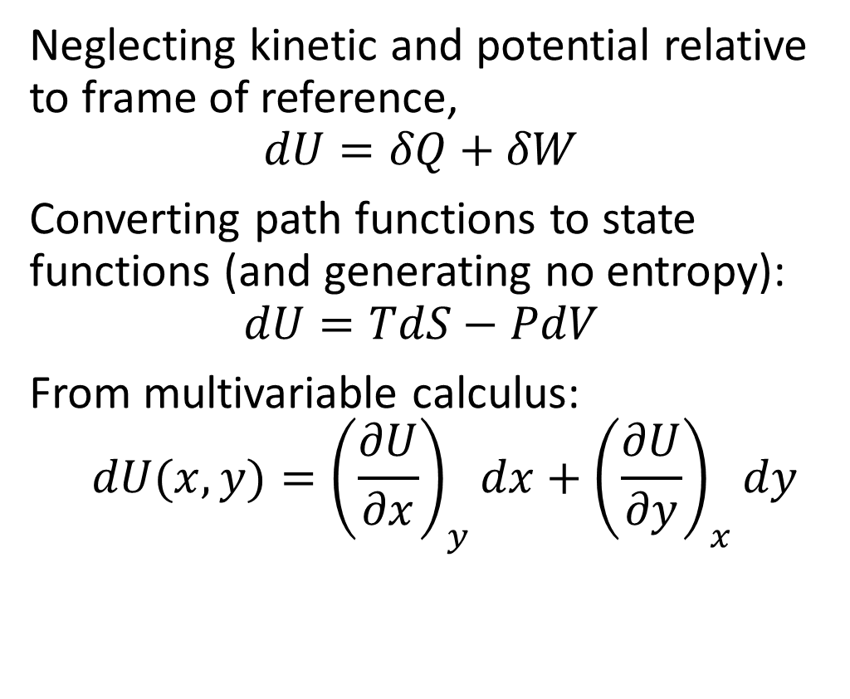
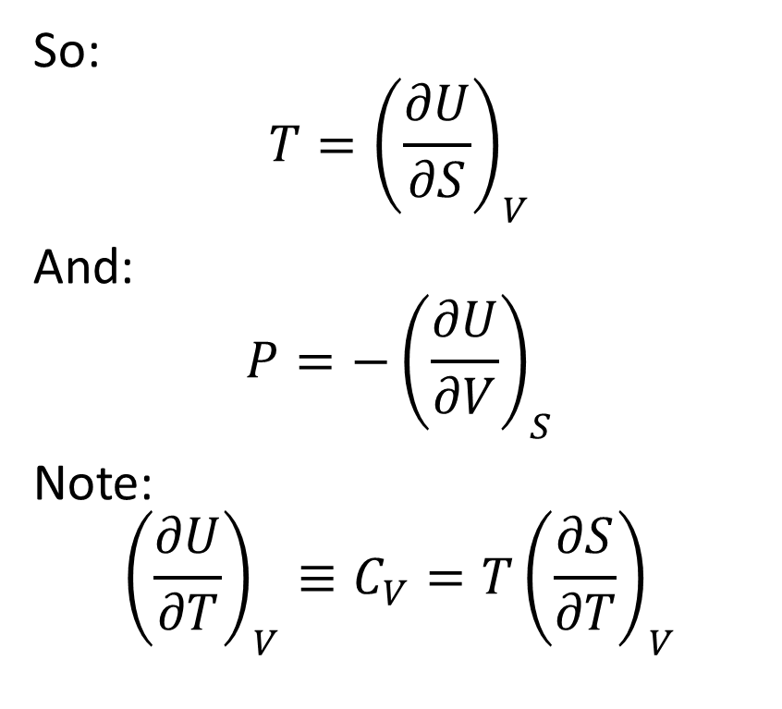
Fundamental Property Relation (Closed System)
Neglecting kinetic and potential relative to frame of reference,
$$dU=δQ+δW$$
Converting path functions to state functions (and generating no entropy):
$$dU=TdS−PdV$$
From multivariable calculus:
$$dU(x,y)={\left(\frac{∂U}{∂x}\right)}_{y}dx+{\left(\frac{∂U}{∂y}\right)}_{x}dy$$
So:
$$T={\left(\frac{∂U}{∂S}\right)}_{V}$$
And:
$$P=−{\left(\frac{∂U}{∂V}\right)}_{S}$$
Note:
$${\left(\frac{∂U}{∂T}\right)}_{V}≡C_{V}=T{\left(\frac{∂S}{∂T}\right)}_{V}$$
Notes:
Process (path) functions: heat and work
Though completely equivalent in conceptual content to temperature, β is generally considered a more fundamental quantity than temperature owing to the phenomenon of negative temperature, in which β is continuous as it crosses zero whereas T has a singularity.^{[6]}
In addition, β has the advantage of being easier to understand causally: If a small amount of heat is added to a system, β is the increase in entropy divided by the increase in heat. Temperature is difficult to interpret in the same sense, as it is not possible to "Add entropy" to a system except indirectly, by modifying other quantities such as temperature, volume, or number of particles.
U(S,V)

Slide 3
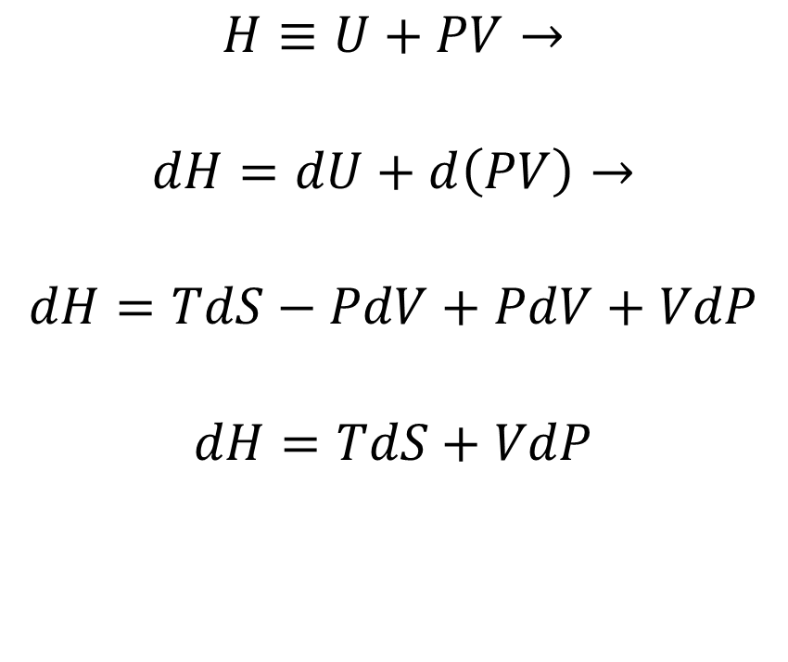
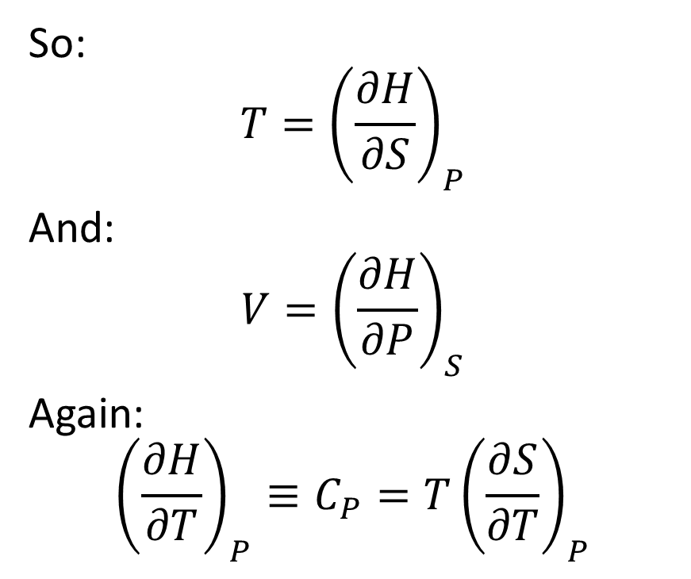
What about an Open System?
$$H≡U+PV→$$
$$dH=dU+d\left(PV\right)→$$
$$dH=TdS−PdV+PdV+VdP$$
$$dH=TdS+VdP$$
So:
$$T={\left(\frac{∂H}{∂S}\right)}_{P}$$
And:
$$V={\left(\frac{∂H}{∂P}\right)}_{S}$$
Again:
$${\left(\frac{∂H}{∂T}\right)}_{P}≡C_{P}=T{\left(\frac{∂S}{∂T}\right)}_{P}$$
Notes:
Note shaft work instead (heat stays the same)
Note sign of temperature/entropy: do $T→\ln{T}$ on the board as aside

Slide 4

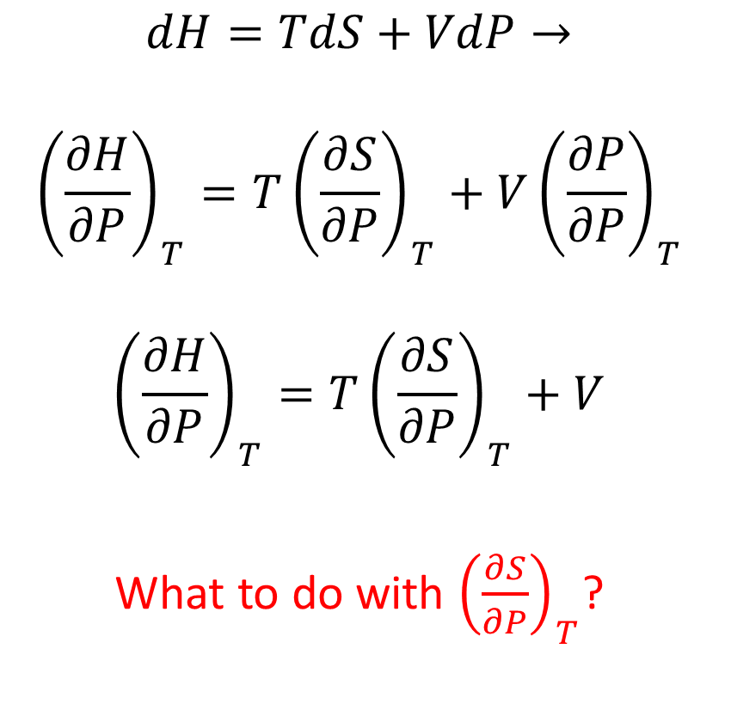
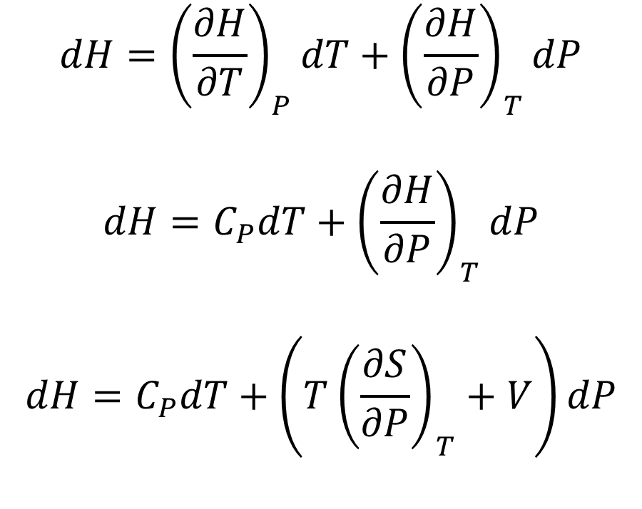
$$H\left(S,P\right)→H\left(T,P\right)$$
$$dH={\left(\frac{∂H}{∂T}\right)}_{P}dT+{\left(\frac{∂H}{∂P}\right)}_{T}dP$$
$$dH=C_{P}dT+{\left(\frac{∂H}{∂P}\right)}_{T}dP$$
$$dH=C_{P}dT+\left(T{\left(\frac{∂S}{∂P}\right)}_{T}+V\right)dP$$
$$dH=TdS+VdP→$$
$${\left(\frac{∂H}{∂P}\right)}_{T}=T{\left(\frac{∂S}{∂P}\right)}_{T}+V{\left(\frac{∂P}{∂P}\right)}_{T}$$
$${\left(\frac{∂H}{∂P}\right)}_{T}=T{\left(\frac{∂S}{∂P}\right)}_{T}+V$$
What to do with ${\left(\frac{∂S}{∂P}\right)}_{T}$?
Notes:
Use chain rule as well on board

Slide 5
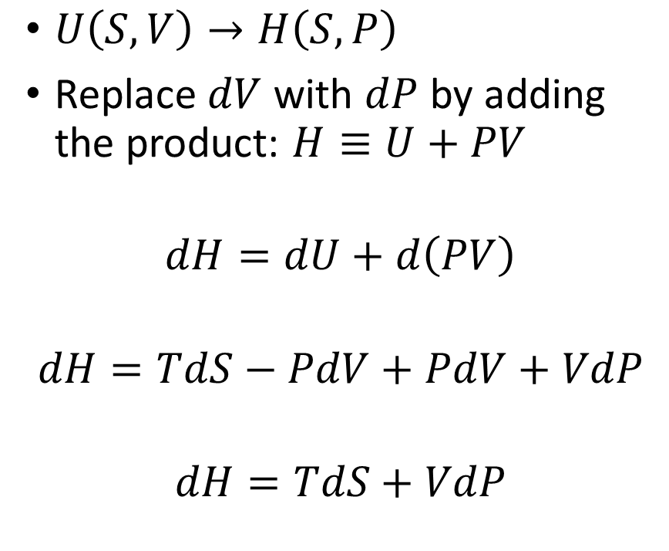
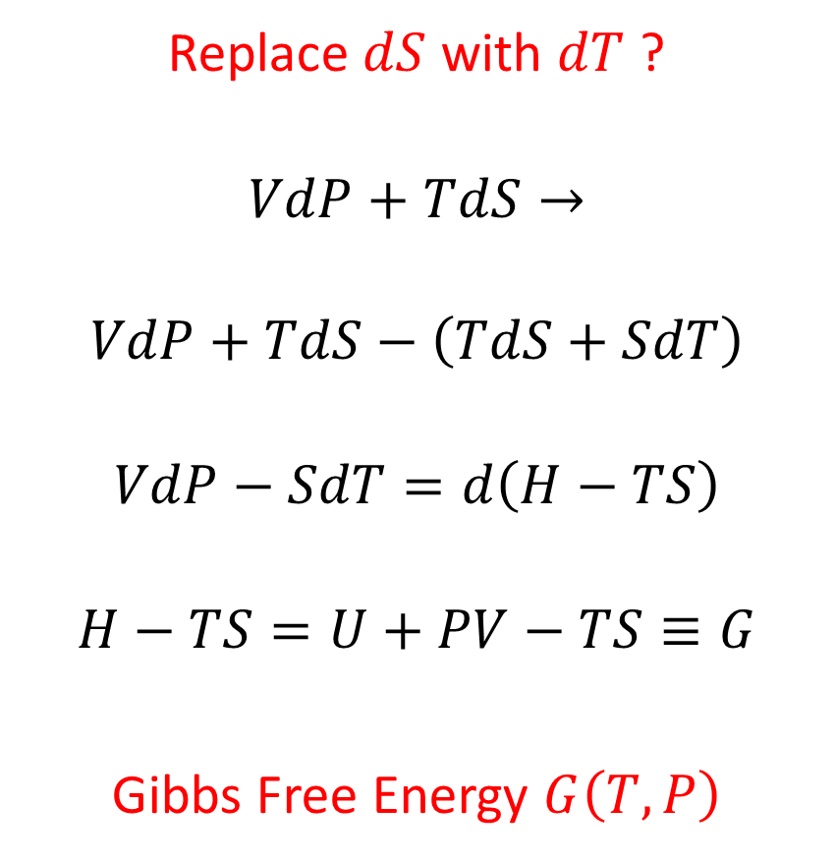
Exchanging Natural Variables
$U\left(S,V\right)→H\left(S,P\right)$
Replace $dV$ with $dP$ by adding the product: $H≡U+PV$
$$dH=dU+d\left(PV\right)$$
$$dH=TdS−PdV+PdV+VdP$$
$$dH=TdS+VdP$$
Replace $dS$ with $dT$ ?
$$VdP+TdS→$$
$$VdP+TdS−\left(TdS+SdT\right)$$
$$VdP−SdT=d\left(H−TS\right)$$
$$H−TS=U+PV−TS≡G$$
Gibbs Free Energy $G\left(T,P\right)$
Notes:
Notice how we changed dV to dP with PV: do the same with entropy?

Slide 6
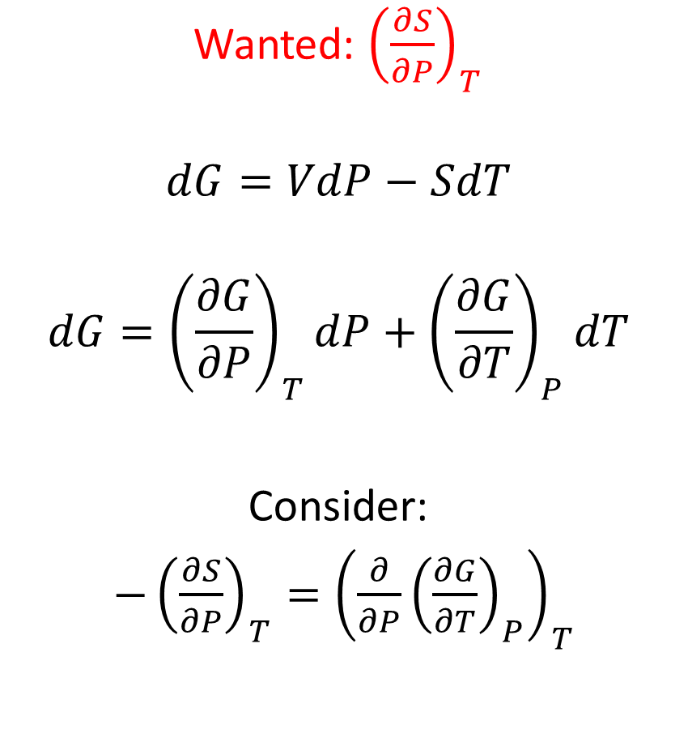

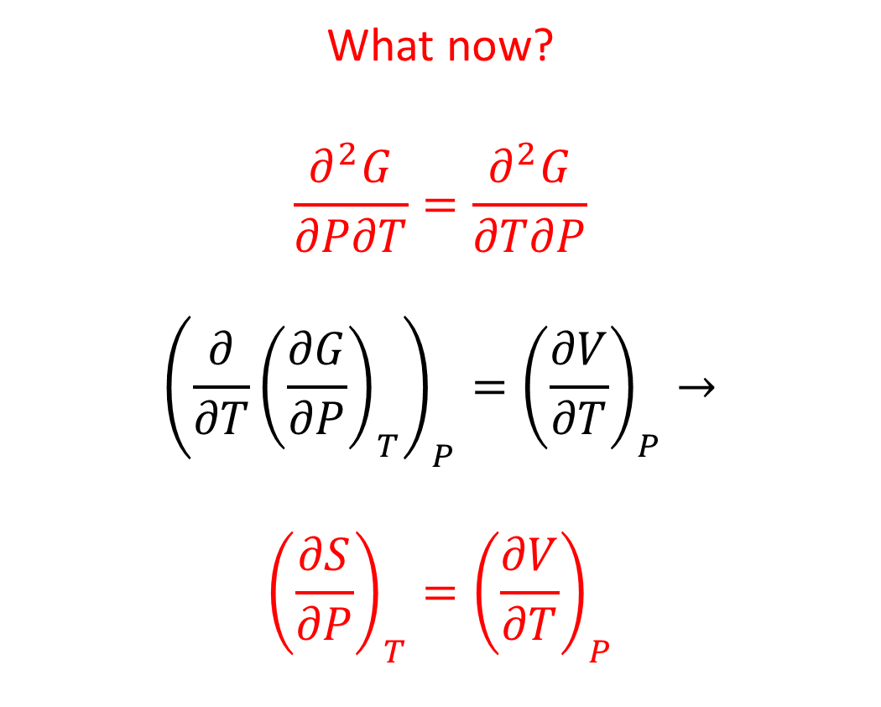
Gibbs Free Energy $G$
Wanted: ${\left(\frac{∂S}{∂P}\right)}_{T}$
$$dG=VdP−SdT$$
$$dG={\left(\frac{∂G}{∂P}\right)}_{T}dP+{\left(\frac{∂G}{∂T}\right)}_{P}dT$$
Consider:
$−{\left(\frac{∂S}{∂P}\right)}_{T}={\left({\frac{∂}{∂P}\left(\frac{∂G}{∂T}\right)}_{P}\right)}_{T}$
What now?
$$\frac{∂^{2}G}{∂P∂T}=\frac{∂^{2}G}{∂T∂P}$$
$${\left({\frac{∂}{∂T}\left(\frac{∂G}{∂P}\right)}_{T}\right)}_{P}={\left(\frac{∂V}{∂T}\right)}_{P}→$$
$${\left(\frac{∂S}{∂P}\right)}_{T}={\left(\frac{∂V}{∂T}\right)}_{P}$$

Slide 7
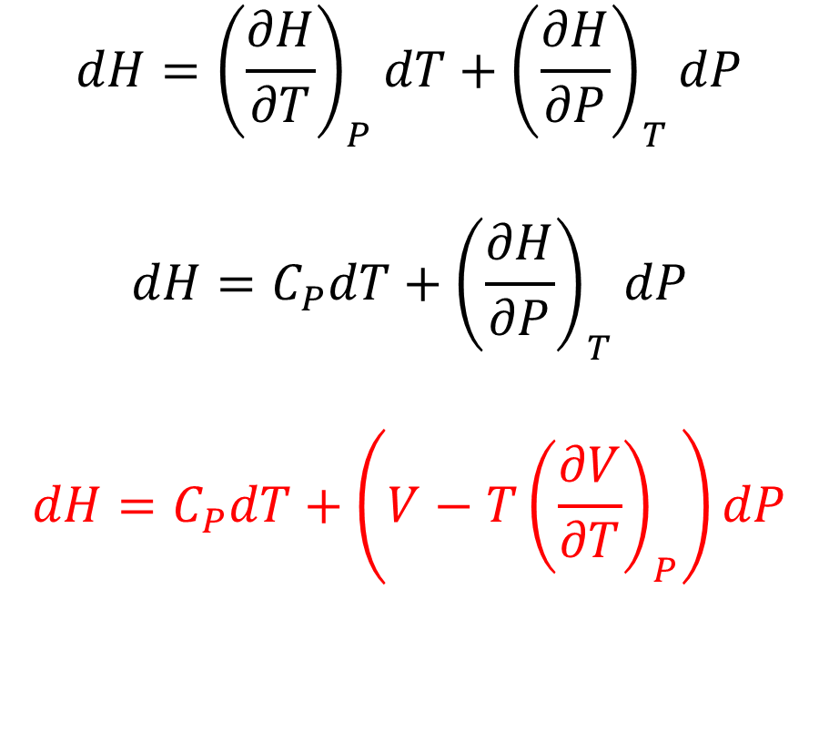
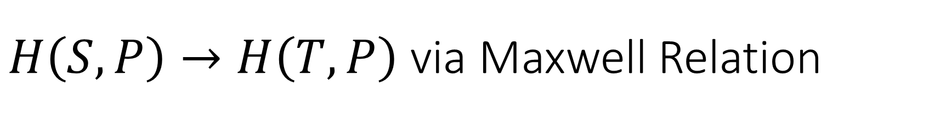
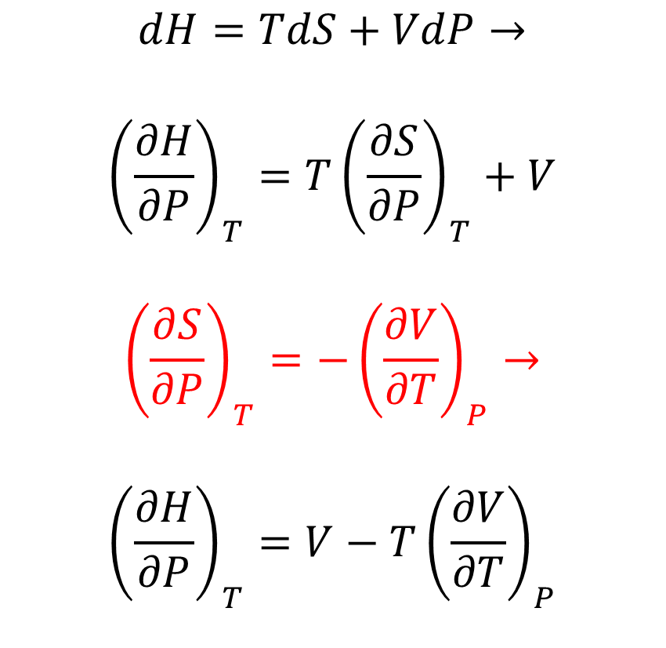
$H\left(S,P\right)→H\left(T,P\right)$ via Maxwell Relation
$$dH={\left(\frac{∂H}{∂T}\right)}_{P}dT+{\left(\frac{∂H}{∂P}\right)}_{T}dP$$
$$dH=C_{P}dT+{\left(\frac{∂H}{∂P}\right)}_{T}dP$$
$$dH=C_{P}dT+\left(V−T{\left(\frac{∂V}{∂T}\right)}_{P}\right)dP$$
$$dH=TdS+VdP→$$
$${\left(\frac{∂H}{∂P}\right)}_{T}=T{\left(\frac{∂S}{∂P}\right)}_{T}+V$$
$${\left(\frac{∂S}{∂P}\right)}_{T}=−{\left(\frac{∂V}{∂T}\right)}_{P}→$$
$${\left(\frac{∂H}{∂P}\right)}_{T}=V−T{\left(\frac{∂V}{∂T}\right)}_{P}$$

Slide 8


$$H\left(T,P\right)$$
$dH=C_{P}dT+\left(V−T{\left(\frac{∂V}{∂T}\right)}_{P}\right)dP$
Isobaric expansivity:
$α_{P}≡\frac{1}{V}{\left(\frac{∂V}{∂T}\right)}_{P}$
$dH=C_{P}dT+\left(1−α_{P}T\right)VdP$
Ideal gas $α_{P}$ ?

Slide 9
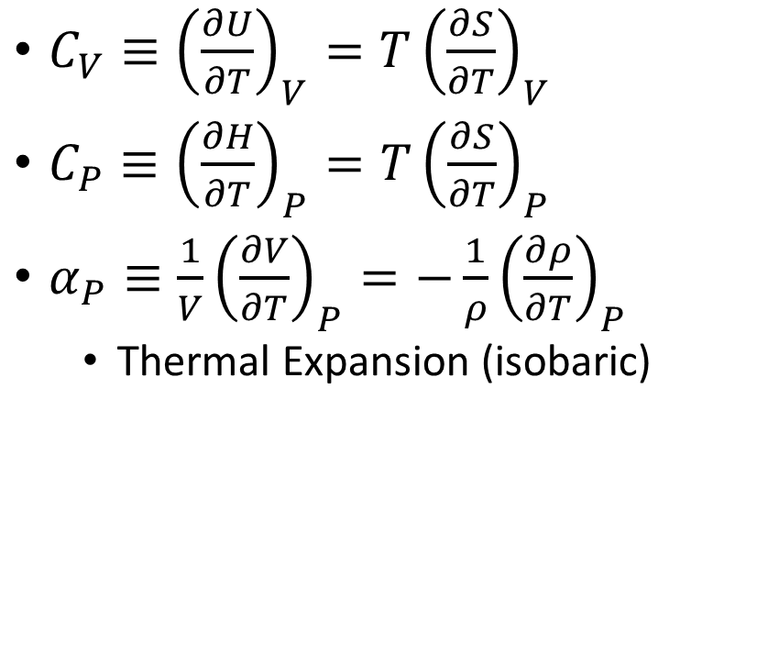
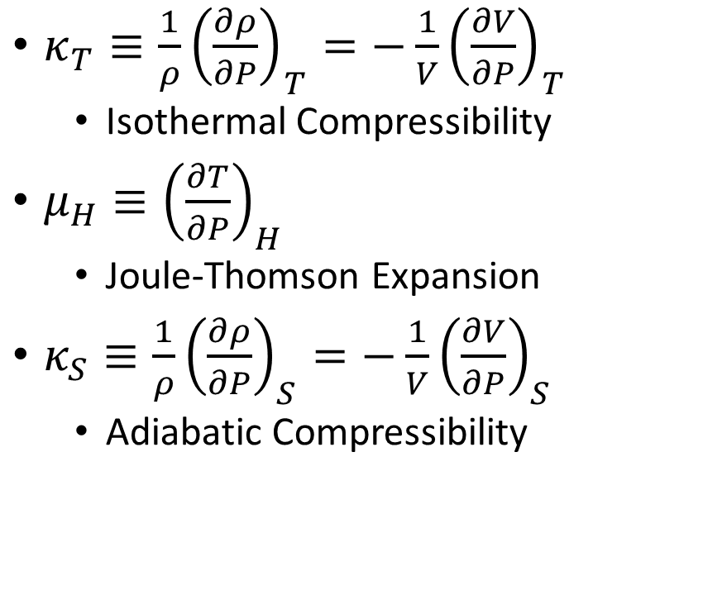
Measurable Derivatives
$C_{V}≡{\left(\frac{∂U}{∂T}\right)}_{V}=T{\left(\frac{∂S}{∂T}\right)}_{V}$
$C_{P}≡{\left(\frac{∂H}{∂T}\right)}_{P}=T{\left(\frac{∂S}{∂T}\right)}_{P}$
$α_{P}≡\frac{1}{V}{\left(\frac{∂V}{∂T}\right)}_{P}=−\frac{1}{ρ}{\left(\frac{∂ρ}{∂T}\right)}_{P}$
Thermal Expansion (isobaric)
$κ_{T}≡\frac{1}{ρ}{\left(\frac{∂ρ}{∂P}\right)}_{T}=−\frac{1}{V}{\left(\frac{∂V}{∂P}\right)}_{T}$
Isothermal Compressibility
$μ_{H}≡{\left(\frac{∂T}{∂P}\right)}_{H}$
Joule-Thomson Expansion
$κ_{S}≡\frac{1}{ρ}{\left(\frac{∂ρ}{∂P}\right)}_{S}=−\frac{1}{V}{\left(\frac{∂V}{∂P}\right)}_{S}$
Adiabatic Compressibility
Notes:
Note sign of temperature/entropy
do $T→\ln{T}$ on the board as aside

Slide 10
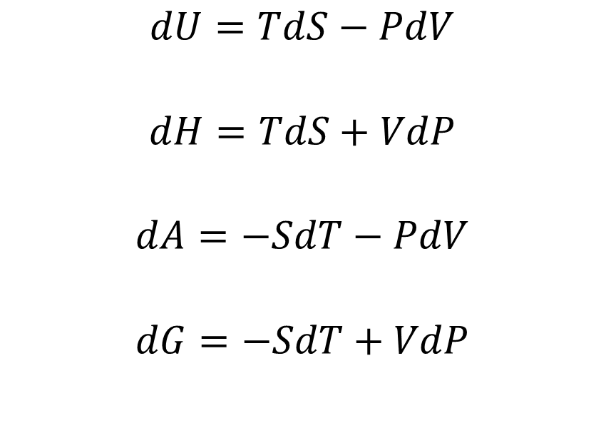
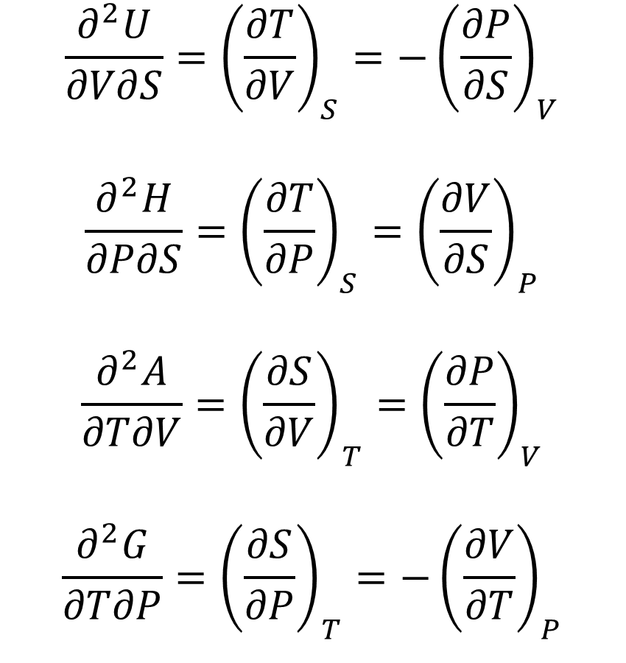
Thermodynamic Potentials and Maxwell Relations
$$\frac{∂^{2}U}{∂V∂S}={\left(\frac{∂T}{∂V}\right)}_{S}=−{\left(\frac{∂P}{∂S}\right)}_{V}$$
$$\frac{∂^{2}H}{∂P∂S}={\left(\frac{∂T}{∂P}\right)}_{S}={\left(\frac{∂V}{∂S}\right)}_{P}$$
$$\frac{∂^{2}A}{∂T∂V}={\left(\frac{∂S}{∂V}\right)}_{T}={\left(\frac{∂P}{∂T}\right)}_{V}$$
$$\frac{∂^{2}G}{∂T∂P}={\left(\frac{∂S}{∂P}\right)}_{T}=−{\left(\frac{∂V}{∂T}\right)}_{P}$$
$$dU=TdS−PdV$$
$$dH=TdS+VdP$$
$$dA=−SdT−PdV$$
$$dG=−SdT+VdP$$
Notes:
Helmholtz free energy $A$ from German Arbeit (work) gives maximum work from constant T
Examples 6.2, 6.3, 6.12 if extra time

