Slide 1

Thursday, October 13
$S\left(T,P\right)$
Ideal Gas $S\left(T,P\right)$
General Relation between $C_{V}$ and $C_{P}$
Notes:
Helmholtz free energy $A$ from German Arbeit (work) gives maximum work from constant T

Slide 2
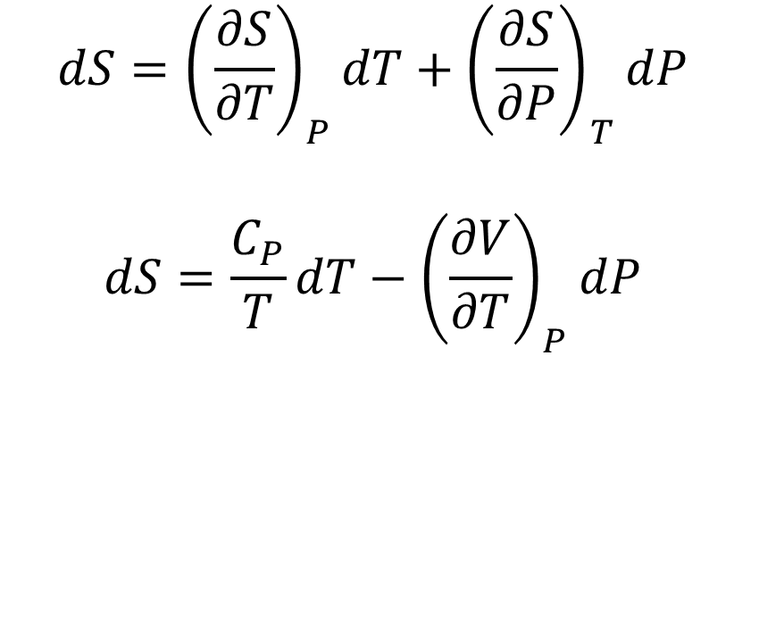

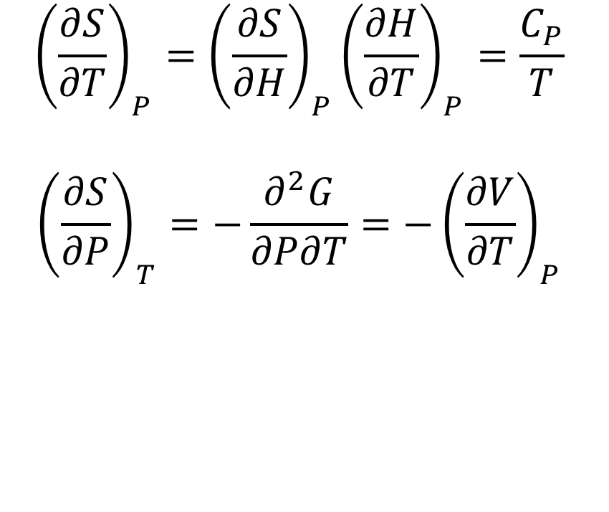
$$S\left(T,P\right)$$
$$dS={\left(\frac{∂S}{∂T}\right)}_{P}dT+{\left(\frac{∂S}{∂P}\right)}_{T}dP$$
$$dS=\frac{C_{P}}{T}dT−{\left(\frac{∂V}{∂T}\right)}_{P}dP$$
$${\left(\frac{∂S}{∂T}\right)}_{P}={\left(\frac{∂S}{∂H}\right)}_{P}{\left(\frac{∂H}{∂T}\right)}_{P}=\frac{C_{P}}{T}$$
$${\left(\frac{∂S}{∂P}\right)}_{T}=−\frac{∂^{2}G}{∂P∂T}=−{\left(\frac{∂V}{∂T}\right)}_{P}$$

Slide 3


Ideal Gas $S\left(T,P\right)$
$$dS=\frac{C_{P}}{T}dT−{\left(\frac{∂V}{∂T}\right)}_{P}dP$$
$${\left(\frac{∂V}{∂T}\right)}_{P}=\frac{∂}{∂T}\left(\frac{RT}{P}\right)=\frac{R}{P}→$$
$$dS=\frac{C_{P}}{T}dT−\frac{R}{P}dP$$
Notes:
Show integration and change of variables $\frac{dT}{T}→d\ln{T}$ on board

Slide 4

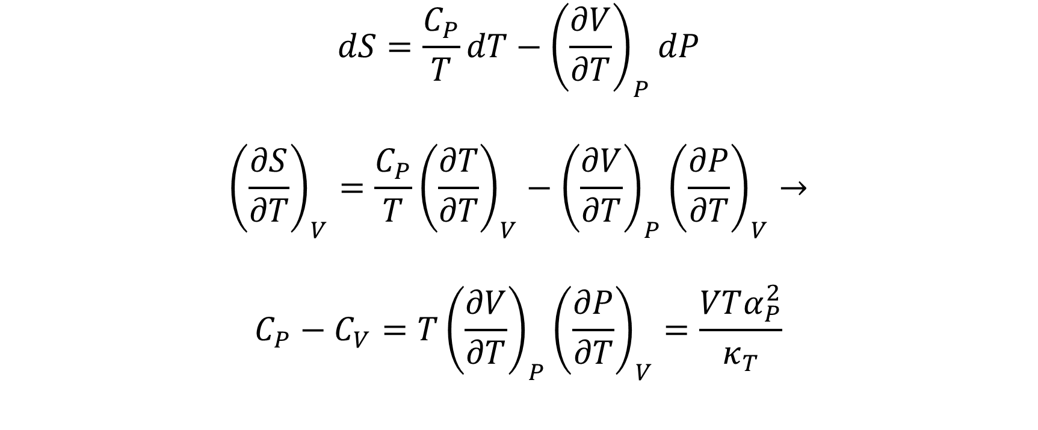
$$C_{V} \& C_{P}$$
$$dS=\frac{C_{P}}{T}dT−{\left(\frac{∂V}{∂T}\right)}_{P}dP$$
$${\left(\frac{∂S}{∂T}\right)}_{V}=\frac{C_{P}}{T}{\left(\frac{∂T}{∂T}\right)}_{V}−{\left(\frac{∂V}{∂T}\right)}_{P}{\left(\frac{∂P}{∂T}\right)}_{V}→$$
$$C_{P}−C_{V}=T{\left(\frac{∂V}{∂T}\right)}_{P}{\left(\frac{∂P}{∂T}\right)}_{V}=\frac{VTα_{P}^{2}}{κ_{T}}$$
Notes:
Ideal gas?

Slide 5
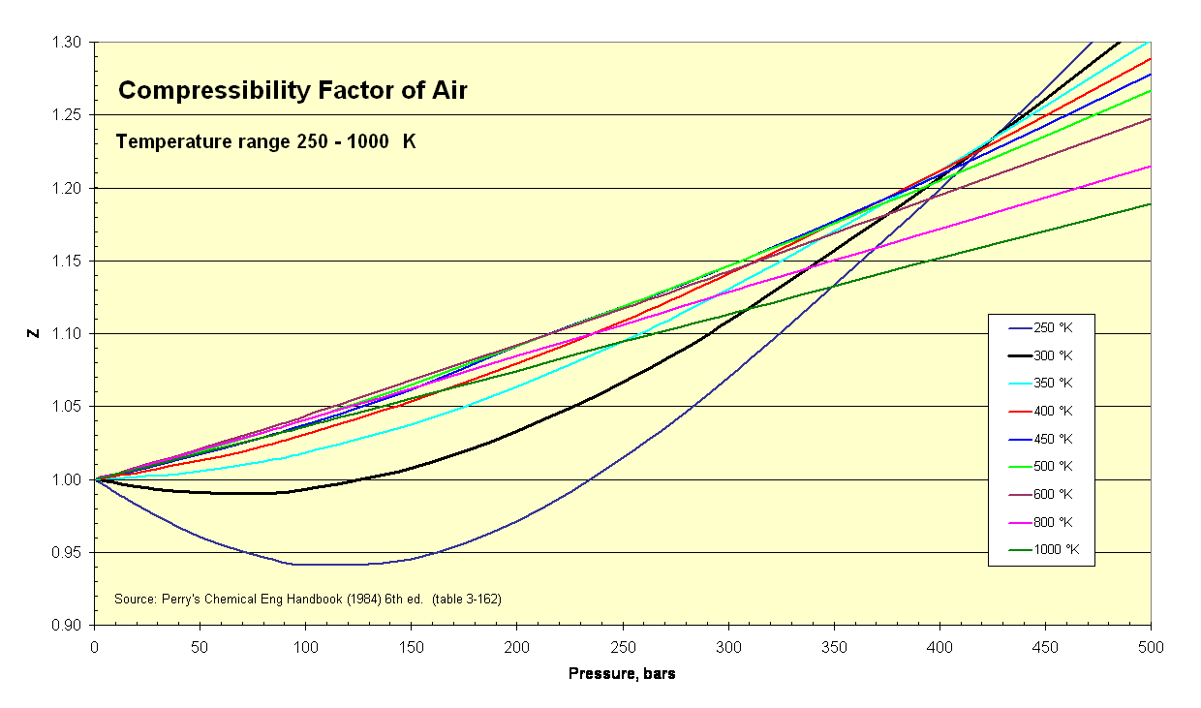

Deviations from Ideal Gas: Compressibility Factor
$$Z≡\frac{PV}{RT}$$
https://en.wikipedia.org/wiki/File:Compressibility_Factor_of_Air_250_-_1000_K.png
Notes:
For high T: linear?

Slide 6
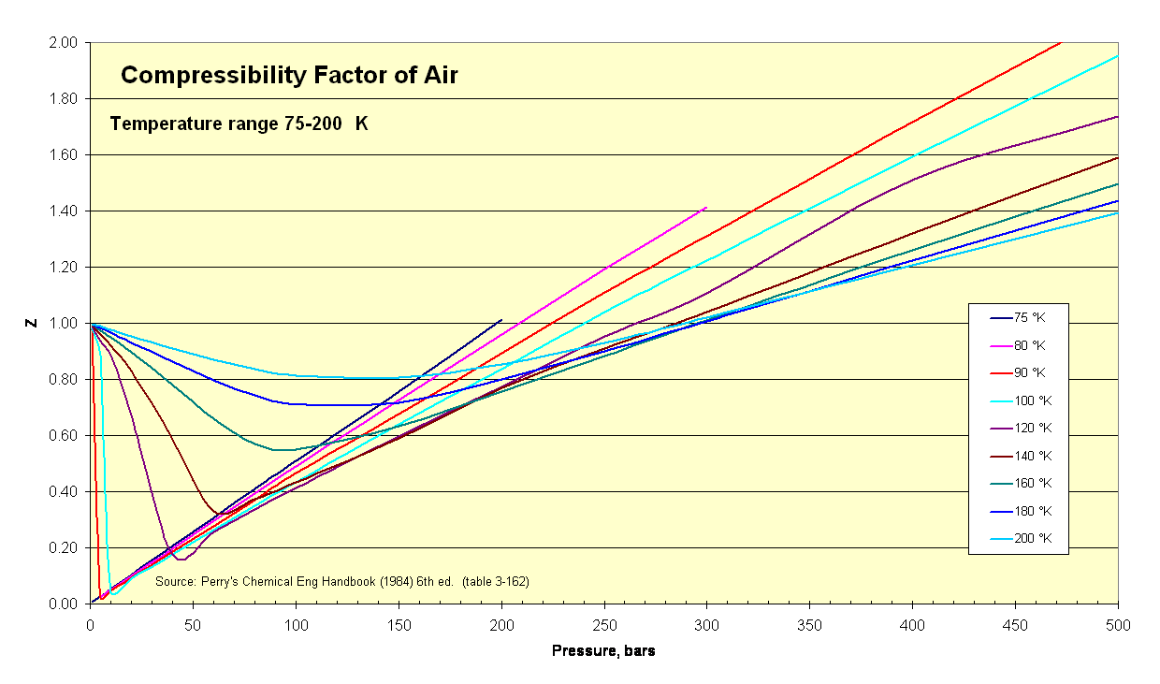
$$Z≡\frac{PV}{RT}$$
https://en.wikipedia.org/wiki/File:Compressibility_Factor_of_Air_75-200_K.png
Notes:
$$Z≈0?$$

Slide 7
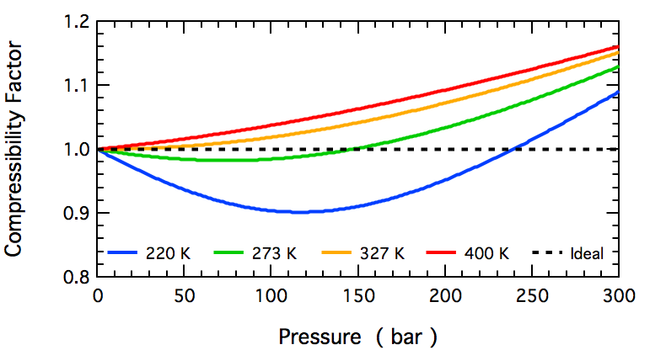
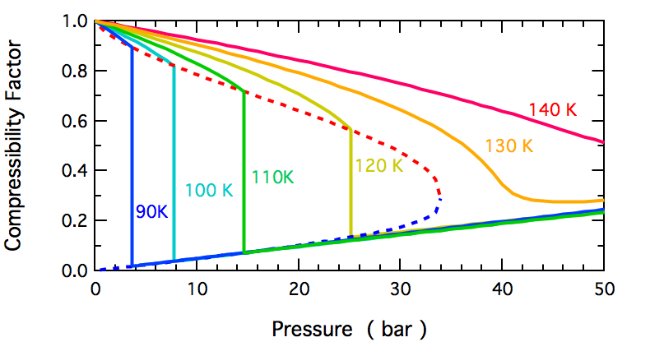
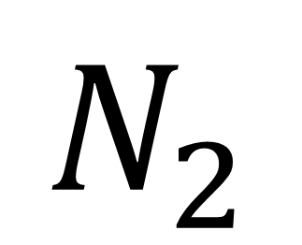
$$N_{2}$$
https://en.wikipedia.org/wiki/File:N2_Compressibility_Factor_High_T.png
https://en.wikipedia.org/wiki/File:N2_Compressibility_Factor_Low_T.png

