Slide 1
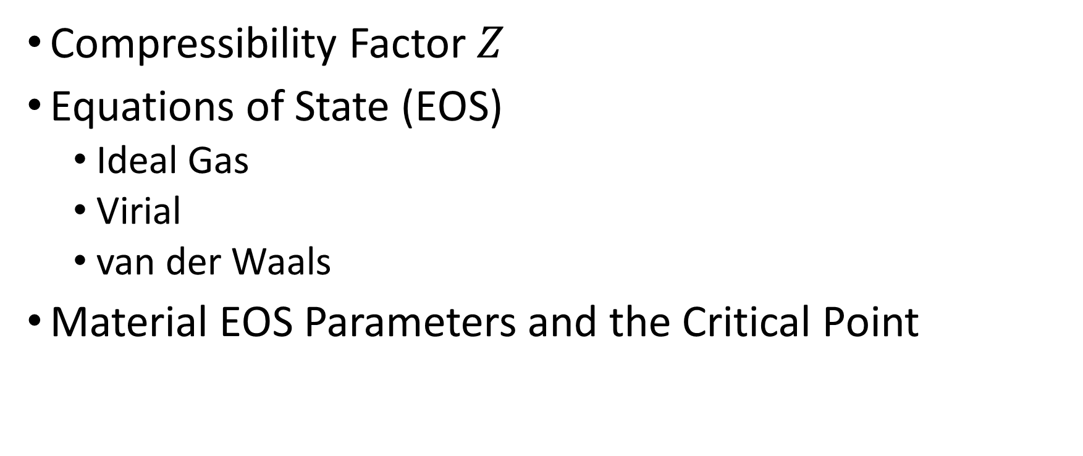
Thursday, October 13
Compressibility Factor $Z$
Equations of State (EOS)
Ideal Gas
Virial
van der Waals
Material EOS Parameters and the Critical Point
Notes:
Helmholtz free energy $A$ from German Arbeit (work) gives maximum work from constant T

Slide 2
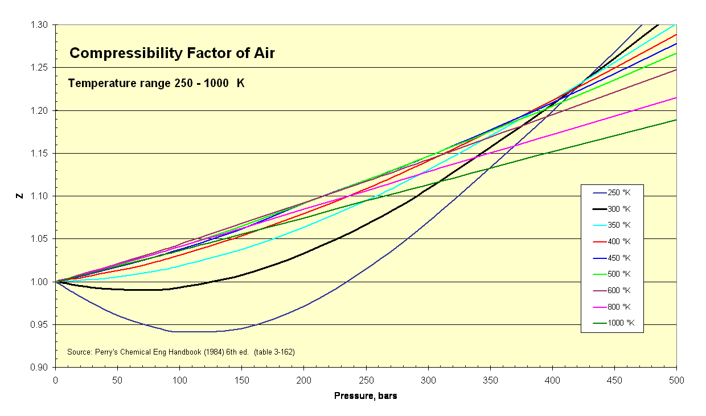

Deviations from Ideal Gas: Compressibility Factor
$$Z≡\frac{PV}{RT}$$
https://en.wikipedia.org/wiki/File:Compressibility_Factor_of_Air_250_-_1000_K.png
Notes:
For high T: linear?
Boyle temperature: non-ideal $Z=1$

Slide 3
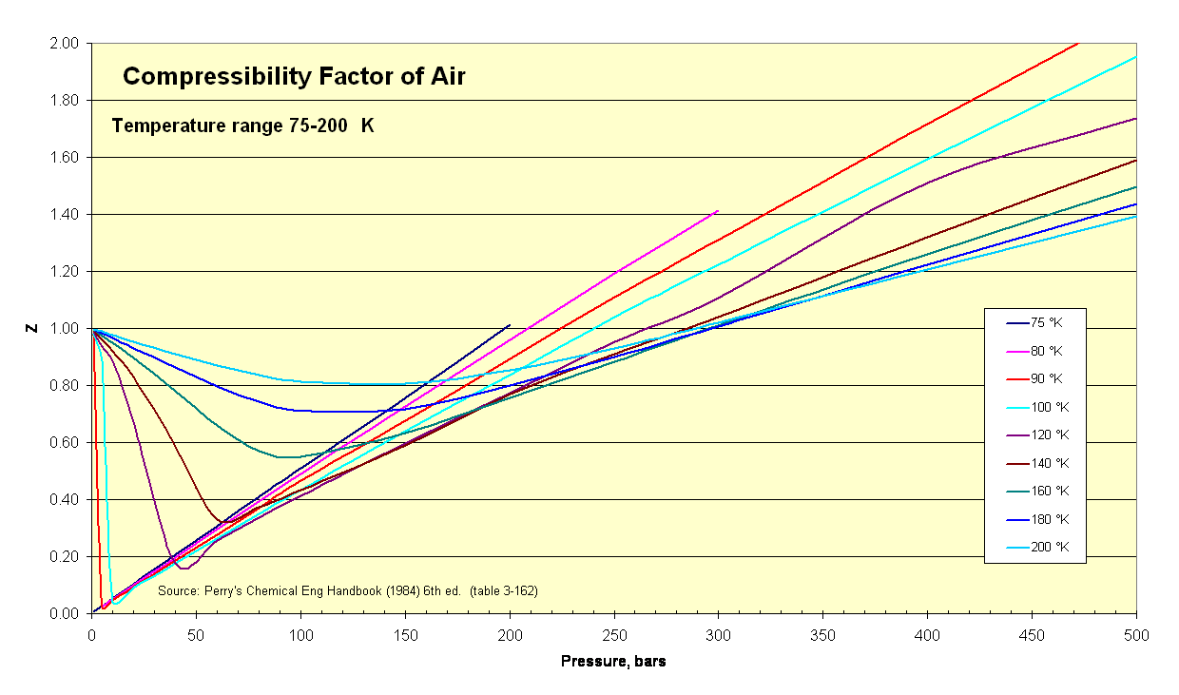
$$Z≡\frac{PV}{RT}$$
https://en.wikipedia.org/wiki/File:Compressibility_Factor_of_Air_75-200_K.png
Notes:
$$Z≈0?$$

Slide 4
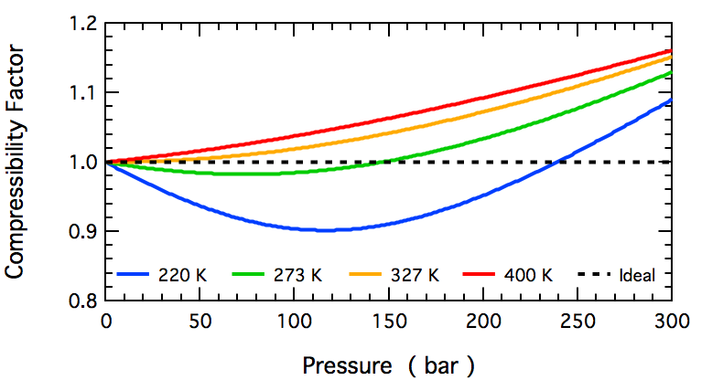
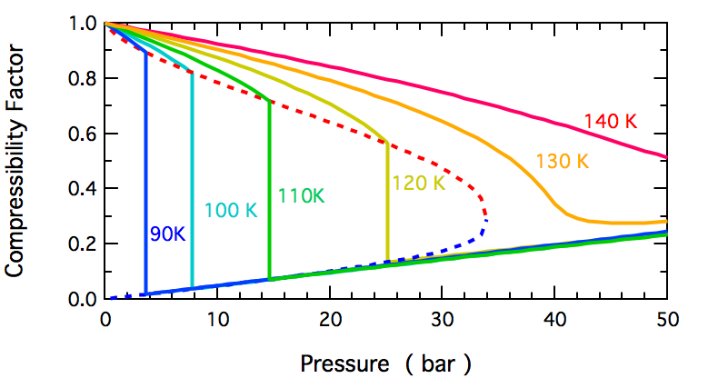
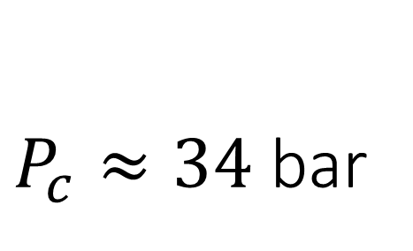
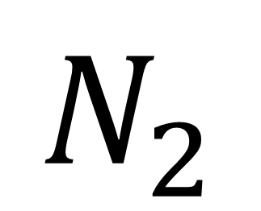
$$N_{2}$$
https://en.wikipedia.org/wiki/File:N2_Compressibility_Factor_High_T.png
$P_{c}≈34$ bar
https://en.wikipedia.org/wiki/File:N2_Compressibility_Factor_Low_T.png
Notes:
$T_{c}≈126$ K
Do ideal N2 to sub-critical in Excel

Slide 5
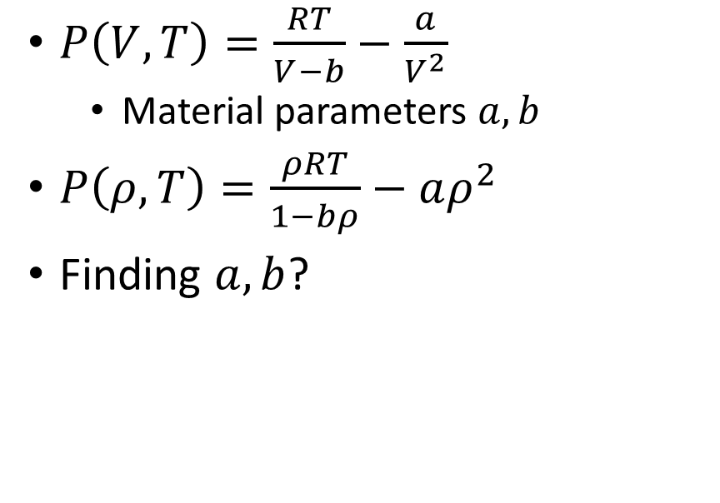
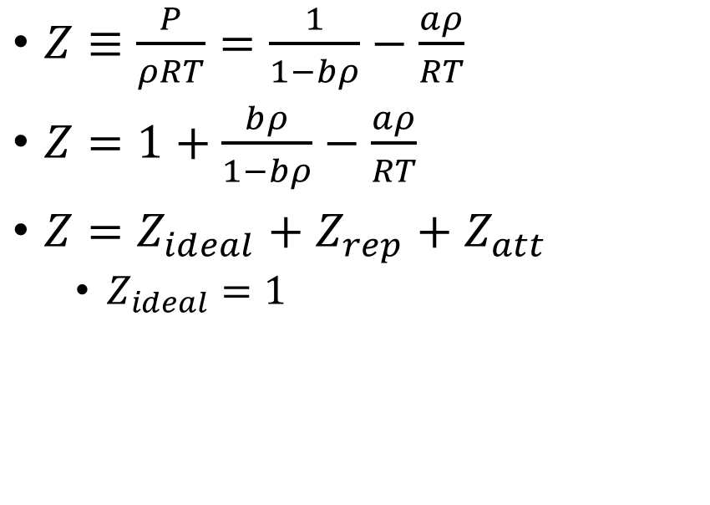
The van der Waals Equation of State (EOS)
Pressure
Compressibility Factor
$P\left(V,T\right)=\frac{RT}{V−b}−\frac{a}{V^{2}}$
Material parameters $a,b$
$P\left(ρ,T\right)=\frac{ρRT}{1−bρ}−aρ^{2}$
Finding $a,b$?
$Z≡\frac{P}{ρRT}=\frac{1}{1−bρ}−\frac{aρ}{RT}$
$Z=1+\frac{bρ}{1−bρ}−\frac{aρ}{RT}$
$Z=Z_{ideal}+Z_{rep}+Z_{att}$
$Z_{ideal}=1$
Notes:
Qualitative $P(ρ,T)$ leads to critical point

Slide 6
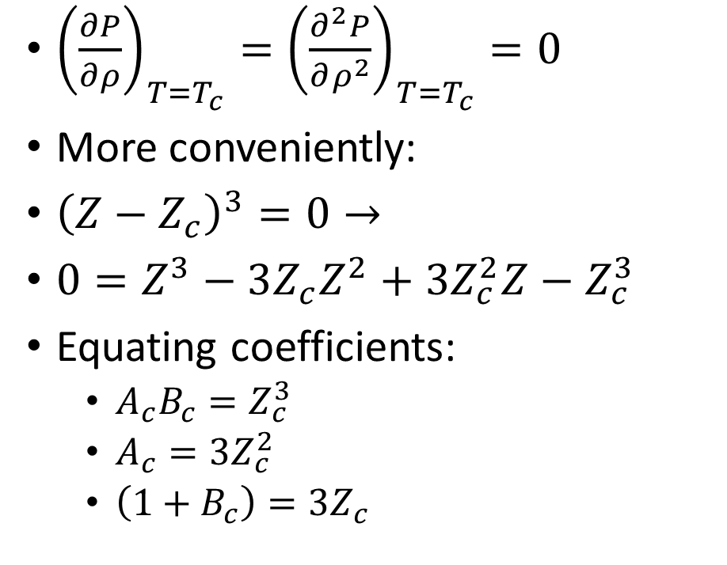
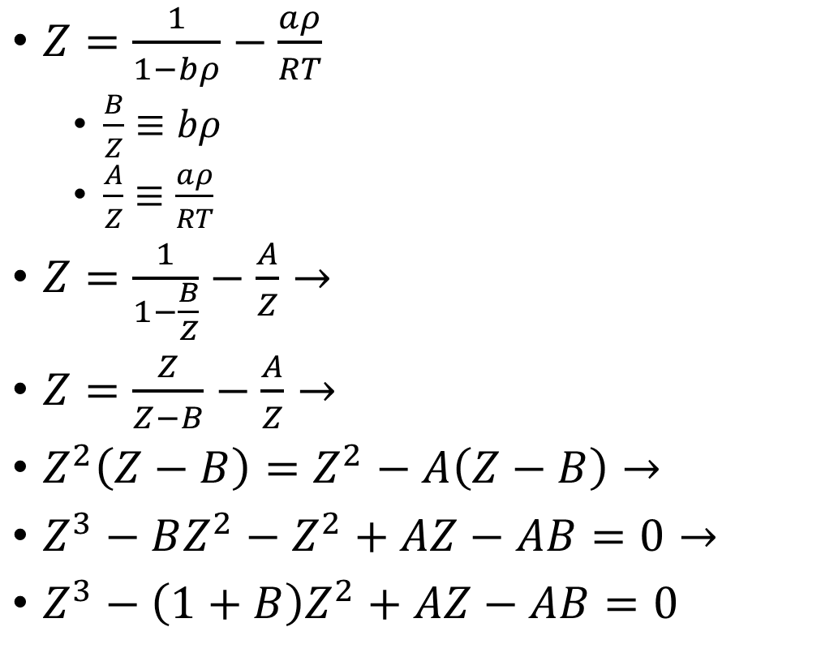
EOS Critical Point
${\left(\frac{∂P}{∂ρ}\right)}_{T=T_{c}}={\left(\frac{∂^{2}P}{∂ρ^{2}}\right)}_{T=T_{c}}=0$
More conveniently:
${\left(Z−Z_{c}\right)}^{3}=0→$
$0=Z^{3}−3Z_{c}Z^{2}+3Z_{c}^{2}Z−Z_{c}^{3}$
Equating coefficients:
$A_{c}B_{c}=Z_{c}^{3}$
$A_{c}=3Z_{c}^{2}$
$\left(1+B_{c}\right)=3Z_{c}$
$Z=\frac{1}{1−bρ}−\frac{aρ}{RT}$
$\frac{B}{Z}≡bρ$
$\frac{A}{Z}≡\frac{aρ}{RT}$
$Z=\frac{1}{1−\frac{B}{Z}}−\frac{A}{Z}→$
$Z=\frac{Z}{Z−B}−\frac{A}{Z}→$
$Z^{2}\left(Z−B\right)=Z^{2}−A\left(Z−B\right)→$
$Z^{3}−BZ^{2}−Z^{2}+AZ−AB=0→$
$Z^{3}−\left(1+B\right)Z^{2}+AZ−AB=0$
Notes:
Draw P and Z functions on board

Slide 7

Relating Material Parameters at Criticality
$Z^{3}−3Z_{c}Z^{3}+3Z_{c}^{2}Z−Z_{c}^{3}=Z^{3}−\left(1+B\right)Z^{2}+AZ−AB→$
$A_{c}B_{c}=Z_{c}^{3}$
$A_{c}=3Z_{c}^{2}$
$\left(1+B_{c}\right)=3Z_{c}$
$B_{c}=\frac{Z_{c}}{3}→$
$Z_{c}=\frac{3}{8}$
$B_{c}=\frac{1}{8}$
$A_{c}=\frac{27}{64}$
Notes:
Finish $a,b$ on board

