Slide 1
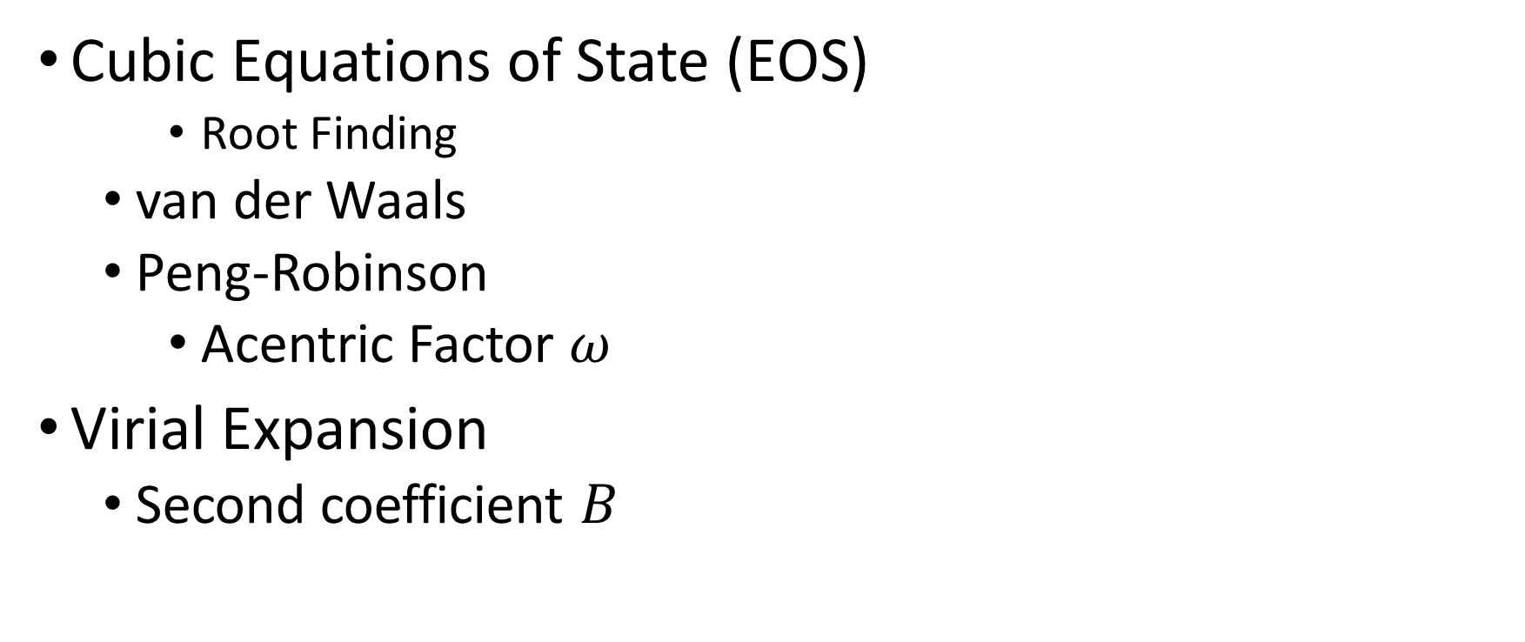
Tuesday, October 25
Cubic Equations of State (EOS)
Root Finding
van der Waals
Peng-Robinson
Acentric Factor $ω$
Virial Expansion
Second coefficient $B$
Notes:
Helmholtz free energy $A$ from German Arbeit (work) gives maximum work from constant T

Slide 2
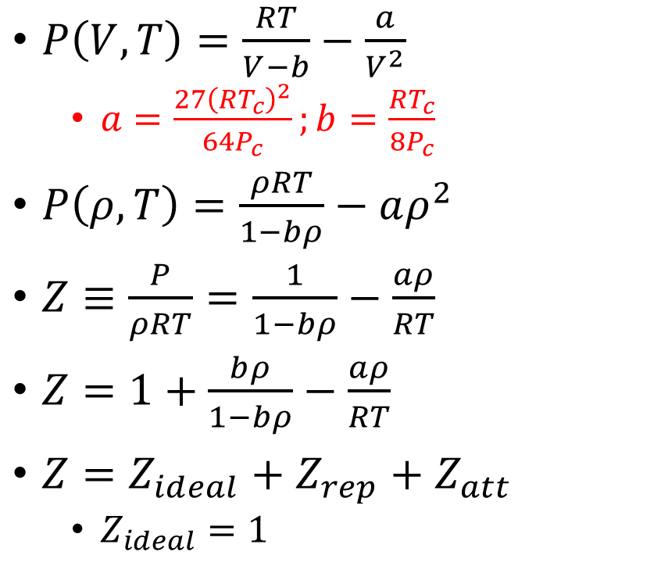
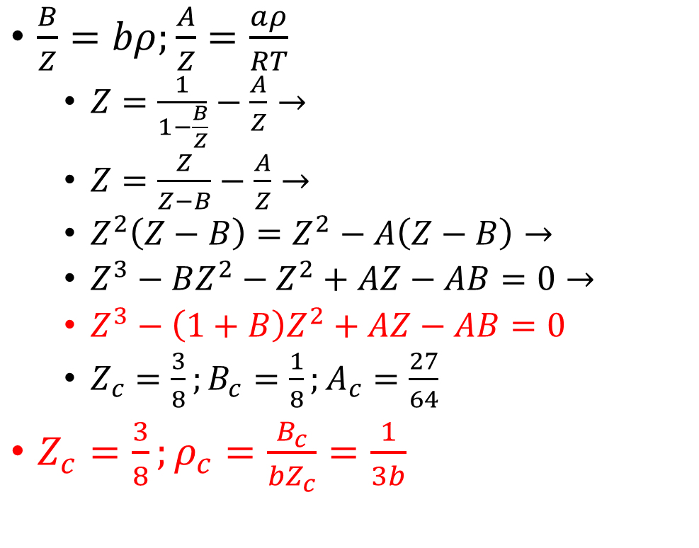
The van der Waals Equation of State (EOS)
Equation of State
Critical Point
$P\left(V,T\right)=\frac{RT}{V−b}−\frac{a}{V^{2}}$
$a=\frac{27{\left(RT_{c}\right)}^{2}}{64P_{c}};b=\frac{RT_{c}}{8P_{c}}$
$P\left(ρ,T\right)=\frac{ρRT}{1−bρ}−aρ^{2}$
$Z≡\frac{P}{ρRT}=\frac{1}{1−bρ}−\frac{aρ}{RT}$
$Z=1+\frac{bρ}{1−bρ}−\frac{aρ}{RT}$
$Z=Z_{ideal}+Z_{rep}+Z_{att}$
$Z_{ideal}=1$
$\frac{B}{Z}=bρ;\frac{A}{Z}=\frac{aρ}{RT}$
$Z=\frac{1}{1−\frac{B}{Z}}−\frac{A}{Z}→$
$Z=\frac{Z}{Z−B}−\frac{A}{Z}→$
$Z^{2}\left(Z−B\right)=Z^{2}−A\left(Z−B\right)→$
$Z^{3}−BZ^{2}−Z^{2}+AZ−AB=0→$
$Z^{3}−\left(1+B\right)Z^{2}+AZ−AB=0$
$Z_{c}=\frac{3}{8};B_{c}=\frac{1}{8};A_{c}=\frac{27}{64}$
$Z_{c}=\frac{3}{8};ρ_{c}=\frac{B_{c}}{{bZ}_{c}}=\frac{1}{3b}$
Notes:
Excel before next slide: make sure to make $Z\left(P,T=T_{c}\right)$

Slide 3
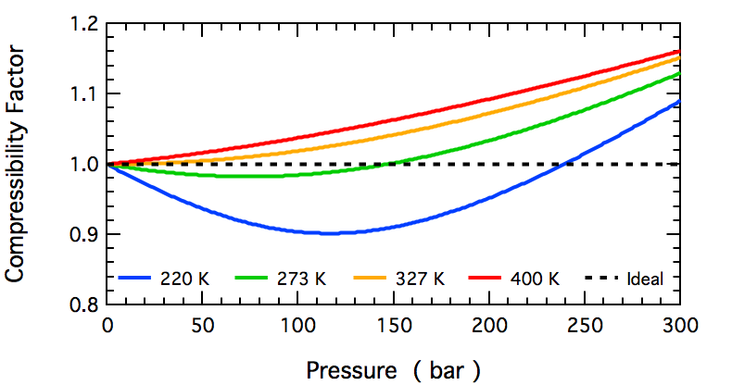
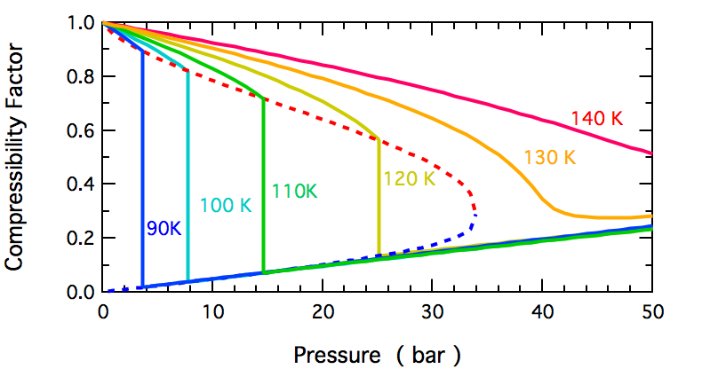

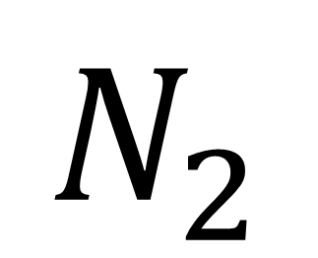
$$N_{2}$$
https://en.wikipedia.org/wiki/File:N2_Compressibility_Factor_High_T.png
$$Z_{c}≈0.3$$
https://en.wikipedia.org/wiki/File:N2_Compressibility_Factor_Low_T.png
Notes:
$T_{c}≈126$ K
$Z_{c}= ?$

Slide 4
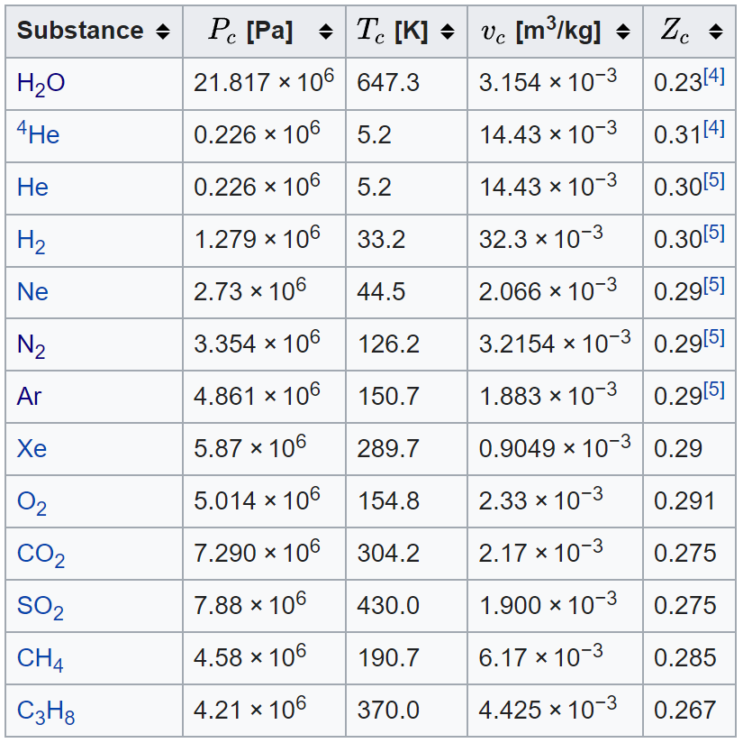

Critical Point Data for Simple Gases
$$Z_{c,vdW}=0.325$$
https://en.wikipedia.org/wiki/Theorem_of_corresponding_states

Slide 5
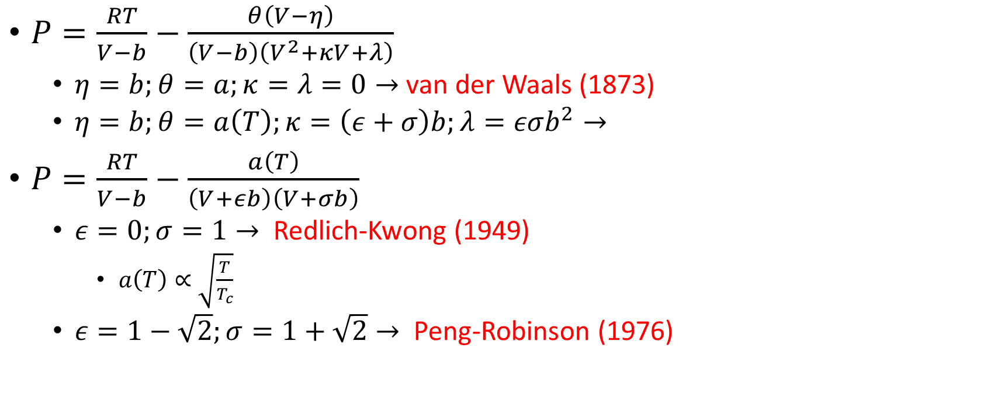
Generic Cubic EOS
$P=\frac{RT}{V−b}−\frac{θ\left(V−η\right)}{\left(V−b\right)\left(V^{2}+κV+λ\right)}$
$η=b;θ=a;κ=λ=0→$ van der Waals (1873)
$η=b;θ=a\left(T\right);κ=\left(ε+σ\right)b;λ=εσb^{2}→$
$P=\frac{RT}{V−b}−\frac{a\left(T\right)}{\left(V+εb\right)\left(V+σb\right)}$
$ε=0;σ=1→$ Redlich-Kwong (1949)
$a\left(T\right)∝\sqrt{\frac{T}{T_{c}}}$
$ε=1−\sqrt{2};σ=1+\sqrt{2}→$ Peng-Robinson (1976)

Slide 6
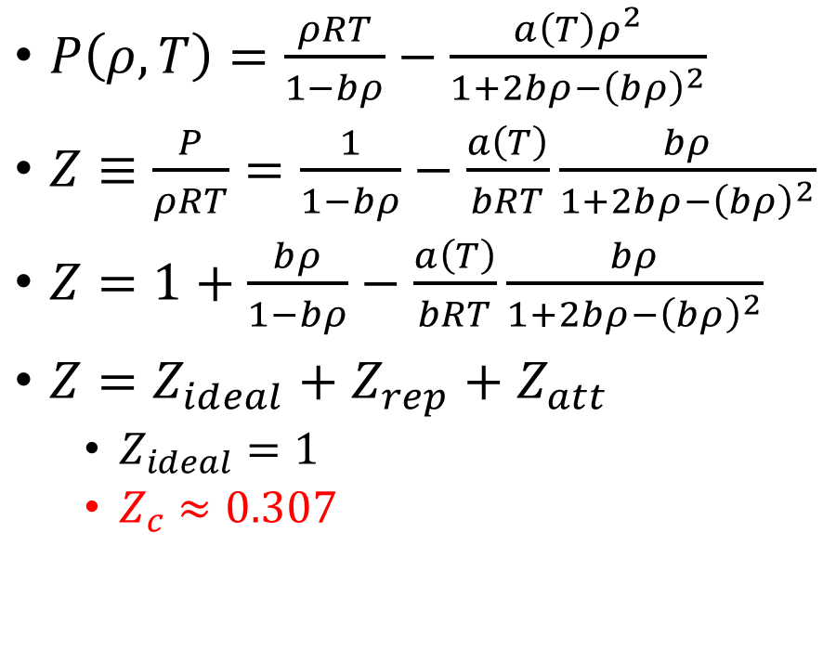
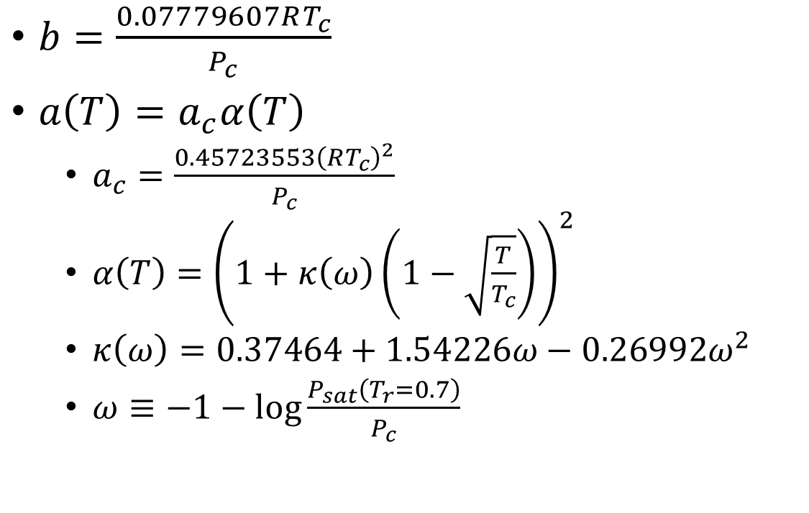
The Peng-Robinson EOS
Equation of State
Material Parameters
$P\left(ρ,T\right)=\frac{ρRT}{1−bρ}−\frac{a\left(T\right)ρ^{2}}{1+2bρ−{\left(bρ\right)}^{2}}$
$Z≡\frac{P}{ρRT}=\frac{1}{1−bρ}−\frac{a\left(T\right)}{bRT}\frac{bρ}{1+2bρ−{\left(bρ\right)}^{2}}$
$Z=1+\frac{bρ}{1−bρ}−\frac{a\left(T\right)}{bRT}\frac{bρ}{1+2bρ−{\left(bρ\right)}^{2}}$
$Z=Z_{ideal}+Z_{rep}+Z_{att}$
$Z_{ideal}=1$
$Z_{c}≈0.307$
$b=\frac{0.07779607RT_{c}}{P_{c}}$
$a\left(T\right)=a_{c}α\left(T\right)$
$a_{c}=\frac{0.45723553{\left(RT_{c}\right)}^{2}}{P_{c}}$
$α\left(T\right)={\left(1+κ\left(ω\right)\left(1−\sqrt{\frac{T}{T_{c}}}\right)\right)}^{2}$
$κ\left(ω\right)=0.37464+1.54226ω−0.26992ω^{2}$
$ω≡−1−\log{\frac{P_{sat}\left(T_{r}=0.7\right)}{P_{c}}}$
Notes:
Qualitative $P(ρ,T)$ leads to critical point

Slide 7
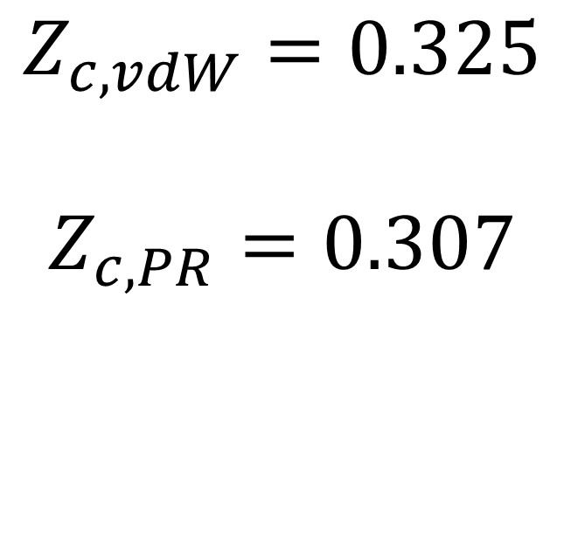
Critical Point Data for Simple Gases
$$Z_{c,vdW}=0.325$$
$$Z_{c,PR}=0.307$$
https://en.wikipedia.org/wiki/Theorem_of_corresponding_states

Slide 8
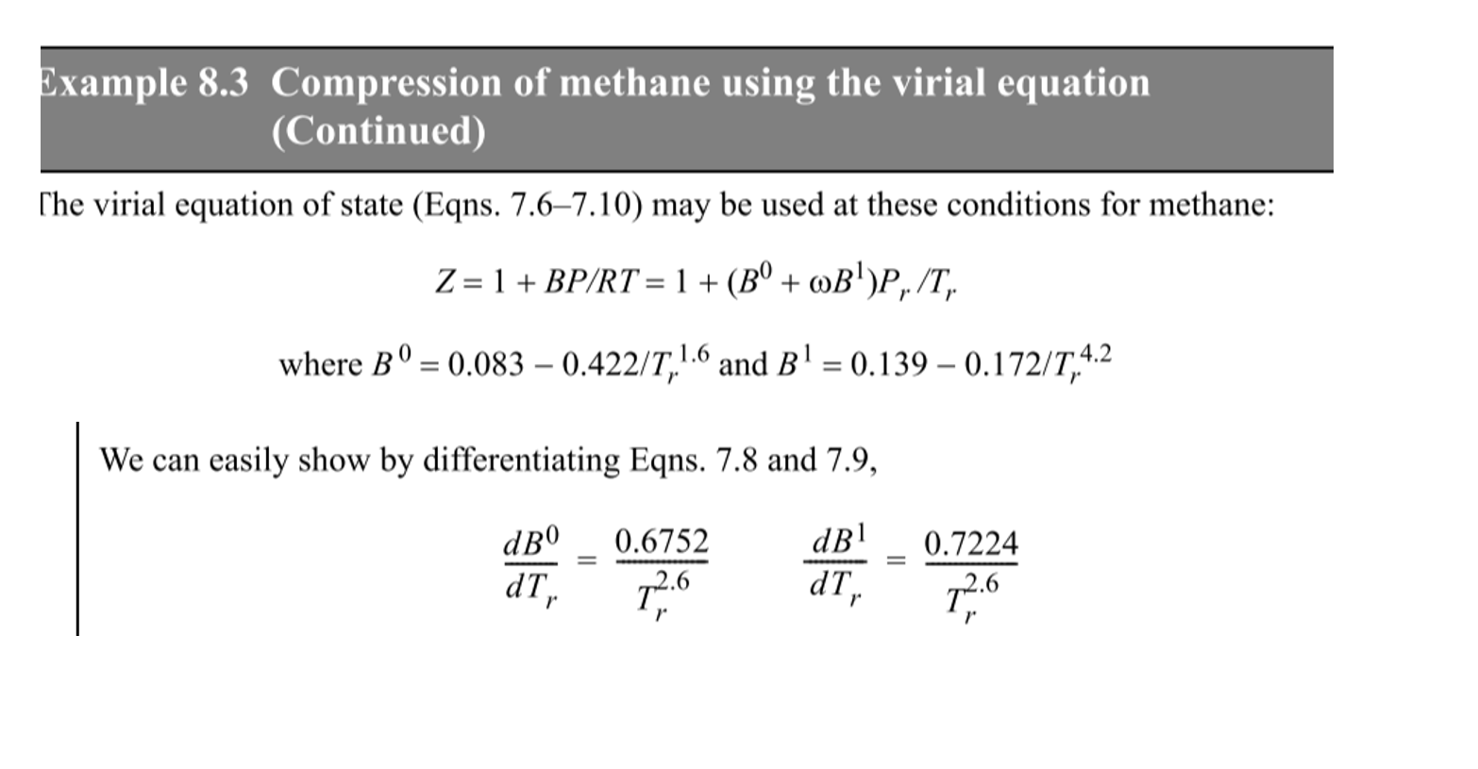
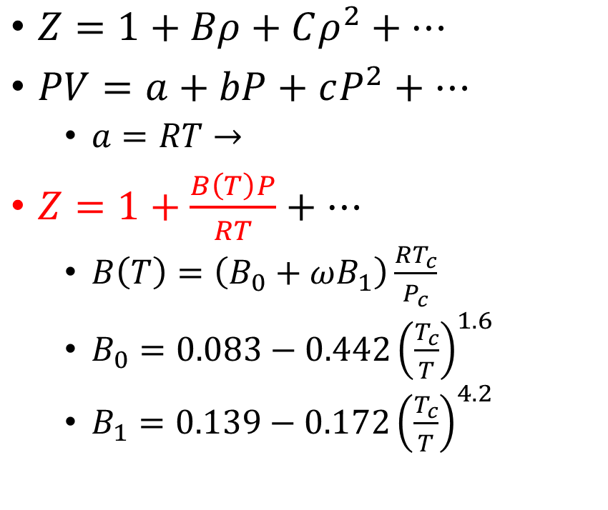
Truncated Virial EOS
$Z=1+Bρ+Cρ^{2}+…$
$PV=a+bP+cP^{2}+…$
$a=RT→$
$Z=1+\frac{B\left(T\right)P}{RT}+…$
$B\left(T\right)=\left(B_{0}+ωB_{1}\right)\frac{RT_{c}}{P_{c}}$
$B_{0}=0.083−0.442{\left(\frac{T_{c}}{T}\right)}^{1.6}$
$B_{1}=0.139−0.172{\left(\frac{T_{c}}{T}\right)}^{4.2}$

Slide 9
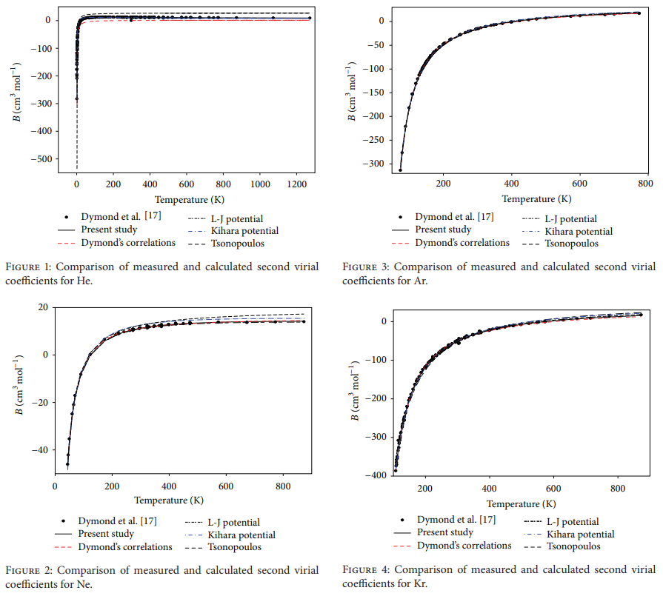
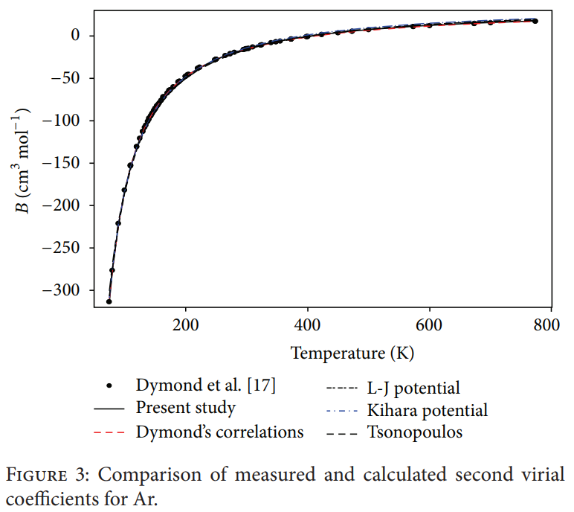
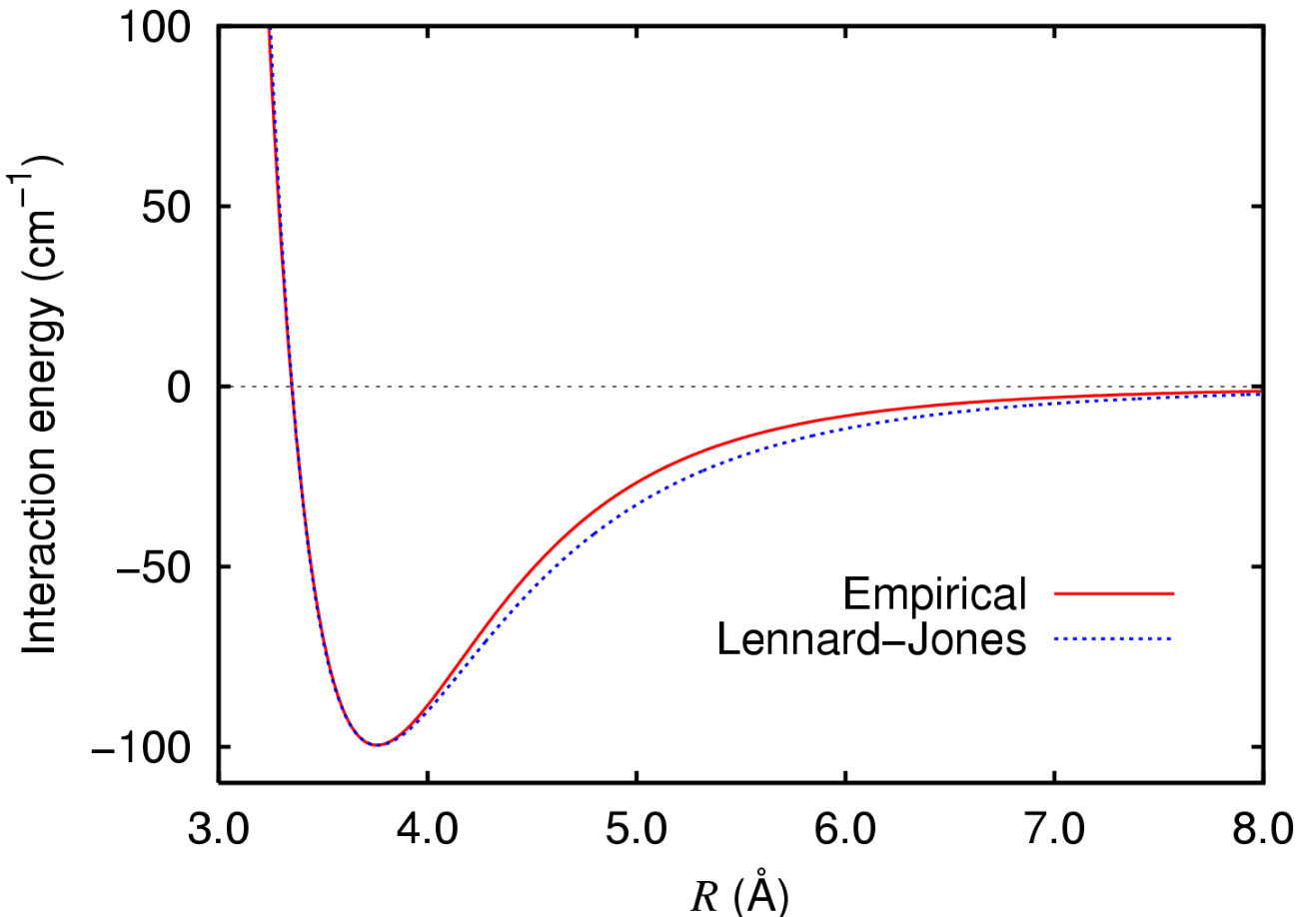

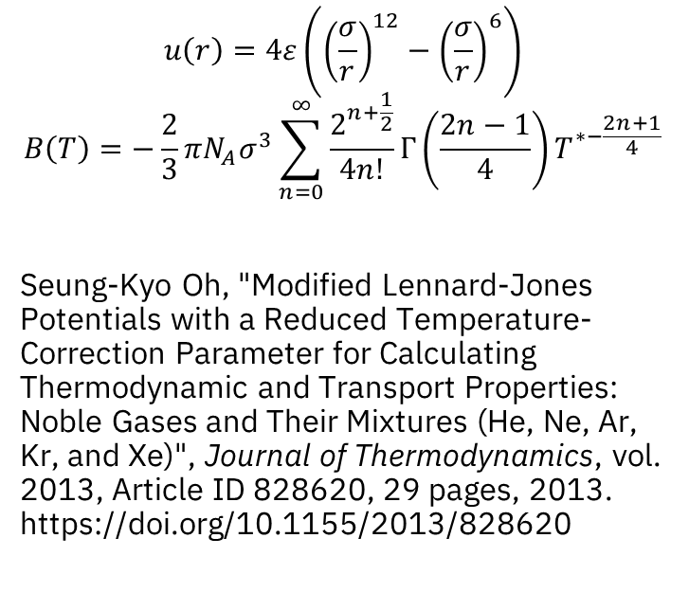
$$u\left(r\right)→B\left(T\right)$$
https://upload.wikimedia.org/wikipedia/commons/9/93/Argon_dimer_potential_and_Lennard-Jones.png
$$u\left(r\right)=4ε\left({\left(\frac{σ}{r}\right)}^{12}−{\left(\frac{σ}{r}\right)}^{6}\right)$$
$$B\left(T\right)=−\frac{2}{3}πN_{A}σ^{3}\sum_{n=0}^{∞}{\frac{2^{n+\frac{1}{2}}}{4n!}Γ\left(\frac{2n−1}{4}\right)}T^{∗−\frac{2n+1}{4}}$$
Seung-Kyo Oh, "Modified Lennard-Jones Potentials with a Reduced Temperature-Correction Parameter for Calculating Thermodynamic and Transport Properties: Noble Gases and Their Mixtures (He, Ne, Ar, Kr, and Xe)", Journal of Thermodynamics, vol. 2013, Article ID 828620, 29 pages, 2013. https://doi.org/10.1155/2013/828620

