Slide 1
Tuesday, October 4
HW3 due tomorrow (5PM)
Exam Thursday
Closed book & notes
Calculator only
Ordinary Vapor Compression (OVC) cycle
Introduction to derivative relations

Slide 2
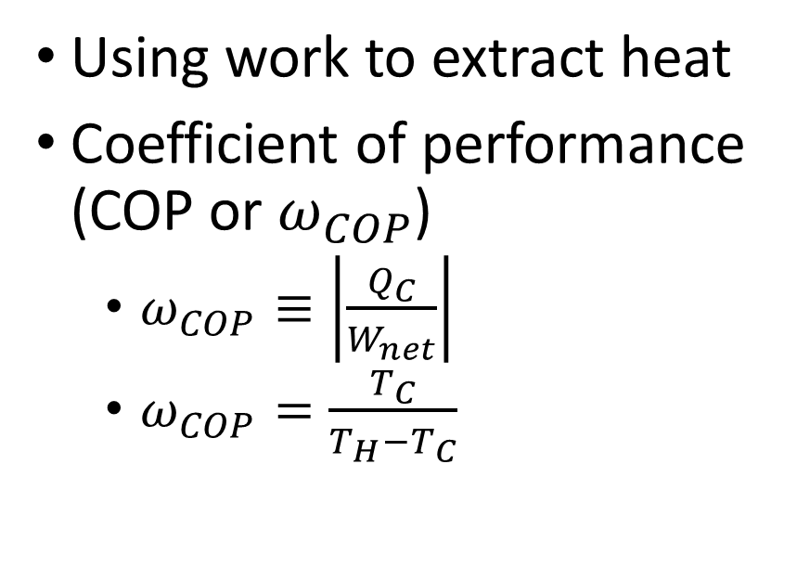
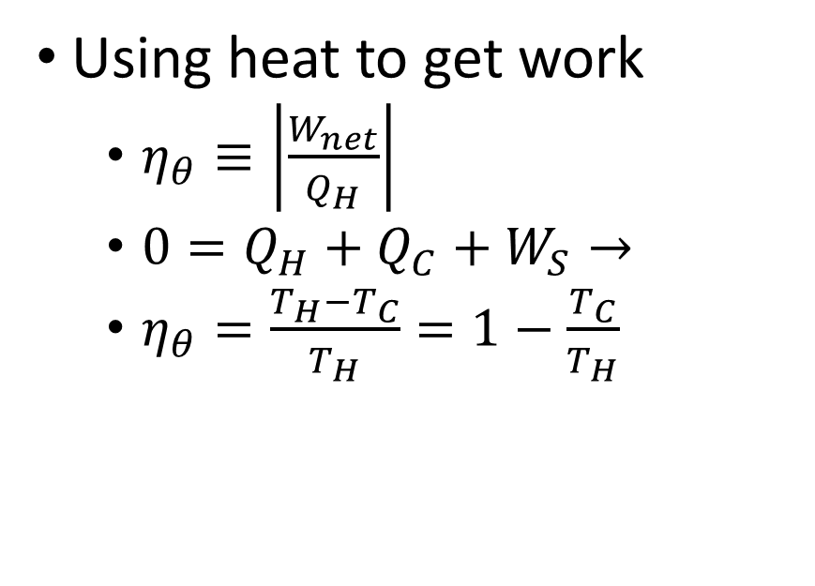
Reversing a Heat Engine?
Carnot Heat Engine
Carnot Heat Pump
Using heat to get work
$η_{θ}≡\left|\frac{W_{net}}{Q_{H}}\right|$
$0=Q_{H}+Q_{C}+W_{S}→$
$η_{θ}=\frac{T_{H}−T_{C}}{T_{H}}=1−\frac{T_{C}}{T_{H}}$
Using work to extract heat
Coefficient of performance (COP or $ω_{COP}$)
$ω_{COP}≡\left|\frac{Q_{C}}{W_{net}}\right|$
$ω_{COP}=\frac{T_{C}}{T_{H}−T_{C}}$

Slide 3

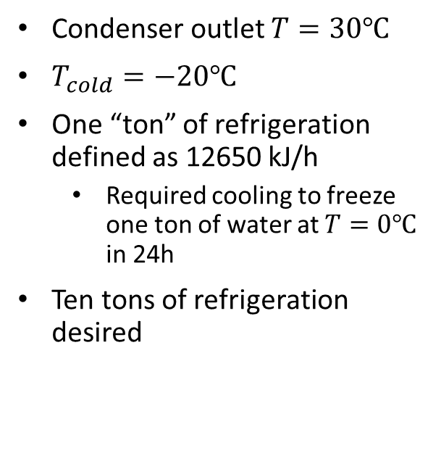

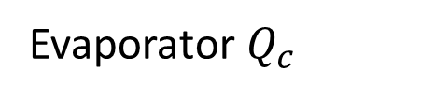

Ordinary Vapor Compression (OVC)
Condenser $Q_{H}$
Condenser outlet $T=30℃$
$T_{cold}=−20℃$
One “ton” of refrigeration defined as 12650 kJ/h
Required cooling to freeze one ton of water at $T=0℃$ in 24h
Ten tons of refrigeration desired
$$W_{pump}$$
$$η_{pump}=0.8$$
Evaporator $Q_{c}$

Slide 4
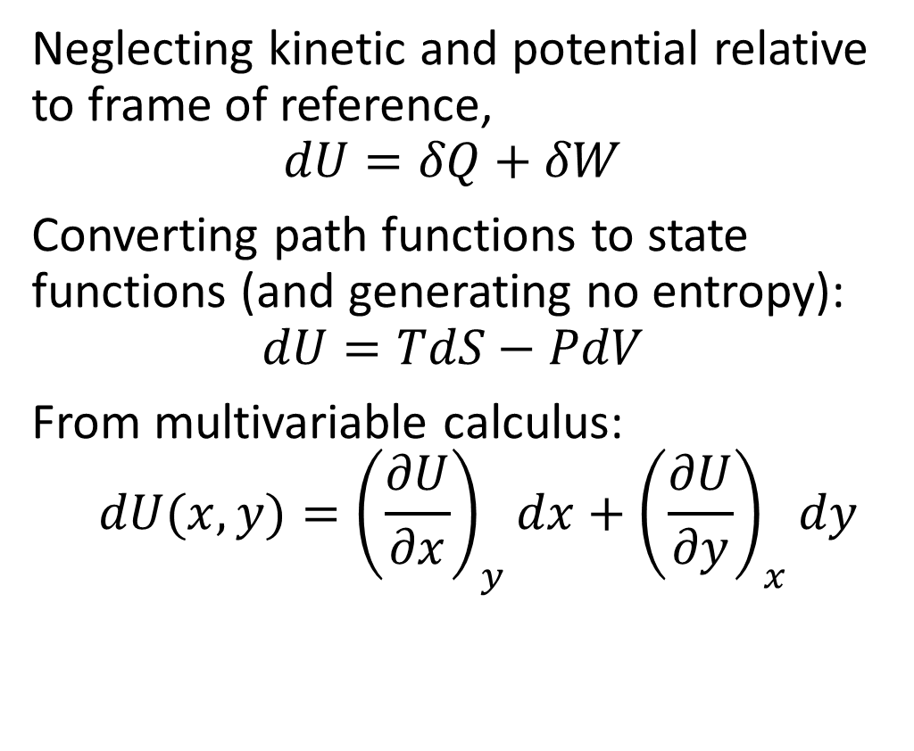
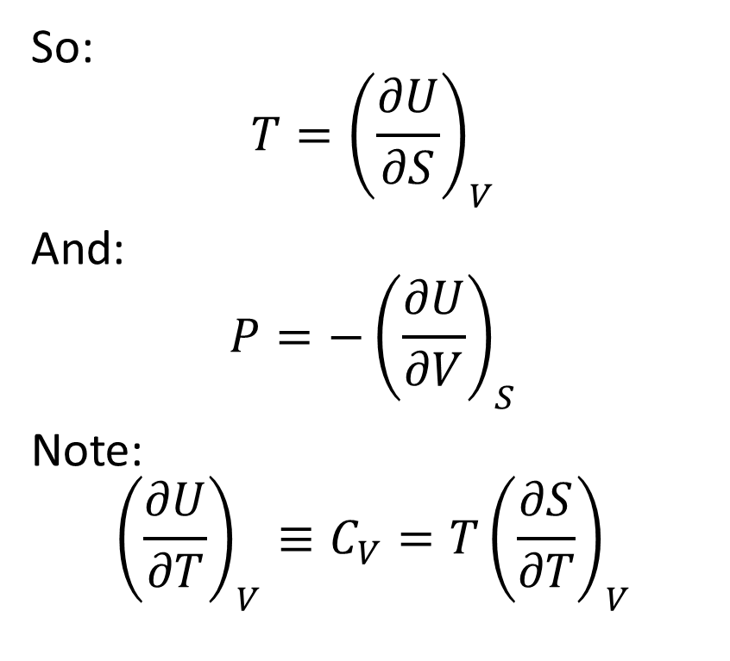
Fundamental Property Relation (Closed System)
Neglecting kinetic and potential relative to frame of reference,
$$dU=δQ+δW$$
Converting path functions to state functions (and generating no entropy):
$$dU=TdS−PdV$$
From multivariable calculus:
$$dU(x,y)={\left(\frac{∂U}{∂x}\right)}_{y}dx+{\left(\frac{∂U}{∂y}\right)}_{x}dy$$
So:
$$T={\left(\frac{∂U}{∂S}\right)}_{V}$$
And:
$$P=−{\left(\frac{∂U}{∂V}\right)}_{S}$$
Note:
$${\left(\frac{∂U}{∂T}\right)}_{V}≡C_{V}=T{\left(\frac{∂S}{∂T}\right)}_{V}$$
Notes:
Process (path) functions: heat and work
Note sign of temperature/entropy
U(S,V)

Slide 5
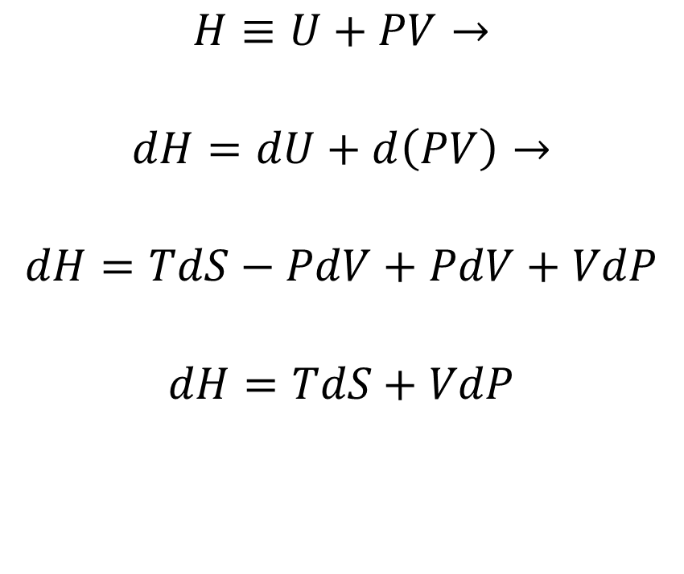
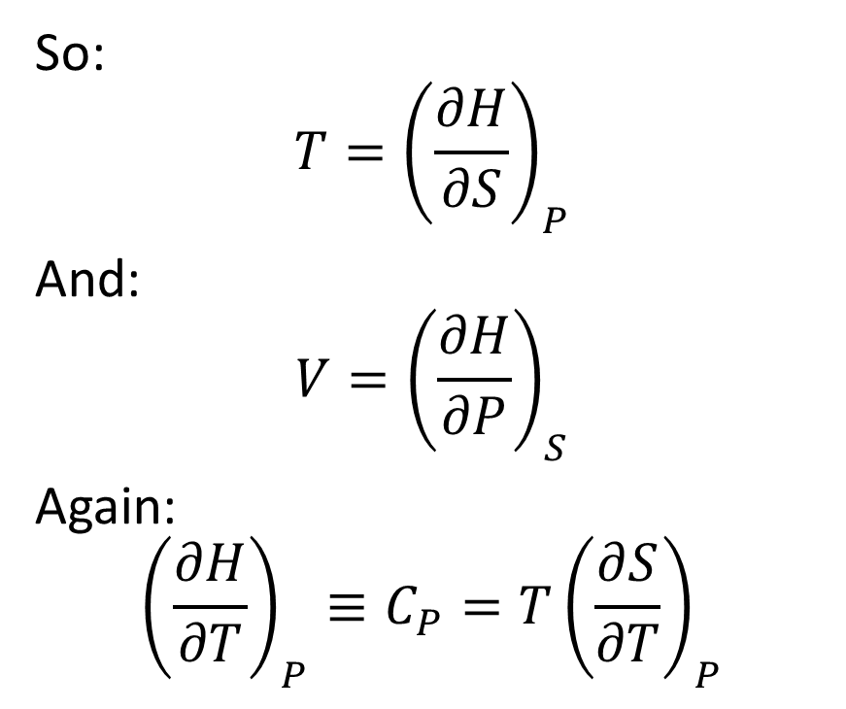
What about an Open System?
$$H≡U+PV→$$
$$dH=dU+d\left(PV\right)→$$
$$dH=TdS−PdV+PdV+VdP$$
$$dH=TdS+VdP$$
So:
$$T={\left(\frac{∂H}{∂S}\right)}_{P}$$
And:
$$V={\left(\frac{∂H}{∂P}\right)}_{S}$$
Again:
$${\left(\frac{∂H}{∂T}\right)}_{P}≡C_{P}=T{\left(\frac{∂S}{∂T}\right)}_{P}$$
Notes:
Note shaft work instead (heat stays the same)
Notice how we changed dV to dP with PV: do the same with entropy?

