Slide 1
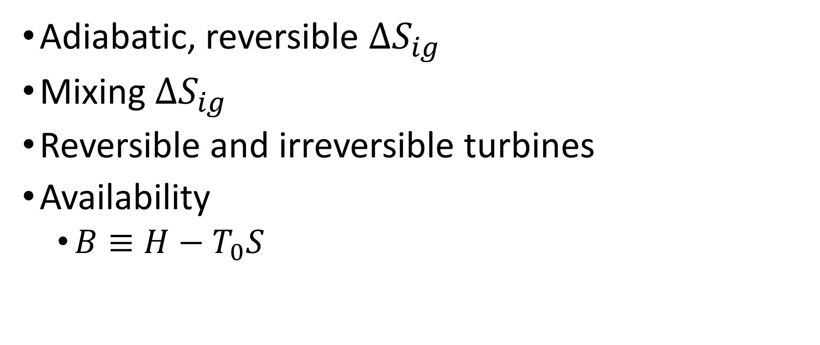
Tuesday, September 13
Adiabatic, reversible $ΔS_{ig}$
Mixing $ΔS_{ig}$
Reversible and irreversible turbines
Availability
$B≡H−T_{0}S$

Slide 2
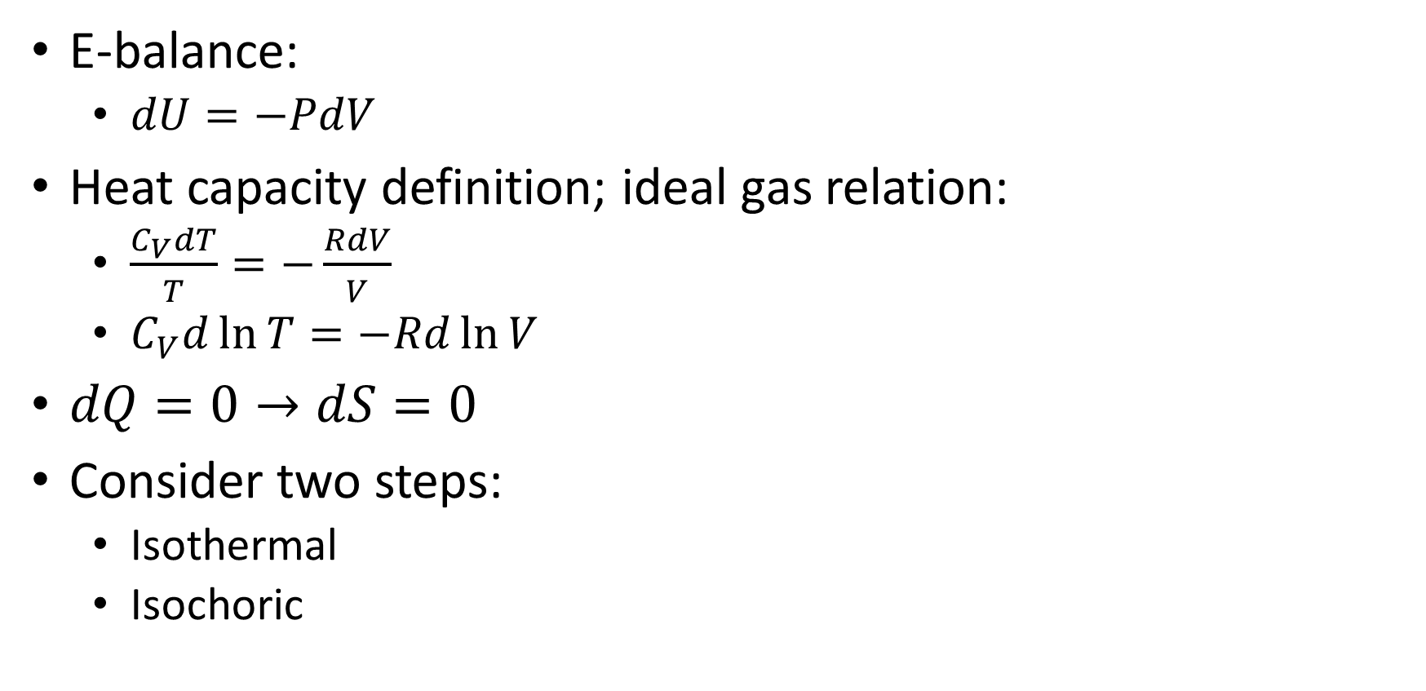
Adiabatic, reversible ideal gas expansion
E-balance:
$dU=−PdV$
Heat capacity definition; ideal gas relation:
$\frac{C_{V}dT}{T}=−\frac{RdV}{V}$
$C_{V}d\ln{T}=−Rd\ln{V}$
$dQ=0→dS=0$
Consider two steps:
Isothermal
Isochoric
Notes:
Draw $\left(\ln{T},\ln{V}\right)$ diagram on board

Slide 3
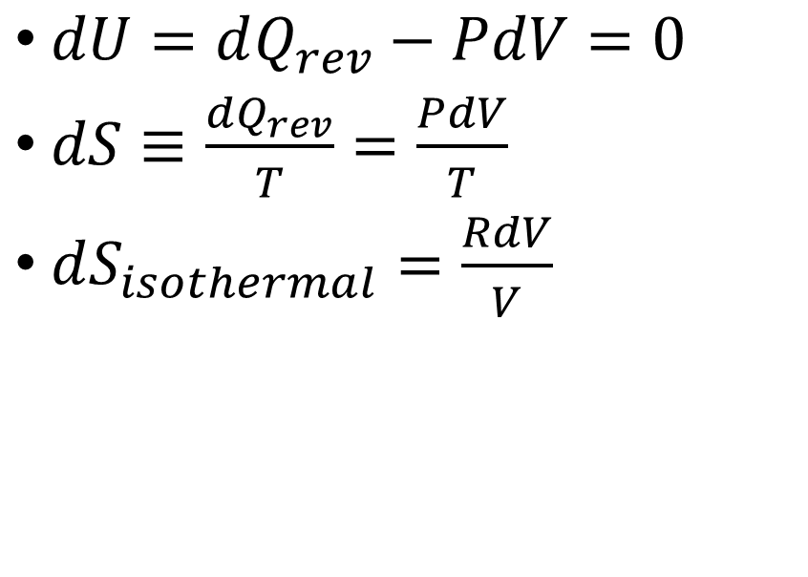
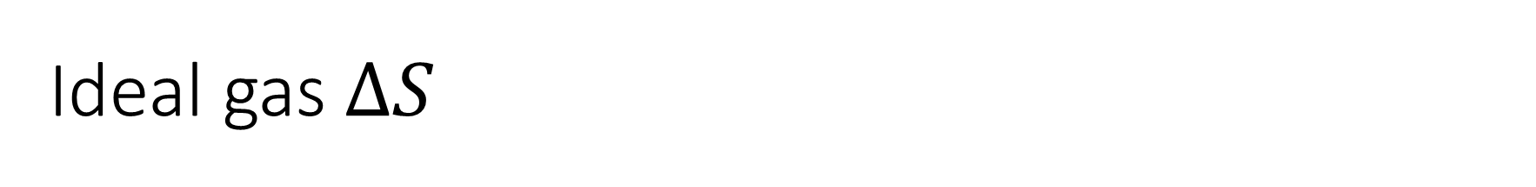

Ideal gas $ΔS$
Isothermal
Isochoric
$dU=dQ_{rev}−PdV=0$
$dS≡\frac{dQ_{rev}}{T}=\frac{PdV}{T}$
$dS_{isothermal}=\frac{RdV}{V}$
$dU=dQ_{rev}$
$dU=C_{V}dT$
$dS_{isochoric}≡\frac{dQ_{rev}}{T}=\frac{C_{V}dT}{T}$
$$dS_{isothermal}+dS_{isochoric}=dS_{total}≡\frac{dQ_{rev}}{T}=\frac{C_{V}dT}{T}+\frac{RdV}{V}=dS$$

Slide 4
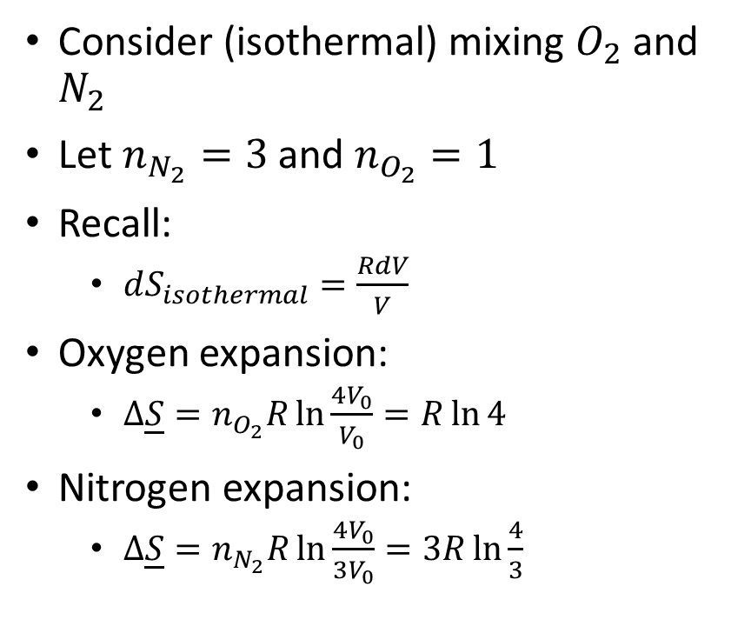
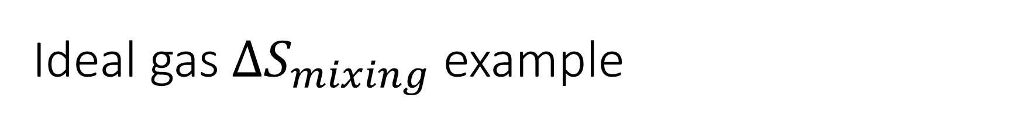
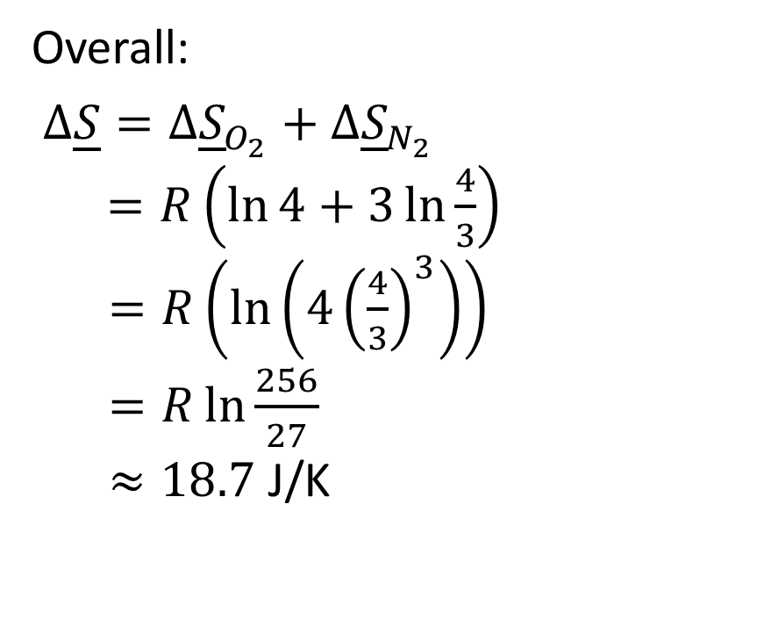
Ideal gas $ΔS_{mixing}$ example
Consider (isothermal) mixing $O_{2}$ and $N_{2}$
Let $n_{N_{2}}=3$ and $n_{O_{2}}=1$
Recall:
$dS_{isothermal}=\frac{RdV}{V}$
Oxygen expansion:
$Δ\underline{S}=n_{O_{2}}R\ln{\frac{4V_{0}}{V_{0}}}=R\ln{4}$
Nitrogen expansion:
$Δ\underline{S}=n_{N_{2}}R\ln{\frac{4V_{0}}{3V_{0}}}=3R\ln{\frac{4}{3}}$
Overall:
$Δ\underline{S}=Δ{\underline{S}}_{O_{2}}+Δ{\underline{S}}_{N_{2}}$
$=R\left(\ln{4}+3\ln{\frac{4}{3}}\right)$
$=R\left(\ln\left(4{\left(\frac{4}{3}\right)}^{3}\right)\right)$
$=R\ln{\frac{256}{27}}$
$≈18.7$ J/K

Slide 5
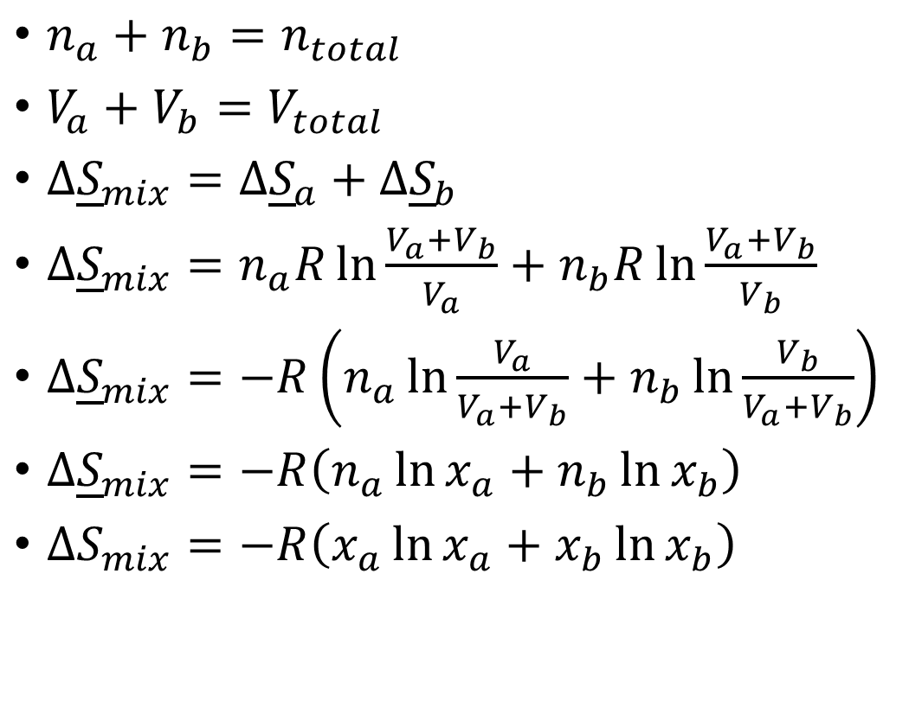
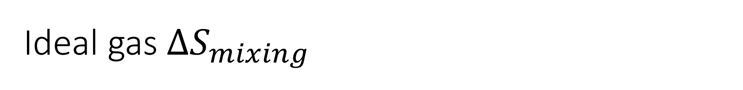
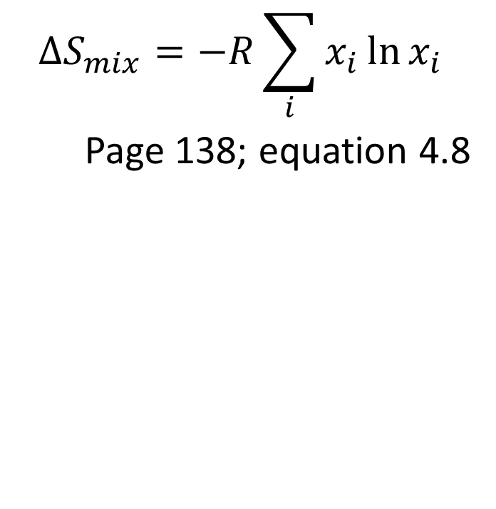
Ideal gas $ΔS_{mixing}$
$n_{a}+n_{b}=n_{total}$
$V_{a}+V_{b}=V_{total}$
$Δ{\underline{S}}_{mix}=Δ{\underline{S}}_{a}+Δ{\underline{S}}_{b}$
$Δ{\underline{S}}_{mix}=n_{a}R\ln{\frac{V_{a}+V_{b}}{V_{a}}}+n_{b}R\ln{\frac{V_{a}+V_{b}}{V_{b}}}$
$Δ{\underline{S}}_{mix}=−R\left(n_{a}\ln{\frac{V_{a}}{V_{a}+V_{b}}}+n_{b}\ln{\frac{V_{b}}{V_{a}+V_{b}}}\right)$
$Δ{\underline{S}}_{mix}=−R\left(n_{a}\ln{x_{a}}+n_{b}\ln{x_{b}}\right)$
$ΔS_{mix}=−R\left(x_{a}\ln{x_{a}}+x_{b}\ln{x_{b}}\right)$
$$ΔS_{mix}=−R\sum_{i}{x_{i}\ln{x_{i}}}$$
Page 138; equation 4.8

Slide 6

Steam Turbine Examples
Inlet:
$T=500℃$
$P=1.4 MPa$
Outlet Pressures:
$P=0.6 MPa$
$P=0.03 MPa$
$P=0.01 MPa$
Desired Quantities:
$T,H,S$
$W$
Notes:
Draw T(S) diagram with isobars

