Slide 1

Thursday, September 15
Turbine examples, cont.
Availability
$B≡H−T_{0}S$

Slide 2
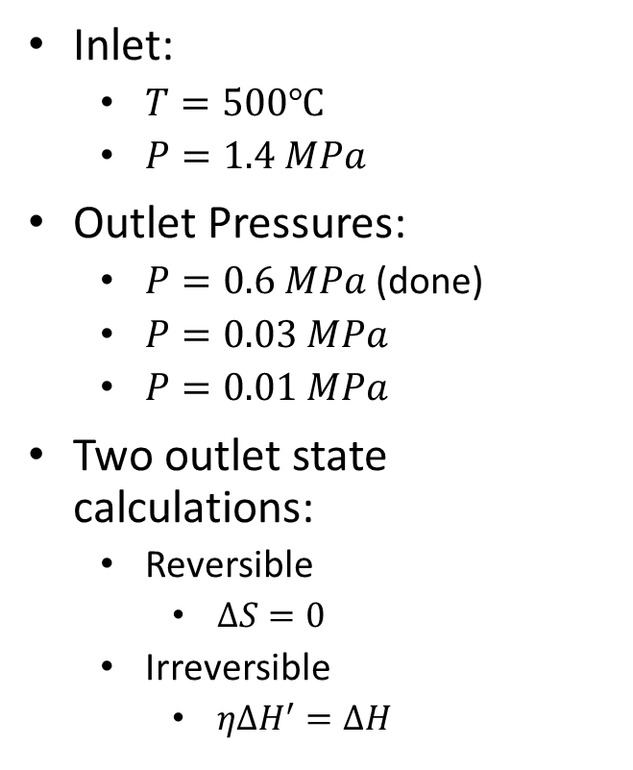

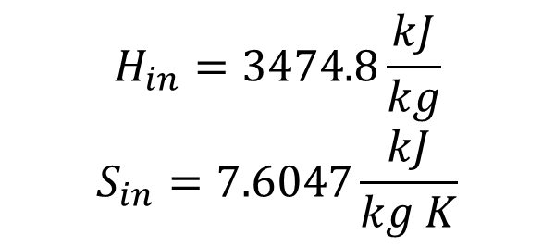

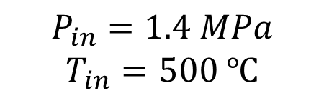
Steam Turbine Examples
$$P_{in}=1.4 MPa$$
$$T_{in}=500 ℃$$
$$P_{out}$$
Inlet:
$T=500℃$
$P=1.4 MPa$
Outlet Pressures:
$P=0.6 MPa$ (done)
$P=0.03 MPa$
$P=0.01 MPa$
Two outlet state calculations:
Reversible
$ΔS=0$
Irreversible
$ηΔH^{′}=ΔH$
$$H_{in}=3474.8\frac{kJ}{kg}$$
$$S_{in}=7.6047\frac{kJ}{kg K}$$
$$\dot{W}$$
Notes:
Draw T(S) diagram with isobars

Slide 3

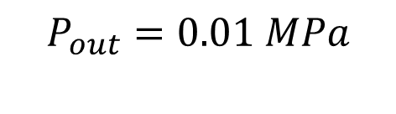

$$P=0.01 MPa$$
$$P_{in}=1.4 MPa$$
$$T_{in}=500 ℃$$
$$P_{out}=0.01 MPa$$
Two outlet state calculations:
Reversible
$ΔS=0$
Irreversible
$ηΔH^{′}=ΔH$
$$H_{in}=3474.8\frac{kJ}{kg}$$
$$S_{in}=7.6047\frac{kJ}{kg K}$$
$$\dot{W}$$
Notes:
Draw T(S) diagram with isobars

Slide 4

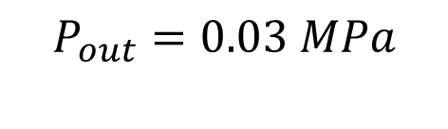
$$P=0.03 MPa$$
$$P_{in}=1.4 MPa$$
$$T_{in}=500 ℃$$
$$P_{out}=0.03 MPa$$
Two outlet state calculations:
Reversible
$ΔS=0$
Irreversible
$ηΔH^{′}=ΔH$
$$H_{in}=3474.8\frac{kJ}{kg}$$
$$S_{in}=7.6047\frac{kJ}{kg K}$$
$$\dot{W}$$
Notes:
Draw T(S) diagram with isobars

Slide 5
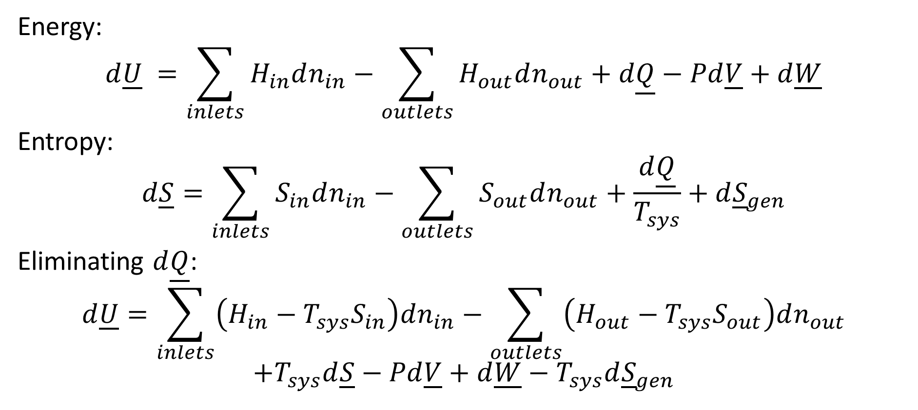
How can we calculate optimal work?
Energy:
$$d\underline{U} =\sum_{inlets}{H_{in}dn_{in}}−\sum_{outlets}{H_{out}dn_{out}}+d\underline{Q}−Pd\underline{V}+d\underline{W}$$
Entropy:
$$d\underline{S}=\sum_{inlets}{S_{in}dn_{in}}−\sum_{outlets}{S_{out}dn_{out}}+\frac{d\underline{Q}}{T_{sys}}+d{\underline{S}}_{gen}$$
Eliminating $d\underline{Q}$:
$$d\underline{U}=\sum_{inlets}{\left(H_{in}−T_{sys}S_{in}\right)dn_{in}}−\sum_{outlets}{\left(H_{out}−T_{sys}S_{out}\right)dn_{out}}$$
$$+T_{sys}d\underline{S}−Pd\underline{V}+d\underline{W}−T_{sys}d{\underline{S}}_{gen}$$

Slide 6
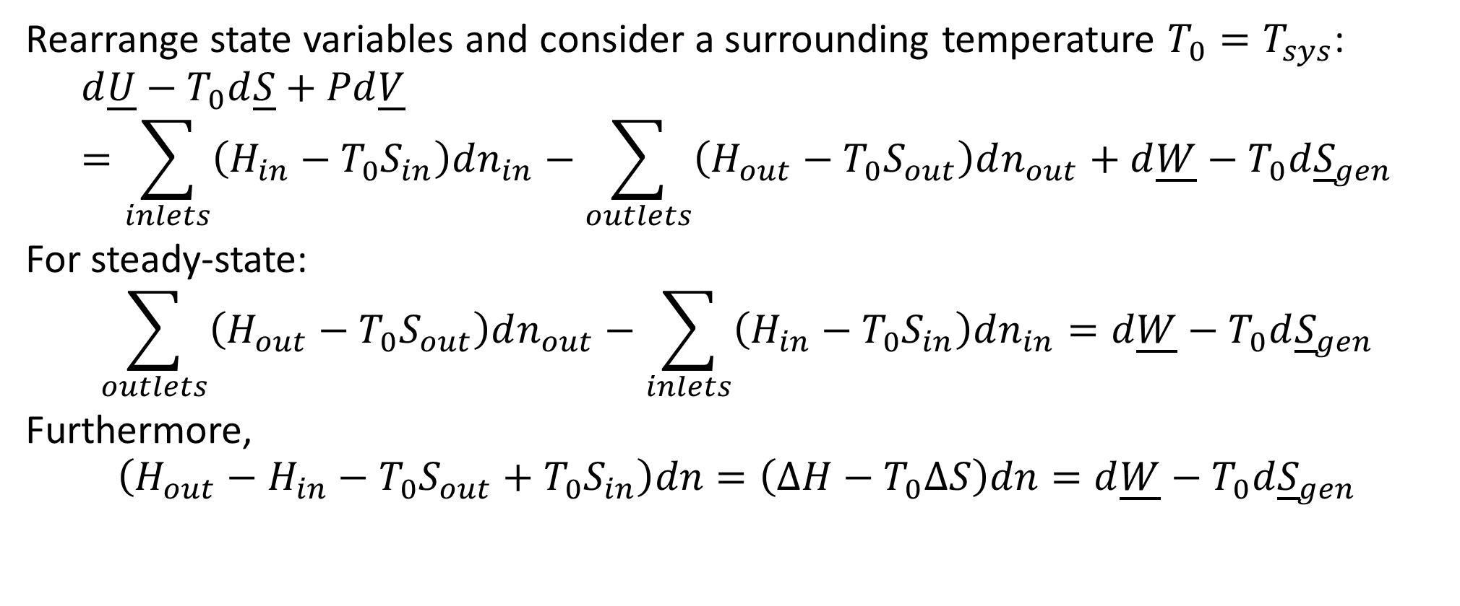
Finding Optimal Work
Rearrange state variables and consider a surrounding temperature $T_{0}=T_{sys}$:
$$d\underline{U}−T_{0}d\underline{S}+Pd\underline{V}=\sum_{inlets}{\left(H_{in}−T_{0}S_{in}\right)dn_{in}}−\sum_{outlets}{\left(H_{out}−T_{0}S_{out}\right)dn_{out}}+d\underline{W}−T_{0}d{\underline{S}}_{gen}$$
For steady-state:
$$\sum_{outlets}{\left(H_{out}−T_{0}S_{out}\right)dn_{out}}−\sum_{inlets}{\left(H_{in}−T_{0}S_{in}\right)dn_{in}}=d\underline{W}−T_{0}d{\underline{S}}_{gen}$$
Furthermore,
$$\left(H_{out}−H_{in}−T_{0}S_{out}+T_{0}S_{in}\right)dn=\left(ΔH−T_{0}ΔS\right)dn=d\underline{W}−T_{0}d{\underline{S}}_{gen}$$

Slide 7

Availability (Exergy)
$$\left(ΔH−T_{0}ΔS\right)dn=d\underline{W}−T_{0}d{\underline{S}}_{gen}$$
Define $B≡H−T_{0}S$
$$ΔBdn=d\underline{W}−T_{0}d{\underline{S}}_{gen}$$

