Slide 1
Tuesday, September 20
Thermodynamic Cycles (Chapter 5)
Carnot
Rankine
Reheat
Ordinary Vapor Compression (OVC)

Slide 2

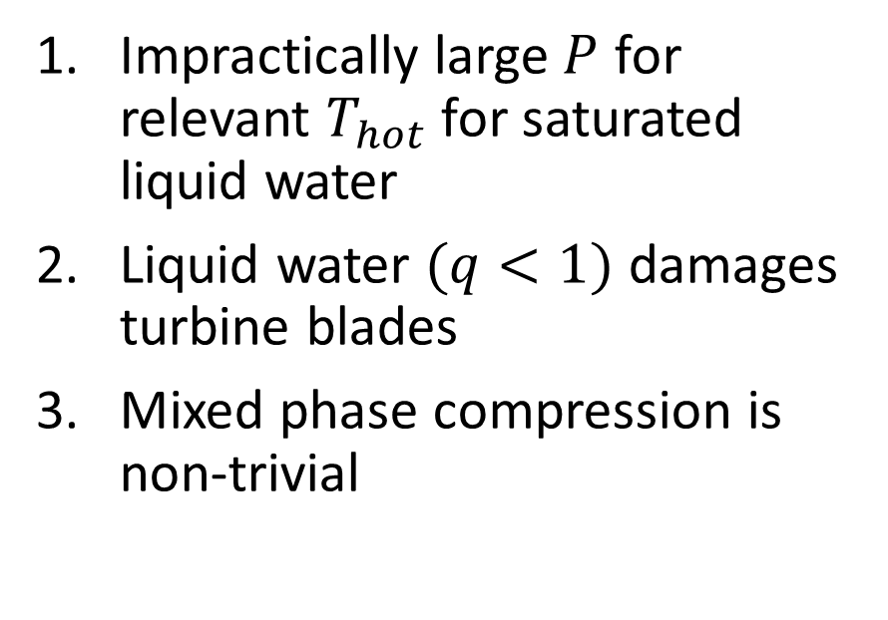
Carnot Cycle
Benefits
Impracticalities
Maximum thermal efficiency $η$
Impractically large $P$ for relevant $T_{hot}$ for saturated liquid water
Liquid water $(q<1)$ damages turbine blades
Mixed phase compression is non-trivial
Notes:
Draw Carnot T(S) on board

Slide 3
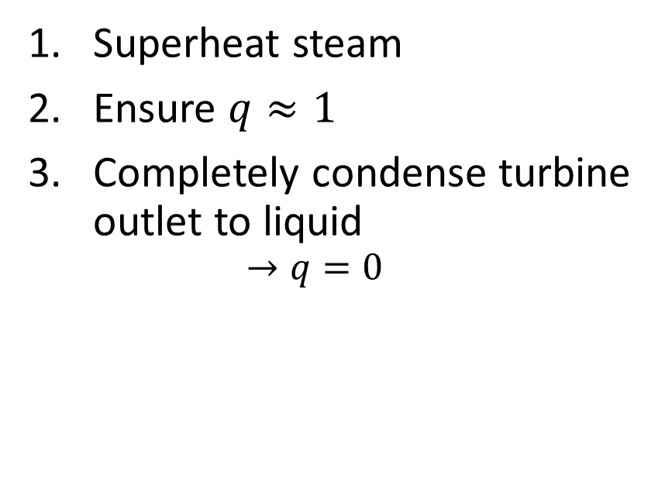
How to resolve impracticalities?
Resolutions
Impracticalities
Superheat steam
Ensure $q≈1$
Completely condense turbine outlet to liquid
$$→q=0$$
Impractically large $P$ for relevant $T_{hot}$ for saturated liquid water
Liquid water $(q<1)$ damages turbine blades
Mixed phase compression is non-trivial
Notes:
Convert Carnot T(S) diagram to Rankine T(S) on board

Slide 4

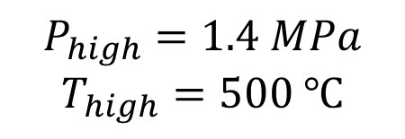


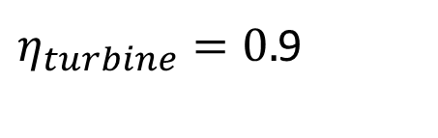


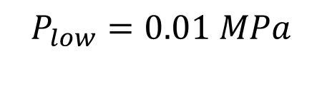
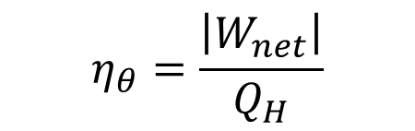
Rankine Cycle
$$Q_{H}$$
$$η_{θ}=\frac{\left|W_{net}\right|}{Q_{H}}$$
$$P_{high}=1.4 MPa$$
$$T_{high}=500 ℃$$
$$W_{pump}$$
$$W_{turbine}$$
$$η_{pump}=0.8$$
$η_{turbine}=0.$9
$$P_{low}=0.01 MPa$$
$$Q_{C}$$
Notes:
Draw T(S) diagram with isobars

Slide 5


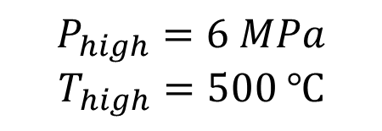



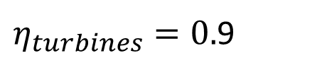


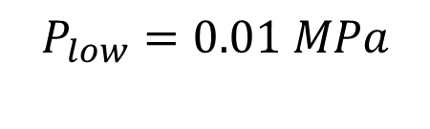

Rankine Cycle: Reheater
$$Q_{H}$$
$$P_{high}=6 MPa$$
$$T_{high}=500 ℃$$
$$η_{θ}=\frac{\left|W_{net}\right|}{Q_{H}}$$
$η_{turbines}=0.$9
$$W_{t1}$$
$$P_{inter}=1.4 MPa$$
$$Q_{reheat}$$
$$W_{t2}$$
$$W_{pump}$$
$$η_{pump}=0.8$$
$$P_{low}=0.01 MPa$$
$$Q_{C}$$
Notes:
Draw T(S) diagram with isobars

Slide 6
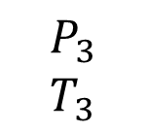



$$Q_{H}$$
$$P_{6}=P_{3}$$
$$P_{3}$$
$$T_{3}$$
$$W_{pump}$$
$$W_{turbine}$$
$$P_{4}$$
$$P_{5}=P_{4}$$
$$Q_{C}$$
Notes:
Draw T(S) diagram with isobars

Slide 7

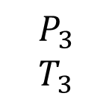




$$Q_{H}$$
$$P_{3}$$
$$T_{3}$$
$$P_{8}=P_{3}$$
$$W_{t1}$$
$$P_{4}$$
$$Q_{reheat}$$
$$T_{5}$$
$$W_{t2}$$
$$W_{pump}$$
$$P_{6}$$
$$P_{7}=P_{6}$$
$$Q_{C}$$
Notes:
Draw T(S) diagram with isobars

Slide 8
DO NOT ENTER

Slide 9
USE 213 DOOR

