Slide 1
Thursday, September 22
Rankine with reheating
Ordinary Vapor Compression (OVC)

Slide 2


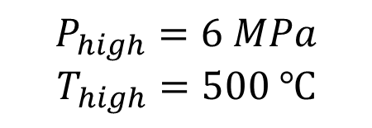



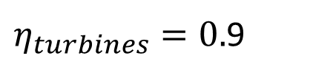


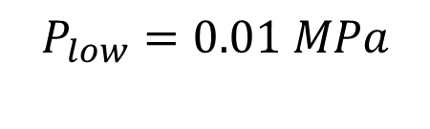
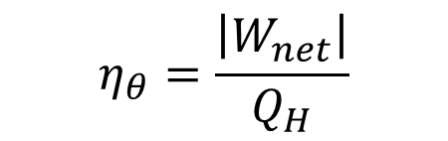

Rankine Cycle: Reheater
$$Q_{H}$$
$$P_{high}=6 MPa$$
$$T_{high}=500 ℃$$
$$η_{θ}=\frac{\left|W_{net}\right|}{Q_{H}}$$
$η_{turbines}=0.$9
$$W_{t1}$$
$$P_{inter}=1.4 MPa$$
$$Q_{reheat}$$
$$W_{t2}$$
$$W_{pump}$$
$$η_{pump}=0.8$$
$$P_{low}=0.01 MPa$$
$$Q_{C}$$
Notes:
Draw T(S) diagram with isobars
Find flowrate for MW power demand

Slide 3
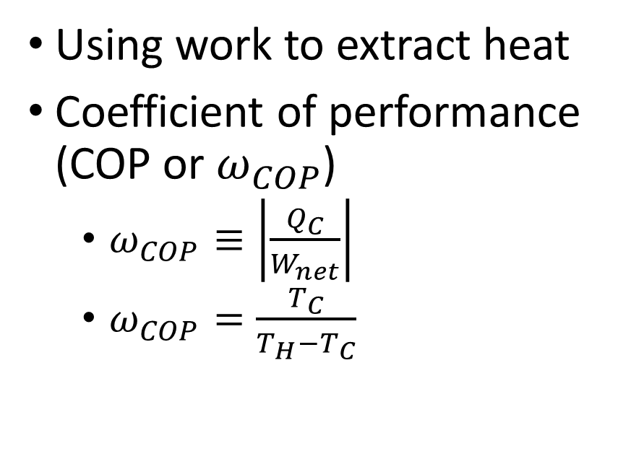
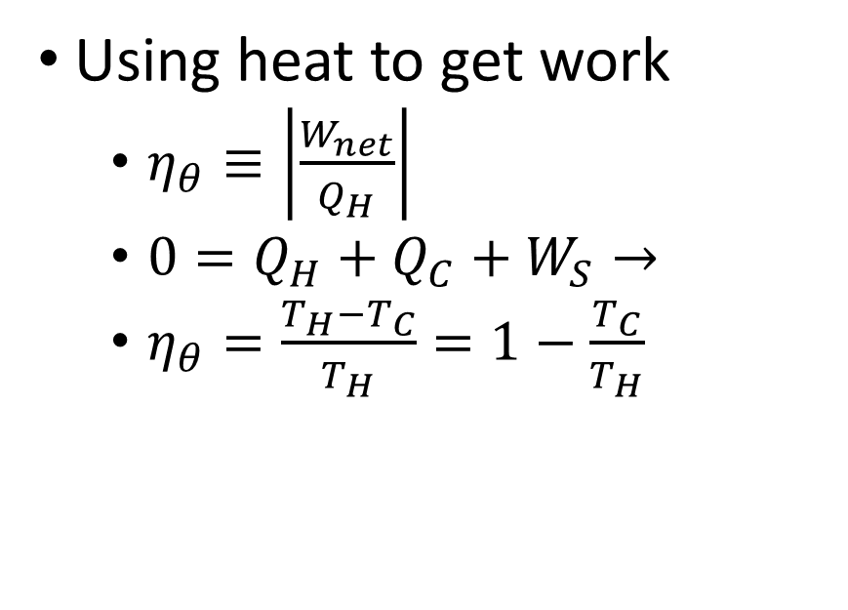
Reversing a Heat Engine?
Carnot Heat Engine
Carnot Heat Pump
Using heat to get work
$η_{θ}≡\left|\frac{W_{net}}{Q_{H}}\right|$
$0=Q_{H}+Q_{C}+W_{S}→$
$η_{θ}=\frac{T_{H}−T_{C}}{T_{H}}=1−\frac{T_{C}}{T_{H}}$
Using work to extract heat
Coefficient of performance (COP or $ω_{COP}$)
$ω_{COP}≡\left|\frac{Q_{C}}{W_{net}}\right|$
$ω_{COP}=\frac{T_{C}}{T_{H}−T_{C}}$

Slide 4

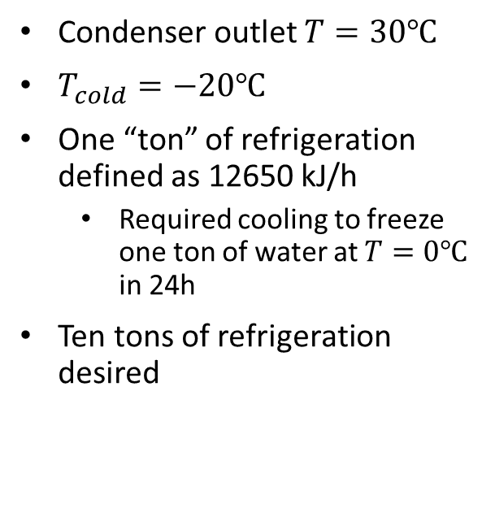
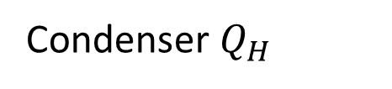
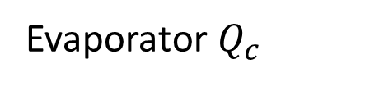

Ordinary Vapor Compression (OVC)
Condenser $Q_{H}$
Condenser outlet $T=30℃$
$T_{cold}=−20℃$
One “ton” of refrigeration defined as 12650 kJ/h
Required cooling to freeze one ton of water at $T=0℃$ in 24h
Ten tons of refrigeration desired
$$W_{pump}$$
$$η_{pump}=0.8$$
Evaporator $Q_{c}$

