Slide 1

ITAU Application Cloning Demo
Diego Rodríguez Bravo – EMEA CSC – Madrid
Aldo Cruz / Denis Pereira – São Paulo - Brasil
May 2020

Slide 2
Zowe Featuring ITAU Application Cloning
Master Schema
Define Txn + Pgm
Install Txn + Pgm
Refresh Pgm
Compile
Link
Deploy
IMS
Objects
CICS
Objects
IMS/CICS
Compile
Link
Deploy
Cobol
Source
Code
PGMO
Batch
Objects
JCLs
PGMB
PDSE
VSAM
PS
CopyBooks
DBRMs
DB2
Bind Package

Slide 3
Zowe Featuring ITAU Application Cloning
Master Schema – ITAU MASTER
ITAUM.IMS.LOAD
ITAUM.CICS.LOAD
IMSM/CICM
ITAUM.COBOL
ITAUM.LOAD
ITAUM.JCL
PDSE
ITAUM.*
VSAM
ITAUM.*
PS
ITAUM.*
ITAUM.COPY
ITAUM.DBRM
DB2M

Slide 4
Zowe Featuring ITAU Application Cloning
Clone Whole Application System & Infrastructure – Same LPAR
ITAUM.IMS.LOAD
ITAUM.CICS.LOAD
IMSM/CICM
ITAU1.IMS.LOAD
ITAU1.CICS.LOAD
IMS1/CIC1
ITAUM.COBOL
ITAU1.COBOL
ITAU1.LOAD
ITAU1.JCL
ITAUM.LOAD
ITAUM.JCL
PDSE
ITAUM.*
VSAM
ITAUM.*
PS
ITAUM.*
PDSE
ITAU1.*
VSAM
ITAU1.*
PS
ITAU1.*
ITAUM.COPY
ITAUM.DBRM
DB2M
ITAU1.COPY
ITAU1.DBRM
DB21

Slide 5
Zowe Featuring ITAU Application Cloning
Pros
Easy to achieve Clone creation
Easy to maintain
Transparent for developers: same names for programs, transaction, tables, JCLs…
Isolated environments
Most changes on infrastructure but easy to automatize
No changes in Programs, Tables, Transactions, Definitions
Customize Compilation & Deployment process to target ITAU1 data sets & libraries and BIND with DB21
Cons
++Resources needed:
Subsystems Management
Same LPAR
ITAUM | ITAU1 | Action
ITAUM.COBOL | ITAU1.COBOL | Create library & Copy Source Programs.
ITAUM.COPY | ITAU1.COPY | Create library & Copy Copybooks
ITAUM.LOAD | ITAU1.LOAD | Create library & Copy Load Objects
ITAUM.IMS.LOAD ITAUM.CICS.LOAD | ITAU1.IMS.LOAD ITAU1.CICS.LOAD | Create library & Copy Load Modules
ITAUM.JCL | ITAU1.JCL | Create library, copy & rename destination libraries from ITAUM.* to ITAU1. Point to DB21 instead DB2M
ITAUM.DBRM | ITAU1.DBRM | Create library & Copy DBRMs
ITAUM.* PDSE / VSAM / PS | ITAU1.* PDSE / VSAM / PS | Create files Copy/Repro & Rename
DB2M | DB21 | Create new DB2 Subsystem; Export Import Tables; Rebind to DB21
IMSM/CICM | IMS1/CIC1 | Define & Install Transactions. Define RCT entries for DB21

Slide 6
Zowe Featuring ITAU Application Cloning
Clone Whole Application System & Infrastructure – Same LPAR
ITAUM.IMS.LOAD
ITAUM.CICS.LOAD
IMSM/CICM
ITAUM.COBOL
ITAUM.LOAD
ITAUM.JCL
PDSE
ITAUM.*
VSAM
ITAUM.*
PS
ITAUM.*
ITAUM.COPY
ITAUM.DBRM
DB2M
ITAUM.IMS.LOAD
ITAUM.CICS.LOAD
IMSM/CICM
ITAUM.IMS.LOAD
ITAUM.CICS.LOAD
IMSM/CICM
ITAUM.COBOL
ITAUM.LOAD
ITAUM.JCL
ITAUM.COBOL
ITAUM.LOAD
ITAUM.JCL
PDSE
ITAUM.*
VSAM
ITAUM.*
PS
ITAUM.*
PDSE
ITAUM.*
VSAM
ITAUM.*
PS
ITAUM.*
ITAUM.COPY
ITAUM.DBRM
DB2M
ITAUM.COPY
ITAUM.DBRM
DB2M
ITAUM.IMS.LOAD
ITAUM.CICS.LOAD
IMSM/CICM
ITAUM.COBOL
ITAUM.LOAD
ITAUM.JCL
PDSE
ITAUM.*
VSAM
ITAUM.*
PS
ITAUM.*
ITAUM.COPY
ITAUM.DBRM
DB2M

Slide 7
Zowe Featuring ITAU Application Cloning
Clone Whole Application Same LPAR – Shared IMS/CICS + DB2 & Shared Libraries
ITAUM.IMS.LOAD
ITAUM001
ITAU#001
ITAUM.CICS.LOAD
ITAUM002
ITAU#002
IMSM/CICM
IM01 – ITAUM001 IM02 – ITAUM002
I#01 – ITAU#002 I#02 – ITAU#002
PDSE
ITAU#.*
VSAM
ITAU#.*
PS
ITAU#.*
ITAUM.COBOL
ITAUM001
ITAUM002
ITAU#001
ITAU#002
ITAUM.LOAD
ITAUM001
ITAUM002
ITAU#001
ITAU#002
ITAUM.JCL
ITAUM001
ITAUM002
ITAU#001
ITAU#002
PDSE
ITAUM.*
VSAM
ITAUM.*
PS
ITAUM.*
ITAUM.COPY
ITAUM001
ITAUM002
ITAU#001
ITAU#002
ITAUM.DBRM
ITAUM001
ITAUM002
ITAU#001
ITAU#002
DB2M
ITAUM
ITAU#

Slide 8
Zowe Featuring ITAU Application Cloning
Pros
No need for creation infrastructure (share same subsystems)
No changes at all in IMS/CICS infrastructure
Customize Compilation & Deployment process to target ITAU# data sets and BIND with DB2#
Cons
Difficult when deploying to Production (rename of programs & recompile)
Extra work for developers: Need to manage different names for programs, transaction, tables, JCLs… than the Master application
Changes may be required for static calls in Programs
ITAUM | ITAU1 | Action
ITAUM.COBOL | Same library | Copy & Rename Source Programs from ITAUM* to ITAU# Attention with calls to subprograms: static or dynamic
ITAUM.COPY | Same library | Copy & Rename Copybooks. Update programs with modified copybook names
ITAUM.LOAD | Same library | Compile all ITAU# programs
ITAUM.IMS.LOAD ITAUM.CICS.LOAD | Same libraries | Compile all ITAU# programs
ITAUM.JCL | Same libraries | Copy & rename JCLs. Change destination libraries from ITAUM.* to ITAU#. Point to DB2# instead DB2M Modify names of programs.
ITAUM.DBRM | Same libraries | Generated when compiled
ITAUM.* PDSE / VSAM / PS | ITAU#.* PDSE / VSAM / PS | Create Copy/Repro & Rename
DB2M | DB2# | Create new DB2 Tables; Export Import Tables; Rebind to DB2#
IMSM/CICM | Same Subsystems | Define & Install Transactions & RCT entries for DB21

Slide 9
Zowe Featuring ITAU Application Cloning
Clone Whole Application Same LPAR– Shared IMS/CICS + DB2 NOT Shared Libraries
ITAU1.IMS.LOAD
ITAU1001
ITAU1.CICS.LOAD
ITAU1002
IMSM/CICM
IM01 – ITAUM001 IM02 – ITAUM002
I101 – ITAU1002 I102 – ITAU1002
I201 – ITAU2001 I202 – ITAU2002
ITAUM.IMS.LOAD
ITAUM001
ITAUM.CICS.LOAD
ITAUM002
ITAU2.IMS.LOAD
ITAU2001
ITAU2.CICS.LOAD
ITAU2002
PDSE
ITAU1.*
VSAM
ITAU1.*
PS
ITAU1.*
ITAU1.COBOL
ITAU1001
ITAU1.LOAD
ITAU1001
ITAU1.JCL
ITAU1001
ITAUM.COBOL
ITAUM001
ITAUM.LOAD
ITAUM001
ITAUM.JCL
ITAUM001
ITAU2.COBOL
ITAU2001
ITAU2.LOAD
ITAU2001
ITAU2.JCL
ITAU2001
PDSE
ITAUM.*
VSAM
ITAUM.*
PS
ITAUM.*
PDSE
ITAU2.*
VSAM
ITAU2.*
PS
ITAU2.*
ITAU2.COPY
ITAU2001
ITAU1.DBRM
ITAU1001
DB2M
ITAUM.DBRM
ITAUM001
ITAUM
ITAU1
ITAUM.COPY
ITAUM001
ITAU1.COPY
ITAU1001
ITAU2.DBRM
ITAU2001
ITAU2

Slide 10
Zowe Featuring ITAU Application Cloning
Pros
Same as before
+more isolated libraries. Different Development teams don’t share.
Probably easier Scheduler Management
Cons
Same as before
More libraries to manage (not more storage, it is the same).
ITAUM | ITAU1 | Action
ITAUM.COBOL | ITAU#.COBOL | Create library, Copy & Rename Source Programs from ITAUM* to ITAU# Attention with calls to subprograms: static or dynamic
ITAUM.COPY | ITAU#.COPY | Copy & Rename Copybooks. Update programs with modified copybook names
ITAUM.LOAD | ITAU#.LOAD | Create library & Compile all ITAU# programs
ITAUM.IMS.LOAD ITAUM.CICS.LOAD | ITAU#.IMS.LOAD ITAU#.CICS.LOAD | Create libraries & Compile all ITAU# programs
ITAUM.JCL | ITAU#.JCL | Create library, Copy & rename JCLs. Change destination libraries from ITAUM.* to ITAU#. Point to DB2# instead DB2M Modify names of programs.
ITAUM.DBRM | ITAU#.DBRM | Create library. DBRMs will be Generated when compiled
ITAUM.* PDSE / VSAM / PS | ITAU#.* PDSE / VSAM / PS | Create Copy/Repro & Rename
DB2M | DB2# | Create new DB2 Tables; Export Import Tables; Rebind to DB2#
IMSM/CICM | Same Subsystems | Define & Install Transactions & RCT entries for DB2#

Slide 11
Zowe Featuring ITAU Application Cloning
What method is better
All of them. It all depends on:
Number of application clones
Number of different applications involved
Infrastructure constraints and limitations
Teams involved
There are many possible solutions besides the ones just presented:
Clone only changing artifacts: i.e. playing with STEPLIBs
//STEPLIB DD DSN=ITAU#.LOAD,DISP=SHR
// DD DSN=ITAUM.LOAD,DISP=SHR
…
Playing with different DB2 Collections, Plans, ..
Use temporary data files cloned from Master just for execution and deleted right after

Slide 12
Zowe Featuring ITAU Application Cloning – CA-Brightside
How can we use zowe to manage the process of cloning a Master application
The same as in the z/OS environment, there are several ways to involve zowe
For file creation:
Execute:
zowe zos-files create bin ITAU1.LOAD --bs 27998 --rf U --rl 27998 --sz 10CYL --ss 10
Create a customized JCL with the help of a script and:
Submit it locally from our zowe workstation client:
zowe zos-jobs submit local-file ./jcls/create_libs.jcl --vasp
Upload the JCL to the mainframe & submit it remotely:
zowe zos-files upload file-to-data-set "./jcls/create_libs.jcl" "ITAU1.JCL(CREALIB)“
zowe zos-jobs submit data-set "ITAU1.JCL(CREALIB)“ –vasc
To rename the program members:
zowe zos-files list all-members “ITAU.COBOL“
Get all member names and issue as much commands as member in the file:
zowe zos-files rename data-set-member “ITAU1.COBOL" “ITAUM001" “ITAU1001”
…
But we could also download the data set, rename the files & upload it again via built-in script functions:
zowe zos-files download all-members "ITAU1.COBOL“
Locally rename the files
zowe zos-files upload dir-to-pds "./itau1/cobol/" "ITAU1.COBOL"
RACF manages
all actions!

Slide 13
Demo

Slide 14
Zowe Featuring ITAU Application Cloning
Use Case achieved with zowe, ooRexx & Jenkins - IMS/CICS NOT Shared Libraries
ITAUM.IMS.LOAD
ITAUM001
IMSM/CICM
IM01 – ITAUM001
IM02 – ITAUM002
IMS#/CIC#
I#01 – ITAU#001
I#02 – ITAU#002
ITAU#.IMS.LOAD
ITAU#001
ITAUM.CICS.LOAD
ITAUM002
ITAU#.CICS.LOAD
ITAU#002
ITAUM.COBOL
ITAUM001
ITAUM002
ITAUM.LOAD
ITAUM001
ITAUM002
ITAUM.PDS1
ITAUM.PDS2
ITAUM.PS1
ITAUM.PS2
ITAUM.VSAM1
ITAU#.PDS1
ITAU#.PDS2
ITAU#.PS1
ITAU#.PS2
ITAU#.VSAM1
ITAU#.LOAD
ITAU#001
ITAU#002
ITAU#.COBOL
ITAU#001
ITAU#002
ITAUM.COPY
ITAUM001
ITAUM002
ITAUM.JCL
ITAUM001
ITAUM002
ITAUMCMP
ITAU#.JCL
ITAU#001
ITAU#002
ITAU#CMP
ITAU#.COPY
ITAU#001
ITAU#002
ITAUM.DBRM
ITAUM001
ITAUM002
DB2M
ITAUM
ITAU#
ITAU#.DBRM
ITAU#001
ITAU#002

Slide 15
Zowe Featuring ITAU Application Cloning
Use Case for ITAU - Process
Application Libraries
ITAU#.COBOL
Create Library like MASTER
Copy programs from Master ITAUM.COBOL
Rename members from ITAUM* to ITAU#*
Search & Update chars ITAUM to ITAU# (will update program name, copybooks and static calls)
ITAU#.COPY
Create like MASTER
Rename members from ITAUMC* to ITAU#C*
ITAU#.DBRM
Create like MASTER
ITAU#.JCL
Create Library like MASTER
Create & load a Generic JCL for compilation + LNK + Deploy + BIND + CICS Refresh
ITAU#.LOAD – ITAU#.IMS.LOAD – ITAU#.CICS.LOAD
Create Libraries Like Master
Compile Programs from ITAU#.COBOL to generate objects & DBRMs

Slide 16
Zowe Featuring ITAU Application Cloning
Use Case for ITAU - Process
Application Libraries
Create like Master and copy/repro data:
ITAU#.PDS1
ITAU#.PDS2
ITAU#.PS1
ITAU#.PS2
ITAU#.VSAM1
IMS/CICS
System Programmer to set environments, define transactions, RCTs …
Link ITAU#.IMS.LOAD & ITAU#.CICS.LOAD libraries to subsystems
DB2
DBA to set environment for ITAU# tablespaces. Copy data from ITAUM tables

Slide 17
Show process …

Slide 18
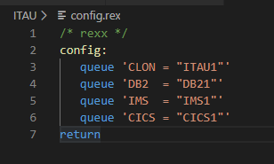
Zowe Featuring ITAU Application Cloning
ooRexx Featuring zowe for Application Cloning
Process Developed in ooRexx.
Simple program with the following Structure:
Read Config File
get_lib_info
load_info
call allocate_files
call load_files

Slide 19
Zowe Featuring ITAU Application Cloning
ooRexx Featuring zowe for Application Cloning
get_lib_info
Retrieve all ITAUMaster Files and store them in a .json file
zowe zos-files list data-set "itaum*" -a --rfj > libraries.json
load_info: Load .json File into M.D.Array
allocate_files
zowe zos-files create data-set-binary
zowe zos-files create data-set-classic
zowe zos-files create data-set-sequential
For VSAM Files I execute a rexx utility to generate IDCAMS Sysin:
zowe tso issue command --ssm “Ex …”
zowe zos-jobs submit local-file temp.jcl --vasc
load_files
zowe zos-files copy data-set
zowe zos-files list all-members

Slide 20
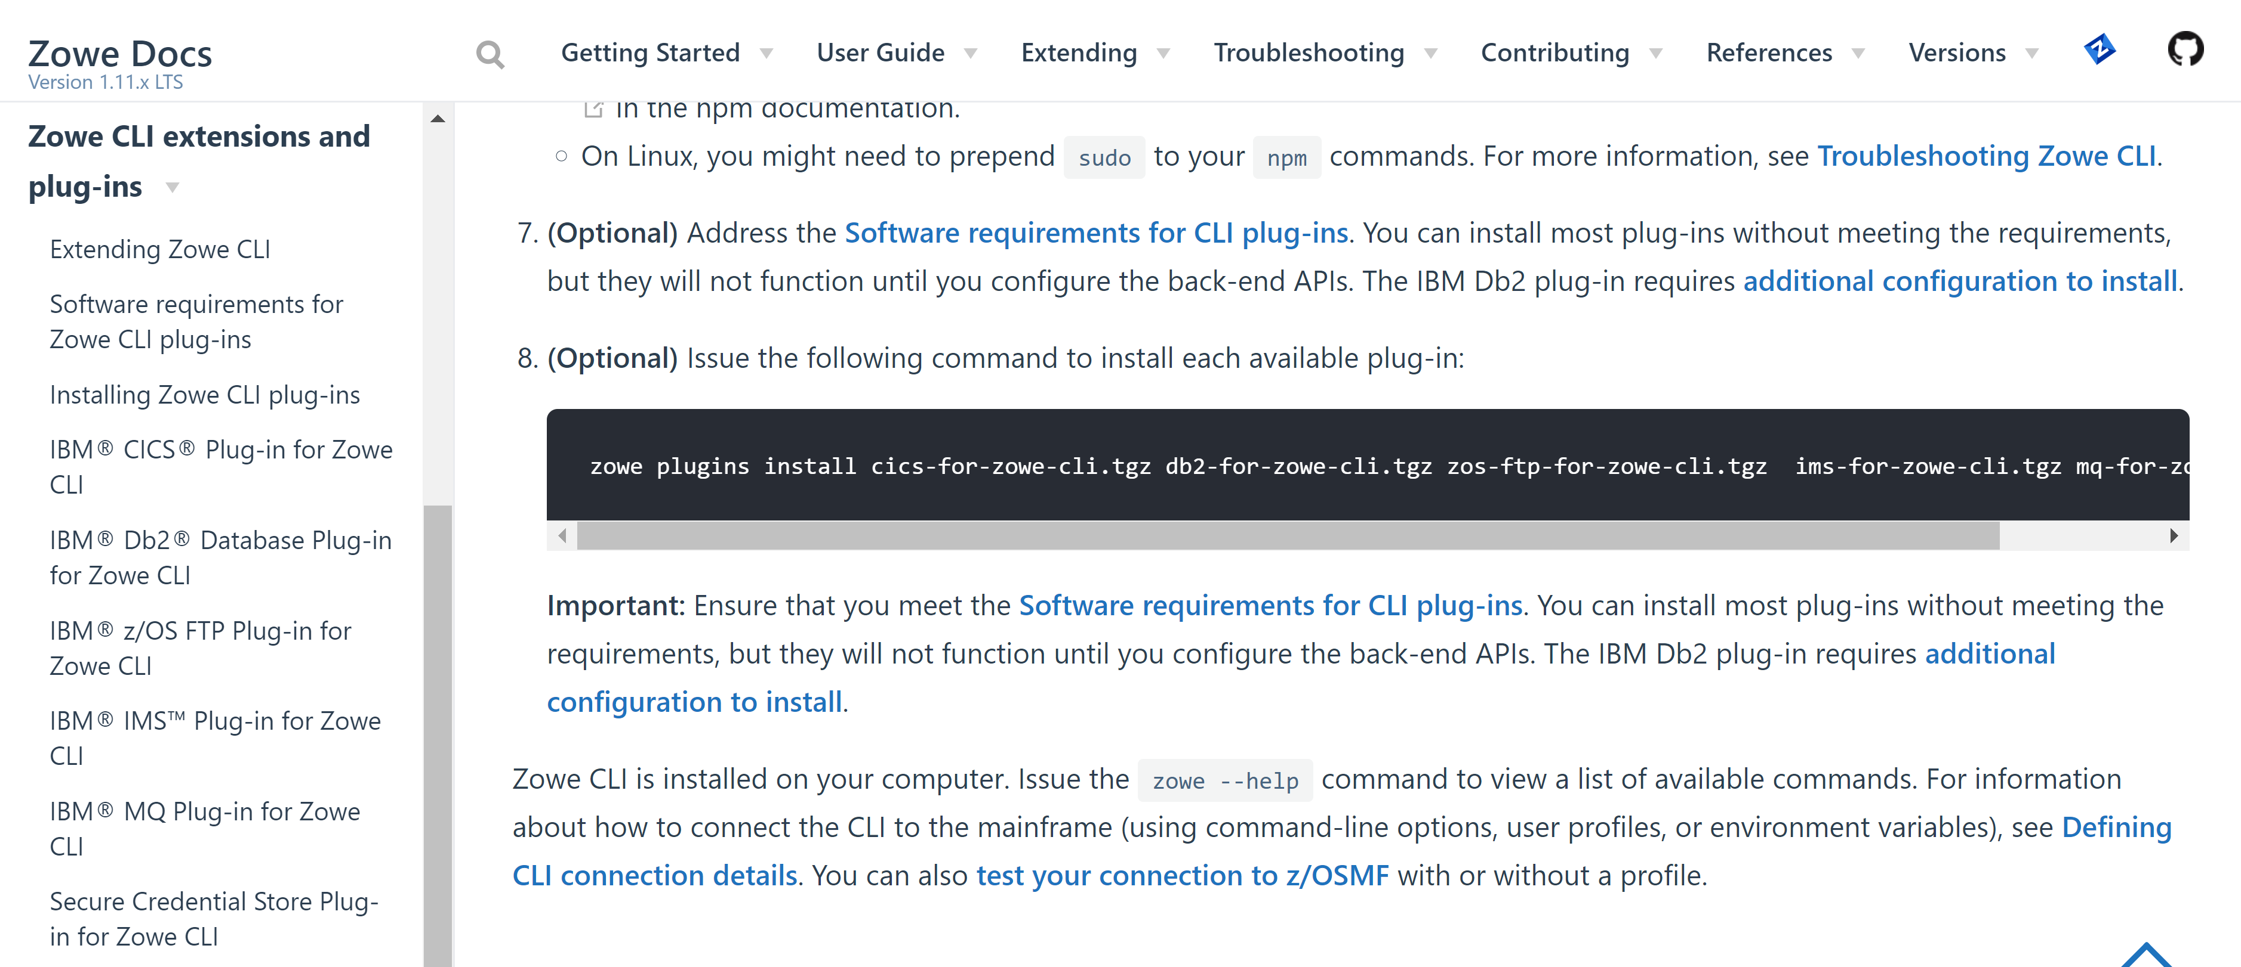
Zowe Plug-in’s documentation – CA-Brightside
https://docs.zowe.org/stable/user-guide/cli-installcli.html#installing-zowe-cli-from-a-local-package

Slide 21
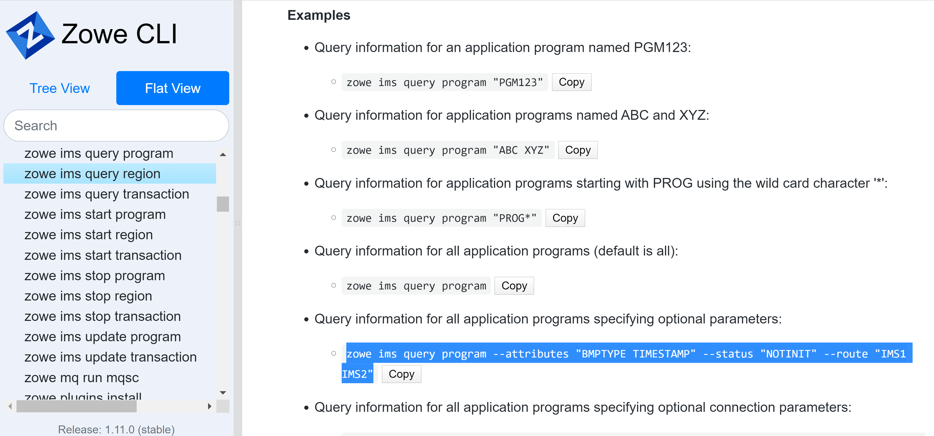
Zowe Plug-in’s documentation – CA-Brightside
https://docs.zowe.org/stable/user-guide/cli-installcli.html#installing-zowe-cli-from-a-local-package

Slide 22
Zowe Featuring ITAU Application Cloning
GitHub Repo with all Data
https://github.com/drb1972/ITAU.git

Slide 23
Obrigado

