Slide 1
ITAÚ Application Cloning Demo
Diego Rodríguez Bravo – EMEA CSC - Madrid
May 2020

Slide 2
Zowe Featuring ITAÚ Application Cloning
Master Schema
Define Txn + Pgm
Install Txn + Pgm
Refresh Pgm
Compile
Link
Deploy
IMS
Objects
CICS
Objects
IMS/CICS
Compile
Link
Deploy
Cobol
Source
Code
PGMO
Batch
Objects
JCLs
PGMB
PDSE
VSAM
PS
CopyBooks
DBRMs
DB2
Bind Package

Slide 3
Zowe Featuring ITAÚ Application Cloning
Master Schema – ITAU MASTER
ITAUM.IMS.LOAD
ITAUM.CICS.LOAD
IMSM/CICM
ITAUM.COBOL
ITAUM.LOAD
ITAUM.JCL
PDSE
ITAUM.*
VSAM
ITAUM.*
PS
ITAUM.*
ITAUM.COPY
ITAUM.DBRM
DB2M

Slide 4
Zowe Featuring ITAÚ Application Cloning
Clone Whole Application System & Infrastructure – Same LPAR
ITAUM.IMS.LOAD
ITAUM.CICS.LOAD
IMSM/CICM
ITAU1.IMS.LOAD
ITAU1.CICS.LOAD
IMS1/CIC1
ITAUM.COBOL
ITAU1.COBOL
ITAU1.LOAD
ITAU1.JCL
ITAUM.LOAD
ITAUM.JCL
PDSE
ITAUM.*
VSAM
ITAUM.*
PS
ITAUM.*
PDSE
ITAU1.*
VSAM
ITAU1.*
PS
ITAU1.*
ITAUM.COPY
ITAUM.DBRM
DB2M
ITAU1.COPY
ITAU1.DBRM
DB21

Slide 5
Zowe Featuring ITAÚ Application Cloning
Pros
Easy to achieve Clone creation
Easy to maintain
Transparent for developers: same names for programs, transaction, tables, JCLs…
Isolated environments
Most changes on infrastructure but easy to automatize
No changes in Programs, Tables, Transactions, Definitions
Customize Compilation & Deployment process to target ITAU1 data sets & libraries and BIND with DB21
Cons
++Resources needed:
Subsystems Management
Same LPAR
ITAUM | ITAU1 | Action
ITAUM.COBOL | ITAU1.COBOL | Create library & Copy Source Programs.
ITAUM.COPY | ITAU1.COPY | Create library & Copy Copybooks
ITAUM.LOAD | ITAU1.LOAD | Create library & Copy Load Objects
ITAUM.IMS.LOAD ITAUM.CICS.LOAD | ITAU1.IMS.LOAD ITAU1.CICS.LOAD | Create library & Copy Load Modules
ITAUM.JCL | ITAU1.JCL | Create library, copy & rename destination libraries from ITAUM.* to ITAU1. Point to DB21 instead DB2M
ITAUM.DBRM | ITAU1.DBRM | Create library & Copy DBRMs
ITAUM.* PDSE / VSAM / PS | ITAU1.* PDSE / VSAM / PS | Create files Copy/Repro & Rename
DB2M | DB21 | Create new DB2 Subsystem; Export Import Tables; Rebind to DB21
IMSM/CICM | IMS1/CIC1 | Define & Install Transactions. Define RCT entries for DB21

Slide 6
Zowe Featuring ITAÚ Application Cloning
Clone Whole Application System & Infrastructure – Same LPAR
ITAUM.IMS.LOAD
ITAUM.CICS.LOAD
IMSM/CICM
ITAUM.COBOL
ITAUM.LOAD
ITAUM.JCL
PDSE
ITAUM.*
VSAM
ITAUM.*
PS
ITAUM.*
ITAUM.COPY
ITAUM.DBRM
DB2M
ITAUM.IMS.LOAD
ITAUM.CICS.LOAD
IMSM/CICM
ITAUM.IMS.LOAD
ITAUM.CICS.LOAD
IMSM/CICM
ITAUM.COBOL
ITAUM.LOAD
ITAUM.JCL
ITAUM.COBOL
ITAUM.LOAD
ITAUM.JCL
PDSE
ITAUM.*
VSAM
ITAUM.*
PS
ITAUM.*
PDSE
ITAUM.*
VSAM
ITAUM.*
PS
ITAUM.*
ITAUM.COPY
ITAUM.DBRM
DB2M
ITAUM.COPY
ITAUM.DBRM
DB2M
ITAUM.IMS.LOAD
ITAUM.CICS.LOAD
IMSM/CICM
ITAUM.COBOL
ITAUM.LOAD
ITAUM.JCL
PDSE
ITAUM.*
VSAM
ITAUM.*
PS
ITAUM.*
ITAUM.COPY
ITAUM.DBRM
DB2M

Slide 7
Zowe Featuring ITAÚ Application Cloning
Clone Whole Application Same LPAR – Shared IMS/CICS + DB2 & Shared Libraries
ITAUM.IMS.LOAD
ITAUM001
ITAU#001
ITAUM.CICS.LOAD
ITAUM002
ITAU#002
IMSM/CICM
IM01 – ITAUM001 IM02 – ITAUM002
I#01 – ITAU#002 I#02 – ITAU#002
PDSE
ITAU#.*
VSAM
ITAU#.*
PS
ITAU#.*
ITAUM.COBOL
ITAUM001
ITAUM002
ITAU#001
ITAU#002
ITAUM.LOAD
ITAUM001
ITAUM002
ITAU#001
ITAU#002
ITAUM.JCL
ITAUM001
ITAUM002
ITAU#001
ITAU#002
PDSE
ITAUM.*
VSAM
ITAUM.*
PS
ITAUM.*
ITAUM.COPY
ITAUM001
ITAUM002
ITAU#001
ITAU#002
ITAUM.DBRM
ITAUM001
ITAUM002
ITAU#001
ITAU#002
DB2M
ITAUM
ITAU#

Slide 8
Zowe Featuring ITAÚ Application Cloning
Pros
No need for creation infrastructure (share same subsystems)
No changes at all in IMS/CICS infrastructure
Customize Compilation & Deployment process to target ITAU# data sets and BIND with DB2#
Cons
Difficult when deploying to Production (rename of programs & recompile)
Extra work for developers: Need to manage different names for programs, transaction, tables, JCLs… than the Master application
Changes may be required for static calls in Programs
ITAUM | ITAU1 | Action
ITAUM.COBOL | Same library | Copy & Rename Source Programs from ITAUM* to ITAU# Attention with calls to subprograms: static or dynamic
ITAUM.COPY | Same library | Copy & Rename Copybooks. Update programs with modified copybook names
ITAUM.LOAD | Same library | Compile all ITAU# programs
ITAUM.IMS.LOAD ITAUM.CICS.LOAD | Same libraries | Compile all ITAU# programs
ITAUM.JCL | Same libraries | Copy & rename JCLs. Change destination libraries from ITAUM.* to ITAU#. Point to DB2# instead DB2M Modify names of programs.
ITAUM.DBRM | Same libraries | Generated when compiled
ITAUM.* PDSE / VSAM / PS | ITAU#.* PDSE / VSAM / PS | Create Copy/Repro & Rename
DB2M | DB2# | Create new DB2 Tables; Export Import Tables; Rebind to DB2#
IMSM/CICM | Same Subsystems | Define & Install Transactions & RCT entries for DB21

Slide 9
Zowe Featuring ITAÚ Application Cloning
Clone Whole Application Same LPAR– Shared IMS/CICS + DB2 NOT Shared Libraries
ITAU1.IMS.LOAD
ITAU1001
ITAU1.CICS.LOAD
ITAU1002
IMSM/CICM
IM01 – ITAUM001 IM02 – ITAUM002
I101 – ITAU1002 I102 – ITAU1002
I201 – ITAU2001 I202 – ITAU2002
ITAUM.IMS.LOAD
ITAUM001
ITAUM.CICS.LOAD
ITAUM002
ITAU2.IMS.LOAD
ITAU2001
ITAU2.CICS.LOAD
ITAU2002
PDSE
ITAU1.*
VSAM
ITAU1.*
PS
ITAU1.*
ITAU1.COBOL
ITAU1001
ITAU1.LOAD
ITAU1001
ITAU1.JCL
ITAU1001
ITAUM.COBOL
ITAUM001
ITAUM.LOAD
ITAUM001
ITAUM.JCL
ITAUM001
ITAU2.COBOL
ITAU2001
ITAU2.LOAD
ITAU2001
ITAU2.JCL
ITAU2001
PDSE
ITAUM.*
VSAM
ITAUM.*
PS
ITAUM.*
PDSE
ITAU2.*
VSAM
ITAU2.*
PS
ITAU2.*
ITAU2.COPY
ITAU2001
ITAU1.DBRM
ITAU1001
DB2M
ITAUM.DBRM
ITAUM001
ITAUM
ITAU1
ITAUM.COPY
ITAUM001
ITAU1.COPY
ITAU1001
ITAU2.DBRM
ITAU2001
ITAU2

Slide 10
Zowe Featuring ITAÚ Application Cloning
Pros
Same as before
+more isolated libraries. Different Development teams don’t share.
Probably easier Scheduler Management
Cons
Same as before
More libraries to manage (not more storage, it is the same).
ITAUM | ITAU1 | Action
ITAUM.COBOL | ITAU#.COBOL | Create library, Copy & Rename Source Programs from ITAUM* to ITAU# Attention with calls to subprograms: static or dynamic
ITAUM.COPY | ITAU#.COPY | Copy & Rename Copybooks. Update programs with modified copybook names
ITAUM.LOAD | ITAU#.LOAD | Create library & Compile all ITAU# programs
ITAUM.IMS.LOAD ITAUM.CICS.LOAD | ITAU#.IMS.LOAD ITAU#.CICS.LOAD | Create libraries & Compile all ITAU# programs
ITAUM.JCL | ITAU#.JCL | Create library, Copy & rename JCLs. Change destination libraries from ITAUM.* to ITAU#. Point to DB2# instead DB2M Modify names of programs.
ITAUM.DBRM | ITAU#.DBRM | Create library. DBRMs will be Generated when compiled
ITAUM.* PDSE / VSAM / PS | ITAU#.* PDSE / VSAM / PS | Create Copy/Repro & Rename
DB2M | DB2# | Create new DB2 Tables; Export Import Tables; Rebind to DB2#
IMSM/CICM | Same Subsystems | Define & Install Transactions & RCT entries for DB2#

Slide 11
Zowe Featuring ITAÚ Application Cloning
What method is better
All of them. It all depends on:
Number of application clones
Number of different applications involved
Infrastructure constraints and limitations
Teams involved
There are many possible solutions besides the ones just presented:
Clone only changing artifacts: i.e. playing with STEPLIBs
//STEPLIB DD DSN=ITAU#.LOAD,DISP=SHR
// DD DSN=ITAUM.LOAD,DISP=SHR
…
Playing with different DB2 Collections, Plans, ..
Use temporary data files cloned from Master just for execution and deleted right after

Slide 12
Zowe Featuring ITAÚ Application Cloning
How can we use zowe to manage the process of cloning a Master application
The same as in the z/OS environment, there are several ways to involve zowe
For file creation:
Execute:
zowe zos-files create bin ITAU1.LOAD --bs 27998 --rf U --rl 27998 --sz 10CYL --ss 10
Create a customized JCL with the help of a script and:
Submit it locally from our zowe workstation client:
zowe zos-jobs submit local-file ./jcls/create_libs.jcl --vasp
Upload the JCL to the mainframe & submit it remotely:
zowe zos-files upload file-to-data-set "./jcls/create_libs.jcl" "ITAU1.JCL(CREALIB)“
zowe zos-jobs submit data-set "ITAU1.JCL(CREALIB)“ –vasc
To rename the program members:
zowe zos-files list all-members “ITAU.COBOL“
Get all member names and issue as much commands as member in the file:
zowe zos-files rename data-set-member “ITAU1.COBOL" “ITAUM001" “ITAU1001”
…
But we could also download the data set, rename the files & upload it again via built-in script functions:
zowe zos-files download all-members "ITAU1.COBOL“
Locally rename the files
zowe zos-files upload dir-to-pds "./itau1/cobol/" "ITAU1.COBOL"

Slide 13
Demo

Slide 14
Zowe Featuring ITAÚ Application Cloning
Use Case achieved with zowe, ooRexx & Jenkins - IMS/CICS NOT Shared Libraries
ITAUM.IMS.LOAD
ITAUM001
IMSM/CICM
IM01 – ITAUM001
IM02 – ITAUM002
IMS#/CIC#
I#01 – ITAU#001
I#02 – ITAU#002
ITAU#.IMS.LOAD
ITAU#001
ITAUM.CICS.LOAD
ITAUM002
ITAU#.CICS.LOAD
ITAU#002
ITAUM.COBOL
ITAUM001
ITAUM002
ITAUM.LOAD
ITAUM001
ITAUM002
ITAUM.PDS1
ITAUM.PDS2
ITAUM.PS1
ITAUM.PS2
ITAUM.VSAM1
ITAU#.PDS1
ITAU#.PDS2
ITAU#.PS1
ITAU#.PS2
ITAU#.VSAM1
ITAU#.LOAD
ITAU#001
ITAU#002
ITAU#.COBOL
ITAU#001
ITAU#002
ITAUM.COPY
ITAUM001
ITAUM002
ITAUM.JCL
ITAUM001
ITAUM002
ITAUMCMP
ITAU#.JCL
ITAU#001
ITAU#002
ITAU#CMP
ITAU#.COPY
ITAU#001
ITAU#002
ITAUM.DBRM
ITAUM001
ITAUM002
DB2M
ITAUM
ITAU#
ITAU#.DBRM
ITAU#001
ITAU#002

Slide 15
Zowe Featuring ITAÚ Application Cloning
Use Case for ITAU - Process
Application Libraries
ITAU#.COBOL
Create Library like MASTER
Copy programs from Master ITAUM.COBOL
Rename members from ITAUM* to ITAU#*
Search & Update chars ITAUM to ITAU# (will update program name, copybooks and static calls)
ITAU#.COPY
Create like MASTER
Rename members from ITAUMC* to ITAU#C*
ITAU#.DBRM
Create like MASTER
ITAU#.JCL
Create Library like MASTER
Create & load a Generic JCL for compilation + LNK + Deploy + BIND + CICS Refresh
ITAU#.LOAD – ITAU#.IMS.LOAD – ITAU#.CICS.LOAD
Create Libraries Like Master
Compile Programs from ITAU#.COBOL to generate objects & DBRMs

Slide 16
Zowe Featuring ITAÚ Application Cloning
Use Case for ITAU - Process
Application Libraries
Create like Master and copy/repro data:
ITAU#.PDS1
ITAU#.PDS2
ITAU#.PS1
ITAU#.PS2
ITAU#.VSAM1
IMS/CICS
System Programmer to set environments, define transactions, RCTs …
Link ITAU#.IMS.LOAD & ITAU#.CICS.LOAD libraries to subsystems
DB2
DBA to set environment for ITAU# tablespaces. Copy data from ITAUM tables

Slide 17
Show process …

Slide 18
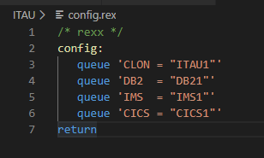
Zowe Featuring ITAÚ Application Cloning
ooRexx Featuring zowe for Application Cloning
Process Developed in ooRexx.
Simple program with the following Structure:
Read Config File
get_lib_info
load_info
call allocate_files
call load_files

Slide 19
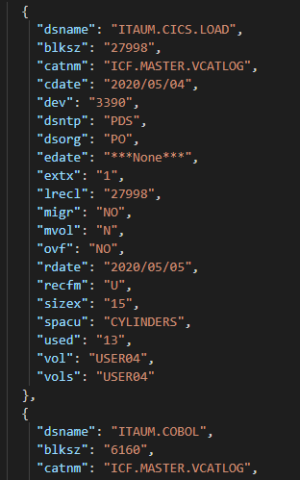
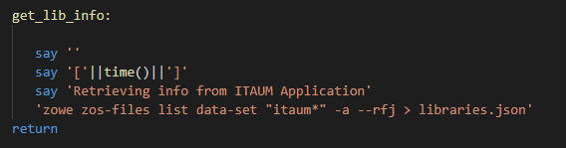
Zowe Featuring ITAÚ Application Cloning
ooRexx Featuring zowe for Application Cloning
get_lib_info
Retrieve all ITAUMaster Files and store them in a .json file

Slide 20
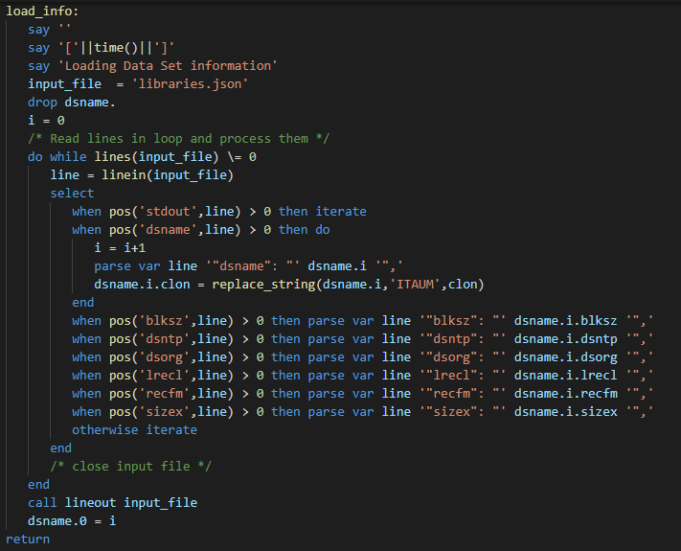
Zowe Featuring ITAÚ Application Cloning
ooRexx Featuring zowe for Application Cloning
load_info

Slide 21
Obrigado

