Slide 1
Chapter 01
An Overview of the Web

Slide 2
Learning Outcomes
By the end of this chapter, you'll be able to:
  Interact with and understand request/response cycles
  Debug web applications using browser tools
  Interpret protocols for client-server communication
  Deal with accepted and error codes from servers
  Create RESTful resources for scalability and caching

Slide 3
Key Terms and Concepts
Protocol - Rules for communication
Client/Server - Architecture pattern
Request/Response - Communication cycle
Methods/Verbs - HTTP actions (GET, POST, etc.)
Stateless Communication - Independent requests
REST - Representational State Transfer
CDNs - Content Distribution Networks

Slide 4
A Little History

Slide 5
CERN
Conseil Européen pour la Recherche Nucléaire
  1983: The discovery of W and Z bosons
  1989: The determination of the number of light neutrino families
  1999: The discovery of direct charge conjugation parity symmetry violation
  2000: Discovered a new state of matter, the Quark Gluon Plasm
  2012: A boson with mass around 125 GeV/c2 consistent with the long-sought Higgs boson

Slide 6
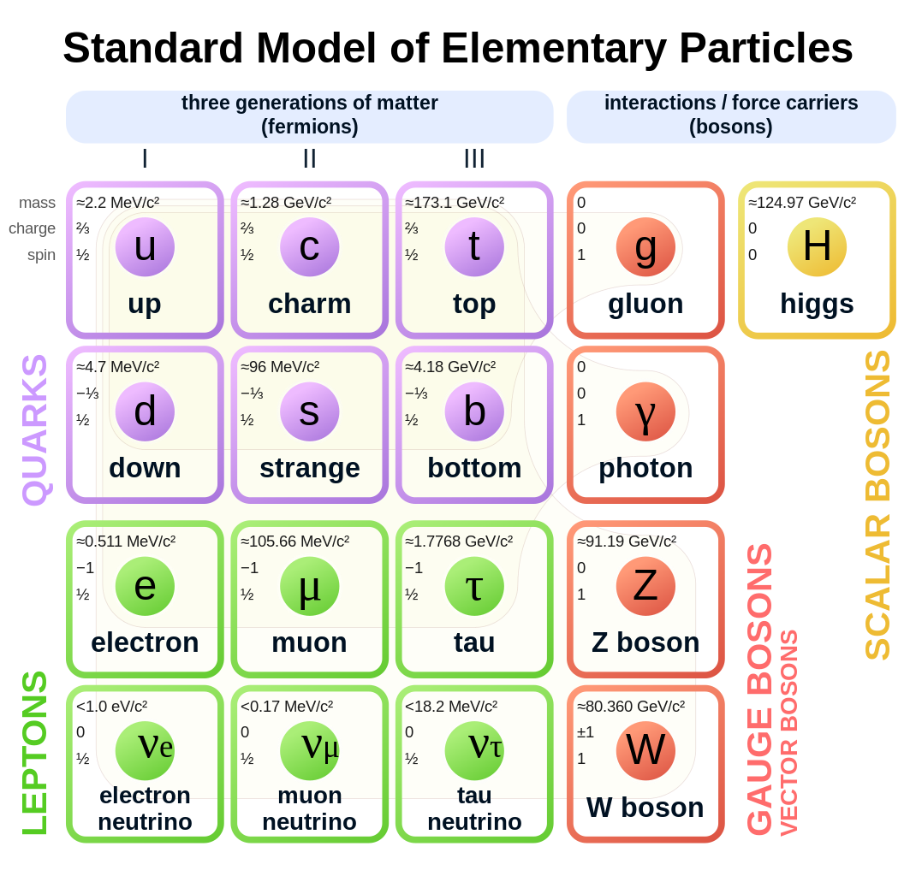

Slide 7

Notes:
By Coolcaesar at the English-language Wikipedia, CC BY-SA 3.0, https://commons.wikimedia.org/w/index.php?curid=395096

Slide 8
NeXT
Founded in 1985 by CEO Steve Jobs
~50,000 made
Apple purchased NeXT in 1997 for $427 million
macOS based on NexTSTEP
  The kernel of NeXTSTEP is based upon the Mach kernel, which was originally developed at Carnegie Mellon University

Slide 9
TimBL
The original idea of the web was that it should be a collaborative space where you can communicate through sharing information. - Tim Berners-Lee

Slide 10
Introduction
The web is pervasive and easy to use, but web developers need deep knowledge of its underpinnings.
What We'll Cover:
  History and evolution of the web
  HTTP protocol and its three versions
  Methods, headers, requests, and responses
  Cookies and MIME types
  Browser tools for development and debugging

Slide 11
Tim Berners-Lee at CERN (1990)
Made the internet accessible to everyone for the first time!
Before the Web
  Internet was difficult to use
  Finding and sharing information was hard
  FTP required exact server and directory knowledge
  WAIS and Gopher were alternatives, but fell from favor

Slide 12
TimBL's Brilliant Combination
SGML/HTML - Describe document relationships
Hypertext & URLs - Connect documents via links
Client/Server & HTTP - Communication protocol
TCP/IP & Internet - Networking foundation
Result: ~70% of the world's population now uses the web

Slide 13
Explosive Growth
1990: 1 user (Tim Berners-Lee)
2025: ~7 billion users
Doubling of users every year
IoT devices now exceed Earth's population
Almost all IoT devices are accessible through the web

Slide 14
Evolution of Browsers
Nexus (CERN) - First browser, also an editor
Mosaic (NCSA/UIUC) - Popularized the web
Netscape Navigator - Evolved from Mosaic
Firefox - Based on Navigator, uses Gecko engine
Safari - Apple's WebKit engine
Chrome - Google's Blink engine (from WebKit)
Edge - Microsoft switched to Blink

Slide 15
Web Standards
W3C (World Wide Web Consortium):
  Oversees ~40 different standards
  CSS, DOM, HTML, SVG, XML, …
  All modern rendering engines comply
ECMA International:
  JavaScript standards (ECMAScript) ECMA-262

Slide 16
Browser Tools

Slide 17
Chrome DevTools
Access: Shift-Ctrl-I (Windows/Linux) or Option-Cmd-I (Mac)
  Or: More Tools → Developer Tools
Also Available
  View Page Source - Right-click (or Ctrl-click on Mac) on any page
  One benefit: Learn from others' HTML/CSS/JavaScript

Slide 18
Elements Tab
Explore HTML and CSS for the page
Hover over page elements to see their HTML/CSS
Hover over HTML in DevTools to highlight on page
Edit CSS live and see effects immediately
Perfect for debugging layout issues

Slide 19
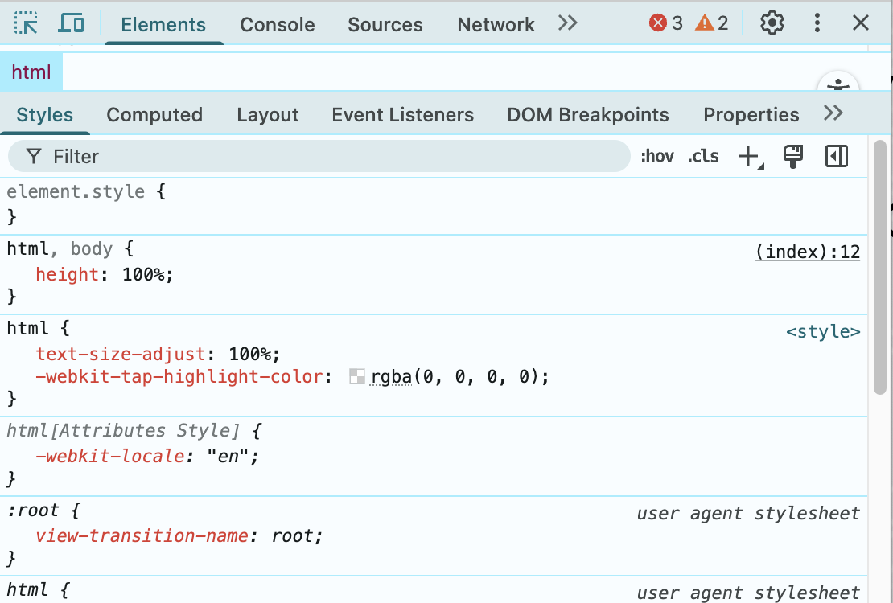

Slide 20
Console Tab
Critical for JavaScript debugging
  JavaScript errors appear here
  Type and execute JavaScript directly
  See results immediately
  Test code snippets without modifying files
console.log("Hello, world!");

Slide 21
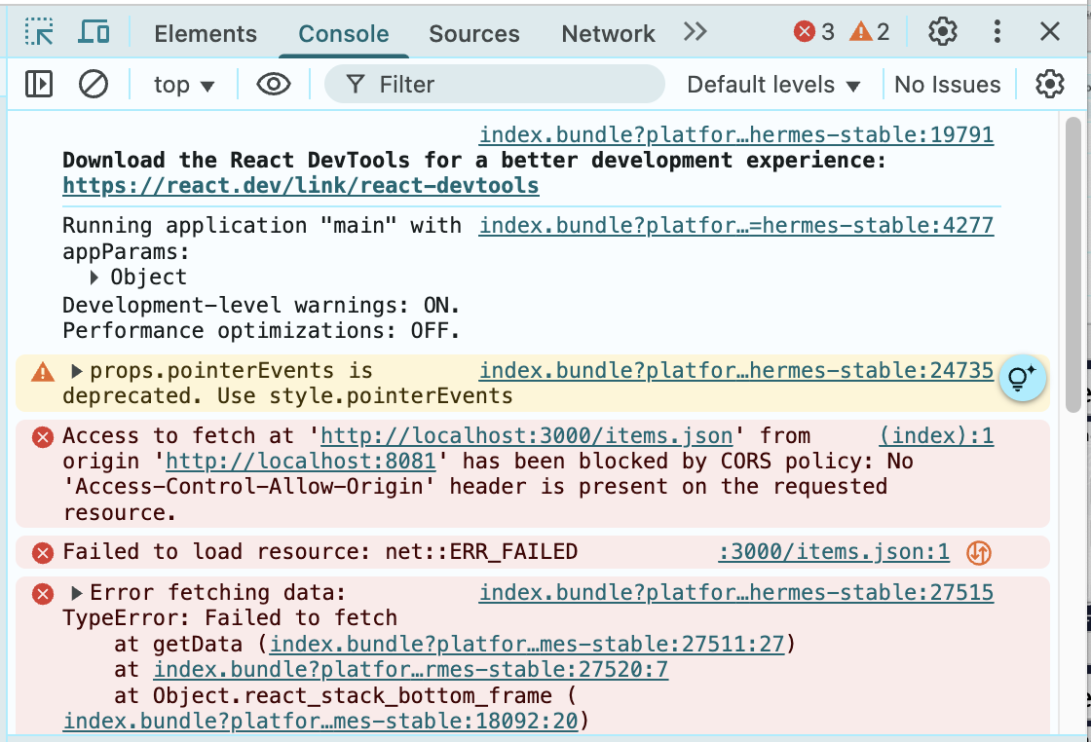

Slide 22
Sources Tab
Shows various data source locations
View all files loaded by the page
Set breakpoints for debugging
Step through JavaScript execution
Add your own sources for testing

Slide 23
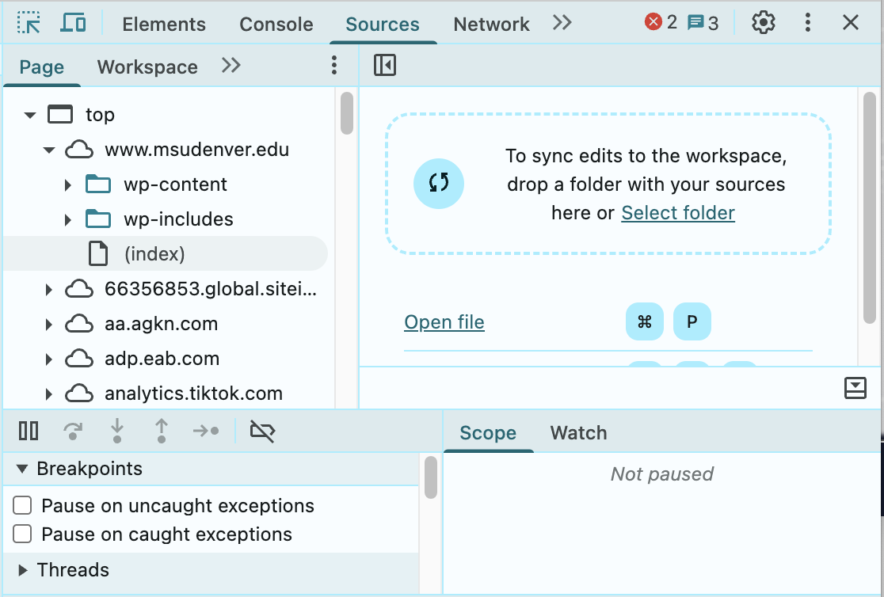

Slide 24
Network Tab
Find performance bottlenecks
  Shows where data was loaded from
  How long each request took
  Identifies network latency issues
  Helps determine what to cache
  Essential for optimization

Slide 25
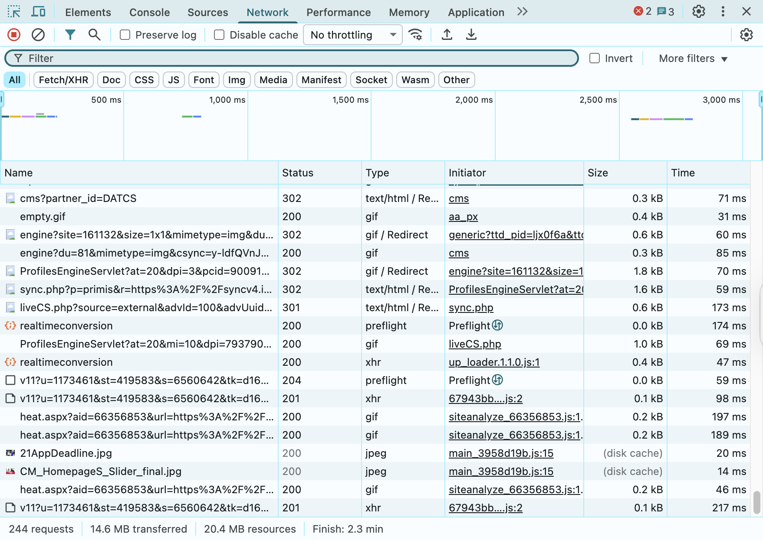

Slide 26
Performance & Application Tabs
Performance Tab
  CPU/GPU/memory usage
  Rendering performance metrics
  Frame rate analysis
Application Tab
  Local and session storage
  Web application databases
  Background services and workers
  Cache inspection

Slide 27
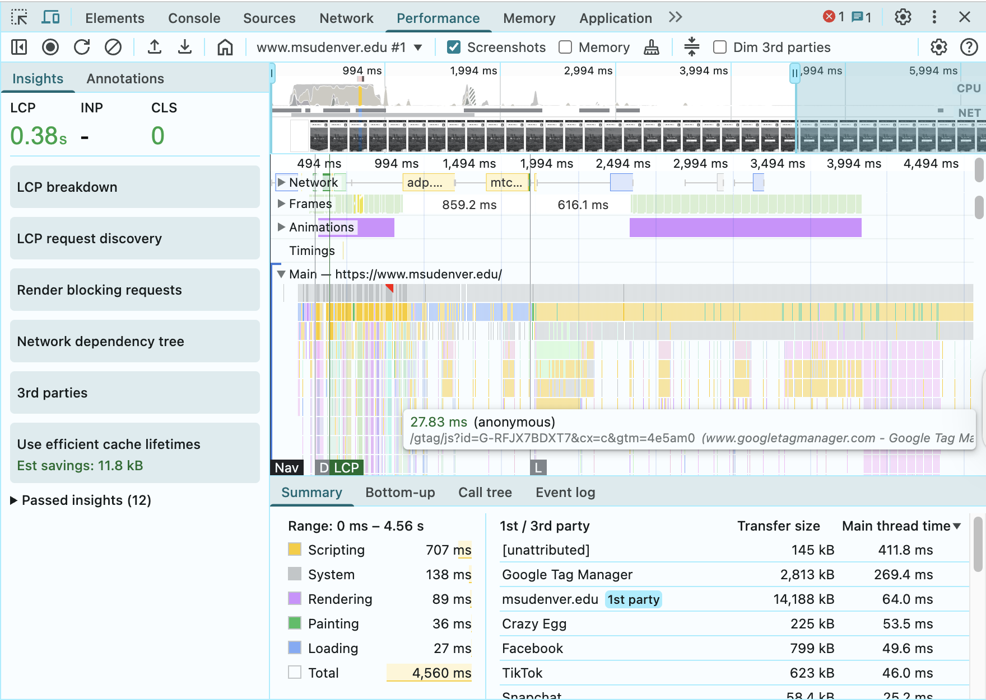
Performance

Slide 28
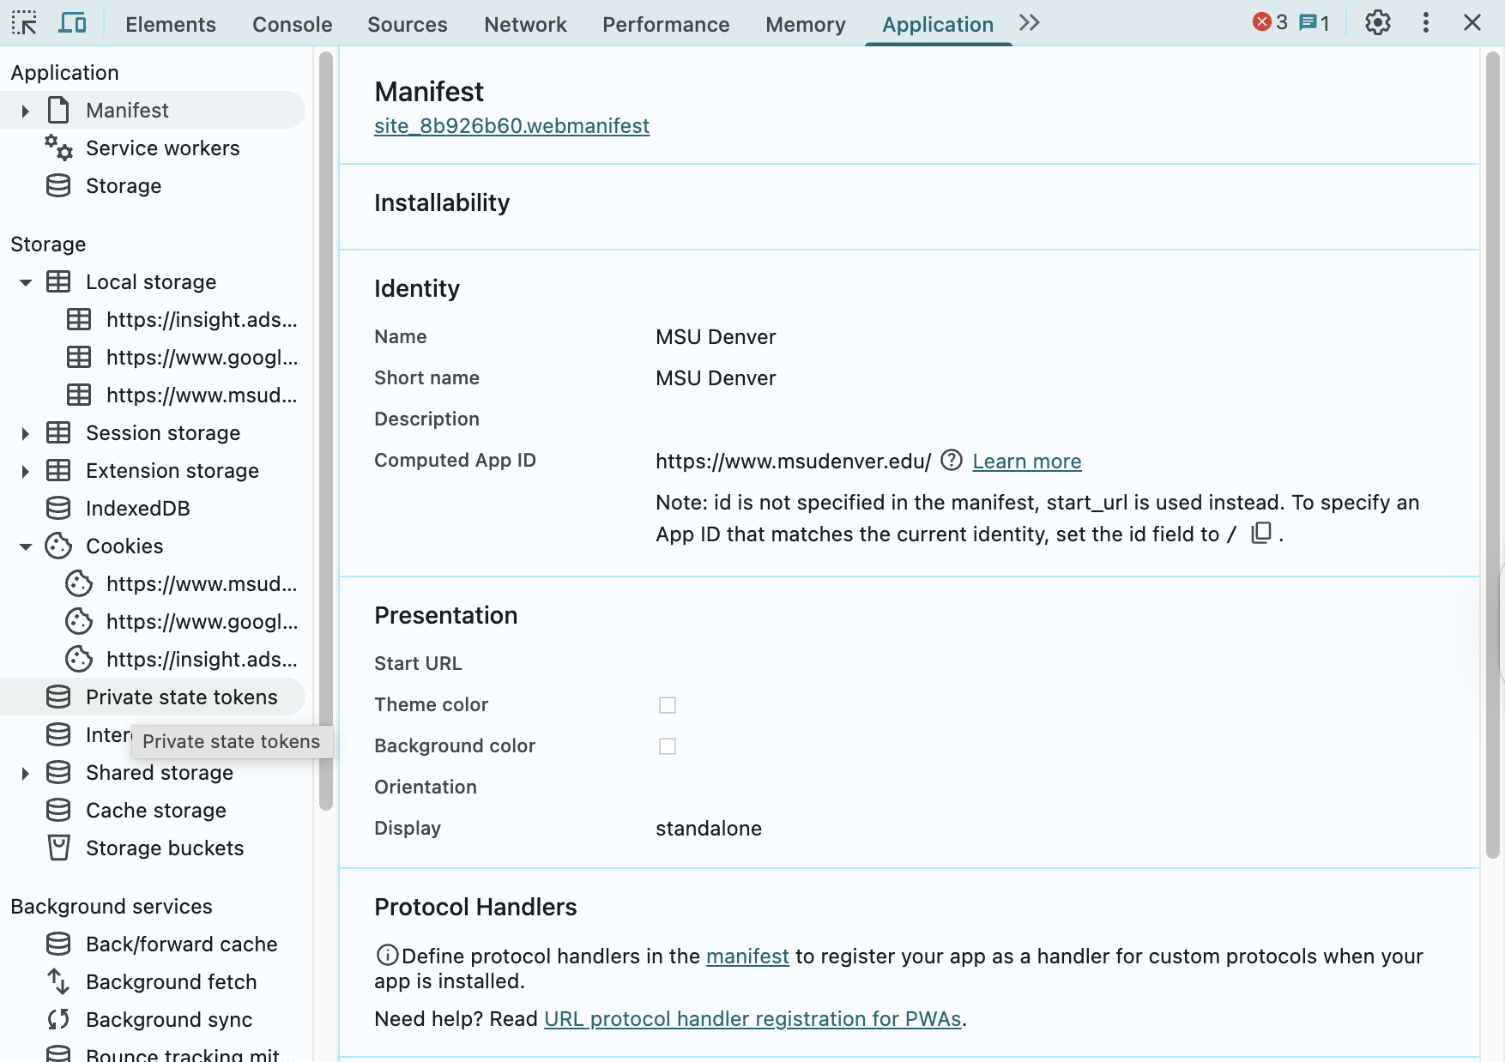
Application

Slide 29
Security Tab
Check if connection is encrypted
Verify certificate trust
View certificate details
Identify security vulnerabilities

Slide 30
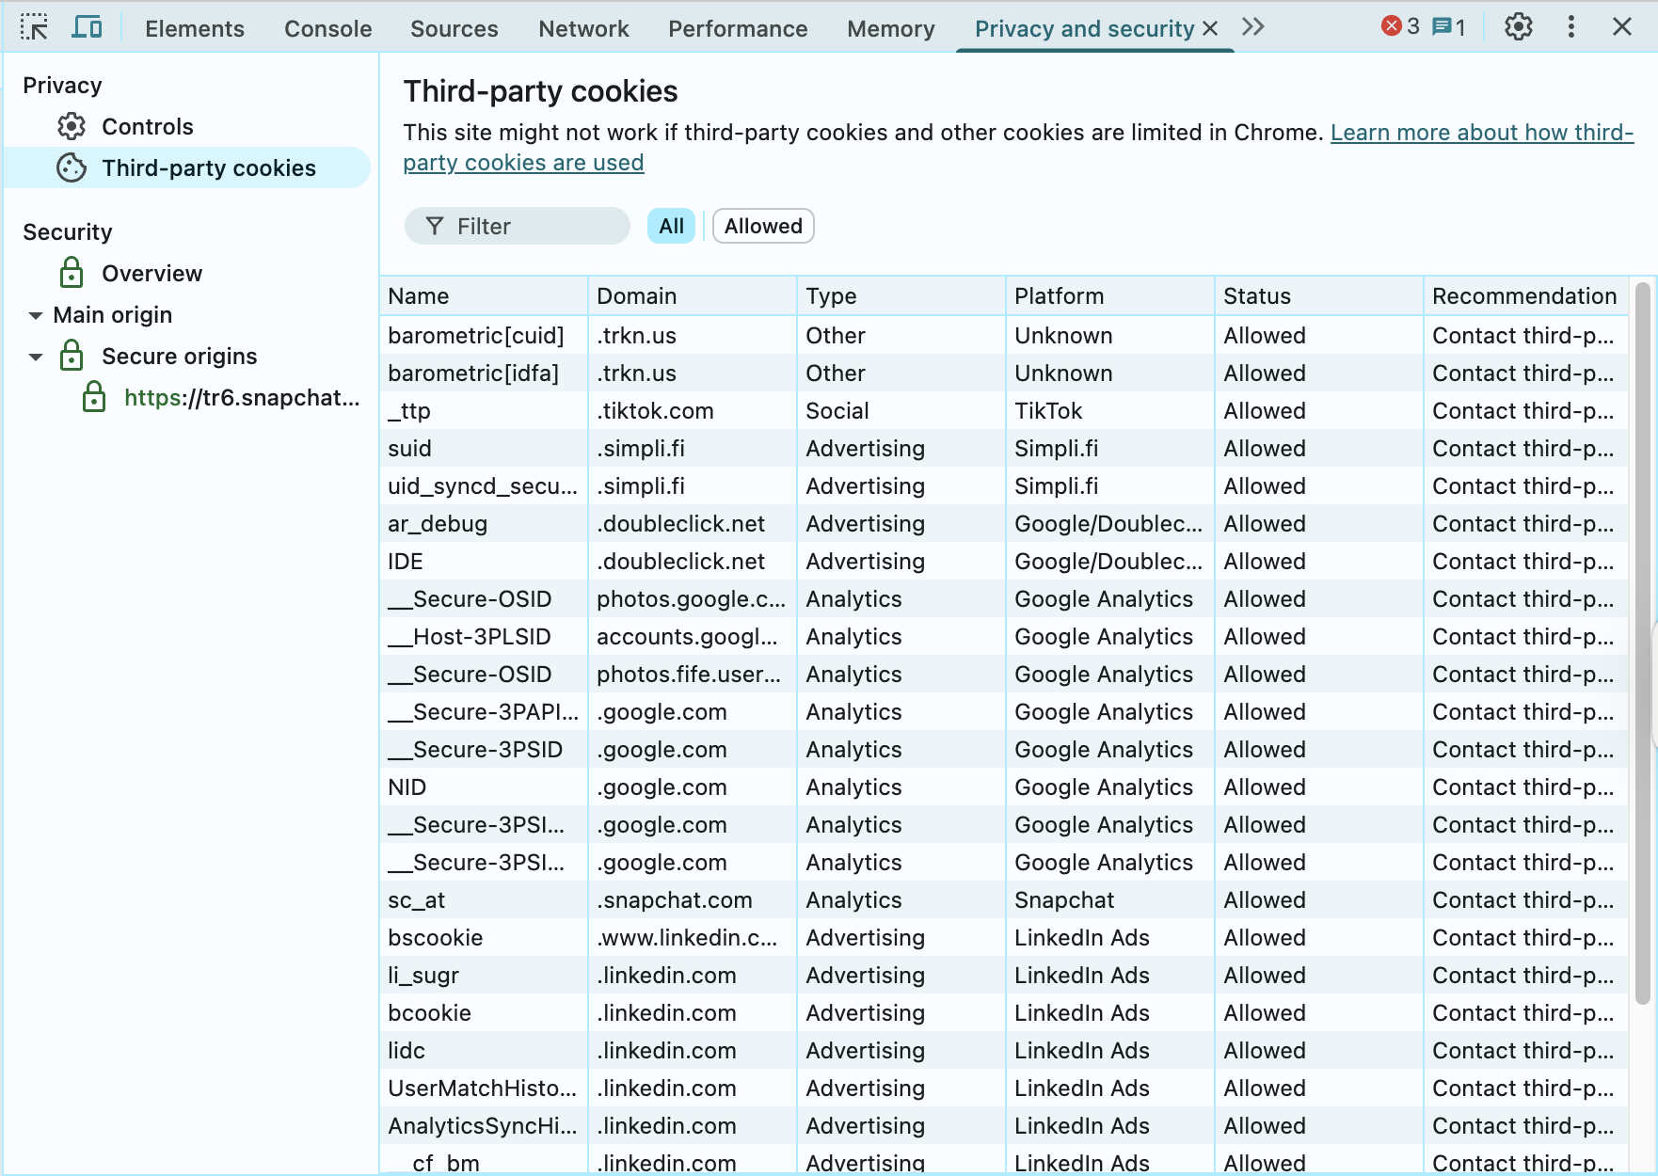

Slide 31
HTTP

Slide 32
Hypertext Transfer Protocol
Application-layer network protocol
Very flexible and powerful
Has subsumed many other protocols
Now in its third version
Core concepts remain unchanged

Slide 33
Understanding Protocols
Like diplomatic protocol officers who know acceptable communication for each country…
Computers need protocol specifications to communicate effectively.
HTTP Specification:
  Defined in RFCs (Request For Comments)
  Major way protocols are codified on the internet
  HTTP/1.1: RFC 2616

Slide 34
Three Versions of HTTP
HTTP/1.1 - Text transfer, independent requests
HTTP/2 - Pipelining, server push
HTTP/3 - QUIC protocol, faster
Methods, status codes, and most headers remain the same

Slide 35
HTTP/1.1
Designed to transfer text documents
Each request/response cycle is independent
New cycle needed for each page element
TCP/IP connection overhead (three-way handshake)
Slows down pages with many resources

Slide 36
HTTP/2
Key Improvements
  Pipelining - Stay connected to fetch multiple elements
  Server push - Server sends resources before client asks
  Speeds up page loading significantly
Note: Not for sessions/authentication - that uses cookies

Slide 37
HTTP/3
Changes transport from TCP to QUIC
QUIC layered on UDP (User Datagram Protocol)
Further increases web speed
Methods, status codes, headers unchanged

Slide 38
Requests

Slide 39
Anatomy of a Request
All requests follow this form:
  <method> <request-URI> HTTP/<version>
Example:
  GET / HTTP/1.1
Followed by
  Header lines (details about the request)
  Blank line (CR+LF)
  Body (optional)

Slide 40
URIs and URLs
URI - Uniform Resource Identifier (general)
URL - Uniform Resource Locator (specific type of URI)
Resources may be actual files OR generated dynamically
Important for ReSTful architecture

Slide 41
HTTP Methods (Verbs)
Note: Method names are in ALL CAPITALS
GET - Request a resource
HEAD - Request only headers
POST - Add a resource to collection
PUT - Replace/create a resource
PATCH - Modify parts of a resource
DELETE - Remove a resource

Slide 42
Safe and Idempotent
Safe: resource is not modified on the server
Idempotent: same result no matter how many times it's called
Safe and Idempotent: GET, HEAD
Idempotent only: PUT, PATCH, DELETE
Neither: POST

Slide 43
GET Method
Request a resource from the server
Properties
  Safe - Resource not modified on server
  Idempotent - Same result no matter how many times called
  Perfect for caching
  First response works for all subsequent requests
  CDNs can respond on behalf of origin server

Slide 44
HEAD Method
Request only the header, not the message body
Use Cases
  Check if large resource has changed
    Now usually use “if-modified-since”
  Verify resource exists before downloading
  Get metadata about a resource
Properties
  Safe
  Idempotent

Slide 45
POST Method
Add a resource to a collection
Characteristics:
  Message body becomes child node of request URI
  NOT safe (creates new resources)
  NOT idempotent (multiple POSTs create multiple resources)
  Should be used to create new resources

Slide 46
PUT Method
Modify or create a specific resource
Different from POST
  POST: Request doesn't specify resource, appends
  PUT: Specifies exact resource, replaces
  Creates resource if it doesn't exist
Properties
  NOT safe
  Idempotent

Slide 47
PATCH and DELETE Methods
PATCH
  Modify existing resource
  Usually only certain attributes
  Doesn't replace entire resource
  Idempotent
DELETE
  Remove the specified resource
  Idempotent

Slide 48
Rails Routes
$ rails new Todos --minimal
$ cd Todos
$ rails generate scaffold Item what:string when:date
$ rails db:migrate
Rails differentiates actions based on methods and URIs

Slide 49
$ rails routes
Prefix Verb URI Pattern Controller#Action
items GET /items(.:format) items#index
POST /items(.:format) items#create
new_item GET /items/new(.:format) items#new
edit_item GET /items/:id/edit(.:format) items#edit
item GET /items/:id(.:format) items#show
PATCH /items/:id(.:format) items#update
PUT /items/:id(.:format) items#update
DELETE /items/:id(.:format) items#destroy

Slide 50
Request Headers

Slide 51
Accept Header
Describes what the client can accept (MIME types)
Accept: text/html,application/xhtml+xml, application/xml;q=0.9,image/avif, image/webp,image/apng,*/*;q=0.8
Comma-separated MIME types
  q= parameter: quality/preference (0-1)
  If q not specified, defaults to 1
  */* means willing to accept any type

Slide 52
MIME Types
Multipurpose Internet Mail Extensions
Format: type/subtype
text/html - HTML documents
image/jpeg, image/png, image/gif - Images
video/mpeg - Videos
audio/mp3 - Audio
application/javascript - JavaScript
application/pdf - PDF documents

Slide 53
Vendor-Specific MIME Types
application/vnd.ms-excel - Excel files
  "vnd" stands for vendor-specific formats
application/octet-stream - Binary data
  Leaves it to client to decide how to render
“x-” experimental

Slide 54
Accept-Encoding Header
What compression types can be accepted
Accept-Encoding: gzip, deflate, br
  gzip - GNU zip compression
  deflate - Deflate algorithm
  br - Brotli compression
Compression reduces bandwidth and speeds up page loads

Slide 55
Accept-Language Header
Request results in specific language
  Accept-Language: en-US,en;q=0.9
Many websites are multilingual
Return results based on client preference
en-US = United States English
Can specify multiple with preferences

Slide 56
Caching directives for the request
  Cache-Control: no-cache
  Pragma: no-cache
no-cache - Fetch from origin, not intermediate caches
Many complex directives available
Control how responses are cached

Slide 57
Connection Header
Control TCP/IP connection behavior
  Connection: keep-alive
keep-alive - Keep connection open for multiple requests
Reduces time for subsequent requests
Required for HTTP/1.0
Default in HTTP/1.1 and beyond
Can specify close if no more requests are coming

Slide 58
Host Header
Required in HTTP/1.1
  Host: localhost:3000
Why Required?
  Single machine (IP address) can host many sites
  Called virtual hosting
  Client must declare which site it wants

Slide 59
User-Agent Header
Identifies who is apparently requesting the resource
  User-Agent: Mozilla/5.0 (Macintosh; Intel Mac OS X 10_15_7) AppleWebKit/537.36 (KHTML, like Gecko) Chrome/108.0.0.0 Safari/537.36
Servers can give different results for different clients
Browser states compatibility with multiple engines
Requests can lie
Useful for analytics and compatibility

Slide 60
X- Headers (Extensions)
Headers beginning with X- are extensions
  Not (yet?) codified in HTTP protocol
  Provide additional useful information
  Used by both requests and responses
  Can be application-specific

Slide 61
Request Body
- GET - Typically empty body
- POST/PUT - Contains resource information
Body May Contain
  Key/value pairs from a form
  JSON data
  Files to be uploaded
  Other structured data

Slide 62
Response Headers

Slide 63
Anatomy of a Response
Similar form to requests:
  HTTP/<version> <status code> <message>
Example:
  HTTP/1.1 200 OK
Followed by:
- Header lines
- Blank line
- Body (the actual resource)

Slide 64
HTTP Status Codes
Five major categories (100-599)
  1xx - Informational
  2xx - Success
  3xx - Redirection
  4xx - Client Errors
  5xx - Server Errors

Slide 65
100 Codes: Informational
No message bodies
Signal client to continue
Server can process the request
May suggest alternative data transfer approach
Rarely seen in typical web applications

Slide 66
200 Codes: Success
200 OK - Request Successful
  GET - Body contains requested resource
  HEAD - Only header fields returned
  Other methods - Headers and body describe result
Other 200 Codes:
  Request accepted
  Additional action may (or may not) be required

Slide 67
300 Codes: Redirection
Client must send additional request to new URI
  301 Moved Permanently
  302 Found (Temporary)
  303 See Other
  304 Not Modified

Slide 68
301 Moved Permanently
Resource moved permanently
Subsequent requests should use new URI
Returns the resource on GETs
New URI specified in Location header
Response is cacheable (never changes)

Slide 69
302 Found and 303 See Other
302 Found
  Resource found and returned
  Result is temporary
  Continue using original URI
  Respects caching headers
303 See Other
  Redirect POST results to GET
  Submit form (POST) → retrieve new data (GET)

Slide 70
304 Not Modified
Important for caching
  Response to conditional GET
  Cached copy is current with origin
  Use cached version
  Dramatically increases rendering speed
  No body sent (saves bandwidth)

Slide 71
Strong vs Weak Validators
Etags on resources specify how to compare previous and current
Strong Validators
  Two versions are bit-by-bit identical
Weak Validators
  Semantically equivalent, but not bit-by-bit
  Some values "good enough"
  Example: Article view count
  ETags starting with W/ specify weak validation

Slide 72
400 Codes: Client Errors
400 Bad Request - Server doesn't understand syntax
401 Unauthorized - Authentication required
403 Forbidden - Understood but not permitted
404 Not Found - Resource doesn't exist
405 Method Not Allowed - Wrong HTTP method
406 Not Acceptable - Wrong format requested

Slide 73
404 Not Found
The most famous error code
Resource doesn't exist on server
Covers a wide variety of client errors
Sometimes used intentionally for security
Better than revealing system details

Slide 74
500 Codes: Server Errors
500 Internal Server Error
  Something caused the server to fail
  No additional information given
  Typically programming errors
501 Not Implemented
  The server understands the request
  Method not implemented for this resource

Slide 75
Response Header Examples
Content-Type: text/html; charset=utf-8
ETag: W/"95169fc2a0f58a5c49be68df615b2034"
Cache-Control: max-age=0, private, must-revalidate

Slide 76
Cookies

Slide 77
Cookies
HTTP is stateless - each request/response is independent
But we need state for
  Sessions
  Shopping carts
  User preferences
  Authentication

Slide 78
Cookie Mechanism
Server creates random value and stores it
Server sends value to client via Set-Cookie: header
Client includes value in subsequent requests via Cookie: header
Server associates client with prior requests
Server can now maintain a conversation without persistent connection

Slide 79
Set Cookie Example
Set-Cookie: _todos_session=EpzRxj3vV0MNuCluks%2B%2FN...
...--mSLASiGeAugVPQqJiSvbIg%3D%3D;
path=/; HttpOnly; SameSite=Lax

Slide 80
Cookie Security Attributes
path=/ - Where cookie is valid
HttpOnly - Only for HTTP protocol (not FTP, etc.)
Secure - Only sent via HTTPS (encrypted)
  Critical for production
SameSite - Controls cross-site cookie sending

Slide 81
Cookie Scope Rules
Only return cookies from specific site and path
Protocol matters (HTTP vs HTTPS)
HttpOnly prevents JavaScript access
Secure ensures encryption
Prevents cross-site attacks

Slide 82
Response Body
The actual requested resource:
  HTML pages
  Images
  Videos
  JSON data
  Applications/executables
  Et cetera
The browser displays it directly or starts an external application to handle the content

Slide 83
REST

Slide 84
Representational State Transfer
Created to rationalize and normalize client-server interactions
Benefits
  Improves server scalability
  Improves resource cacheability
  Creates predictable, readable URLs
  Not just for web - any communication

Slide 85
How REST Works
The server delivers resources that expose
  Current state of the resource
  Available methods to modify that resource
REST relies on both URL and HTTP verb to map interactions
JSON isn’t, and probably can’t be RESTful

Slide 86
Rails and REST
Rails follows REST conventions - it's RESTful
Examples from rails routes:
  GET /todos - Display all todos
  POST /todos - Create new todo
  GET /todos/:id - Display one todo
  PUT /todos/:id - Modify that todo
  DELETE /todos/:id - Remove that todo

Slide 87
Why REST Matters
Predictable and easy to read URLs
Clear separation of operations
Better caching opportunities
Improved scalability
Works well with CDNs
Creates better user interactions

Slide 88
Content Distribution Networks (CDNs)

Slide 89
Content Distribution Networks
When a computer is slow, throw cache at it
Caching Works Because:
  Temporal locality - Revisit recent resources
  Spatial locality - Access nearby resources
If already downloaded (to your browser, your organization, etc.) , no need to download again
If not, find it close by

Slide 90
Where Caches Exist
In your browser
At your organization
At your ISP
Distributed throughout the web (CDNs)
  CDNs cache resources closer to users (fewer hops, faster delivery)

Slide 91
CDN Mechanism
Intercept calls via Domain Name System (DNS)
Direct requests to closer server
Serve cached content if available
Fetch from origin if needed
Faster, more compelling user experience

Slide 92
Why Organizations Use CDNs
Faster content delivery
Reduced server load
Lower bandwidth costs
Better user experience
Global reach
Improved reliability

Slide 93
Chapter Review

Slide 94
History
History and creation of the web
How TimBL combined existing technologies
Evolution from 1 user to 7 billion
Browser evolution and rendering engines
W3C and ECMA standards

Slide 95
Browser Tools
Elements - Inspect HTML/CSS
Console - JavaScript errors and testing
Network - Performance bottlenecks
Performance - CPU/GPU usage
Application - Storage and caching
Security - Encryption and certificates

Slide 96
HTTP Protocol
Three versions (1.1, 2, 3)
Methods: GET, POST, PUT, PATCH, DELETE
Safe and idempotent operations
Request structure: method, headers, body
Response structure: status code, headers, body

Slide 97
Status Codes
1xx - Informational
2xx - Success
3xx - Redirection
4xx - Client errors (404!)
5xx - Server errors

Slide 98
Headers and Content
MIME types for content negotiation
Accept, Accept-Encoding, Accept-Language
Cache-Control for performance
User-Agent for client identification
Cookies for maintaining state

Slide 99
REST and CDNs
REST
  Normalizes client-server interactions
  Improves scalability and cacheability
  Rails is RESTful by design
CDNs
  Cache resources closer to users
  Works well with REST
  Improves performance dramatically

Slide 100
Key Takeaways
Understand request/response cycles
Use browser DevTools effectively
Know HTTP methods and when to use them
Understand status codes
Appreciate REST principles
Leverage caching for performance

