Slide 1
Chapter 02
Ruby for Rails

Slide 2
Ruby
Ruby is an interpreted, high-level, general-purpose programming language which supports multiple programming paradigms.
It was designed with an emphasis on programming productivity and simplicity.
In Ruby, everything is an object, including primitive data types. - Wikipedia
Creator: Yukihiro "Matz" Matsumoto (mid-1990s, Japan)

Slide 3
Why Ruby?
Ruby expresses complicated ideas succinctly
Key Benefits
  Fewer lines written = fewer bugs written
  Object-oriented with unique features
  Features not found in many other languages
  Expressive and readable

Slide 4
Learning Outcomes
By the end of this chapter, you will be able to:
Leverage the big four OOP principles for better design
Create appropriate APIs using encapsulation and visibility
Use Ruby's strengths to create readable, parsimonious programs
Apply knowledge to other programming languages

Slide 5
Key Terms
Abstraction - Hiding complexity
Encapsulation - Hiding implementation
Inheritance - Gaining functionality from parent classes
Polymorphism - Many shapes, same interface
Dynamic arrays - Auto-sizing arrays
Dictionaries - Key/value pairs (Hashes)
Symbols - Immutable identifiers
Scopes - Visibility

Slide 6
Object Oriented Programming

Slide 7
Why OOP?
The Challenge: Modern programs are too complex for humans to understand.
Miller's Law (1956)
  "The Magical Number Seven, Plus or Minus Two”
    https://www.musanim.com/miller1956/
  Working memory: 7 ± 2 items
  Beyond this, we cannot understand programs
  Must narrow focus to manageable chunks
  Need to abstract away details

Slide 8
Origins of OOP
Simula 67 (1967)
  Introduced objects, classes, inheritance, virtual procedures, garbage collection
Smalltalk
  Inspired by Simula 67
Ruby
  Inspired by Smalltalk (and others)

Slide 9
Core OOP Concepts
Independent objects holding their own state
  State = values object's variables hold
  Objects expose services via public messages
  Messages = methods
  Classes = blueprints for objects
  Instantiation = creating new objects

Slide 10
The Big Four of OOP
A, E, I, O+1
  Mnemonic: The vowels (with off-by-one error)
A - Abstraction
E - Encapsulation
I - Inheritance
O+1 (P) - Polymorphism

Slide 11
Abstraction

Slide 12
A: Abstraction
Most important OOP principle
Need to abstract away from data details.
In the end, everything is numbers
  Booleans = 1-bit numbers
  Dates = multiple numbers
  Images = files of numbers
  Audio/video = numbers representing sounds/frames
  Phone numbers = numbers or strings
But we don't want to care how data are stored

Slide 13
Abstraction in Practice
With dates, we don't want to know
  Is day, month, or year stored first?
  How are leap years handled?
  How leap seconds work?
We just want
  Date arithmetic that works
  Invalid dates handled correctly
  Assume implementation is correct

Slide 14
Creating Good APIs
Every class creates an Application Programming Interface (API)
Best Practices
  Keep API as constant as possible
  Clients know what to expect
  Services that work (and we don't care how)
  Underlying data/algorithms can change
  Interface stays the same

Slide 15
Arrays in Ruby
Different from most languages
  Store values of any type (all references to objects)
  Dynamically sized (auto-grow/shrink)
  Gaps filled with ‘nil’
  0-based indexing
  Negative indices from end
  Slices using indices or ranges

Slide 16
Unconventional Operations
Set: intersection, union, difference
Queue: push, pop, shift, unshift
Enumerable: map, each, find, select, grep, sort
Functional Programming
  Most methods take blocks for functional operations

Slide 17
A Few Examples
irb> a = [/regex/]
=> [/regex/]
irb> a[5] = "foo"
=> "foo"
irb> a
=> [/regex/, nil, nil, nil, nil, "foo"]
irb> a.pop
=> "foo"
irb> a.compact
=> [/regex/]
irb> b = (0..5).to_a
=> [0, 1, 2, 3, 4, 5]
irb> b.map{|i| i*i}
=> [0, 1, 4, 9, 16, 25]
irb> b.filter{|i| i > 3}
=> [4, 5]

Slide 18
Set Operations
irb> c = (0..5).to_a
=> [0, 1, 2, 3, 4, 5]
irb> d = (4..10).to_a
=> [4, 5, 6, 7, 8, 9, 10]
irb> c.union(d)
=> [0, 1, 2, 3, 4, 5, 6, 7, 8, 9, 10]
irb> c.intersection(d)
=> [4, 5]
irb> c.difference(d)
=> [0, 1, 2, 3]
irb> c[-1]
=> 5
irb> c[3,2]
=> [3, 4]

Slide 19
Symbols
Begin with : sigil
:symbol_name
Characteristics
  Creates global identifier (not a variable)
  Is an object
  Cannot assign to or change once created
  Added to global set named Symbol
  Similar to a dynamic global enumeration
Rails uses symbols extensively for parameters

Slide 20
Hashes
Key/value pairs, aka associative arrays, maps, hashes
Properties
  Values accessed by key
  Keys must be unique
  Values can duplicate
  Last assignment wins
  Any object with hash method can be key (including nil, regex)

Slide 21
Hash Examples
irb> a = {"a" => "b"}
=> {"a"=>"b"}
irb> a = {:a => "b"}
=> {:a=>"b"}
irb> a = {a: "b"} # Symbol shorthand
=> {:a=>"b"}
irb> a = {1 => "one"}
=> {1=>"one"}
irb> a = {/regex/ => "regex"}
=> {/regex/=>"regex"}
irb> a = {nil => "nil"}
=> {nil=>"nil"}
irb> a = {a: "eh", b: "bee", c: "see"}
=> {:a=>"eh", :b=>"bee", :c=>"see"}
irb> a[:a]
=> "eh"

Slide 22
Encapsulation

Slide 23
The E: Encapsulation
Helps with abstraction and complexity.
Historical Context
  Unstructured code → Dijkstra's "Go To Statement Considered Harmful" (1968)
  Shared mutable data = "go-tos" of data world
  Cannot count on values (may be changed by others)
  Thread-safety issues
Solution: Hide implementation details

Slide 24
Why Encapsulate?
Referential Transparency
  Calculated value ↔ constant value (interchangeable)
  Don't care how service is provided
  Implementation can change
  Interface stays the same
  Clients don't notice difference
Object behavior shouldn't change during lifetime

Slide 25
Encapsulation Guidelines
All variables private/protected - no direct writing by other objects
All methods reference all variables giving high coherence
Loosely coupled classes not tightly tied to implementations
Read-only accessors - no mutators

Slide 26
Sigils
Ruby uses sigils for scope
  Unique approach
A sigil is a type of symbol used in magic
Notes:
https://en.wikipedia.org/wiki/Sigil

Slide 27
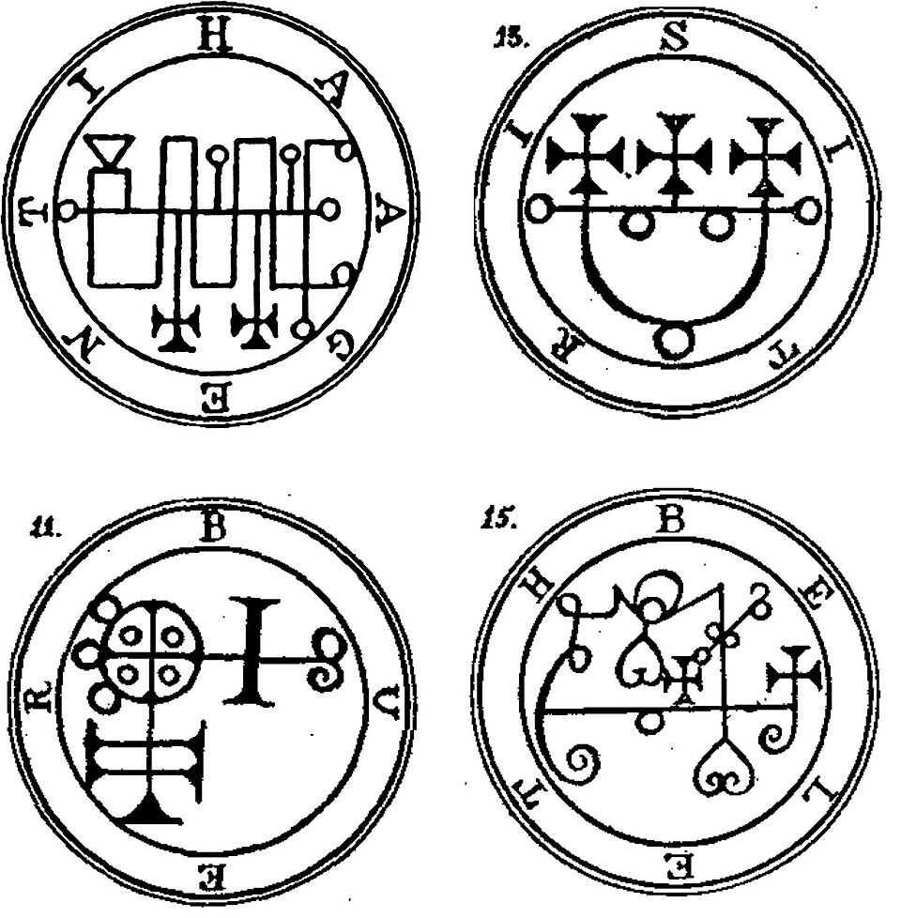
Goetic seals from the Lesser Key of Solomon
Notes:
https://commons.wikimedia.org/wiki/File:Goetia_seals.jpg

Slide 28
Scopes and Sigils
$global - Global variables
@@class - Class variables
@instance - Instance variables
:symbol - Symbols
local - Local variables (block scope)
Defaults
  Class/instance variables: private
  Methods: public

Slide 29
Visibility Modifiers
Methods
  public
  private
  protected
For instance variables
  attr_reader - read-only
  attr_writer - write-only
  attr_accessor - read and write

Slide 30
Scope Example
$global = "global"
local = "local"
class Demo
@@class = "class"
def initialize
@instance = "instance"
end
def scope
method_local = ”local"
# Access all scopes here
end
end
demo = Demo.new
demo.scope

Slide 31
Inheritance

Slide 32
The I: Inheritance
Classes gain functionality from parent (super) classes.
Key Concepts
  Child/derived class extends base/parent class
  Access to public and protected members
  Use with caution (less flexible than composition)
Is-a vs Has-a
  Cat is-a mammal is-an animal
  SortedList has-a List (not is-a)

Slide 33
Ruby's Approach
Single Inheritance
  Inherit from one class only
  Easier to understand than multiple inheritance
  Limits flexibility
Mixins
  Alternative way to gain functionality
  Uses modules
  Mixins are more flexible than multiple inheritance
Syntax
class Child < Parent

Slide 34
Example
class Animal
TRAITS = ["eat", "breathe", "move", "reproduce"]
def method_missing(m, *args, &block)
TRAITS.include?("#{m}".sub(/\?/, ""))
end
end

Slide 35
Example
class Mammal < Animal
TRAITS = ["fur", "hair", "lactate"]
def method_missing(m, *args, &block)
if TRAITS.include?("#{m}".sub(/\?/, ""))
true
else
super(m, *args, &block)
end
end
end

Slide 36
Example
class Cat < Mammal
TRAITS = ["claws", "sharp_teeth"]
def method_missing(m, *args, &block)
if TRAITS.include?("#{m}".sub(/\?/, ""))
true
else
super(m, *args, &block)
end
end
end

Slide 37
Modules (Mixins)
module Conversions
@@F2C = 5/9.0
@@C2F = 9/5.0
def c2f(celsius)
(celsius * @@C2F) + 32
end
def f2c(fahrenheit)
(fahrenheit - 32) * @@F2C
end
end
include Conversions
p f2c(212) # => 100.0
p c2f(100) # => 212.0

Slide 38
Polymorphism

Slide 39
The O+1 (P): Polymorphism
From Greek "many shapes"
Methods take different types and perform same operations

Slide 40
Sort Polymorphism
irb> ["5", "2", "1"].sort
=> ["1", "2", "5"]
irb> [5, 2, 1].sort
=> [1, 2, 5]
irb> arr = ['5', 1, '2', 4, 3]
=> ["5", 1, "2", 4, 3]
irb> arr.sort{ |x, y| x.to_i <=> y.to_i }
=> [1, "2", 3, 4, "5"]
Notes:
UFO operator

Slide 41
Debugging

Slide 42
Rails Debugging
Everyone writes bugs
  Become an expert at debugging.
Tools Available
  Browser developer console
  Server logs
  Built-in debugging shell
Activate Debugger
  Add to Gemfile gem 'debug’
  Call in code debugger

Slide 43
Debug Commands
break - List/set breakpoints
  N - line number N in current file
  F:N - file F, line N
  C#M - class C, method M
delete - Delete breakpoints
info - Show Rails variables
step - Step into next line
next - Go to next line (don't step into)
continue - Resume until next breakpoint

Slide 44
Example
# POST /items
def create
@item = Item.new(item_params)
debugger
# [...]
end
(rdbg) p item_params
Unpermitted parameter: :priority
(rdbg) p @item
=> #<Item id: nil, what: "Melissa", priority: nil>
(ruby) @item.priority=5
5
(rdbg) c

Slide 45
Summary

Slide 46
What We Learned
Big Four OOP: Abstraction, Encapsulation, Inheritance, Polymorphism
Ruby Arrays: Dynamic, powerful, many operations
Symbols: Immutable global identifiers
Hashes: Key/value pairs with flexible keys
Scopes: Using sigils ($, @@, @, :)
Debugging: Built-in tools and commands

