Slide 1
Electron

Slide 2
Overview
Electron (https://www.electronjs.org) is another approach to front ending a web application
Is uses both Node (https://nodejs.org/) and Chromium (https://www.chromium.org/Home/) to create a native application that runs on the three major operating systems
End users cannot tell the difference between an Electron application and one that was written specifically for the operating system
This is because Node has access to the native operating systems calls and therefore exposes the native user interface to end user

Slide 3
Native Interfaces
clipboard
dialog
Menu
Notification
screen
session
shell
systemPreferences

Slide 4
Creation
It is relatively straightforward to create a simple Electron app
  Create a directory and place a "index.html" file from a (e.g.) Vue application into it.
  You'll then need a main.js file that creates an Electron window and loads that index.html file
  There is also a developer tools window that is useful during development

Slide 5
index.js
const { app, BrowserWindow } = require('electron')
const createWindow = () => {
const mainWindow = new BrowserWindow({
width: 800, height: 600 })
mainWindow.loadFile('index.html')
mainWindow.webContents.openDevTools()
}
app.whenReady().then(() => {
createWindow()
app.on('activate', () => {
if (BrowserWindow.getAllWindows().length === 0) createWindow()
})
})

Slide 6
index.html
<!DOCTYPE html>
<html>
<head>
<title>A Todo SPA</title>
<script src="https://cdn.jsdelivr.net/npm/vue@2/dist/vue.js"></script>
</head>
<body>
<div id="Itemlist">
<ul>
<li v-for="item in items">
<button v-on:click="deleteItem(item.id)">Done!</button>
{{item.when}} {{item.what}}
</li>
</ul>

Slide 7
<form v-on:submit="newItem">
<div>
<label for="what">What: </label>
<input id="what" type="text">
<label for="when">When: </label>
<input id="when" type="date">
<input type="submit" value="New">
</div>
</form>
</div>

Slide 8
<script type="text/javascript">
new Vue({
el: '#Itemlist',
data: { items: [] },
methods: {
showItems: function() {
fetch('http://localhost:3000/items.json')
.then(response => response.json()
.then(json => { this.items = json; }))
.catch(error => { console.log(error); })
.catch(error => { console.log(error); })
},

Slide 9
deleteItem: function(id) {
fetch('http://localhost:3000/items/'
+ id + '.json',
{method: 'DELETE'})
.then(this.showItems)
.catch(error => {
console.log(error);})
},

Slide 10
newItem: function(e) {
e.preventDefault()
// Grab the data from the form.
data = {what: e.target.elements.what.value,
when: e.target.elements.when.value}
// Submit via JSON.
fetch('http://localhost:3000/items.json', {
method: 'POST',
headers: { "Content-Type": "application/json" },
body: JSON.stringify(data),
})
.then(this.showItems)
.catch(error => { console.log(error); })
},
},

Slide 11
// The first thing to do.
mounted: function() {
this.showItems()
},
})
</script>
</body>
</html>

Slide 12
Disable CSRF Check, Development Only!
class ItemsController < ApplicationController
skip_before_action :verify_authenticity_token

Slide 13
Initialize Node
Now we need to initialize the folder so that Node packages can be installed
The Node Package Manager (npm) can be used for this
npm init
This utility will walk you through creating a package.json file
It only covers the most common items and tries to guess sensible defaults

Slide 14
Add a Start Script
"scripts": {
"start": "electron .",
"test": "exit 1"
},

Slide 15
Install Electron
npm install --save-dev electron
npm install --save-dev @electron-forge/cli

Slide 16
Run It
npm run start

Slide 17
Create a Stand-Alone App
npx create-electron-app@latest import
npm run make
# On a Mac, look in:
# out/todo-darwin-arm64/todo.app

Slide 18
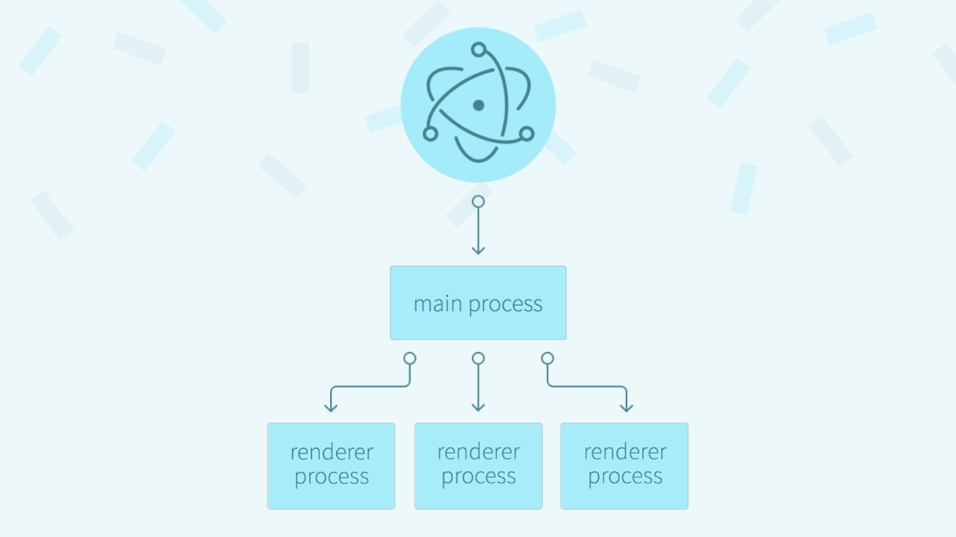
Electron Process Model
Notes:
https://www.linkedin.com/pulse/understanding-ipc-electron-youssef-labrahmi-dodme/

Slide 19
Electron and OS Interaction
Main Process
  Acts as the application's entry point (running main.js or main.ts)
  Runs in a full Node.js environment with direct access to the operating system, file system, and native APIs
  Manages the application lifecycle, system events, and native menus
  Creates and controls app windows using BrowserWindow
Notes:
Gemini

Slide 20
Renderer Process(es)
Renders the graphical user interface using standard web tech (HTML, CSS, and JavaScript or frameworks like React/Vue)
Runs inside a Chromium-based sandbox for isolation and security
Lacks direct access to Node.js or low-level operating system APIs
Can have multiple renderer processes, typically one per open window or web embed

Slide 21
Preload Scripts & IPC Bridge
Preload Scripts: Execute safely before web content loads, having restricted access to Node.js APIs.
Context Bridge (contextBridge): Exposes safe, selective APIs from the preload script to the renderer without leaking full Node.js power.
Inter-Process Communication (IPC): Bridges messages between the renderer and main processes (ipcRenderer and ipcMain) to handle privileged tasks like saving files or opening system dialogs.

Slide 22
Very Simple Example
Query OS to retrieve CPU
https://github.com/drb80/ElectronOS

