Slide 1
React

Slide 2
Components
React apps are made out of components
A component is a piece of the UI (user interface) that has its own logic and appearance
A component can be as small as a button, or as large as an entire page

Slide 3
Components
React components are JavaScript functions that return markup
React component names must always start with a capital letter, while HTML tags must be lowercase
The export default keywords specify the main component in a file

Slide 4
Simple JSX
function MyButton() {
return (
<button>I'm a button</button>
);
}

Slide 5
Nesting
export default function MyApp() {
return (
<div>
<h1>Welcome to my app</h1>
<MyButton />
</div>
);
}

Slide 6
JavaScript XML
JSX is stricter than HTML
You must close tags like <br />
Your component also can’t return multiple JSX tags
  You must o wrap them into a shared parent, like a <div>...</div> or an empty <>...</> wrapper

Slide 7
Wrapping
function AboutPage() {
return (
<>
<h1>About</h1>
<p>Hello there.<br />How do you do?</p>
</>
);
}

Slide 8
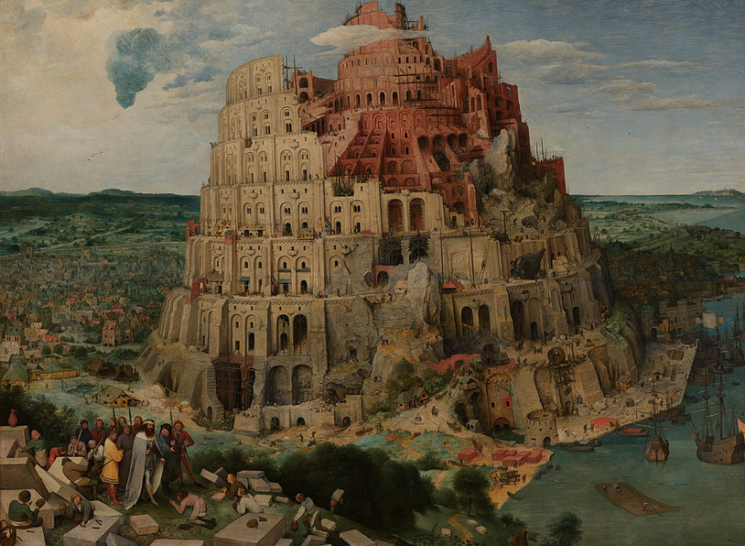
Babel
Notes:
By Pieter Brueghel the Elder - bAGKOdJfvfAhYQ at Google Arts &amp; Culture, Public Domain, https://commons.wikimedia.org/w/index.php?curid=22178101

Slide 9
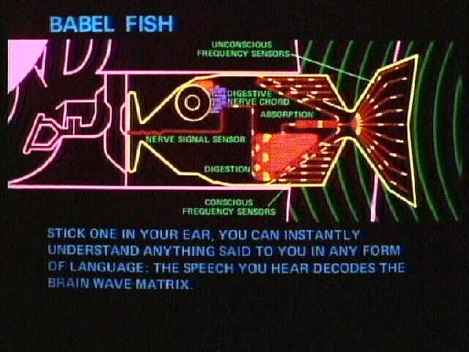
Notes:
https://hitchhikers.fandom.com/wiki/Babel_Fish

Slide 10
Displaying Data
return (
<h1>
{user.name}
</h1>
);

Slide 11
Lists
const listItems = products.map(product =>
<li key={product.id}>
{product.title}
</li>
);
return (
<ul>{listItems}</ul>
);

Slide 12
Events
function MyButton() {
function handleClick() {
alert('You clicked me!');
}
return (
<button onClick={handleClick}>
Click me
</button>
);
}

Slide 13
useState Hook
function MyButton() {
const [count, setCount] = useState(0);
function handleClick() {
setCount(count + 1);
}
return (
<button onClick={handleClick}>
Clicked {count} times
</button>
);
}

Slide 14
Changing State
State changes re-render the virtual DOM and possibly the actual DOM
Local variables don’t persist between renders
Changes to local variables won’t trigger renders

Slide 15
State is isolated and private
  Each component has their own copy

