Slide 1
Good Vue

Slide 2
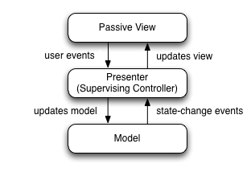
Model View Presenter
Notes:
By Google - http://www.gwtproject.org/articles/testing_methodologies_using_gwt.html, CC BY-SA 3.0, https://commons.wikimedia.org/w/index.php?curid=34271902

Slide 3
Wikipedia
Model–view–presenter (MVP) is a derivation of the model–view–controller (MVC) architectural pattern, and is used mostly for building user interfaces.
In MVP, all presentation logic is pushed to the presenter.

Slide 4
Wikipedia
The model is an interface defining the data to be displayed or otherwise acted upon in the user interface.
The view is a passive interface that displays data (the model) and routes user commands (events) to the presenter to act upon that data.
The presenter acts upon the model and the view. It retrieves data from repositories (the model), and formats it for display in the view.

Slide 5
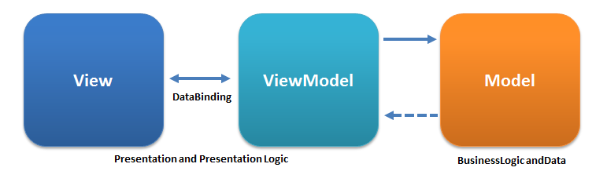
Model View ViewModel

Slide 6
MVVM
The view model of MVVM is a value converter
The view model is more model than view, and handles most if not all of the view's display logic
MVVM has a binder, which automates communication between the view and its bound properties in the view model

Slide 7
MVVM
The main difference between the view model and the presenter in the MVP pattern, is that the presenter has a reference to a view whereas the view model does not
Instead, a view directly binds to properties on the view model to send and receive updates

Slide 8
MVVM
Declarative data and command-binding are implicit in the MVVM pattern
The binder frees the developer from being obliged to write boiler-plate logic to synchronize the view model and view

Slide 9
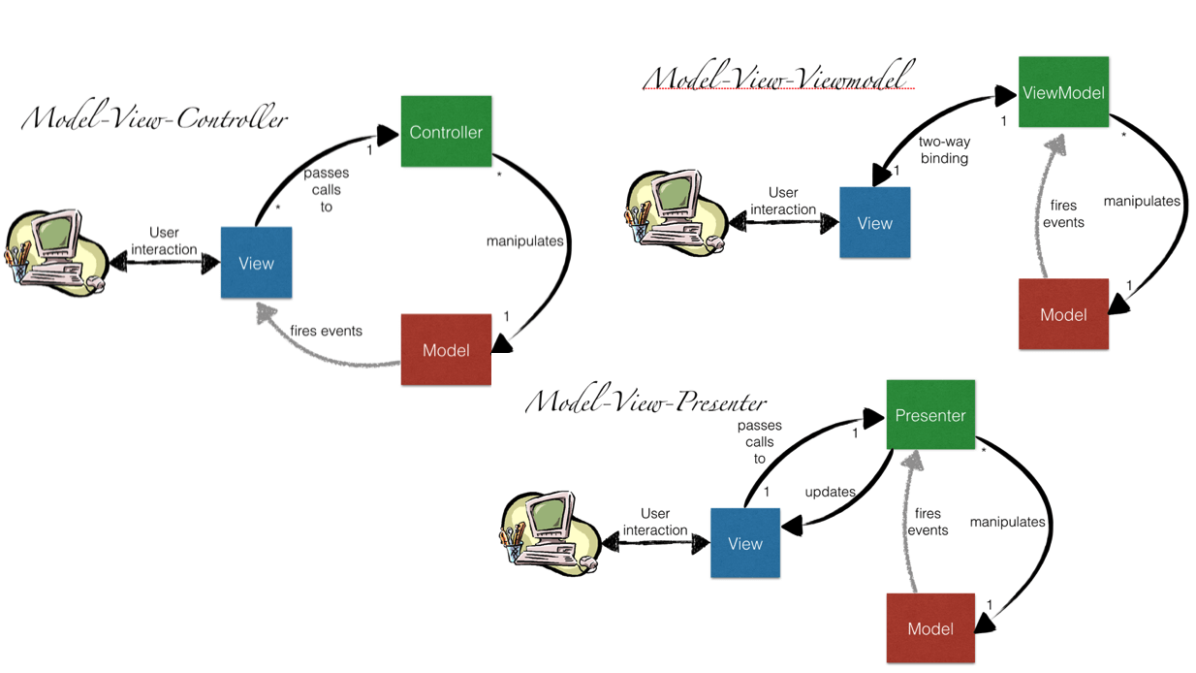
Notes:
https://www.beyondjava.net/model-view-whatever

Slide 10
Vue
Vue (pronounced /vjuː/, like view) is a progressive framework for building user interfaces
Notes:
https://vuejs.org/v2/guide/

Slide 11
Progressive Web Applications (PWAs)
Web applications that load like regular web pages or websites but can offer the user functionality such as working offline, push notifications, and device hardware access traditionally available only to native mobile applications
PWAs combine the flexibility of the web with the experience of a native mobile application
Notes:
https://en.wikipedia.org/wiki/Progressive_web_applications

Slide 12
PWA Characteristics
Progressive - Work for every user, regardless of browser choice because they’re built with progressive enhancement as a core tenet.
Responsive - Fit any form factor: desktop, mobile, tablet, or forms yet to emerge.
Connectivity independent - Service workers allow work offline, or on low quality networks.

Slide 13
PWA Characteristics
App-like - Feel like an app to the user with app-style interactions and navigation
Fresh - Always up-to-date thanks to the service worker update process
Safe - Served via HTTPS to prevent snooping and ensure content hasn’t been tampered with

Slide 14
PWA Characteristics
Discoverable - Are identifiable as “applications” thanks to W3C manifests[6] and service worker registration scope allowing search engines to find them.
Re-engageable - Make re-engagement easy through features like push notifications.
Installable - Allow users to “keep” apps they find most useful on their home screen without the hassle of an app store.

Slide 15
PWA Characteristics
Linkable - Easily shared via a URL and do not require complex installation

Slide 16
Basics
<html>
<head>
<title>01</title>
<!-- development version, includes helpful console warnings -->
<script src="https://cdn.jsdelivr.net/npm/vue/dist/vue.js"></script>
</head>
<body>
<div id="app">
{{ message }}
</div>

Slide 17
Reactive
<script>
var app = new Vue({
el: '#app',
data: {
message: 'Hello Vue!'
}
})
</script>
<!-- app.message = 'Goodbye Vue!'; -->
</body>
</html>

Slide 18
Reactive
Now can change app.message and view will update

Slide 19
Binding
<div id="app">
<span v-bind:title="message">
Hover your mouse over me for a few seconds
to see my dynamically-bound title!
</span>
</div>

Slide 20
Binding
<script>
var app = new Vue({
el: '#app',
data: {
message: 'You loaded this page on ‘ +
new Date().toLocaleString()
}
})
</script>

Slide 21
Conditional
<div id="app">
<span v-if="seen">Now you see me</span>
</div>
<script>
var app = new Vue({
el: '#app',
data: {
seen: true
}
})
</script>
<!-- app.seen = false; -->

Slide 22
Loops
<div id="app">
<ol>
<li v-for="todo in todos">
{{ todo.text }}
</li>
</ol>
</div>

Slide 23
Loops
<script>
var app = new Vue({
el: '#app',
data: {
todos: [
{ text: 'Learn JavaScript' },
{ text: 'Learn Vue' },
{ text: 'Build something awesome' }
]
}
})
</script>
<!-- app.todos.push({ text: 'New item' }) -->

Slide 24
Button
<div id="app">
<p>{{ message }}</p>
<button v-on:click="reverseMessage">
Reverse Message
</button>
</div>

Slide 25
Button
<script>
var app = new Vue({
el: '#app',
data: {
message: 'Hello Vue.js!'
},
methods: {
reverseMessage: function () {
this.message =
this.message.split('').reverse().join('')
}
}
})
</script>

Slide 26
Two-way Binding
<div id="app">
<p>{{ message }}</p>
<input v-model="message">
</div>
<script>
var app = new Vue({
el: '#app',
data: {
message: 'Hello Vue!'
}
})
</script>

