Slide 1
Trip Scheduler

Slide 2
Introduction
Problem Statement - Travel Planning
Challenges
Unknown place / Limited knowledge of venues
Tasks
Identify the popular places to visit
Visit all the places within the given days of stay
Optimize the number of places that can be covered per day
Prepare the itinerary for each day
Trip Scheduler
Takes City to be visited and the number of days of stay as input
Prepare the day to day itinerary

Slide 3
Data
Geocoders
To get latitude and longitude of the city
Foursquare
List of travel categories (venues/categories)
List of venues (venues/explore)
Venue Details (venues/VenueID)

Slide 4
Methodology
Step 1: Import needed libraries, turn off warnings, load foursquare credentials
Step 2: Input the location to visit (city), number of days, and categories
Step 3: Get the latitude and longitude of the location (Geocoders)
Step 4: Get the list of supported venue categories (Foursquare)
Step 5: Get applicable tourism categories
Step 6: Get the list of Venues matching the tourism categories
Step 7: Convert to Dataframe with columns, Venue Name, ID, Category, Latitude and Longitude
Step 8: Get the details of each travel venue
Step 9: Add the columns 'Rating' and 'Likes' to the dataframe based on the values received from the Venue details
Step 10: Sort the dataframe based on the Rating and Likes. Pick up top N travel venues
Step 11: Form a new dataframe by dropping everything except Lat and Long
Step 12: Use K-Means clustering to segment venues based on the Latitude and Longitude values
Step 13: Display the list of venues (for each day for 3 days)
Step 14: Use Folium to visualize the travel venues on the City map.¶

Slide 5
Results Day 1 Schedule
 | Name | Category
12 | Buckminster Fuller's Fly's Eye Dome | Museum
18 | The Land of Happy Monkeys | Zoo
86 | Park Street Baptist Church | Church
103 | S.O.D POD | Shrine
27 | Crystal Bridges Trail | Trail
71 | First United Methodist Church Bentonville | Church

Slide 6
Results Day 2 Schedule
 | Name | Category
77 | The Church of Jesus Christ of Latter-day Saints | Church
15 | Daisy Airgun Museum | Museum
41 | Foerster Park | Park
89 | oakley chapel | Church
104 | Church | Church

Slide 7
Results Day 3 Schedule
 | Name | Category
57 | Bentonville Bike Trail | Park

Slide 8
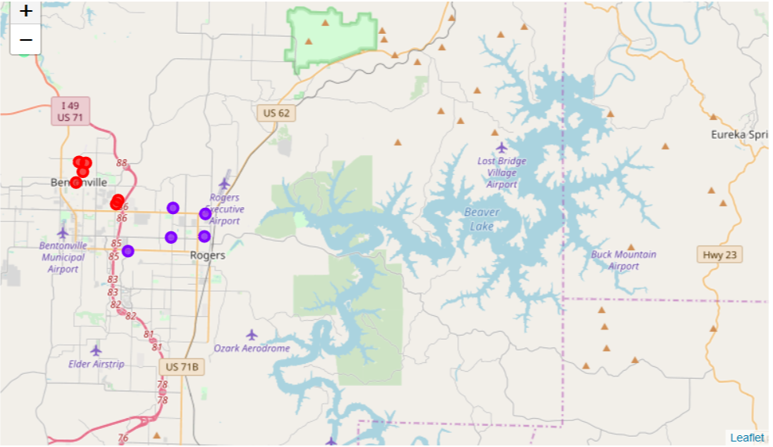
Results Map

Slide 9
Discussion
The number of places to be covered on any day can be longer than the number we would like to visit because only latitude and longitude were used in the K-Means algorithm to do the clustering.
Future improvements could add options such as hours to visit at a venue, number of hours users spend on average at each venue, etc, then the algorithm could do further splits on this list.

Slide 10
Conclusion
When someone is planning a trip to an unknown city, the planning becomes difficult due to the lack of knowledge about the city. This tool can help.
The tool uses preference of venue categories, number of days stay, ratings of venues, and venue likes. This helps the traveler by making it easy for the user to make a schedule without going to multiple web pages.

