Slide 1
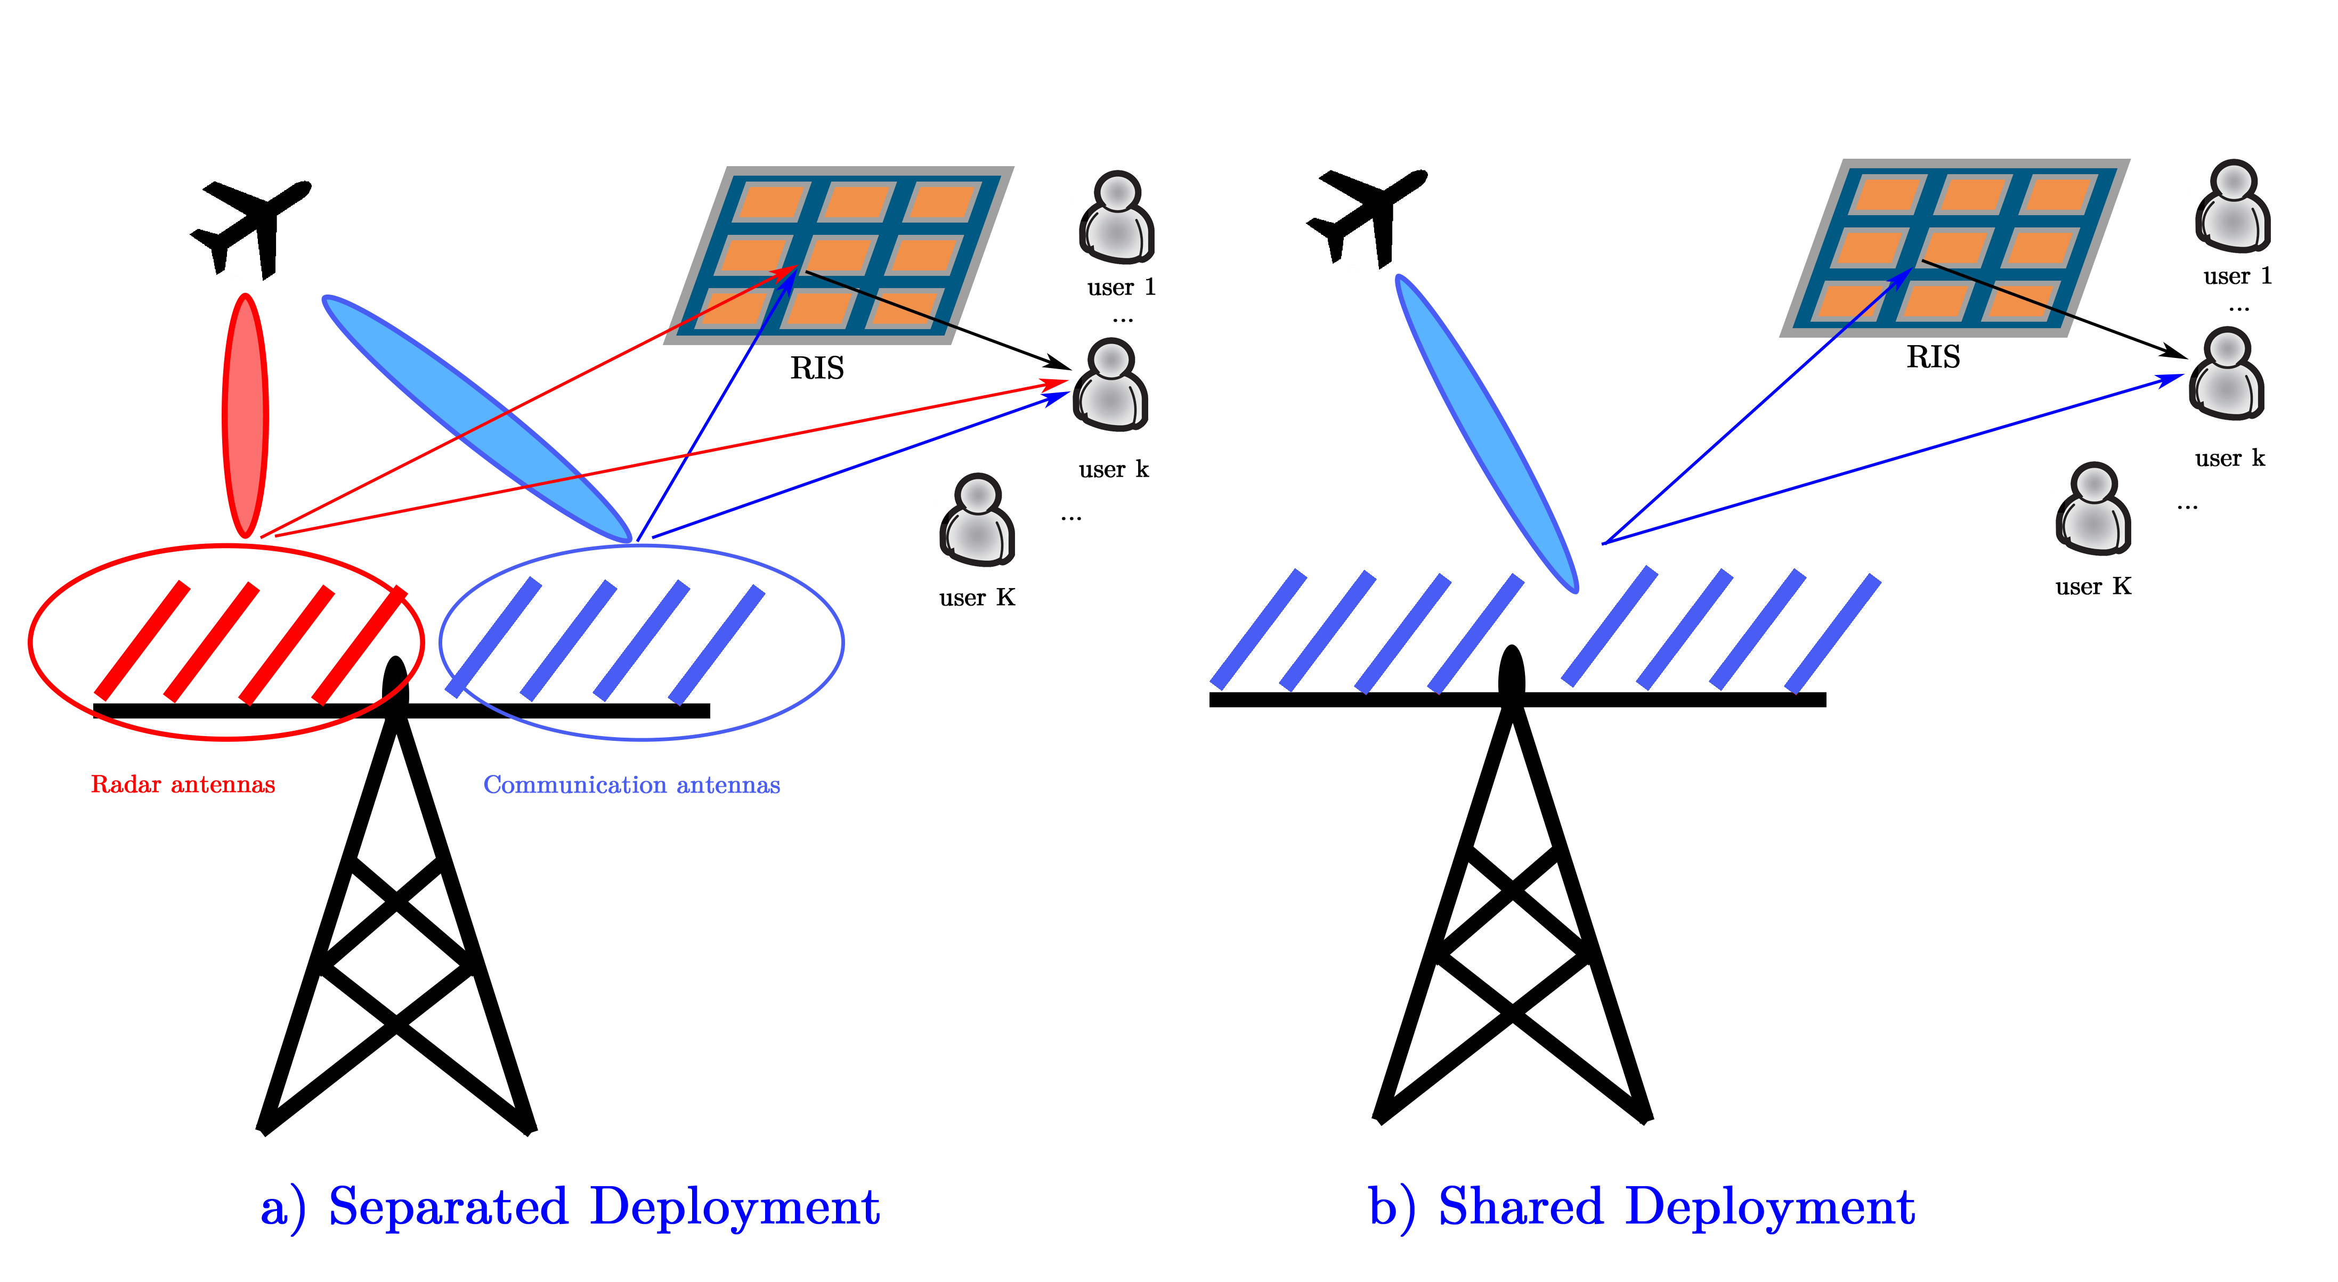
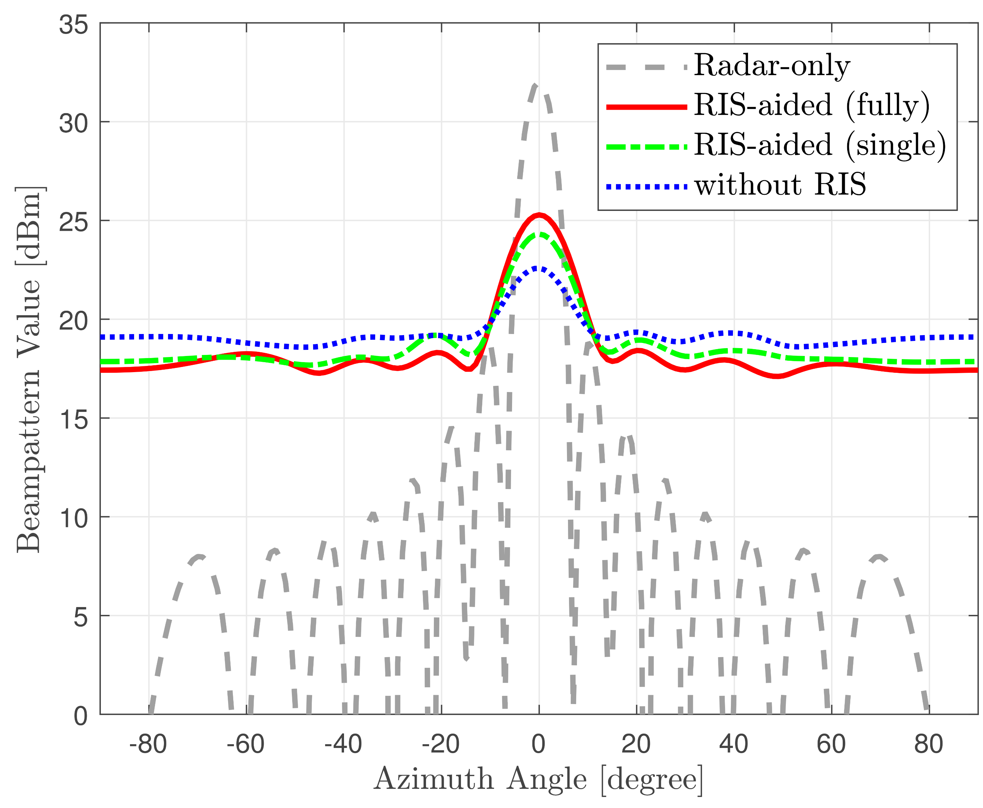
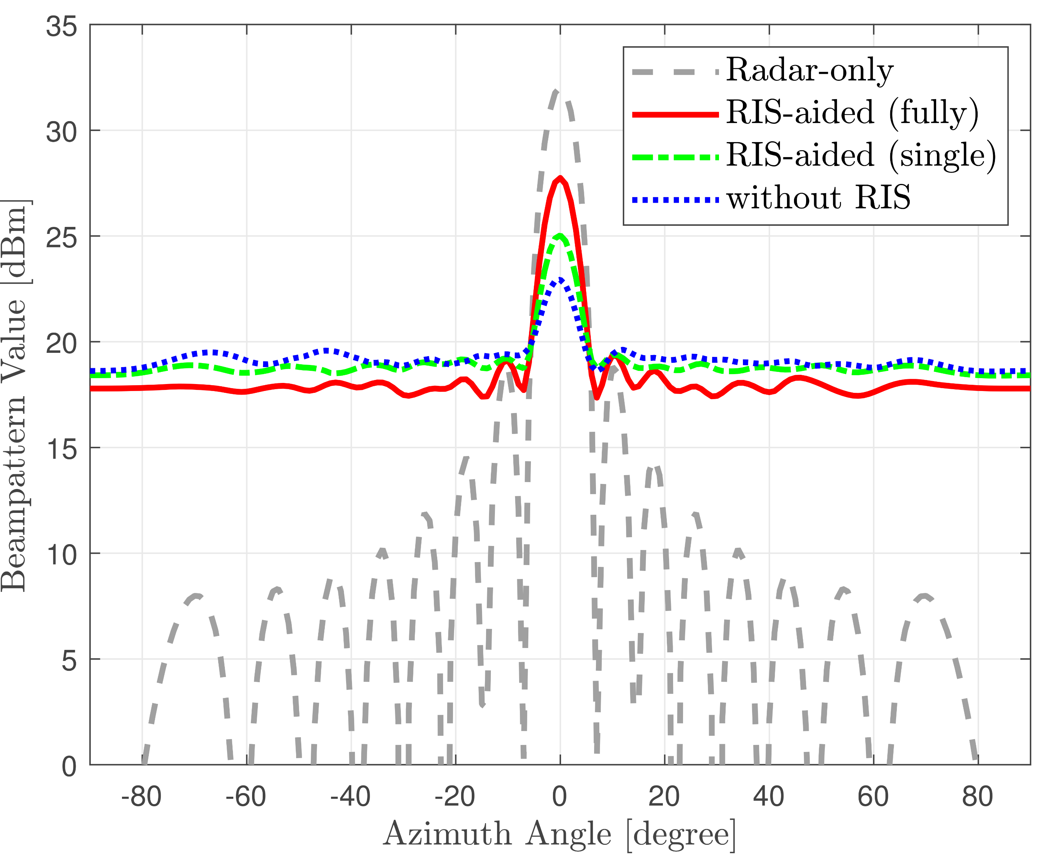
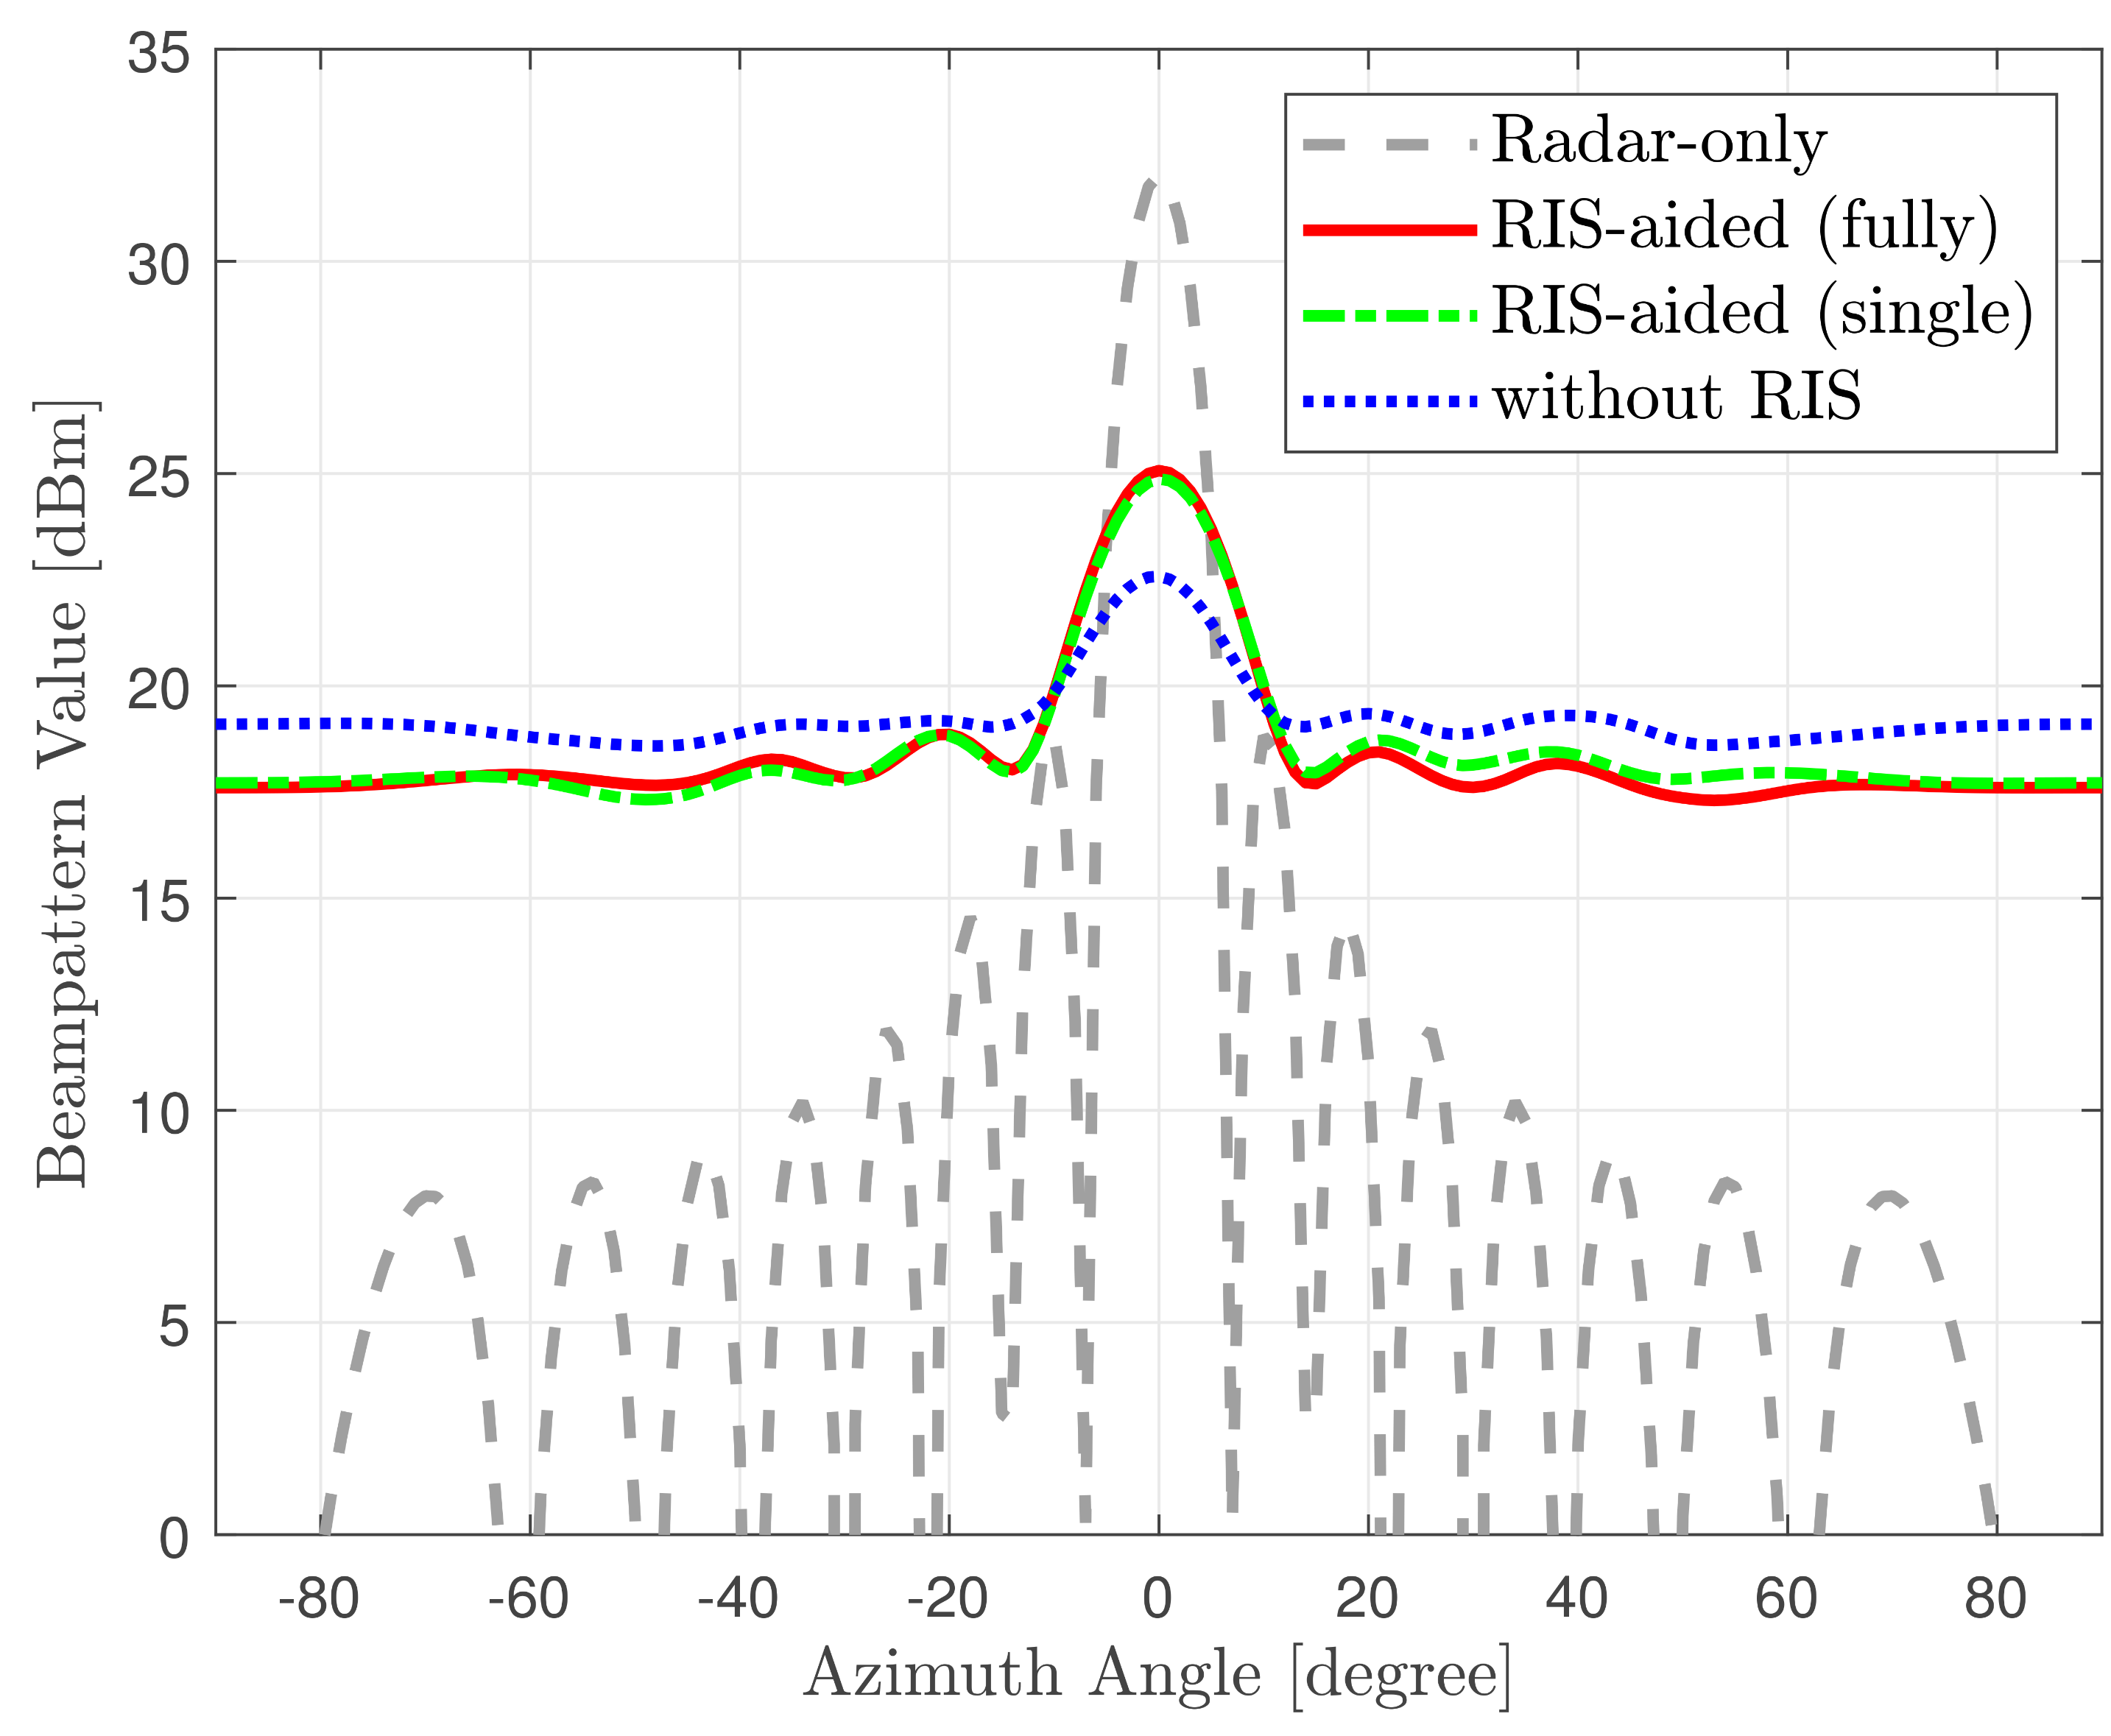
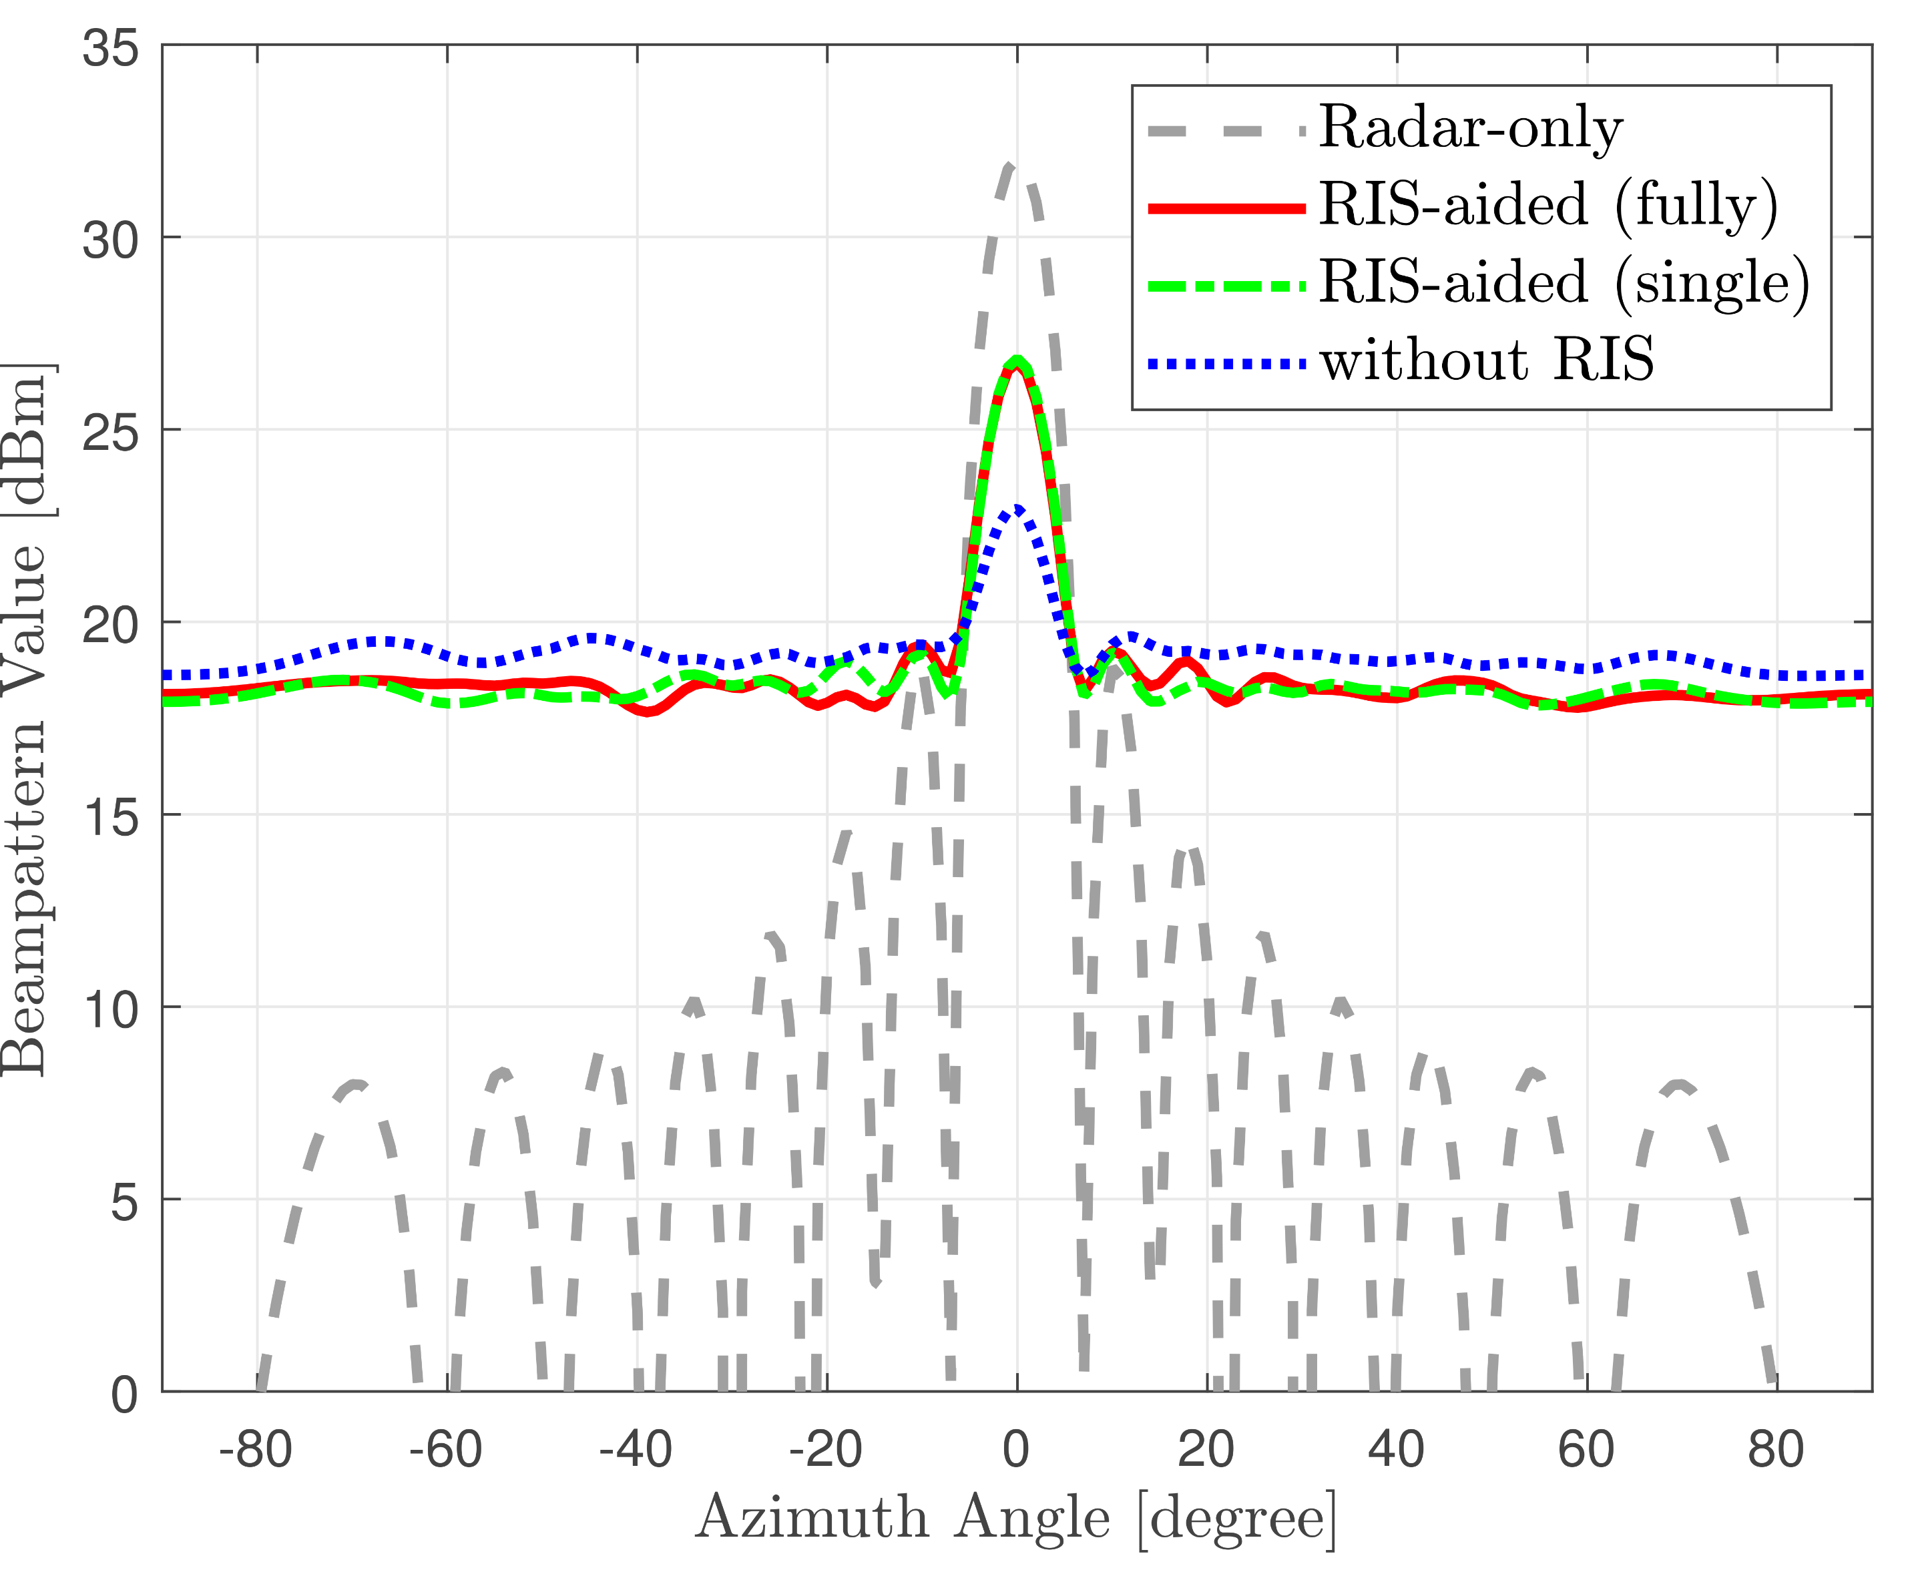
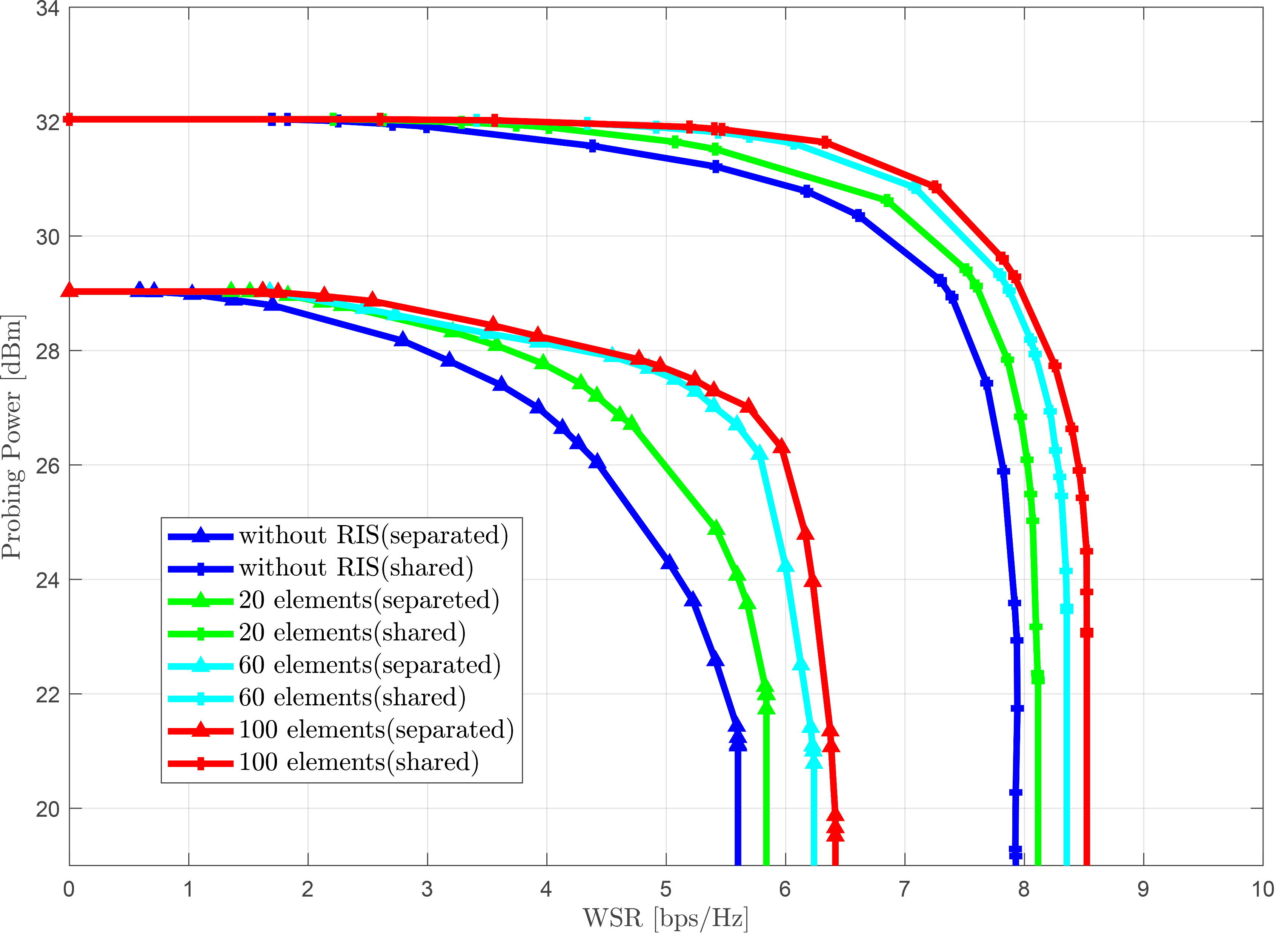

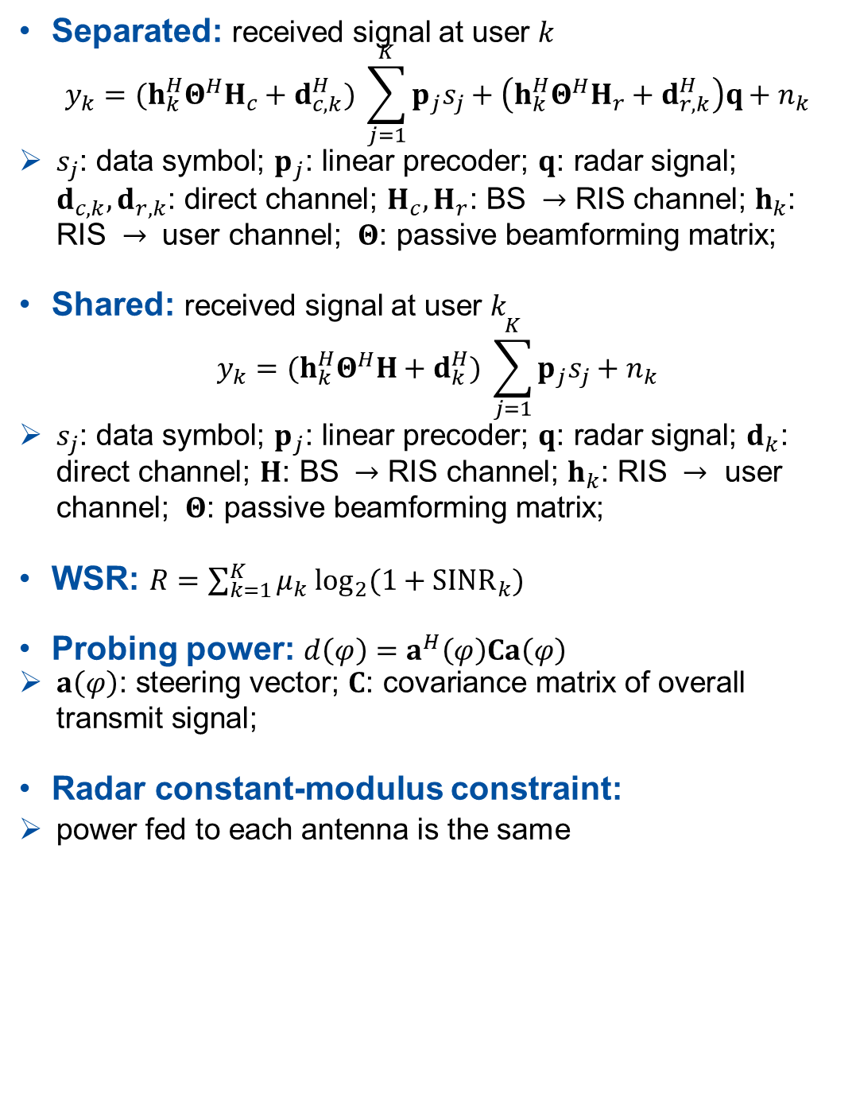
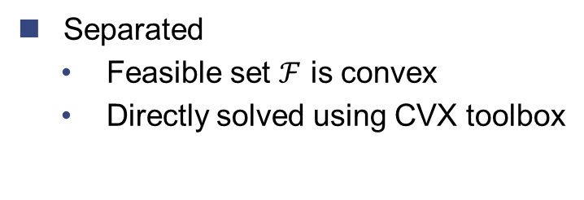

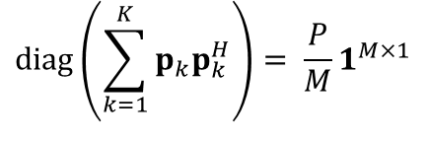
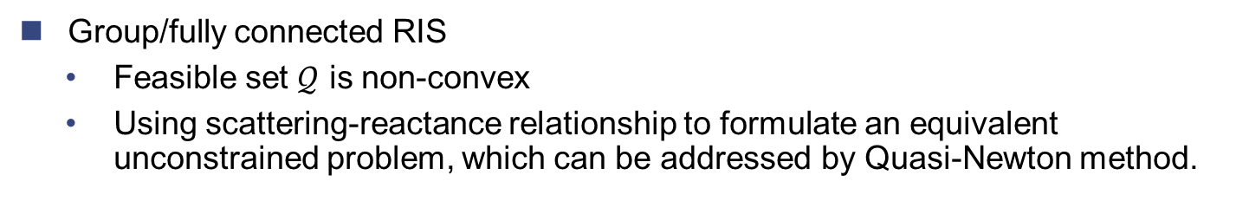

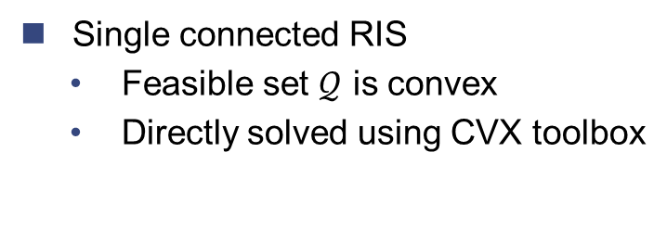
RIS-aided Dual-Functional Radar and Communications Beamforming Design
Author: Zhaolin Wang Supervisor: Prof Bruno Clerckx
Motivation
Contribution
Separated/Shared Deployment
Simulation Rsults
CRSS
Enable two systems perform in the same frequency band with tiny performance loss
Long-term solution for the spectrum management of communications and radar.
RIS
Modify wireless channel via passive beamforming.
Provide extra capability for the CRSS system.
Group/fully connected RIS
A novel RIS model wherein elements are connected mutually.
Lead to higher received power than single connected RIS in Rayleigh channel.
WSR maximization
The most representative communication metric.
Has not been investigated in this field.
WSR maximization is non-convex and hard to solve
The first work that studies WSR maximization and group/fully connected RIS in CRSS
A new framework
A BS with separated or shared setup probing one target and serving multiple users.
The users receive signal from BS plus reflected signal from RIS
An algorithm for separated deployment
Non-convexity from WSR is tackled by WMMSE framework and Fractional Programming (FP)
Non-convexity from group connected RIS is tackled by scattering-reactance relationship.
An algorithm for shared deployment
Similar as separated deployment, but additional non-convexity from radar constant-modulus constraint
Lower complexity SDR method than the existing Majorization-Minimization (MM) method.
a) Separated Deployment
b) Shared Deployment
Separated: two groups of antennas transmit radar and communication signals
Shared: all antennas transmit communication signal under radar constraint.
Tradeoff between complexity and performance
a) Separated, Rayleigh, WSR = 5.4 bps/Hz
b) Shared, Rayleigh, WSR = 7.9 bps/Hz
System Model
Algorithm for WSR and Probing Power Maximization
Separated: received signal at user $k$
$$y_{k}={(h}_{k}^{H}Θ^{H}H_{c}+d_{c,k}^{H}) \sum_{j=1}^{K}{p_{j}s_{j}}+\left(h_{k}^{H}Θ^{H}H_{r}+d_{r,k}^{H}\right)q+n_{k}$$
$s_{j}\text{: }\text{data} \text{symbol}\text{;}$ $p_{j}\text{: }\text{linear} \text{precoder}\text{;}$ $q\text{: }\text{radar} \text{signal}\text{;}$ $d_{c,k}, d_{r,k}\text{: }\text{direct} \text{channel}\text{;}$ $H_{c}, H_{r}\text{:} \text{BS} →\text{RIS} \text{channel}\text{;} h_{k}\text{: }\text{RIS} → \text{user} \text{channel}\text{;}$ $Θ\text{: }\text{passive} \text{beamforming} \text{matrix}\text{;}$
Shared: received signal at user $k$
$$y_{k}={(h}_{k}^{H}Θ^{H}H+d_{k}^{H}) \sum_{j=1}^{K}{p_{j}s_{j}}+n_{k}$$
$s_{j}\text{: }\text{data} \text{symbol}\text{;}$ $p_{j}\text{: }\text{linear} \text{precoder}\text{;}$ $q\text{: }\text{radar} \text{signal}\text{;}$ $d_{k}\text{: }\text{direct} \text{channel}\text{;}$ $H\text{:} \text{BS} →\text{RIS} \text{channel}\text{;} h_{k}\text{: }\text{RIS} → \text{user} \text{channel}\text{;}$ $Θ\text{: }\text{passive} \text{beamforming} \text{matrix}\text{;}$
WSR: $R=\sum_{k=1}^{K}{μ_{k} \log_{2}(1+SINR_{k})}$
Probing power: $d\left(φ\right)=a^{H}\left(φ\right)Ca\left(φ\right)$
$a\left(φ\right)\text{: }\text{steering} \text{vector}\text{;}$ $C\text{: }\text{covariance} \text{matrix} \text{of} \text{overall} \text{transmit} \text{signal}\text{;}$
Radar constant-modulus constraint:
power fed to each antenna is the same
da
WMMSE: fix passive beamforming, optimize active beamforming
Calculate MMSE receiver for each user $k$ as $g_{k}^{MMSE}=\arg{\min_{g_{k}}{E\left[{\left\|g_{k}y_{k}−s_{k}\right\|}^{2}\right]}}$
According to WMMSE to framework, the WSR maximization w.r.t. active beamforming can be converted to weighted MSE minimization problem with MMSE receiver.
$$\max_{p_{k},R_{q}∈ℱ}{\sum_{k=1}^{K}{μ_{k}\log_{2}{(1+SINR_{k})} ⇒}} \min_{p_{k},R_{q}∈ℱ}{\sum_{k}^{K}{w_{k}E\left[{\left\|g_{k}^{MMSE}y_{k}−s_{k}\right\|}^{2}\right]}}$$
FP: fix active beamforming, optimize passive beamforming
Based on FP, the WSR maximization w.r.t. passive beamforming can be reformulated as a minimization problem with a convex objective function through Largrangian dual transform and quadratic transform
$$\max_{Θ∈𝒬 }{\sum_{k=1}^{K}{μ_{k}\log_{2}{(1+SINR_{k})} ⇒}} \min_{\begin{aligned}θ=vec(Θ^{H}) \\ Θ∈𝒬 \end{aligned}}{θ^{H}Uθ−2Re\{θ^{H}v\}}$$
Alternating between 1) and 2) until convergence
c) Separated, LOS, WSR = 5.4 bps/Hz
d) Shared, LOS, WSR = 7.9 bps/Hz
non-convex
convex
Separated
Feasible set $ℱ$ is convex
Directly solved using CVX toolbox
Shared
Feasible set $ℱ$ is non-convex
Using SDR technique and dominant eigenvalue approximation
non-convex
convex
e) Effect of the number of reflecting elements
Separated:
$$diag\left(R_{q}\right)= \frac{P_{r}}{M_{r}}1^{M_{r}×1}$$
Single connected RIS
Feasible set $𝒬$ is convex
Directly solved using CVX toolbox
Group/fully connected RIS
Feasible set $𝒬$ is non-convex
Using scattering-reactance relationship to formulate an equivalent unconstrained problem, which can be addressed by Quasi-Newton method.
In both separated and shared deployments, the RIS aids the system in achieving improved radar beampatterns and achievable region.
The fully connected RIS brings more improvements in terms of radar beampattern and achievable region than single connected RIS in Rayleigh channel, while its performance is the same as single connected RIS in LOS channel.
Compared with separated deployment, the shared deployment achieves better beampattern and larger achievable region because the antennas are fully exploited.
$$diag\left(\sum_{k=1}^{K}{p_{k}p_{k}^{H}}\right)= \frac{P}{M}1^{M×1}$$
Shared:

