Slide 1

﻿MACHINE LEARNING ASSIGNMENT 2025
SUMMATIVE ASSIGNMENT
MACHINE LEARNING MODEL
Notes:
In this project, we developed machine learning models to predict stroke mortality within two weeks of treatment using 22 baseline variables.

Slide 2
TABLE OF CONTENTS
KEY ASPECTS
TASK-1B: TEST-TRAIN SPLIT & SMOT
TASK-2: LOGISTIC REGRESSION
TASK-2: TUNING
TASK-3: GRADIENT BOOSTING
TASK-4: MODELS COMPARATIVE ANALYSIS
TASK-4: FUTURE PERSPECTIVES
TASK-1A: EXPLORATORY ANALYSIS
Notes:
We will begin with exploratory analysis, followed by model development using regularised regression and tree-based methods, and conclude with model comparison and final selection.

Slide 3
KEY ASPECTS OF MACHINE LEARNING MODEL
Predict the probability of death within 2 weeks of stroke treatment using 22 baseline variables.
Identify the main predictors influencing the cause of death.
Compare regularised regression models (Lasso, Ridge, Elastic Net) and tree-based models (Boosting) based on the following;
Performance on the validation set.
Variable importance across models.
Notes:
Final Goal: Identify the most effective model for clinical decision-making
Before doing that, we have taken into consideration the following aspects:
Human-Friendly Exploratory Analysis is performed, where labels are marked accordingly
A color-blind-friendly template is used to ensure the entire audience understands the graphs.
Along the presentation, you’ll see default and tuned/optimized results; it is due to the models we ran first with default settings, and based on its results, tuning/optimization was performed accordingly to gain better results.

Slide 4
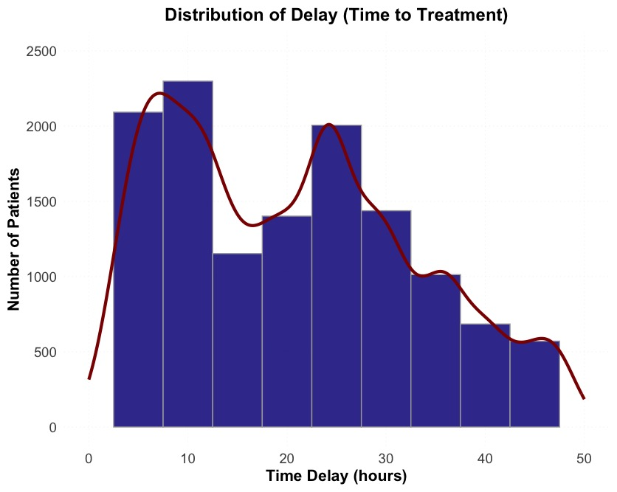
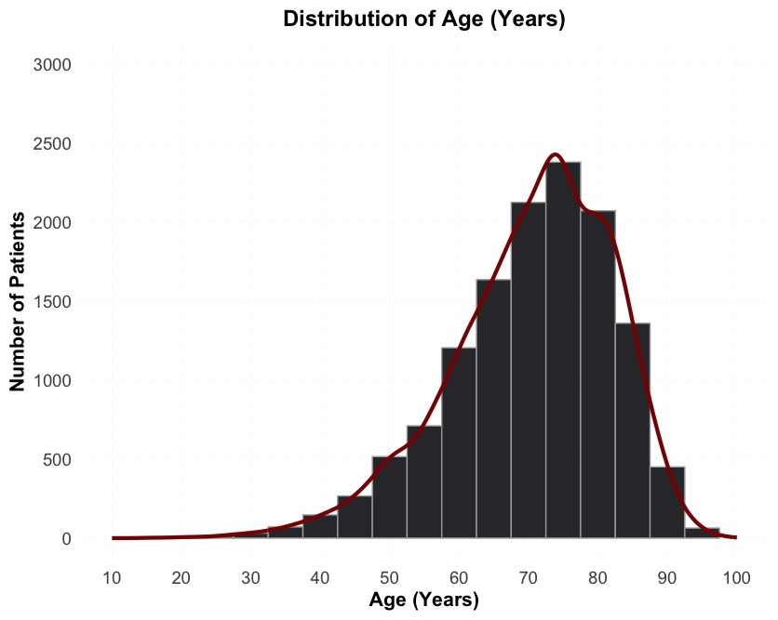
TASK 1-A: EXPLORATORY ANALYSIS OF THE DATA SET
Notes:
his slide presents the distribution of two key variables: time delay before treatment and patient age. The left plot shows that treatment delays vary widely, with peaks around 10 and 20 hours, highlighting potential intervention gaps. The right plot shows that most stroke patients are aged 60–80, suggesting that older adults are the most affected group. These insights help in understanding risk factors and model design.

Slide 5
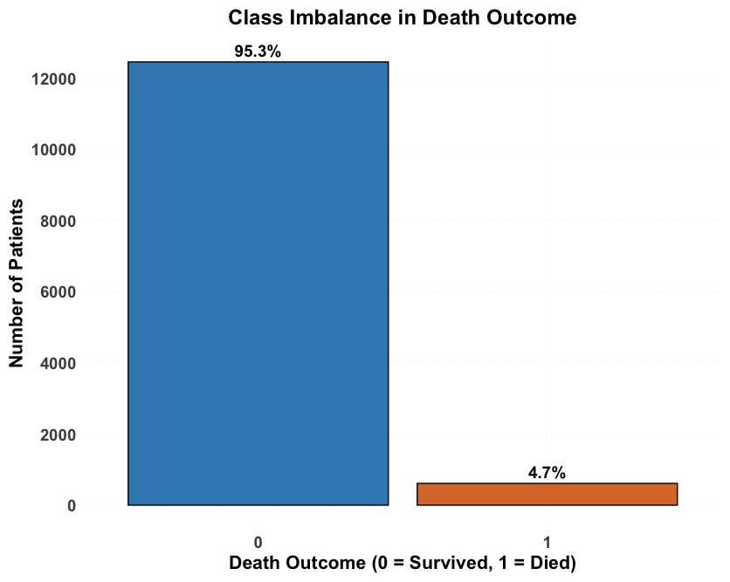
Outcome (Death) Distribution
Notes:
The dataset is highly imbalanced, with only 4.7% of patients dying,
which can significantly affect model training. We'll address this in the modelling phase using class balancing techniques.

Slide 6
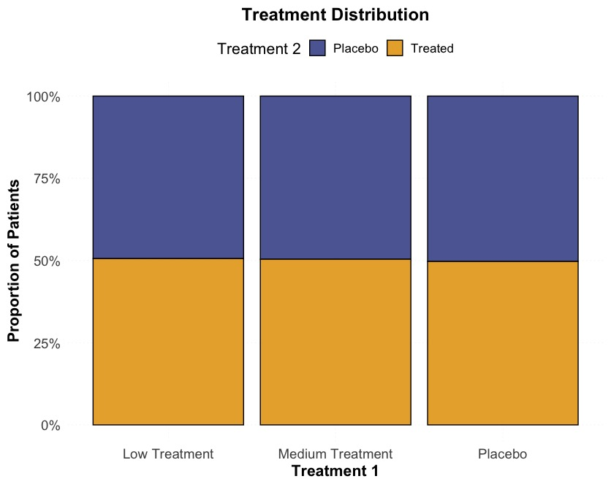
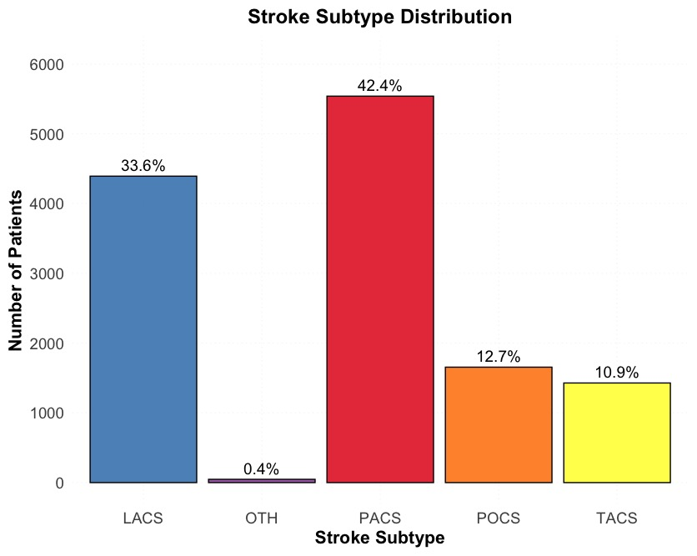
EXPLORATORY ANALYSIS OF THE DATA SET
Notes:
Graph-1
Each treatment group is evenly split between Treated and Placebo. This ensures fair comparisons between treatment effects.
No significant imbalance, meaning the study design is statistically valid.
Graph-2
This chart shows the distribution of stroke subtypes in the dataset.PACS (42.4%) and LACS (33.6%) are the most common subtypes, making up the majority of cases.
POCS and TACS account for 12.7% and 10.9%, while 'OTH' (Other) is rare at only 0.4%.

Slide 7
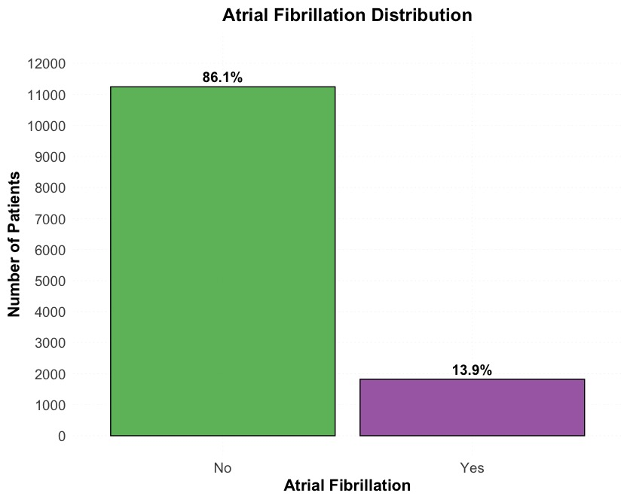
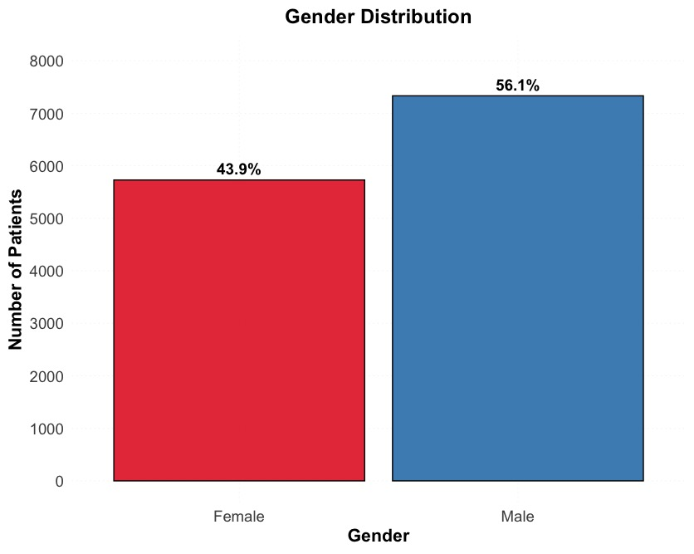
PATIENT DEMOGRAPHICS AND COMORBIDITIES
Notes:
Gender Distribution:
We see a slightly higher proportion of males (56.1%) compared to females (43.9%). This distribution is fairly balanced, minimising gender bias in outcome analysis."
Atrial Fibrillation Distribution: Most patients (86.1%) did not have Atrial Fibrillation, but 13.9% did. This is a relevant comorbidity that could influence treatment outcomes for this subgroup."

Slide 8
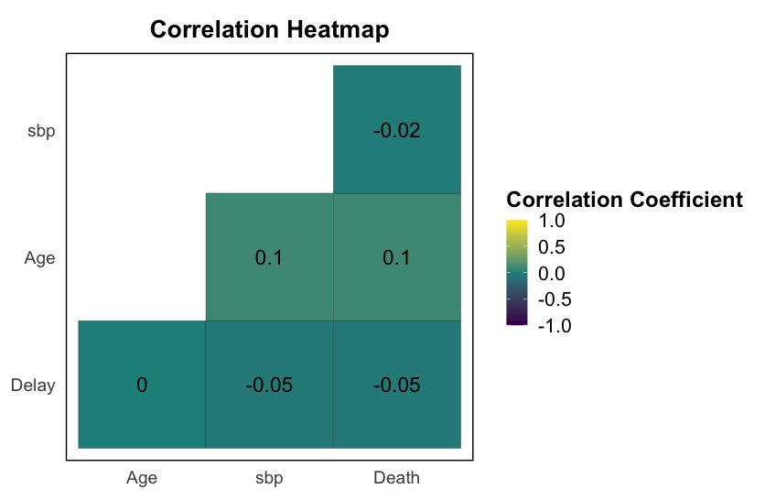
Correlation
Notes:
his heatmap shows the correlation between key numerical features and death outcome. Age has a weak positive correlation with death (0.1), suggesting older patients have slightly higher mortality risk. Delay and SBP (systolic blood pressure) have near-zero correlations, meaning they are not strong predictors on their own. This highlights the need for more complex models to capture interactions.

Slide 9
TASK 1-B (ONE-HOT ENCODING)
Original Variable | Unique Categories Before Encoding. | New Binary Columns After Encoding | Expected Encoded Columns in df_encoded
consc | 2 | 2 | conscD, conscF
gender | 2 | 1 | genderM
wakesym | 2 | 1 | wakesymY
atrial | 2 | 1 | atrialY
CTScan | 2 | 1 | CTY
Infarction | 0 | 1 | InfarcY
hep24 | 2 | 1 | hep24Y
asp3 | 2 | 1 | asp3Y
Subtype | 5 | 4 | subtypeOTH, subtypePACS, subtypePOCS, subtypeTACS
Treatment 1 | 3 | 2 | treat1M, treat1N
Treatment 2 | 2 | 1 | treat2Y
Notes:
We transformed categorical variables into numerical format using one-hot encoding ML-friendly and ensures accurate modeling.

Slide 10
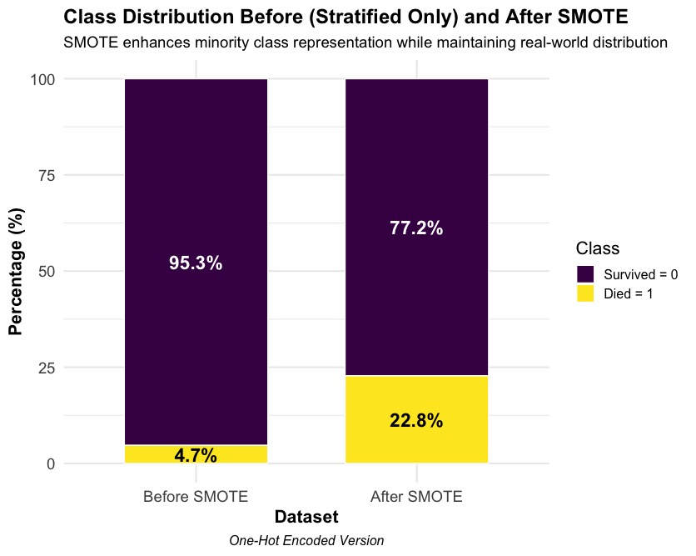
TASK 1-B
STRATIED SPLIT AND SMOTE
Notes:
Before applying SMOTE, we had an extreme imbalance—only 4.7% of cases were Death = 1 while the remaining 95.3% were Death = 0.
This imbalance affects the model’s ability to accurately predict the minority class.
To improve the model’s learning on the minority class, we applied Synthetic Minority Oversampling Technique (SMOTE).
This creates synthetic examples of the minority class while maintaining the overall data distribution.
SMOTE effectively improves model training while maintaining real-world distributions.
This is a crucial step for handling imbalanced datasets in medical research.

Slide 11
LOGISTIC REGRESSION
As data was binary, logistic regression was used. The three models below were used to check the prediction performance.
Lasso Regression (L1 Regularisation) Key Feature: Feature selection capability Mechanism: Uses L1 penalty Limitation: Can be unstable when features are highly correlated | Ridge Regression (L2 Regularisation) Key Feature: Shrinks coefficients but does not set them to zero. Mechanism: Uses L2 penalty Limitation: Doesn’t perform feature selection | Elastic Net Regression (Combination of L1 & L2) Key Feature: Combines the benefits of Lasso (feature selection) and Ridge (handles multicollinearity). Mechanism: Uses a mix of L1 and L2 penalties Limitation: Requires tuning of α and λ parameters
Notes:
Since the outcome variable is binary (death or survival), logistic regression was chosen. We used three variations: Lasso, Ridge, and Elastic Net. Lasso performs feature selection by shrinking some coefficients to zero, Ridge stabilizes the model by shrinking coefficients without eliminating them, and Elastic Net balances both approaches. This helps optimize model performance while addressing overfitting and multicollinearity.

Slide 12
PARAMETERS TUNED BASED ON DEFAULT RESULTS
Tuning Parameters | Pros | Cons
λ (lambda) | Controls model complexity | Overfitting and Underfitting
cross-validation (cv.glmnet) | Prevents overfitting & improves generalisation. | Might not always capture the best threshold for classification.
Log-loss | Effective for classification problems | Can be sensitive to outliers, leading to instability in model training.
Threshold Tuning | Optimizes trade-off between false positives and false negative | May sacrifice accuracy for recall/precision balance
Notes:
The parameters were tuned to balance bias-variance tradeoff, prevent overfitting, and improve classification performance.
λ (Lambda) controls model complexity to avoid underfitting or overfitting.
Cross-validation ensures generalisation but may not always find the best threshold.
Log-loss helps with classification but is sensitive to outliers.
Threshold tuning optimises the trade-off between precision and recall, critical for medical predictions.
These adjustments help models better differentiate between survival and mortality while maintaining performance consistency

Slide 13
MODELS DEFAULT AND OPTIMIZED PERFORMANCE MEASURES
Model | Threshold_Type | Accuracy | Recall | Specificity | Precision | F1_Score | MCC
Lasso | Default (0.5) | 90.9% | 32.0% | 93.8% | 20.1% | 0.25 | 0.21
Lasso | Optimised (F1) | 89.1% | 38.5% | 91.6% | 18.3% | 0.25 | 0.21
Ridge | Default (0.5) | 91.0% | 30.3% | 93.9% | 19.7% | 0.24 | 0.20
Ridge | Optimised (F1) | 89.0% | 39.3% | 91.4% | 18.3% | 0.25 | 0.22
Elastic Net | Default (0.5) | 90.9% | 32.0% | 93.8% | 20.1% | 0.25 | 0.21
Elastic Net | Optimised (F1) | 89.1% | 38.5% | 91.6% | 18.3% | 0.25 | 0.21
Notes:
This slide compares the performance of Lasso, Ridge, and Elastic Net models using default vs. optimized thresholds. Optimized thresholds (yellow bars) generally improve recall and F1-score while maintaining accuracy and specificity. This shows the impact of threshold tuning in balancing false positives and false negatives, which is crucial in medical decision-making.

Slide 14
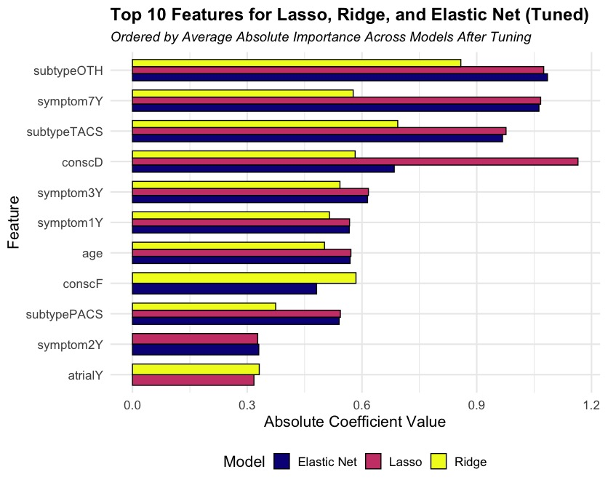
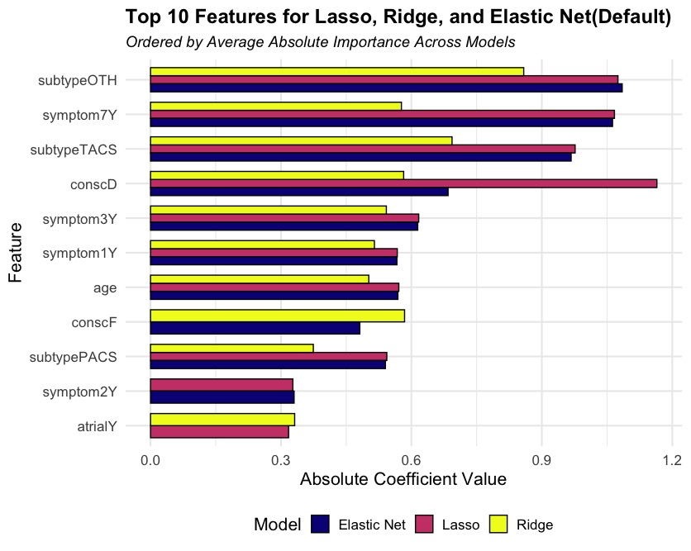
LASSO-RIDGE-ELASTIC KEY FEATURES
Notes:
This slide shows the top 10 important features identified by Lasso, Ridge, and Elastic Net models. Features like stroke subtype, symptoms, and age play a major role in mortality prediction. However, ‘Subtype Other’ may be a false positive due to sampling imbalance, highlighting the need for careful interpretation. Ridge distributes feature importance more evenly, while Lasso and Elastic tend to shrink less relevant features toward zero.

Slide 15
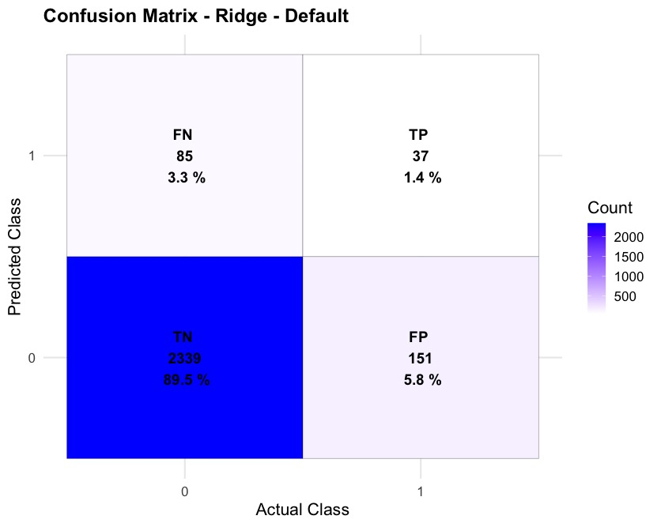
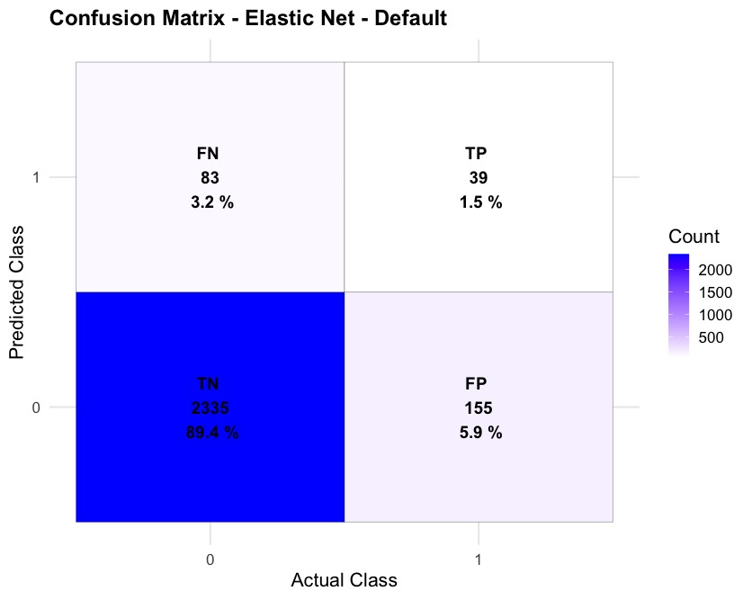

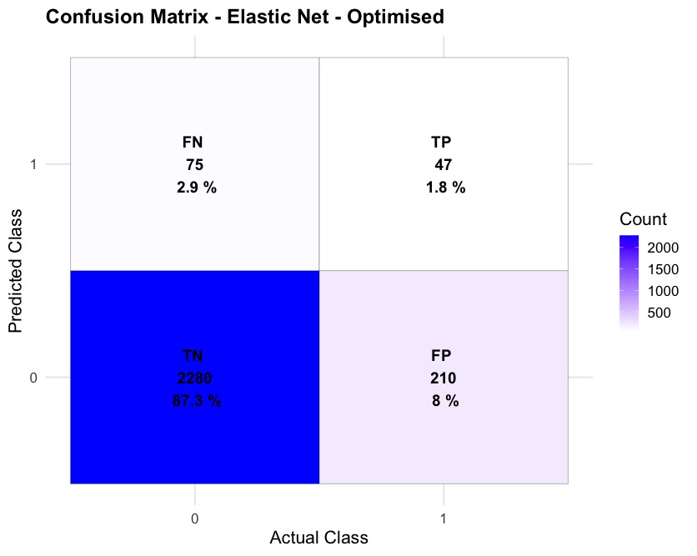
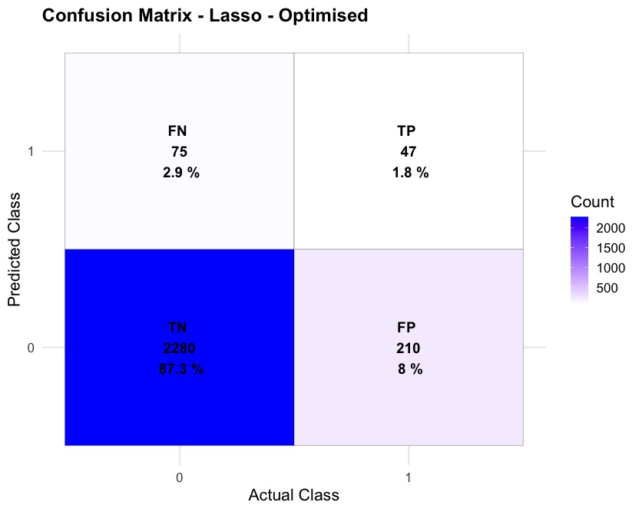

CONFUSION METRICS
Notes:
These confusion matrices compare model performance before and after threshold optimization. Optimized models (bottom row) reduce false negatives (FN), improving recall, which is crucial for identifying high-risk patients. However, this comes at the cost of slightly increasing false positives (FP). This trade-off is essential in medical applications, where missing a critical case is more dangerous than a false alarm.

Slide 16
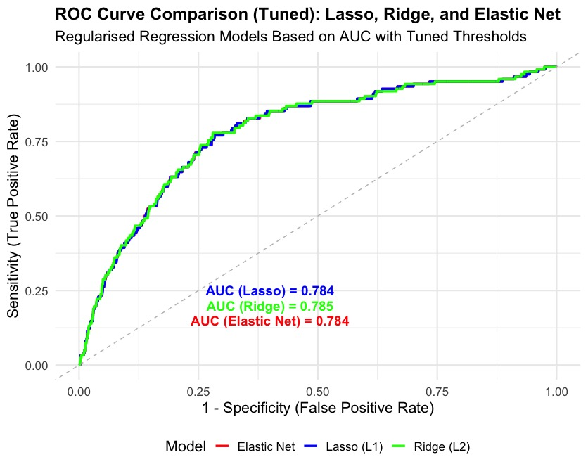
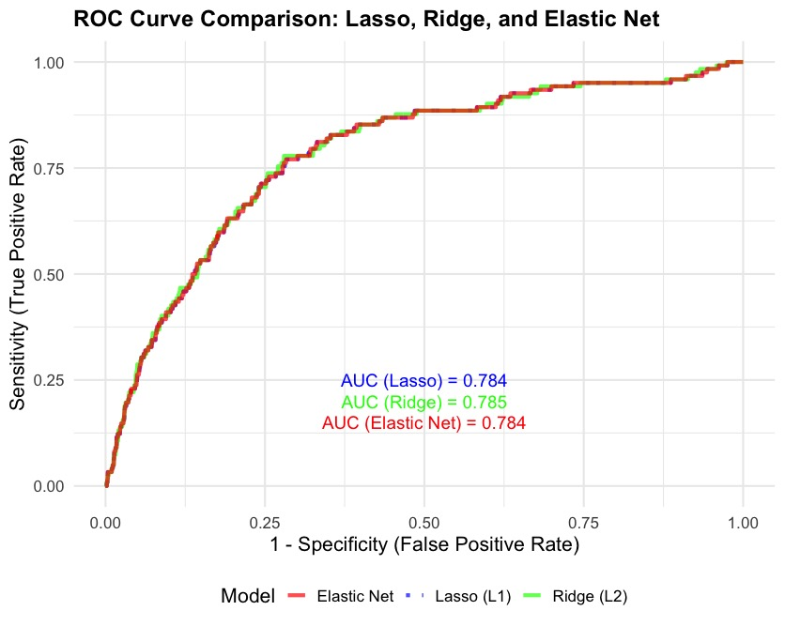
AUC-ROC CURVE
Notes:
This slide compares the AUC-ROC curves of Lasso, Ridge, and Elastic Net models. AUC-ROC measures how well a model distinguishes between death and survival. Ridge performed the best with an AUC of 0.785, meaning it has the strongest discriminatory power among regularised models. The similar AUC values across models indicate that all three perform comparably in distinguishing positive and negative cases.

Slide 17
TASK THREE – BOOSTING WAS OPTED
Boosting is particularly effective in handling class imbalances, ensuring fewer false negatives, which is critical in stroke mortality prediction.
WHY BOOSTING GBM will iteratively learn from misclassifications, making it better at optimizing recall/specificity Your dataset is likely complex and imbalanced. Limitations Slower training compared to Random Forest More sensitive to hyperparameters (needs tuning)
Notes:
Gradient Boosting was chosen because it learns iteratively from misclassifications, making it excellent for optimizing recall and specificity. Given our dataset’s complexity and imbalance, Boosting adapts well to these challenges. However, it has limitations, including longer training times and higher sensitivity to hyperparameters, requiring careful tuning.

Slide 18
TUNING PARAMETERS BASED ON DEFAULT RESULT(G-Boosting)
Tuning Parameters | Pros | Cons
scale_pos_weight | Adjusts class weighting to handle imbalanced data, making the model more sensitive to the minority class. | If tuned incorrectly, can overcompensate minority class, leading to excessive false positives
eta (Learning Rate) | Controls step size for weight updates, improving convergence stability | Lower eta improves generalization but requires more training iterations, while higher eta speeds up convergence but risks overfitting.
min_child_weight | Prevents overfitting by avoiding excessively small leaf nodes | Reduces flexibility, which may affect capturing subtle relationships in data
max_depth | Higher values capture complex patterns but risk overfitting, | Lower values enhance generalization but may miss key interactions.
early_stopping_rounds | Helps prevent overfitting by stopping training when validation performance stops improving. | A low value may stop training too early, while a high value may continue unnecessary iterations.
Folds | Reduces risk of model overfitting to a particular dataset split | More folds = more computational cost
Notes:
Gradient Boosting requires careful tuning to optimize recall and precision while avoiding overfitting. scale_pos_weight was adjusted to handle class imbalance, significantly improving recall from 10% to 56.1%, ensuring fewer missed critical cases. eta (learning rate) was fine-tuned to stabilize learning, balancing accuracy and generalization, which resulted in higher specificity (83.61%) and precision (98.58%). max_depth and min_child_weight were optimized to prevent overfitting, leading to a model that captures complex relationships without excessive false positives. early_stopping_rounds ensured that training stopped at the optimal point, preventing unnecessary computations while maintaining performance. As seen in our optimized model, these hyperparameter adjustments led to a well-balanced classifier that prioritizes high-risk stroke patients while maintaining strong specificity.

Slide 19
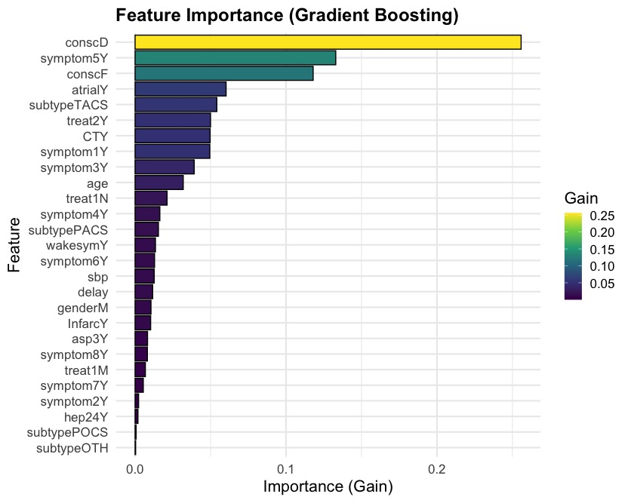

KEY FEATURES (G-BOOSTING) DEFAULT & OPTIMIZED
Notes:
This slide compares feature importance in default vs. optimized Gradient Boosting models. Key predictors include consciousness level (fully conscious vs. drowsy) and symptom-5, which play a crucial role in stroke mortality. Optimization refined feature importance, emphasizing clinically relevant variables. Unlike logistic regression, boosting captures complex, non-linear interactions between symptoms and outcomes, making it valuable for clinical decision-making.

Slide 20
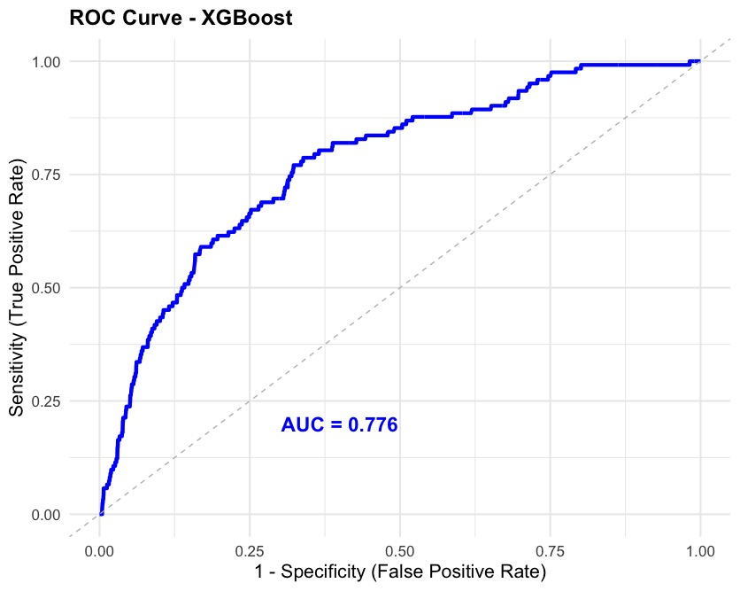
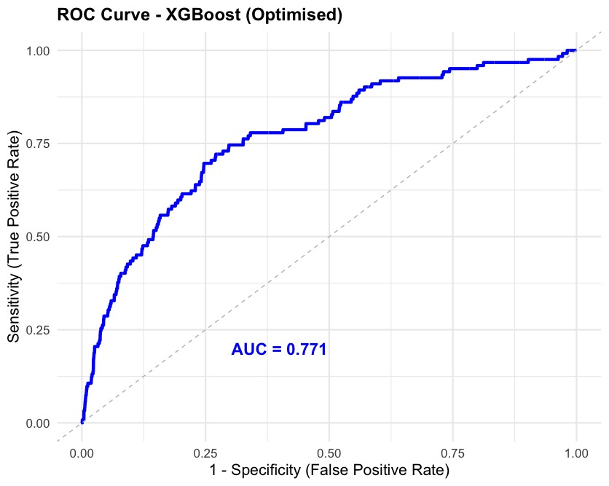
ROC CURVE (G-BOOSTING) DEFAULT & OPTIMIZED
Notes:
This slide compares the ROC curves for the default vs. optimized XGBoost models. The AUC (Area Under Curve) for the default model is 0.776, while the optimized model achieves 0.771, indicating a very small difference in overall discrimination ability. The ROC curve shape remains similar, showing that the model maintains a consistent trade-off between sensitivity and specificity after optimization.

Slide 21
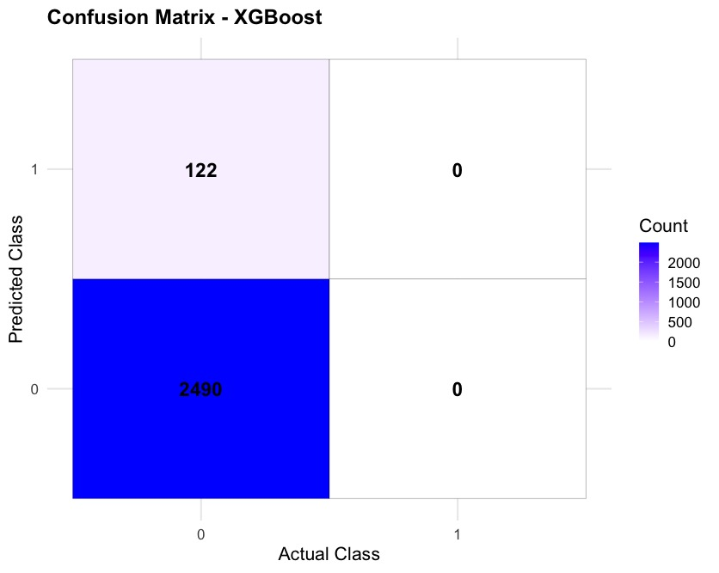
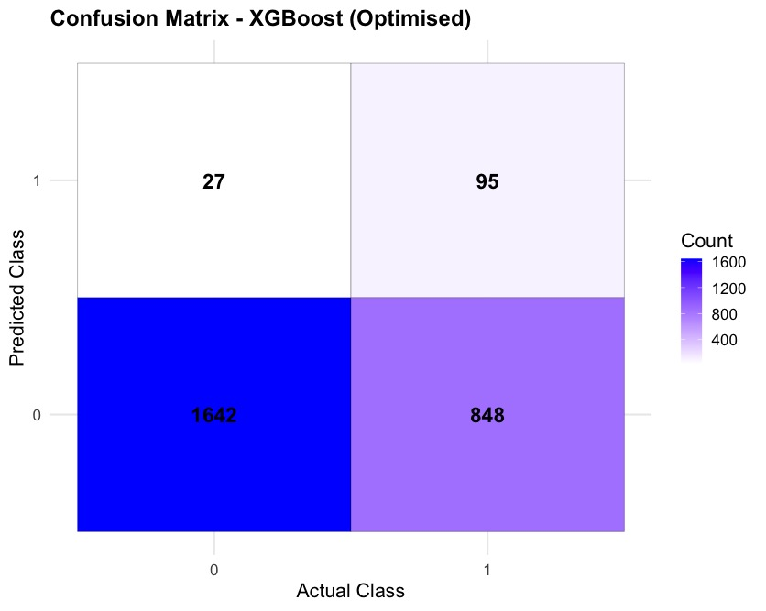
CONF-MATRIX (G-BOOSTING) DEFAULT & OPTIMIZED
Notes:
This slide compares confusion matrices for default and optimized XGBoost models. In the default model, all deaths (positive cases) were misclassified as survivors, resulting in 0 true positives. After optimization, the model correctly identified 848 deaths while reducing false negatives from 122 to 27. This trade-off improves recall significantly, ensuring that high-risk patients are identified rather than overlooked.

Slide 22
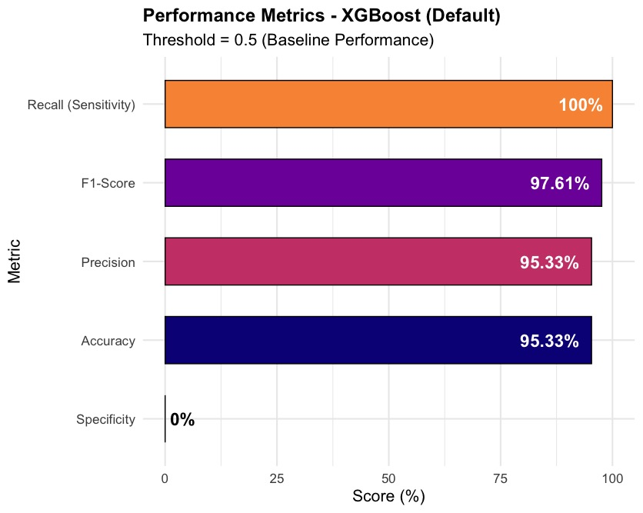
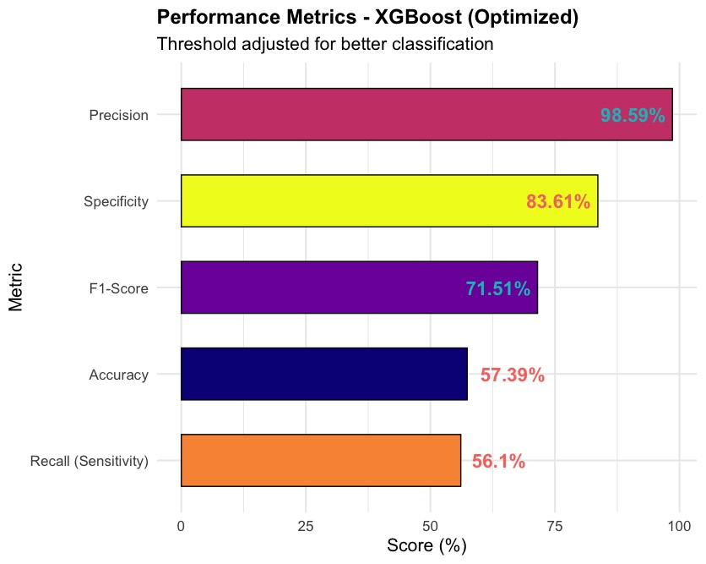
PERFORMANCE (G-BOOSTING) DEFAULT & OPTIMIZED
Notes:
This slide compares the default vs. optimized performance of XGBoost. The left graph shows baseline performance at a 0.5 threshold, while the right graph shows performance after optimization for better classification.
Optimized model improves Precision (98.59%) & Specificity (83.61%) but slightly lowers Recall (56.1%).
Default model has 100% Recall but fails on Specificity (0%), leading to many false positives.
Balanced trade-offs were made to improve real-world applicability.

Slide 23
TASK FOUR: COMPARATIVE ANALYSIS
Summary Statistics Against Each Model (Optimized Version)
METRIC | LASSO | RIDGE | ELASTIC | BOOSTING
Accuracy | 89.08% | 88.97% | 89.09% | 57.39%
Recall | 38.52% | 39.34% | 38.52% | 56.10%
Specificity | 91.56% | 91.40% | 91.57% | 83.61%
Precision | 18.28% | 18.32% | 18.28% | 98.59%
F1 Score | 24.80% | 25.00% | 24.80% | 71.51%
AUC-ROC | 76.2% | 76.9% | 76.5% | 77.10%
MCC (Metrics) | 0.213 | 0.216 | 0.213 | NA
Threshold(Youden’s) | 0.21 | 0.21 | 0.21 | 0.066
Threshold (F-1) | 0.45 | 0.41 | 0.45 | NA
Lambda | Optimal | Optimal | Optimal | NA
Alpha | 1.0 | 0.0 | 0.5 | NA
Youden's Index | 0.301 | 0.305 | 0.301 | 0.393
Overall Best Performing Models Data Scientist Point-Of-View
Ridge, Boosting
Notes:
As Data Scientists, we would go with Ridge and Boosting:
Ridge: Ridge → Best AUC-ROC, MCC, and Youden’s Index (most stable and generalizable model).
While Lasso and Elastic, though they have good general scores, but not selected because they have lower recall, AUC-ROC, and MCC, meaning they are less effective in predicting actual deaths and less stable overall
Boosting → Best Recall, Precision, and F1 Score and good at identification

Slide 24
BEST MODEL BASED ON NATURE OF DATA
Requirements | RIDGE | BOOSTING
Identification of Death with Two Weeks | High accuracy (88.97%) and AUC-ROC (76.9%) → Good at distinguishing survivors vs. non-survivors. | Best recall (56.10%) → Better at detecting actual deaths, reducing false negatives.
Factors playing the key role in death | Identifies linear relationships between features and death risk → useful for understanding key predictors. | Can capture non-linear relationships and interactions, providing a more nuanced understanding of risk factors.
Identification of effective treatment | More interpretable model → Suitable for understanding how different treatments influence outcomes. | Boosting’s high precision (98.58%) ensures fewer false alarms in death classification, making it useful for evaluating treatment effectiveness and prioritizing urgent cases..
Final Selection Justification (Clinical vs. Predictive Perspective)
Clinical Scientists Prefer Boosting → Its superior recall ensures that critical cases are detected, reducing the risk of missing high-risk patients needing urgent care.
Data Scientists May Prefer Ridge → Because it provides a stable, interpretable model with strong overall performance.
Notes:
This slide compares Ridge and Boosting models based on their strengths. Ridge provides high accuracy (88.97%) and strong interpretability, making it ideal for understanding factors influencing death. Boosting, however, has the best recall (56.1%) and high precision (98.58%), ensuring high-risk patients are identified. Clinicians prefer Boosting for its ability to detect critical cases, while data scientists may favor Ridge for its stability and transparency.

Slide 25
FUTURE PERSPECTIVES
Well Planned Collection of data to avoid Imbalanced data
Inclusion of more more sites within planned study for wider population & extensive data
Ensuring population representation if done so
Inclusion of Socio-Economic Factors
Inclusion of Behavioral Sciences Indicators
ntegrate detailed patient histories, including past conditions, treatment adherence, and comorbidities, for more robust predictions.
Inclusion of Environmental Factors
Studies of this magnitude should always be conducted by a team of data scientists, epidemiologists, and medical professionals.
Accurate data collection is the foundation of meaningful analysis—without it, even the best models cannot deliver reliable insights.

