Slide 1
GIT
Peter Blanchfield

Slide 2
But First
What went wrong yesterday?
First I left a bit out of my initial form
<form action='./StoreCSVtoSQLTable.php' method="post" enctype="multipart/form-data">
Select a file: <input type="file" name="file_to_upload" id = "file_to_upload"><br><br>
<input type="submit" value="Open File">
</form>
I wanted to send the file and this was going to need the FILES type to be added.
This allows the transport of the file

Slide 3
Then I needed to upload the file!
I just uploaded the name
$file = $_POST['file'];
$target_file = $_FILES["file_to_upload"]["name"];
move_uploaded_file($_FILES["file_to_upload"]["name"], $target_file);
The first of these lines was the one I had. It found the file name
It did not locate the File itself
PHP accesses that through the $_FILES object
Which is now sent
move_uploaded_file actually moves it to the server!

Slide 4
Software Engineering
OK so far
We have been hacking a bit
We need to learn to plan
We have done some of this
A paper lo fi version of our interface
An HTML version
And now some PHP
What we could do with is some tools

Slide 5
GIT Helps us keep track
What were you doing on your code Monday?
Did anything go wrong?
Did something stop working?
Where did you keep it?
When you went home and did some work
How did you continue?
Most of you may have kept it on a usb type device
Or you lugged around your laptop
GIT helps us to be more organised

Slide 6
What is GIT
It is a repository system
A place to store things
It is especially good for code
It also gets us in to good habits
But it is really good for groups/teams/companies
It has tools to help us coordinate
Used carefully it helps us not get lost
We can share work out
And blame the failures on the right culprit

Slide 7
GIT Repositories
Are kept on an on line server.
Can be cloned on a local device
Where we can make our changes
Before committing them
We can check they work
Other people will not hate us
Because what we commit will not break their code

Slide 8
Which GIT?
There are lots of GITs
We have a GitLab system in the School on one of our servers
@ projects.cs.nott.ac.uk
You log on the LDAP tag
With your uni username
There is BitBucket
There is GitHub
I like this best
It is used for sharing open source code
But you can make private repositories

Slide 9
Using GitHub
You will need to register at
github.com
I already have a username
It is drbatnott

Slide 10
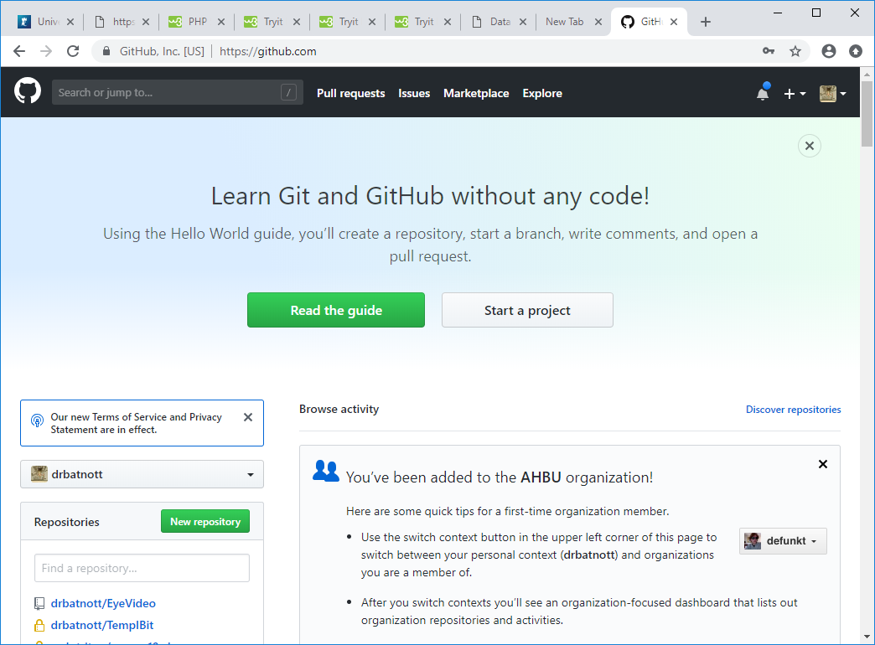
My Dashboard

Slide 11
I'm going to make a new repository
Demo for DIS or DISDEMO ☺

Slide 12
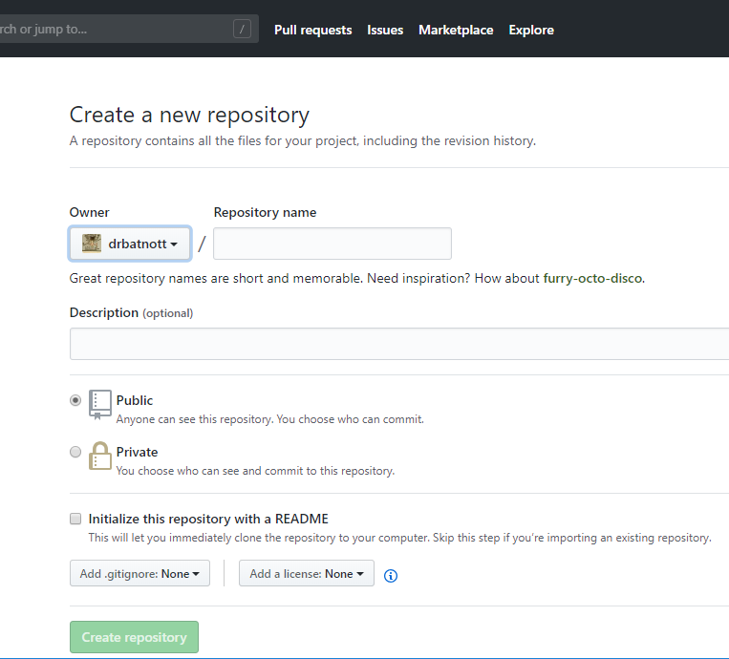
I get this

Slide 13
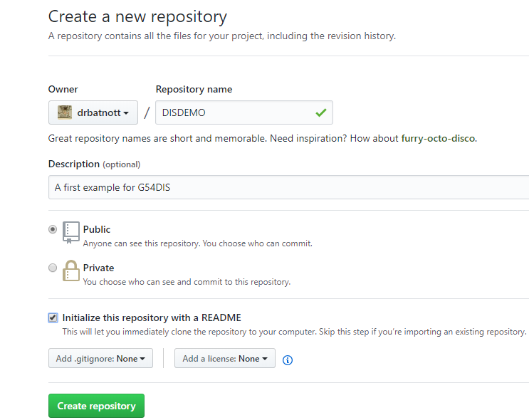
So

Slide 14
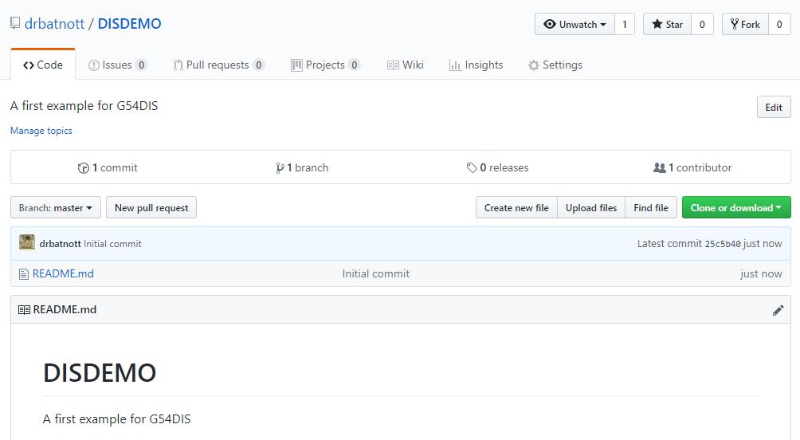
And here it is

Slide 15
There is nothing there yet
I am going to clone it on my machine(s)
I have loaded a program called GitKraken
But you can get GitHub for Windows (or a similar thing for Mac)

Slide 16
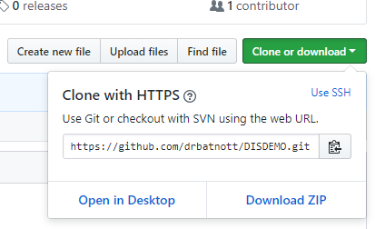
Cloning with GitHub for Windows
Over here I choose Open in Desktop

Slide 17
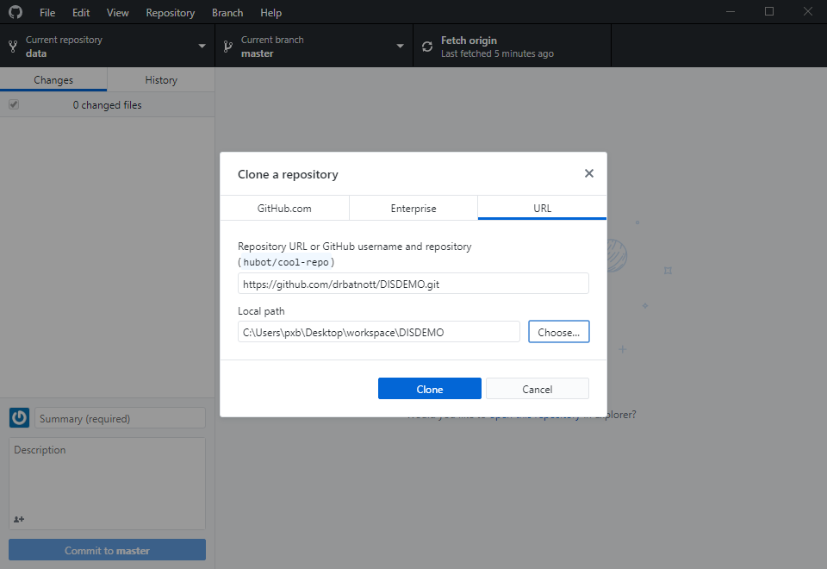
In GitHub for Windows I set up my preferences to use a folder called workspace

Slide 18
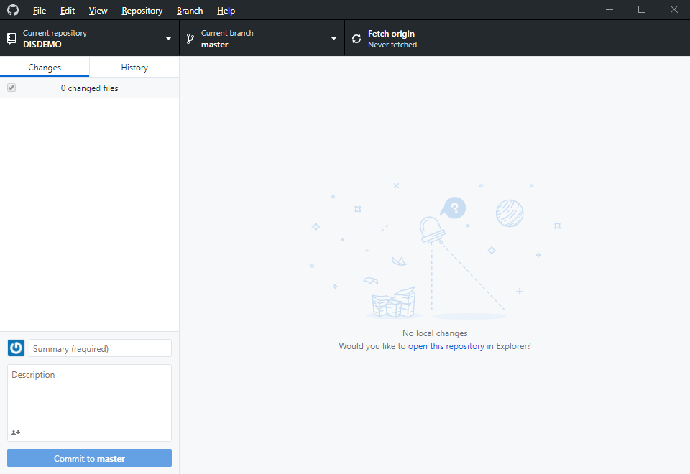
When I clone I Get

Slide 19
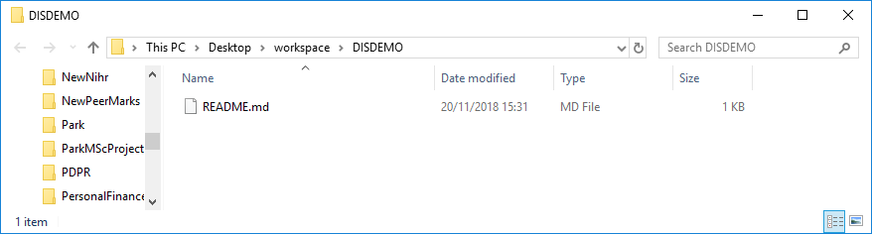
If I open the repository in Explorer I get
Just my README.md

Slide 20
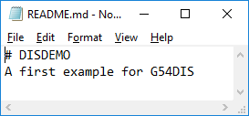
My README.md

Slide 21
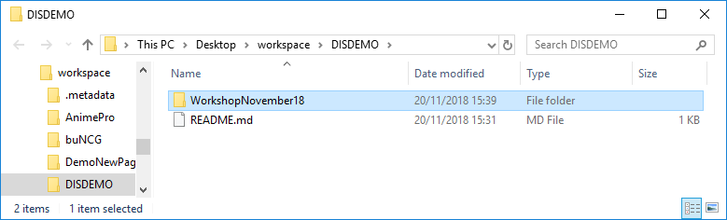
Pretty Boring
I am going to store All the work I have been doing here

Slide 22
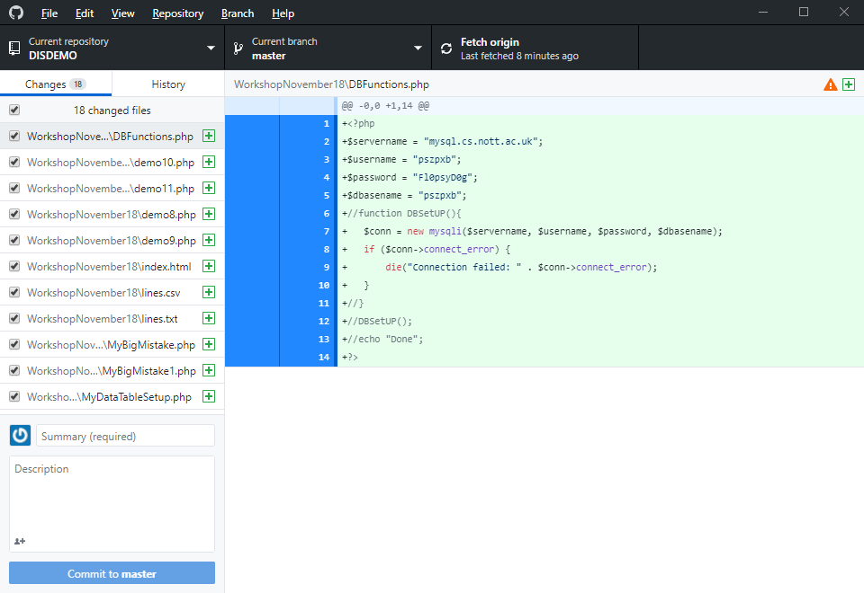
Now I can save this to GitHub
First commit the changes locally. I need to say what I have been doing

Slide 23
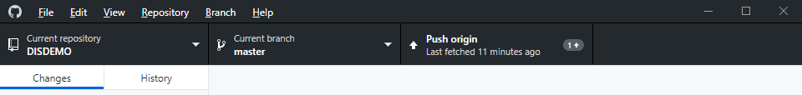
Then I push them to the origin on the GitHub server
By clicking push

Slide 24
Now on any other computer
I can clone the project
Make changes
And push these back

Slide 25
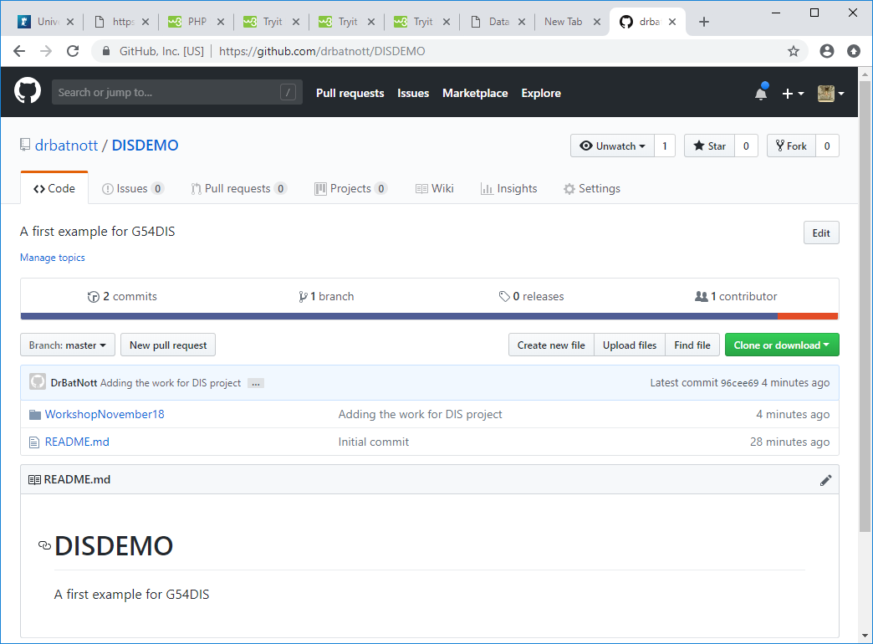
On the server I can see things have arrived

Slide 26
I can get graphs of what has been happening
OK I will show you this in class

Slide 27
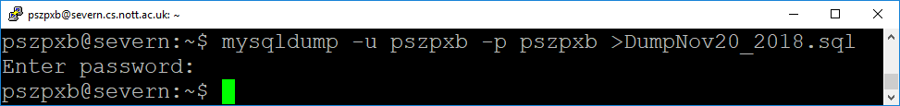
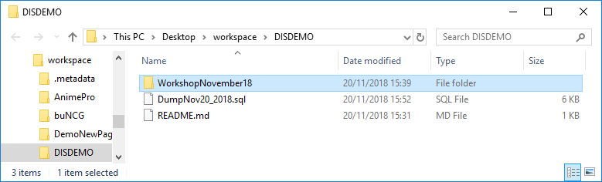
Doing my mysqldump
The password needed is for the log on to the database. I move the file into my workspace

Slide 28
Do a new commit and push
My commit title is
Create DumpNov20_2018.sql
And the full description
Saving the state of the database at this point

Slide 29
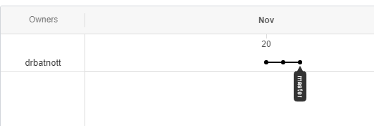
The state of the on line graph changes
Under Insights-Network on GitHub
Shows the three commits I made

Slide 30
Now to plan
What am I going to do next?

