Slide 1
Time for Breakfast
Determining the best location for
a breakfast cafe
in Indianapolis, Indiana

Slide 2
Criteria
To be successful, a breakfast cafe needs:
  To get traffic
  To be ahead of the competition
Therefore, opening it in a place with high morning traffic and low number of competitors would be ideals

Slide 3
Data
Start with a medium sized city
  Indianapolis, IN in the American Midwest
Obtain the coordinates
  I found a .csv file online containing the coordinates of the zip codes around Indianapolis, with about 60 different locations

Slide 4
Venues
First, we get the venues
  Similar to previous assignments and exercises
However, later on, to get hours we will need premium calls
  Limit venues to 50 per zip code
We also don’t need all categories
  If it’s a late business, such as specialty dinner/dining or nightlife, it can be excluded

Slide 5
Venues cont’d
Perform clustering to get 5 clusters
From these clusters, determine best for business
  Lots of hotspots like hotels, museums, or other attractions
  Not a lot of cafes, bakeries, etc. that might be competitors
Narrow down to a list of zip codes to find popular hours for

Slide 6
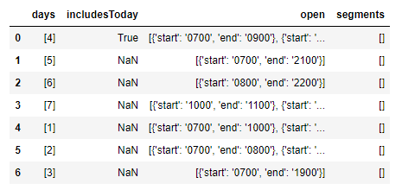
Hours
Use the narrowed down list to do premium calls to get popular hours
  Popular hours are nested with hours per week, and they’re sorted into timeframes
  Need to extract all hours between “start” and “end” times

Slide 7
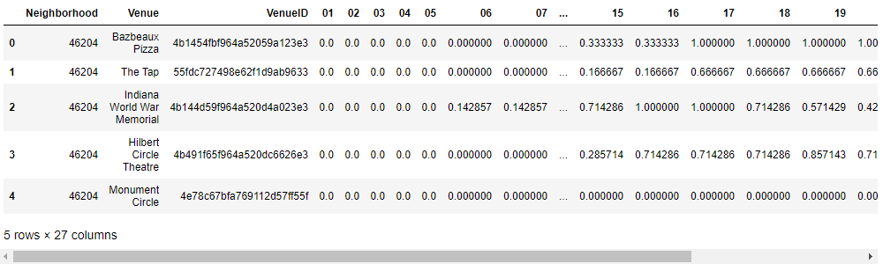
Hours cont’d
Create two functions to extract popular hours per day, and then average all days per week
  Get a 1x24 array containing a value for every hour
Use a function to do premium calls for all venues, getting their popular hours

Slide 8
Hours cont’d
These hours can be used directly for clustering
Also do some exploratory analysis on subset of hours 0-12 to see which neighborhoods had the highest mean, which would likely be good candidates (zip codes: 46280, 46278, 46204, or 46207)
Used 3 clusters, which ideally would split more into morning, afternoon, and night

Slide 9
Hours cont’d
One cluster appeared to be oriented strongly towards the hours between 8am and 2pm
Compared the number of venues in this cluster to all venues in each zip code
Zip codes 46204 and 46207 had the best result

Slide 10
Result
If you want to open a breakfast spot in Indianapolis, Indiana, with a high amount of morning traffic and a lower number of competitors, consider opening it in the zip codes 46204 or 46207
Thank you!

Slide 11
This work is licensed under a Creative Commons Attribution-ShareAlike 3.0 Unported License.
It makes use of the works of Mateus Machado Luna.

