Slide 1
The World Wide Web, or simply the Web, is a way of accessing information through the medium of the Internet. It is an information-sharing model that is built on top of the Internet. So how does the web work ?
Its done with a helpful complicated network of optical fibee cables which connect between the data centre and the device .
Actually It's a little complicated so we'll summarize it in some steps
You enter "youtube.com" (that is called "a domain") but actually, the server which hosts the source code of a website, is identified via IP (= Internet Protocol) addresses. The browser sends a "request" to the server with the IP address you entered .
The job of these DNS servers is to translate domains to IP addresses. You can imagine those servers as huge dictionaries that store translation tables.

Slide 2
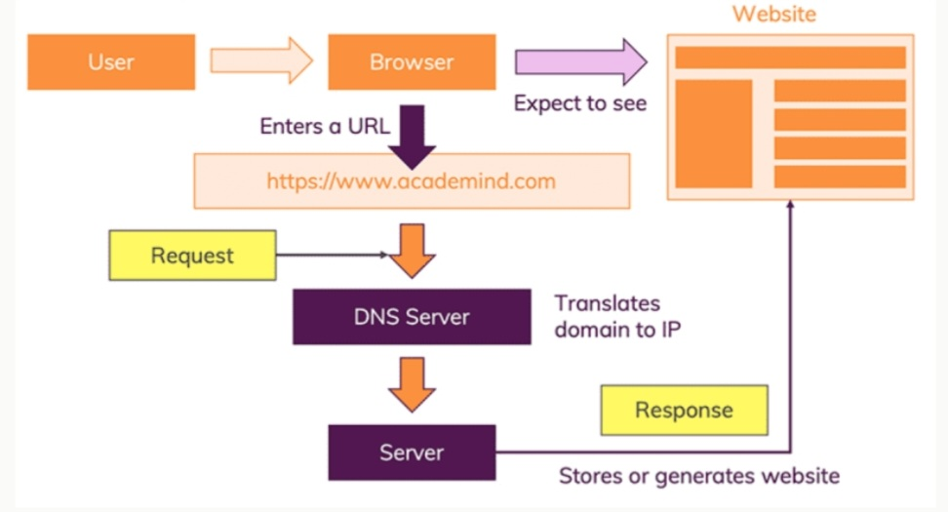
When you enter "youtube.com", the browser therefore first fetches the IP address from such a DNS server. The browser bundles up a bunch of information (What's the exact URL and sends that data package to the IP address.The data is sent via the "HyperText Transfer Protocol" (known as "HTTP") which data may be included and how the request will be submitted. In the end, a response has to be sent.

Slide 3
And what do you need to be a weeb developer ?
Mainly, it requires the mastery of these three languages: HTML, CSS and JavaScript.
They are the three pillars of web development, which we’ll be learning about over the next few weeks.
Collectively, these three pillars are what make a website function, by defining the content to be displayed (HTML), instructing a browser how to display that content (CSS), and making the content interactive (JavaScript).

Slide 4
Why did you choose to learn web development?
From my vantage point it gives you the opportunity to express yourself creativity on the internet try to discovre your web development skills and have a fun experience
Attractive salaly package with high growth

