Slide 1
UGRP - Presentation
Mouna Rajesh G, ee22b100
Topic: Efficient Excitation Optics for NV center based Magnetometry

Slide 2
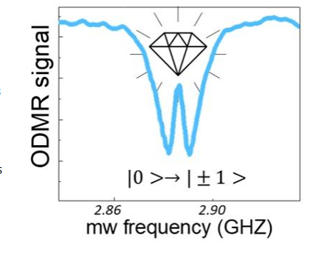
NV Quantum Magnetometer
Nitrogen Vacancy color centres in Diamond offer long spin coherence times even at room temperature, ideal for quantum sensing.
Magnetic field measured using ODMR technique
Parts of the system
  Laser + Excitation Optics
  Diamond Sample
  Fluorescence Collection Optics
  Microwave field generator
  Bias magnetic field

Slide 3
Scope of the project
Survey of excitation optics of the magnetometer
  Determine the current spatial optics scheme efficiency of light conversion
  Key parameters that affect the sensitivity of magnetometer
  Explain why integrated optics is a good choice
Design of an efficient excitation scheme
  Investigate waveguide level designs to couple light into Diamond
  Simulate and evaluate the efficiency of light coupling

Slide 4
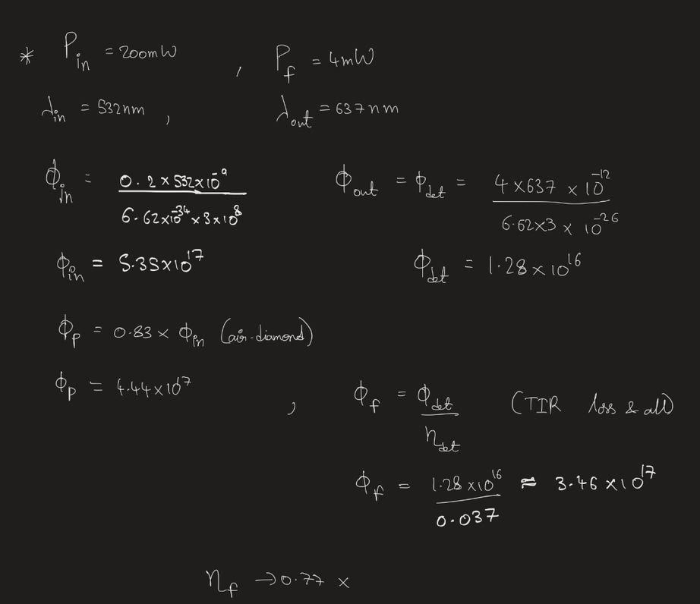
Spatial Optics - IIT Madras
η_{f} = φ_{p} / φ_{f} , is the number of red photons emitted per green photon
It is optimized by long interacting path length , but 0.7 is already a high value

Slide 5
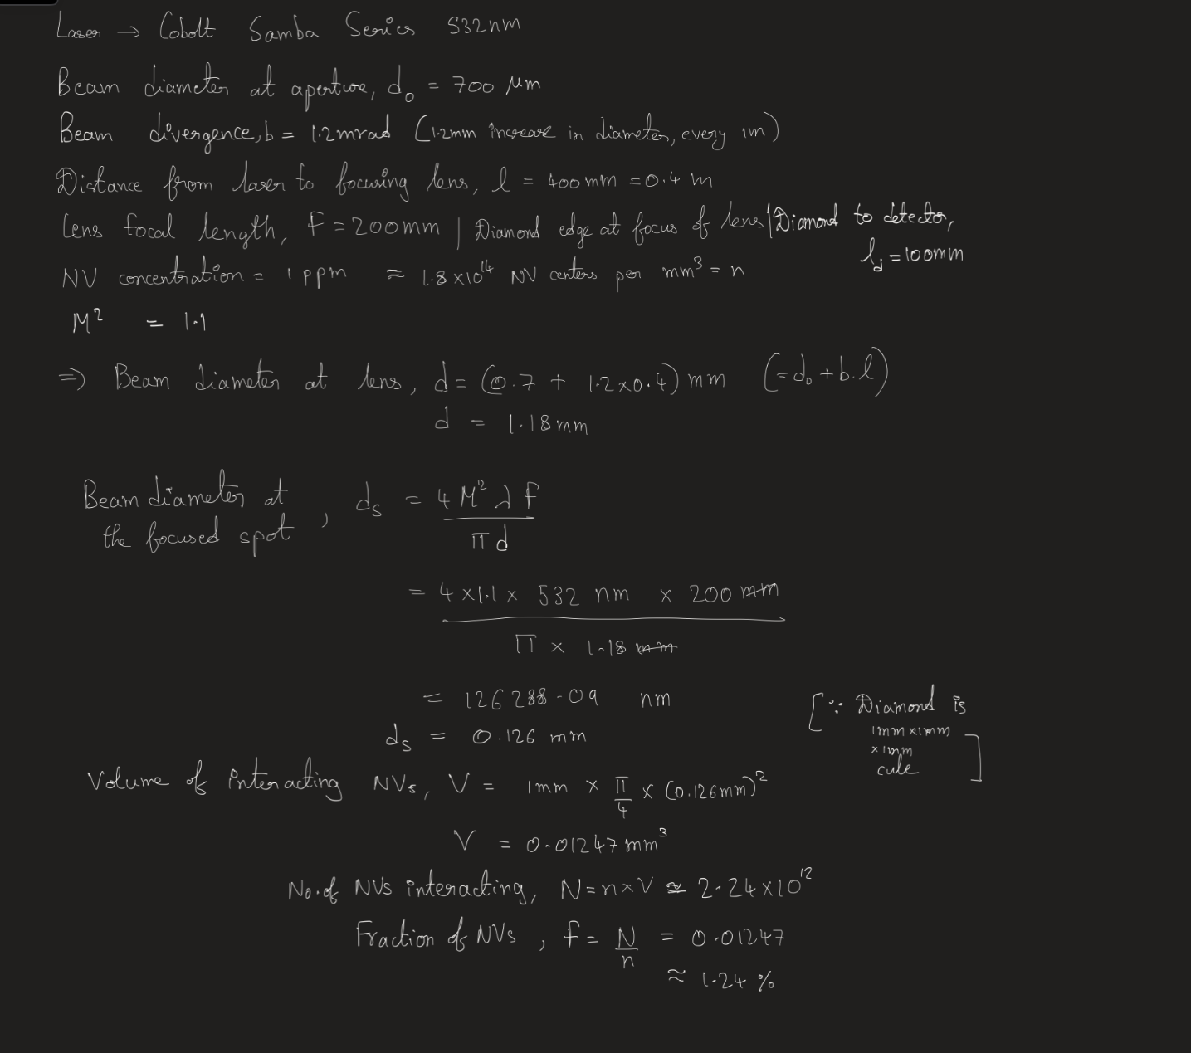
Spatial Optics - IIT Madras
Number of interacting NVs is an important parameter affecting the sensitivity of magnetometer
This number has to be improved

Slide 6
Why integrated design?
Current designs
Bulky optics, not portable
Very low percent of light from source actually interacts with NVs
  Leads to low overall efficiency
Not much control over volume of interaction
  Crucial factor in determining sensitivity
Ideally
High efficiency light coupling into diamond
Control over volume of excitation

Slide 7
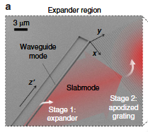
Extreme Mode Converter
300 nm x 250 nm SiN waveguide to 160 µm Gaussian beam
1: Waveguide to Slab mode expander
2: Apodized grating , slab to free space
Designed for 780nm , Si₃N₄ on SiO₂
68% port coupling efficiency
https://doi.org/10.1038/s41377-018-0073-2

Slide 8
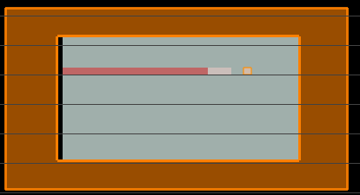
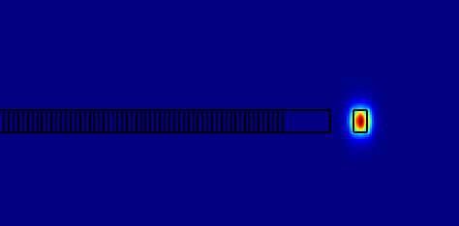
Gap vs Effective index
Find the effective index profiles as function of gap.
Need to use Lumerical Finite Difference Eigenmode (FDE) solver.
Red → Waveguide + Slab = Si₃N₄ with n = 2.01
Gray → Cladding = SiO₂ with n = 1.45
Designed the slab with increasing loss from 1 µm wide onwards
Run FDE mode solver and manually pick the waveguide TE₀ mode

Slide 9
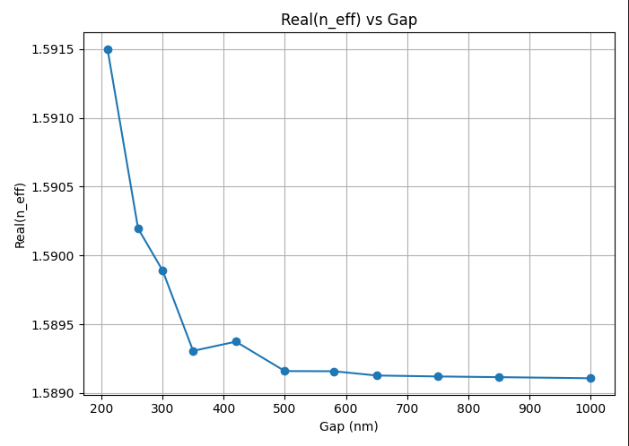
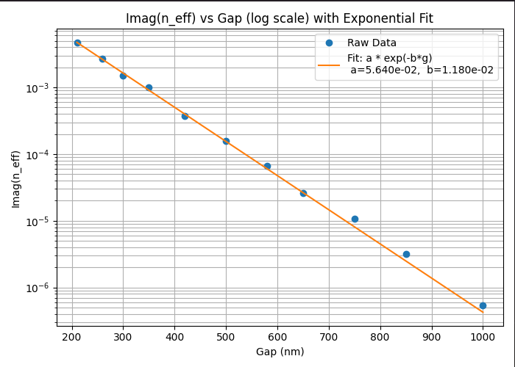
Gap vs Effective index plots
Re{n_{eff}} saturates at 1.589 for g > 500 nm | Paper result : 1.578 for g > 500nm
Im{n_{eff}} is linear in log scale with a = 0.05639 ,1/b =84.7731 nm
| Paper result : a = 0.06423,1/b = 84.2612 nm

Slide 10

Gap profile
θ_{tilt} = cos⁻¹(1.589/1.79) = 24.41°
Analytic equation remains same as in the paper(with -ve sign and z`² in exp) with a,b modified
w₀ = w . sin(θ_{tilt}) = 100 . √2 µm → w = 342.16 µm
Gap profile plotted using python

Slide 11
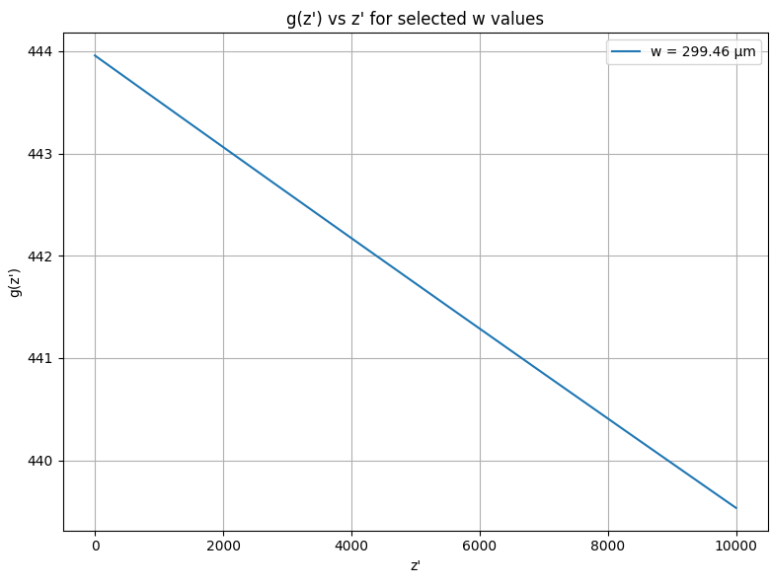
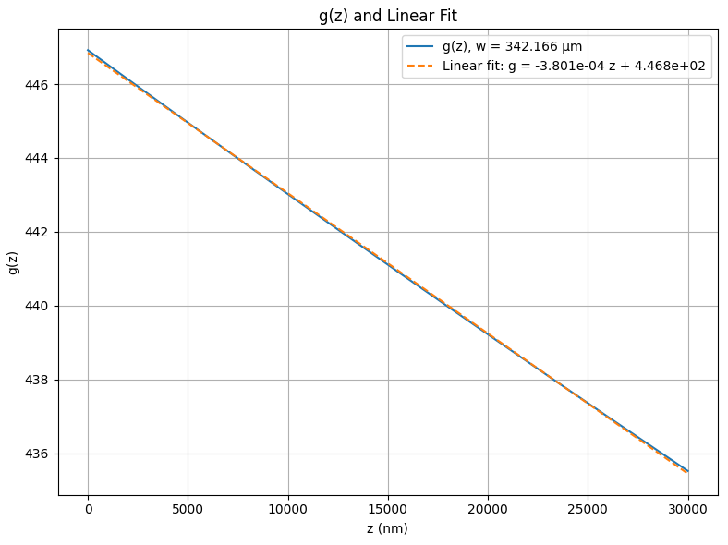
Gap profile
With paper’s a,b,w values
4 nm variation for 9 µm length
With obtained a,b,w values
11.5 nm variation for 30 µm length

Slide 12

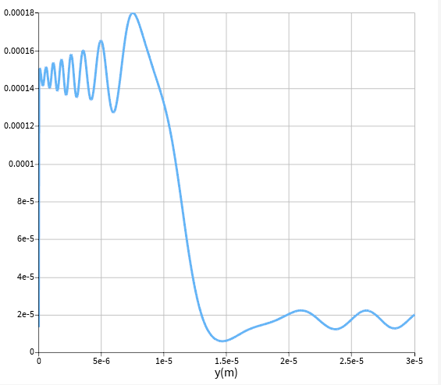
Design of varying gap profile
Coded in Python to output the (g(z) , z) pairs for several points for 30 µm of z
Imported these data points in Lumerical FDTD to create the slab
Comments:
Very tiny changes in the gap size - in the order of 10 nm
Meshing for this - too expensive
Might be the cause of inaccurate field profile
Power vs z

Slide 13
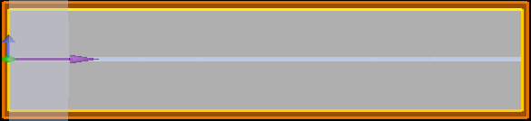
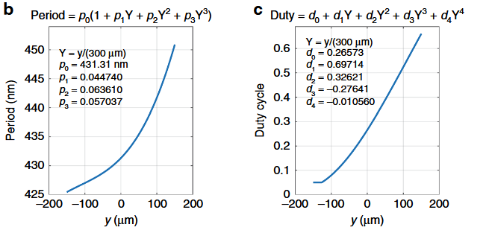
Apodized Grating
Designed using the parameters given in the paper

Slide 14
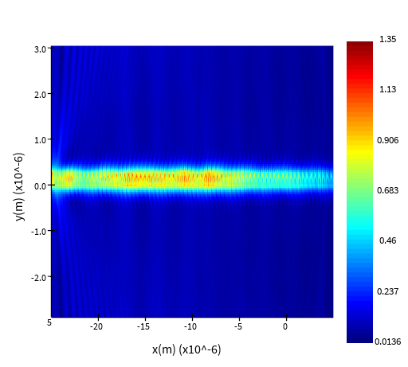
Apodized Grating
Comments:
Gaussian beam of waist 100 µm , but too expensive to simulate z-axis for that length
Might be the reason for unexpected field profiles

Slide 15
Problems with Extreme Mode Converter
Simulation issues
Efficiency
  Design focuses on getting a Gaussian beam - controls volume of excitation
  Power conversion efficiency is not very great
  Loss of light at air-diamond interface is not avoided
Unclear parameters in paper:
  Length of the waveguide section , gap profile used
  Gaussian beam profile of slab
Adapting to 532 nm
  Apodized grating parameters need to be optimized again
Need a design to
Focus on power conversion efficiency ,whilst also controlling volume of excitation
Direct coupling into diamond

Slide 16
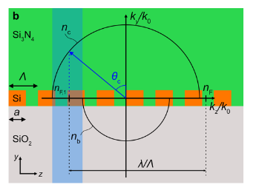
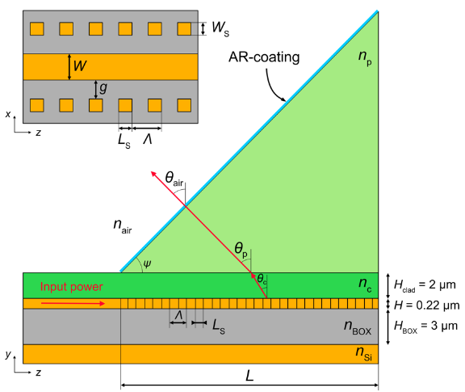
Ultra Efficient Grating Coupler
Single Beam radiation condition:
-n_{c} < λ/Λ - n_{F} < -n_{b}
Design for chip to free-space coupling:
Materials, and Λ are chosen to satisfy single beam condition
W, H are chosen to allow TM₀
W_{s}, g, L_{s} are variable and determine 𝛼_{F} = -ln(1-P_{rad}/P_{in})/(2.L)
  Length to radiate 99% , L = 2.3/𝛼_{F}
https://doi.org/10.1364/OE.537112

Slide 17
Ultra Efficient Grating Coupler
For single beam radiation of green light into Diamond substrate:
λ = 532 nm, n_{c} = 2.425
Core material : n > 2.425 at 532 nm
Options
Gallium Phosphide (GaP) : n = 3.4932 , k = 0.00263
Titanium Dioxide (TiO₂) : n = 2.6678 , k = 0

Slide 18
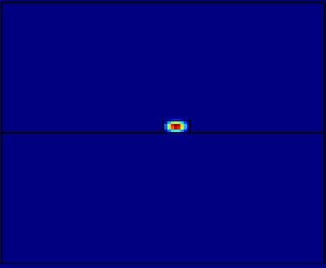
Ultra efficient grating coupler
GaP: n = 3.49,k = 0.0026 | Diamond n_{c} = 2.42,k = 0 | SiO2 n_{b} = 1.46,k=0
n_{eff} = 3.368 + 0.0026i
loss = 2745.3 (dB/cm)
  Attributed to the k value of GaP at 532 nm
Similar loss was obtained by changing the lower cladding to other materials
TM₀

Slide 19
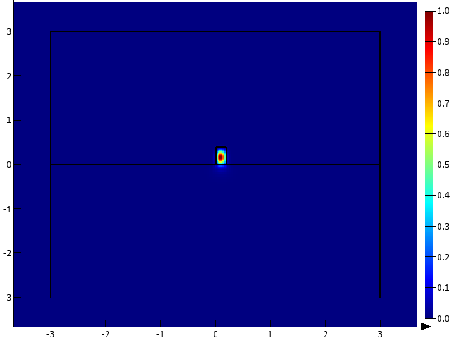
Ultra efficient grating coupler
TiO₂: n = 2.667,k = 0 | Diamond n_{c} = 2.42,k = 0 | SiO₂ n_{b} = 1.46,k=0
SiO₂
n_{eff} = 2.439 + 0i
loss = 0
Good choice for our design
Need to adjust the core dimensions to allow some leaking for evanescent coupling
Diamond
TM₀

Slide 20
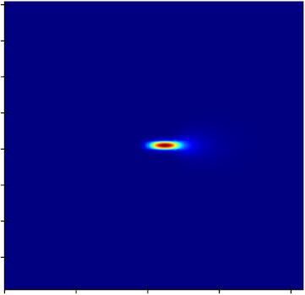
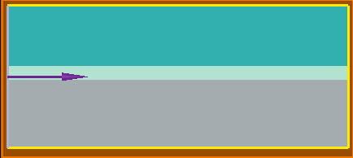
Ultra efficient grating coupler
With W = 200 nm , H = 400 nm :
n_{eff,0} = 2.439 + 0i , and leaking into sides as well
From single beam condition :
3.899< λ/Λ < 4.864 , chose Λ = 125 nm for λ/Λ = 4.256
  θ_{c} = 48.5° (from vertical)
L_{s} chosen as 50 nm arbitrarily, and L is fixed at 10 µm
g and w_{s} are varied to get different 𝛼_{F} values

Slide 21
Ultra efficient grating coupler
lower g and higher w_{s} → higher 𝛼_{F} , target : get L for 99% coupling around 1 mm
w_{s} (nm) | g (nm) | T_{up} | T_{down} | 𝛼_{F} (m⁻¹) | L for 99% coupling (mm)
500 | 50 | 0.212 | 3.52e-4 | 11937 | 0.19
400 | 100 | 0.0422 | 6.35e-5 | 2155.9 | 1.06

Slide 22
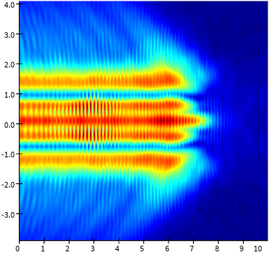
Ultra efficient grating coupler
Field profile of a monitor placed in diamond
The abrupt cutoff before ending
  Observed for any length
  Maybe simulation related issue
The field covers around 4 µm , in the lateral direction
For a diamond sample of 1 mm width, estimated number of such couplers in parallel is 25

Slide 23
Conclusions
Adapted a novel design for efficient coupling to our diamond platform
Future work
  Vary parameters to get desired field profiles
  Simulate long length structures
  Efficient coupling from laser source to the waveguide
  Fabrication and testing

Slide 24
Steps from the paper
Find mode profile for waveguide TE₀ mode , for varying gap values between waveguide and slab. Obtain the Re{n_{eff}} and Im{n_{eff}} vs gap plots.
Find out the saturation value of Re{n_{eff}} and exponential curve fit of Im{n_{eff}}
Use the analytic equation to find gap profile for beam waist w
Simulate the varying gap structure and capture the fields in slab to verify the 1D gaussian
Design apodized grating in the y-z plane as given by the paper. (Need to optimize later for the parameters of our design)
Verify free space Gaussian beam

Slide 25
Comparison of existing methods
Description | Diamond size | Input power | Fluorescence power | Excitation Type | Sensitivity
Baseline (Our lab) | 1mm x 1mm x 1 mm | 200mW | 4mW | Side excitation | 1 nT/sqrt Hz
CMOS integrated | 200um x 200um |  | 0.54 QE PD | Side excitation | 32.1 uT/sqrt Hz

Slide 26
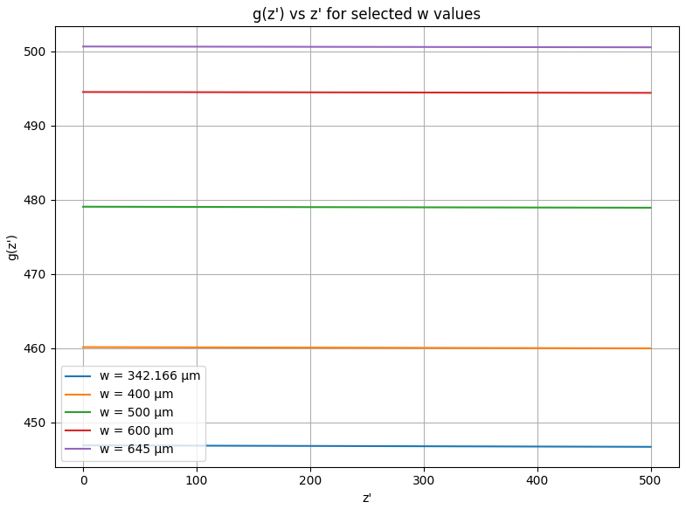
Gap profile
Plotted for varying w (beam waist)
For gap to be > 500 nm , w has to be 645 µm

Slide 27
Gap vs Effective index
gap (nm) | Re{n_{eff}} | Im{n_{eff}}
210 | 1.591501 | 0.004724549
260 | 1.590196 | 0.002709159
300 | 1.589892 | 0.001485438
350 | 1.589307 | 0.001013330
420 | 1.589374 | 0.0003723158
500 | 1.589160 | 0.0001591399
580 | 1.589159 | 6.6451e-5
650 | 1.589128 | 2.590849e-5
750 | 1.589121 | 1.080486e-5
850 | 1.589116 | 3.181339e-6
1000 | 1.589108 | 5.409172e-7

