Slide 1

The Effect of Academic Performance on
Athletic Success in Collegiate Athletic
Programs
How does success in the classroom relate to how a team performs?

Slide 2
Introduction
What are we researching?
How does success in the classroom relate to how a team performs?
Why do we care?
College sports as a business
Impact on student-athletes
Mixed-Effects Modeling

Slide 3
Data
3 Datasets
Directly from NCAA
College Scorecard
Panel Data
14 Variables
394 Schools
9 Sports
8 Years
Team Sports Only
Division 1
Notes:
Men’s Soccer, Women’s Soccer, Baseball, Softball, Men’s Basketball, Women’s Basketball, Football, Men’s Ice Hockey, and Women’s Ice Hockey

Slide 4
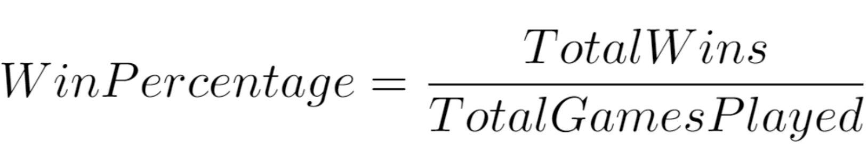
Dependent Variable
A measure of programs' athletic performance

Slide 5
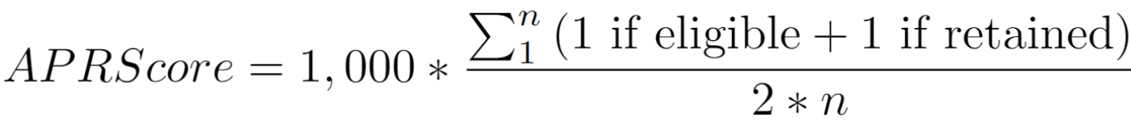
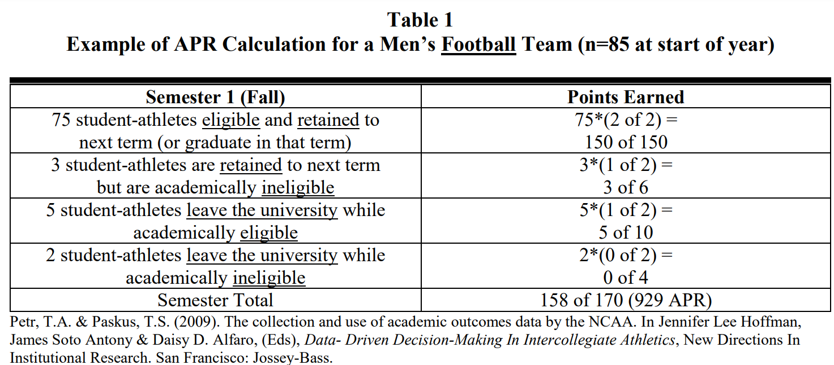
Academic Progress Rate (APR)
Notes:
Specify percentage /1 multiply by 1000

Slide 6
Additional Covariates
Geographic Region
Total Enrollment
Percent of the student body that is white
Percent of the student body that is male
Average cost of attendance in each year
Average age at which students enroll at the institution.
Percentage of degrees awarded in Communication, Journalism, And Related Programs

Slide 7
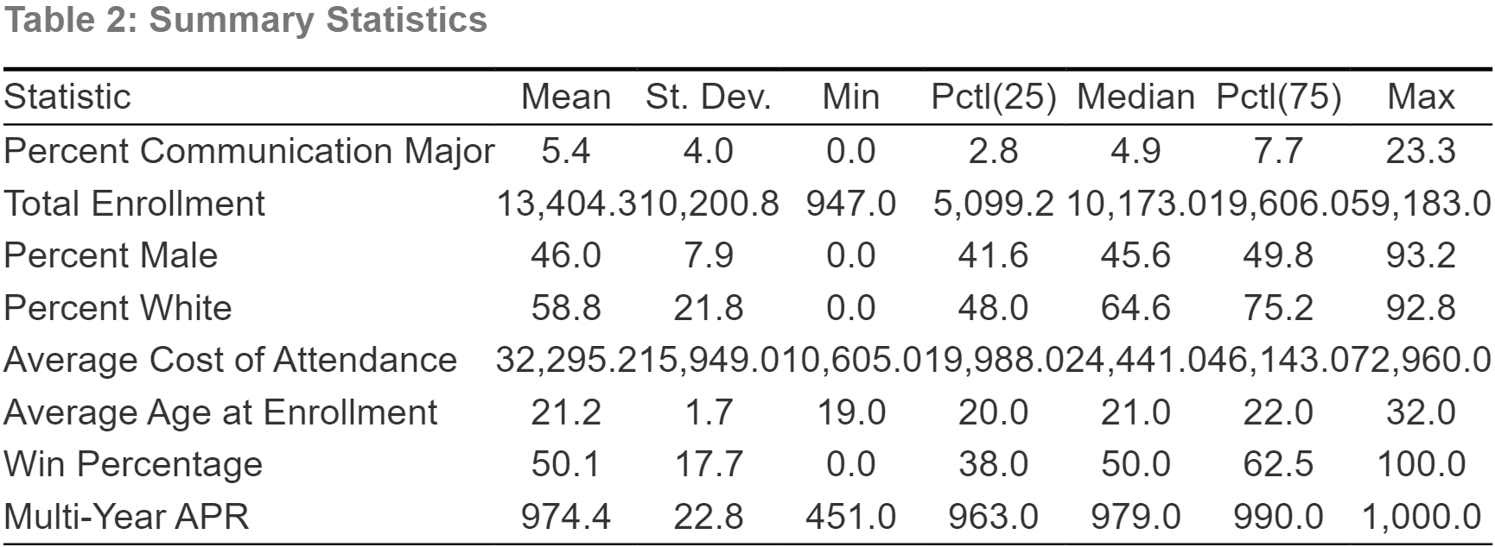

Slide 8
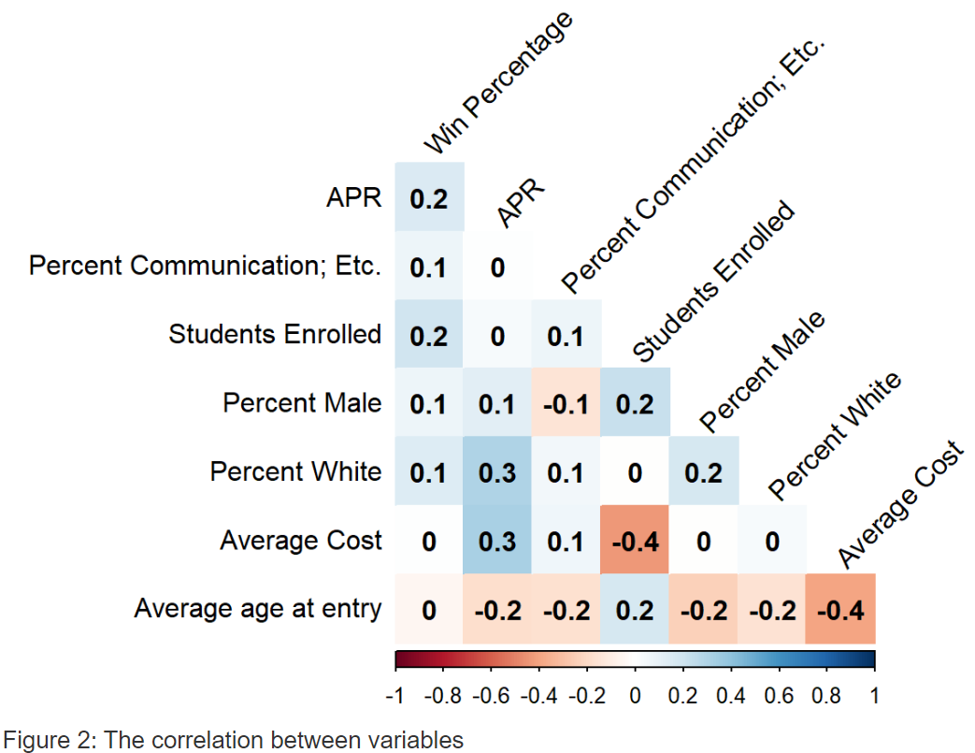
Methodology

Slide 9
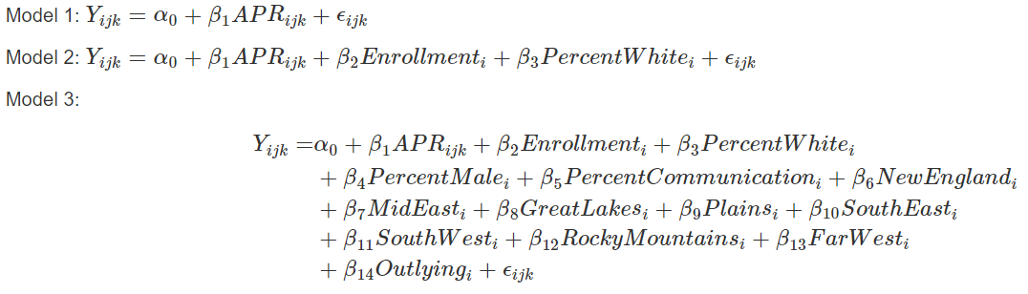
OLS Models

Slide 10
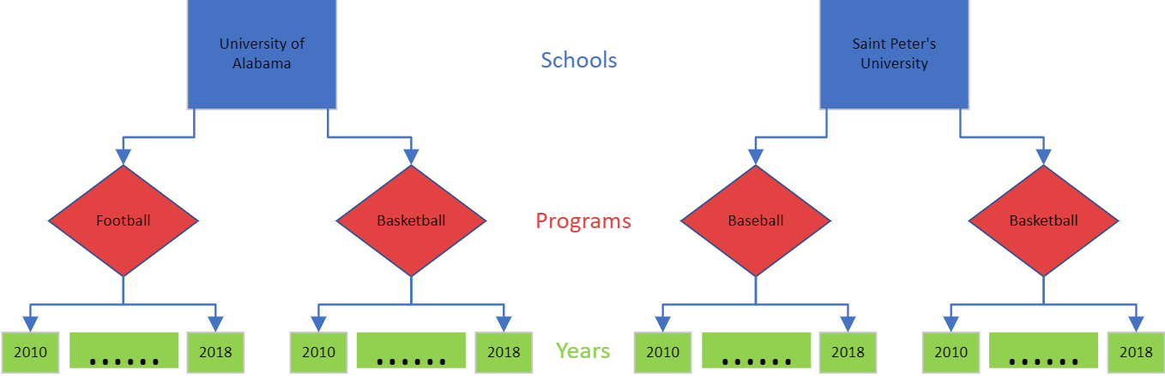
Three-Level Models
Notes:
OLS INDEPENDENCE UNREASONABLE IN THIS CASE*

Slide 11
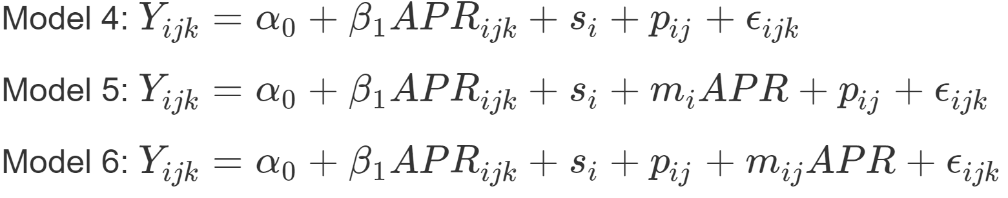
Mixed Effects Models
Subscripts:
i = School
j = Program
k = Year

Slide 12
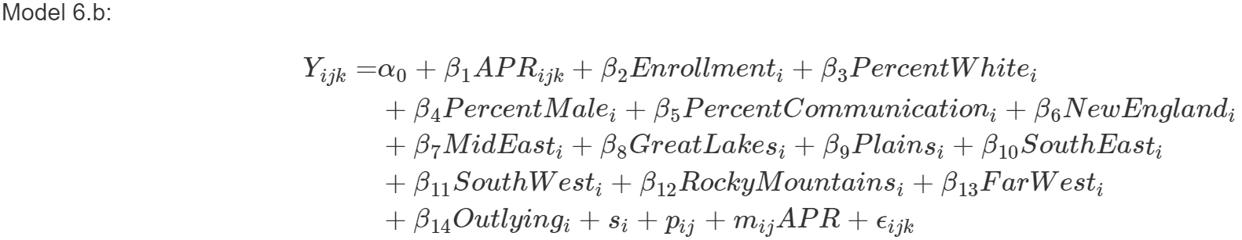
Final Model

Slide 13
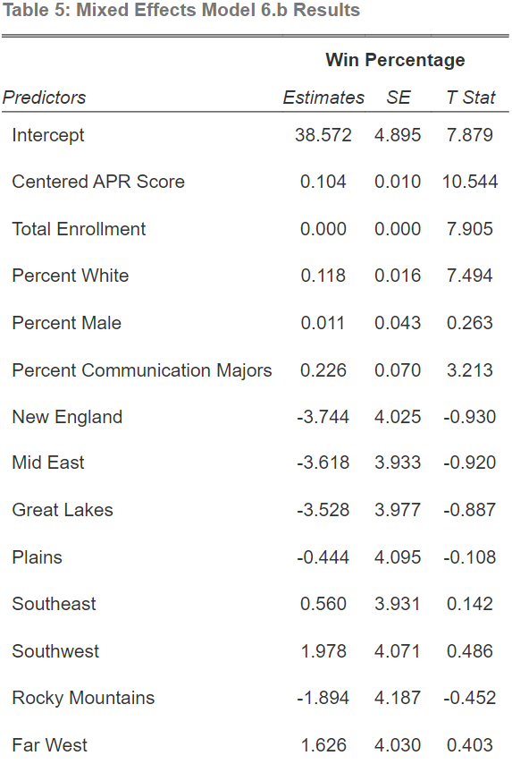
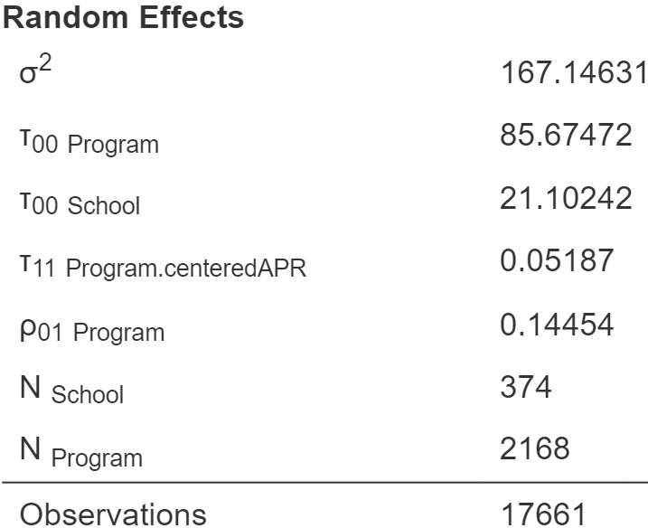
Results
Year
Notes:
INTERCEPT BE SPECIFIC ALL VARIABLES 0 – DOESN'T MATTER; 1 point is not MEANINGFUL (it is reliable, just small); remind of APR definition – out of 1,000 equivalent to one more eligibility/ retention

Slide 14
Conclusion
Direct positive relationship between academic success and athletic performance.
Implications
Incentive to improve athlete's academics
Future Research
Division 2 and 3 Programs
Individual Sports
Notes:
Implication changes; not recruiting

Slide 15
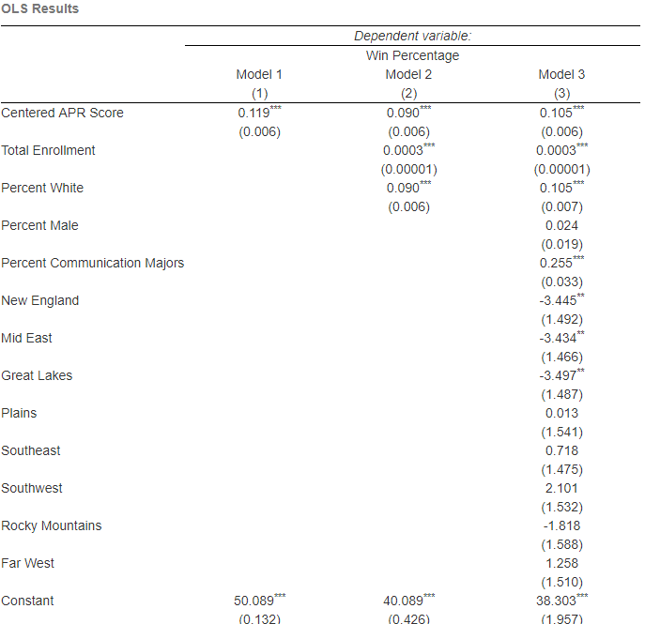
OLS Results

