Slide 1
Airbnb Business Analysis

Slide 2
Business Objective
The primary objective is to analyze Airbnb data to reveal insights into user experiences and satisfaction levels with the numerous listed stays, all accomplished using Power BI

Slide 3
Business analysis slide 2
Business Analysis
DISTRICT LOCATION SCORE
VISUALIZING LISTING PRICES
Goals
LISTING AGE & HOST TENURE
HOST RESPONSE TIME IMPACT
COMPOSITE SCORES
PROPERTY TYPE PRICE

Slide 4
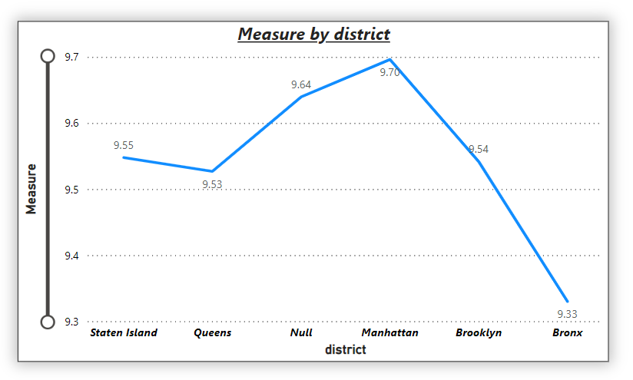
1. DISTRICT LOCATION SCORES
The aim is to pinpoint the location in the district with the least favorable location scores.
Average review score of location by District
Represented in line graph

Slide 5
DISTRICT LOCATION SCORES
The district with highest location score is ‘Manhattan’, whereas the lowest score is seen in ‘Bronx.
District | Average Location Score
Staten Island | 9.55
Queens | 9.53
Manhattan | 9.70
Brooklyn | 9.54
Bronx | 9.33

Slide 6
Host Response Time Impact
The goal is to delve into the relationship between host response times and the overall ratings of Airbnb listings providing valuable insights.

Slide 7
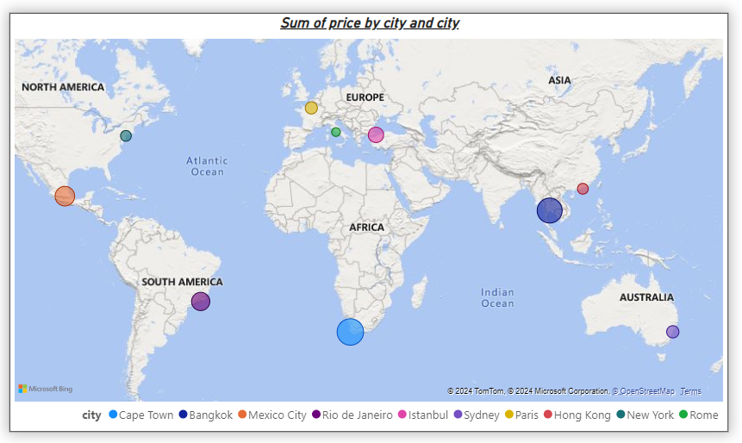
3. LISTING PRICES TREND AS PER CITY
The objective is to create visual representations of Airbnb listing prices across different cities and summarize any noteworthy trends or variations.

Slide 8
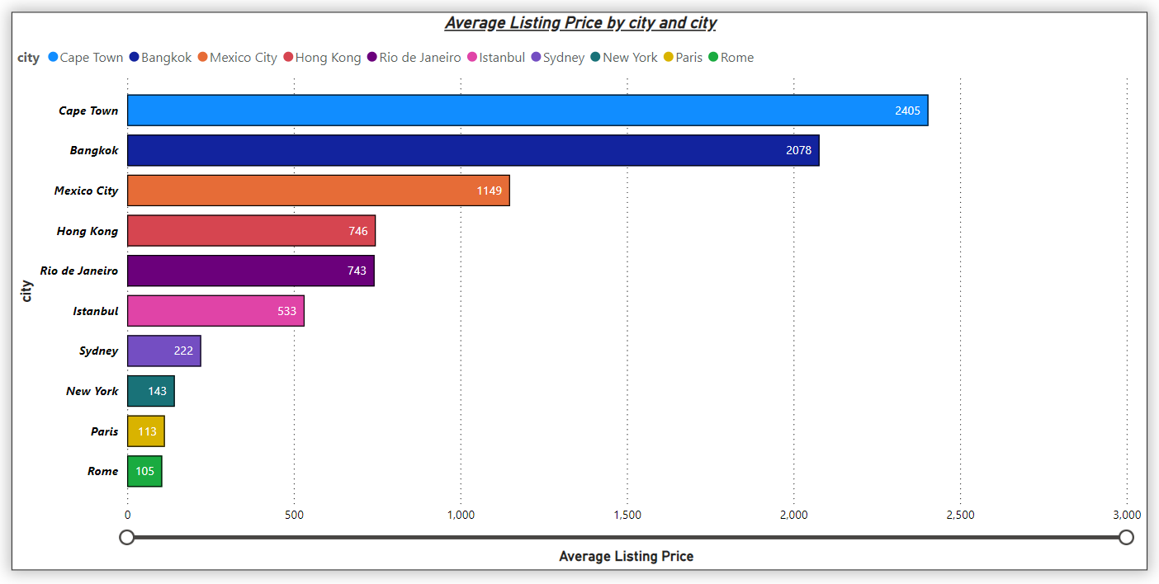
Listing Prices
highest average listing prices at the top

Slide 9
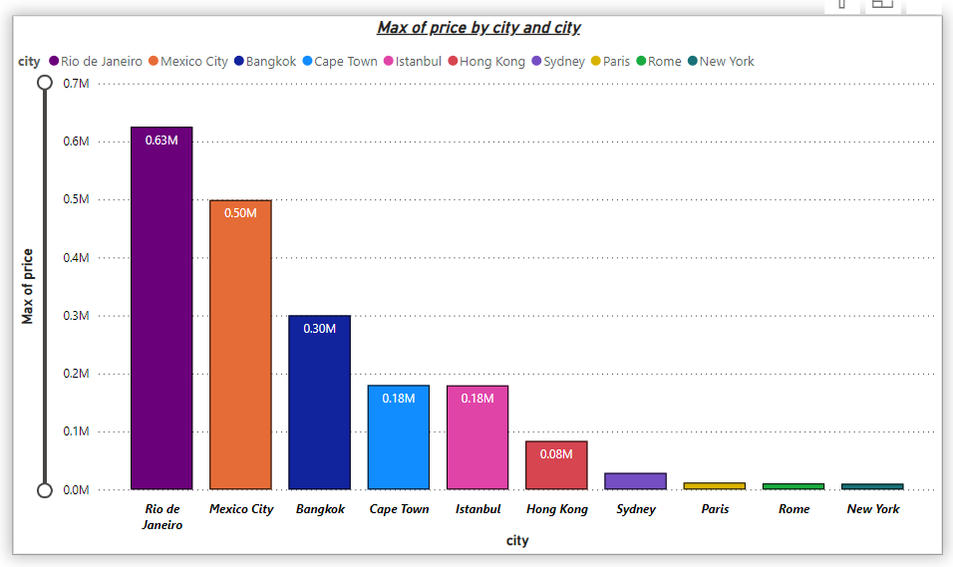
Listing Prices
Maximum listing prices at the right most

Slide 10
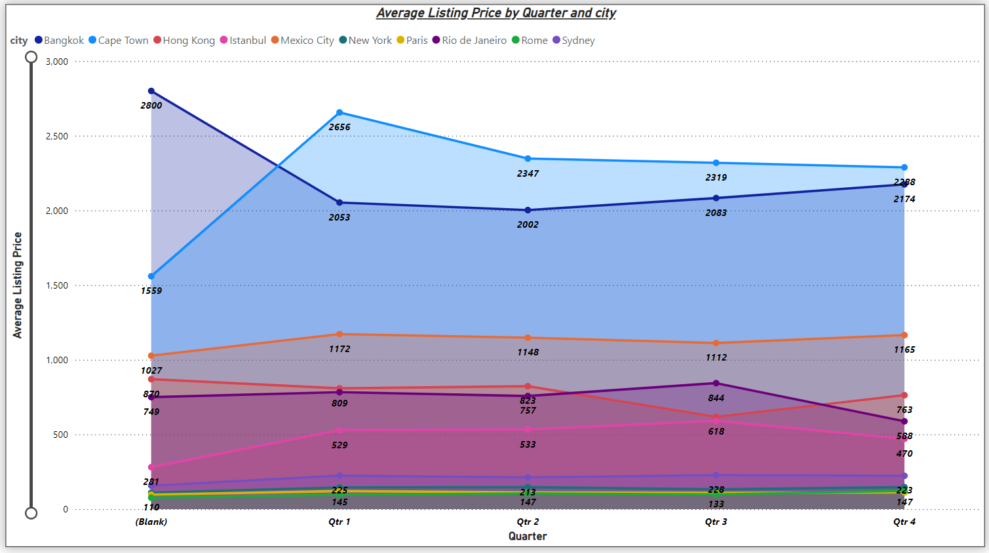
Listing Prices
Average listing price trend of cities in quarterly manner

Slide 11
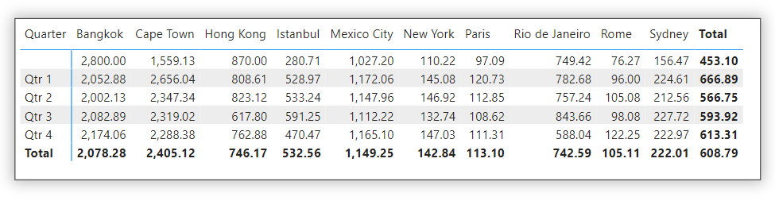
Listing Prices
Listing Prices quarterly trend by city-wise in tabulated version

Slide 12
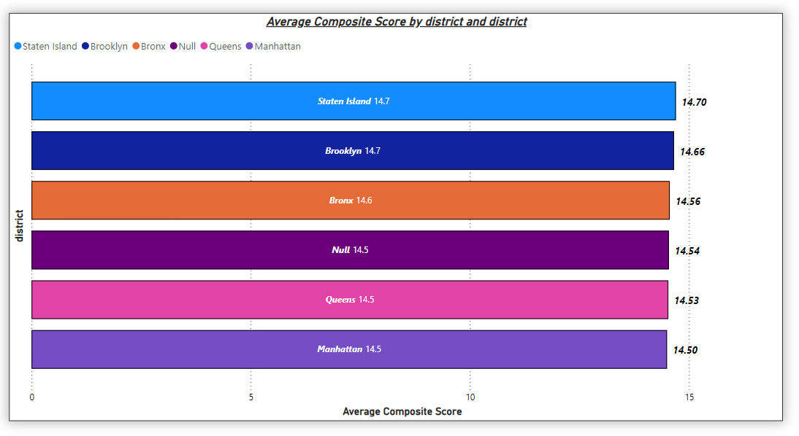
4. COMPOSITE SCORES
The task involves creating a composite score that integrates check-in experience and host communication for various districts with subsequent analysis and insights.

Slide 13
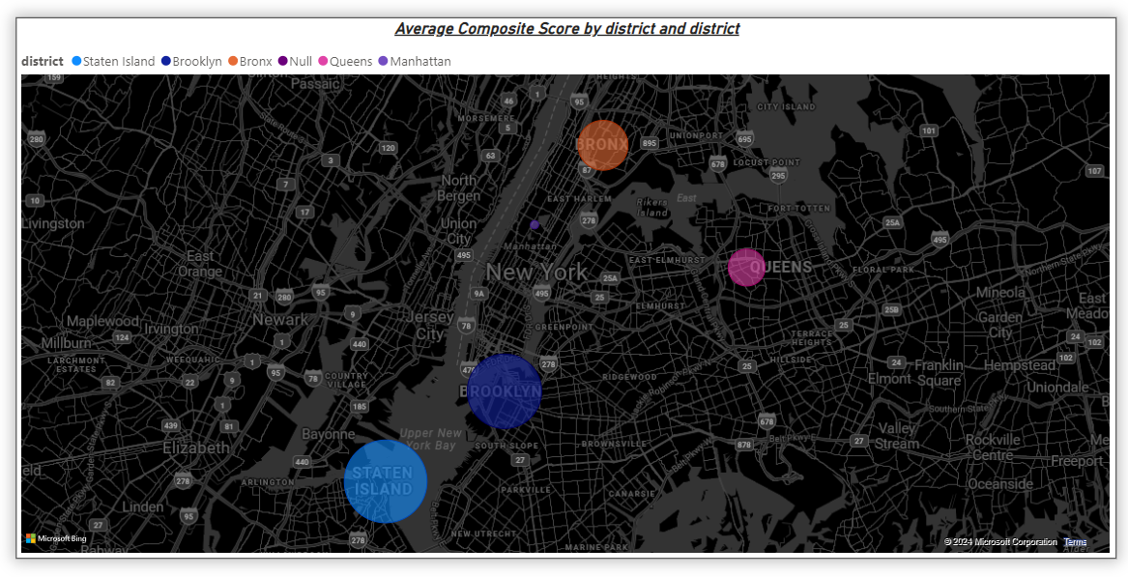
Composite Scores
Map showing the bubbles of different sizes indicating the districts with highest and lowest check-in experiences

Slide 14
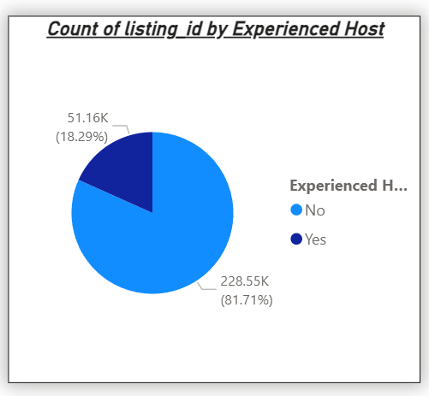
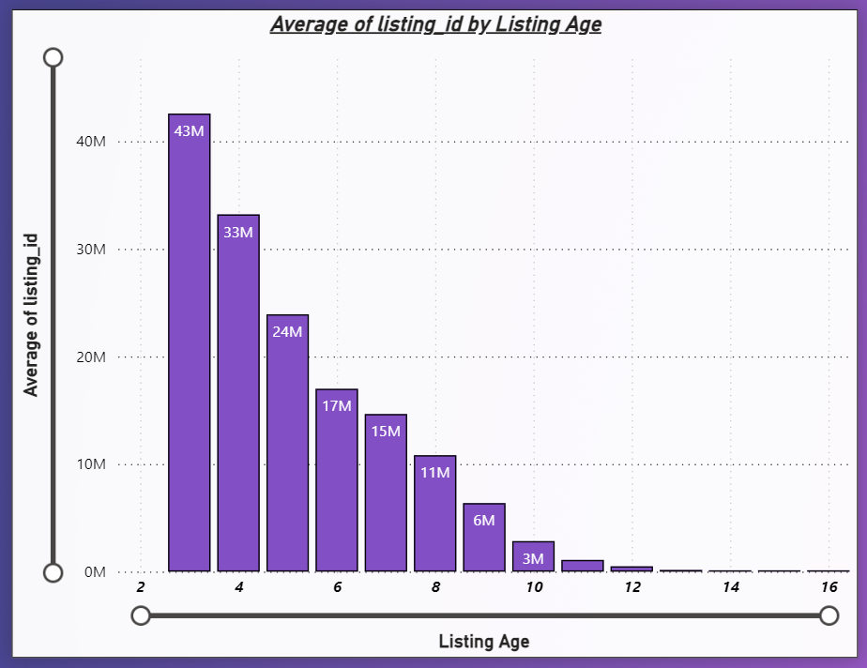
5. LISTING AGE AND HOST TENURE
This objective entails computing the age of Airbnb listings and identifying hosts who have accumulated more than ten years of hosting expertise.

Slide 15
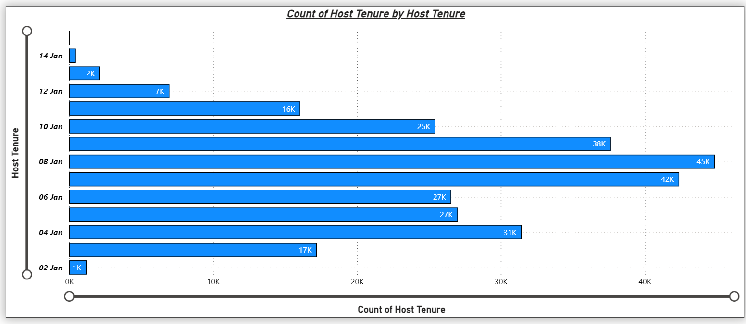
Listing Age and Host Tenure

Slide 16
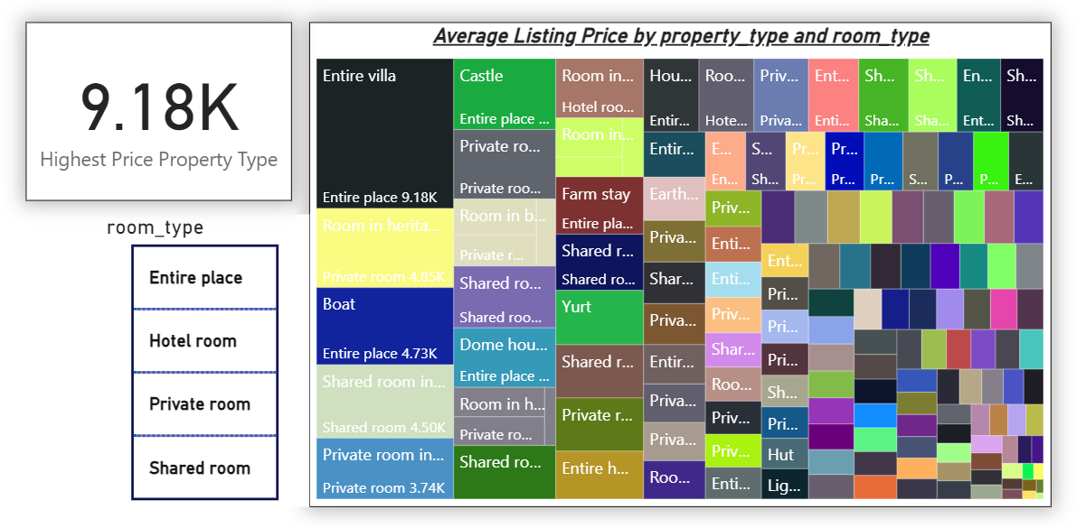
6. PROPERTY TYPE PRICE
The task involves the creation of a visual tree map that displays average prices for various room and property types with specific attention given to the property type associated with the highest prices for entire places.

Slide 17
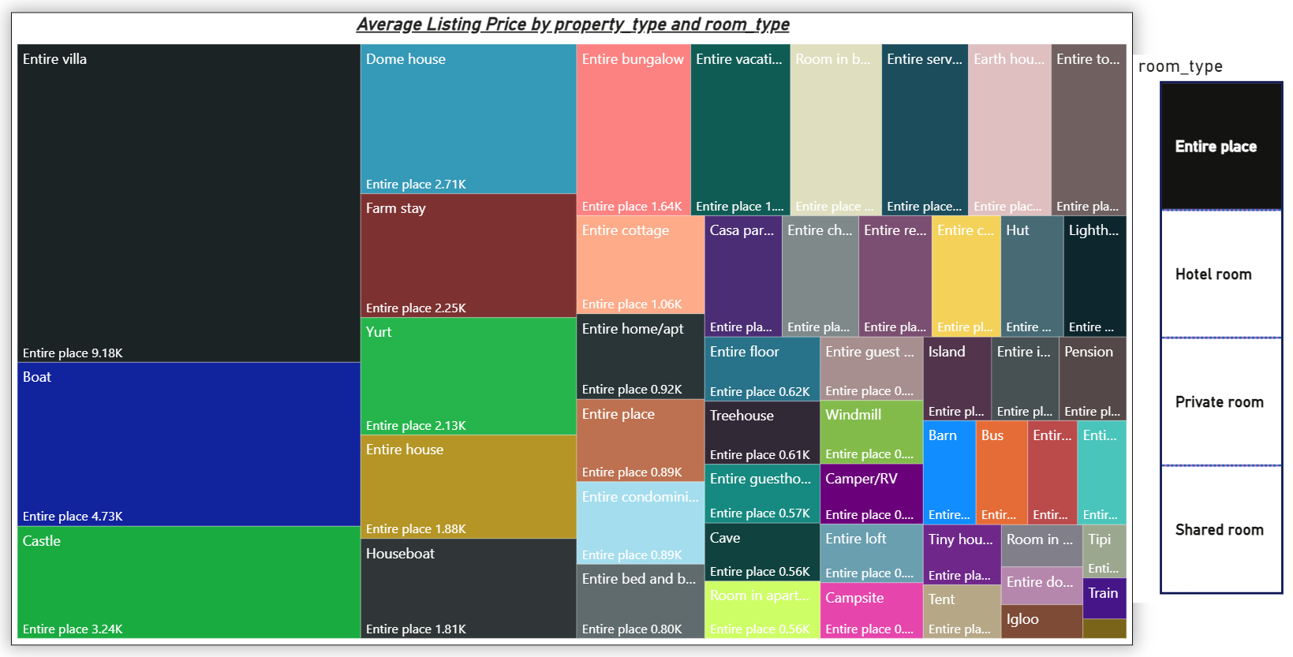
Property Type Price

Slide 18
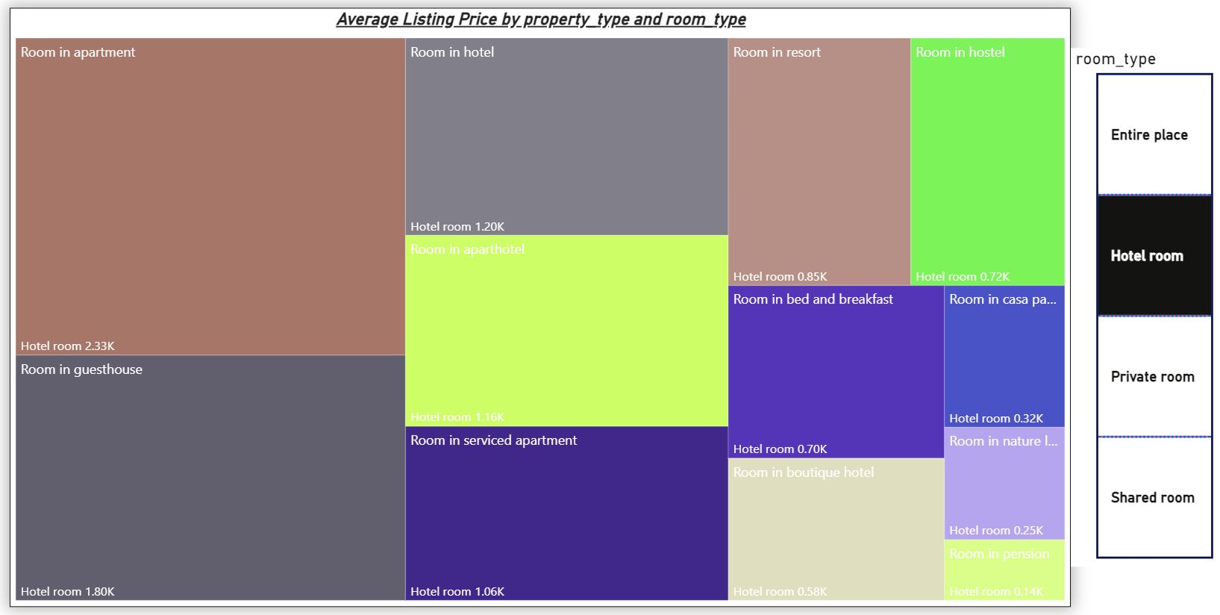
Property Type Price

Slide 19
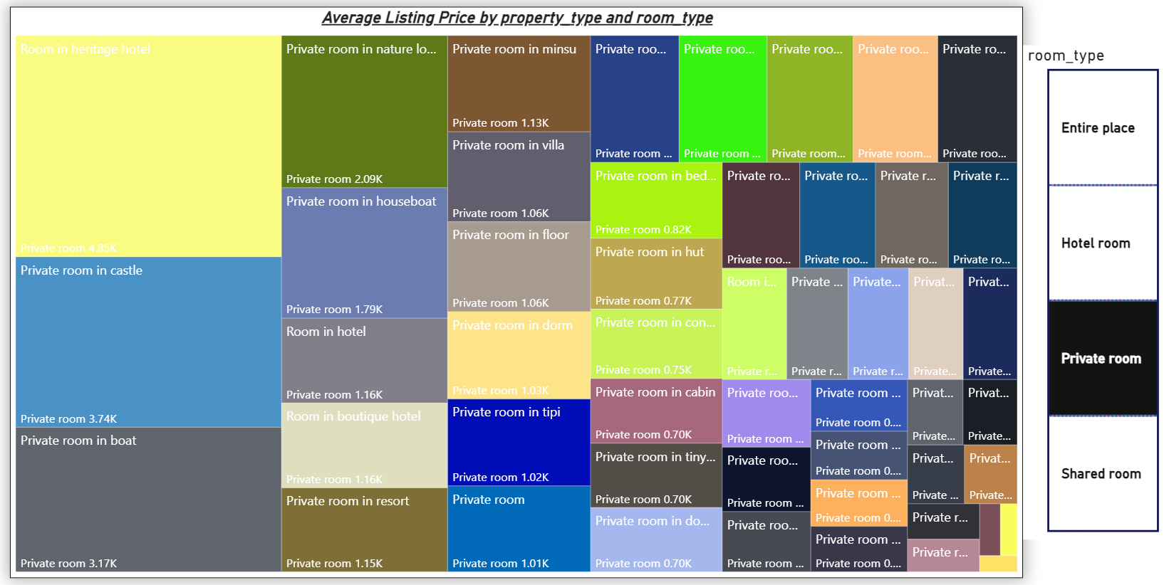
Property Type Price

Slide 20
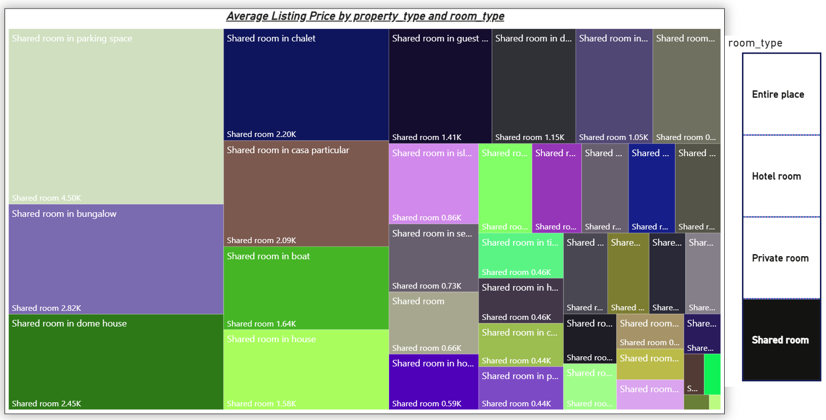
Property Type Price

Slide 21
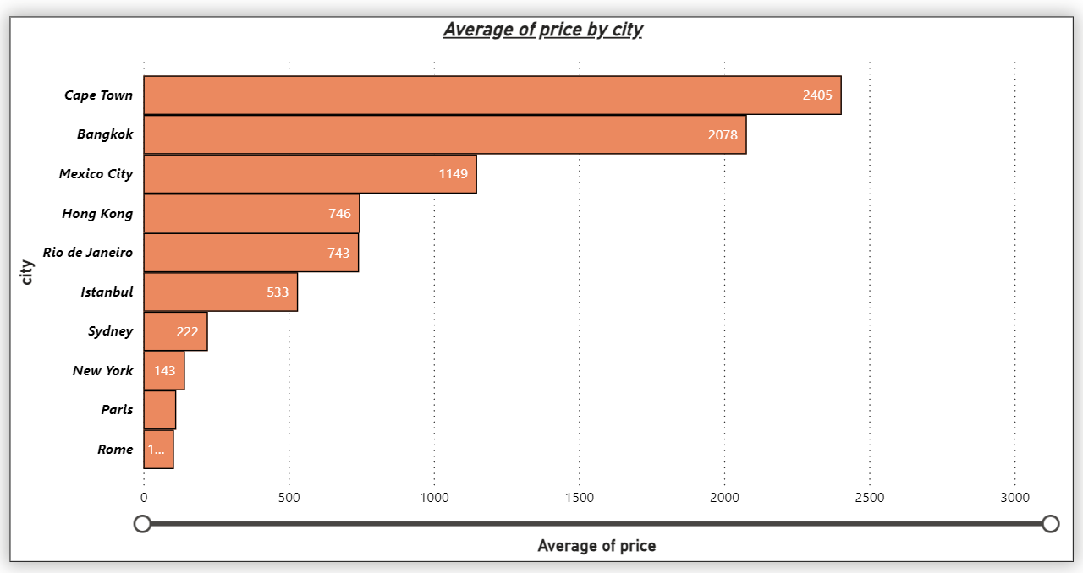
7. COMPREHENSIVE CITY INSIGHTS
Crafting a Comprehensive City Insights Report: This objective entails the creation of a comprehensive report that presents listing prices, guest ratings, and visitor trends for multiple cities, with a particular focus on assessing changes in visitor trends in 2020 in contrast to earlier years.

Slide 22
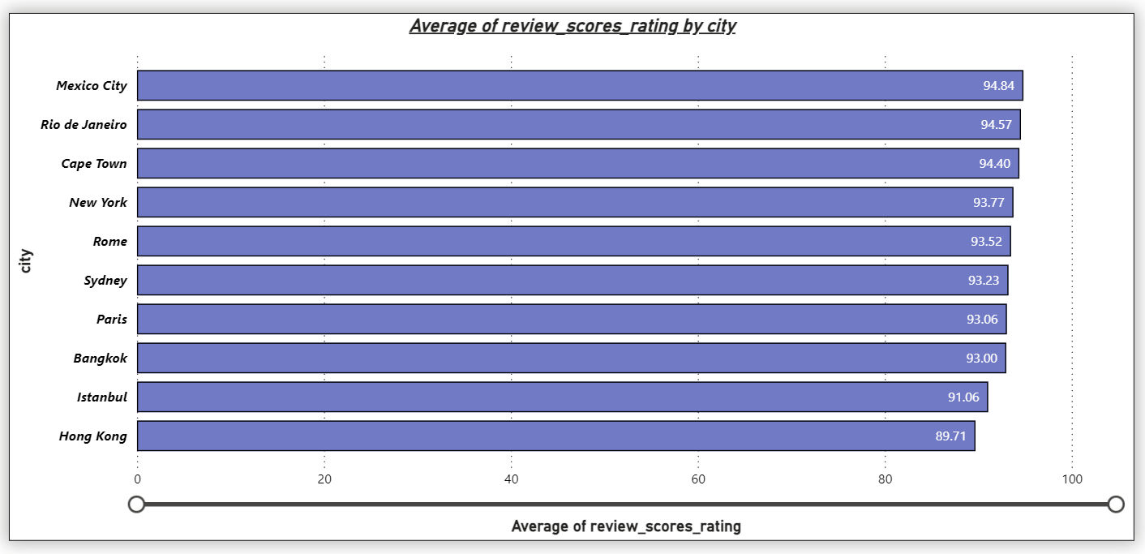
Comprehensive City Insights
Average of Guest rating for all the cities

Slide 23
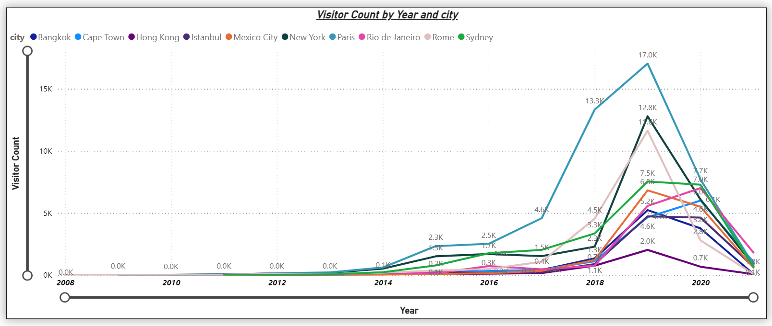
Comprehensive City Insights
changes in visitor trends in 2020 in contrast to earlier years

Slide 24
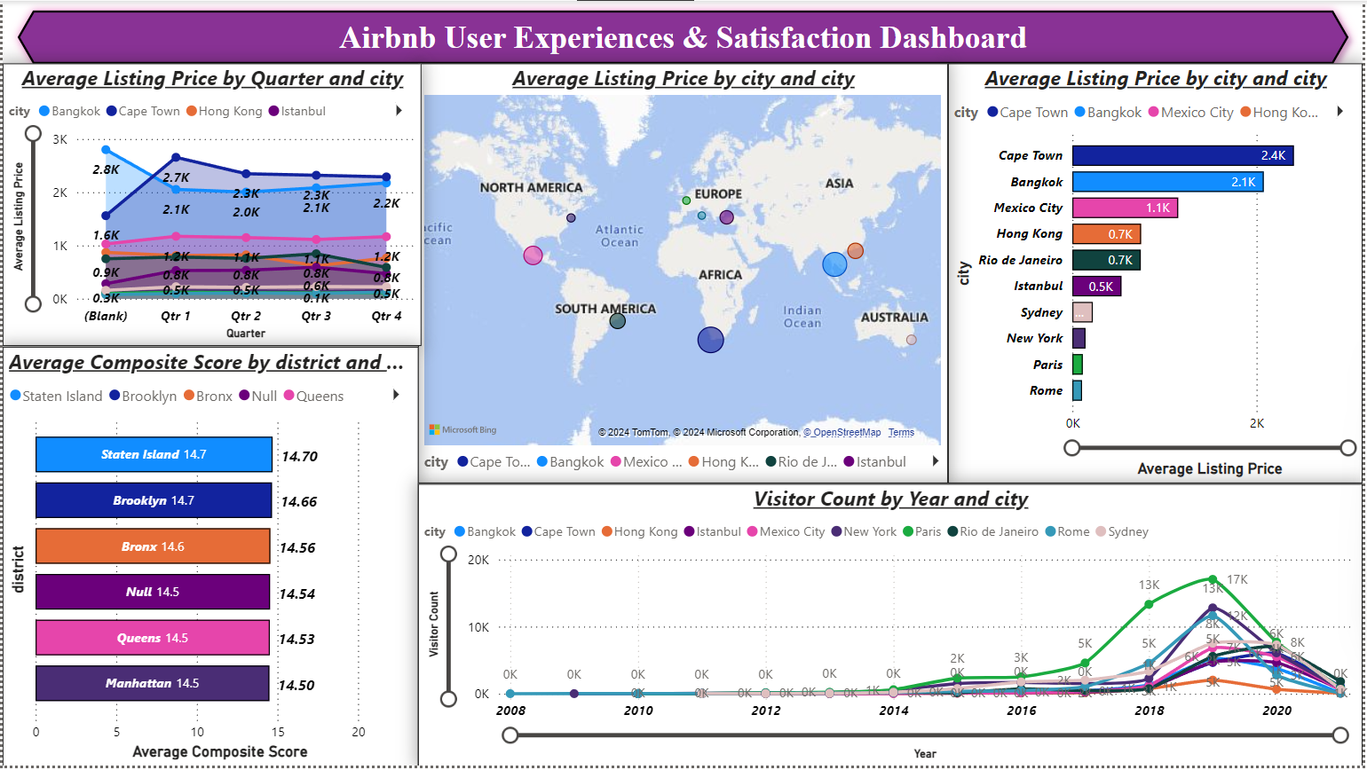

Slide 25
Thank You

