Slide 1
Google Test
a C++ unit testing framework

Slide 2
So many C++ Unit Testing Frameworks
CppUnit, Boost.Test, ...
pros:
well supported, steady
cons:
verbose codes, sometimes needs manual registration of each test;
lack of portablility
Catch(also recommended), an intriguing alternative.
lightweighted, TDD/BDD style.
CxxTest(also recommended),
lightweighted, utilize Python to scan source codes and discover all tests automatically.
Google Test: powerful features, good choice.

Slide 3
Who Is Using Google Test?
Many internal projects at Google.
The Chromium projects (behind the Chrome browser and Chrome OS).
The LLVM compiler.
Google Protocol Buffers.
The OpenCV computer vision library
Open Source Computer Vision Library

Slide 4
Concepts for any testing frameworks
Test Fixture
A test fixture represents the preparation needed to perform one or more tests, and any associate cleanup actions.
SetUp(); RUN_ALL_TESTS() ;TearDown();
For example: creating temporary or proxy databases, directories, or starting a server process.
Test Case
A test case is the smallest unit of testing.
Test Suite
A test suite is a collection of test cases, test suites, or both. It is used to aggregate tests that should be executed together.
Test Runner
A test runner is a component execution of tests and provides the outcome to the user. The runner may use a graphical interface, a textual interface to indicate the results.

Slide 5
Write a simple test
TEST(test_suite_name, test_case_name) { TEST(foo, bar) { {
test body. ===> EXPECT_EQ( 1+1, 2);
} }
The whole name of a test case: test_suite_name.test_case_name
The 'TEST' macro is just an ordinary C++ functions.
The definition of C++ classes for the tests and the registration of tests are hidden before this macro.

Slide 6
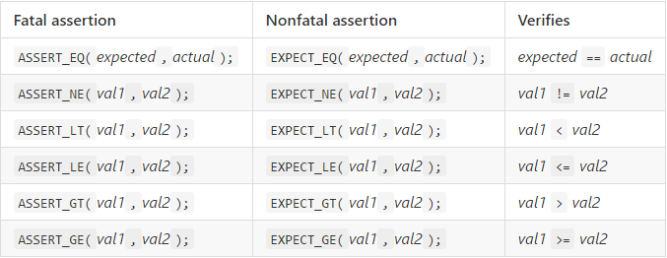
Basic Assertions
When they fail, ASSERT_* yields a fatal failure and returns from the current function, while EXPECT_* yields a nonfatal failure, allowing the function to continue running. In either case, an assertion failure means its containing test fails.

Slide 7
0.00000001 == 0 ?
Typically, different CPUs and operating environments store floating points differently and simple comparisons between expected and actual values don't work.
JUST DON`T USE ASSERT_EQ (0.00000001,0)!
USE ASSERT_FLOAT_EQ()!
ASSERT_FLOAT_EQ (2.00001, 2.000011) passes—Google does not throw an error if the results tally up to four decimal places.

Slide 8
Wait, can I use this method?
float threshold = 0.0001;
if( Math.abs(a-b) < threshold ){
printf(“Since the diff between a and b is quite small, I now \n pronounce they are equal.”);
}
Good idea, but not recommended when we need high precision
Reference: http://floating-point-gui.de/errors/comparison/

Slide 9
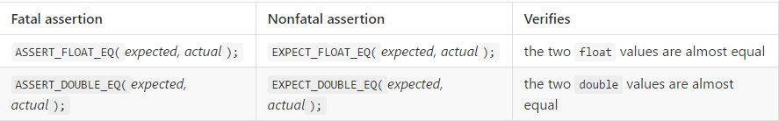
Floating-Point Macros

Slide 10
Running a Subset of the Tests
Why?
How?
./foobar --gtest_filter=<Suite>.<TestCase>
'*' (matches any string) , '?' (matches any single character).
'-' (means except)
examples:
./foo_test --gtest_filter=Suite1.* Runs all tests of Test suite: Suite1.
./foo_test --gtest_filter=-*Suite.* Runs all test suites except Suite1.
./foo_test --gtest_filter=*.Test* Runs all test cases start with 'Test'

Slide 11
Tip:
It is currently unsafe to use Google Test assertions from two threads concurrently on other systems (e.g. Windows).

Slide 12
Thank U!

