Slide 1


CICAG
Python course

Slide 2

OVERVIEW

Slide 3

Overview
01
Setting up
02
Python
All tools installed and running on your computer along.
We will lay the foundations of Python for you to build upon in your own work.

Slide 4
DOWNLOADING THE TOOLS

Slide 5





The Tools

Slide 6
KEY TERMS

Slide 7
Bash
Terminal
Bash, short for Bourne Again SHell, is a popular command-line interface for interacting with operating systems, particularly Unix-based systems like Linux and macOS. It is a powerful tool for software developers, enabling them to navigate file systems, run applications, and even write scripts to automate tasks.
A terminal, also known as a command-line interface, is a tool that allows users to interact directly with the operating system by entering commands as text.
Python
Git
Python is a high-level, interpreted programming language known for its simplicity and readability. It's widely used for tasks ranging from web development to data analysis and machine learning
Git is a distributed version control system used to track changes in source code, facilitating collaboration among developers and maintaining a history of modifications.
Code editor
GitHub
A code editor is a tool used by developers to write and modify programming code, offering features like syntax highlighting, auto-completion, and error detection.
GitHub is a web-based platform that uses Git for version control, providing a space for developers to host, share, and collaborate on software projects.

Slide 8
VSCODE

Slide 9

VSCode
Visual Studio Code (VSCode) is a free and open-source, lightweight but powerful source code editor developed by Microsoft. It comes with built-in support for JavaScript, TypeScript, and Node.js, and has a rich ecosystem of extensions for other languages (such as Python, R, C++, and more) and runtimes.
What is it?

Slide 10
VSCode
Multi-Language Support: VSCode supports almost all major programming languages. This is achieved through a rich ecosystem of extensions.
Integrated Terminal: VSCode includes an integrated terminal that enables you to stay in your code editor while using your system's command line shell.
Key Features

Slide 11
Debugging: VSCode has a rich debugging experience, making it easier to diagnose and fix issues.
Version Control: VSCode includes built-in Git support for version control to track changes, stage them and commit them right from the editor.
Extensibility: There are thousands of extensions available for VSCode that can add languages, debuggers, tools, and more functionalities.
VSCode
Key Features

Slide 12
VSCode
In the context of Chemistry, VSCode is an excellent tool for writing and editing Python scripts for simulations, data analysis, and other computational tasks. Its extensibility allows it to work well with Python, and its built-in Git support makes it easy to manage version control of your code
Use in Chemistry

Slide 13
PYTHON TOOLS

Slide 14
Python is a highly versatile, interpreted, object-oriented, and high-level programming language.
Python's design philosophy emphasizes code readability with its notable use of significant whitespace. Its language constructs and object-oriented approach aim to help programmers write clear, logical code for small and large-scale projects.
Python is dynamically typed and garbage-collected. It supports multiple programming paradigms, including procedural, object-oriented, and functional programming.
Python
What is it?

Slide 15
Ease of Learning: Python has a simple syntax which makes it a great language for beginners. It's designed to be easy to understand and write.
Portability: Python code can run on a wide variety of systems and has the same interface on all platforms.
Versatility: Python is used in many areas such as web development, data analysis, artificial intelligence, scientific computing, etc.
Python
Key features

Slide 16
Python
Wide Standard Library: Python's standard library is very portable and cross-platform compatible on UNIX, Windows, and Macintosh.
Open Source: Python is developed under an OSI-approved open-source license, making it freely usable and distributable.
Key features

Slide 17
Python
Python is extensively used in the field of Chemistry for tasks such as data analysis, molecular modelling, quantum chemistry calculations, chemoinformatics, and more.
Its simple syntax, coupled with its powerful libraries and frameworks, make Python an excellent tool for chemists to use.
Use in Chemistry

Slide 18
Miniconda
Miniconda is a stripped down free and open-source distribution of the Python and R programming languages for scientific computing (data science, machine learning applications, large-scale data processing, predictive analytics, etc.), that aims to simplify package management and deployment.
What is it?

Slide 19
Package Management: Miniconda uses a package manager called conda that enables you to install multiple versions of software packages and their dependencies. It also allows you to create isolated environments where you can install different package versions without conflicts.
Platform-Agnostic: Miniconda is available for Windows, macOS, and Linux. This makes it easier for teams to collaborate regardless of their operating system.
Miniconda
Key features

Slide 20
Conda
Conda can be used in Chemistry for managing packages and environments necessary for various computations, simulations, and data analysis tasks. Python libraries such as NumPy, SciPy, Matplotlib, pandas, and many others that are commonly used in scientific computing, are included in the Miniconda distribution.
Use in Chemistry

Slide 21
Why Conda?

Slide 22
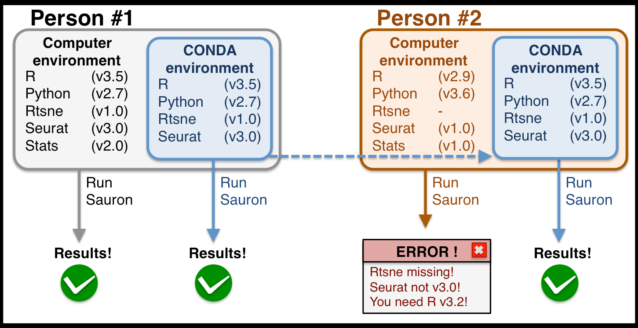

Slide 23
CREATE CONDA ENVIRONMENT

Slide 24
Create a new conda environment using the command line
Hint: Use anaconda prompt -windows
Hint: Use ‘Conda create’

Slide 25
PYTHON

Slide 26
KEY TERMS

Slide 27
Interpreted
Scripting/None compiled
Interpreted refers to the type of programming language that is executed by an interpreter without needing to be compiled. Python is an interpreted language, it reads and executes code line-by-line, which allows for easier debugging and flexibility.
A scripting or non-compiled language, like Python, is a type of programming language that doesn't require a separate compilation step. Instead, it's executed line-by-line at runtime, which allows for more flexibility and quicker iteration.
Object Oriented
Dynamically typed
Object-oriented programming (OOP) is a paradigm that uses "objects" – instances of classes – which contain data and procedures to manipulate data. In Python, this allows for code to be structured as reusable/interactive components.
In a dynamically typed language like Python, variable types are checked during runtime, which means you can assign different types of data to the same variable and the interpreter determines the type on the fly.
High level
Garbage Collected
A high-level language, like Python, is designed to be more user-friendly, readable, and abstracted from machine language, making it easier for people to write and understand.
Garbage collection in Python refers to the automatic management of memory, where the interpreter automatically frees up the memory that is no longer in use, eliminating the need for manual memory management.

Slide 28
White Space
Module
In Python, whitespace is significant as it uses indentation to define blocks of code. This means the structure of your code is determined by the spaces and tabs, enhancing readability and consistency.
A module in Python is a file containing Python code, usually with definitions of functions, classes, or variables, that can be imported and used in other programs. This promotes code organization and reuse across different projects.
Function
Package
A function in Python is a block of reusable code that is used to perform a specific action. You can define your own functions, and Python also provides many built-in functions. Functions help improve modularity and code reusability.
A package in Python is a way of organizing related modules into a hierarchy. It's a directory that contains multiple module files and a special `__init__.py` file to indicate that the directory is a package.
Class
Library
A class in Python is a blueprint for creating objects. It defines a set of attributes and methods that characterize any object created from the class. This concept is part of Object-Oriented Programming, promoting code reuse and encapsulation.
A library in Python is a collection of modules and packages that provides functionality, such as input-output processing, image manipulation, or scientific calculations. By importing a library, you can use pre-written code and functions, which saves time and allows you to perform complex tasks more easily.

Slide 29
List
Set
A list in Python is an ordered collection of items, which can be of different types. It is mutable, meaning that its elements can be changed after the list is created. Lists are defined by enclosing a comma-separated sequence of items in square brackets `[]`.
A set in Python is an unordered collection of unique items. They are mutable, but they can only contain immutable (hashable) data types. Sets are useful for eliminating duplicate entries. Sets are defined by enclosing items in curly braces `{}`.
Tuple
Int
A tuple in Python is an ordered collection of items, similar to a list, but it is immutable, meaning that its elements cannot be changed after it's created. Tuples are defined by enclosing a comma-separated sequence of items in parentheses `()`.
An `int` in Python refers to an integer, which is a whole number (positive, negative, or zero) without a decimal point. It's one of the basic built-in types in Python used for numeric computations.
Dictionary
Float
A dictionary in Python is an ordered collection of items where each item is stored as a key-value pair. It's mutable and allows for fast lookup of values based on their keys. Dictionaries are defined by enclosing a comma-separated sequence of key-value pairs in curly braces `{}`.
A `float` in Python refers to a floating-point number, which is a number that has a decimal point. This data type is used when more precision is needed than what integers can provide. Floats can represent real numbers, such as 0.1, 0.5, or even 3.14.

Slide 30
String
Comments/docstrings
A `string` in Python is a sequence of characters enclosed in quotation marks. They are used to represent text-based data in Python. Strings are immutable, meaning once defined, their contents cannot be changed.
Comments in Python are lines of text in your code that are not executed by the Python interpreter. They're used to explain what the code does or provide additional context. Comments in Python start with the `#` symbol.
Mutable
Object
In Python, a mutable object is one that can be changed after it's created. This means you can modify, add, or remove items without creating a new object. Examples of mutable objects in Python are lists, dictionaries, and sets.
In Python, an object is an instance of a class that encapsulates both data (attributes) and functions (methods) related to that data. Every value in Python is an object, and they can be manipulated and passed around in your program.
Immutable
Method
In Python, an immutable object is one that can't be changed after it's created. This means that modifying its state or contents would result in a new object. Examples of immutable objects in Python are strings, tuples, and numbers (int, float).
A method in Python is a function that is defined within a class and is associated with objects of that class. Methods provide a way to interact with the object and often manipulate the object's internal state. They can be called using the notation `object.method()`.

Slide 31
Variable
A variable in Python is a symbolic name that is used to store data in memory. This stored data can be of any type, like numbers, strings, lists, etc. A variable allows us to retrieve the stored data by referring to the variable name. Variable assignment is done using the `=` operator.
Exception
An exception in Python is an event that occurs during the execution of a program that disrupts the normal flow of the program's instructions. Exceptions are typically errors that are detected during runtime. Python uses exception objects to represent and handle error conditions.
Iterable
An iterable in Python is any object capable of returning its elements one at a time, permitting it to be iterated over in a `for`-loop. Common examples of iterable objects include lists, strings, dictionaries, and sets. Also, files in Python are iterable, as they return lines of text one at a time.

Slide 32
THE BASICS

Slide 33
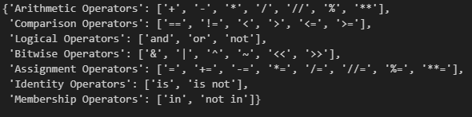
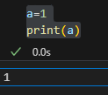
Operators
In Python, operators can include arithmetic operators (+ for addition), comparison operators (like == for equality), logical operators (and, or)
Variables
Variables are used to store references to objects in memory.
= is assignment !!!
Equals assigns some data to
what is print?

Slide 34

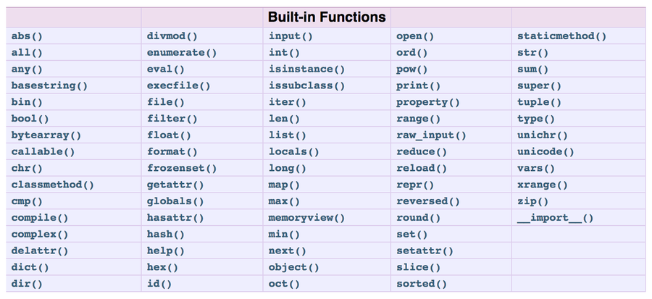
Builtin functions
returns a list of all builtin functions
__builtins__ allows direct access to the built-in functions and names defined in the built-in scope of the Python interpreter.
dir()
Returns all properties and methods of the specified object, without the values.

Slide 35
IMPLEMENTING PRIMITIVE DATA STRUCTURES

Slide 36
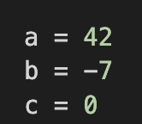
Integers
Each int object has int and meta data
Ints have arbitary precision meaning they can grow very large
Stored as objects
in memory
How can you find the memory address?

Slide 37
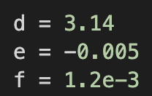
Floats
Stored as 64 bit numbers so have limited precision
Try this code:
x = 0.1
print(x)
print('{0:.30f}'.format(x))
Represented in memory as using IEEE754 standard

Slide 38
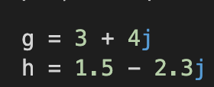
Complex numbers
One for real
One for imaginary
Uses IEEE 754
same as floats
Stored as pairs of
floating point
numbers

Slide 39
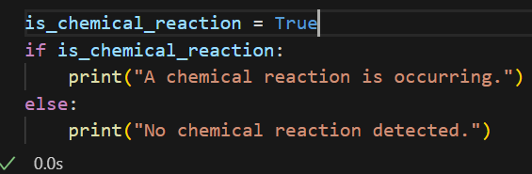
Booleans
Stored as 1 or
0
Used in conditional checks
They are still
objects like
everything else

Slide 40
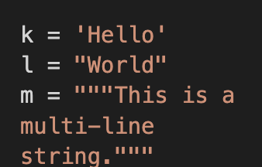
Strings
Used to represent text
Stored as an array of Unicode points
Ordered, immutable
sequence of characters

Slide 41
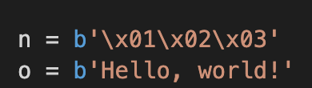
Bytes
Objects used to represent binary
Each byte is an integer in the range 0-255
Ordered, immutable
sequence of bytes

Slide 42
These fundamental data types are the building blocks for more complex data structures

Slide 43
If 1 is an int how could we make it a float - casting?

Slide 44
Use + operator on 2 different data types - is there an error? what does this tell you?

Slide 45
f-string
good variable naming/ commenting
refer to the documentation + Google is your friend
A method to concatonate variables and strings
https://doc.pypy.org/en/latest/
Go Good enough variable names limit the number of comments needed - these can be saved for reasoning behind the code

Slide 46
Collections data types

Slide 47
On the board how would you code the python data collections

Slide 48
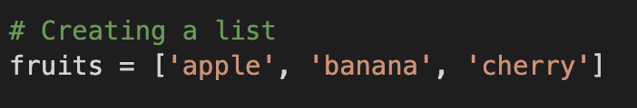
Deep dive on lists
Built in data strcuture representing ordered collection of mutable elements
Lists stored as overallocated arrays of pointers
Python pre-allocates space
Lists implemented as dynamic arrays
Automatic resizing happens as elements added/removed
This means you can have different datatypes. When a list is full, Python creates a larger memory block and copies over.
This all creates memory overhead.

Slide 49

Deep dive on tuples
Contiguous block of memory
Store pointer
Tuples are static arrays
Fixed size determined at the time of creation. This makes them different to lists
This memory is reserved to store pointers and there is no over allocation. Tuples are more memory efficient and faster.
Pointers to the actual objects

Slide 50
Deep dive on dictionaries
A mutable, ordered collection of key-value pairsused to store and retrieve data in the form
of a hash table
Initially they allocate a small amount of memory
Collision resolution
Built in implementation of a hash table
Hash functions convert keys into hash codes, which are used as indices in an array called the hash table
The memory requirements are determined by the size of the hash table
Due to hashing you can get collisions. Suffice to say it is handled under the hood!

Slide 51
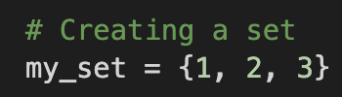
Deep dive on sets
An unorded collection of unique elements
Sets are fast and
efficient
Operations such as union are good
Built in implementation of a hash table
The elements are the keys in the hash table, the values are ignored.
As they have unique elements
There are many operations that can be done on sets that make them very useful

Slide 52
Return the 4th value in the list
Append a value to you python list
What happens when you do the same to a tuple

Slide 53
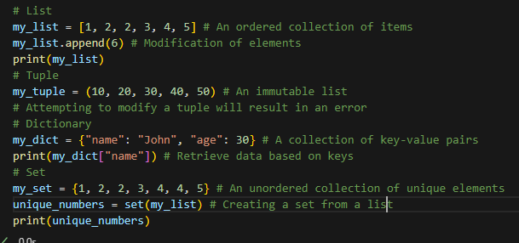
Coding python collections

Slide 54
Return values linked to the name key
Return unique numbers for a list of duplicated numbers

Slide 55
Coding python collections

Slide 56
Coding python collections

Slide 57
Create list and cast it to a tuple
What happens to the memory address of the objects?

Slide 58
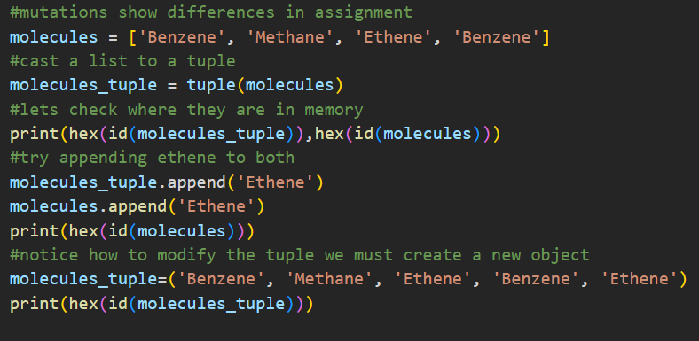

Slide 59
Append a new item to the list and tuple.
Whats the cause of any errors?

Slide 60
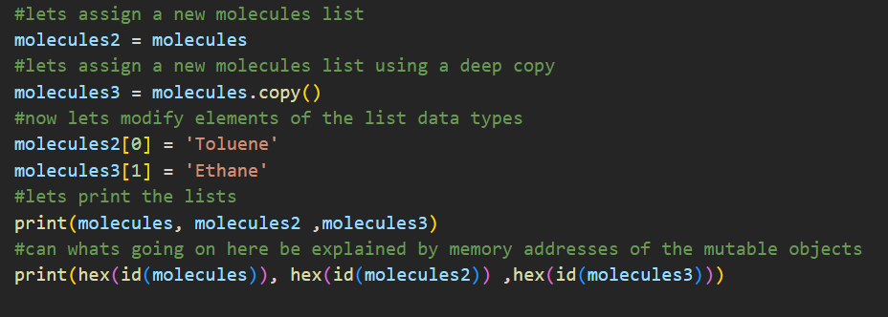

Slide 61
Note these are Pythonic data structures - linked lists, tree, stacks and queues exist give them a google or a chatty if you are intrested

Slide 62
LOOPS

Slide 63
Loops
For loop:
Conditional checks can be added
While loop
A for loop iterates over a sequence of elements and executes a block of code for each element.
A while loop repeatedly executes a block of code as long as a specified condition remains True.
We can break or continue the loop based on conditions

Slide 64
Write code that takes x (starting as 0.1) and using a for loop that iterates 20 times, update the value of x in each iteration according to the following formula: x = x * 11 - 1. Print the value of x in each iteration.

Slide 65
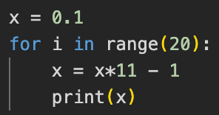

Slide 66
Could we impliment in break at a threshold?
Could this be done with a while loop?

Slide 67
CREATE A FUNCTION

Slide 68
4 main catagories of functions
Built in-functions
User defined functions
These are functions that come downloaded with Python.They are always available such as print(), len() etc
Functions that programmer writes themselves to solve their own specific problems.
Library functions
Other functions
Functions provided by external libraries or modules, which can be imported and used in your own code. These enable you to leverage Python's extensive ecosystem of libraries for a wide range of tasks.
Other types of functions such as Anonymous (Lambda) Functions, Recursive Functions, and Generator Functions. These aren’t covered in this course.

Slide 69
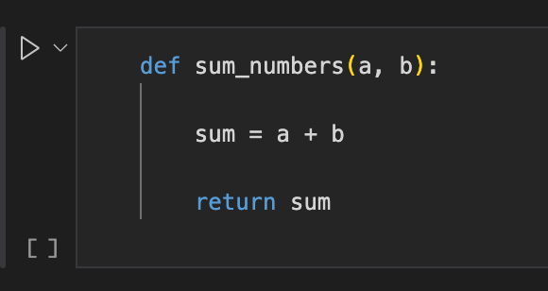
User defined functions
def
The start of the function
Arguments
Inthis case a and b, the inputs
return
Returns the values or objects calculated/created in the function body

Slide 70
Can you make a function that calculates the square root of a number?
Further challange: Can how does your function deal with negative values?
What are some solutions to the problem?
If this is still to easy can you create a function to sort a list of data?
Challenge: Write a function which does vector multiplication

Slide 71

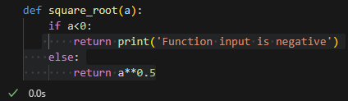
Where can this function be improved to make it more readable?
On the whiteboard can the function be writen to deal with negative input
Can we assign the output of the function to a variable?
How would this be done if the function output 2 values? - variable unpacking
Whats the output from print(square_root)?
What does this tell us about the function you have made and functions in general?

Slide 72
Challange: Can you comment your function?
Come show an example on the board :)

Slide 73
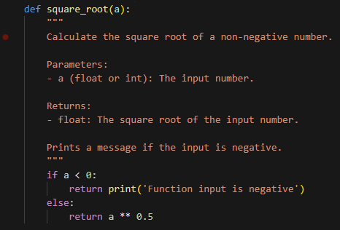

Slide 74
IMPORT FUNCTIONS FROM A LIBRARY

Slide 75


Functions from libaries
Libary
A Python library is a collection of modules and functions that provides pre-written, reusable code for a specific set of tasks.
Install the libary in conda prompt/ cmd
Remember to check if you are in the correct environment
Import numpy in your code
Thoughout the workbook anytime you want to call numpy call np.<function name>

Slide 76
Use Numpy to take the square root of 25
Hint: Python is logical and the np.<function> is named logically
Whats the benefit over the function you made?

Slide 77

What are the advantages of using the numpy libary over writing your own functions?
Whats the output from print(sqrt)?
Ufuncs are functions that operate element-wise on NumPy arrays, enabling efficient array processing.
More info - https://numpy.org/doc/stable/reference/ufuncs.html
Can you use hex and id inbuilt python functions to display the memory address?
Answer - print(hex(id(np.sqrt)))

Slide 78
Can you create a function which takes in molecule_name, carbon_atoms, aromatic and outputs information about this molecule?
How could this be commented?
Can we pre-assign inputs?

Slide 79
Python data model

Slide 80
What have we been building towards?
A set of conventions that Python uses to define and interact with objects and data types.
Python Data Model
Python Object Model
These are sets of conventions

Slide 81
The fundamental building blocks of the Python data model
The data model defines how much of all we have spoken about so far
Objects
Types
Identity, Value and Type
Everything is an object - including data types
collections, classes, modules
Every object has type (like ’int’ etc) which determines what kind of operations can be performed on the object
Every object has an identity (which never changes after creation), a type (which also never changes), and a value (which can change for mutable objects)

Slide 82
The fundamental building blocks of the Python data model
The data model defines how much of all we have spoken about so far
Attribute Access
Methods
Special Methods
Objects can have attributes which you access using
the dot operation (so object.attribute)
Objects can have methods which are functions that are associated with the object and can access its internal data
These methods with special names that start and end with double underscores (__) like __init__ etc

Slide 83

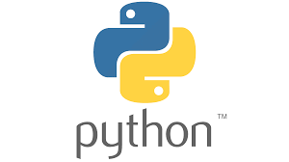


Slide 84
Python Cheminformatics - An End to End Project

Slide 85
Learning Outcomes
01
Chemical Structure Analysis Fundamentals
02
RDKit Workflow
03
ML in Drug Discovery
04
Best Practices

Slide 86
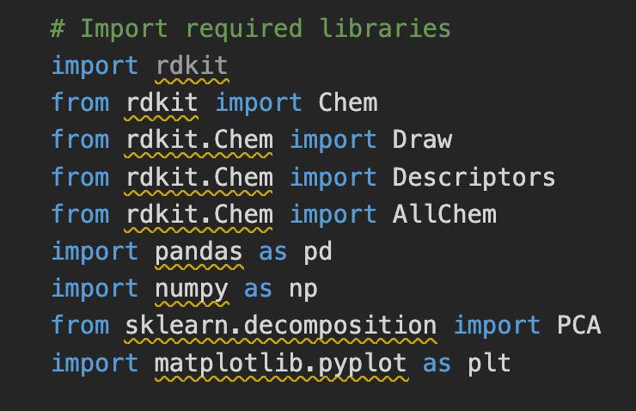
RDKit
Cheminforamtics library that is widely used in industry. You can think of it like the swiss army knofe for cheminformatics
Chem/Draw module
These modules contain all the functionality for doing molecular operations and visualising molecules. Descriptions module contains different mathematical descriptors for understanding molecular properties
numpy/pandas/sklearn/etc
Standard data science/machine learning modules in Python

Slide 87
Molecular Representation & SMILES Basics
Basic SMILES Elements
C = Carbon
O = Oxygen
N = Nitrogen
No symbol = single bond
= means double bond
# means triple bond
Ring Numbering
Numbers show ring connections
Same number = atoms connected
C1CCCCC1 = cyclohexane
c1ccccc1 = benzene (lowercase = aromatic)
Common Ring Structures
C1CCCCC1 # cyclohexane
c1ccccc1 # benzene
C1CCCC1 # cyclopentane
C1CCC1 # cyclobutane
Simple Examples
CC → ethane (C-C)
C=C → ethene (C=C)
CO → methanol (C-O)
CCO → ethanol (C-C-O)

Slide 88
Molecular Representation & SMILES Basics
Aspirin Breakdown
CC(=O)OC1=CC=CC=C1C(=O)O
CC(=O) → acetyl group
O → oxygen link
C1=CC=CC=C1 → benzene ring C(=O)O → carboxylic acid
Paracetamol Breakdown
CC(=O)NC1=CC=C(O)C=C1
CC(=O) → acetyl group
N → nitrogen link
C1=CC=C(O)C=C1 → phenol ring

Slide 89
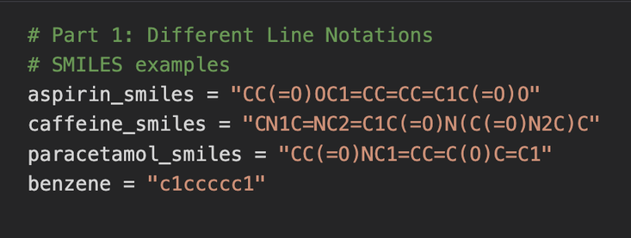
SMILES
Encoded as strings in Python
No Libraries required
At this point standard Python is all that’s required
Other line notations
There are other line notations. INCHI, INCHI-key, WLN etc

Slide 90
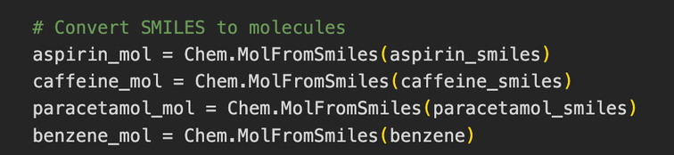
Creating the molecular object
Computational representation that contains all atomic coordinates, bond information, and molecular properties in a format the computer can manipulate
Uses Chem module to convert SMILES into3D structure
Key step in cheminformatics
To perform calculations, generate 3D structures, or analyse molecular properties, we need the more detailed molecular object format that contains spatial and electronic information

Slide 91
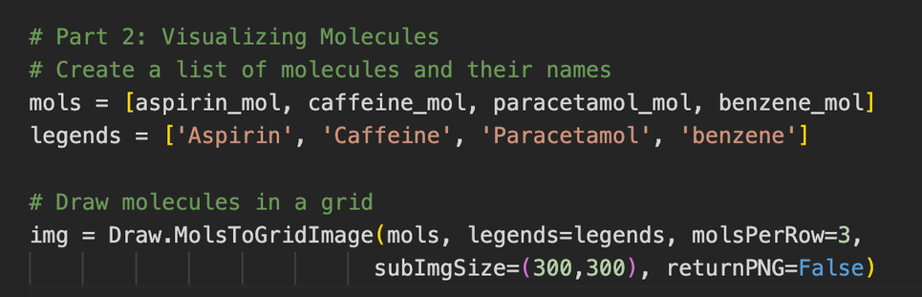
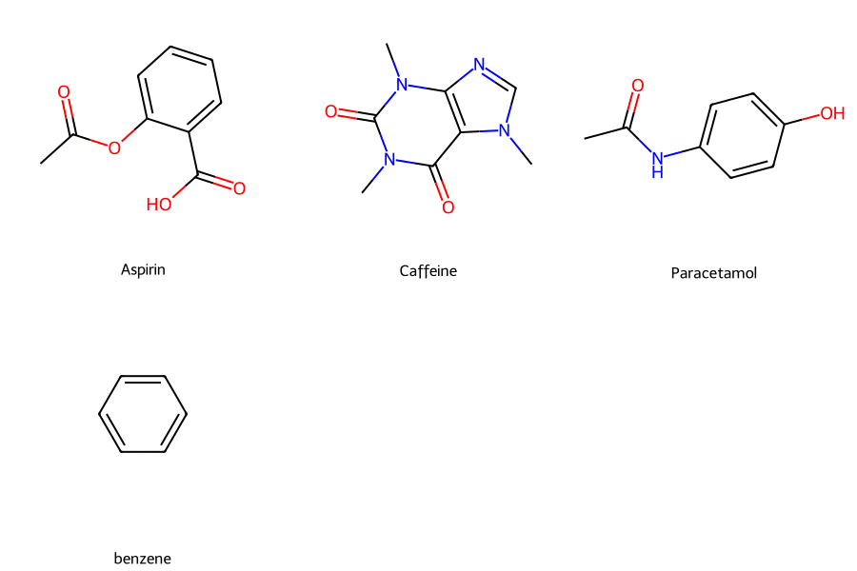
Visualising Molecules

Slide 92
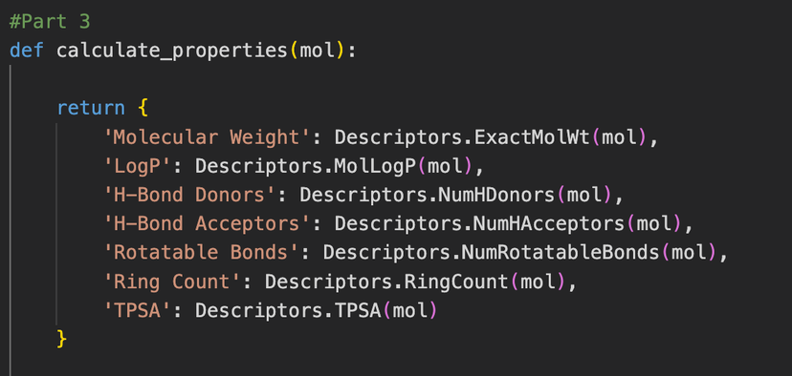
Chemical Descriptors
Numerical values that characterise specific properties of a molecule, such as molecular weight, number of rotatable bonds etc
Using the mol object
Takes the mol object, created from the SMILEs, as an input. The structure of the molecule is required for determining its properties
Descriptors class
RDKit descriptors class has many many descriptor calculations that it can perform

Slide 93
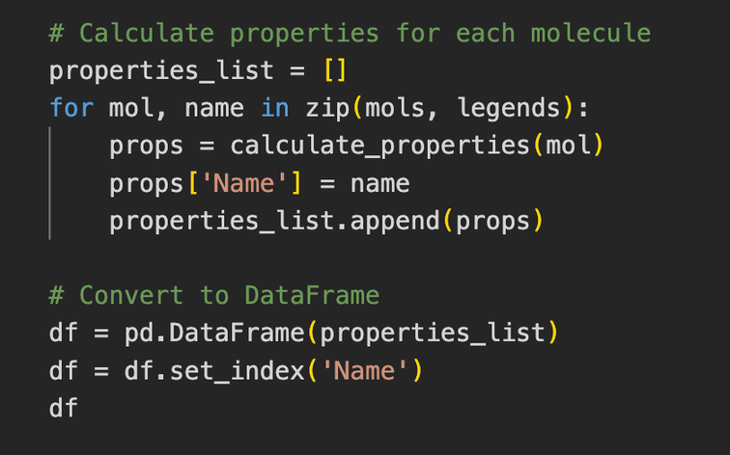
Calculating Descriptors
Creating DataFrame of descriptors
Carrying out calculations on many mols

Slide 94
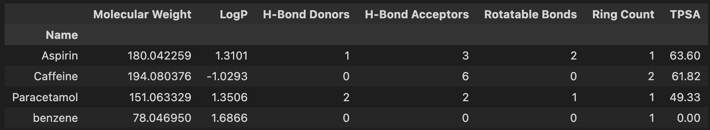

Slide 95
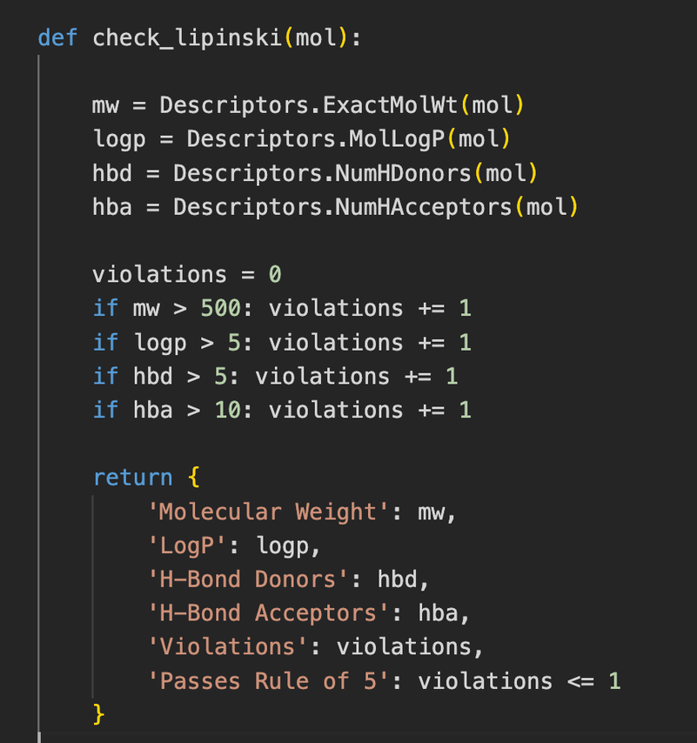
Lipsinkis Rule of 5
Used for predicting drug-likeness and oral availability. Four physiochemical parameters that influence drug absorption. The rules are more like guidlines no flaws, however they are great for quickly filtering many compounds in drug discovery.
The rules
Molecular weight < 500
Log P ≤ 5
H-Bond Donors ≤ 5
H-Bond acceptors ≤ (5x2): 10 (bit of a fudge for this one!)
If 3/4 rules are met, the molecule likely has good bio-availability

Slide 96
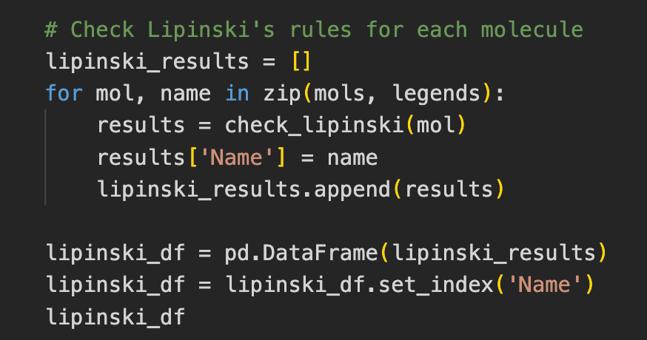

Slide 97
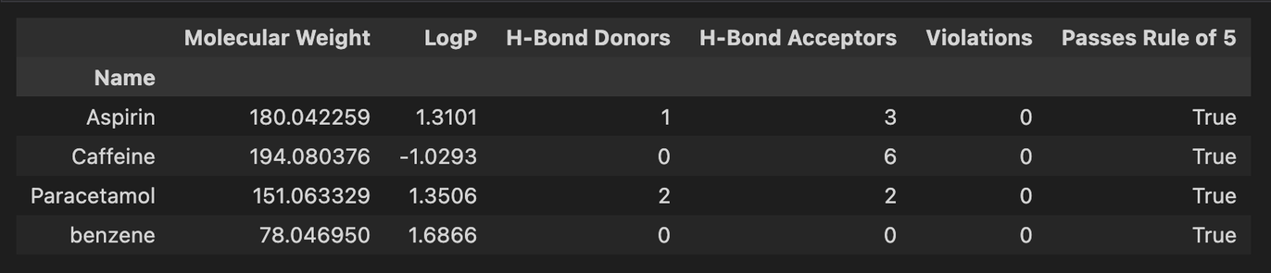
All 4 molecules are bioavailable. Finding this out using lab based methods would have taken months, teams of people, and thousands of pounds!!
Does anything surprise you about the results below?

Slide 98
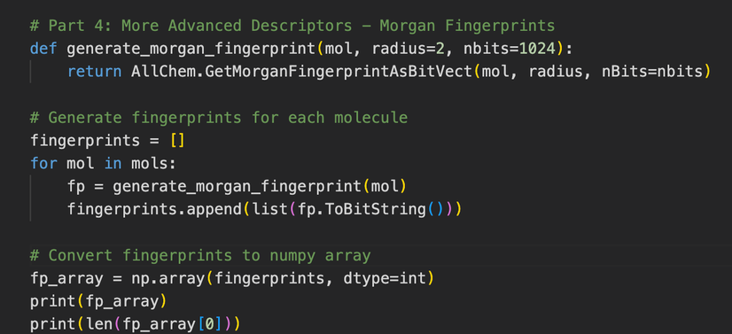
Checking for Similarity
Finding out how ‘similar’ a set of molecules is can be useful in drug discovery. Similarity isn’t an easy thing to quantify in chemistry in chemistry though.
The morgan fingerprint
Binary vector represting the molecular structure and features. Calculated using Morgans algorithm, which captures the local molecular environment. Used in similarity searching, machine learning, compression etc. Uniquely descibes a molecule
A barcode for molecules?
Morgan fingerprints are unique for each molecule

Slide 99
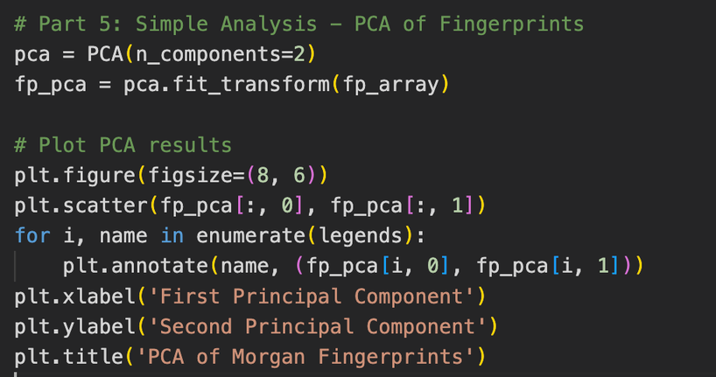
PCA with Morgan fingerprints
PCA enable dimensionaltiy reduction. By carrying out one of a fingerprint that is made from the structure of a molecule we can check for similarity between those molecules
PCA
Principle component analysis transforms high-dimensional data into a new coordinate system where the axes (principal components) represent directions of maximum variance in the data. It works by finding linear combinations of the original features that capture the most important patterns while minimizing information loss.
Visual representation
Our example only has 4 molecules. But imaging have 4 million. You could quickly see clusters.

Slide 100
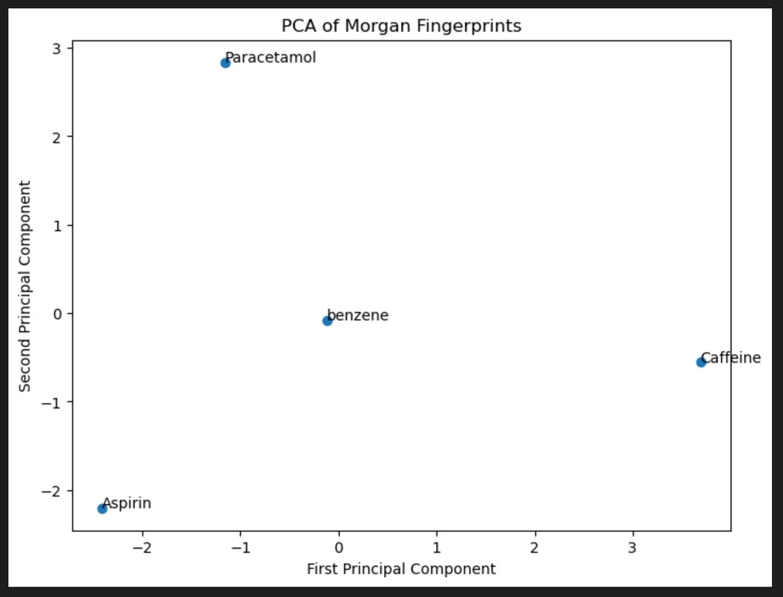
Visualising the PCA

Slide 101
End to End Project Complete
We’ve read in some molecules into RDKit, calculated descriptors for them in order to check their bioavailability and then checked to see how similar they are. Put all this on git/github if you want to properly complete this project. You could use your own list of molecules (maybe generate 10k?).

Slide 102
Some project ideas
Create and plot dataframes contain molecules with ring systems - can you colour this by TPSA?
Can you generate all the descriptors for all the SMILES in the dataframe - output this to a new file
Explore the scikit learn libary - can you model solubility?

