Slide 1

airquality.co
AI-Powered Respiratory Risk Intelligence
Predicting Respiratory Health Risks Before They Strike

Slide 2





The
$580 Billion
Problem
262 Million
Global Respiratory Health Crisis by the Numbers
People worldwide suffer from asthma, resulting in 461,000 deaths annually
290,000-650,000
Respiratory deaths per year from influenza globally
$30 Billion
Annual cost in Australia alone from asthma and influenza-related productivity losses
Current surveillance systems remain reactive, expensive, and geographically limited — with no real-time mould spore data available in Australia or Southeast Asia

Slide 3

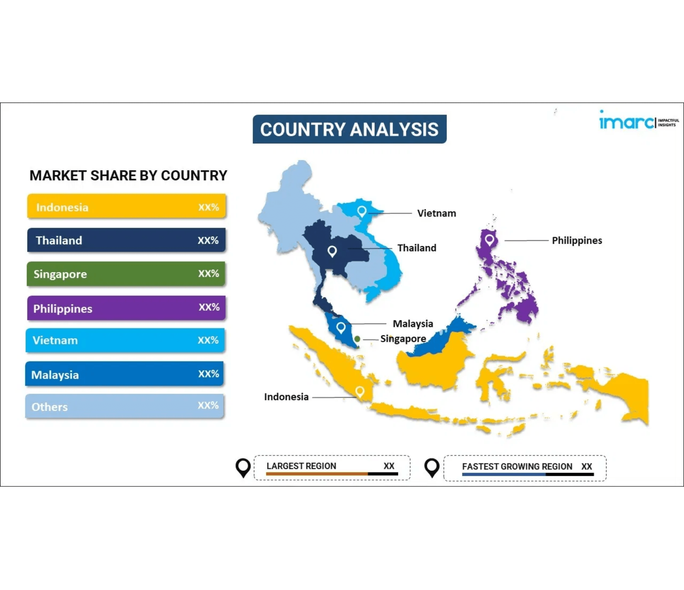
Market Opportunity
Australia
$30+ Billion
2.7 million asthma sufferers (11% of population), 1 in 5 children affected
Southeast Asia
$20+ Billion
50+ million people with asthma across ASEAN nations, year-round tropical transmission
Global Expansion
$580+ Billion
Total addressable market with proven model scalable worldwide
Growing middle class, rapid urbanization, and climate change are driving increased healthcare spending and air quality concerns across all markets

Slide 4

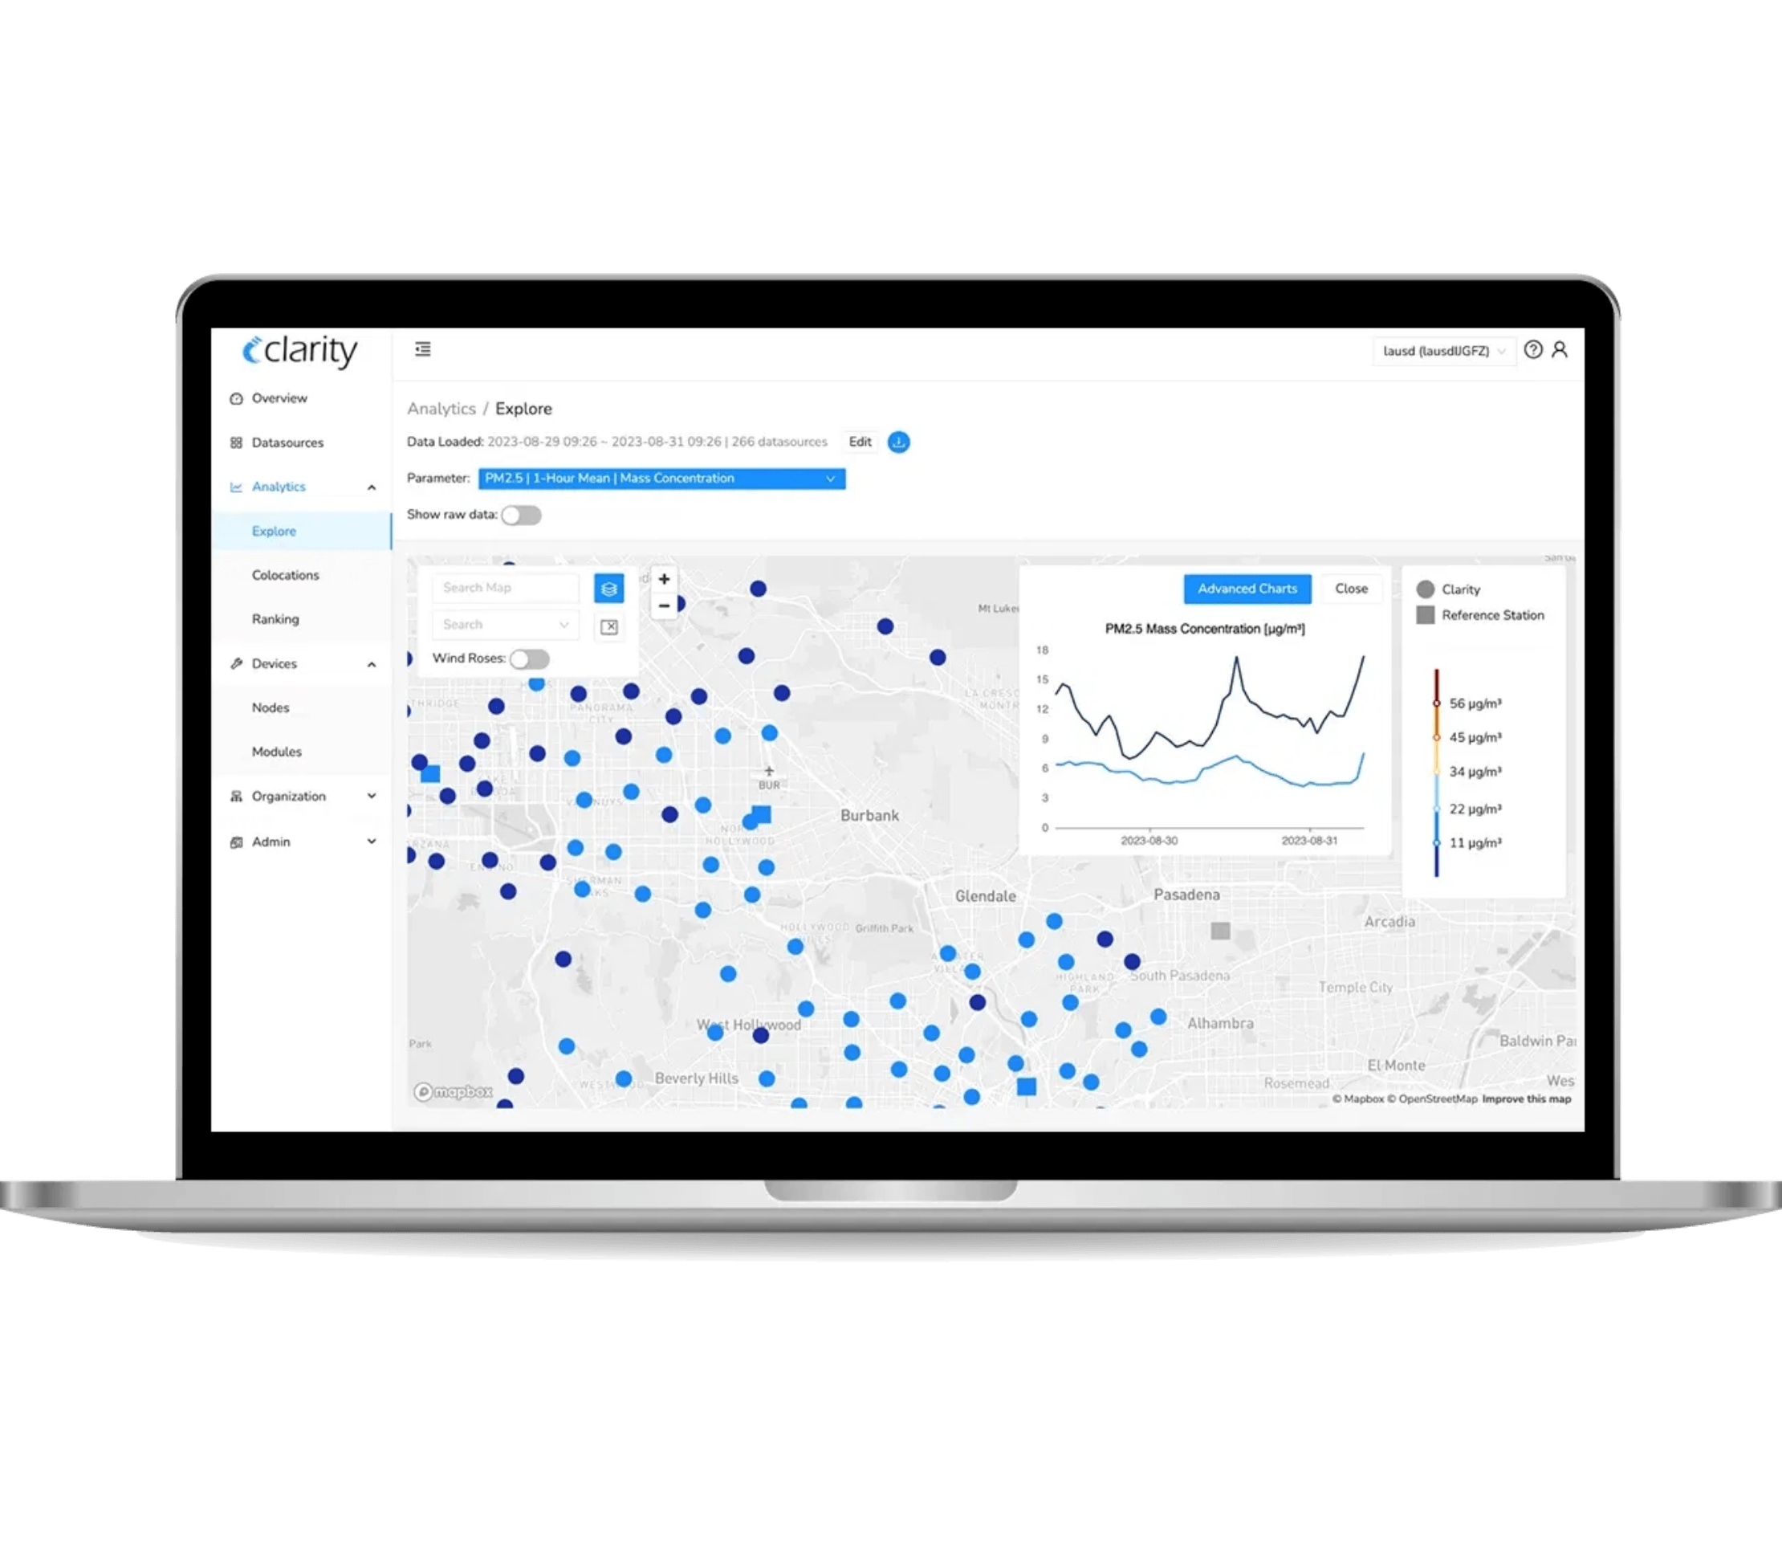
Our Solution
Real-time and predictive respiratory risk intelligence without deploying a single sensor
AI-Driven Forecasting
Predicts illness risk 7-30 days in advance using bioaerosol proxies and infodemiology
Zero Hardware Required
Leverages existing environmental APIs (Ambee, OpenWeatherMap, Google Trends)
Bioaerosol Proxy Modeling
Uses PM2.5, PM10, and pollen data to predict mould spore exposure
Green/Yellow/Red Risk System
Simple, universally understood exposure model for immediate action
Multi-Platform Access
Web dashboard, mobile-responsive design, API integration, embeddable widgets

Slide 5



Scientific Foundation
Proven Accuracy
Peer-Reviewed Research
80%+ Sensitivity
Methodology presented at Clean Indoor Air for ALL Conference 2025 with rigorous scientific validation and academic review
Validated forecasting accuracy for illness spike predictions in Melbourne data analysis

Slide 6
Scientific Foundation
Hygiene Hypothesis Application
Infodemiology Integration
Unique understanding of "protective zones" versus traditional pollution-only approaches — a key scientific differentiator
Combines environmental monitoring with Google Trends data for unprecedented predictive accuracy and early warning capabilities
Institutional Affiliations & Partnerships
National Institute of Integrative Medicine • BioMedix • Monash University • Mote.io

Slide 7


Competitive Advantages
01
First-Mover Advantage
No competitor combines bioaerosol proxies, infodemiology, and AI forecasting
02
Scientific Validation
Peer-reviewed research establishes credibility competitors lack
03
Scalable Technology
API-driven model enables infinite geographic expansion at near-zero marginal cost

Slide 8
Competitive Advantages
Part 2: Network Effects & Development Speed
04
Data Network Effects
More users generate better validation, improving forecast accuracy and attracting more users
05
Vibe Coding Development
AI-assisted rapid iteration delivers features faster than traditional development
Together, these
five defensible moats
position airquality.co as the
category leader
in
respiratory risk intelligence

Slide 9

Diversified Revenue Streams Across Multiple Markets
B2C Subscriptions
Enterprise Solutions
Personal Pro
Workplace Wellness
$9.99/month ($99/year)
$500-5,000/month
Multi-location monitoring, 30-day forecasting, custom alerts
Unlimited employees, company dashboard, absenteeism tracking
Family Plan
Healthcare Organizations
$19.99/month ($199/year)
$1,000-10,000/month
Up to 5 users, shared locations, priority support
Multi-site monitoring, patient alerts, admission forecasting
Government Licensing
Research & API Access
Public Health Surveillance
Research Licensing
$50,000-500,000/year
$10,000-50,000/project
State/national licensing, customized dashboards, epidemic early warning systems
Academic institutions, pharmaceutical companies, environmental studies
API Access
$500-5,000/month
Third-party integration, real estate platforms, health tech companies

Slide 10

Freemium Growth Engine & Customer Acquisition
Freemium Model Creates Powerful Network Effects
100,000 free users provide real-time risk data for single locations, driving 5-10% conversion to paid tiers while creating powerful network effects for validation and accuracy improvements
100,000
5-10%
27,000
Free Users
Conversion Rate
Paid Subscribers
Building awareness and validating forecasts
Free to paid tier conversion
Target by Year 3 across all B2C tiers
Enterprise and government contracts
provide diversified revenue stability, reducing dependence on any
single customer segment and creating
predictable recurring revenue

Slide 11

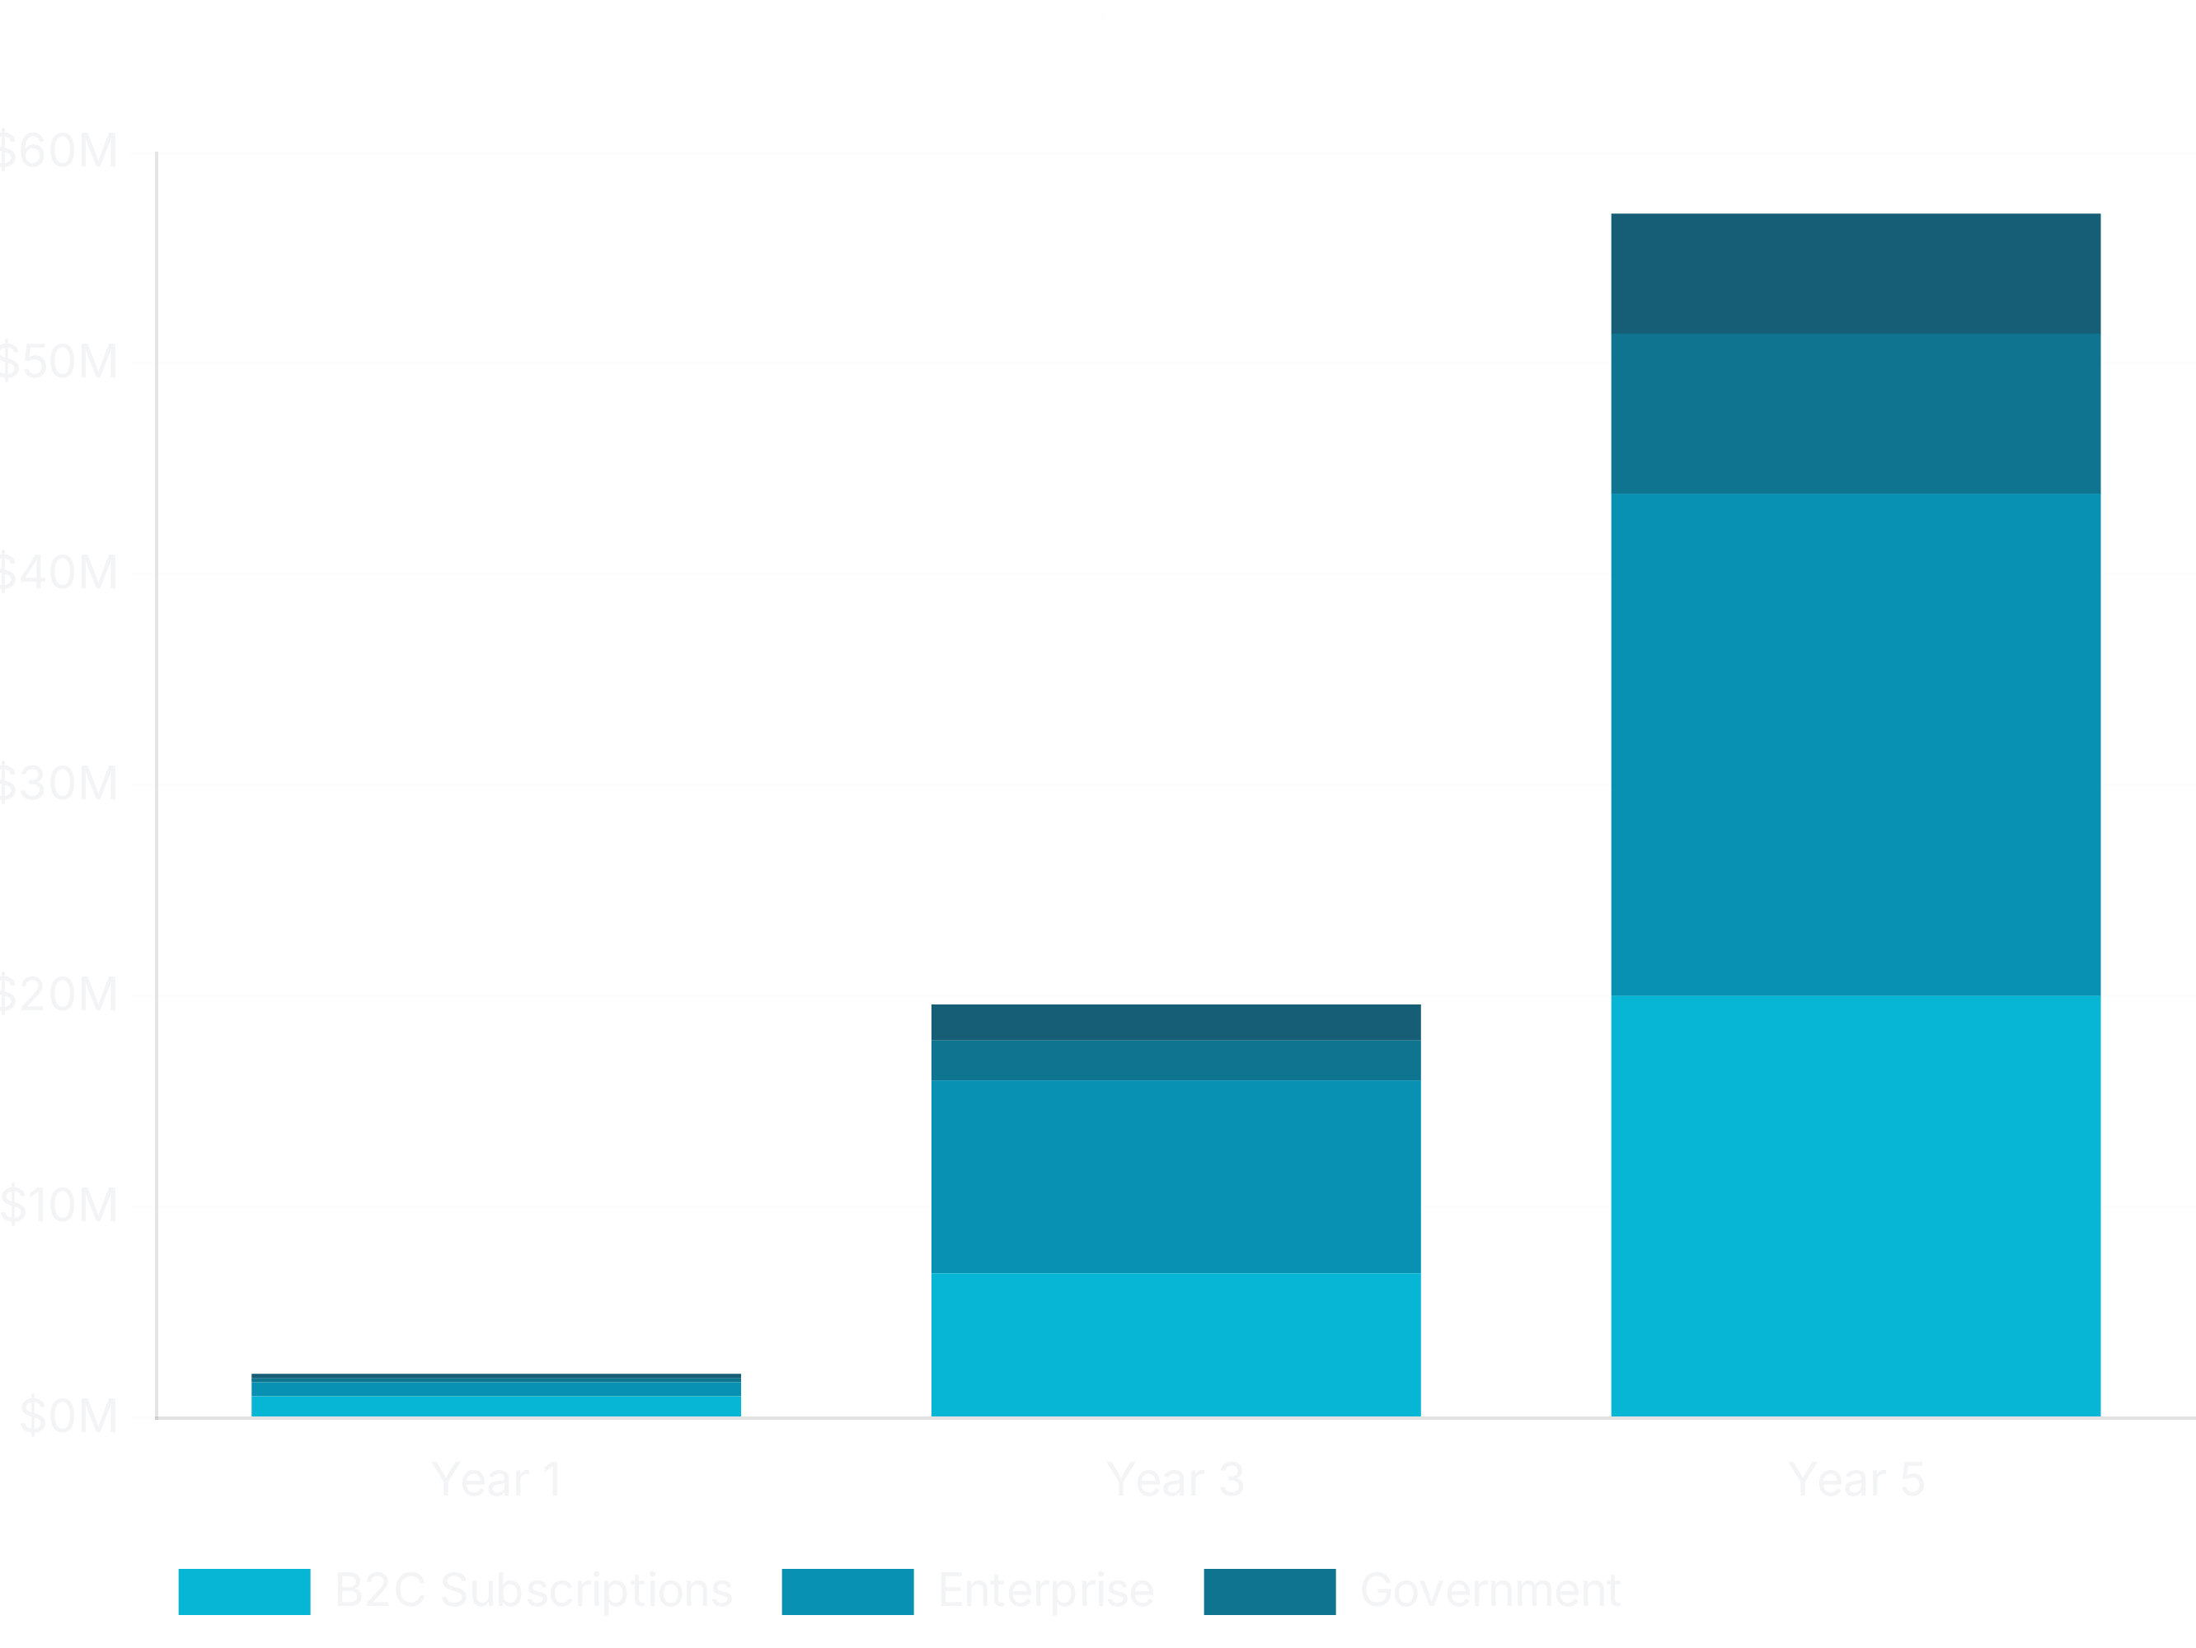
Revenue Growth Trajectory
Year 1 Revenue Breakdown
$2.25M
B2C Subscriptions
$1.08M
Enterprise
$696K
Government
$200K
Research & API
$220K

Slide 12

Revenue Projections: Unit Economics & Targets
Year 3 Revenue Target
$20.3M
$7.2M
$9.6M
$2M
$1.8M
B2C Subscriptions
Enterprise
Government
Research & API
Unit Economics
Year 5 Target
>10:1
$60M+
LTV:CAC ratio demonstrating sustainable growth and strong profitability potential
With geographic expansion to US, Europe, and additional Southeast Asian countries

Slide 13

Phased Geographic Expansion Strategy
01
Target
Channels
Australia Launch
1,000 paid subscribers, 10,000 free users
Digital ads, partnerships with Asthma Australia, Lung Foundation Australia
Months 1-6
02
Target
Channels
Enterprise & Government
10 enterprise clients, 1-2 government contracts
Direct sales to corporations (ESG focus), state health department RFPs
Months 7-12
03
Target Markets
Localization
Southeast Asia Expansion
Thailand, Singapore, Malaysia (tropical year-round transmission)
Thai language, local health partnerships, adjusted pricing ($4.99-7.99/month)
Year 2
04
Target Markets
Partnerships
Global Expansion
US ($87B ILI burden), Europe, Japan with multinational employers
Global health insurers, NIH, WHO, international universities
Year 3+

Slide 14

Impact & ROI
Early Warnings Enable Measurable Global Impact
15-30%
$25-50B
Hospitalization Reduction
Global Savings Potential
Reduce Lost Productivity
Prevent Hospitalizations
1+ Billion Work Days
Forecasting allows at-risk individuals to take precautions during high-risk periods, reducing emergency department visits and acute care costs
Address global missed work days from respiratory illnesses through proactive planning and prevention

Slide 15

Impact & ROI: Humanitarian & Long-Term Value
Lives Saved
Climate Adaptation
461,000 Annual Deaths
Enable population health resilience as climate change affects respiratory disease patterns and air quality globally
Global asthma deaths represent preventable tragedies that early warning systems can help avoid
Quantified ROI for Enterprise Clients
Cost savings calculator quantifies value from prevented hospitalizations, enabling enterprise clients to measure direct financial impact and demonstrate return on investment
Immediate economic value
through reduced healthcare costs combined with
long-term societal
impact
through lives saved and climate resilience

Slide 16




Team & Expertise
Founder & Core Team
Dr Cameron Jones, PhD
Meow Meow
Early Team
Founder/CEO
Co-founder
Contractors
50-60%
5-10%
3-8%
Created core IP
Pitch deck suggestions
Bhavya Raj (2-5%): 3 months research assistant
Academic paper author
Strategic input
Divya Sharma (1-3%): Potential involvement
Conference presenter
90%+ of codebase
Advisory Board
Aron Gingis
Dr Heike Neumeister-Kemp
Mr Peter Eng
Dr Peter Eng Sr.
Climate Science Advisor
Aerobiology/Mycology
Blockchain Business
Medical Advisor
0.25-1% vesting
0.25-1% vesting
0.25-1% vesting
0.25-1% vesting
Employee Option Pool
Biological Health Services/Lab
10-15%
5-10%
For future hires
Infrastructure support

Slide 17

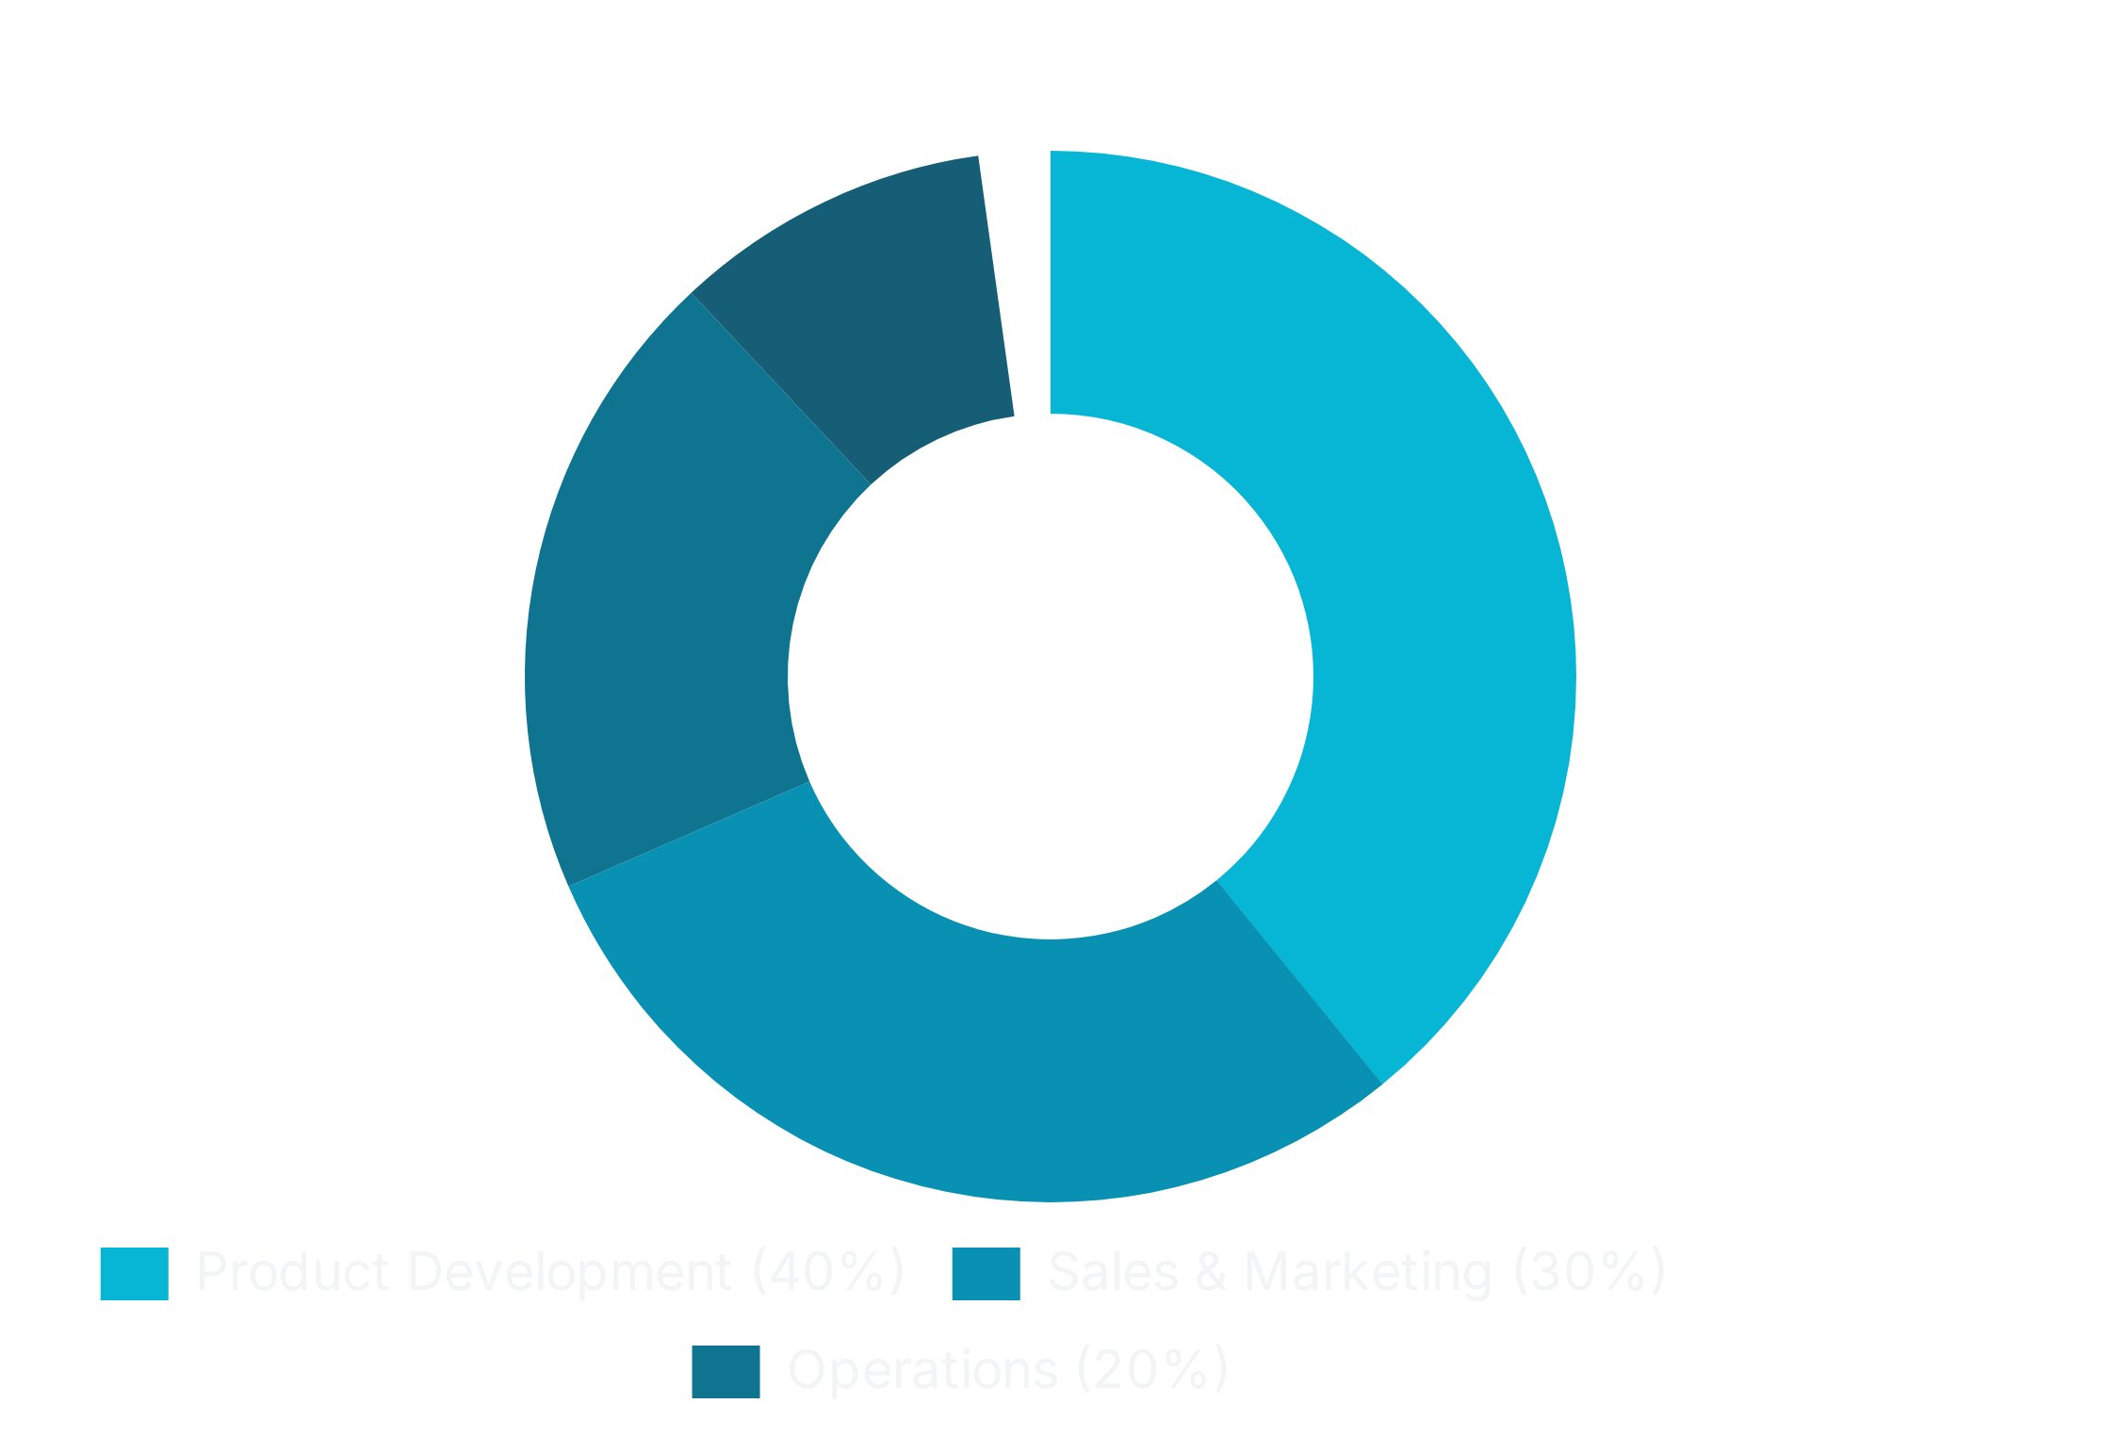
Investment Ask
$2 Million Seed Round
Fund Allocation
Product Development
40% ($800K)
Sales & Marketing
30% ($600K)
Operations
20% ($400K)
Research & Validation
10% ($200K)
18-Month Milestones
25,000
paid subscribers
100,000
free users
30
enterprise clients
3
government contracts
Southeast Asia launch
(2 countries)
Revenue:
$5M ARR
Ready for Series A:
$10-15M

Slide 18
Exit Strategy
Multiple High-Value Acquirer Categories
Health Insurance
Digital Health Platforms
Environmental Tech
Bupa, Medibank, NIB — preventive care value-add services
Apple Health, Google Fit — data integration into health ecosystems
IQAir, Plume Labs — air quality product expansion
Pharma Companies
Smart Home / IoT
Health Systems
Respiratory drug manufacturers — patient engagement and adherence tools
Google Nest, Amazon, Samsung — home health ecosystem integration
Large hospital networks — population health management

Slide 19

Exit Strategy: Valuation & Timeline
Valuation Comparables
BreezoMeter
IQAir
Airthings
Acquired by Google
Valuation
Valuation
Est. $50-100M
$100M+
$100M+
Target Exit Valuation
$200-500M
Based on achieving $50-100M ARR with high SaaS margins in 5-7 years

Slide 20






Why Now?
Post-COVID Awareness
Climate Change Impact
Elevated public consciousness about airborne health risks and respiratory protection
Increasing frequency of extreme weather events affecting air quality and respiratory disease patterns
AI/LLM Technology
ESG Commitments
Recent advances enable sophisticated forecasting and vibe coding development approaches
Corporations prioritizing employee wellbeing and demonstrating duty of care obligations
Government Investment
Public health agencies seeking cost-effective surveillance without sensor infrastructure costs

Slide 21

"The Zoom for Respiratory Health"
Essential infrastructure for an airborne illness world. We are
transforming respiratory health from
reactive crisis management
to
proactive risk intelligence
, protecting 262 million asthma sufferers
worldwide and preventing billions in economic losses.
airquality.co
Founder:
Cameron Jones
Email:
cameron@drcameronjones.com
Website:
airquality.co

