Slide 1


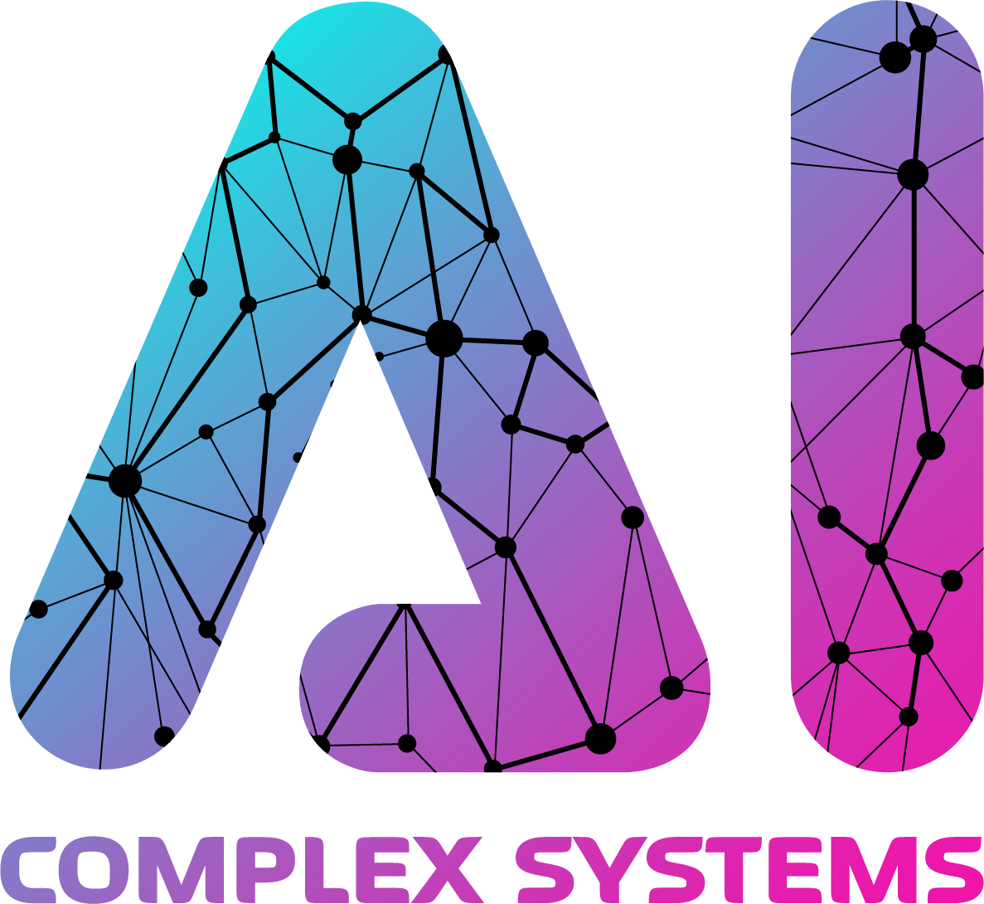
Introduction to AI Project Management
Successful AI projects require specialized management techniques to navigate the unique challenges and opportunities presented by this rapidly evolving technology. This presentation will provide a comprehensive overview of the key principles and best practices for effectively managing AI initiatives from start to finish.
M. Abdullah Canbaz, Ph.D.
Ai in Complex Systems Lab
College of Emergency Preparedness, Homeland Security, and Cybersecurity

Slide 2
Understanding AI Governance Frameworks
Ethical Considerations
Regulatory Compliance
Organizational Policies
Establishing clear ethical guidelines and principles to ensure AI systems are developed and deployed responsibly.
Identifying and adhering to relevant laws, regulations, and industry standards governing the use of AI.
Developing internal policies and processes to govern the lifecycle of AI projects within the company.

Slide 3

Defining AI Project Objectives and Scope
1
Identify Business Needs
Clearly define the specific problems or opportunities the AI project aims to address.
2
Determine Technical Feasibility
Assess the available data, infrastructure, and talent required to successfully implement the AI solution.
3
Establish Project Scope
Outline the specific goals, deliverables, and timeline for the AI initiative.

Slide 4




Assembling the AI Project Team
Data Scientists
Software Engineers
Business Analysts
Project Managers
Professionals skilled in machine learning, data analysis, and model development.
Individuals who understand the domain-specific requirements and use cases for the AI solution.
Professionals who coordinate the various team members and ensure the project stays on track.
Experts in designing, building, and deploying AI-powered applications and systems.

Slide 5





Implementing AI Project Lifecycle Stages
Ideation
Brainstorming and identifying potential AI use cases that align with business objectives.
Data Preparation
Collecting, cleaning, and structuring the data required to train and deploy AI models.
Model Development
Designing, training, and validating the machine learning algorithms that power the AI solution.
Deployment
Integrating the AI system into existing infrastructure and making it available for end-users.
Monitoring
Continuously evaluating the performance, accuracy, and impact of the AI system in production.

Slide 6
Monitoring and Evaluating AI Project Performance
1
Key Performance Indicators (KPIs)
2
Continuous Validation
Regularly assess the AI model's accuracy, reliability, and compliance with intended use cases.
Establish relevant metrics to measure the effectiveness and impact of the AI solution.
3
Feedback Loops
4
Auditability
Implement processes to gather user feedback and continuously improve the AI system.
Maintain detailed records and documentation to ensure transparency and accountability.

Slide 7
Addressing AI Ethical and Regulatory Considerations
Fairness and Bias
Transparency and Explainability
Ensure AI systems do not discriminate or perpetuate biases against protected groups.
Provide clear and understandable explanations for the decisions and outputs of AI models.
Privacy and Security
Accountability and Governance
Implement robust data protection measures to safeguard sensitive information used by AI.
Establish clear policies and procedures to oversee the responsible development and deployment of AI.

Slide 8
Conclusion and Key Takeaways
Comprehensive Planning
Clearly define objectives, scope, and governance for AI projects.
Multidisciplinary Team
Assemble a diverse group of experts to tackle the technical and business challenges.
Lifecycle Management
Implement a structured process to guide AI projects from ideation to deployment.
Continuous Monitoring
Regularly evaluate performance, address ethical concerns, and iterate on the AI solution.

Slide 9
Thank you!
M. Abdullah Canbaz, Ph.D.
Ai in Complex Systems Lab
College of Emergency Preparedness, Homeland Security, and Cybersecurity

