Slide 1
Center for Cyber Analysis and Assessment (CCAA)
Dr. Jaime C. Acosta, Ph.D.
Survivability/Lethality Analysis Directorate
Cyber Vulnerability Analysis and Assessment Division
Notes:
Here I’ll introduce myself; talk about ARL at White Sands and a little bit about me
-Located 45 miles away (about an hour drive)
-Part of White Sands Missile Range (tenant org)
-HQ is at Adelphi, MD (about 20 miles from DC area)
-Survivability/Lethality Analysis Directorate
-3 directorates at WSMR: M&S, Electronic Warfare, Cyber
-Cyber has 2 thrusts: assessments (ethical hacking) and research (improve tools, time, military of the future – collaborate with academia/industry/other gov)
-65 analysts, 60 assessments (1-4, sometimes 6 weeks long)

Slide 2
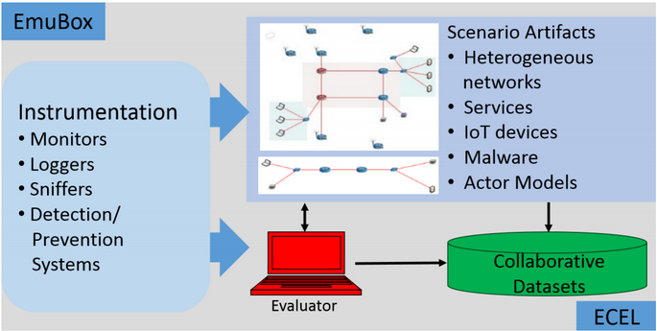




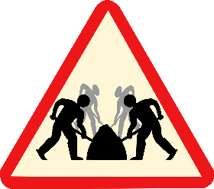


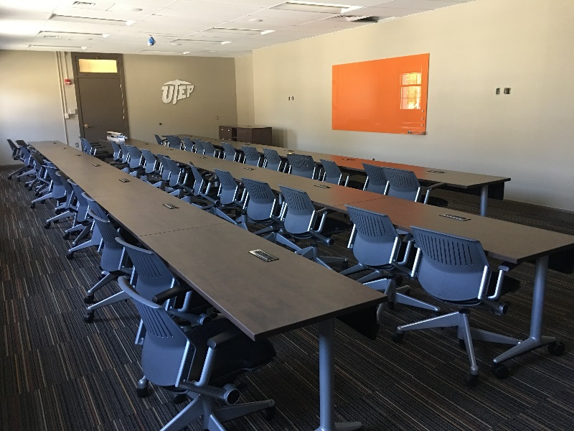
Center for Cyber Analysis and Assessment (CCAA)
Advance the state-of-the art in cybersecurity by working collaboratively
Offers co-developed cyber workshops for training, data collection, and analysis
Workshop Scenario Architecture
Enables face-to-face working meetings with government, industry, and academia
Facilitates collaborative development of fundamental R&D
Promotes University staff involvement
Attracts exemplary students
Influences degree foci and skillsets
One of the Collaborative Spaces at UT El Paso
Notes:
Talk about workshops, capture the flag development (cooperatively)

Slide 3
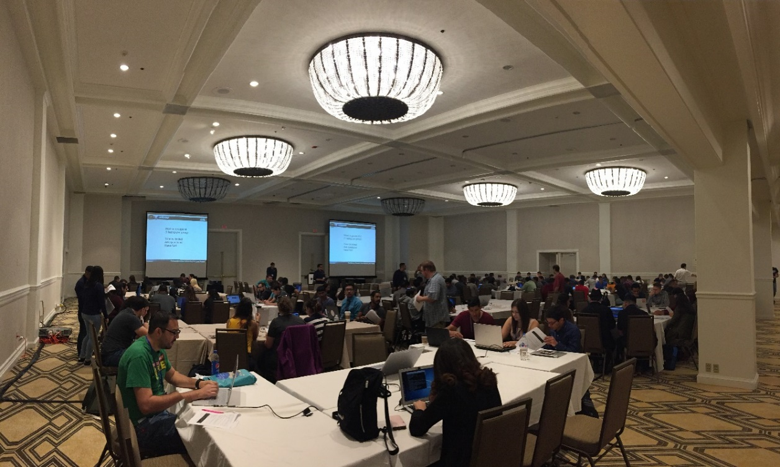
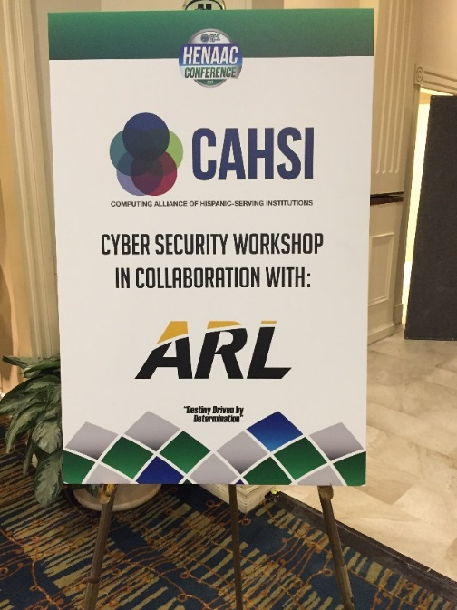
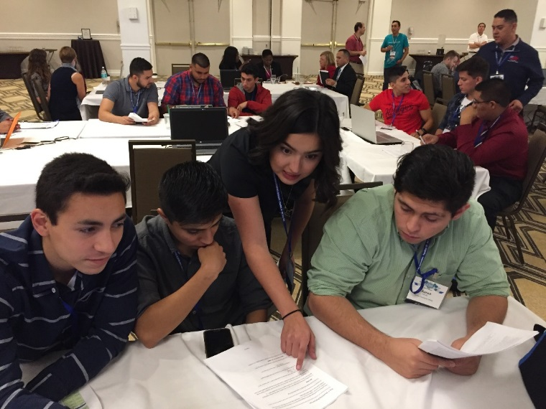
Workshops Enable Deeper Understanding and Analyses
Workshop Name | Developer
WannaCry (ransomware) | ARL/UTEP/FBI
DEFCON qualifying challenge | UTEP/ARL
Slow HTTP POST DoS | UTEP/ARL
Cross-site scripting | UTEP/ARL
Bot malware Forensics | ARL
Web client authentication | ARL
Watering hole | ARL
Route hijacking | ARL
Pivoting and intranets | ARL
Introduction to reverse engineering | UTEP Cyber Club
Buffer overflow | UTEP
ARP spoof | UTEP
…
Hosted over 15 Workshops at various venues
Over 500 participants in 2017
Notes:
HENAAC – Hispanics in Engineers National Achievement Awards Corporation

Slide 4

Why are you at NMSU?

Slide 5




ARL Extended
Physical presence in regions beyond ARL’s current locations to foster deep, enduring collaborations with regional academia & industry
Army technology interests & needs will be brought to external researchers when research is in formative stages
Opportunities to transition new non-DoD specific technologies into the Army
Access to world class laboratories & facilities
Significantly expand the pool of potential new ARL employees
ARL will operate in a more integrated, networked way with a host of partners

Slide 6
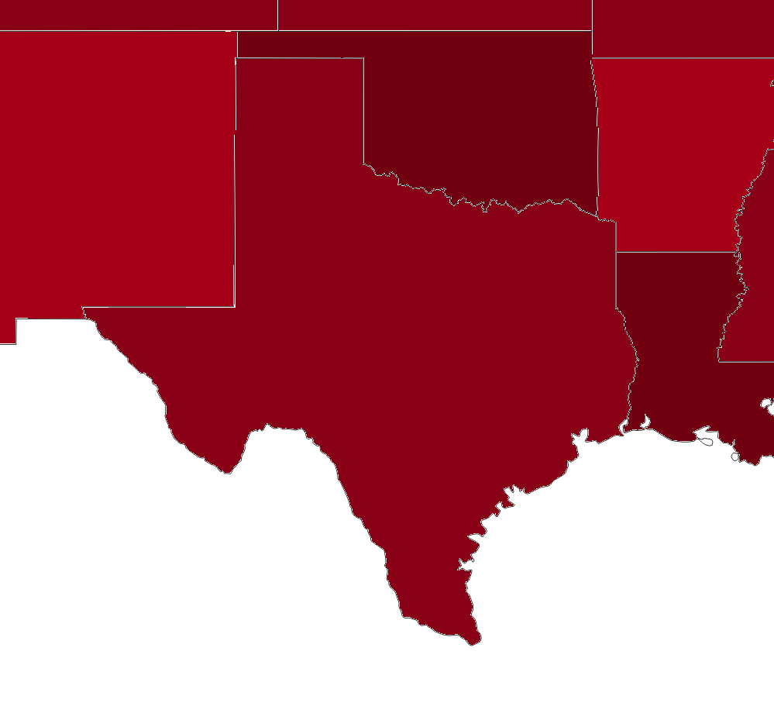
ARL-South focuses on cybersecurity
Potential Benefits
First-hand contributions to the Cyber community
Co-hosted cyber awareness workshops
Joint publications
Student employment
Joint grants
Cyber designations
Regional cyber outreach
Training
Shared resources
Cross-pollination
Collaboration with other ARL Campuses
Relocation opportunities
…
UT
Dallas
NMSU
UT Arlington
UTEP
UT Austin
Texas A&M
UT San Antonio
Notes:
I spend 10 hours a week; going to be more; at least 1 person a day
Such a success that the relationship has grown to UTEP becoming an ARL-South satellite

Slide 7
Cyber Operations Awareness Hands-On Series: Exploitation and Pivoting
Center for Cyber
Analysis and Assessment
U.S. Army Research Laboratory
Cyber Vulnerability Analysis Division

Slide 8
Security awareness is essential
“Know your enemy and know yourself and you can fight a hundred battles without disaster.”
-Sun Tzu (Author of Art of War)

Slide 9
Do not try this at home
WARNING!
Never tamper without written consent
This can lead to academic suspension, legal prosecution, prevent you from getting a job, …

Slide 10



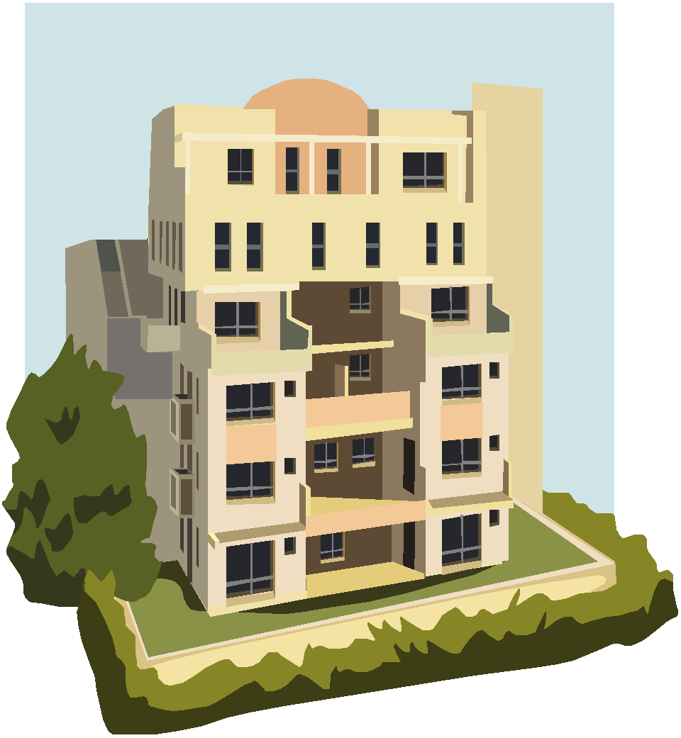



Network Routing is Similar to the Mail System
Mail is routed across several postal sites
destination
Site E
source
Site F
Site A
Site B
Site D
Site C

Slide 11
Network Routing is Similar to the Mail System
Package Path:
1. Site A
2. Site B
3. Site D
4. Site F
5. destination
destination
Site E
source
Site F
Site A
Site B
Site D
Site C

Slide 12

IP Addresses are Used to Route Traffic
Traffic is routed across several network routers
router
15.0.0.1
router
router
destination
source
router
router
16.0.0.1
10.0.4.1
11.0.0.1
14.0.0.1
10.0.4.10
11.0.0.2
12.0.0.1
13.0.0.1
router

Slide 13
IP Addresses are Used to Route Traffic
Traffic Path:
1. 11.0.0.1
2. 12.0.0.1
3. 14.0.0.1
4. 16.0.0.1
5. 10.0.4.10
router
15.0.0.1
router
router
destination
source
router
router
16.0.0.1
10.0.4.1
11.0.0.1
14.0.0.1
10.0.4.10
11.0.0.2
12.0.0.1
13.0.0.1
router

Slide 14
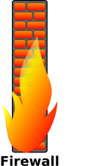
Firewalls are used to restrict access from unauthorized network locations
Internet
Company Network
source
router
router
company-internal webserver
11.0.0.2
11.0.0.1
router
router
12.0.0.1
13.0.0.1
10.0.4.10
only certain traffic is allowed to pass through the firewall
(e.g., web)
Public Webserver

Slide 15
Pivoting allows adversaries to gain trusted access
Internet
Company Network
source
router
router
company-internal webserver
11.0.0.2
11.0.0.1
router
router
12.0.0.1
13.0.0.1
10.0.4.10
only certain traffic is allowed to pass through the firewall
(e.g., web)
VULNERABLE
Public Webserver

Slide 16
Exercise
Work in groups of 2
(1 laptop per group)
Laptop Login:
visit
N0guey
Workshop Login:
root
toor
Time is limited
Ask questions!
Have fun!

