Slide 1


Digital India: A Data-Driven Analysis of Internet and Smartphone Growth (2015–2025)
Chandana D.R
Tools: Excel & Power BI

Slide 2
Introduction
Digital India aims to transform India into a digitally empowered society
Project analyzes the growth of Internet & Smartphone usage (2015–2025)
Highlights national, state, rural & urban digital adoption
Shows how technology is shaping India’s development

Slide 3
Project Overview
Data-driven study of India’s digital growth (2015–2025)
Focus on Internet & Smartphone adoption trends
Uses Power BI & Excel for analytics and visualization
State-wise & year-wise comparison of digital penetration
Identifies key patterns, growth factors, and insights
Helps understand India’s progress toward a digitally empowered society

Slide 4
Objectives
Measure state-wise internet & smartphone penetration.
Analyze India’s digital growth from 2015–2025
Understand year-wise growth trends and patterns
Identify top and bottom performing states
Explore factors influencing digital adoption
Provide insights to support Digital India initiatives
Build interactive dashboards using Power BI

Slide 5
Data Description
Dataset: India State-wise Digital Growth (2015–2025)
Total years covered: 11 years
Key fields: Year, State, Internet Users (Millions), Smartphone Users (Millions), Population, Internet Penetration (%), Smartphone Penetration (%), Growth rate(%)
Type of data: Structured, numeric, state-wise panel data
Used for: Trend analysis, comparison, forecasting
Source: Public digital reports, telecom surveys, statistical projections

Slide 6
Data Model
Single table data model
Columns: Year, State, Population, Internet Users, Smartphone Users, etc.
Calculated fields for penetration rates
Simple star-like structure (no relationships needed)
Easy to use for time-series & state-wise analysis
Supports all visuals in the dashboard

Slide 7
Dashboard Visuals Overview
Interactive Power BI dashboard
Key visuals included: Year-wise line chart (Internet & Smartphone users)
State-wise bar chart
Penetration % comparison
Map visual for regional insights
KPI cards (Total users & growth)
Filters/Slicers: Year, State
Designed for easy interpretation and quick insights

Slide 8
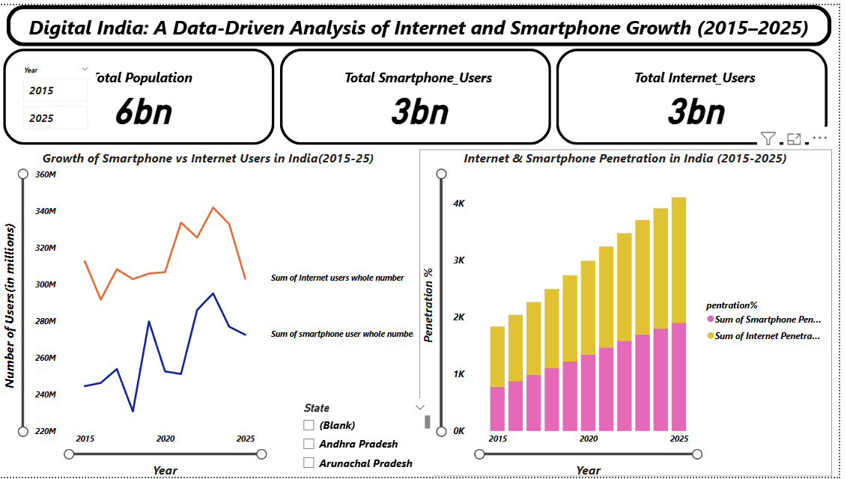

Slide 9
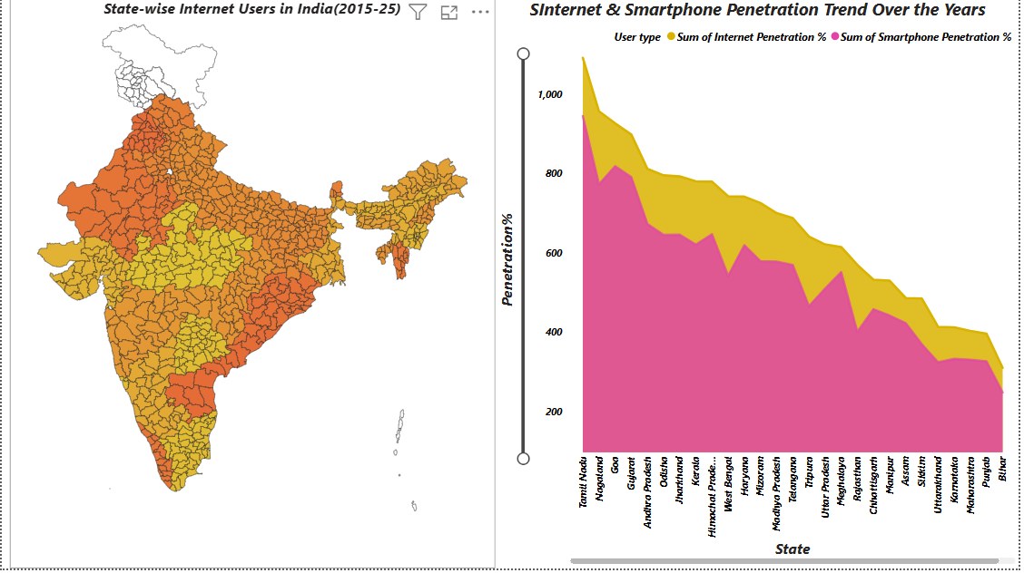

Slide 10
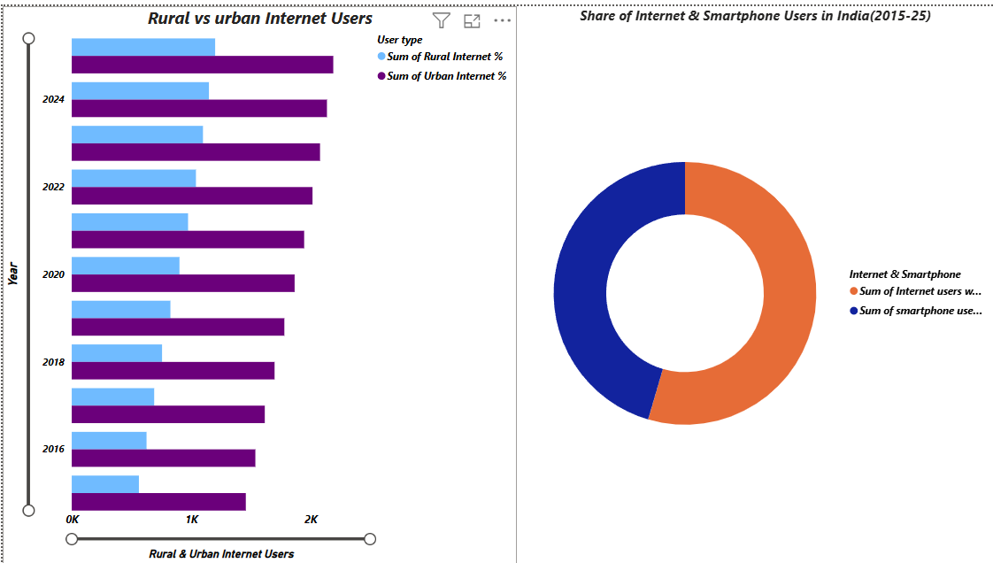

Slide 11
Key Metrics
Total Internet Users (2015–2025)
Total Smartphone Users (2015–2025)
Internet Penetration Rate (%)
Smartphone Penetration Rate (%)
Year-over-Year (YoY) Growth
State Growth Ranking
Digital Adoption Gap (Top vs Bottom States)

Slide 12
Insights
Steady rise in internet & smartphone users (2015–2025)
Southern & Western states lead digital penetration
Northeastern & some central states show slower adoption
Major growth after 2018 due to cheaper mobile data
Increasing digital gap between top & bottom states
Clear shift toward mobile-first digital access
Smartphone adoption growing faster than internet usage

Slide 13
Conclusion
India is rapidly becoming a digitally connected nation
Strong growth in both smartphone and internet penetration
Regional digital divide still exists
Digital India initiatives driving adoption
Future potential for even higher connectivity
Data insights help support policy & business decisions

Slide 14
Future Scope
Add more datasets like income, education, network coverage
Use forecasting models to predict future digital growth
Expand dashboards with AI-based insights
Compare rural vs urban digital adoption
Study impact of 5G rollout
Create more detailed state profiles

