Slide 1
MicroRTS LLM Game AI Competition
Final Results & Analysis
2026 IEEE World Congress on Computational Intelligence
Organizers: Chang Liu et al. · 13 teams · 15 agents evaluated
github.com/drchangliu/MicroRTS · drchangliu.github.io/MicroRTS

Slide 2
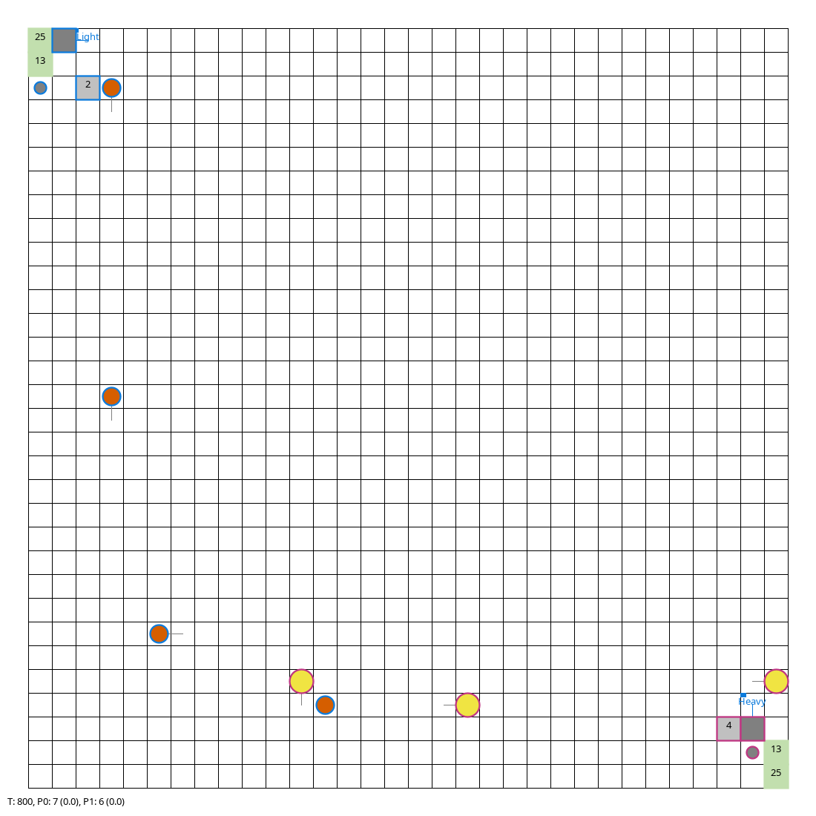
Background & History
MicroRTS — a decade-old benchmark for real-time strategy AI
About MicroRTS
Same engine, ten years on
• Lightweight Java RTS designed for AI research — workers, light / heavy / ranged units, bases, barracks, resources.
• Created by Santiago Ontañón (Drexel) and presented at AIIDE 2013 (Combinatorial Multi-Armed Bandit work).
• Fully observable or partially observable; deterministic engine; fast simulation (thousands of games per minute) — ideal for tree search, RL, and benchmark studies.
• Maintained jointly with Levi Lelis and Rubens O. Moraes, who have driven the competition for years.
• Open source: github.com/santiontanon/microrts
Competition history
2017
IEEE-CIG
First MicroRTS AI Competition
2018
IEEE-CIG
Tree-search + scripted hybrids dominate
32×32 mid-play: LightRush vs HeavyRush at tick 800
2019
IEEE-COG
Renamed conference; CoacAI emerges
2020-21
IEEE-COG
POLightRush, Mayari, Tiamat refine the ladder
2022-25
IEEE-COG
RL-track and PO-track expand
2026
IEEE-WCCI
First LLM-only edition (this competition)
2026 IEEE WCCI · MicroRTS LLM Game AI Competition
2

Slide 3
Why an LLM Edition?
Motivation for the 2026 WCCI track
Use LLMs as the core of intelligence to solve RTS-game problems.
LLM-based RTS agents are not the top solution today — but the area has high growth potential, and is likely a research direction that compounds quickly over the next few years.
A two-pronged research program
Prong 1 · How best to use an LLM to solve RTS?
Prong 2 · Which LLM is best at RTS?
Architecture / scaffolding question
Benchmark / model-comparison question
• Where does the LLM sit in the loop — every tick, every N ticks, or only at strategy switches?
• How do you compose an LLM with classical search (MCTS) or scripted policies?
• What prompt format and game-state encoding makes the LLM reliable?
• How do you handle latency, validity constraints, and JSON parsing failures?
• A standardized RTS benchmark across open and closed models.
• Measures planning, instruction-following, and structured-output reliability.
• Holds scaffolding constant; isolates the model as the independent variable.
• Tracks year-over-year LLM progress on a real-time, partially observable task.
2026 IEEE WCCI · MicroRTS LLM Game AI Competition
3

Slide 4
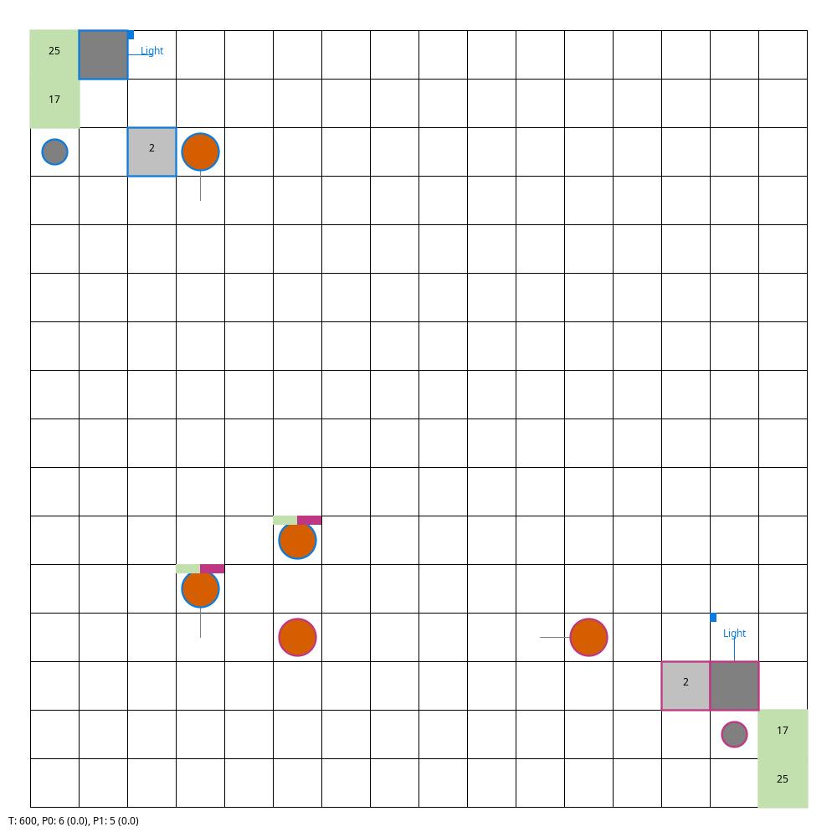
Competition Overview
What we asked the teams to build
Build an LLM-powered MicroRTS agent — no training, no fine-tuning, prompt-only.
• MicroRTS: open Java RTS benchmark (Ontañón et al.) — workers, light/heavy/ranged units, bases, barracks.
• Agents read the game state, prompt an LLM, parse JSON moves, submit them per tick.
• Success requires prompt engineering and strategy design, not weight updates.
• Submitted via GitHub PR; central server runs each agent against a six-anchor ladder.
• Tests LLM reasoning, planning, and instruction-following under real-time constraints.
MicroRTS · 16×16 · mid-play
13 teams · 15 binaries · 4 map sizes (8×8 → 64×64) · 6 anchors · 1 A+
Blue = Player 0 · Pink = Player 1 · Orange circle = Light unit
2026 IEEE WCCI · MicroRTS LLM Game AI Competition
4

Slide 5
Tournament Format & Scoring
Single-elimination, multi-map ladder
Map gauntlet (per agent)
Anchor opponents (weight)
Map
Cycle cap
Opponent
Tier
Weight
8×8 basesWorkers
1,500
RandomBiasedAI
easy
10
16×16 basesWorkers
3,000
WorkerRush
medium
15
32×32 basesWorkers
5,000
LightRush
medium
15
64×64 GardenOfWar
8,000
HeavyRush
medium-hard
20
Tiamat
hard
20
CoacAI
hard
20
Scoring
Weighted points per win (1.0) and draw (0.5), averaged across maps. A loss to an anchor stops that map (single-elimination) and the agent banks whatever it earned reaching that anchor.
Grades: A+ ≥ 90 · A ≥ 80 · B ≥ 70 · C ≥ 60 · D ≥ 40 · F < 40
Default server model: llama3.1:8b (Ollama). Teams could declare a preferred model.
2026 IEEE WCCI · MicroRTS LLM Game AI Competition
5

Slide 6
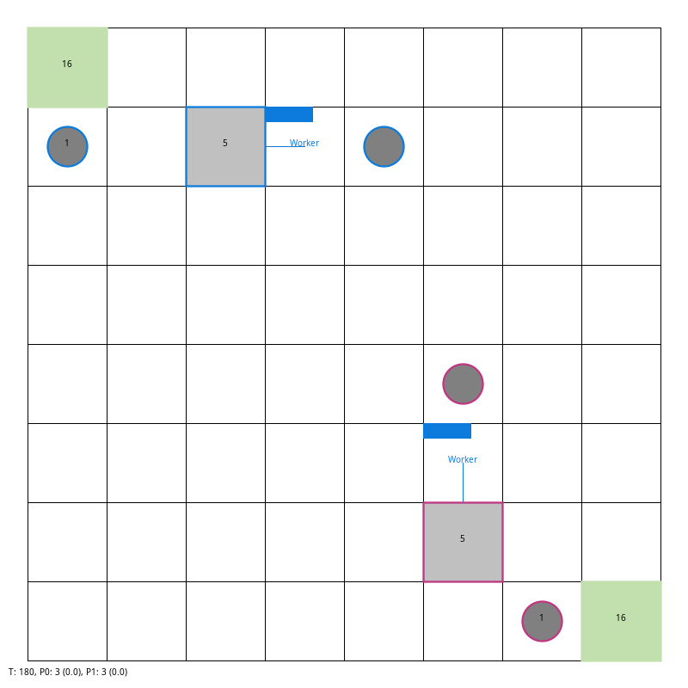
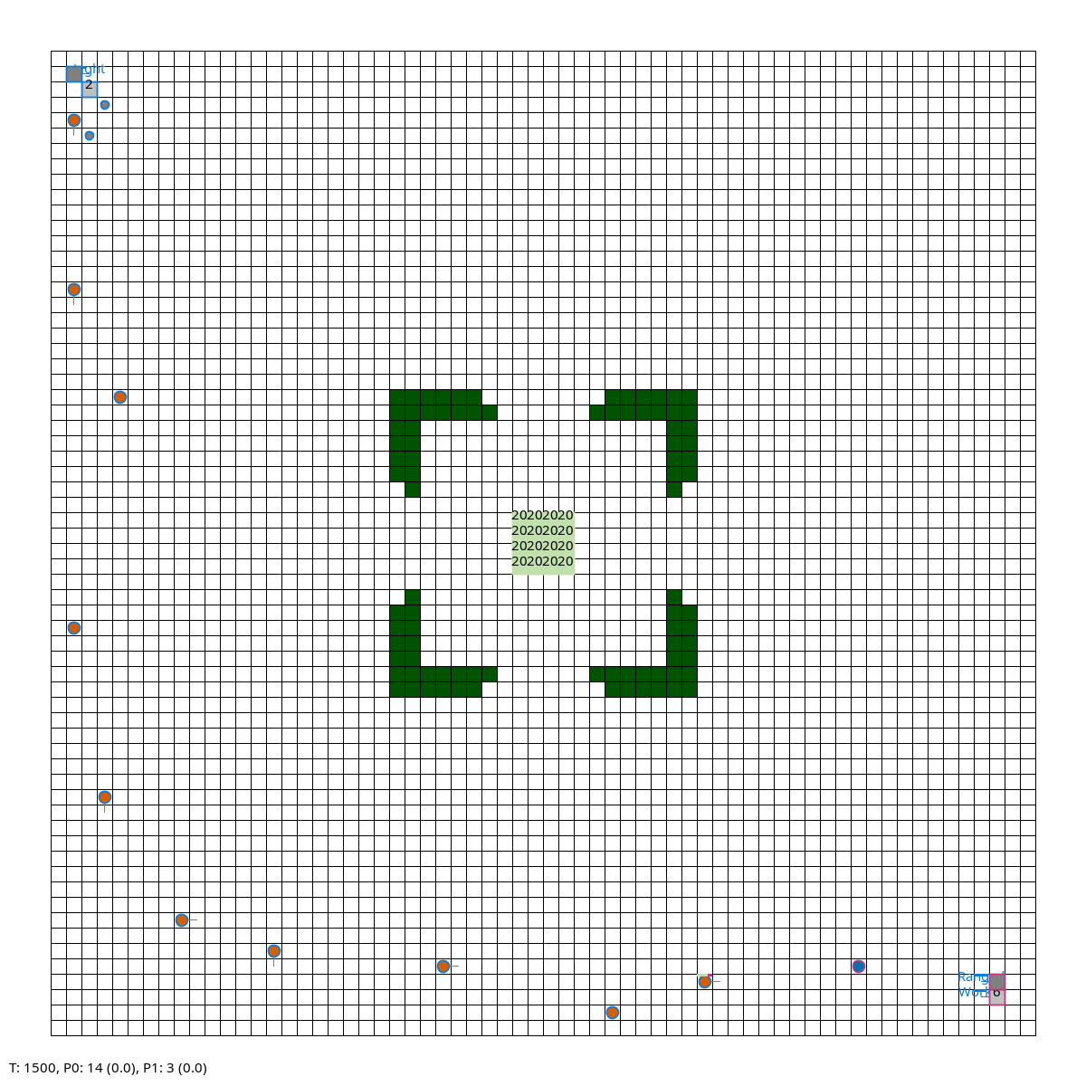
MicroRTS — Four Map Sizes
Same engine, same rules, very different strategic horizon
8×8 basesWorkers
16×16 basesWorkers
1,500 cycles · WorkerRush mirror @ tick 180
3,000 cycles · LightRush mirror @ tick 600 (HP bars = engaged)
32×32 basesWorkers
64×64 GardenOfWar
5,000 cycles · LightRush vs HeavyRush @ tick 800
8,000 cycles · LightRush vs RangedRush @ tick 1500 — walls split the map
Screenshots captured mid-play with scripted rush bots on the organizers' server.
2026 IEEE WCCI · MicroRTS LLM Game AI Competition
6

Slide 7
Final Leaderboard
Best score per team across all tournament runs
#
Team
Score
Grade
Model
Approach
1
AlliBot
100.5
A+
qwen3:14b
Hybrid + LLM advisor/search
2
Mayari-LLM
87.0
A
llama3.1:8b
MayariBot + LLM consultation
3
HOPE
79.0
B
llama3.1:8b
Ollama + MCTS + prediction
4
Chase
69.0
C
llama3.1:8b
Rush engine + advisor every ~500 ticks
5
yebot
69.0
C
qwen3:8b
Macro-LLM + hard-coded micro
6
Fortress Bot
57.5
D
llama3.1:8b
LLM planner + scripted opening + rush mirrors
7
PenguinBot
54.0
D
llama3.1:8b
NaiveMCTS + LLM stance controller
8
xiebot
54.0
D
llama3.1:8b
LLM planner + selective tactical MCTS
9
jmurr
35.0
F
none
Symmetric self/opponent state eval
10
AI4PC
33.8
F
llama3.1:8b
LLM picks rush every 100 ticks (counter-triangle)
11
Parker's Bot
33.0
F
llama3.1:8b
LLM-guided adaptive rush + fallback
12
jmurrllm
24.0
F
llama3.1:8b
Light-rush opener + LLM classifier + counter table
13
EAGLE
3.8
F
llama3.1:8b
Structured prompt policy, role-based workers
13
Adil Bot
3.8
F
none
Rule-based: harvest/build/train + early rush
2026 IEEE WCCI · MicroRTS LLM Game AI Competition
7

Slide 8
🏆 Champion: AlliBot
Score 100.5 · Grade A+ · Model qwen3:14b
The only A+ submission, and the only agent to complete the full 4-map gauntlet.
Architecture
Per-map performance
• Mayari-derived hybrid macro/micro execution layer
• Rush-defense rule set: counter-build vs. visible enemy composition
• Small-map (4×4 / 8×8) WorkerRush delegation
• qwen3:14b advisor: high-level strategic guidance
• Search component biased by LLM priors over actions
• Deterministic fallback if LLM stalls (latency budget)
Map
Score
Grade
Eliminated by
8×8
69
C
Tiamat
16×16
117
A+
—
32×32
96
A+
CoacAI
64×64
120
A+
—
Headline: AlliBot is the only entry to beat CoacAI on any map (32×32, 2W–1L) and to score A+ on three of four maps.
2026 IEEE WCCI · MicroRTS LLM Game AI Competition
8

Slide 9
Five Design Patterns
How teams composed LLMs with classical game AI
1. MCTS + LLM stance
Search-led, LLM-advised
Teams: PenguinBot · HOPE · xiebot
Tree search drives micro; LLM is consulted every few hundred ticks to bias exploration toward ATTACK/DEFEND or to set macro priors.
2. LLM strategy controller over scripted rushes
Script-led, LLM-routed
Teams: AI4PC · Parker's Bot · Chase · Fortress Bot · jmurrllm
Each tick is executed by a canonical rush bot (Worker/Light/Heavy/Ranged); LLM picks which rush — often with a counter-triangle fallback.
3. Hybrid macro/micro with LLM macro layer
LLM-led, scripted micro
Teams: AlliBot · Mayari-LLM · yebot
LLM proposes goals; deterministic code handles harvesting, building, and combat micro. Top performers cluster here.
4. Pure-prompt LLM policy
LLM-only
Teams: EAGLE
Every action generated from a structured prompt under rule constraints. Heavy latency cost — hard to clear even the weakest anchor.
5. Heuristic / no-LLM baselines
No LLM
Teams: jmurr · Adil Bot
Submitted to measure how much the LLM layer is actually worth.
2026 IEEE WCCI · MicroRTS LLM Game AI Competition
9

Slide 10
What Worked · What Didn't
Lessons from 15 agents
✓ What worked
✗ What didn't
Hybrid architectures dominated.
Per-tick LLM prompting.
Every A/B-grade entry kept the LLM out of the per-tick loop and used it as a strategic advisor (100–500 ticks).
EAGLE (pure-prompt policy) struggled with action validity and latency — could not reliably beat RandomBiasedAI.
Stronger models translated to wins…
Small-map tuning rarely transferred.
…when the rest of the stack was sound. AlliBot (qwen3:14b) is the only A+. yebot (qwen3:8b) edges out llama3.1:8b peers.
Mayari-LLM scored A+ on 16×16 but D on 8×8. Map-specific heuristics broke under different cycle budgets.
Counter-triangle reasoning recurs.
Stickiness without re-evaluation.
Light beats Ranged · Heavy beats Light · Ranged beats Heavy — appears in 5 entries, reliable at 8×8.
Per-100-tick strategy pickers (AI4PC) lost on larger maps where the opponent's composition shifted faster than polling.
Deterministic fallback paths.
Tiamat was the bottleneck.
Every top-half entry has a heuristic plan B if the LLM stalls or returns invalid JSON.
Tiamat eliminated 3 top-half entries. Only AlliBot beat it on any map.
2026 IEEE WCCI · MicroRTS LLM Game AI Competition
10

Slide 11
Per-Map Performance — Top Finishers
Score per map · grade · anchor that eliminated the agent
Team
8×8
16×16
32×32
64×64
AlliBot
69 C
Tiamat
117 A+
—
96 A+
CoacAI
120 A+
—
Mayari-LLM
54 D
WorkerRush
120 A+
—
— not run
— not run
HOPE
79 B
advanced
— not run
— not run
— not run
Chase
69 C
advanced
— not run
— not run
— not run
yebot
69 C
advanced
— not run
— not run
— not run
Fortress Bot
79 B
Tiamat
36 F
LightRush
— not run
— not run
AI4PC
79 B
Tiamat
22 F
HeavyRush
22 F
HeavyRush
12 F
HeavyRush
Only AlliBot completed all four maps; only AlliBot beat CoacAI on any map.
2026 IEEE WCCI · MicroRTS LLM Game AI Competition
11

Slide 12
Headline Numbers
13
15
teams submitted via GitHub PR
agent binaries evaluated
1
38%
A+ submission (AlliBot, 100.5)
of teams scored C or higher
4
3
different LLMs used: llama3.1:8b · qwen3:14b · qwen3:8b · gpt-5 (dev)
no-LLM/heuristic baselines (control group)
1
agent beat CoacAI on a map (AlliBot, 32×32)
2026 IEEE WCCI · MicroRTS LLM Game AI Competition
12

Slide 13
Future Work & Acknowledgments
Toward the 2027 edition
• Multiple games per matchup (variance reduction) and per-anchor seeds.
• Standardize LLM latency budget reporting to compare hybrid designs fairly.
• Allow team-selected model on the server, paired with a fixed compute cap.
• Add additional anchors (e.g. POLightRush, NaiveMCTS+) to further separate entries.
• Per-game replay viewer hosted on the leaderboard site for transparency.
Acknowledgments
• All 13 teams for their submissions and reproducible code.
• Santi Ontañón, Levi Lelis, and Rubens O. Moraes for the open MicroRTS engine.
• IEEE WCCI 2026 competition committee for hosting the track.
• Submissions, logs, and per-game results: github.com/drchangliu/MicroRTS
2026 IEEE WCCI · MicroRTS LLM Game AI Competition
13

Slide 14
Thank you
Questions & discussion
drchangliu.github.io/MicroRTS · github.com/drchangliu/MicroRTS
The submission site remains open — try the 2027 leaderboard at the same address.

