Slide 1
Industrial Calibration
Introduction
Presented by:
  Dr. Chris Lewis
  Div 10

Slide 2
Close Range Photogrammetry Systems
Image plane of cameras
z
y
x
Spatial
Intersections
Of Light Rays
Lens Focal Points
3D object points to be measured
The Process:
Record multiple overlapping images
Determine 3D positions via Photogrammetric Bundle Triangulation

Slide 3
Inside Out CRPS
Stationary
Fiducial
Targets
z
y
x
Mobile Camera
The Process:
Record Image
Determine 3D position of Camera via Photogrammetric Bundle Triangulation
Using Fiducial Markers in Known Locations

Slide 4
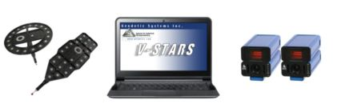
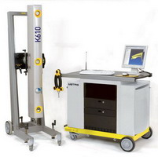
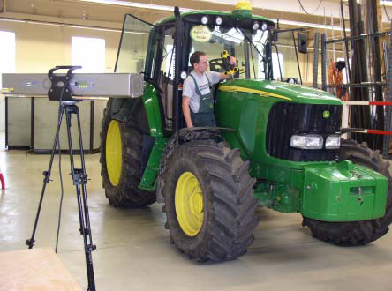
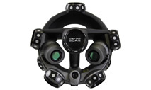
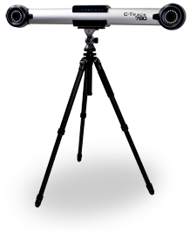
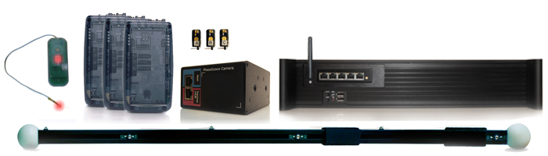
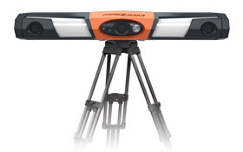
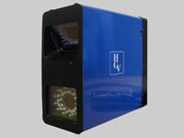
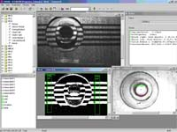
Commercial Systems
Geodetics V-STARS (10µm/m)
Nikon K610 (37µm/m)
Creaform MetraSCAN 210-R (50 µm/m)
Phase Space
NDI Multi-TRAK (35 µm/m)
Zeiss 3D Robo Sense

Slide 5
Bundle Adjustment
Minimize the sum of squared difference between where objects appear in an image and where they are predicted to appear.
Adjust lens parameters for every camera
  Focal length
  Optical Center
  Radial and Tangential Distortion
Adjust 6DoF relative pose between cameras
Adjust 3DoF locations of tie points
Requires “Control Points” to establish scale

Slide 6
Intrinsic Calibration
Bundle Adjustment for a single camera
Adjust lens parameters
  Focal length
  Optical Center
  Radial Distortion (6th order polynomial with even terms)
  Tangential Distortion( 2nd order 2 terms)
Adjust 6DoF relative pose between camera and target at each scene
Know the relative locations between all points on the calibration target (establish scale).

Slide 7
Extrinsic Calibration
Use rectified images
Adjust the pose parameters of the cameras
Adjust locations of points consistent with constraints
  Grid of points: Adjust pose
  Scale bar: Keep Length constant

Slide 8
Triangulation
Use a network of cameras to determine location of an object by only adjusting its pose while keeping intrinsic and extrinsic parameters of lenses and cameras constant
Accuracy of triangulation varies
  Number cameras
  Resolution of cameras
  Accuracy of object key-point localization in each image
  Number and spatial distribution of key-points
  Accuracy of intrinsic parameters
  Accuracy of extrinsic parameters
  Geometry

Slide 9
Re-Projection Error
The Cost Function
Process image to locate points in each image
Transform points into the camera coordinates
  Use kinematic relationships both known and unknown
  Parameterize unknown relationships with minimal set of variables (x,y,z and angle-axis).
Project points into image plane
  Use distortion model on raw images
  Use pinhole camera model on rectified images
Compare to observation
  Residual_x = prediction_x – observation_x
  Residual_y = prediction_y – observation_y

Slide 10
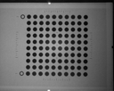
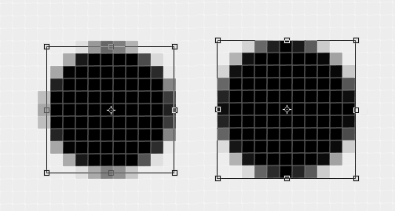
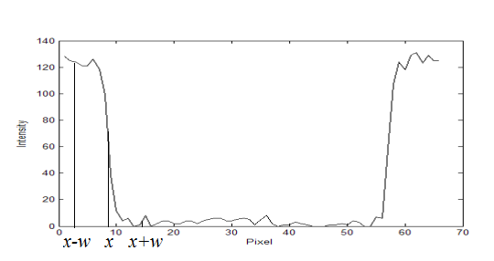
Locating Points in Images
OpenCV:
  FindCheckerboard()
  FindCirclesGrid()
Keypoint Detection
  Simple blob
  Contour
  Center of Mass
  Best Ellipse Fit
Variance in fixed scene
  Small circle, poor lens ¼ pixel
  Large circle, good lens .05 pixels

Slide 11
Points in Camera Frame
Known kinematics
  Robot holds camera
  Robot holds target
  Target or camera on a motion stage
Unknown kinematics
  Pose between robot tool point and camera
  Pose between robot tool point and target
  Pose between base of robot and camera or target
Intermediate frames
  Locate camera housing where relationship between camera and housing is assumed known

Slide 12
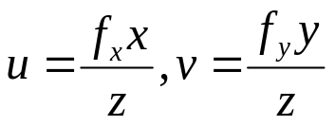
Perspective Projection
Image of
object
object
x, or y
u or v
z
Focal_length
Focal Point
Image plane
Pinhole camera model predicts the image of an object
Raw images have lens distortion

Slide 13
What is Known?
Image
plane
Target
Target
Mount
Reference
Frame
Camera
Mount
Camera
Housing
Camera
Optical
Two types of values
  Known values in “cost constructor”
  Unknowns in “cost evaluator” so that Ceres can adjust these values to minimize the total sum of squared cost
Focal Length
Optical Center
Distortion
Model

Slide 14
Industrial Calibration in ROS
Xacro, urdf
Killer
App
MoveIt!
Robot
And
Joint State Publishers
Hardware
Mutable
Joint State Publisher
Button
Press
Cal_Joints.Yaml
Calibration
Set & Store
Cameras.yaml
Targets.yaml
Scenes.yaml

Slide 15
Industrial Calibration in ROS
Xacro, urdf
Killer
App
MoveIt!
Robot
And
Joint State Publishers
Hardware
Mutable
Joint State Publisher
Button
Press
Cal_Joints.Yaml
Calibration
Set & Store
Post Analysis
Cameras.yaml
Targets.yaml
Scenes.yaml
Accuracy
Field

Slide 16
Process Flow
Trigger Each Scene
  Update kinematic relationships
  For each camera, target, ROI triad
    Locate Target in ROI
    For each Point in Target
      Add observation to list
        u,v
        Pointer To Target Parameters
        Pointer to Camera Parameters
        Intermediate Transforms
For each observation in list
  Add cost function to Ceres-Solver::Problem
Problem.Solve()

Slide 17
Input Files
Cameras.yaml
  Camera Interface
    Topic
    Trigger
  Transform Interface
  Intrinsic Parameters (Intrinsic Interface…eventually)
Targets.yaml
  Target Type
  Transform Interface
  List of Points
Scenes.yaml
  Scene Trigger
  Camera, Target, ROI Triads
  Desired Cost Function

Slide 18
Interfaces
Scene Triggers
  Print Instructions on Screen, Wait to Hit Return
  Run a GUI which insures target is correctly positioned
  Move Robot using MoveIt! Action message
Camera
Transform
  Interact with ROS tf
  Convert from Solved Parameters to Updated

Slide 19
URDF Issus
URDFs model world with ad-hoc kinematic structures (trees).
  Example: Asus sensor has two cameras
    Housing link
    IR link
    RGB link
    Housing-IR, Housing-RGB, or Housing-RI-RGB
Usually calibrating one or more 6DoF transforms linking the target to the camera’s optical frame
Can’t possibly update the URDF
  Create joints similar to a robot’s
  Add a special joint state publisher
    Publishes state of joint just like robot controller
    Allows updates (transform interface)

Slide 20
Calibration URDF Example
<xacro:include filename="$(find industrial_extrinsic_cal)/urdf/calibration_transform_macro.xacro" />
<xacro:include filename="$(find industrial_extrinsic_cal)/urdf/asus_sensor_cal_macro.xacro" />
<link name="world_frame" />
<link name="target_frame" >
<visual>
<origin xyz="0.6096 1.2192 0.0254" />
<geometry>
<box size="1.2192 2.4384 0.0508" />
</geometry>
</visual>
</link>
<link name="Basler1" >
<visual>
<origin xyz=".01 .01 .01" />
<geometry>
<box size=".02 .02 .02" />
</geometry>
</visual>
</link>
<joint name="$world_2_cal_target_joint" type="fixed" >
<parent link="world_frame" />
<child link="target_frame" />
<origin rpy="1.4312 0.0 -1.5708" xyz="5.64 0.5 0.0" />
</joint>
<xacro:calibration_definitions child_link="Basler1" parent_link="world_frame" /> <xacro:asus_sensor_definitions prefix="asus1" parent_link="world_frame" />

Slide 21
Targets Cameras and Scenes
Target File
Cameras
Scenes

Slide 22
Inside A Cost Function
class CameraReprjError
  Templated Class
  Constructor – pass all known quantities needed
  Evaluate implemented as () operator overload
  Creation Factory returns a Ceres::CostFunction
  All math including subroutines must be template compliant
Helper functions
  Transform points using pose
  Transform points using parameter block
  re-projection error for points in camera coordinates

Slide 23
Triangulation Example
Create a URDF
Create a Cost Function
System Launch
Targets, Cameras, Scenes(only one)
Calibration Launch
Note: new cost functions requires adding to switch statement in runOptimization()

Slide 24
Using the system
Define your ROS system
  Create a URDF
    Use special macros to define calibration transforms
  Create launch files for system
    Run Cameras
    Run Robots
    Load URDF
    Start any Trigger Services
    Mutable Joint State publisher
Create Calibration Input Files
  Targets, Cameras, Scenes
Launch Calibration Service Node

