Slide 1
Lung Cancer Services at Homerton
Urgent pathway performance, screening readiness & research
Dr Carl Reynolds · Lung Cancer Lead
Trust Cancer Board · 26 June 2026

Slide 2
What I'll cover today
Building on strong foundations — with thanks to Dr Bhowmik
Our urgent suspected cancer (USC) lung pathway — redesign & results
Latest data, and how we compare nationally
Recognition: ERS 2026 abstract accepted
Strengthening the service — SOP, digital tools, MDT & pathway
Pressures we're escalating
Lung cancer screening — coming to Hackney
Occupational research, goals, and what I'd ask of the Board

Slide 3
The Homerton lung service today
~10 urgent suspected lung cancer referrals per week
~2 new lung cancer diagnoses per week (~100 per year)
28-day Faster Diagnosis Standard (FDS) is the key target
Physicians: Dr Reynolds (lead), Dr Bhowmik, Dr Raluca, Dr Callum (locum)
Thoracic radiology: Dr Sayan, Dr Shritika (locum)
Lung CNS: Beatrice & Katherine; Macmillan support worker Shanez
MDT coordinator: Jaan Begum; respiratory secretary: John
Small, single-site team — agility is our advantage

Slide 4
The problem we set out to fix
USC lung pathways are complex and often miss the FDS
Traditional pathway: multiple appointments, routine bloods, CXR, contrast & abdominal imaging
Delay and waste before patients reach definitive CT
Nationally (NLCA 2026): median referral to surgery 81 days; referral to systemic therapy 63 days
32% of lung cancers still diagnosed after emergency admission
Our aim: early diagnosis, clear communication, avoidance of waste

Slide 5
A streamlined USC pathway (August 2025)
Co-designed with patients and clinicians
Upfront lung cancer consultant triage of every referral
Straight-to-CT as the first definitive investigation
By default: no bloods, no CXR, no contrast, no abdominal imaging
By default: no routine follow-up appointment
A shorter pathway, with fewer visits

Slide 6
Results: before vs after the SOP
Outcome | Pre-SOP | Post-SOP
Completed pathways (n) | 102 | 185
Median time to pathway completion (days) | 18 | 16.5
Pathways completed within 28 days (FDS) | 77.1% | 80.5%
Median time to CT chest (days) | 15 | 5.5
CT chest within 7 days | 5% | 68.7%
Median outpatient attendances per pathway | 1 | 1
Time to CT cut from 15 to 5.5 days; CT within 7 days up from 5% to 69% — no increase in appointments, no adverse impact on cancer detection.

Slide 7
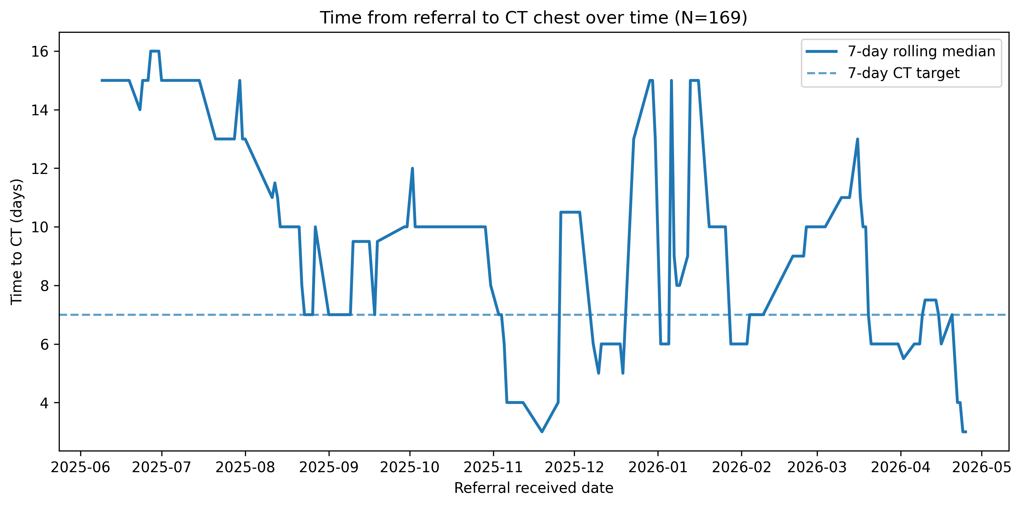
Time to CT has fallen — and stayed down
Rolling median time to CT down from ~15 days (mid-2025) to at or below the 7-day NOLCP target.

Slide 8
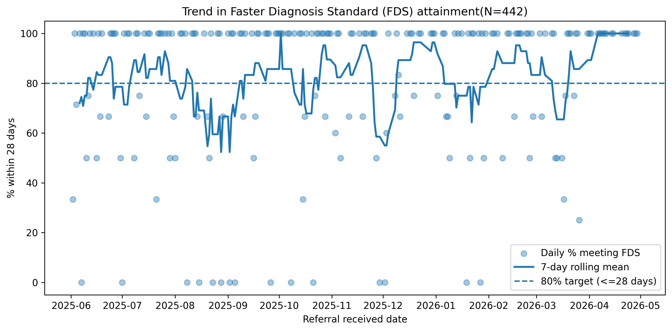
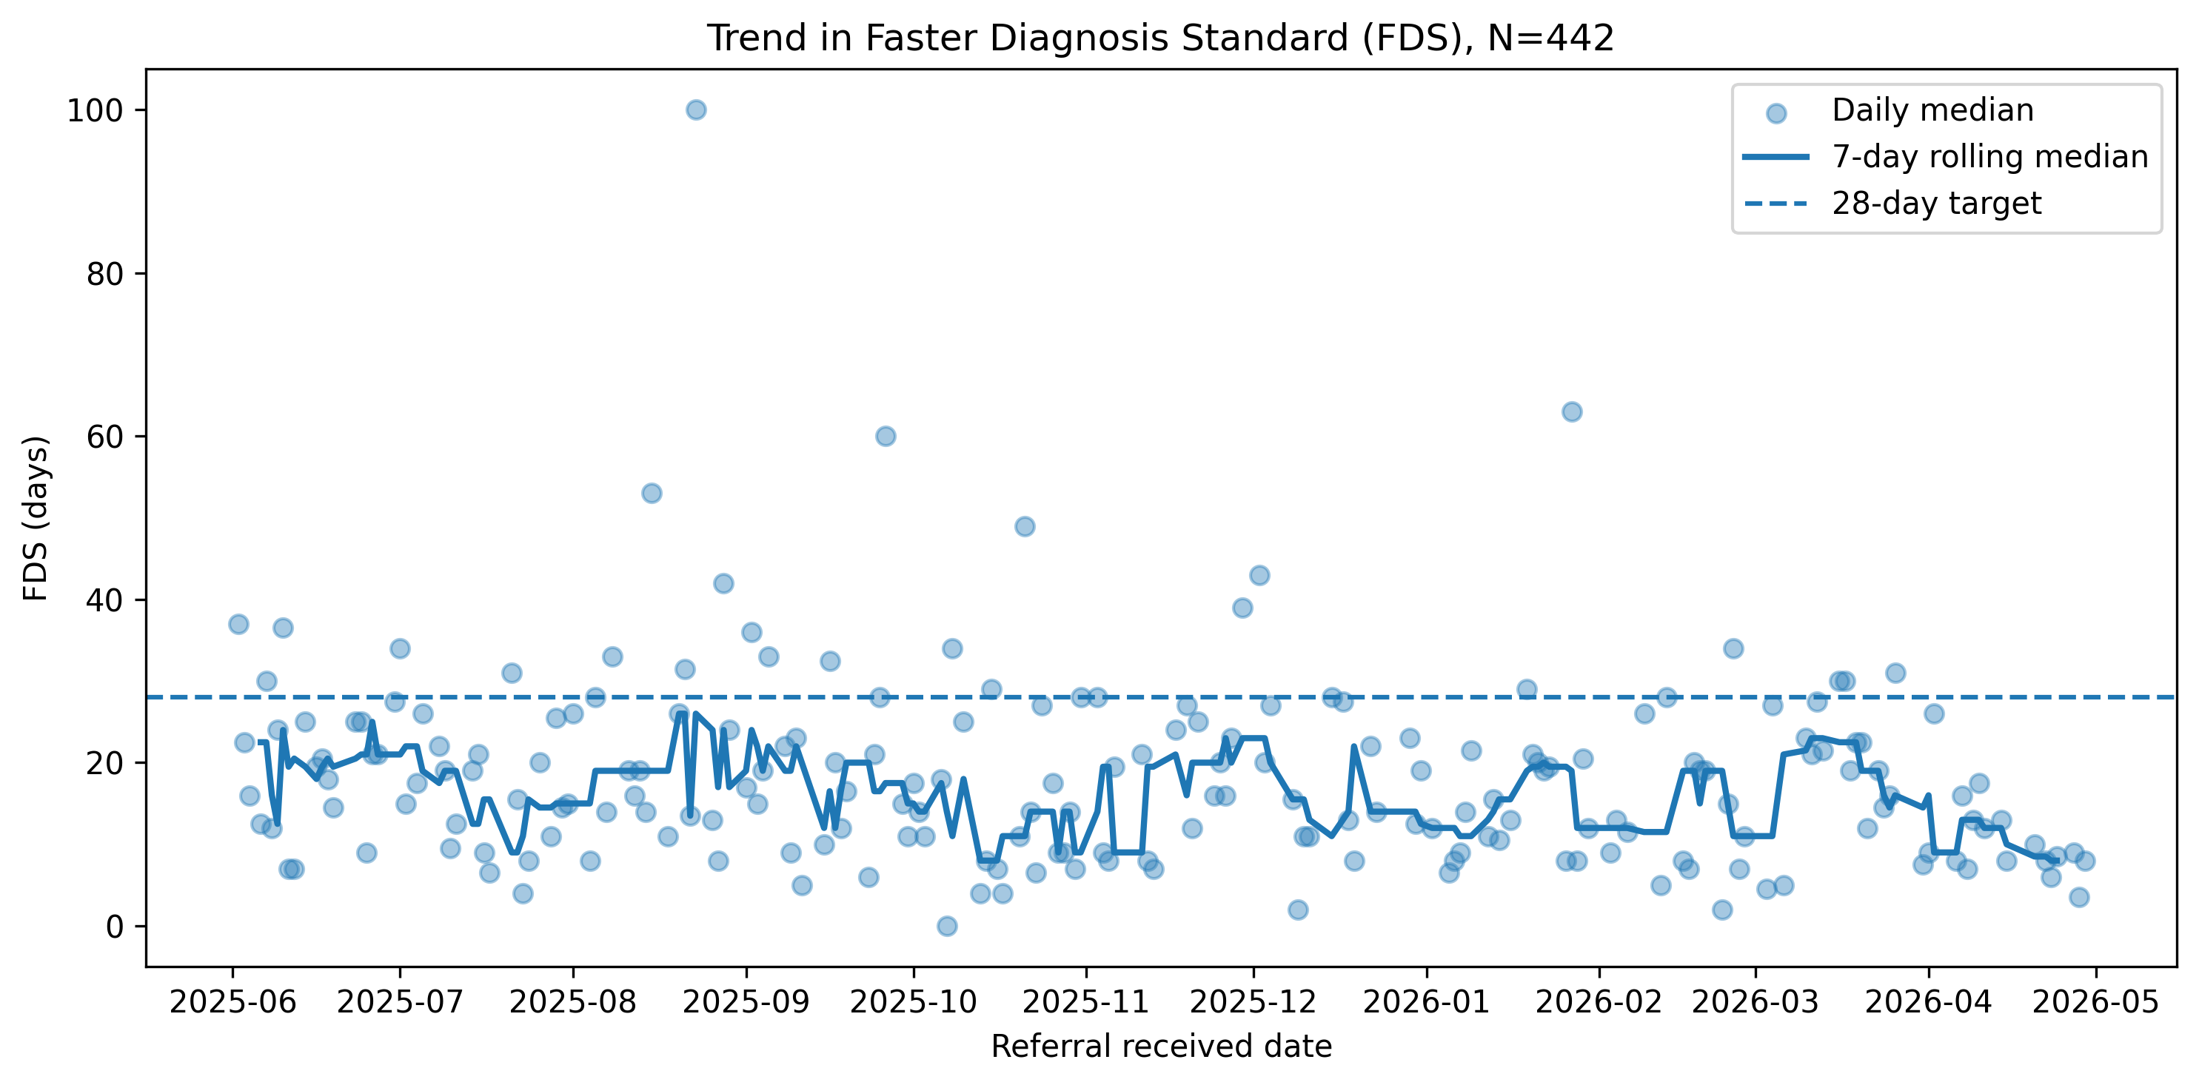
Latest data: sustained FDS performance
N = 442 to May 2026. Daily FDS attainment now consistently above 80%; median days-to-FDS well inside the 28-day target — improvement has been maintained.

Slide 9
How we compare nationally (NLCA 2026)
Homerton: referral to CT 5.5 days; CT within 7 days ~69%; FDS within 28 days ~80%
National median referral to surgery 81 days; referral to systemic therapy 63 days
39,409 people diagnosed with lung cancer in England in 2024
40.2% diagnosed at stage 1-2 (up from 35.5% in 2023) — driven by screening
32% diagnosed after emergency admission; 1-year survival 50.7%
National data gaps: smoking status 45.7%, LCNS contact 64.2% — a chance for us to lead

Slide 10
External recognition: ERS 2026
Abstract accepted for the European Respiratory Society Congress 2026
  “Impact of a co-designed streamlined urgent suspected lung cancer pathway on time to diagnosis, investigation, and appointment burden”
Homerton's pathway redesign on an international stage
Analysis is open and reproducible: github.com/drcjar/usc-times

Slide 11
Developing a lung cancer MDT SOP
Building on our approved SOPs: USC referral SOP v1.3 and CT-guided lung biopsy SOP
Developing a single MDT operational policy and service specification
Covers MDT membership & meetings, referral, the streamlined USC pathway, diagnostics, treatment & onward referral, CNS/key-worker, audit
Adapted to our single-site service and the City & Hackney population
Aligns with the National Optimal Lung Cancer Pathway (NOLCP) and NICE QS17
First draft ready to share — I'd welcome the Board's support to develop it

Slide 12
Digital innovation & safer follow-up
Lung follow-up app — built in-house (carlreynolds.net/lung-followup-app/)
With radiology: standardised wording of follow-up recommendations
Autotext for abnormal chest radiographs — consistent reporting and onward action
Autotext for pulmonary nodules — standardised surveillance advice
Next step: an automated nodule registry — reduce loss to follow-up, improve efficiency

Slide 13
Strengthening the MDT and pathway
Working well:
CNS-led wash-up meetings to ensure MDT-planned actions are actioned
Improved treatment-MDT proforma — better content and completeness
Streamlined diagnostic MDT by screening cases before the meeting
Still refining:
Ensure the first outpatient appointment occurs after CT chest, not before
Push time-to-CT even lower
Formalise vetting cover when the primary vetter is on leave

Slide 14
Pressures we're escalating and monitoring
Robotic bronchoscopy: access delays affecting the diagnostic pathway — escalated and under ongoing monitoring
Radiology USC upgrades scheduled 7+ days out by default — we need 72h for vetted referrals
Histopathology turnaround (~40% within 10 days) — a shared risk as volumes rise
Screening-driven demand ahead — capacity planning underway
Approach: surface risks early, monitor, and escalate

Slide 15
Lung cancer screening is coming to Hackney
NHS England Lung Cancer Screening Programme (formerly Targeted Lung Health Checks)
Low-dose CT for people aged 55-74 who have ever smoked and meet a risk threshold
Expected in City & Hackney in Q4 2026 / Q1 2027, delivered at high volume
Evidence (Lee et al., Nature Medicine 2026): 2M+ invited, 7,193 cancers, 63.1% at stage 1, ~76% stage 1-2
Proven to cut lung-cancer and all-cause mortality by finding disease early
Biggest early-stage gains seen in the most deprived communities — highly relevant to East London

Slide 16
What screening means for Homerton
City & Hackney eligible population ~39,500
Modelled ~195 lung cancers/year at full scale (~130+ additional diagnoses/year)
Order of ~544+ extra appointments/year on the way to diagnosis
Plus years of surveillance imaging for treated patients
Tower Hamlets comparator (Barts): 58.6% uptake, 56 cancers in first tranche
Strategy: make today's pathway as efficient as possible now, while we plan capacity

Slide 17
Occupational lung cancer research
East London has a legacy of asbestos and occupational dust exposure
Building a programme on occupational and environmental contributors to lung disease
Linking with the mesothelioma pathway (St Bartholomew's) and APRALD asbestos work
Using our open, reproducible analysis pipeline to embed research in routine care
Aim: research that informs prevention and policy

Slide 18
Goals for the service
1. Best USC performance in London
Sustain and extend our pathway gains — fastest, most patient-centred diagnosis
2. Smoking cessation
Embed opt-out cessation across respiratory and cancer pathways
3. Research
Occupational lung cancer, pathway science and screening

Slide 19
What I'd ask of the Board
Protect rapid-access CT capacity — and make 72h the default for vetted USC upgrades (currently 7+ days)
Align diagnostic capacity with demand — histopathology turnaround and robotic bronchoscopy delays
Support screening capacity planning now — for ~130+ extra cases per year
Support service development — the lung cancer MDT SOP and an automated nodule registry
Thank you — and thanks to Dr Bhowmik for the foundations we're building on

