Slide 1
Monoclonal antibody capture using affinity complexation
Reconditing Buffer
Drain
Low pH
Affinity reagent
Regeneration
BRX
+
Cell retention
Elution
Membrane
Affinity
Reagent
Impurity Wash
Eluted mAb
SPTFF
Membrane
Wash
HCP, DNA…
Drain
HCP, DNA…
mAb depleted
1
mAb rich

Slide 2
Properties of Successful mAb Affinity complex
Size
Binding, Elution
Sustainability, Cost
Stability
100 nm-5 μm
< 5x Elution MWCO (non-mAb components)
High capacity (mg mAb/mg NP)
Precipitating
Reversible
Soluble Expression
Assembled and Folded
High Yield
Time (process speed)
PMI
Low pH stable
Salt stable
Non aggregating
Notes:
Nanoparticle viability for continuous ultrafiltration is dependent on several key metrics:
Low pH stability
Solubility when bound to mAb
High binding capacity
Robust expression (E. coli)
Reliable and agnostic purification
Talk about how these properties Lead to our constraints for expression and design
Filtration process itself forces us to target a large particle size,
Binding/elution constraints require broad pH stability
Cost reduction requires affordable and speedy production
Stable to unbind form the mAb at conditions that are stable for the NP and the mAb. Fragmentation of NP can prevent its separation from the mAb.

Slide 3







Methodology for screening mAb Affinity complex Spin filter test
500 uL
L
+
50 uL
SDS-PAGE buffer
Rinse filter by pipetting
+
450 uL
Buffer
mix
100
100
100
100
100
75
75
75
75
75
100
50
50
50
50
50
75
R
50
2000 x g
<=50 uL
2000 x g
<=50 uL
W
F1
F2
L
F1
F2
R
W
Successful enrichment in retentate denotes a functional capture of bioparticle
Crucial first test of feasibility for each conception of the system

Slide 4
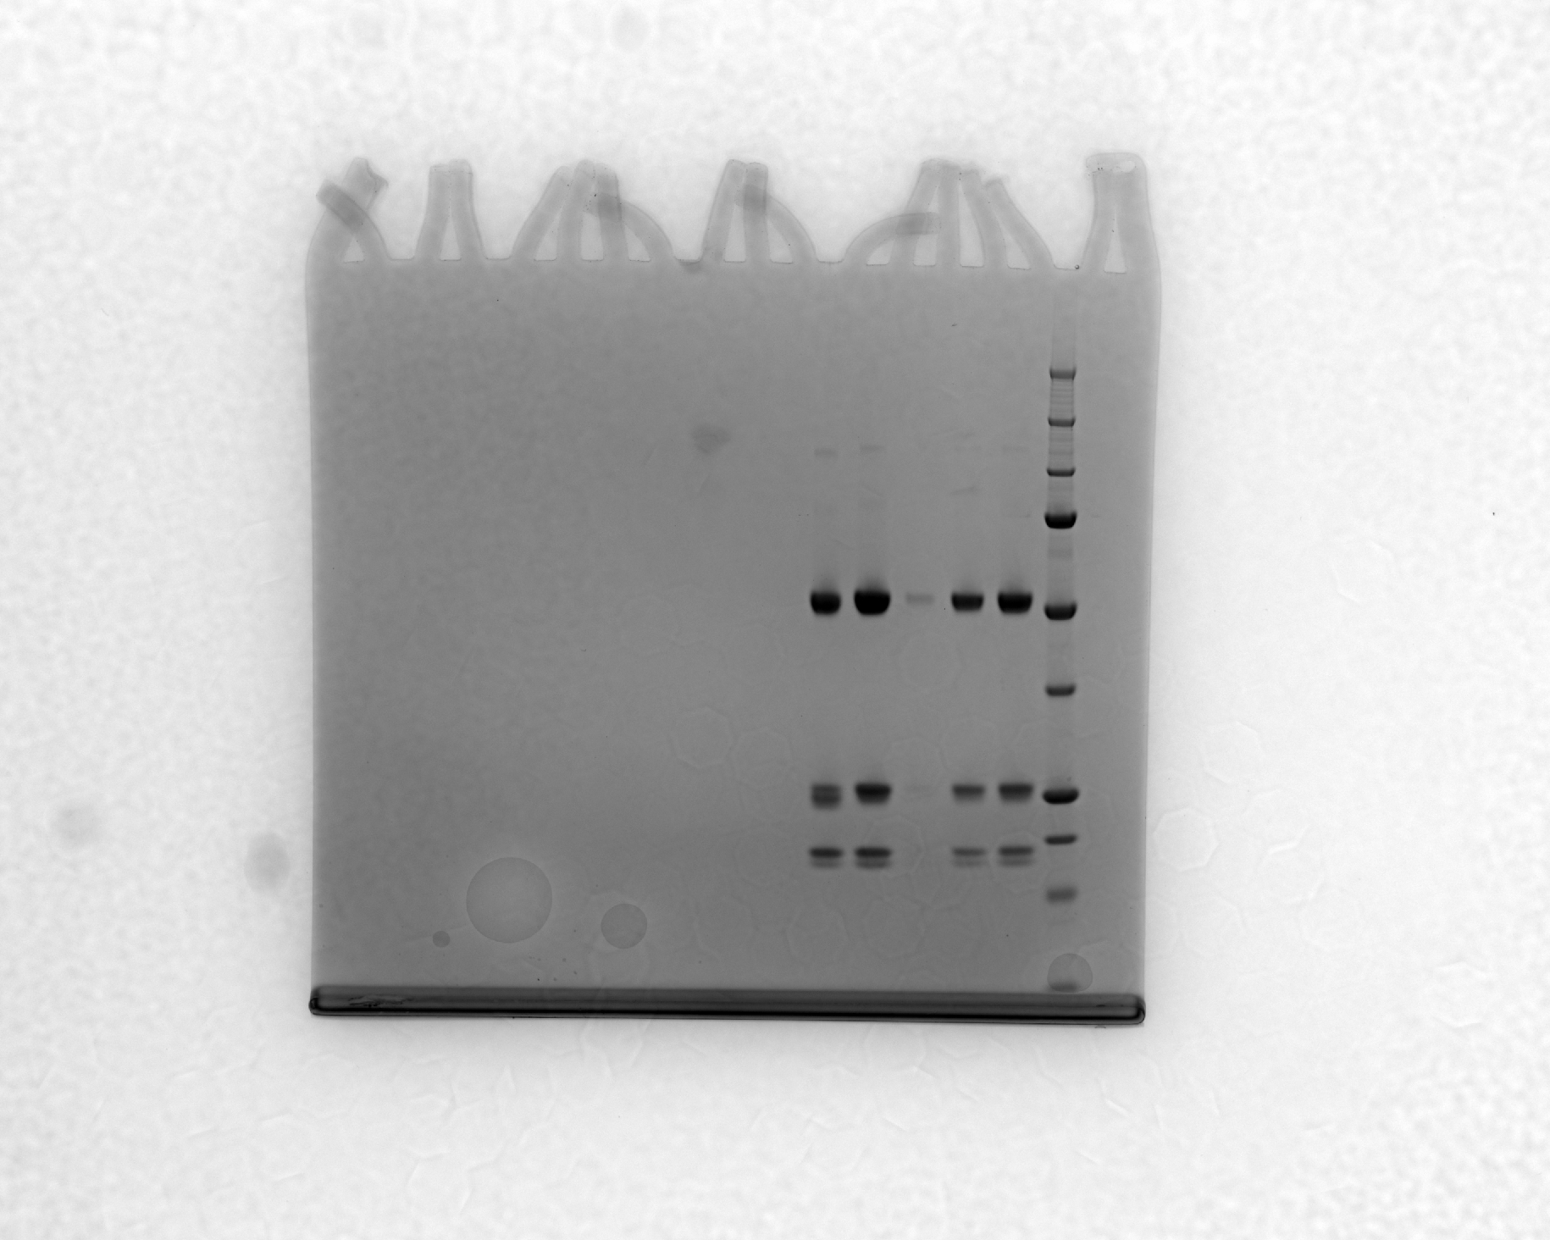
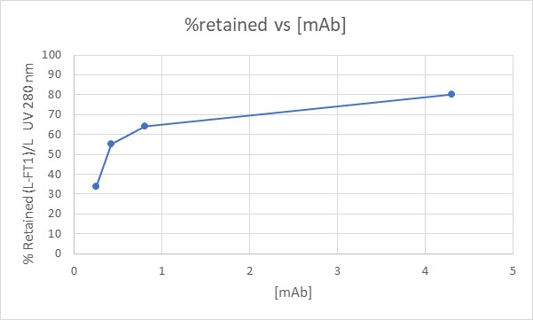


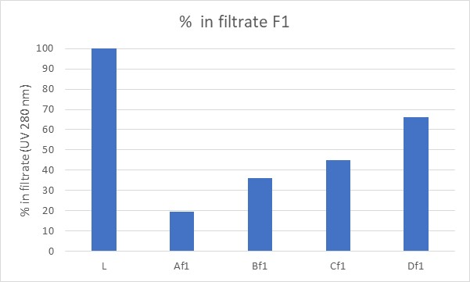
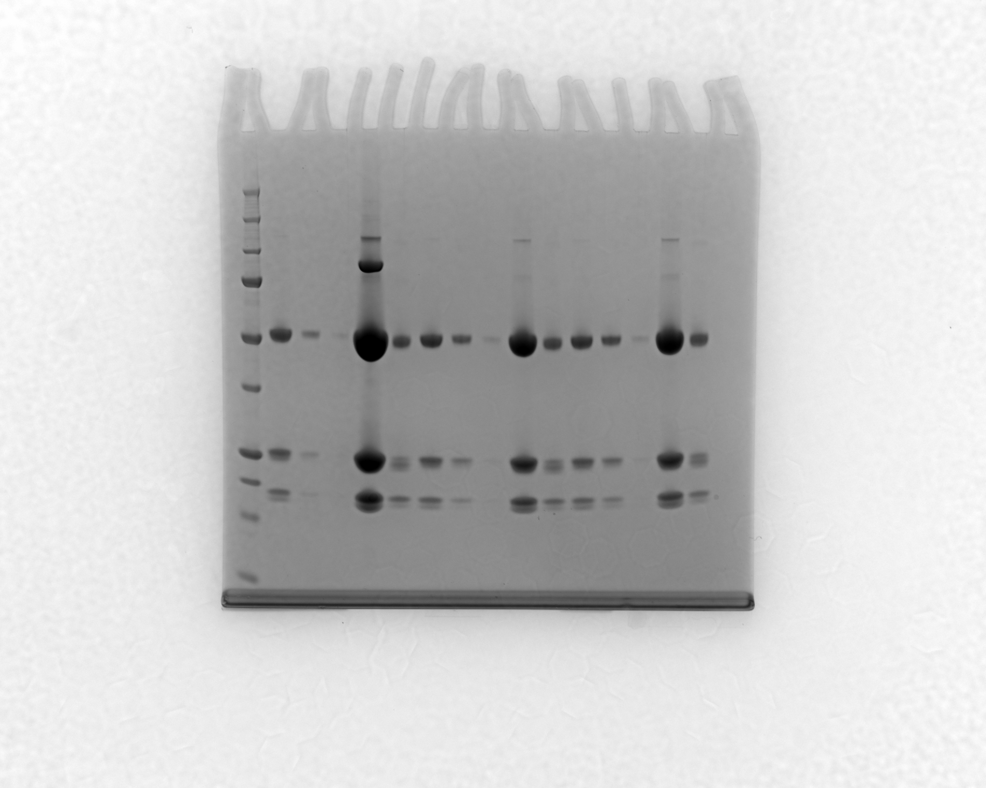


Initial mAb Affinity complex showed [mAb] dependence
L
F1
F2
R
W
Target 95%
A Mix at 4.3 mg/mL
Preferred operating range
Retention>80%
B Mix at 0.81 mg/mL
C Mix at 0.43 mg/mL
D Mix at 0.25 mg/mL
Target 5%
Increase in mAb concentration was linked to higher retention of bioparticle. We determined that improvements should decrease concentration dependence and maximize % retained.

Slide 5
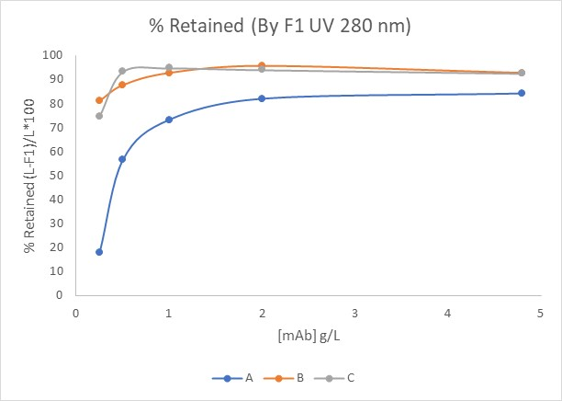
mAb Affinity complex B and C are more concentration independent and Show higher overall retention
Decreased concentration dependence and increased retention are proxies for improved performance over capture
Curves gives insight into formation and structure of mAb-bioparticle system
Compare different conceptions of the system at screening stage.
Target 95%

Slide 6
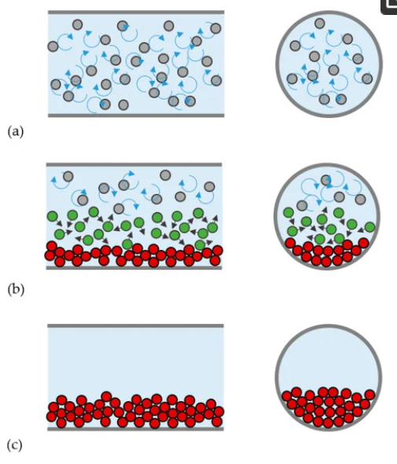
Upcoming Challenges
Desired state
Low self-interaction
Measuring Particulate Size Distribution
Controlling Particulate Size (peak)
Controlling Particulate Size (breadth)
Understanding Fluid Dynamics of Particulate Suspension
Controlling Particulate self-interaction
De-risking Particulate Membrane Interactions
Controlling Particulate Flow
High self-interaction
Silva, R.C. Experimental Characterization Techniques for Solid-Liquid Slurry Flows in Pipelines: A Review. Processes 2022, 10, 597. https://doi.org/10.3390/pr10030597

