Slide 1





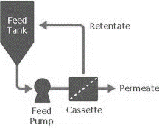
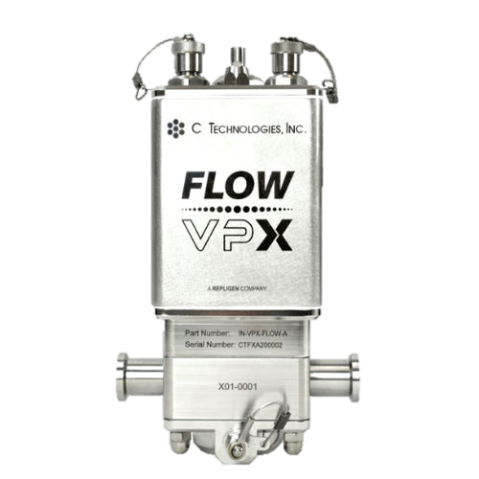
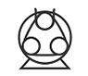


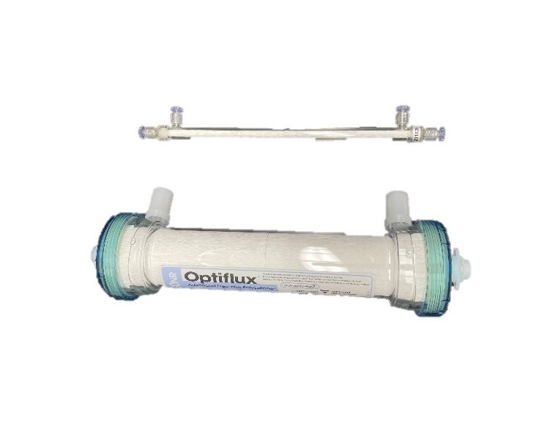





Asymmetric Dialysis: 12-Day Scale-Down Simultaneous Single-Pass Concentration and Buffer Exchange
NEXT GENERATION MANUFACTURING
Michelle Chen¹, Ujwal Patil¹, Irina Ramos, Jon Coffman¹
¹Bioprocess Technologies and Engineering, Biopharmaceutical Development, AstraZeneca, Gaithersburg, MD, USA
Introduction
Process Intensification
Results: Maintained Concentration & Product Specifications at Steady-State
Next Generation Manufacturing (NGM) refers the development of new technologies for a continuous bioprocess platform to improve efficiency, productivity, and sustainability compared to the current batch manufacturing process.
Current-gen, batch diafiltration (DF), performed as a formulation buffer-exchange step, is time- and resource-intensive. Successful evaluation of hollow-fiber membranes for continuous, countercurrent dialysis (C3D) can reduce buffer consumption by 80% but still requires an ultrafiltration (UF) step.
In previous work, we have successfully demonstrated:
(A) Product mAb Concentration
(C) Product pH and Conductivity
Single-pass, integrated buffer exchange and concentration, up to 300 g/L from 7-30 g/L
0.7 kg/m²/day productivity, suitable for a 500L perfusion bioreactor
5-day continuous operation at lab-scale
99.7% B12 impurity clearance
75% less buffer utilization compared to batch DF
Evaluating Long-Term Asymmetric Dialysis Operation on Scale-Down Model
Two step process: UF + DF
The NGM downstream process will require at least 10 days of continuous downstream operation, including the asymmetric dialysis process.
FlowVPX: In-line Concentration Measurement
DF
Concentrated &
Dialyzed Product
Target: 220 g/L (9.6x);
pH: 5.6-6.2; Cond: <2 mS/cm
Low Conc Feed
Concentrated Retentate
(B) Transmembrane Pressure Profile
(D) Product Quality: Size Exclusion Chromatography % Monomer
C3D
P
Ultrafiltration (UF)
Fresh Dialysate
Histidine buffer, pH 5.75
P
Buffer Exchange
Unified, single-pass
Benchmark: 1.8 m²
105 mL hold-up
Scale-Down: 0.025 m²
1.5 mL hold-up
Asymmetric Dialysis
Permeate/Waste
P
Concentrated & Dialyzed Product
Feed Pool
23 g/L mAb, at 1 LMH
pH 6.1, 12 mS/cm
Fresh Dialysis Buffer
P
α’=
Product Flow Rate < Feed Flow Rate
Retentate Product
Low Conc Feed
Conclusions
Next Steps
Asymmetric dialysis integrates both UF and buffer exchange into a single system by proportionately manipulating the flow rates on a hollow fiber membrane by reducing retentate flow rate and increasing permeate flow rate.
Achieved 12 cumulative days of runtime with process performance and product specifications remaining largely within range
Returned process to steady state after pressurization of >40 psi
No impact on product quality during steady-state, comparable to legacy UF/DF results
Qualify hemodialyzers for bioprocess use
Mitigate histidine deficiency using established dialysis buffer compensation strategy
Test asymmetric dialysis at-scale for clinical and commercial-level membrane loading, in tandem with preceding purification process steps
Test flow and pressure regulators as product pump alternatives
References
7 kg/m² total membrane loading
Observed TMP increase over time, from 3.8 psi up to 5.8 psi during steady state
Average product histidine concentration was 68% that of the dialysate
Coffman, J., Patil, U., Ramos, I., (2023). (US Patent No. WO2023238098A1). U.S. Patent and Trademark Office.
%
Presented at the ACS Spring 2025 Meeting
March 23-27, 2025, at the San Diego Convention Center, San Diego, CA

