Slide 1
HIGH AGITATION ADAPTATION AS A FRAMEWORK FOR NEXT GENERATION MANUFACTURING CLONE SELECTION
M Annoh, S Das, J Finch, Y Lan, J Coffman, K Lee

Slide 2
Project motivation:
Key words:
NGM- Next Generation Manufacturing (now IDB, integrated Dynamic Bioprocessing)
HAA- High Agitation Adapted
TFF- Tangential flow filtration
Product retention- [(1-permeate titer/retentate titer)*100]
How do we improve cell culture performance with existing clones previously selected in a Fed-batch environment?
Can phenotypic/genotypic plasticity of existing clones allow for implementation of adaptation techniques during clone selection?
Continuous feed stream
Permeate stream
High product retention from filter fouling
Shear stress susceptibility of cells especially with increasing viscosity
Bleed stream
Toxic metabolite accumulation
Decrease in cell culture performance beyond d10
Notes:
Advantages: scalability (>2000L), compatibility with different hollow fiber manufacturers
Given this, the adaptation of existing clones to the NGM environment is feasible.
Karensa feedback….how different is the subclone really from the original bank do not use the word ‘sub-clone’. Population adaptation…cut down text. How close is the ATF host to this? Existing clones only….
Focus on pre-adaptation rather than directed evolution

Slide 3
Project hypothesis:
‘Pre-stressing/adapting’ clones in a simple shake flask prior to bioreactor inoculation yields increased survivability, as well as improved product quality and retention profiles.
Proposed schema:
NGM Adapted Clone with increased NGM robustness
Improved product retention profile
Improved end of run viability
Improved product quality
Decreased shear stress susceptibility
Development working cell bank vial
Recovery/ expansion flask (250ml flat bottom, 120 RPM)
High agitation adaptation flask
(2L baffled, 400 RPM)
High agitation adapted cell bank (HAA)

Slide 4
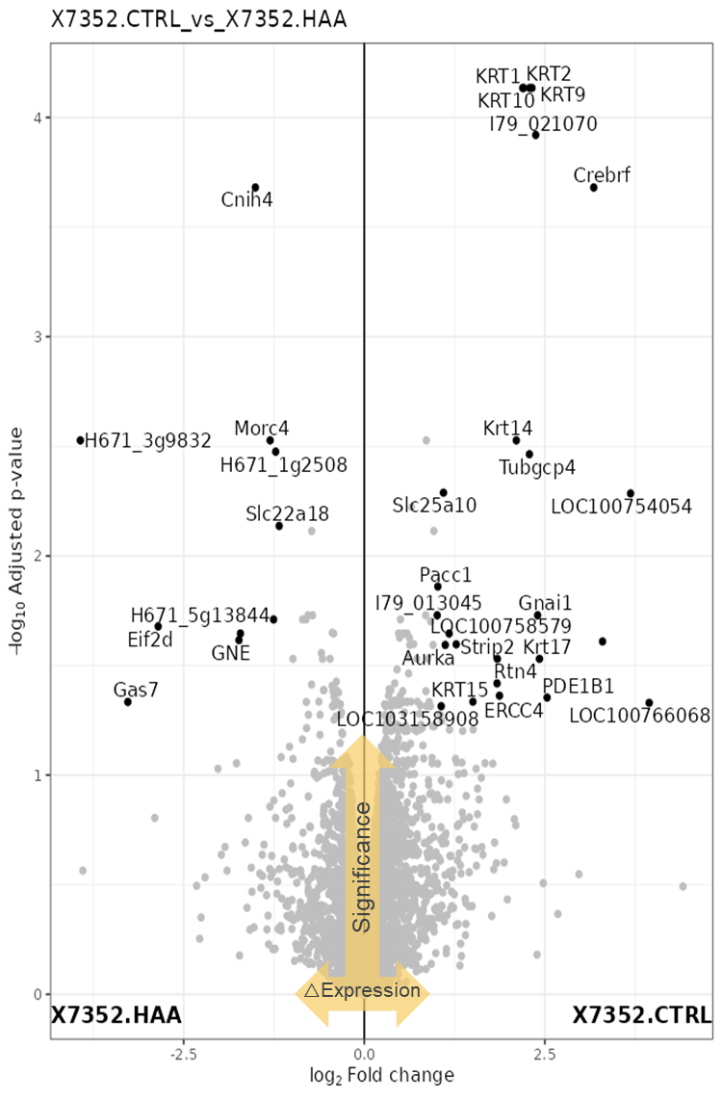
Novel aspects and Potential Impact:
High Agitation Adaptation of three projects (two shown) demonstrated improved cell culture performance with significant improvements in end of run viability, with no trade-offs with biomass generation and cell specific productivities.
Adapted clones in both projects demonstrated significantly improved product quality attributes. A small improvement in product retention was observed in late-stage culture for both projects compared to unadapted controls.
We assessed minimum energy dissipation levels required for adaptation using computational fluid dynamics.
The proteome of assessed projects was probed to elucidate specific pathways and potential markers involved in improving shear susceptibility.
We found that pathways associated with lipid biosynthesis, inflammatory response and cytoskeleton reorganization, were differentially expressed in successfully adapted clones.

