Slide 1

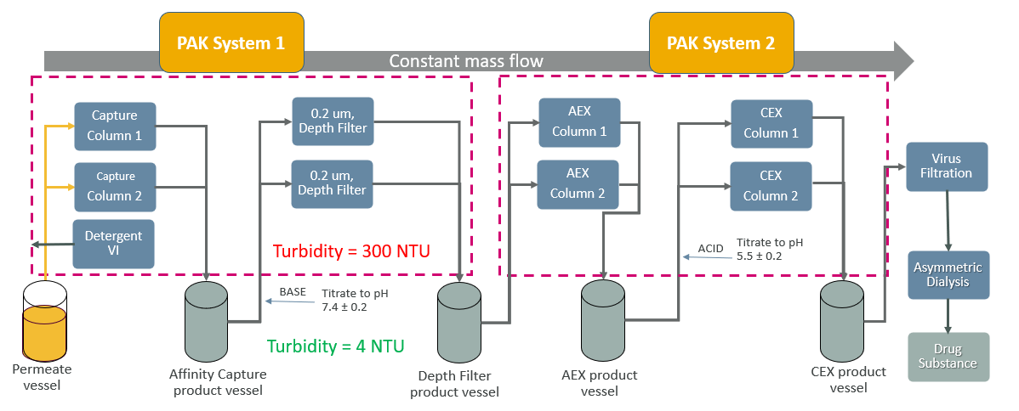
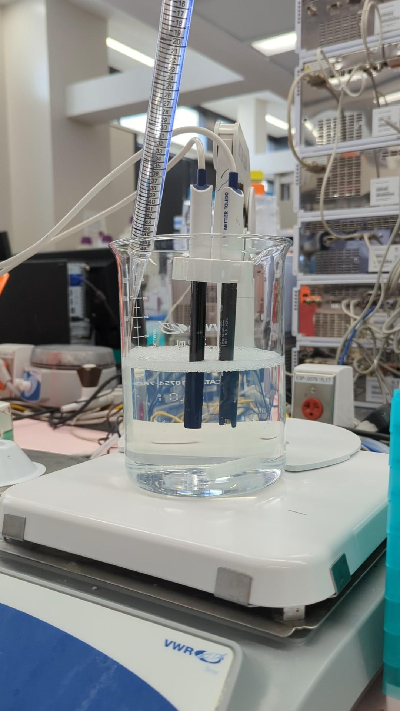
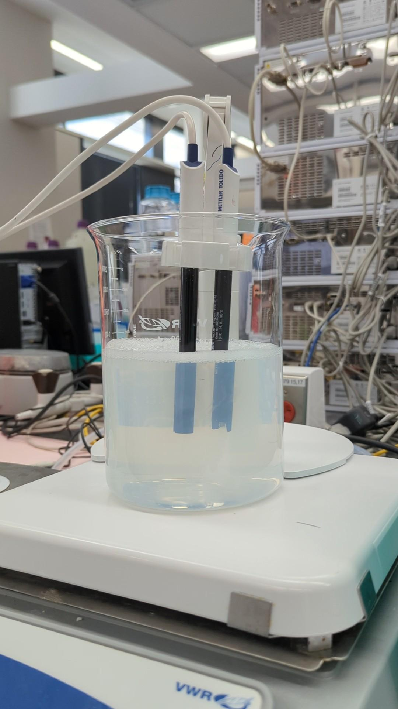
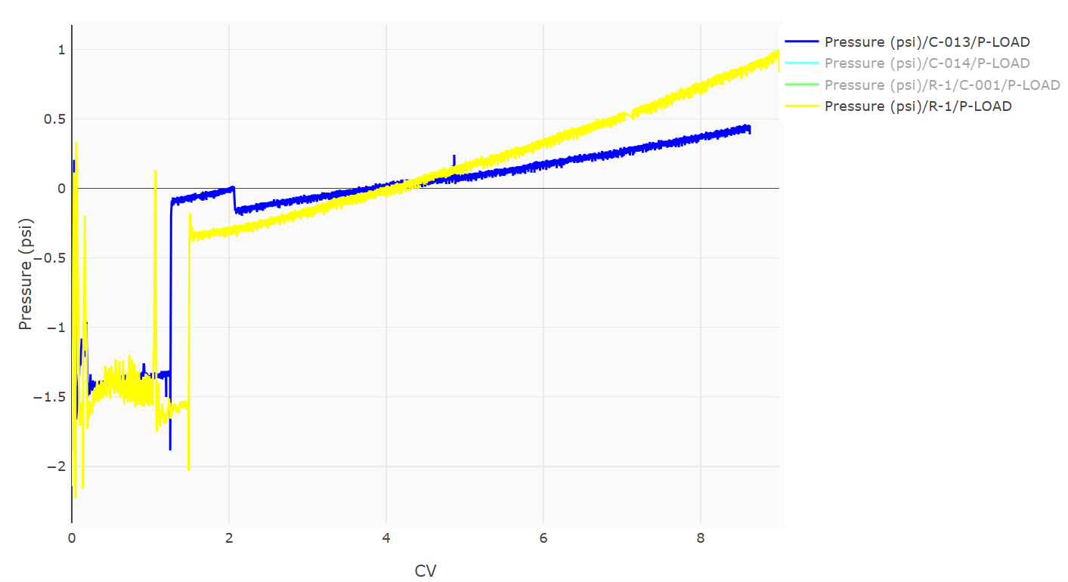
Depth Filter Cycling and Sanitization for Removal of Precipitate in Integrated Dynamic Bioprocessing (IDB) Purification
David Scherr¹, Nikunj Sharda¹, Michael Mollet¹, Jon Coffman¹
¹BioProcess Technologies and Engineering, Biopharmaceutical Development, AstraZeneca, Gaithersburg, MD
Abstract
Cycling results
Integrated Dynamic Bioprocessing (IDB) is the future of biotherapeutics due to low cost of goods, improved patient access, and diminished environmental impact. As the biopharmaceutical industry moves towards continuous bioprocessing, the implementation of some critical unit operations presents unique challenges to scale-up and commercialization. Depth filtration, a common purification step for removing precipitate formation in fed batch processes, has yet to be implemented in IDB. Depth Filtration is necessary for the purification of bsAb 1 as the affinity capture product precipitates when titrating to a target pH of 7.4. Here in, we established a sanitization protocol for cycling the depth filter that keeps bioburden low and increases the filter capacity. At the bench, the depth filter was cycled 10 times for a total capacity of 2000 L/m², doubling the capacity of the single pass operation. When performing depth filtration at the 50 L scale, the filter was cycles 15 times for a total capacity of 3000 L/m2 with no pressure increase, indicating a successful cleaning protocol that can be scaled. To our knowledge, this method is the first time a depth filter has been cycled and sanitized in a continuous process, demonstrating our ability to implement novel unit operations in IDB.
Table 2: Sanitization buffers used in each cycle during the process development of Emphaze AEX operation. The sanitization buffers were used after loading 200 L/m² of precipitated material (Fig. 1C) through the filter. The first 4 cycles were to determine the ideal Salt strength for Salt B and ideal pH conditions for Salt A. The wash conditions tested in Cycle 6 were applied to depth filter cycling at the 50 L scale (Fig. 2). There was no noticeable difference in sanitization performance between 0.1- 1.0 N NaOH
 | Sanitization Wash steps in order (2 Membrane volumes per wash)
Cycle | 1st buffer | 2nd buffer | 3rd buffer | % yield
1 | 0.5 M Salt B pH 7 | 1 M Salt B pH 7 | 2 M Salt B pH 7 | 83
2 | 0.5 M Salt B pH 5 | 1 M Salt B pH 5 | 2 M Salt B pH 5 | 74
3 | 1 M Salt A pH 9 | 1 M Salt A pH 7 | 1 M Salt A pH 5 | 77
4 | 1 M Salt A pH 5 | 1 M Salt A pH 7 | 1 M Salt A pH 7 | 81
5 | 1 M Salt A pH 5 | 1 N NaOH | 2 M Salt B pH 5 | 88
6 | 1 M Salt A pH 7 | 1 N NaOH | 2 M Salt B pH 5 | 84
7 | 1 M Salt A pH 5 | 0.1 N NaOH | 2 M Salt B pH 5 | 92
8 | 1 M Salt A pH 7 | 0.1 N NaOH | 2 M Salt B pH 5 | 84
9 | 1 M Salt A pH 7 | 0.1 N NaOH | 2 M Salt B pH 5 | 83
10 | 1 M Salt A pH 7 | 0.1 N NaOH | 2 M Salt B pH 5 | 87
11 | 1 M Salt A pH 7 | 0.1 N NaOH | 2 M Salt B pH 5 | 87
Precipitate formation in Downstream IDB
A)
B)
C)
Figure 1: A) Downstream IDB purification configuration with depth filtration cycling. The depth filter is on PAK System 1 and is operated like a column for automation purposes. The depth filter captures precipitate formed during base addition as seen below in B) and C)
Table 1: Impurity removal over 11 cycles with a cumulative capacity of 2100 L/m² . The depth filter consistently reduced HCP conc. by 1 log reduction and DNA conc. by 3 log
bsAb 1 Affinity capture product pH adjusted to 7.4
Sample | Concentration g/L | HCP (ng/mg bsAb) | DNA (ng/mg bsAb
Load Material | 5.8 | 1000 | 3.6E-01
1400-1600 L/m² cumulative capacity, 8 cycles | 2.6 | 174 | 6.4E-04
1800-2100 L/m² cumulative capacity, 11 cycles | 2.9 | 206 | 2.8E-04
BsAb 1 precipitates when titrating to pH 7.4 after capture column (300-500 NTU)
Need to implement depth filter that can be sanitized with NaOH to operate in a closed system
Emphaze AEX (Solventum)
When operating in single pass, the capacity is 1000 L/m², requiring 22 depth filters per commercial scale 14 day operation
Need to increase capacity of depth filter to decrease # of filters required at commercial scale
Developing cycling protocol where depth filter is operated like a column, is “underloaded” and then cleaned to reduce bioburden and increase the total capacity of the filter.
Depth Filter cycling at 50 L scale with 170 cm² Filter
Figure 2: Pressure profile of the 1st (blue) and 15th (yellow) cycle when loading the depth filter to a capacity of 200 L/m² at the 50 L scale. Pressure remained low over the course of 15 cycles with a cumulative capacity of 3000 L/m². The consistent pressure curve during loading indicates an effective sanitization method that inhibits pressure increases over time. Max pressure of filter is 35 psi.
Cycle 1
Cycle 15
Dept Filter cleaning development
Researched literature on solubization of precipitated pellet
Centrifuged precipitate into pellet, exposed to different buffers to elucidate conditions that dissolve precipitate
Loaded 4 cm² bench scale Emphaze AEX filter to capacity of 200 L/m² followed by chase and sanitization buffers
Recorded %yield recovered in depth filter product and in the cleaning buffers
Varied NaOH concentration from 0.1-1.0 N NaOH
Lessons Learned and Next steps
1 M Salt A pH 7 -> 1 N NaOH -> 2 M Salt B pH 5 is an acceptable sanitization method
Achieved a capacity of 2100 L/m2 over 11 cycles at bench scale before filter fouled
Reduced depth filters required at commercial scale from 22 filter to 12 filters. Estimated $65K in savings per IDB operation, $1.5M/year
Achieved 3000 L/m2 at 50 L scale with minimal pressure increase, indicating a higher max capacity at scale vs bench.
Need to find maximum capacity at 50 L scale to update facility fit
Need for vendor extractable and leachable qualification for prolonged exposure to 0.1-1.0 N NaOH.
Currently, filter is approved for 1 hour of 1 N NaOH exposure
Continue to optimize sanitization protocol to increase capacity
Apply cycling and sanitization to other brands of depth filters as part of IDB toolbox
Acknowledgments
Vishaal Gupta, Randy Rubright, and Darby Reinhart (AZ)
Alexei Voloshin, Ethan Butler, Laura Brown, and Masa Nakamura (Solventum)
Supported by
Presented at 6th Harvest Industry Summit, Upper Gwynedd , PA, 2025

