Slide 1
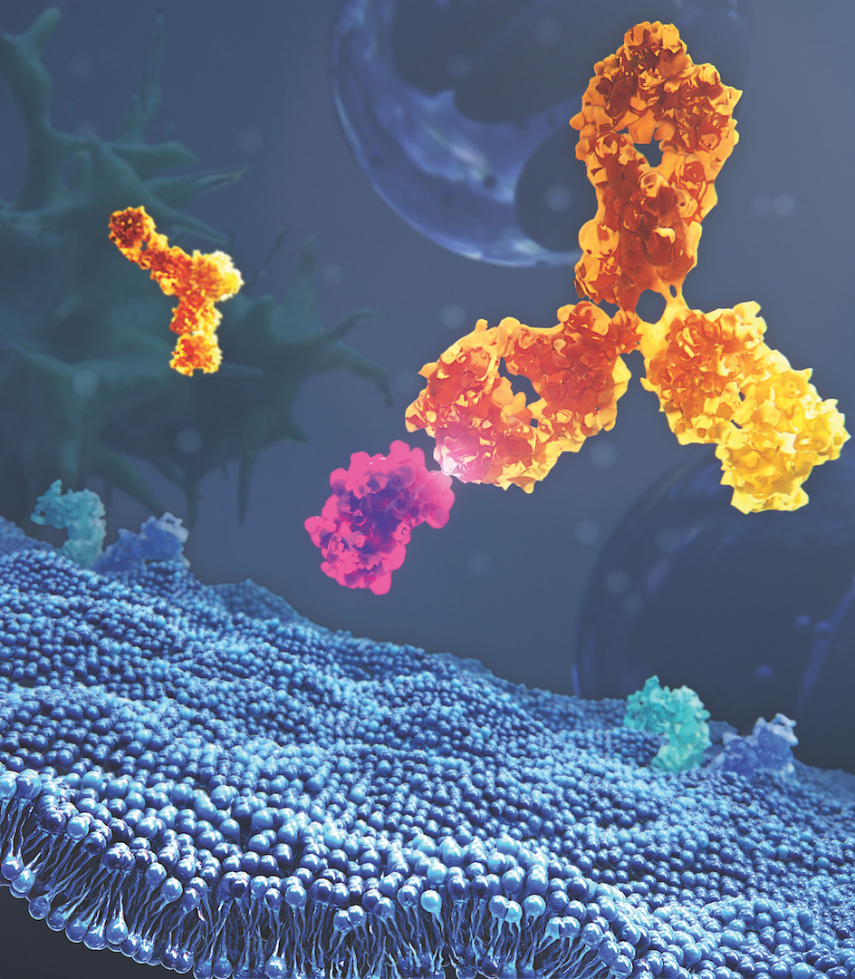
Converting a commercial fed-batch process to continuous manufacturing
Andrea Squeri, Robert Luo, Guru Thuduppathy, Jon Coffman, Ken Lee
Bioprocess Technologies & Engineering,​
BioPharmaceuticals & Development, R&D,​
AstraZeneca, Gaithersburg, MD, US

Slide 2
Agenda
2
Introduction: AZ Integrated Dynamic Bioprocess (IDB)
3
Feasibility: IDB upstream process evaluation
4
Scalability and optimization
4
Cost of goods
5
Conclusions and future work

Slide 3
Introduction
1

Slide 4
Background
Cost of goods manufactured (COG_{m}) using Integrated Dynamic Bioprocess (IDB) process significantly lower than fed-batch process
Dynamic perfusion process
Allows for higher space-time yield
Motivation to move high volume commercial products to continuous manufacturing

Slide 5

AZ Integrated Dynamic Bioprocess (IDB)
Dynamic process:
Upstream product quality may vary over the culture duration
Similar to fed-batch
Media
Nutrient feeds
Hollow fiber filter
Cell retention
Permeate
Continuous cell-free harvest
acceptable limit
Perfusion bioreactor
Tangential
Flow Filtration
Continuous
downstream
Pooled drug
substance
Cell Bleed
(Peak Cell Density: 90-120e6 cells/mL)

Slide 6
Feasibility: IDB upstream process evaluation
1

Slide 7


Feasibility strategy: converting from fed-batch to continuous
Demonstrate IDB upstream platform process can significantly reduce commercial COG_{m}
Demonstrate product quality meets acceptable range for critical quality attributes (CQAs)
Upstream space-time yield target (g/L_{brx}/day) defined
Fed-batch process differences were addressed to enable successful fit to IDB upstream platform
Feasibility range:
Global drug substance release spec
Tolerance interval from commercial runs
Fed-batch characterization range
Notes:
Release spec: drug substance specification the product must meet before it can be release to market
Tolerance interval: takes all existing data from commercial runs that completed as expected and determines the range that all future commercial runs should fall within: more runs=tighter tolerance interval
Fed-batch characterization data: data generated during cycle3 characterization, containing deliberate deviations in process parameters (pH, temp, etc.) so there could be a likelihood that PQ could fall back in line with process development
Overall goal of feasibility was to reduce the risk of not achieving COGM and PQ targets during the 18-month Cycle “2” and the one-year Cycle ”3” development

Slide 8
Feasibility study: evaluating fed-batch process differences in IDB
Process | Basal Media | Production pH
Commercial fed-batch | Media 1 | 6.70 ± 0.10
IDB platform | Media 2 | 7.00 + 0.10
3L: Condition 1
3L: Condition 2
Media 1 higher cost than Media 2
Large impact to COG_{m} for perfusion
pH cited in fed-batch characterization studies to impact product quality and titer
Media 1, pH 6.70
Media 2, pH 7.00
Match fed-batch process
Most likely to achieve targets
Match IDB platform
Notes:
Mention all other process parameters kept similar such as nutrient feed strategy/amounts, perfusion rate, cell retention device parameters

Slide 9
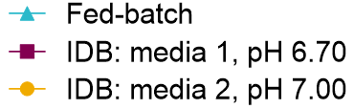
Feasibility study: cell culture performance
14-day IDB production process compared fed-batch process
Cell bleed 90e6 cells/mL
IDB process resulted in sustained high cell density and viability
Fed-batch cell specific productivity matched with IDB
Space-Time Yield (STY):
Total harvested protein
=
Culture time
Perfusion process exceeded STY target: 5x improvement over fed-batch space-time yield
Notes:
Metabolically behaving similarly, would expect product quality to be similar
Fed-batch productivity reported as product concentration (titer) because it typically occurs in 14 days. Comparing different fed-batch processes is done by comparing titer, because titer a shorthand describing the productivity. ​
Perfusion can be developed to run as short as 14 days or as long as 120 days, so product concentration is not a good way of comparing different processes. ​
​
Productivity is described in both fed-batch and perfusion by the Space-Time yield: The mass made per unit bioreactor volume per unit time: [g/L/day]

Slide 10

Feasibility study: product quality attribute (PQA) results
Day 0-14 product pool (post capture) compared against fed-batch reference standard and pre-defined acceptance range
= acceptable range
Widest range from the following:
Global drug substance release spec
Tolerance interval from commercial runs
Fed-batch characterization range
Culture mediums and pH setpoints tested resulted in similar product quality
All results met the proposed feasibility ranges for CQAs

Slide 11
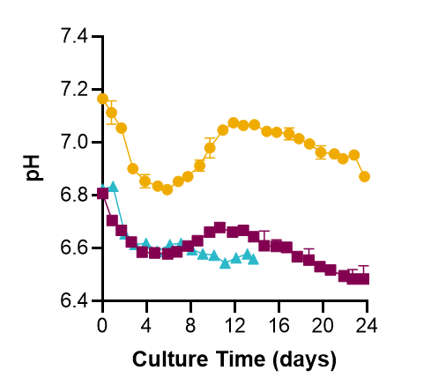
Feasibility study: cell culture performance
High day 14 viability in IDB process: culture was extended out to 24-days
Cell bleed 90e6 cells/mL
Best process performance with media 2 despite different pH profile than fed-batch
Similar STY between IDB processes (higher cell bleed with media 2 resulted in lower overall yield)
Space-Time Yield (STY):
Total harvested protein
=
Culture time
Extended perfusion process further exceeds STY target: 6.3x improvement over fed-batch space-time yield
Notes:
Metabolically behaving similarly, would expect product quality to be similar
Am I allowed to call out that a “steady state” was achieved with media 2?

Slide 12
Feasibility study: product quality attribute (PQA) results
Product quality time-course collected over the 24-day culture
Product quality well controlled with media 2 process over the 24-day culture
Notes:
Product quality changes in this process appeared to be cell viability driven…?

Slide 13
Feasibility study: product quality attribute (PQA) results
Day 0-24 pooled product quality calculated as a mass average of the time-course data
= acceptable range
Media 1 day 0-24 pool result falls within acceptable range for PQA 6
No significant impact on pooled product quality result harvesting days 0-14 vs. days 0-24 with media 2 process
Notes:
Media 1 process, pool results significantly changed

Slide 14
Feasibility study: conclusions
Perfusion improved cell viability and productivity compared to fed-batch
Allowed the run to extend out to 24 days
IDB platform media (media 2) resulted in similar viability, productivity, and similar product quality to fed-batch media (media 1)
Day 0-14 pooled product quality results met proposed feasibility acceptable range for critical quality attributes (CQAs)
Product quality did not change significantly over the course of the 24-day perfusion run with the IDB platform media
Notes:
Point 2, specifically in the 14-day process

Slide 15
Beyond feasibility: scalability and optimization
3

Slide 16


Beyond feasibility: objectives
Maintain similar productivity and product quality scaling up
Optimization to match fed-batch product quality for non-CQAs
Media optimization to bring PQA 6 into acceptable range for 14-day process
Compare product quality post small-scale capture to post continuous capture
Complete first 250L scale integrated run

Slide 17
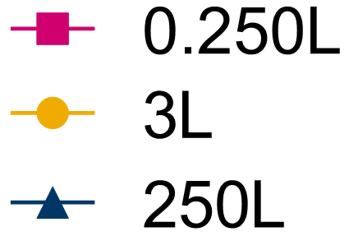
Scaling from 0.250L to 250L: culture performance
IDB upstream platform (media 2) feasibility process
Similar process performance across scales
Space-Time Yield (STY):
Lower space-time yield in 230L due to lower end of run product sieving
Total harvested protein
=
Culture time

Slide 18
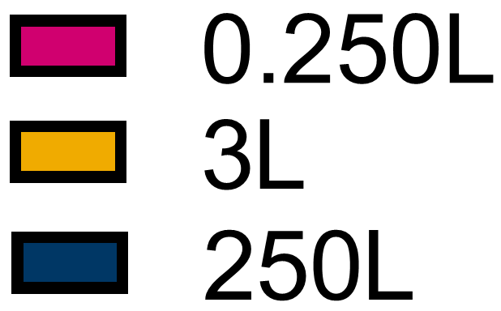
Scaling from 0.250L to 250L: product quality attribute (PQA) results
Day 0-14 pool (post capture) compared against fed-batch reference standard and pre-defined acceptance range
250L results are the mass average of the daily post protein A results compared to 3L upstream CM pool purified by Tecan
= acceptable range
Similar product quality across scales
All results met the proposed feasibility ranges for CQAs

Slide 19

Optimization: cell culture performance
Media profile had no impact on culture performance (growth, viability, pH) and space time-yield
Space-Time Yield (STY):
Total harvested protein
=
Culture time

Slide 20

Optimization: product quality attribute (PQA) results
Day 0-14 pool (post capture) compared against fed-batch reference standard and pre-defined acceptance range
= acceptable range
Media 3 had a high impact on PQA 6 result
Results met the proposed ranges for all PQAs
Notes:
No need to operate production at pH 6.70

Slide 21
Costs of goods
4

Slide 22
Cost of goods assessment
Overhead
Operators
Overheads, i.e., electrical, HVAC
Raw materials
Media
Resin
Single use components
Additional costs
Capital depreciation
Other
Labor
QA/QC
* Does not include final device cost

Slide 23
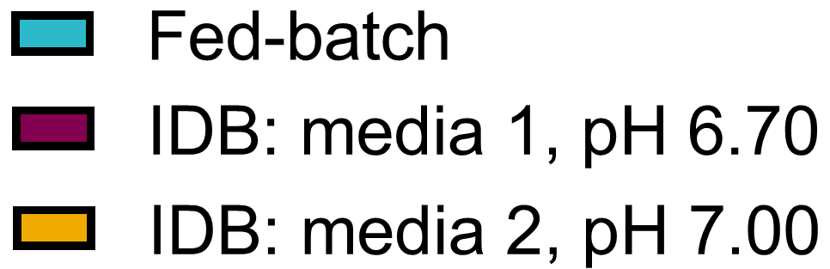
Feasibility study: media costs
64.4% COG_{m} reduction with IDB platform media

Slide 24
Conclusions
4

Slide 25
Conclusions and future work
Successfully implemented IDB upstream process
5x improvement in productivity compared to commercial fed-batch process
Product quality met pre-defined feasibility acceptable range for all product quality attributes (PQAs)
Project was stopped prior to cost projection for media 3
Business decision to switch to a different project that would have more benefit

Slide 26
Acknowledgements
Bioprocess Technologies Engineering
Mike Mollet
Zayla Schaeffer
Alex Gadberry
Ana DiLillo
Manufacturing Sciences
Nicole Bleckwenn
Corley Simons
Sok Soy
Jim Dyer
Analytical Sciences
Yoen Joo Kim
PhysicoChemical-Development Operations & Testing (PDOT) analysts
Sponsors
Jon Coffman
Venkat Raghavan
Support functions
Media prep
Bioreactor prep

