Slide 1

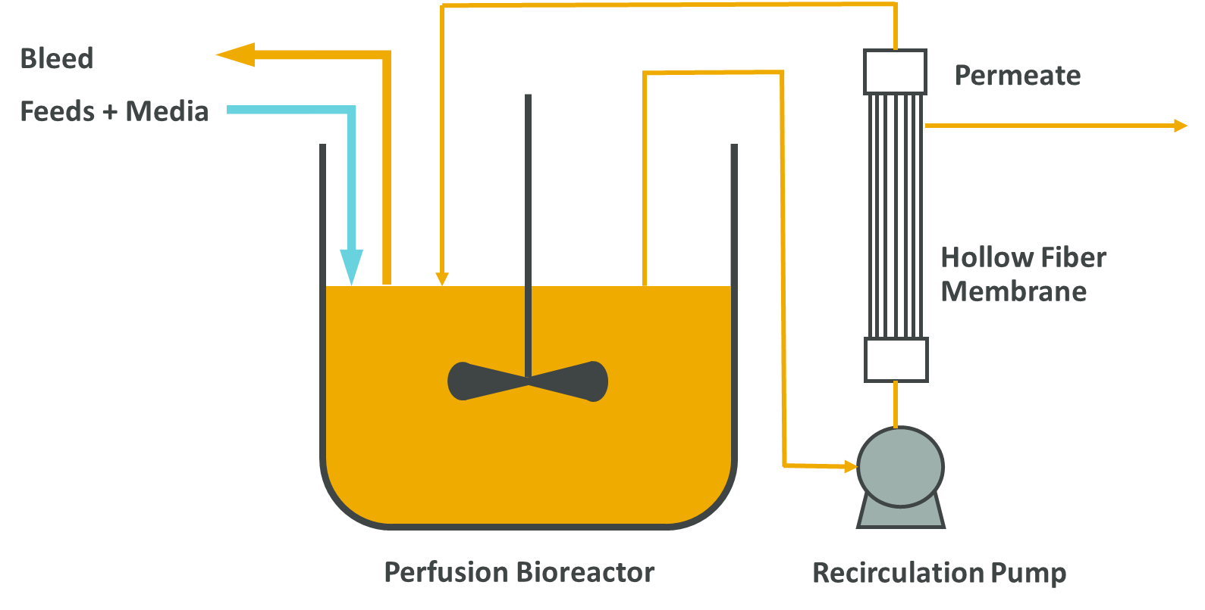
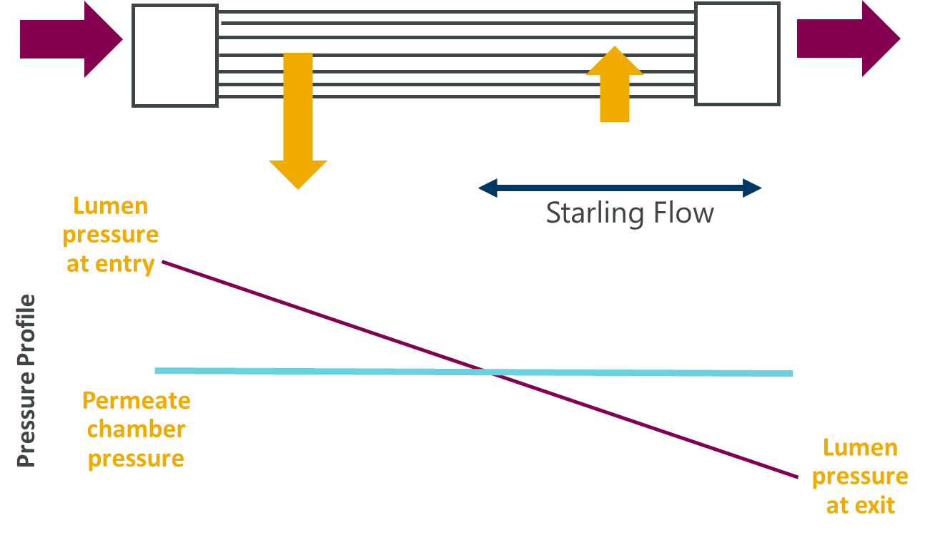
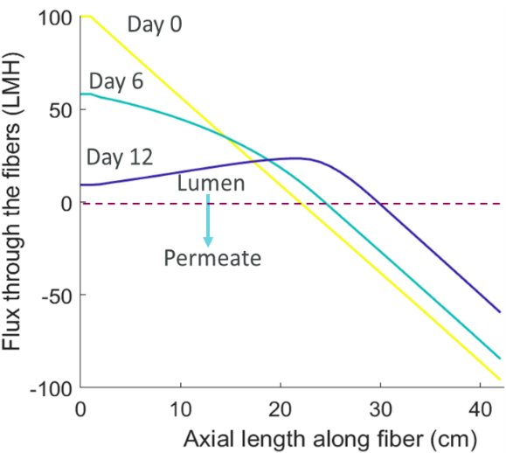

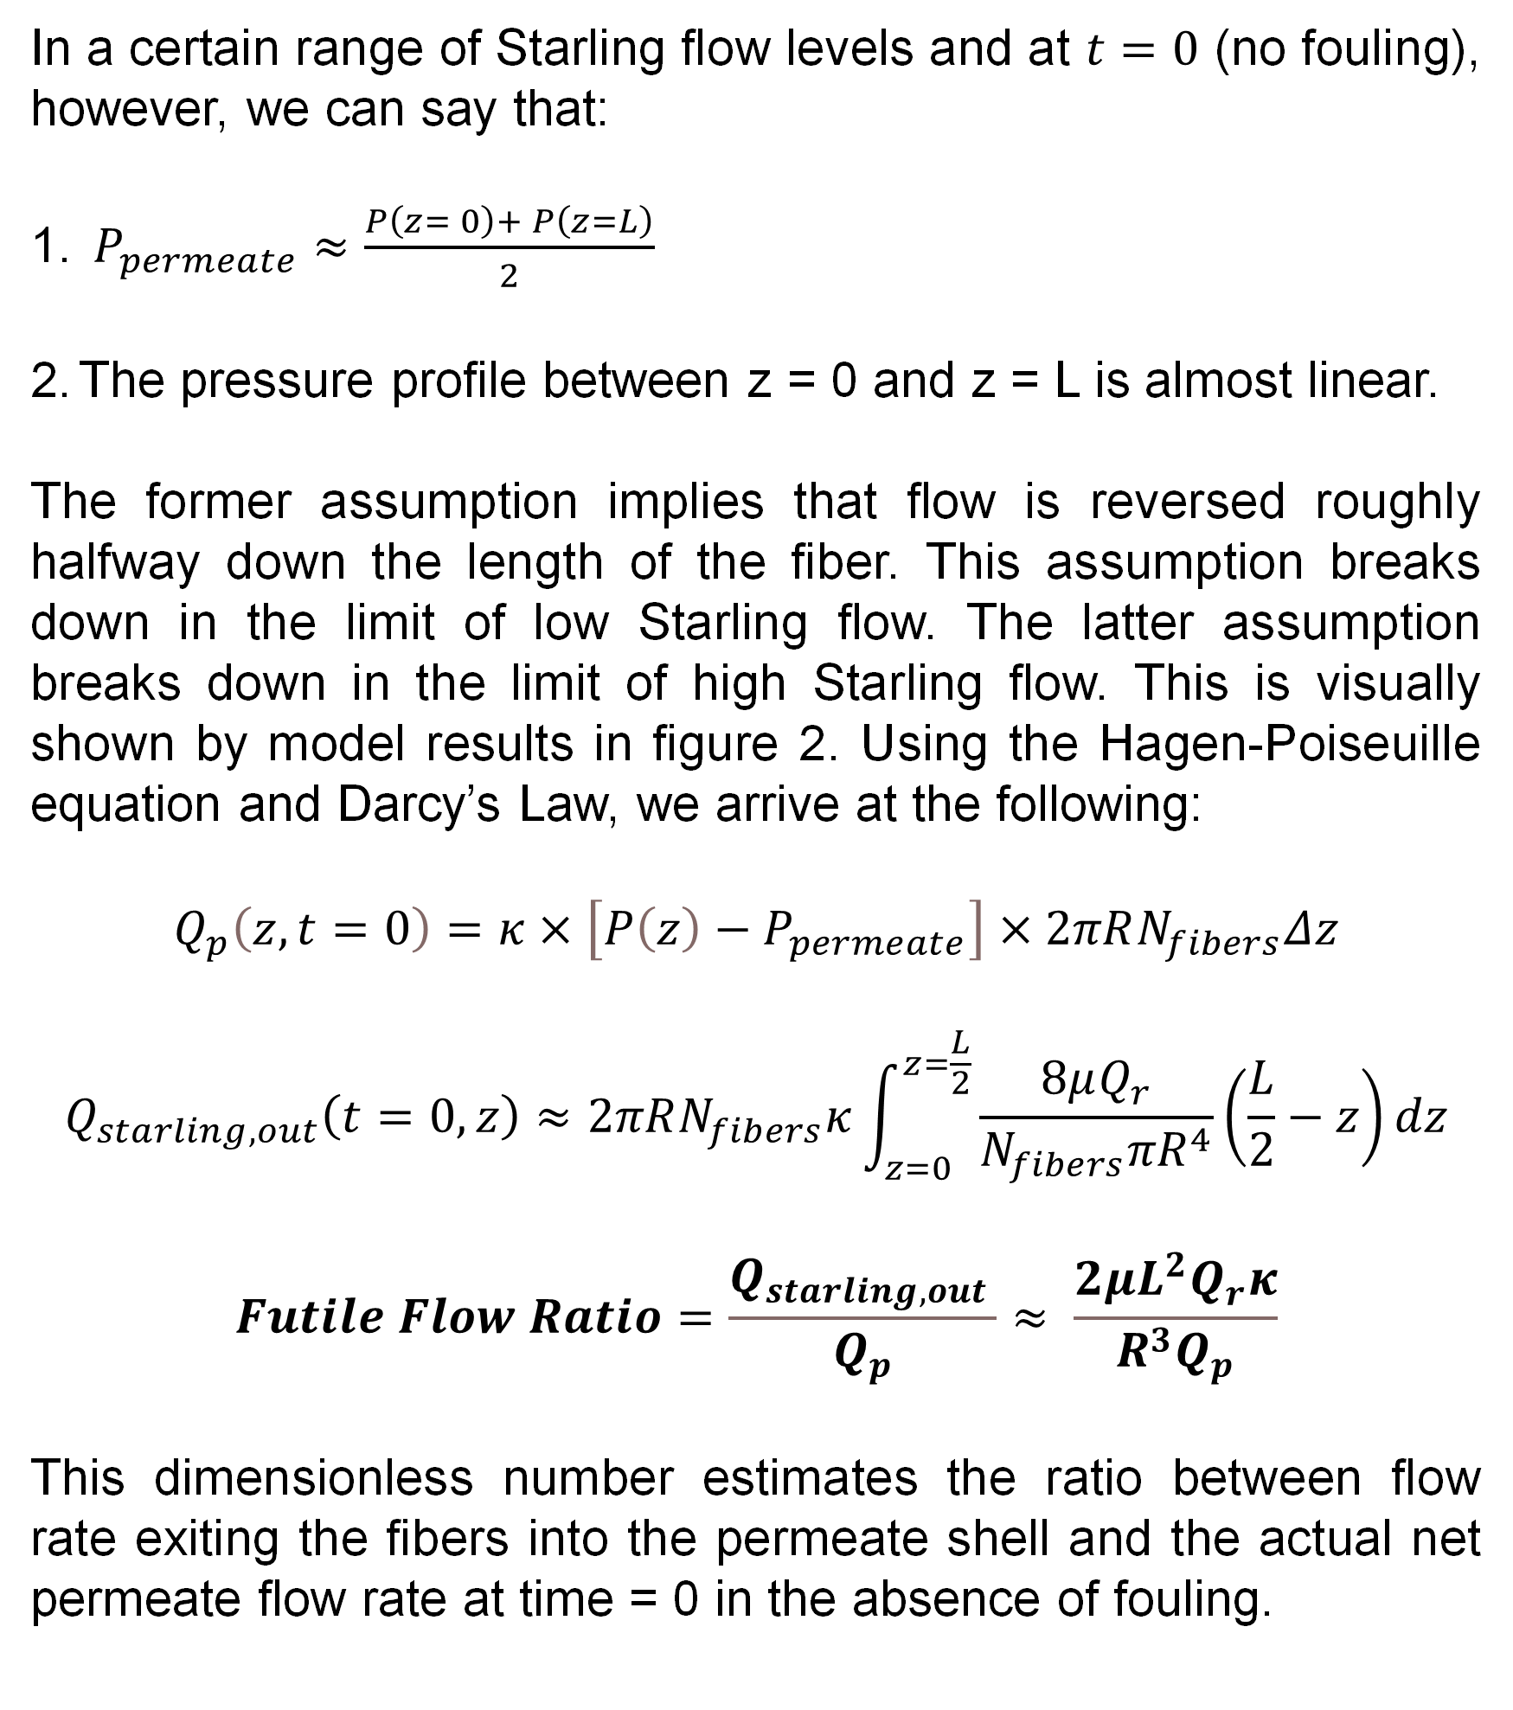

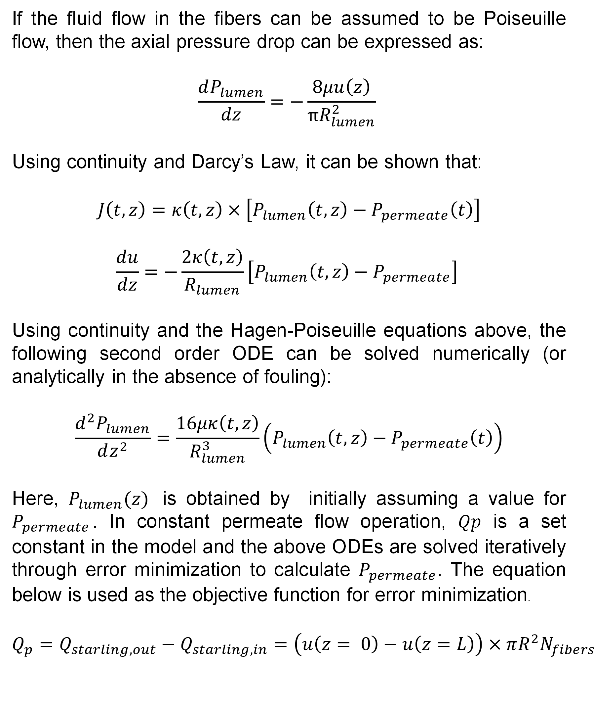

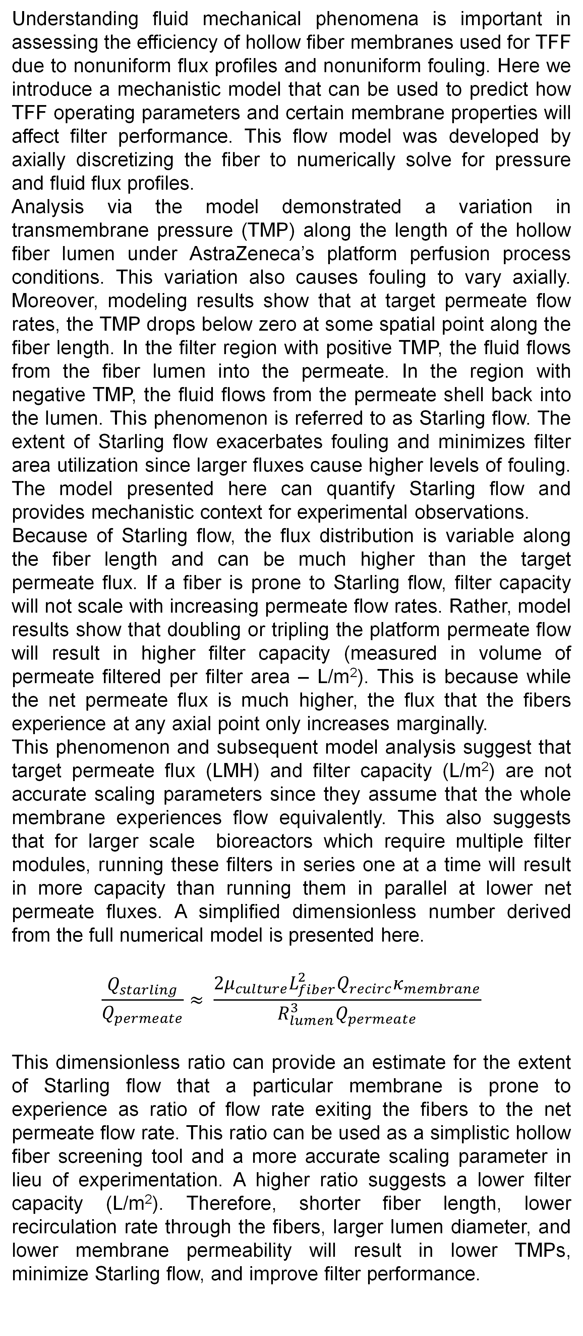

Mechanistic Modeling to Quantify Starling Flow in Hollow Fiber Membranes Used for Tangential Flow Filtration (TFF) in Perfusion Processes
Ashna Dhingra, Michael Mollet, Ken Lee, Jon Coffman
Bioprocess Technologies & Engineering - Biopharmaceutical Development, AstraZeneca, Gaithersburg, USA
Abstract
Understanding fluid mechanical phenomena is important in assessing the efficiency of hollow fiber membranes used for TFF due to nonuniform flux profiles and nonuniform fouling. Here we introduce a mechanistic model that can be used to predict how TFF operating parameters and certain membrane properties will affect filter performance. This flow model was developed by axially discretizing the fiber to numerically solve for pressure and fluid flux profiles.
Analysis via the model demonstrated a variation in transmembrane pressure (TMP) along the length of the hollow fiber lumen under AstraZeneca’s platform perfusion process conditions. This variation also causes fouling to vary axially. Moreover, modeling results show that at target permeate flow rates, the TMP drops below zero at some spatial point along the fiber length. In the filter region with positive TMP, the fluid flows from the fiber lumen into the permeate. In the region with negative TMP, the fluid flows from the permeate shell back into the lumen. This phenomenon is referred to as Starling flow. The extent of Starling flow exacerbates fouling and minimizes filter area utilization since larger fluxes cause higher levels of fouling. The model presented here can quantify Starling flow and provides mechanistic context for experimental observations.
Because of Starling flow, the flux distribution is variable along the fiber length and can be much higher than the target permeate flux. If a fiber is prone to Starling flow, filter capacity will not scale with increasing permeate flow rates. Rather, model results show that doubling or tripling the platform permeate flow will result in higher filter capacity (measured in volume of permeate filtered per filter area – L/m²). This is because while the net permeate flux is much higher, the flux that the fibers experience at any axial point only increases marginally.
This phenomenon and subsequent model analysis suggest that target permeate flux (LMH) and filter capacity (L/m²) are not accurate scaling parameters since they assume that the whole membrane experiences flow equivalently. This also suggests that for larger scale bioreactors which require multiple filter modules, running these filters in series one at a time will result in more capacity than running them in parallel at lower net permeate fluxes. A simplified dimensionless number derived from the full numerical model is presented here.
$$\frac{Q_{starling}}{Q_{permeate}}≈ \frac{2μ_{culture}L_{fiber}^{2}Q_{recirc}κ_{membrane}}{R_{lumen}^{3}Q_{permeate}}$$
This dimensionless ratio can provide an estimate for the extent of Starling flow that a particular membrane is prone to experience as ratio of flow rate exiting the fibers to the net permeate flow rate. This ratio can be used as a simplistic hollow fiber screening tool and a more accurate scaling parameter in lieu of experimentation. A higher ratio suggests a lower filter capacity (L/m²). Therefore, shorter fiber length, lower recirculation rate through the fibers, larger lumen diameter, and lower membrane permeability will result in lower TMPs, minimize Starling flow, and improve filter performance.
$$Q_{r}$$
$$Q_{starling,out}$$
$$Q_{starling,in}$$
Figure 1A. Schematic of AstraZeneca’s Perfusion Bioreactor Set Up. Feeds and media are exchanged at a constant rate of 1.2 vessel volumes per day (VVD) . Bleed is employed to maintain peak CHO cell densities at the desired target, so permeate and bleed flow rates combined equal 1.2 VVD.
Figure 1B. Visualization of Starling flow in a Hollow Fiber Membrane. Each axial point along the fiber is experiencing a different TMP and therefore different flux. Larger pressure drops along the fiber length cause unnecessarily high fluxes which leads to more filter fouling.
Scalable Parameter: Futile Flow Ratio
Experimental Comparison
In a certain range of Starling flow levels and at $t=0$ (no fouling), however, we can say that:
$P_{permeate}≈\frac{P\left(z= 0\right)+ P\left(z=L\right)}{2}$
The pressure profile between z = 0 and z = L is almost linear.
The former assumption implies that flow is reversed roughly halfway down the length of the fiber. This assumption breaks down in the limit of low Starling flow. The latter assumption breaks down in the limit of high Starling flow. This is visually shown by model results in figure 2. Using the Hagen-Poiseuille equation and Darcy’s Law, we arrive at the following:
$$Q_{p}\left(z,t=0\right)=κ×\left[P\left(z\right)−P_{permeate}\right]×2πRN_{fibers}Δz$$
$$Q_{starling,out}\left(t=0,z\right)≈2πRN_{fibers}κ\int_{z=0}^{z=\frac{L}{2}}{\frac{8μQ_{r}}{N_{fibers}{πR}^{4}}\left(\frac{L}{2}−z\right)dz}$$
$$Futile Flow Ratio=\frac{Q_{starling,out }}{Q_{p}}≈ \frac{2μL^{2}Q_{r}κ}{R^{3}Q_{p}}$$
This dimensionless number estimates the ratio between flow rate exiting the fibers into the permeate shell and the actual net permeate flow rate at time = 0 in the absence of fouling.
Bench (3L), mid (50L), and large (220L) scale perfusion experiments were conducted using a proprietary Chinese Hamster Ovary (CHO) cell line that expressed a proprietary recombinant monoclonal antibody¹. At bench scale, various membrane chemistries (PVDF, PES, mPES) and fiber geometries were tested. Hollow fibers from Repligen, Asahi Kasei, and Sartorius were tested at net permeate fluxes between 0.8 and 5.5 LMH. Bioreactor and permeate titer samples were collected every day to measure the sieving decline over a 14-day culture.
The futile flow ratio was calculated for each fiber type and operation condition. This was then compared to permeate throughput per fiber area (L/m²) at 50% sieving. Viscosity was taken to be an inoculation viscosity of 1 cP. Membrane permeabilities were either retrieved from literature² or natural flux water testing was performed. Permeabilities for each fiber ranged from 100 to 1600 LMH/psi. Results are shown below.
Introduction
Figure 4. Permeate volumetric throughput at 50% sieving vs. Calculated Futile Flow Ratio. Throughput is calculated by dividing liters of permeate collected up until 50% sieving loss by the total filter area.
AstraZeneca’s upstream continuous manufacturing platform uses TFF as a cell retention device for dynamic perfusion (figure 1).
In perfusion, the main evidence of filter fouling is seen by the drop in sieving, which is defined as the concentration of antibody or titer in the permeate stream relative to the concentration of titer in the bioreactor.
Experimentation at the bench scale has shown that running TFF at higher permeate fluxes results in greater throughput capacities before filter failure.
These results show a clear correlation between throughput and futile flow ratio values for three different scales and three different membrane chemistries.
Conclusions and Next Steps
Figure 2. Model-Calculated TMP as a function of fractional distance from fiber entry for varying futile flow ratio values. High TMP results in high fluxes which results in more filter fouling.
A fluid flow model was developed from first principles to better understand how Starling flow results in non-uniform flux profiles and TFF performance during perfusion cell culture experiments.
The futile flow ratio was derived as a scaling tool to estimate the ratio between flow rate exiting the fibers into the permeate shell and the actual net permeate flow rate. High values (>>1) signify high Starling flow and poor membrane usage efficiency. This ratio was shown to be very well-correlated with filter throughput for different scales, fluxes, and fiber types. Experiments with higher ratios generally showed lower throughputs.
Future work at AstraZeneca aims to utilize these tools to help accurately the design the TFF system for larger-scale perfusion processes
Fluid Flow Model
Futile flow ratios >> 1 signify high Starling flow and therefore poor membrane usage efficiency and higher likelihood of poorer sieving profiles. This equation can be used as a tool to assess relative impact of Starling flow when considering hollow fibers from different vendors and when scaling up from bench scale.
As fouling occurs over the course of a cell culture run, the fiber’s membrane permeability will drop as a function of axial length, therefore decreasing the impact of Starling flow (figure 3).
If the fluid flow in the fibers can be assumed to be Poiseuille flow, then the axial pressure drop can be expressed as:
$$\begin{aligned}\frac{dP_{lumen}}{dz}=−\frac{8μu\left(z\right)}{{πR}_{lumen}^{2}} \#\end{aligned}$$
Using continuity and Darcy’s Law, it can be shown that:
$$J\left(t,z\right)=κ\left(t,z\right)×\left[P_{lumen}\left(t,z\right)−P_{permeate}\left(t\right)\right]$$
$$\frac{du}{dz}=−\frac{2κ\left(t,z\right)}{R_{lumen}}\left[P_{lumen}\left(t,z\right)−P_{permeate}\right]$$
Using continuity and the Hagen-Poiseuille equations above, the following second order ODE can be solved numerically (or analytically in the absence of fouling):
$$\frac{d^{2}P_{lumen}}{dz^{2}}=\frac{16μκ\left(t,z\right)}{R_{lumen}^{3}}\left(P_{lumen}\left(t,z\right)−P_{permeate}\left(t\right)\right)$$
Here, $P_{lumen}(z)$ is obtained by initially assuming a value for $P_{permeate}$. In constant permeate flow operation, 𝑄𝑝 is a set constant in the model and the above ODEs are solved iteratively through error minimization to calculate $P_{permeate}$. The equation below is used as the objective function for error minimization.
$$\begin{aligned}Q_{p}=Q_{starling,out}−Q_{starling,in}=\left(u\left(z= 0\right)−u\left(z=L\right)\right)×πR^{2}N_{fibers}\#\end{aligned}$$
References
WuDunn, D., Squeri, A., Vu, J., Dhingra, A., Coffman, J., & Lee, K. (2024). Biotechnology Progress.
Pinto, N. D. S. & Brower, M. Biotechnol Bioeng 117, 3336–3344 (2020).
Acknowledgements
This project began as a collaboration between the Massachusetts Institute of Technology (MIT) and AstraZeneca. The authors would like to thank:
Devashish Gokhale and Sungyun Yang for their theoretical contributions to the model
Dominique WuDunn, Jimmy Vu, Andrea Squeri, Sam Preza, J. Alex Gadberry, and the Development & Scale-Up Center for their experimental contributions
Figure 3. Model-generated spatially and temporally varying flux profiles for AstraZeneca’s 3L bench scale platform operation.
Presented at ICB VI, 20Oct24

