Slide 1
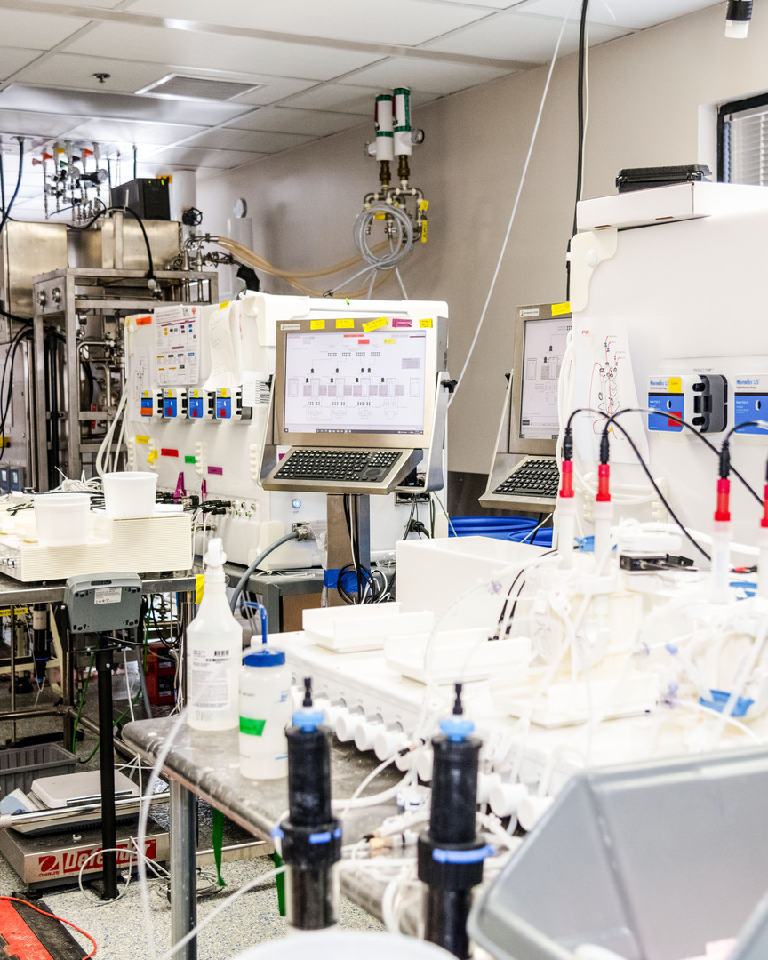
Overcoming challenges with scale-up and GMP implementation of an integrated dynamic bioprocessing (IDB) platform for multiple products
Nicole A. Bleckwenn, Ph.D.
Kate Harvey & MTD team, Jon Coffman, Carrington Edmunds, Ken Lee & BTE team, CCFS team, PPS team, Dan Pappas & MS team, QA team, and Operations and Regulatory Colleagues
On behalf of the entire AZ organization developing and supporting IDB implementation
ICB 2025

Slide 2
Agenda
Background - IDB platform
Implementation strategy
Scale-up and GMP implementation challenges and lessons learned
Future direction and a challenge to our industry

Slide 3
Integrated Dynamic Bioprocessing (IDB) Platform
Variable Perfusion Bioreactor
Virus Inactivation
Dual Column Affinity Capture
Dual Depth Filtration (Optional)
Dual Column FT-Polishing
Dual Column B&E-Polishing
Dual Virus Filtration
Asymmetric Dialysis
Load Adjustment
Load Adjustment
Load Adjustment
Slide modified and courtesy of Nikunj Sharda and Jon Coffman

Slide 4
Drivers of IDB GMP Implementation Strategy
Speed of the pipeline
Biopharma and V&I therapeutic areas can be more sensitive to margin than oncology or rare disease areas
Account for upside and downside risks
Limited initial capital
Plant capacity and CMO capability
Diverse product portfolio with wide ranging demand
Product quality (labile molecules)

Slide 5
IDB Clinical GMP Manufacturing Implementation Plan*
Potential Clinical and Commercial Scale IDB Product Manufacturing Timelines Based on New Candidate Drug IDs (CDIDs)
2022 | 2023 | 2024 | 2025 | 2026 | 2027 | 2028 | 2029 | 2030 | 2031 | 2032 | 2033 | 2034 | 2035
1st clinical plant online
2nd clinical plant online
CDIDs in Fed-Batch/Intensifed Fed-Batch
CDIDs in IDB
Engr Run 1st plant
Engr Run 2nd plant
Engr Run CMO plant
Project 1 Mfg
Project 2 Ph3 Mfg
Project 1 Ph3 Mfg
Project 3 Ph3 Mfg
Phase 1/2 Production in Clinical Plant
Project 4 Mfg
Phase 3 Production in Clinical Plant
Project 5 Mfg
Project 10 Mfg
Project 5 Ph3 Mfg
Phase 3 Production in Clinical Plant or Commercial Plant/CMO
Project 6 Mfg
Project 11 Mfg
Project 7 Mfg
Project 12 Mfg
Project 7 Ph3 Mfg
Project 8 Mfg
Project 13 Mfg
Project 8 Ph3 Mfg
Project 14 Mfg
Project 9 Ph3 Mfg
Project 9 Mfg
5
* Project timelines estimated

Slide 6
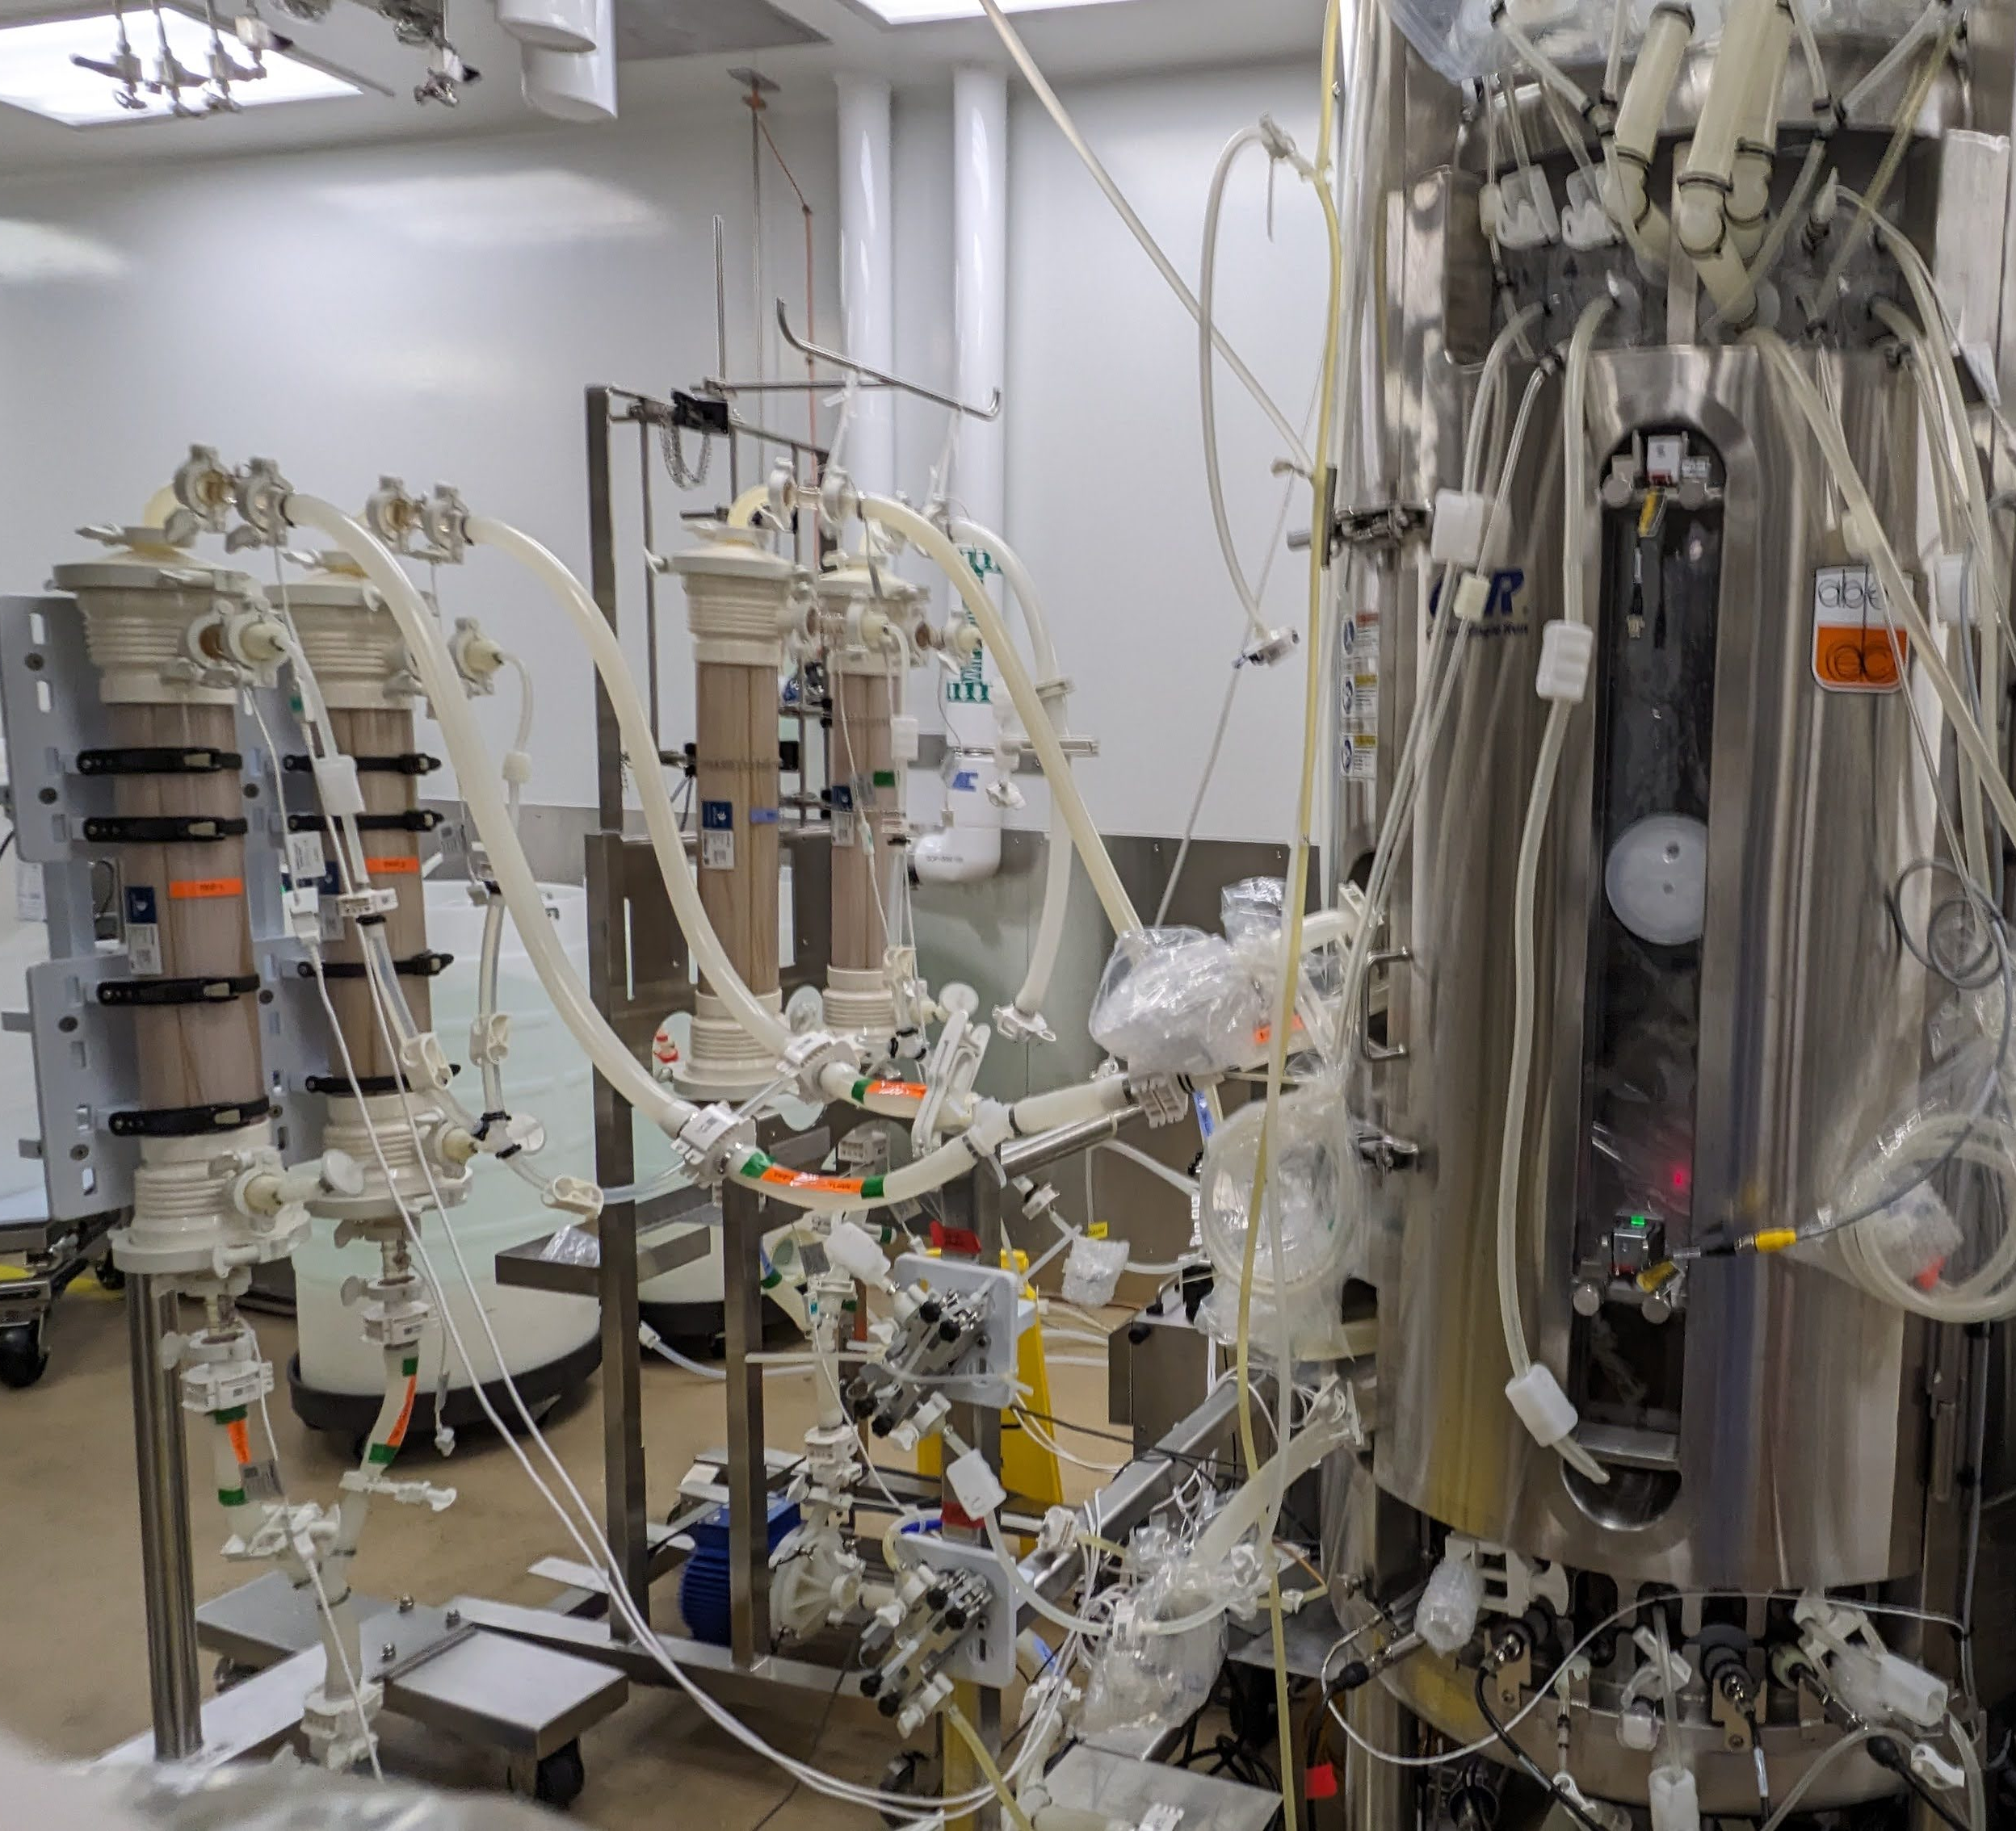
Strategic Planning for Scale-Up and GMP Production
Planning is key
Scale-up bioreactor & TFF
Our particular challenges
Strategic alignment of technical and regulatory goals
Thorough technology evaluation
Maintaining GMP standards
Don’t forget to address the people element
New technology
Build new automation
Implementation in older traditional stainless fed-batch facility
Defining the “sterile” boundary much wider than previous experience
Dynamic nature
Batch definition
Response time strategy without 24/7 staffing
Balance robustness with flexibility

Slide 7

Failure Modes During Scale-up: Some Old, Some New
Multiple contaminations of bioreactor
More opportunity with:
More connections
Complex hand-built and autoclaved parts
Wider “sterile boundary”
Contamination of media/feed additions
Bubbles in “high” downstream product lines due to gas permeability of tubing
CM precipitation
Notes:
Building the plane as you attempt to fly it
Scaling protocols from lab to pilot scale often reveals unexpected challenges related to equipment and process dynamics that must be addressed.
Maintaining process reproducibility while adhering to GMP standards is essential to build confidence for full-scale manufacturing.

Slide 8
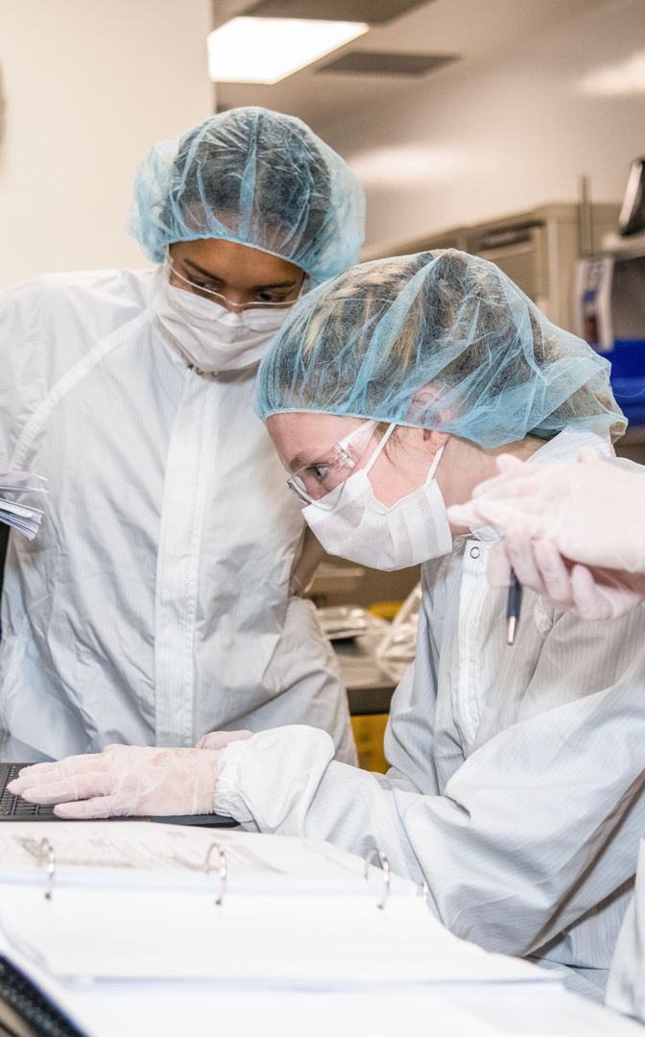
The People Element
Write it down early and share often
Can’t always do it the way we’ve done it
Failures are an opportunity to learn
Collaboration is key!

Slide 9
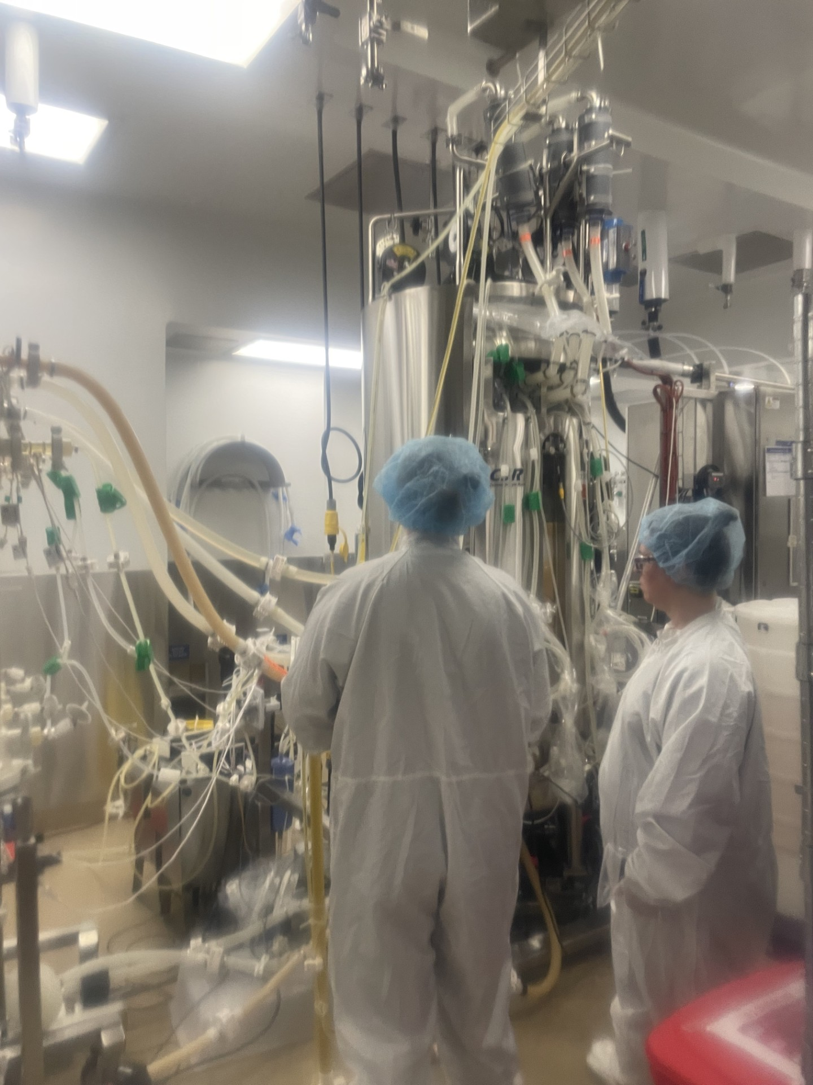
Engineering Run in GMP Clinical Facility (Molecule A)
Purpose: Shake down equipment with an IDB process through the second polishing step
Limited to 10 production bioreactor days due to time available in plant

Slide 10
Upstream Engineering Run - Growth
Early lower osmolality observed due to cumulative effect of wide tolerances on concentrated media and water addition
Lower osmolality may impact peak VCD
Bench
Pilot
Engr Run Clinical Manufacturing

Slide 11
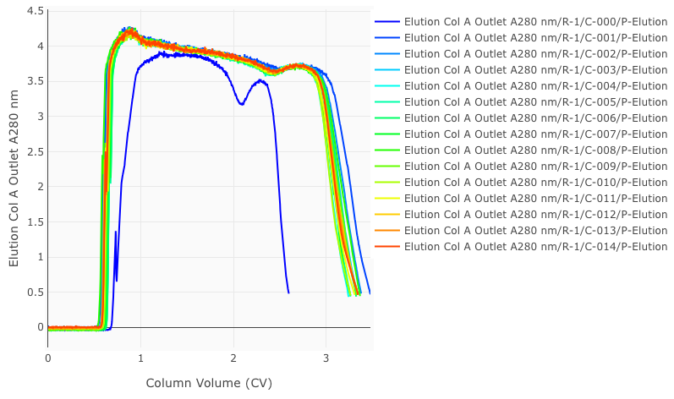
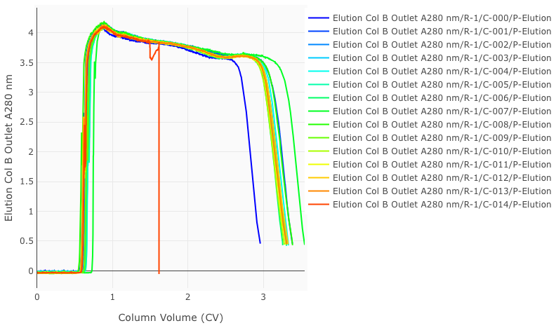
Downstream Engineering Run - Capture Overlays
First cycles of each column cut early due to imposed limit of 24 hour load time for bioburden control (when titer is lowest)
Column A
Column B
Elution UV
*Expected Elution CVs: ~ 3.0
Last cycle, limited material

Slide 12
Downstream Engineering Run – Impact of Filter Swap
Engineering run filter swap impacts CM concentration
Downstream capture dampens impact of filter swap during engineering run
TFF Filter Swap
Bench
Pilot
Engr Run Clinical Manufacturing

Slide 13
First GMP Campaign – Molecule B (labile molecule)
Continuous through affinity capture only
3rd TFF filter swap failure likely caused by “less synchronized” manual valve switching
Long term mitigation: automated filter swaps (in scale-up demonstration currently)
Drug Substance successfully released!
Perfusion Bioreactor
Dual Column Affinity Capture
Affinity Pool
Remainder batch operation

Slide 14
And then we switched from some “easy” molecules to a “difficult” molecule (Molecule C)…

Slide 15
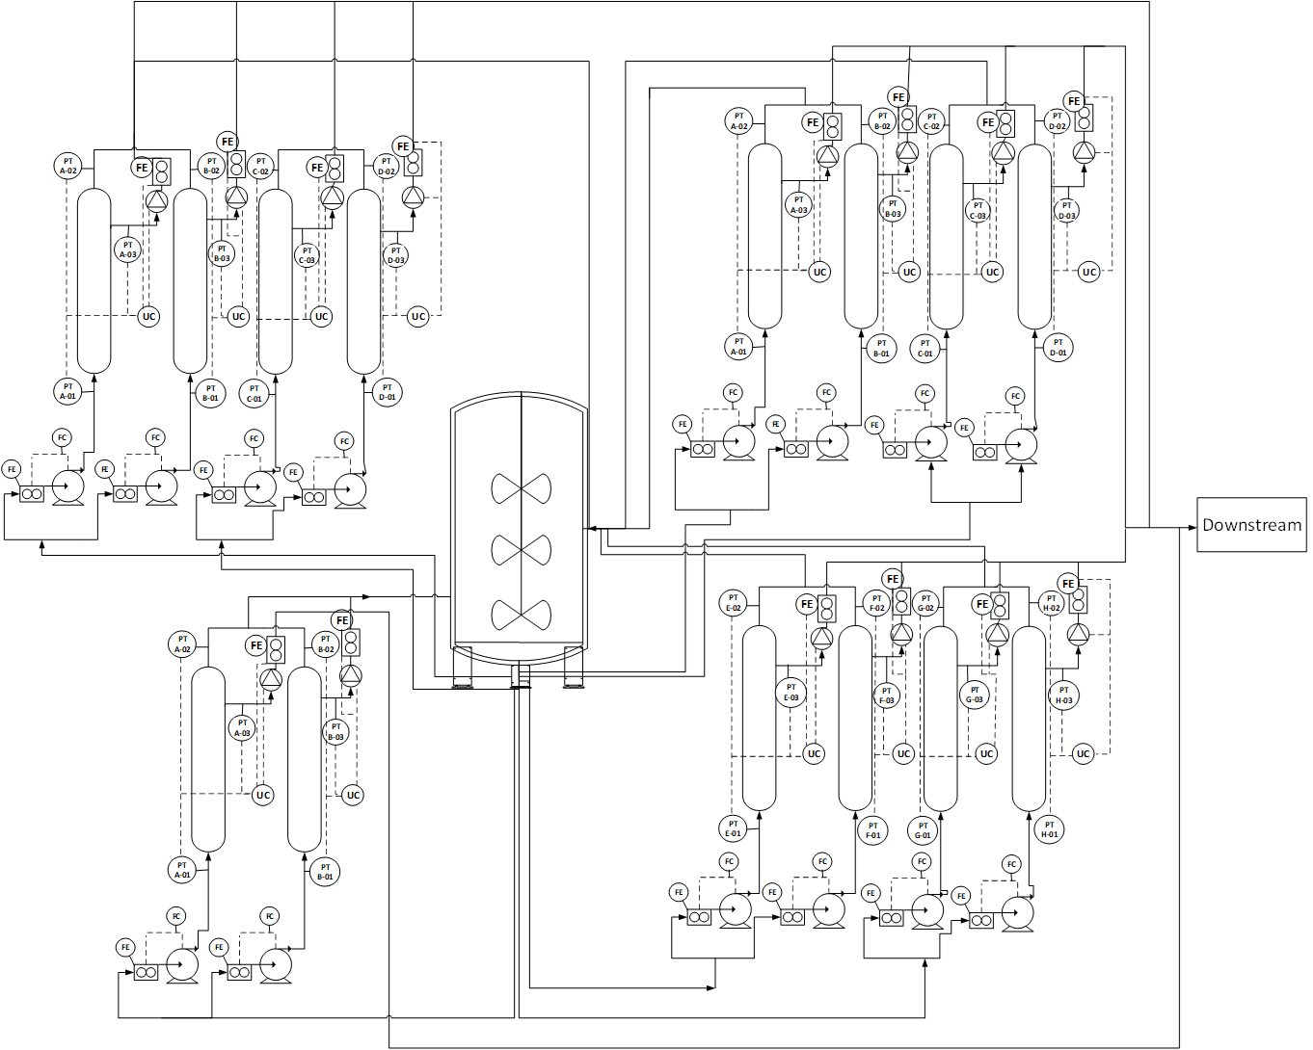
TFF Scaling Concerns
Next product (Molecule C):
Fouling mechanism changed- included product binding
14 filters required for clinical manufacturing under platform conditions
Excessive number of outlet/inlet ports on BRX bag
Large footprint required
Numerous retentate/permeate pumps
High demand on operators
Slide modified and courtesy of Ana Dilillo

Slide 16
Part of the Solution: TFF Regeneration
The highest cost consumables in the IDB process are TFF membranes ​
Directionally, cell culture and titer continue to increase resulting in greater filter area demand
TFF Regeneration is a process to remove foulants from the membrane without stopping perfusion
TFF Regeneration employs swapping between two sets of TFFs, so that one set is always operating perfusion, while the second set is being cleaned and equilibrated
TFF Regeneration will reduce the required filter area and improve facility fit design
Slide modified and courtesy of Ana Dilillo

Slide 17
TFF Regeneration Performance Reduces Filter Demand
TFF Regeneration swaps performed on days 7, 10, and 13
Combination of higher flux with TFF regeneration resulted in 2-3 fold filter demand
Projected 4-8 TFF filters vs 14 for clinical manufacturing
No impact to cell culture performance
No impact to product quality
TFF1
TFF2
TFF1
TFF2
89%
84%
79%
Bench 1x Flux
Bench 3-4x Flux
Pilot 3-4x Flux
Pilot 3-4x Flux with Regeneration
Slide courtesy of Ana Dilillo

Slide 18
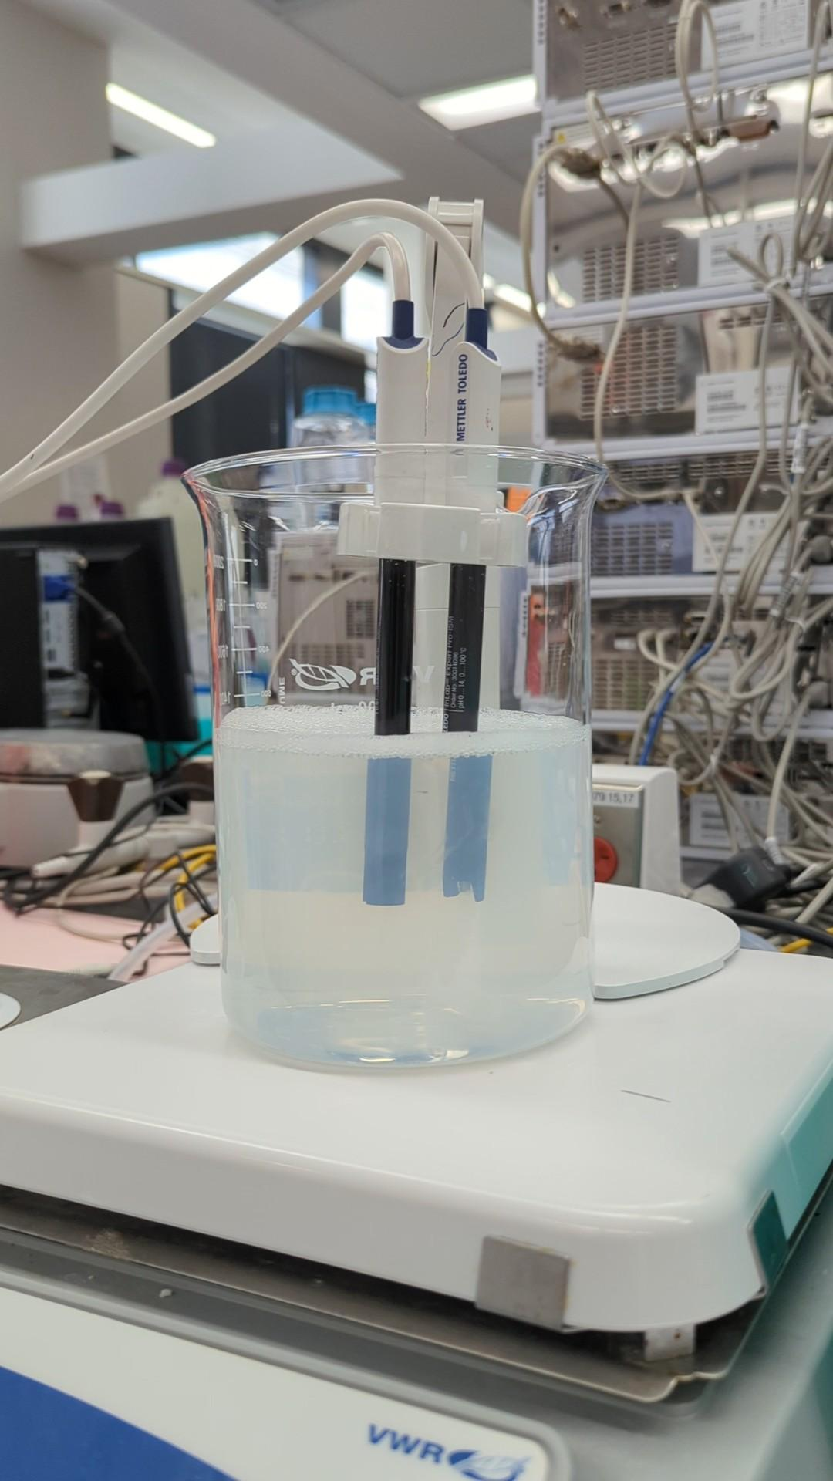
Next Issue: Molecule C forms precipitate when load adjusting prior to first polishing step
Single Pass Operation
Cycling Operation
Precipitate forms
300-500 NTU
Affinity Capture product vessel
Affinity Capture product vessel
Titrant
Titrant
Filter Sani Buffer(s)
4 filters required
22 filters required
7 L Hold-up volume
Cumulative 75 L Hold-up volume
Polish Buffer(s)
Polish Buffer(s)
Depth Filter FT + Chase vessel
Polish Step 1
Polish Step 1
Slide courtesy of David Sherr

Slide 19
Mitigation: Continuous depth filter cycling reduces filter demand/hold-up volume and allows for bioburden control
Single Pass Operation
Cycling Operation
Precipitate forms
300-500 NTU
Affinity Capture product vessel
Affinity Capture product vessel
Titrant
Titrant
Filter Sani Buffer(s)
4 filters required
22 filters required
7 L Hold-up volume
Cumulative 75 L Hold-up volume
Polish Buffer(s)
Polish Buffer(s)
Depth Filter FT + Chase vessel
Polish Step 1
Polish Step 1
Slide courtesy of David Sherr

Slide 20
The Journey Forward
Continuous evolution and improvement
A challenge to us all
TFF regeneration and depth filter cycling are in scale-up testing now
Next GMP campaign will include these and process through 2nd polishing step
Future scale-up work and GMP campaigns will incorporate viral filtration and asymmetric dialysis
Feedback to the IDB platform team will refine and improve the process
Push the limits of traditional paradigms
explore new technologies
set ambitious targets
collaborate to redefine bioprocessing boundaries
Emerging technologies and digital tools offer opportunities to increase automation and enhance data-driven decision-making in continuous biomanufacturing

Slide 21
Thank you

