Slide 1
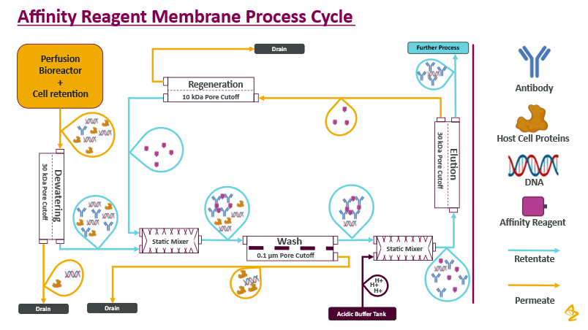
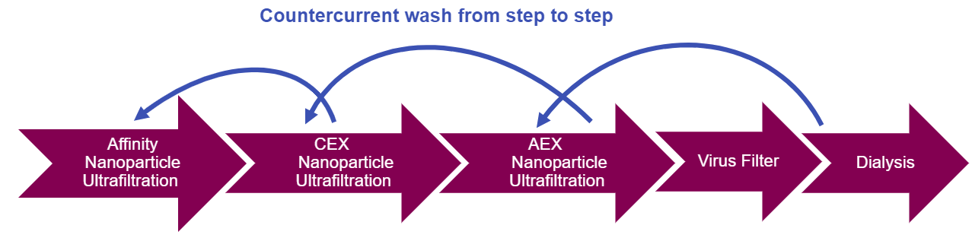
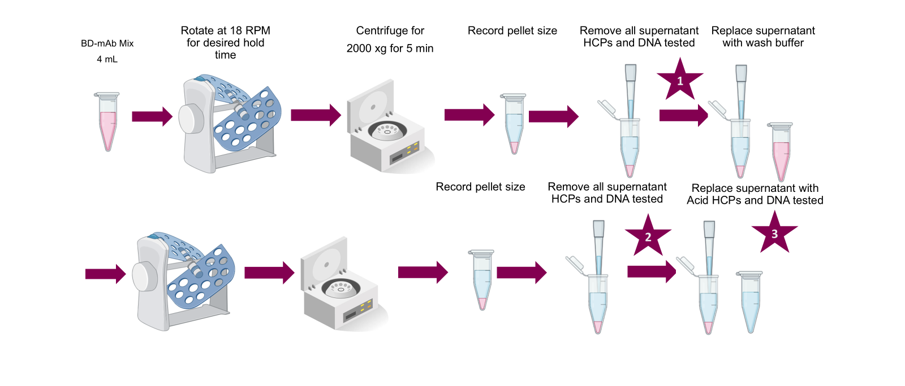
Screening Affinity Reagents in Automated Membrane SKID to Monitor and Control Column-Free Purification
Keith Morgan¹, Ujwal Patil¹, Irina Ramos², Jon Coffman¹
¹ Bioprocess Technologies and Engineering, Biopharmaceutical Development, AstraZeneca, Gaithersburg, MD, USA ²Therapeutics Development & Supply, Johnson and Johnson, Malvern, PA
Introduction
Screening for Suitable Conditions
In a related work, affinity reagents are designed and developed to serve as vehicle to purify mAb molecules in TFF ultrafiltration operation. This method facilitated continuous downstream mAb purification, enhancing productivity and sustainability.
In this work, a small scale method was developed to screen the suitability of different affinity reagents with associated wash buffers in TFF without conducting TFF. A bench-scale proof-of-concept SKID (CAAMP) was utilized to monitor and operate automatically over 10 filtration parameters to confirm comparability with TFF performance on screened candidates . We successfully demonstrated mAb concentration and purification in ultrafiltration membranes, maintaining consistent transmembrane pressure and providing real-time parameter measurements. We conducted HCPs and DNA assays to determine successful removal of mAb impurities.
Figure 3. Transmembrane pressure profiles for SPTFF wash runs at 0.1 µm. TMP over 50 HVs comparing 10 g/L (Dark Color) and 2.5 g/L mAb (Light Color) at 5:1 mAb A:SNGP0094, feed flux 20 LMH, and VCF 5×.
Figure 4. Small‑scale ratio screen for mAb recovery. mAb recovery at 5 g/L (Dark Color) and 2.5 g/L (Light Color). A 10:1 mAb A:affinity reagent ratio improved recovery while reducing affinity reagent consumption.
Figure 5. SPTFF performance at 0.1 µm with optimized 10:1 ratio. TMP over 50 HVs for 2.5 g/L mAb A and 0.25 g/L affinity reagent, feed flux 20 LMH, VCF 5×. Run ended due to feed depletion without over‑pressurization.
Figure 1. Truly Continuous Counter Current Downstream
Final CM run and purity
Conclusions
Figure 6. SPTFF performance with a feed flux of 60 LMH, VCF 5×, and using a 0.2 µm, 110 cm² membrane, with optimized 10:1 ratio. Operation with purified mAb feed (Light Line) reached 50 HVs without exceeding pressure limits; The precipitate fraction was 3.3% ± 0.0% (N=8), and permeate loss was 10% ± 1% (N=30). For conditioned media feed, operation similarly reached 50 HVs (Dark Line) without over‑pressurization. The precipitate fraction was 3.3% ± 0.0% (N=4), and permeate loss was 13% ± 0% (N=15).
Affinity capture during SPTFF is feasible and stable across operating ranges: Affinity reagent with IgG1 enabled low, controlled TMP. At 2.5 g/L and 5× VCF, TMP stayed below limits; runs reached 50 HVs.
Small scale screening sharply reduced TFF development cycles: Benchtop screening set mAb A:reagent ratio, washes, and precipitation, making TFF confirmatory and cutting experiments, materials, and time.
mAb/reagent ratio is a critical lever for recovery and cost of goods: 5:1 at 2.5 g/L had high permeate loss; 10:1 improved recovery and reduced reagent, lowering COGs.
Concentration effects drive performance differences: At 10 g/L and 5:1, over-pressurized at 5× VCF; at 2.5 g/L, TMP <1 psi to 10× VCF, showing feed concentration impact.
Process intensification via membrane selection enables 3× productivity increase: 0.2 µm vs 0.1 µm raised flux 20→60 LMH at 5× VCF with TMP and yield maintained, as predicted.
Performance is consistent across feed types: Similar TMP, ~3.3% precipitate, and ≈10–13% permeate losses for purified mAb and conditioned media at 60 LMH on 0.2 µm.
.
Small Scale Screening Methods
Acknowledgments
Joel Graham and Taylor Bloom for developing affinity reagent and affinity reagent analytical methods
Figure 7. Bar charts show HCP removal. Post‑run analyses of small‑scale screens and TFF samples confirmed clearance of host cell proteins and DNA, indicating effective removal of both impurities. Expected vs. actual post‑wash results suggest slight HCP coprecipitation/entrapment in the small‑scale screen due to non‑constant flow of precipitate. SPTFF results matched expectations and provided confidence in typical 3–4 log removal using 3–5 SPTFF membranes in series with a capture reagent.
References
Systems and methods for end-to-end continuous downstream processing, Jon Coffman et al. June 2023, Patent Filed
Jabra, M. Lipinski, S. Zydney, A. (2021). Journal of Membrane Science, 637, 119606.
Pires, I. S., & Palmer, A. F. (2021). Journal of Membrane Science, 618, 118712.
Figure 2. Small scale screening workflow. Affinity reagent and mAb were buffer-exchanged, filtered, mixed (2 mL each) for 20 minutes, centrifuged, washed, and redissolved; supernatants quantified by Solo VPE/HP-SEC, with CHO HCP and DNA assays performed at sample points (stars). Pellet sizing and supernatant composition determine filtration suitability
Supported by
Presented at the ACS Spring 2026 Meeting ​
March 22-26, 2026, at the Georgia World Congress Center, Atlanta, GA

