Slide 1
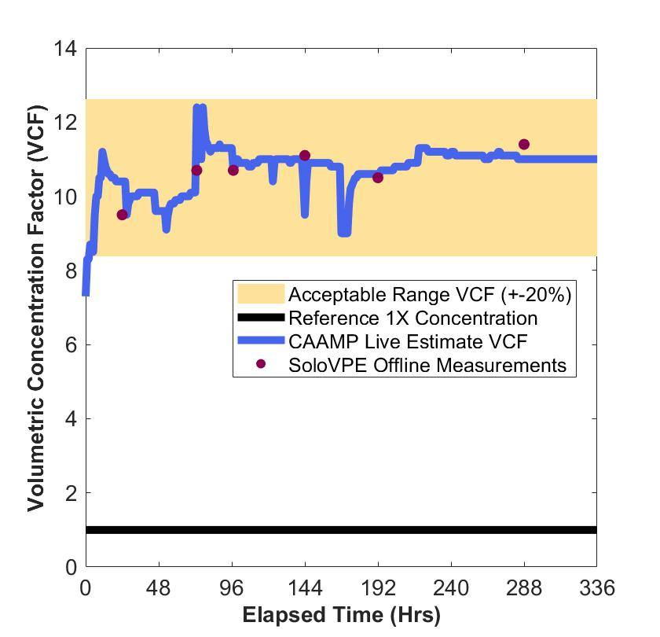
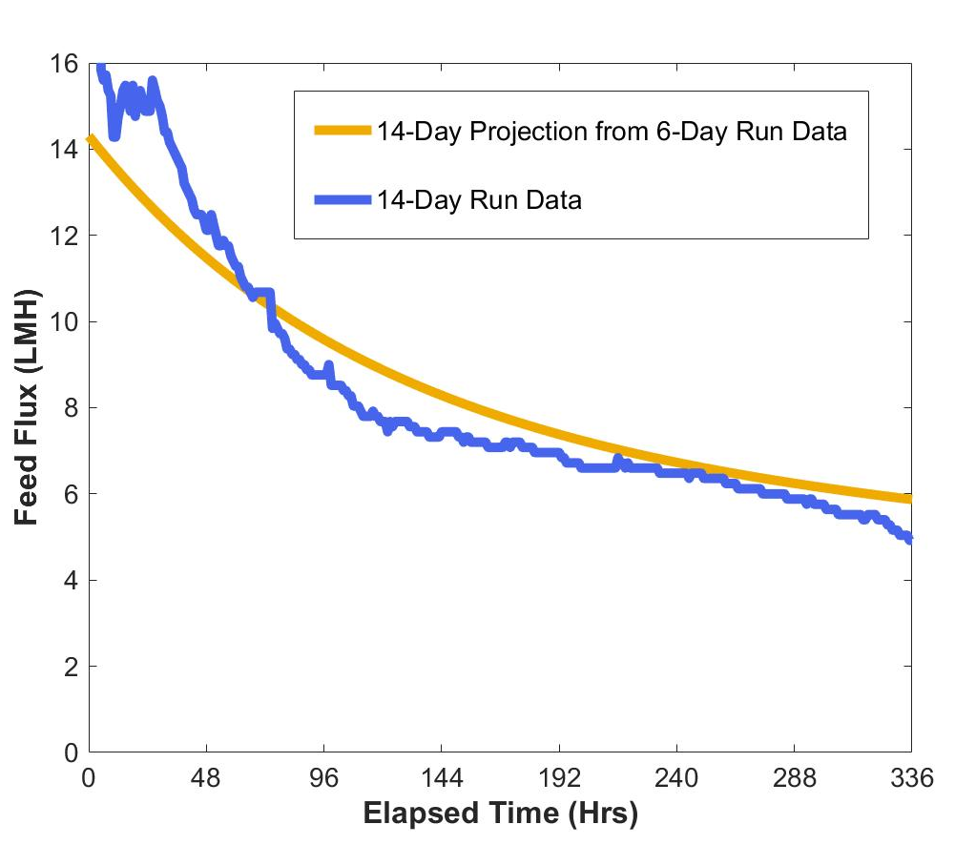
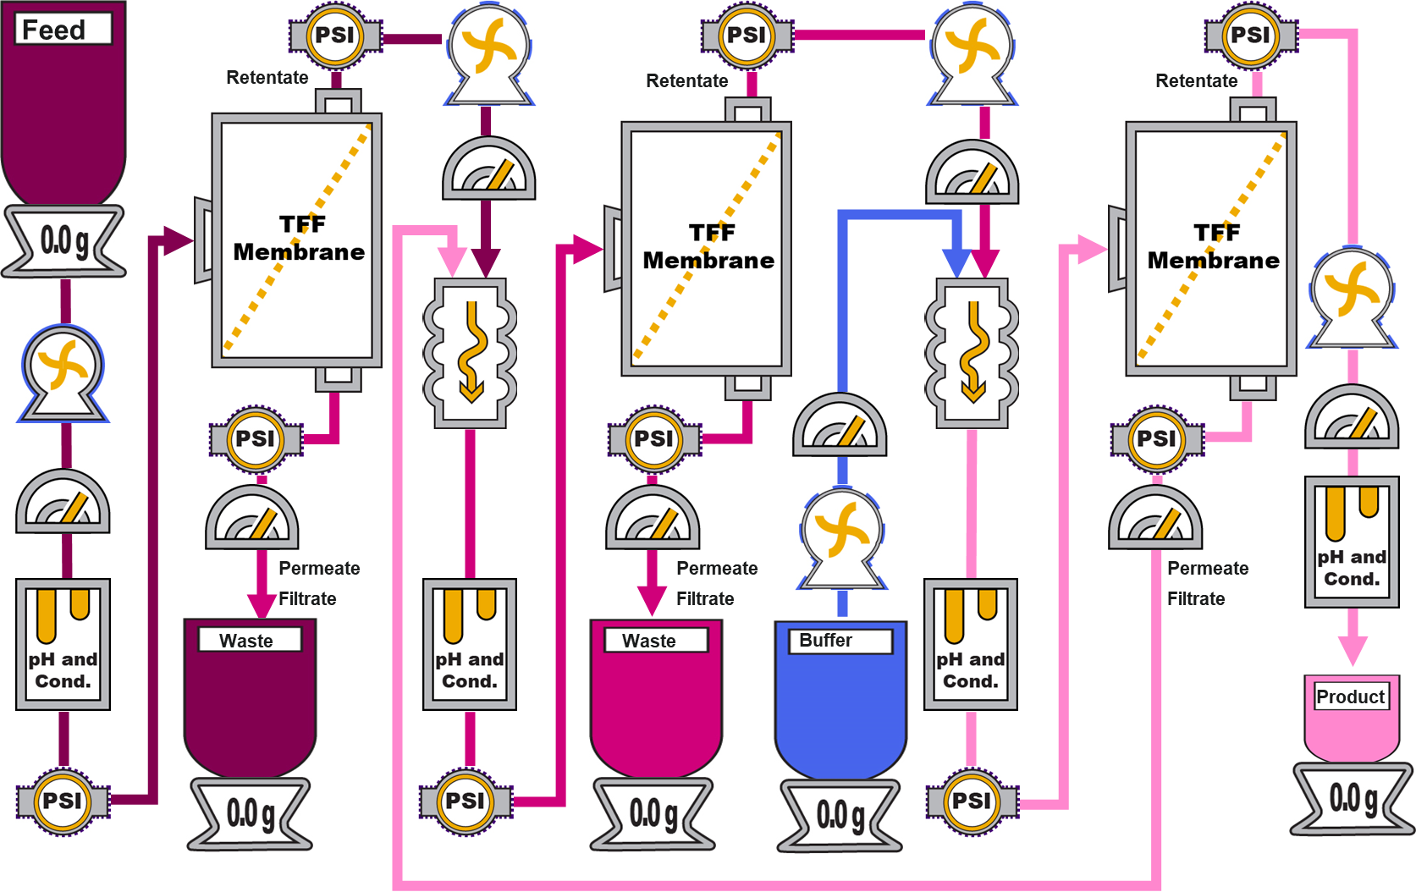
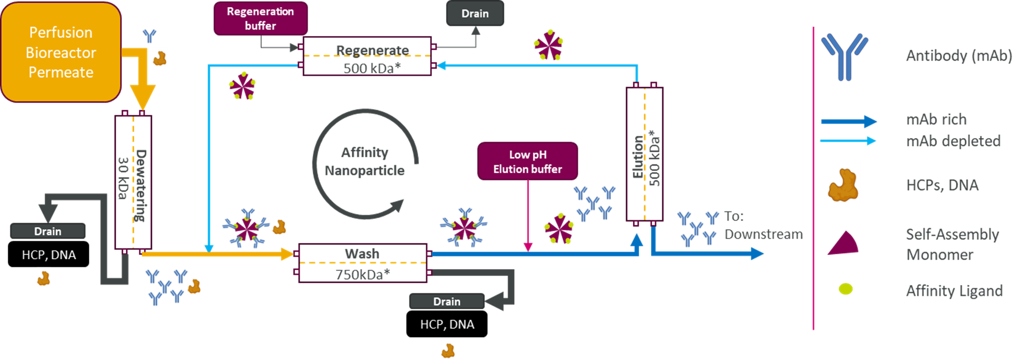
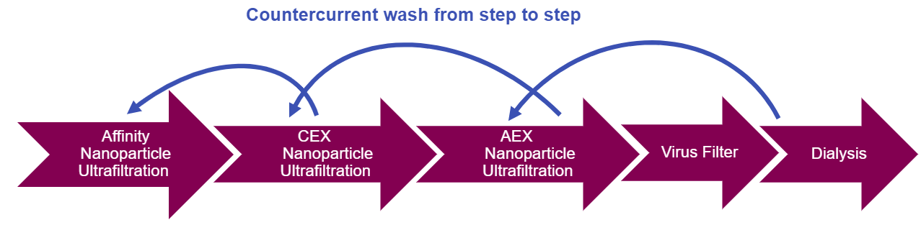
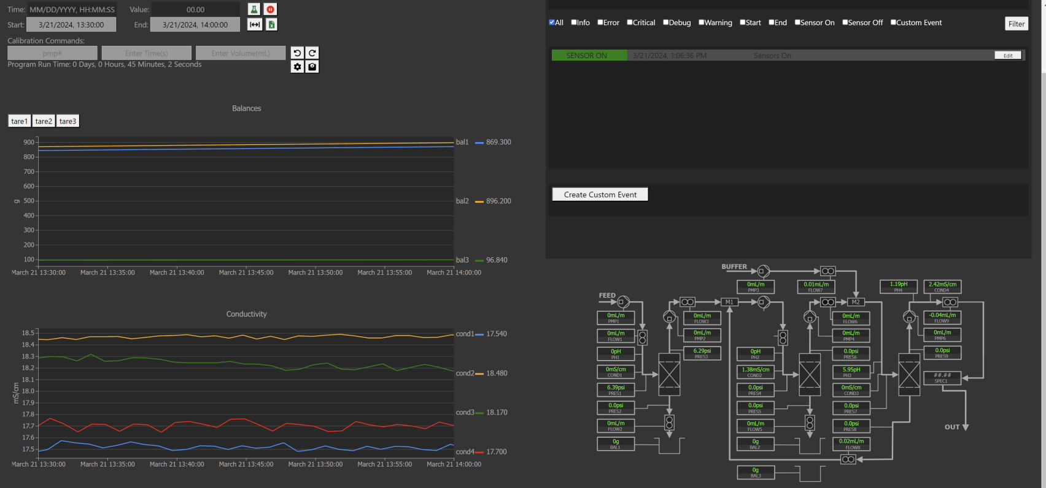
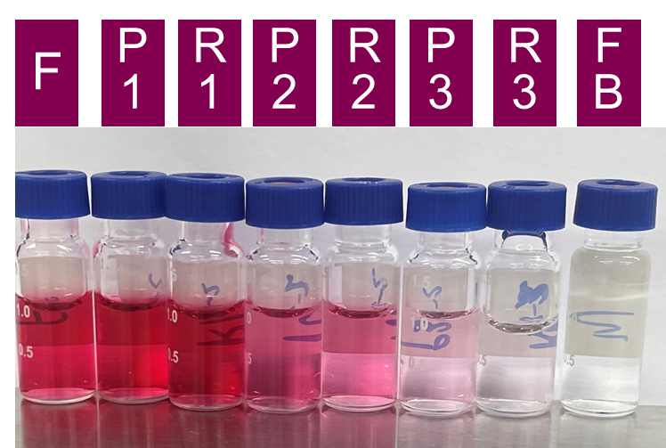
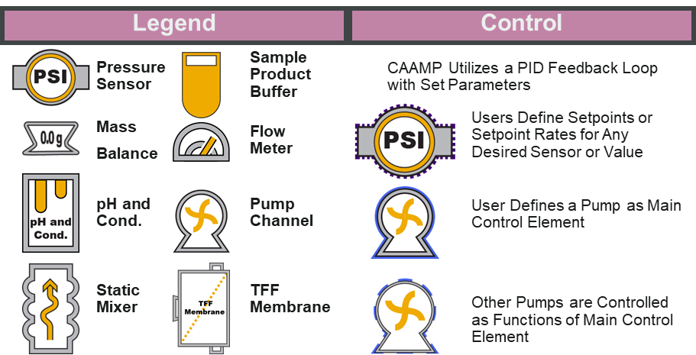
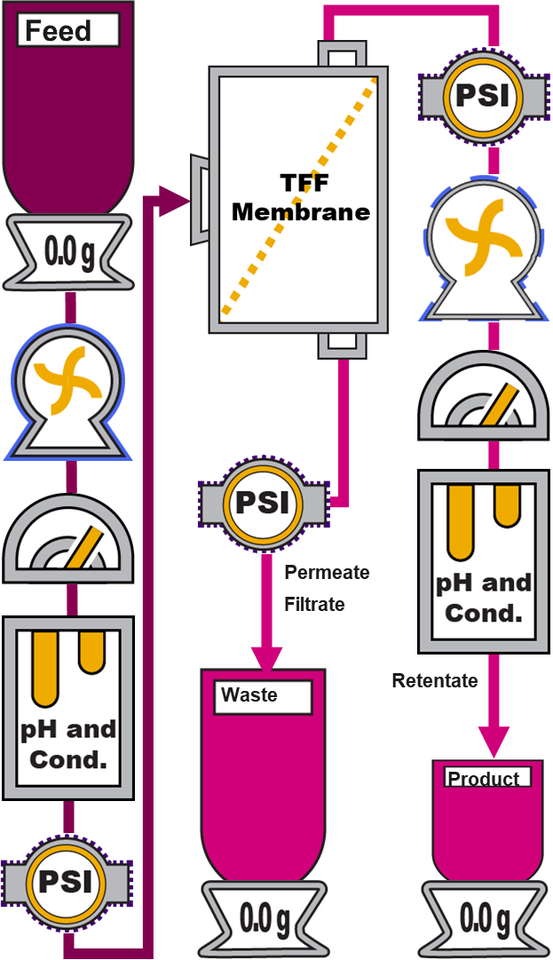
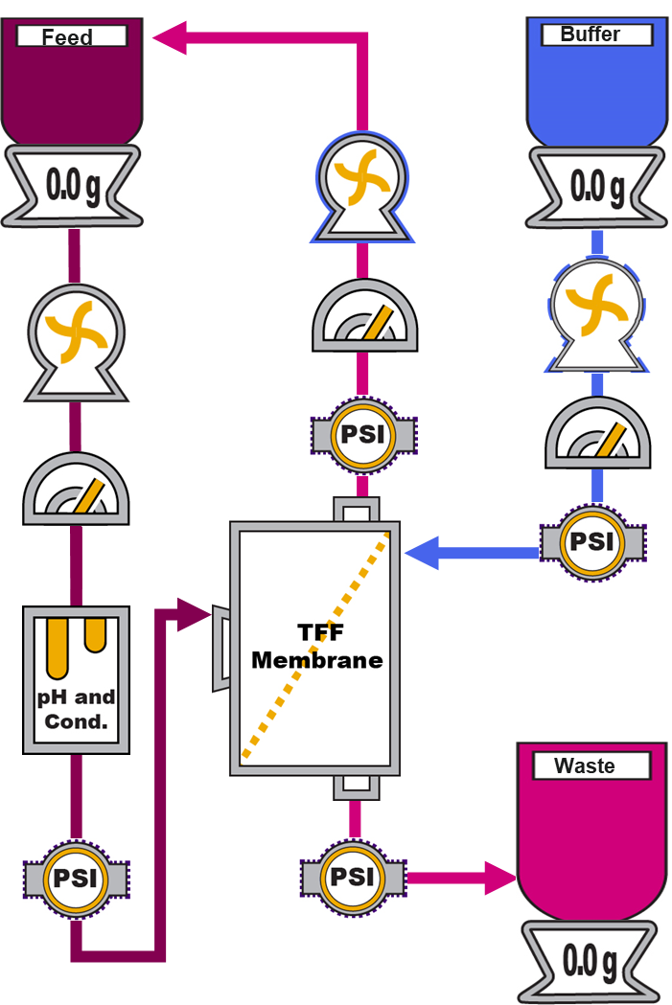
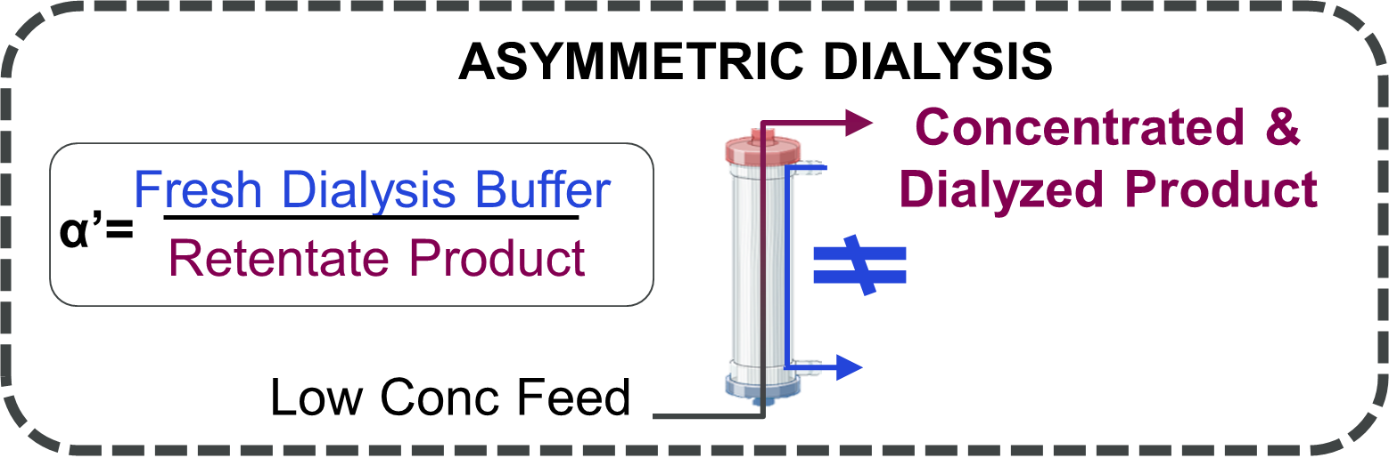
NEXT GENERATION MANUFACTURING
CAAMP: Continuous Automated Affinity Membrane Purification SKID/Software
Keith Morgan¹, Ujwal Patil¹, Irina Ramos¹, Jon Coffman¹
¹ Bioprocess Technologies and Engineering, Biopharmaceutical Development, AstraZeneca, Gaithersburg, MD, USA
Introduction
3 Stage CAAMP Summarized Results
In a related work, nanoparticles are designed and developed to serve as vehicle to purify mAb molecules in TFF ultrafiltration operation. This method facilitated continuous downstream mAb purification, enhancing productivity and sustainability.
In this work, a bench-scale proof-of-concept SKID was developed to monitor and operate automatically to control over 25 filtration parameters. We successfully demonstrated mAb concentration and purification using single-stage and 3-stage membranes, maintaining consistent transmembrane pressure and providing real-time parameter measurements. This system was capable of monitor/operate/control traditional UF/DF. CAAMP is designed to monitor/operate C3D Dialysis with experiments currently in progress .
Figure 1. Truly Continuous Counter Current Downstream
Figure 4. Truly Continuous Counter Current Downstream 3-Stage Capture with mAb with Vitamin B12 Impurity
Figure 9. Concentration factor over time using 3-stage membrane process are monitored within ±20 % of actual value. Concentration measured offline by UV280 nm confirmed 10X VCF achieved within ±5% target.
Figure 10. 14-Day 3-stage membrane process flux data demonstrated average of 8.5 LMH and matched 6-day flux projections. 3.0 kg/m² membrane loading, and anticipated impurity removal of >99%
A
B
B12 Tracer Removal
Conclusions
Operates in user-operated and user-written method modes, and autonomously adjust pump flow rates to maintain desired parameters or parameter rates with a defined response sensor, demonstrating its capacity for process automation
To demonstrate PID and safety control we underwent rigorous testing through multiple single stage 7-day experiments, a subsequent 6-day and 14-day 3-stage run
Achieves a 5x or 10x volumetric concentration factor (VCF) 3-stage membrane process with anticipated >99% removal
Provides a system that will achieve the objectives of a truly continuous counter current downstream and shorten process development time on several membrane processes
Effectively tracks all 25+ parameters and estimates anticipated concentration factor with a 5% error rate except for flow meter.
C
Process Analytical Technology/User Interface
D
Figure 5 : CAAMP User Interface.
A) Pump calibration panel, data export, and experimental start
B) Alarms and run notes
C) data profiles ex. Balances and conductivity
D) 3- stage schematic with associated values
Figure 7. B12 removal with 3-stage 5X concentration factor CAAMP for 48 hrs
From Left : Feed, Permeate 1, Retentate 1, Permeate 2, Retentate 2, Permeate 3 Retentate 3 (Product), and Fresh Buffer
Platform Work: UF/DF
On-Going Work : CC-Dialysis
Table 1. CAAMP Equipment Schematic Legend
Feed Flux of 200-250 LMH
TMP Under 15 psi
Concentrated to 75 g/L with UF1
7 DV of Buffer Exchange
Concentrated to 120 g/L with UF2
Yield of 90 %
1.5 kg/m2
Current PAT* | Measured Values | Error (+-%)
Flow Meters | 5 Calibration Ranges 0.01 – 20 mL/min | 10%
4 Channel Pump ** | 0.01-20 mL/min | 5%
pH | 1 - 14 pH units | 3%
Conductivity | 0 - 40 mS/cm | 5%
Balances | 0.00 - 6200.00 mg | N/A
*Higher Capacity Balances, and Flow Meters Available
** Error based on current tubing and peristaltic pumps
Figure 8. Asymmetric Counter Current Dialysis
Acknowledgments
External Collaborators : Root3 LabsSM is a product engineering company who provided services on the automation and data acquisition software
Integrates UF and Buffer Exchange
80% Less Buffer for Diafiltration
Lower Pressures
Continuous Operation
References
Systems and methods for end-to-end continuous downstream processing, Jon Coffman et al. June 2023, Patent Filed
Jabra, M. Lipinski, S. Zydney, A. (2021). Journal of Membrane Science, 637, 119606.
Pires, I. S., & Palmer, A. F. (2021). Journal of Membrane Science, 618, 118712.
Figure 2. CAAMP Single-Stage TFF
Table 2. CAAMP Sensor Accuracy
Figure 6. CAAMP for UF/DF
Supported by
Presented at the ACS Spring 2025 Meeting ​
March 23-27, 2025, at the San Diego Convention Center, San Diego, CA
Notes:
Highlight the parts of the GUI for user understanding of the sections #DONE
Try to make the graph larger and the legends larger #DONE
Make a 3rd line under figure 9 which explains accuracy of sampling vs accuracy of run #DONE
Figure 7 spell out permeate, retentate, feed #DONE
Find a way to spell out CC-dialysis to countercurrent dialysis #DONE
Acknowledgments this work was possible with collaboration with an automation/electrical engineering company root3labs inc/cc/r #DONE

