Slide 1
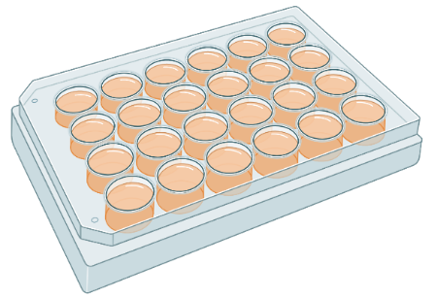
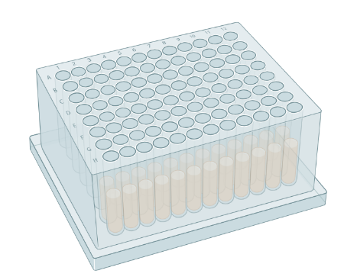
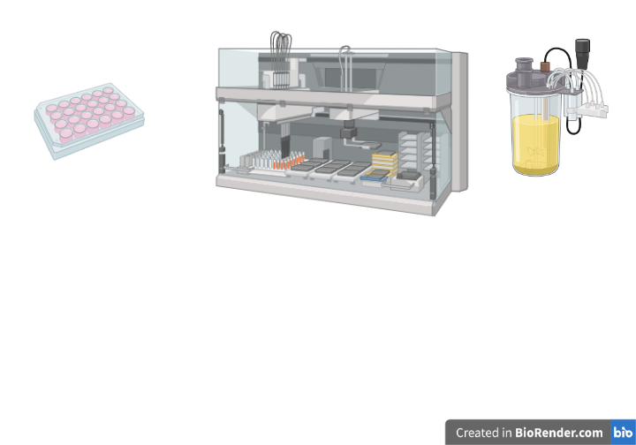
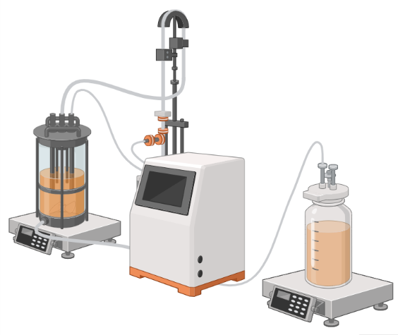



Early Manufacturing Insights and Clone Selection for perfusion processes
Marie Dorn¹, Kerensa Klottrup-Rees², Kenneth Lee³, Martina Micheletti¹
¹Department of Biochemical Engineering, University College London, UK
²Cell Culture and Fermentation Sciences, Biopharmaceutical Development, R&D, AstraZeneca, Cambridge, UK
³Bioprocess Technologies and Engineering, Biopharmaceutical Development, R&D, AstraZeneca, Gaithersburg, Maryland, USA
Contact: marie.dorn.21@ucl.ac.uk
Background
Knowledge gap
Perfusion processes: Goals & parameters
Challenge: Process development & optimisation
Complex processes due to several parameters including various process flow rates
Solution: Scale down models
SDMs are utilised for high-throughput parameter screenings
Microwell plates (MWP) operated in semi-perfusion mode showed good representation of growth & titre to 5L perfusion bioreactor (Tregidgo et. al., 2023)
(1) bioreactor, (2) cell and product removal, (3) cell retention device, (4) cell recirculation, (5) medium feed, (6) product removal
High cell density
Cell retention /bleed
Stable & controlled environment for cells
Screening in MWP
Fed-Batch
Shift of operation mode
Different physiological conditions experienced by the cell culture
FB to (quasi-)perfusion – changing to (quasi-)constant environment
Continuous medium exchange
Perfusion rate
Screening in mini-bioreactor (MBR)
Semi-perfusion/retro-fitted perfusion
Bench scale optimisation
Perfusion
What impact does operation mode have on early-stage clone selection?
Results
Comparison of Fed-batch and Semi-perfusion
Ranking of cell clones by q_{P}
mAb1_C4
mAb1_C5
mAb1_C7
Initial rankings at MWP scale are typically performed based on measured titre as single productivity value. To account for different feed and medium exchange protocols, the cell specific productivity (q_{P}) was used for ranking of the clones.
MWP in Fed-Batch
MWP in Semi-perfusion
Total medium exchange
Partial medium exchange
Fig 1: Growth for mAb1 CHO cell clones in MWP using fed-batch and semi-perfusion methodologies. A total of 8 clones were investigated and 3 clones are displayed as examples. For fed-batch cultures, cells were cultivated in CD CHO with a feed step from day 3 to day 7 (●). For semi-perfusion cultures, a perfusion rate of 1 RVd⁻¹ with CD CHO (▲) and HIP media (▼) or 0.75 RVd⁻¹ with HIP medium (▼) was used from days 3 to 10.
FB CD CHO |  | SP CD CHO 1 RV/d |  | SP HIP 1 RV/d |  | SP HIP 0.75 RV/d
C4 |  | C4 |  | C4 |  | C5
C5 |  | C6 |  | C6 |  | C4
C8 |  | C1 |  | C1 |  | C2
C2 |  | C5 |  | C5 |  | C1
C1 |  | C2 |  | C2 |  | C8
C6 |  | C7 |  | C3 |  | C6
C3 |  | C3 |  | C8 |  | C3
C7 |  | C8 |  | C7 |  | C7
FB CD CHO
SP 1 RVd⁻¹ CD CHO
SP 1 RVd⁻¹ HIP
SP 0.75 RVd⁻¹ HIP
Fed-batch methods serves as base case scenario. Semi-perfusion methods were performed with (i) total medium exchange (1 RVd⁻¹), typical for manual operation, and (ii) with a partial medium exchange (0.75 RVd⁻¹) to represent automated workflows in industry. Different media were used in semi-perfusion mode to understand their influence on clone performance independent of operation mode.
Fig 2: Cell specific productivity for mAb1 CHO cell clones in MWP using fed-batch and semi-perfusion methodologies.
→ Semi-perfusion outperforms fed-batch
→ Methodology impacts ranking
→ Perfusion rate impacts ranking
How to improve the ranking procedure?
How reproducible are the rankings?
Problem: Ranking only based on q_{P}
Solution: Leverage more data
mAb1_C4
mAb1_C5
mAb1_C7
Other parameter such as growth, metabolites and process flow rates are not accounted for.
Combine parameter into a single metric - manufacturability index (MI_{CL}; Goldrick et. al., 2023), while accounting for different feeding and medium exchange protocols.
Single parameter - q_{P}
Multiple parameter - MI_{CL}
Fig 3: Growth for mAb1 CHO cell clones in MWP using semi-perfusion methodologies. A total of 8 clones were investigated and 3 clones are displayed as examples. Cells were cultivated in HIP medium with a perfusion rate of 0.75 RV d⁻¹.
FB CD CHO | SP CD CHO 1 RV/d | SP HIP 1 RV/d | SP HIP 0.75 RV/d |  | FB CD CHO | SP CD CHO 1 RV/d | SP HIP 1 RV/d | SP HIP 0.75 RV/d
C4 | C4 | C4 | C5 |  | C4 | C7 | C5 | C5
C5 | C6 | C6 | C4 |  | C5 | C4 | C6 | C4
C8 | C1 | C1 | C2 |  | C8 | C6 | C4 | C6
C2 | C5 | C5 | C1 |  | C2 | C5 | C1 | C8
C1 | C2 | C2 | C8 |  | C1 | C1 | C2 | C1
C6 | C7 | C3 | C6 |  | C6 | C3 | C3 | C3
C3 | C3 | C8 | C3 |  | C3 | C2 | C7 | C2
C7 | C8 | C7 | C7 |  | C7 | C8 | C8 | C7
Semi-perfusion mode with partial medium exchange (0.75 RVd⁻¹) was selected to investigate industrially relevant settings of prospective automated workflows . Two biologically independent runs with triplicate measurements per sample were performed.
q_{P} |  |  | MI_{CL}
Run 1 | Run 2 |  | Run 1 | Run 2
C5 | C5 |  | C5 | C5
C4 | C4 |  | C4 | C8
C2 | C8 |  | C6 | C4
C1 | C6 |  | C8 | C6
C8 | C2 |  | C1 | C3
C6 | C7 |  | C3 | C1
C3 | C1 |  | C2 | C7
C7 | C3 |  | C7 | C2
MI_{CL} strategy confirm differences between operation modes
Fig 4: Cell specific productivity for mAb1 CHO cell clones in MWP using semi-perfusion.
Reproducible; increased consistency with MI_{CL} strategy
Validation studies
Impact and Outlook
Validation studies in MWP: Second CHO cell line
Comparison studies of fed-batch vs semi-perfusion methodologies with various clones of a bspAb1 producing CHO cell line.
Aim:
Showing applicability across different CHO cell lines and types of protein product
Results: Similar outcome as for mAb1 producing CHO cell line
Semi-perfusion outperformed fed-batch
Rankings differ between different operation modes and perfusion rate strategies
Utilising multiple parameter (i.e. MI_{CL}) for ranking resulted in greater consistency
Highlights the importance of considering the operation mode during early cell clones screening
Further scale down to deep well plates
Automation of industrially relevant, methodological workflow
Validation studies in 250mL perfusion bioreactors

